Slide 1
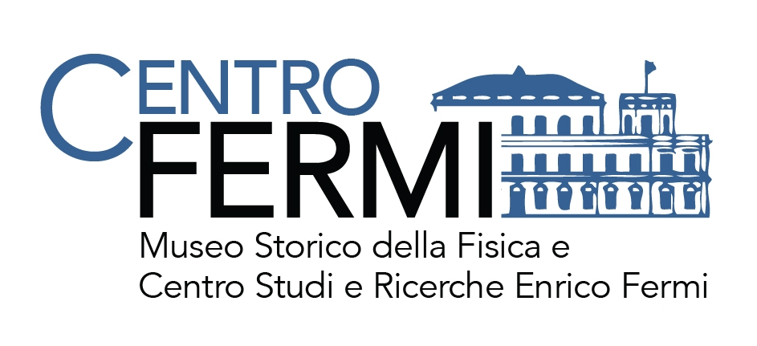
TNAAF - Neutron techniques for
Archaeology and Forensic Science
Coordinator: Roberto Senesi, Università degli Studi di Roma Tor Vergata, Centro NAST
Participants:
Università Tor Vergata – Team: C. Andreani, R. Senesi, C. M. Labarga, O. Rickards (Centro NAST).
Centro Fermi – Team: G. Festa, L. Arcidiacono (October 2016 - September 2017)
Università di Firenze - Team: P. Baglioni; Università di Milano-Bicocca – Team: G. Gorini
University College London (UK) Science and Engineering in Art, Heritage and Archaeology (SEAHA) Centre for Doctoral Training - Team: Marcos Martinon-Torres
Place of work & Collaborations:
Place of Work
Centro Fermi - Research Institution
ISIS Spallation Neutron Source (Harwell, UK) – Research Institution
University College London (UK) – SEAHA, http://www.seaha-cdt.ac.uk - Research Institution
Università degli Studi di Roma Tor Vergata - Research Institution
Collaborations
Anthropological Service, Soprintendenza Archeologia del Lazio e dell‘Etruria Meridionale - (MIBACT, I) – Heritage Institution
Consiglio Nazionale delle Ricerche (CNR-IBAM Catania and CNR-IPCF Messina) - Research Institution
MOLAB (I), Oak Ridge National Laboratory (USA), Helmholtz-Zentrum Berlin (G), Argonne National Laboratory (USA)
Museo Egizio, Torino - Heritage Institution, Sapienza Università di Roma
Tarisio – Fine Instrumentations & Bows - Heritage Institution, Fondazione Pro Canale - Heritage Institution
University of Coimbra (Portugal), Universita’ di Firenze - Research Institution and Heritage Institution
Universita’ di Milano Bicocca - Research Institution, Universita’ di Palermo- Research Institution
Notes:
A Studentship agreement to be signed between Centro Fermi, TOV and SEAHA, support for Master and PhD proposal for co-financement agreed on the 19th January 2016 among the 3 institutions.

Slide 2
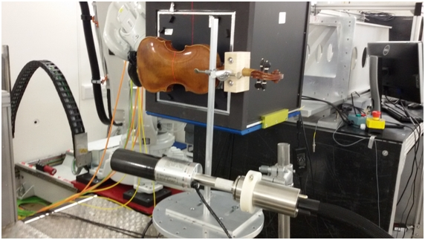
TNAAF - Neutron techniques for
Archaeology and Forensic Science
Project main goals
Project objectives: Element/isotope analysis, DNA-collagen content, microstructure and spectroscopy on archaeometry and forensic analysis.
To realize a Time-Resolved Prompt Gamma Activation Analysis (T-PGAA) apparatus yet available at Spallation Neutron Sources→ to expand the needs of chemical/isotope analysis for Cultural Heritage and forensic studies.
To create an outpost in UK of the Centro Fermi - TNAAF team (under the CNR-STFC Agreement) for interdisciplinary research activities and projects: Harwell, London.
To Apply advanced neutron techniques for the study of cultural heritage artefacts, materials and forensic samples.
Example of the PGAA set-up on IMAT
(ISIS spallation neutron source)
Example of the PGAA measurements on IMAT beamline (ISIS spallation neutron source)
PTA 2016-2018
Notes:
Obiettivo è espandere le capacità di analisi chimico-elementare tramite la tecnica di TPGAA
Rafforzare la nostra presenza internazionale in particolare in UK nell’ambito di attività di ricerca multidisciplinare
Ed infine applicare tecniche avanzate di neutroni nell’ambito BC e forense

Slide 3
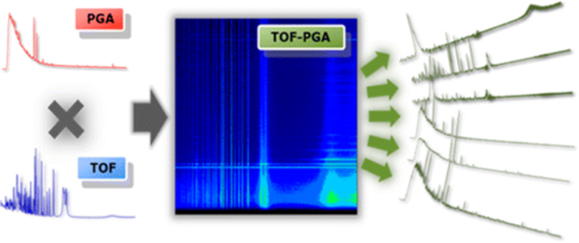
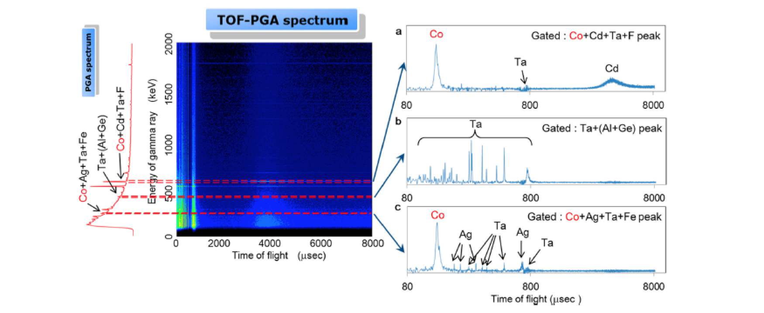
TNAAF - Neutron techniques for
Archaeology and Forensic Science
Results - T-PGAA Neutron Energy Resolved PGAA
T-PGAA: Simultaneous measure of the energy of gamma emitted from (n,γ) reaction (Prompt Gamma Activation Analysis) and the neutron energy that produce the detected gamma (Neutron Resonance Capture Analysis).
PGAA and NRCA have different sensitivity and specificity for individual elements
T-PGAA improve elemental selectivity (scanning and cutting through neutron energy-gamma energy maps)
Notes:
Una delle principali innovazioni del progetto è la possibilità di ottenere una migliore sensibilità elementare tramite la misura simultanea dell'energia dei gamma emessi a seguito di cattura neutronica radiativa e dell’energia del neutrone che ha prodotto il dato gamma.

Slide 4
TNAAF - Neutron techniques for
Archaeology and Forensic Science
Results - T-PGAA/PGAA apparatus
G. Festa, L. Arcidiacono, T. Minniti, W. Kockelmann, G. Burca, C. Andreani, R. Senesi, ‘Characterization of γ-ray signal on the IMAT imaging neutron beamline’, article in preparation.
G. Festa, L. Arcidiacono, A. Pappalardo, T. Minniti, C. Cazzaniga, A.Scherillo, C. Andreani and R. Senesi, ‘Isotope identification capabilities using time resolved prompt gamma emission from epithermal neutrons’, Journal of Instrumentation,11, C03060, (2016).
I.S. Anderson, C. Andreani, J. M. Carpenter, G. Festa, G. Gorini, C.K. Loong, R. Senesi, ‘Research Opportunities with Compact Accelerator-driven Neutron Sources’, Physics Reports 654, 1-58 (2016).
G. Festa, L. Arcidiacono, A. Pappalardo, T. Minniti, C. Cazzaniga, A. Scherillo, C. Andreani and R. Senesi, ‘Time resolved prompt gamma activation analysis from epithermal neutrons applied to Cultural Heritage’, SIF 2016.
PTA 2016-2018
Notes:
Sono qui riportati alcuni dei principali risultati relativi alle attività di ricerca e sviluppo relativi agli apparati sviluppati nell’ambito del progetto.

Slide 5
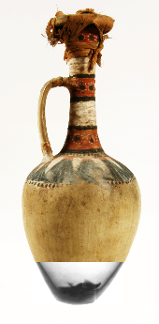
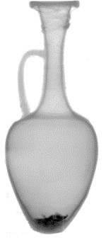
TNAAF - Neutron techniques for
Archaeology and Forensic Science
Results – Neutron applications to CH
C. Andreani, F. Aliotta, L. Arcidiacono, M. Borla, E. P. Cippo, D. Di Martino, F. Facchetti, E. Ferraris, G. Festa, G. Gorini, W. Kockelmann, J. Kelleher, D. Malfitana, D. Micieli, T. Minniti, V. Mollica Nardo, R. Ponterio, G. Salvato, R. Senesi, V. Turina, C. Vasi and C. Greco, ‘A neutron study of sealed ceramic vases from the grave-goods of Kha and Merit’, article in preparation
About 6 articles in preparation on Museo Egizio measurements.
I. Bukreeva, A. Mittone, A. Bravin, G. Festa, M. Alessandrelli, P. Coan, V. Formoso, R. G. Agostino, M. Giocondo, F. Ciuchi, M. Fratini, L. Massimi, A. Lamarra, C. Andreani, R. Bartolino, G. Gigli, G. Ranocchia, A. Cedola, ‘Enhanced X-ray-phase-contrast-tomography brings new clarity to the 2000-year-old “voice” of Epicurean philosopher Philodemus’, Scientific Reports 6:27227 (2016).
Press coverage:
TGLeonardo on Egyptian Museum measurements (14/11/2016)
CNR and Università degli Studi di Roma Tor Vergata press release on Egyptian Museum measurements
APPLIED NEUTRON TECHNIQUES:
Imaging
Diffraction
Elemental analysis
Spectroscopy
Notes:
Nelle prossime due slide riportiamo alcuni degli principali studi effettuati. E’ stato ad esempio possibile avere informazioni circa il contenuto di vasi egizi sigillati in maniera non distruttiva e non invasiva.
Abbiamo effettuato uno srotolamento virtuale di alcuni papiri carbonizzati provenienti dal sito archeologico di Ercolano.

Slide 6
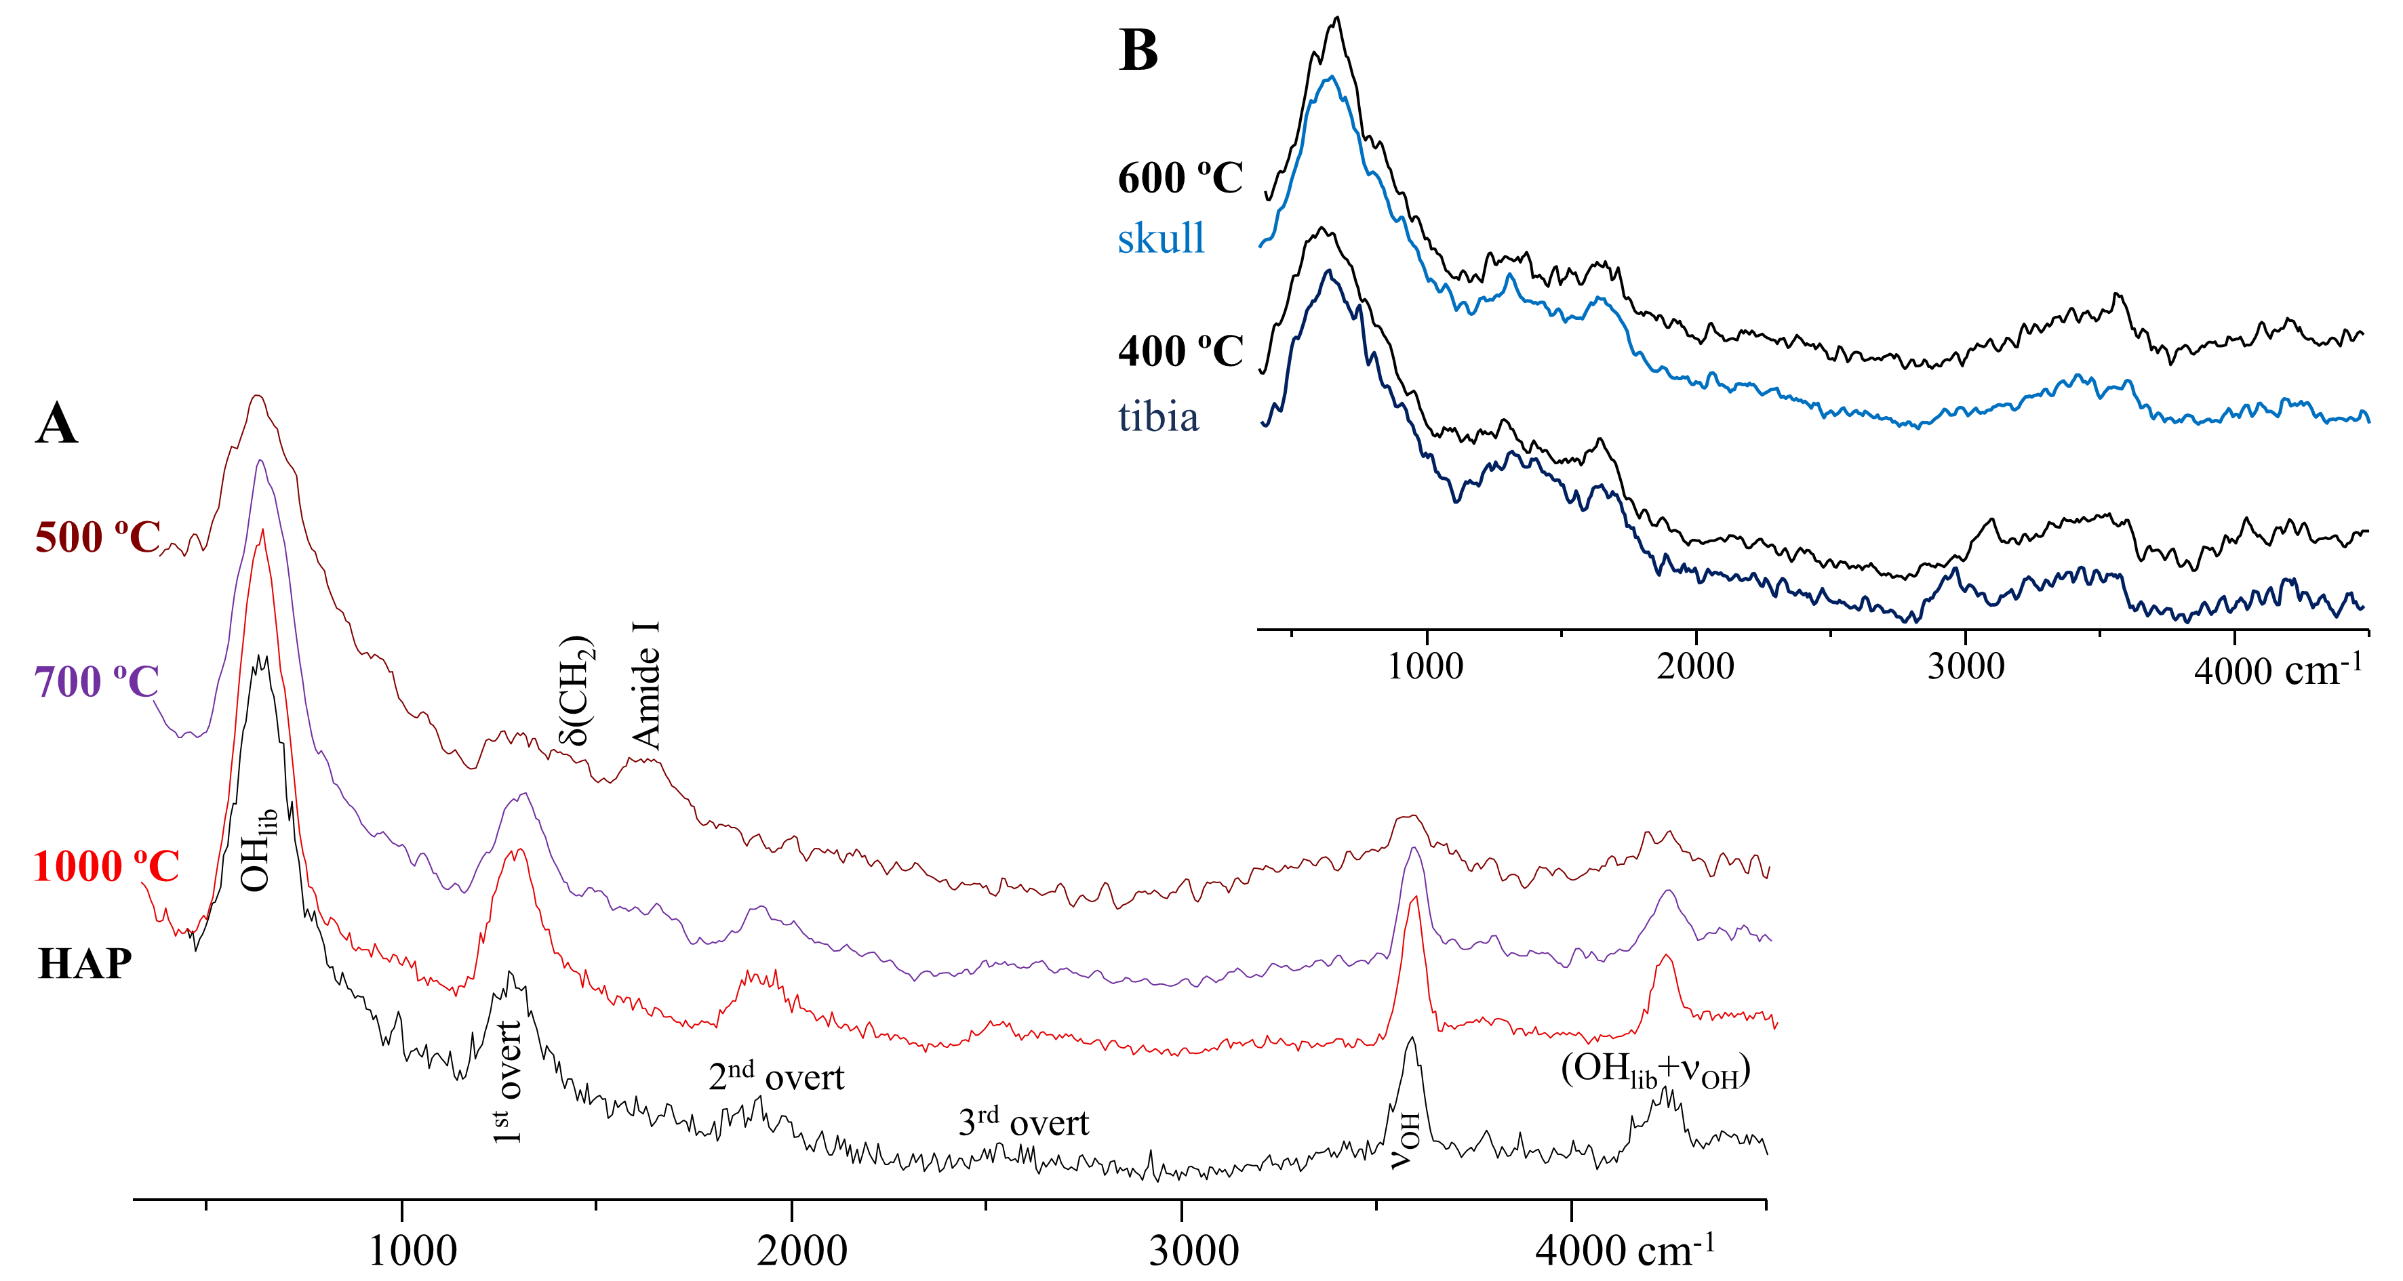
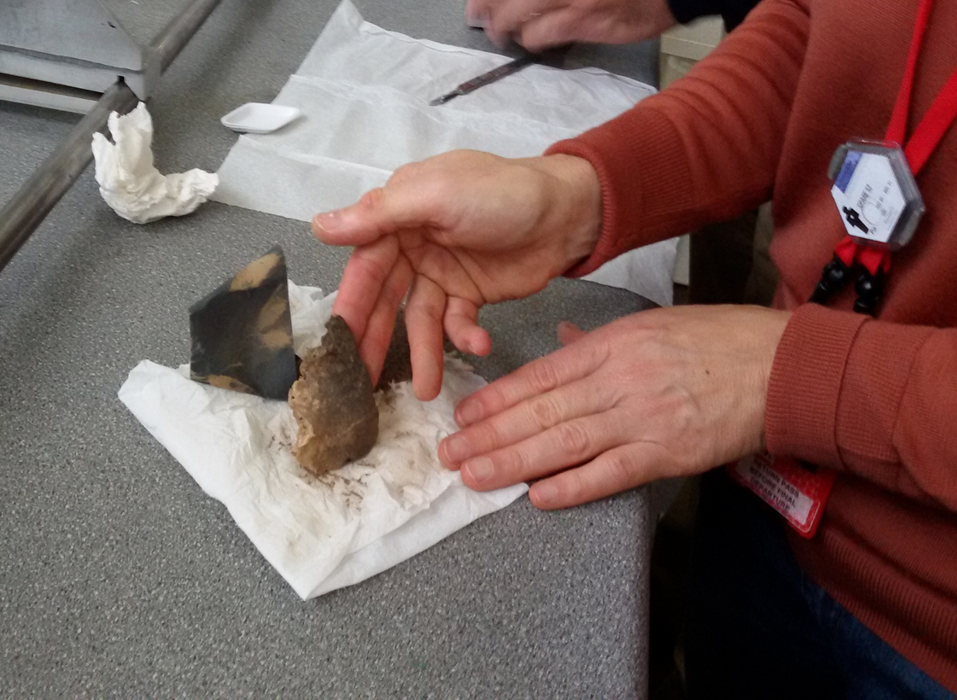
TNAAF - Neutron techniques for
Archaeology and Forensic Science
Results - Neutron applications to CH and forensic study
M.P.M. Marques, D. Gonçalves, S.F. Parker, G. Festa, C. Andreani and L.A.E. Batista de Carvalho, ‘Burned Skeletal Human Remains Probed by Neutron and Optical Vibrational Spectroscopy’ article in preparation.
C. Conti, C. Colombo, G. Festa, J. Hovind, E. Perelli Cippo, E. Possenti, M. Realini.‘Investigation of ammonium oxalate diffusion in carbonatic substrates by neutron tomography’, Journal of Cultural Heritage, 19, 463–466 (2016).
G. Festa and N. Kardjilov, ‘Neutron Methods for Archeology and Cultural Heritage’, Springer International Publishing AG (2016).
Press coverage:
Bones - BBC South (December 2016)
More than 10 articles on newspapers about ‘Enhanced X-ray-phase-contrast-tomography brings new clarity to the 2000-year-old “voice’
Notes:
Abbiamo studiato reperti umani ossei carbonizzati provenienti da sito archeologici del mediterraneo ed infine studiato il potere di diffusione di consolidanti in matrici carbonatiche per applicazioni BC.
Nel 2016 è uscita una monografia sugli argomenti trattati nel progetto pubblicato dalla Springer che ha visto una importante presenza di ricercatori e associati del centro fermi.

Slide 7
TNAAF - Neutron techniques for
Archaeology and Forensic Science
Plan of activities 2017 - 2019
January – September 2017
Research Activities at ISIS Spallation Neutron Source (UK): set-up
T-PGAA and experimental measurements; three T-PGAA experiments planned at ISIS facility
January - September 2017
MASTER at SEAHA Centre for Doctoral Training, UCL (UK), research activities are carried at Centro Fermi, ISIS and Tor Vergata
From September 2017 (to 2020)
PhD at SEAHA Centre for Doctoral Training, UCL (UK): research activities to be carried out at ISIS and Tor Vergata
PTA 2016-2018
Notes:
In questa slide sono riportate le attività previste nel prossimo periodo in particolare…..

Slide 8
TNAAF - Neutron techniques for
Archaeology and Forensic Science
Plan of activities 2017 - 2019
January 2017 to December 2018
5 Experiments per year on PGAA and T-PGAA at ISIS spallation neutron source
3 Experiments per year on archaeological objects (i.e. ancient gold coins – in collaboration with UCL, ancient metals).
1 Experiment per year (“Xpress” access) using epithermal (eV) neutrons for H content in burned bones (Collagen, DNA).
2 Experiments per year on light spectroscopy measurements on bones.
PTA 2016-2018
Notes:
Alcuni degli obiettivi prefissati sono….5 esperimenti….etc…

Slide 9
TNAAF - Neutron techniques for
Archaeology and Forensic Science
Expected Products:
4 publications on the T-PGAA technique
6 publications on light/neutron measurements, DNA analysis on burned remains and metallic artefacts.
Transportable T-PGAA device
Impact of the research and outreach initiatives:
Enabling techniques in Cultural Heritage, forensic sciences. Enhance the range of neutron techniques and integrated use of other techniques.
Outreach through the ERICE annual School “NEUTRON SCIENCE AND INSTRUMENTATION”- the School of Neutron Scattering “Francesco Paolo Ricci” (SoNS) - 2016, 2017, 2018
Agreements:
Centro Fermi, Tor Vergata, Milano Bicocca and Museo Egizio – ARKHA Project
Centro Fermi, Scuola Normale Superiore, Tor Vergata and Milano Bicocca
PTA 2016-2018
Notes:
Inoltre prevediamo di….

Slide 10
TNAAF - Neutron techniques for
Archaeology and Forensic Science
Funding requested (total for the next 3 years):
To Centro Fermi
2 Grants → 1 in 2017 + 1 in 2018
Consumables, 30 k€ →15 k€ (for 2017) and 15 k€ (for 2018)
Co-funding
Instrumentation, 30 k€ → 10 keuro/year for 3 years (2017-2018-2019), supported by Università Roma Tor Vergata
1 Assegno di ricerca, 25 k€ for 2017, supported by Università di Roma Tor Vergata
1 Assegno di ricerca, 25 k€ for 2019 for LA, supported by Università di Roma Tor Vergata
Travel and consumables 45 k€ for LA= consumables (30 k€) and student accommodation support (15 k€) in UK for 2017-2018-2019, supported by Università di Roma Tor Vergata
≈23 k£ Master (2017) and PhD (2018-2019-2020) fees for LA – supported by UCL, SEAHA Centre for Doctoral Training
Potential external funding
Bandi Distretto Regione Lazio BC, expected in 2017
Bando Horizon2020 call expected end 2017
Notes:
In questa slide riassumiamo gli aspetti finanziari del progetto in particolare prevediamo due grants rispettivamente nel 2017-2018 ed un contributo per le spese
Vedete qui i dettagli della struttura di cofinanziamento del progetto ed i potenziali bandi per eventuali cofinanziamenti esterni.

Slide 11
TNAAF - Neutron techniques for
Archaeology and Forensic Science
Thank you for your attention
Notes:
In questa slide riassumiamo gli aspetti finanziari del progetto in particolare prevediamo due grants rispettivamente nel 2017-2018 ed un contributo per le spese
Vedete qui i dettagli della struttura di cofinanziamento del progetto ed i potenziali bandi per eventuali cofinanziamenti esterni.

