Slide 1
Report from the Editorial and Conference Committee Board
M.Battaglieri & F.Riggi
EEE Meeting, January 27, 2021

Slide 2
Summary
Report summary:
● Some statistics on EEE publications
● Latest and on-going papers
● Upcoming Conferences
● Short comments and remarks

Slide 3
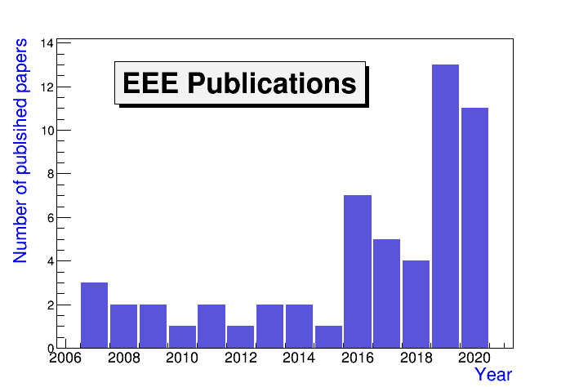
EEE Publications statistics
● 56 in total (to our knowledge), also including Conference Proceedings in refereed Journals

Slide 4
Papers in press
The cosmic muon and detector simulation framework of the EEE experiment
EPJ C (2021)
The EEE Multigap Resistive Plate Chambers as tracking devices to monitor the stability of a civil building
JINST (last of four contributions to Proceedings of RPC2020)

Slide 5
On-going papers
Papers in preparation:
Search for long distance correlation with multi-track events
Reported to several meetings, new analysis ongoing
Latitude dependence of the cosmic ray flux
Under discussion, reported to a recent meeting
Underground measurements
Results reported to several meetings, to be prepared
GEANT4 simulations (Part II)
To be still discussed

Slide 6
International Conference contributions in 2019 & 2020
2019: 15 Contributions
ICRC36: 2 posters (C.Pellegrino, C.Cicalò), published on POS
TAUP19: 1 talk (I.Gnesi), published on J.Phys.G.Conf.Ser.
DesyT: 4 talks (M.Abbrescia, P.La Rocca, G.Mandaglio, C.Pinto),
published on J.Phys.G.Conf.Ser.
EPS2019: 1 talk (P.La Rocca), published on POS
IPRD19: 1 talk (C.Pinto), published on JINST
SIF2019: 6 talks (La Rocca, Pinto, Serri, Abbrescia, Grazzi, Noferini)
2020: 4 Contributions
RPC 2020: 4 talks (Coccetti, Mandaglio, Panetta, Pinto),
published on JINST

Slide 7
Upcoming Conferences of possible interest
Conference | Place/Date | Abstract Deadline
TIPP2021: Technology & Instrumentation in Particle Physics | Online, May 24-29, 2021 | February 7
ICRC2021: Cosmic Ray Conference | Online, July 12-23, 2021 | February 15
iWORID 2021 | Ghent, June 27-July 1, 2021 | March 31
EPS-HEP 2021 | Hamburg? Online? | To be defined
PSD12: Position Sensitive Detectors | Birmingham, Sept.12-17, 2021 | May 6
LHCP21 | Paris, June 7-12, 2021 | April 5
TWEPP2021: Topical Workshop on Electronics for Particle Physics | Bergen, Sept.20-24, 2021 | To be defined
ICHEP2022 | Bologna, July 6-13, 2022
15° Pisa Meeting on Adv. Detectors | Elba, May 2022
27° ECRS, European Cosmic Ray Symposium | Nijmegen, July 25-29, 2022 | April 2022

Slide 8
Remarks and comments
● EEE activity supported up to now by many publications and conference contributions
- A total of 40+ publications and Conference Proceedings in the last 5 years
- Covid emergency and EEE reorganization resulted in a significant
modification of the increasing trend observed over the past years
● Next challenges for the editorial activity
New ideas for
- Analysis of existing datasets
- Measurements (new conditions, additional detectors,…)
-Technological developments and improvements
- Educational results and related papers
● Remarks:
- Do we need to reorganize, update and maintain a new EEE Web site? (Complete list of publications and contribution to conferences, full text,.. as far as the EB is concerned, but the opportunity of a maintained Web site is of general interest)

