Slide 1
Modalità e prospettive per la presa dati 2021 per EEE e PolarquEEEst
C. Cicalò/M. Garbini

Slide 2
Overview
Satus of the telescopes
Special Cases
Steps for the restart
Schedule proposal
"Polar" telescopes status

Slide 3
Status of the telescopes
To define the restart of the data taking we contacted the local responsibles to check the situation of all the telescopes.
Synthetic status of each area reported in the following slides.
Please report any errors still present.
Number of installed EEE telescopes = 61 (+ 4 Polar)
NOTE: Some telescopes need to be moved to new sites.
Installations to be completed = 2 (Bitetto, Carcare)
Other installations foressen in 2019/2020 = 2 (Bra, Lampedusa)

Slide 4
Piemonte
Referente/i:I. Gnesi
ID Telescopio | SITO | Hardware | Leak Test 2019 | Convenzione
TORI-01 | Liceo Bruno | ~Ok | Ok | - | 3
TORI-02 | Volta ma va a INRIM | ~Ok | Da rifare | -
TORI-03 | Liceo Ferraris | Ok | Ok | Ok | 1
TORI-04 | Liceo D’Azeglio | ~Ok | Ok | - | 2
TORI-05 | INFN da completare | No ok | Ok | Ok
Total = 5 Telescopes
Total ok/~ok = 3 Telescopes
~ok = should be “easy” to fix.

Slide 5
Lombardia&Liguria
Referente/i: M. Battaglieri
ID Telescopio | SITO | Hardware | Leak Test 2019 | Convenzione
LODI-01 | Liceo Gandini | Ok | Ok | - | 3
LODI-02 | IIS Volta | Ok | Ok | - | 4
LODI-03 | IIS Volta | Ok | Ok | - | 5
CARCARE | Liceo Calasanzio | No | No | Ok
GENO-01 | INFN | Ok | Ok | Ok | 1
SAVO-01 | Liceo Chiabrera Martini | Ok | Ok | - | 2
SAVO-02 | Liceo Grassi | ~ok | Ok | - | 3
SAVO-03 | ITIS Ferrari-Pancaldo | ~ | Da Fare | - | 6
Total = 7 Telescopes (Carcare not counted)
Total ok/~ok = 6 Telescopes

Slide 6
Veneto
Referente/i: F. Coccetti
ID Telescopio | SITO | Hardware | Leak Test 2019 | Convenzione
TREV-01 | Liceo Duca degli Abruzzi | No Ok | Ok | Ok | 2
VICE-01 | Liceo Quadri | ~Ok | Ok | - | 1
Total = 2 Telescopes
Total ok/~ok = 1 Telescopes

Slide 7
Toscana
Referente/i: E. Bossini
ID Telescopio | SITO | Hardware | Leak Test 2019 | Convenzione
PISA-01 | INFN | Ok | Da Fare | Ok | 8
GROS-01 | IIS Manetti | ~ok | ~ok | - | 6
GROS-02 | IIS Manetti | ok | bad | - | 7
SIEN-01 | Istituto Sarrocchi | Ok | Bad | - | 3
SIEN-02 | Liceo Galilei | ~ok (mixer) | ok | - | 2
AREZ-01 | ITIS Galilei | ~ok | OK | - | 1
VIAR-01 | Liceo Barsanti e Matteucci | ok | Da fare | - | 4
VIAR-02 | IIS Galilei Artiglio | ok | Da fare | - | 5
Total = 8 Telescopes
Total ok/~ok = 6 Telescopes

Slide 8
Emilia Romagna e Marche
Referente/i:M. Garbini,F. Noferini
ID Telescopio | SITO | Hardware | Leak Test 2019 | Convenzione
BOLO-01 | INFN-Bologna | Ok | Ok | Ok | 1
BOLO-02 | Liceo Fermi -Bologna | Ok | Ok | - | 3
BOLO-03 | Liceo Galvani-Bologna | Ok | Ok | Ok | 2
BOLO-04 | Da spostare | Ok | Ok | Ok
BOLO-05 | Liceo Galvani Succ-Bologna | SF6 Leak | Da fare | Ok | 7
REGG-01 | IIS Nobili-Reggio Emilia | Ok | Ok | - | 5
PARM-01 | Liceo Marconi-Parma | ~Ok | Ok | Ok | 4
COSE-01* | Liceo Scorza-Cosenza | Ok | Ok | Ok | 6
ANCO-01 | Liceo Rinaldini-Ancona | Ok | Ok | - | 8
Total = 9 Telescopes
Total ok/~ok = 8 Telescopes

Slide 9
Sardegna
Referente/i: C. Cicalò
ID Telescopio | SITO | Hardware | Leak Test 2019 | Convenzione
CAGL-01 | Liceo Pacinotti | ~Ok | Ok | Ok | 2
CAGL-02 | Liceo Michelangelo | Ok | Ok | - | 1
CAGL-03 | Liceo Alberti | ~Ok | Ok | - | 3
CAGL-04 | IIS Levi | No Ok | Ok | - | 4
Total = 4 Telescopes
Total ok/~ok = 3 Telescopes

Slide 10
Lazio
Referente/i:S. Pisano, M. Garbini
ID Telescopio | SITO | Hardware | Leak Test 2019 | Convenzione
FERM-01 | Centro Fermi | ~Ok | Ok | Ok | 1
FRAS-01 | Liceo Touscheck | ~Ok | Ok | Ok | 2
FRAS-02 | ITT Fermi | ~Ok | Bad | Ok | 4
FRAS-03 | Villa Sora | Da SPOSTARE |  |  | 6
ROMA-01 | Albertelli | ~Ok | Da Fare | - | 5
ROMA-02 | Liceo Hertz | ~Ok | Ricontrollare | - | 3
Total = 6 Telescopes
Total ok/~ok = 5 Telescopes

Slide 11
Abruzzo e Campania
Referente/i: D. De Gruttola
ID Telescopio | SITO | Hardware | Leak Test 2019 | Convenzione
TERA-01 | IIS Alessandrini-Marino | ~Ok | No ok | Ok | 5
LAQU-01 | Liceo Bafile | ~Ok | Ok | - | 4
LAQU-02 | IIS D'Aosta | Ok | Ok | Ok | 3
SALE-01 | Liceo Da Procida | ~Ok | Ok | Ok | 2
SALE-02 | Liceo Regina Margherita | Ok | Ok | - | 1
Total = 5 Telescopes
Total ok/~ok = 5 Telescopes

Slide 12
Puglia
Referente/i:M: Abbrescia, M. Panareo, M.P. Panetta
ID Telescopio | SITO | Hardware | Leak Test 2019 | Convenzione
ALTA-01 | Liceo Cagnazzi | Ok | Ok | Ok | 3
BARI-01 | Liceo Scacchi | ~Ok | Ok | Ok | 1*
TRIN-01 | IIS Staffa | Ok | OK | Ok | 2*
BITETTO | Liceo Amaldi | Check | - | OK
LECC-01 | Liceo Banzi Bazoli | Ok | Ok | - | 1
LECC-02 | Liceo Palmieri | Ok | Ok | - | 2
LECC-03 | MIGRATO
Total = 5 Telescopes (Bitetto not counted)
Total ok/~ok = 5 Telescopes

Slide 13
Calabria
Referente/i:M. Schioppa
ID Telescopio | SITO | Hardware | Leak Test 2019 | Convenzione
CARI-01 | IIS Cariati | Ok | Ok | Ok | 3*
CATZ-01 | IIS Fermi | Ok | Ok | - | 4
RECA-01 | Liceo Volta-da portare lì ora a UNICAL | ~ok | ~Ok | Ok | 2*
REND-01 | UNICAL | ~Ok | ~Ok | Ok | 1*
Total = 4 Telescopes (Carcare not counted)
Total ok/~ok = 4 Telescopes

Slide 14
Sicilia
Referente/i:P. La Rocca
ID Telescopio | SITO | Hardware | Leak Test 2019 | Convenzione
CATA-01 | INFN | ~Ok | Ok | Ok | 1
CATA-02 | ITI Cannizzaro DA SPOSTARE | ~ok | - | -
TRAP-01 | Liceo Fardella | Ok | Ok | Ok | 2
PATE-01 | Liceo Fermi | Ok | Ok | - | 3
LAMPEDUSA | Da Installare | - | - | -
Total = 4 Telescopes (Lampedusa not counted)
Total ok/~ok = 3 Telescopes

Slide 15
CERN
Referente/i: D. Hatzifotiadou/ R. Zuyeuski
ID Telescopio | SITO | Hardware | Leak Test 2019 | Convenzione
CERN-01 | Building 167 | ~Ok | Da controllare | Ok | 1
CERN-02 | Building 167 | ~Ok | Test ricorcolo | Ok | 2
Total = 2 Telescopes (Carcare not counted)
Total ok/~ok = 2 Telescopes

Slide 16
Special Cases
Telescopio | Situazione
TORI-02 | Da Spostare
TORI-05 | Completare
BOLO-04 | SITO DA CERCARE
CATA-02 | DA SPOSTARE
RECA-01 | DA UNICAL a SITO
FRAS-03 | Non Risponde
ROMA-01 | ?
Bitetto | Completare
Carcare | Completare
Bra | Da spostare e completare
Lampedusa | ?

Slide 17
Steps for the restart
Inizio Flussaggio
1 litro/h
1 telescope in each area
Start gas flow and check
Measure the efficiency of all the MRPCs
Aspettare
~1 giorni
No
Ok Flussaggio?
Sì
Check Perdite e Fix
Aspettare
~5 giorni
Tensioni Run Precedente e ulteriore check sui dati
Ok?
No
Sì
Check e Fix
Misura Efficienza

Slide 18
Schedule Proposal
Each responsible has defined a schedule for each area. For the moment we will try to focus on a single telescope at a time.
The proposed schedule foresees to start a telescope in 3 weeks
Checks and site preparation
Week 1
Start activity
Week 2
Measure of efficiency
Week 3
Assuming Tzero on 8 February 2021 we should be able to measure the efficiency of 12 telescopes and use the results to define next steps.

Slide 19
Telescopes Restarting
AREA | N. Tele
Piemonte | 1
LOMBARDIA/LIGURIA | 1
VENETO | 1
Emilia/Marche | 1
TOSCANA | 1
SARDEGNA | 1
Lazio | 1
Abruzzo/Campania | 1
Calabria | 1
Puglia | 1
Sicila | 1
CERN | 1
We can try to restart 12 telescopes.
We will try to prvide the needed material by February the 8th.
Update meeting on February the 12th with local responsibles.
Update meeting at beginning of march.
By February the 19th we will provide and discuss the procedure to measure efficiencies.

Slide 20
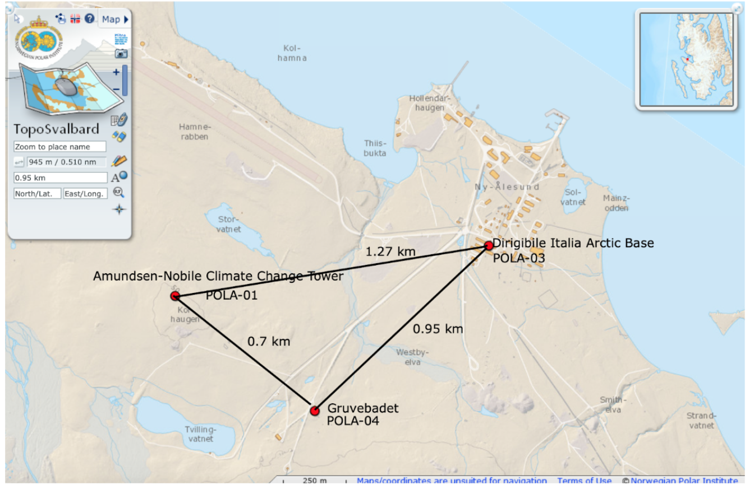
Status of POLA Telescopes
POLA-03/04 @ Ny Alesund OK
POLA-01 at Ny Alesund needs new SD card installation.
We will start soon to plan the intervention.
POLA-02 in Bologna and Ok after some fix.

Slide 21
Conclusions
Information on the status of the telescopes and possible schedule of the interventions were preliminarly discussed with the local responsibles.
If the COVID situation allows the work to start we could indicate February the 8th as Tzero.
First week devoted to the preparation of the activity (material, bureaucracy). Update meetings on week/bi-week base.
We could have 36 efficiency curves measured by beginning of March.
On the basis of the results we can decide the future steps.

