Slide 1
Search for long distance correlations from multitrack events
Present status of the analysis
Further investigations and checks to be done
Paper proposal

Slide 2
Search for long distance correlations from multitrack events Present status of the analysis
Last update to the Collaboration on July 4th 2019 (EEEmeeting@CentroFermi)
Latest results presented @EPS (July 2019) and @DeSyT-2019 (Sept. 2019)
Analysis strategy: Search for correlations between any telescope pair, looking at two- and multi-track events in both telescopes
Dataset: Full available statistics: 2013-2018
42 telescopes + 5 clusters
30M coincidence events (within ±2 s)
Info saved on ROOT file for further analyses:
Telescope code
Event time
Direction and χ2 of individual tracks
Sum of scalar products between tracks (alignment between tracks)
Preselection cuts:
χ2 < 10
Rough alignment between tracks in the same telescope
Distance between telescopes > 5 km

Slide 3
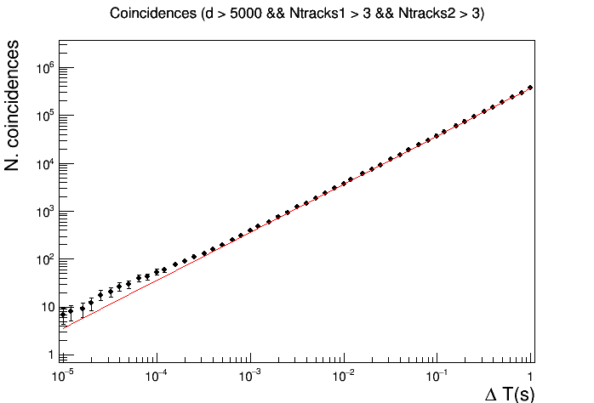
Search for long distance correlations from multitrack events Present status of the analysis
Events excess observed for ΔT ≈ 10⁻⁴ s
40 coincident events observed
(expected background ∼ 23.4 events)
p-value ∼ 10⁻³

Slide 4
Search for long distance correlations from multitrack events Further investigations and checks to be done
Investigation of multi-track events:
Optimization of the tracking algorithm (to be done?)
Study of the topology of multi-track events
Selection of good multi-track candidates for the analysis
Who, when, how?
Cuts optimization:
Multi-tracks events selection (parallelism and quality)
N. of tracks
Site distance
Relative angle

Slide 5
Search for long distance correlations from multitrack events Paper proposal
Possible content:
Introduction (physics motivations)
The experimental apparatus
Dataset and selection of multi-track events
Analysis Procedure
Results and conclusions
Target: which journal?
Deadline: further studies on multi-track events have to be done before finalizing the results
Manpower: Catania, ?

