Slide 1
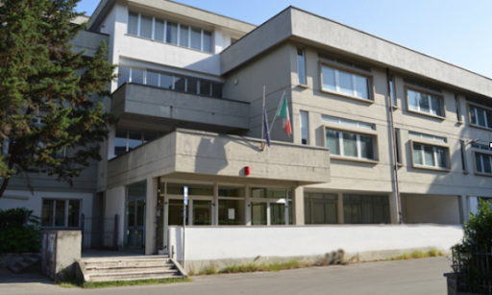
Our first data analysis with
root
Gaia Pasquini, Giulia De Pascale, Giuseppe Bevilacqua, Lorenzo Bartolini, Lorenzo Dalla Rosa, Luca Gonfiantini, Marica Gallo, Valentino Cecconi, Wekin Palandri
EEERaggiCosmici@liceosavoia.edu.it

Slide 2
Index
Introduction
Slides 3-11
First approach to EEE data
Code
Graphs/Histograms
Poisson
DISTRIBUTION
Slides 12-21
What is the distribution of Poisson?
Code
Histograms
Time Differences
Slides 22-28
Time interval distribution
Code
Histograms
Coincidences
Slides 29-36
What is a coincidence?
How can we detect them? - the code
Histograms

Slide 3
Introduction to our work

Slide 4
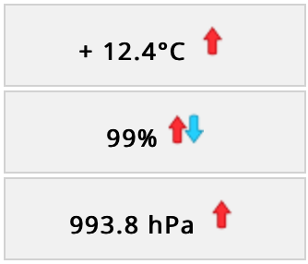
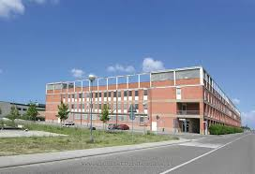
INTERNATIONAL COSMIC DAY
Atmospheric Conditions
International Cosmic Day, Florence 6th November
Lessons about cosmic rays and particle detectors
Measurement of muon rate in relation to the zenithal angle
Video conference with experiment sites
Sharing to other european schools the result of our measurements
Coordinates 43.818364, 11.194422

Slide 5
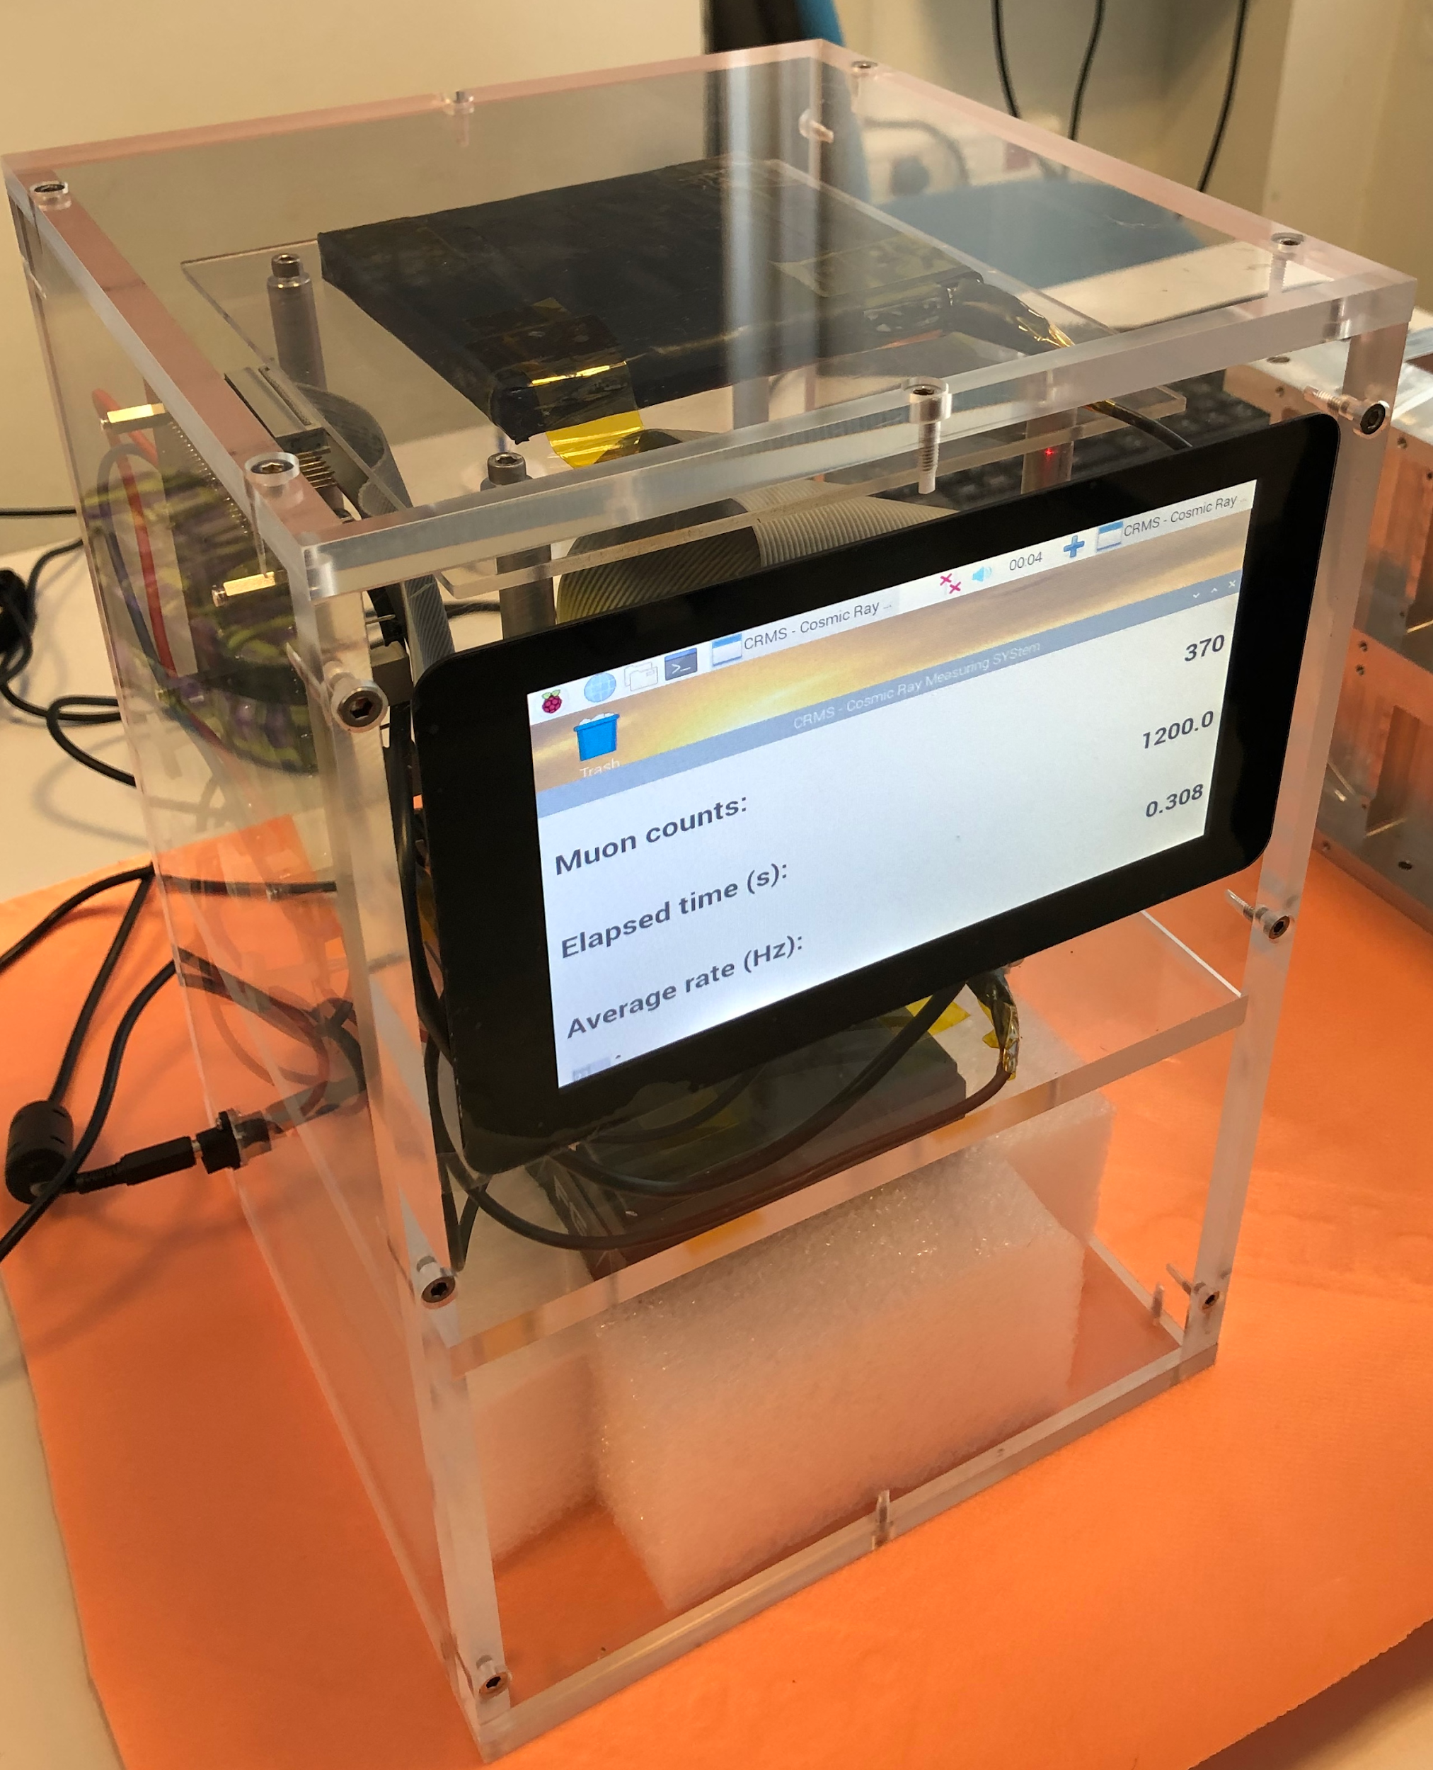
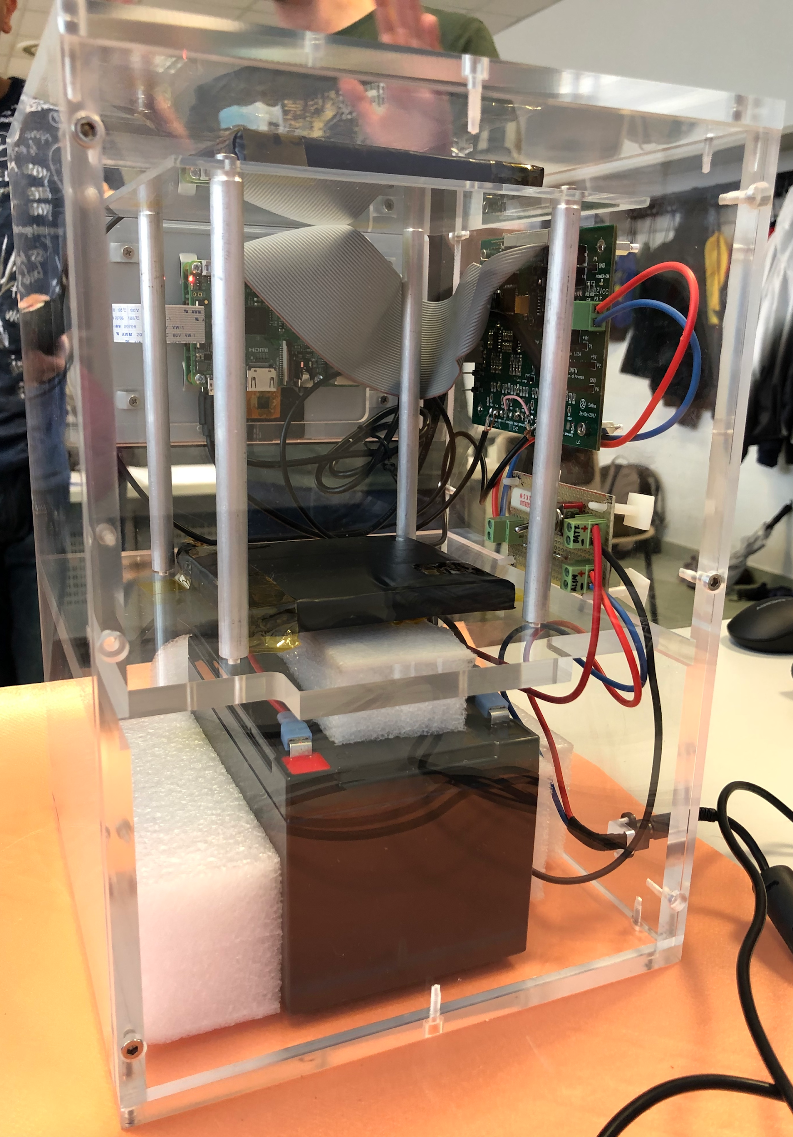
The cosmic box
Scintillator
Muon
The instrument is composed of two plastic scintillators
Measurement of muon rate by counting them in different time lapses
Measurement of the angle of inclination done by using a gyroscope
The sensibility is 1⁰
Scintillator

Slide 6
Code: muons rate depending on the angle
Inserting x-axis data
Double_t X[6]={0,30,45,60,75,90}
Double_t Y[6]={0.31,0.24,0.16,0.14,0.13,0.09}
Double_t ErroreX[6]={1,1,1,1,1,1}
Double_t ErroreY[6]={0.01,0.01,0.01,0.01,0.01,0.01}
TGraphErrors* grafico =newTGraphErrors(6,X,Y,ErroreX,ErroreY)
grafico->Draw("ap")
TF1* myFitFunction
=newTF1("myFitFunction","[0]+ [1]*cos(x*TMath::Pi()/180)^2")
grafico->Fit("myFitFunction")
Inserting y-axis data
Inserting x-axis error data
Inserting y-axis error data
Defining graph
Drawing graph
Defining fit function
Drawing fit function

Slide 7
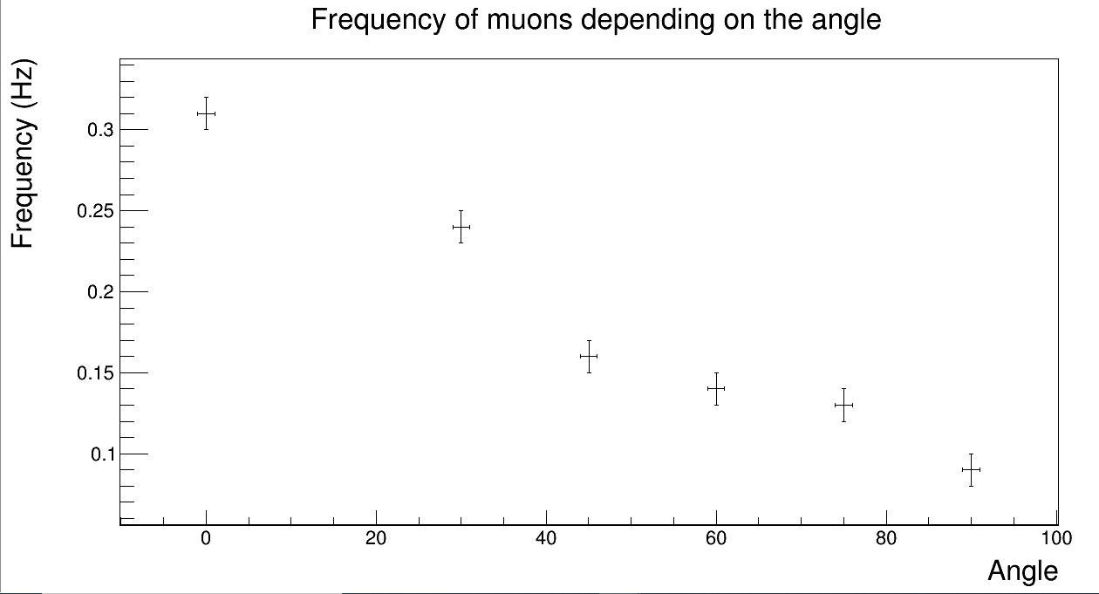
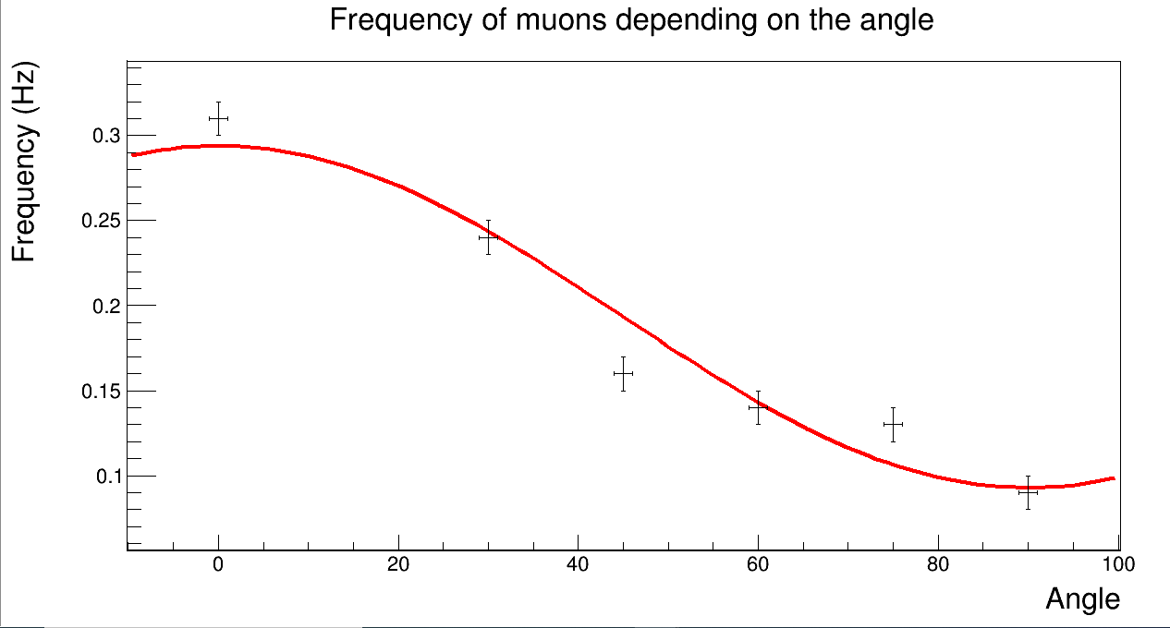
Our measurement
F
Δt=1200s
Δt=1200s
Fit function:y=a+bcos²(θ)
a=(9.3±0.6)۰e-2 Hz
b=(2.0±0.1)۰e-1 Hz

Slide 8
EEE data analysis:Speed of muons
TH1F* myhisto = new TH1F("myhisto","Speed of muons",1000,0,50)
myhisto->GetXaxis()->SetTitle("speed (10^{7} m/s)")
myhisto->GetYaxis()->SetTitle("entries")
eee->Draw("TrackLength/TimeOfFlight>>myhisto")
myhisto->Fit("gaus","","R",22,32)
Defining histogram
Setting x-axis title
Setting y-axis title
Drawing histogram
Drawing fit function

Slide 9
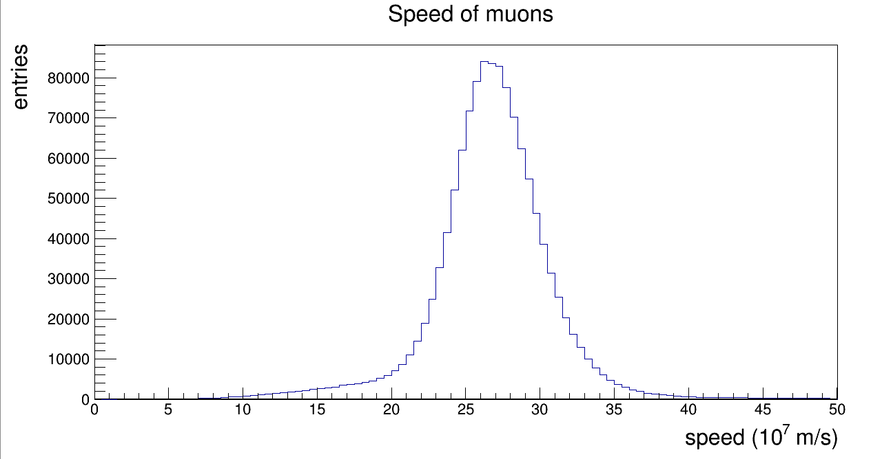
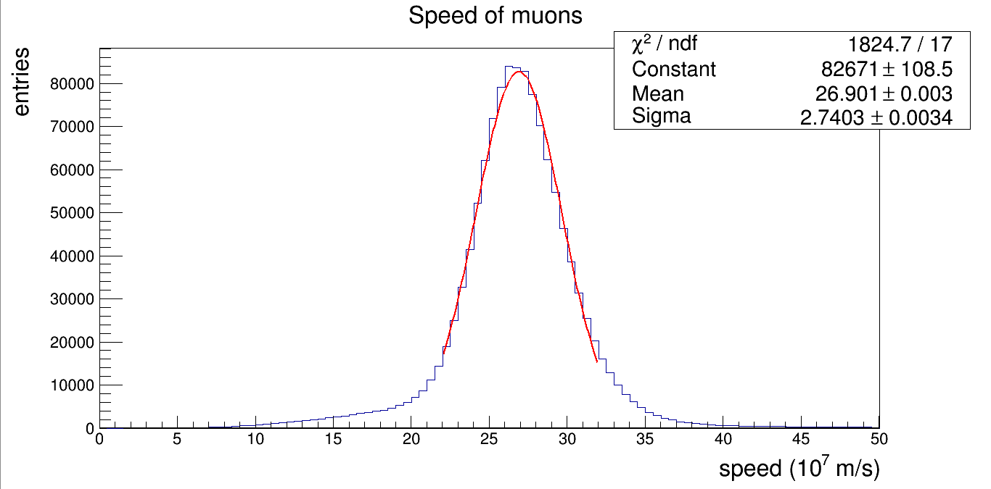
⊽=0,90 c

Slide 10
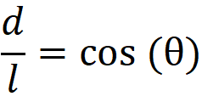
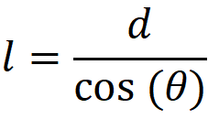
Code:Distance between detectors
Detector
l
Ө
d
=>
=>
Detector
TH2F* myhisto2D
=new TH2F("myhisto2D","",1000,0,2,100, 0, 400);
eee->Draw("TrackLength:Theta*TMath::Pi()/180>>myhisto2D");
TF1* myFitFunction=new TF1("myFitFunction","[0]/cos(x)")
myhisto2D->Fit("myFitFunction");
Defining histogram
Drawing histogram
Defining fit function
Drawing fit function

Slide 11
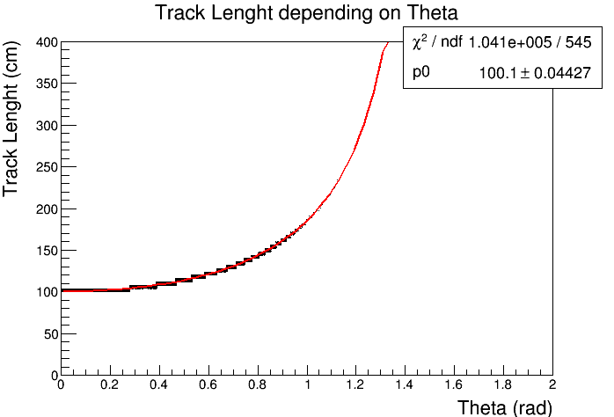
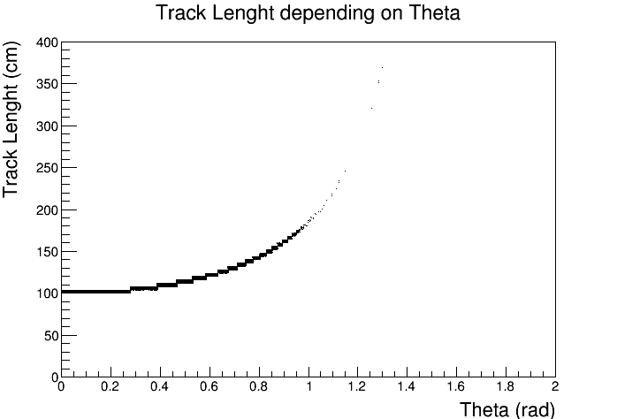
Detector | Distance (cm)
FRAS-01 | 80,09±0,04
CERN-01 | 86,97±0,04
LODI-01 | 92,99±0,04
CAGL-01 | 100,07±0,03
ANCO-01 | 100,09±0,04
BOLO-01 | 100,12±0,04
BARI-01 | 100,99±0,04
COSE-01 | 148,12±0,04
CATA-01 | 160,14±0,04
Arez01
Fit function d/cos(θ)
d=(1,00±0,04)*10^2 cm

Slide 12
POISSON DISTRIBUTION

Slide 13
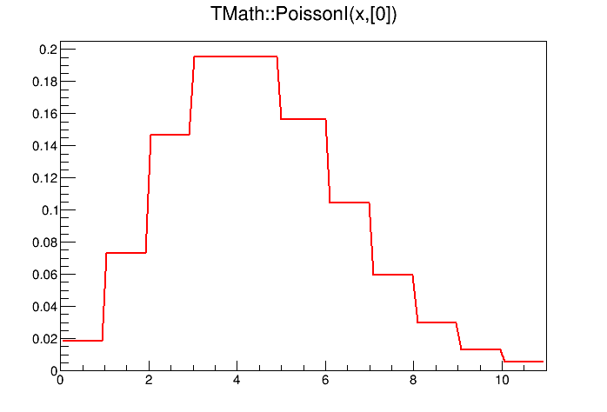
POISSON DISTRIBUTION
counting the number of muons in a certain interval of time
collecting the data in a histogram
Verifying that the data will be distributed according to the Poisson statistics
Poisson is a discrete probability distribution
It expresses the probability of a given number of events occurring in a fixed interval of time
[0]=𝜆=4

Slide 14
CODE: poisson distribution
long long int rate=0, atime, btime, range, a, b,ientry;
TH1F* myhisto = new TH1F("myhisto","",100, 0,100);
--------------------------------------------------------
void intervalli( TString filename, int range=1*pow(10,09))
{ a=0;b=1;
ReadNewEvent(myTree, a);
atime=((Seconds)*pow(10,09))+Nanoseconds;
while(true)
{ ientry=ReadNewEvent(myTree,b);
if(ientry<0)break;
btime=((Seconds)*pow(10,09))+Nanoseconds;
if((btime-atime)>=range)
{
myhisto->Fill(rate);
rate=-1;
atime=btime;
}
rate++;
b++;
}
}
define the variables
If the difference between the muons’ time is bigger than the range we fill the histogram and reset the counter
If the difference between the time of the muon A and the time of the muon B is less than the range we count the muon.

Slide 15
code: fit with poisson distribution
write a pointer to a new function “TF1 *myFit”
TF1 *myFit = new TF1("myFit","[0]*TMath::PoissonI(x,[1])");
myFit->SetParameter(1,myhisto->GetMean());
myFit->SetParameter(0,myhisto->GetEntries());
myhisto->Fit("myFit");
Set two parameters:
P1 = average value
P0 =number of events
Draw the fit

Slide 16
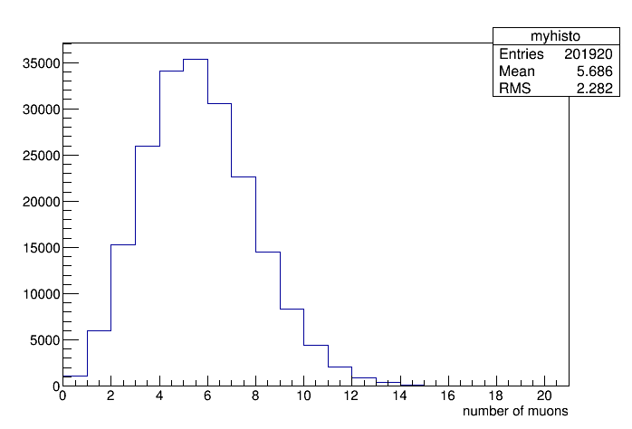
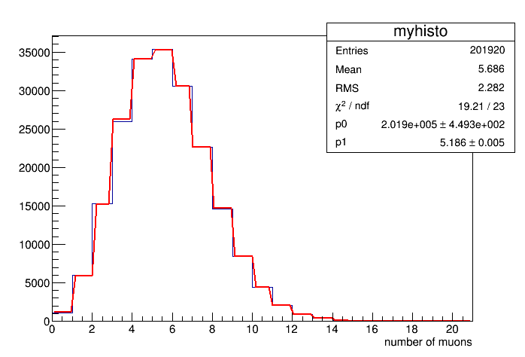
THE HISTOGRAM fitted with poisson
This is the fit of our chart with the distribution of poisson.
𝜆=5,186
The blu line is the histogram
The red line is the fit
Range:10⁸ ns

Slide 17
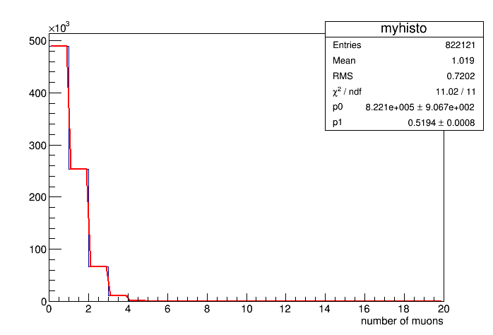
THE HISTOGRAMS
Range=10⁷ ns
𝜆=0,5194

Slide 18
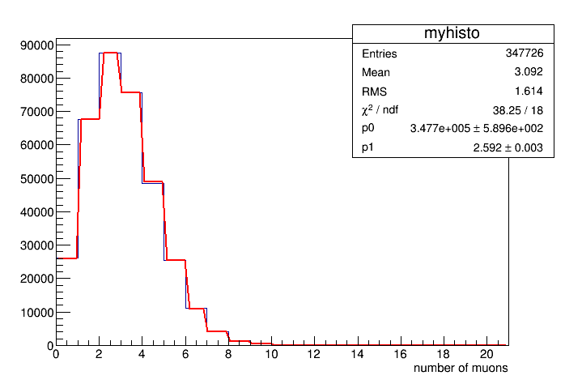
THE HISTOGRAMS
Range=5*10⁷ ns
𝜆=2,592

Slide 19
THE HISTOGRAMS
Range=10⁸ ns
𝜆=5,186

Slide 20
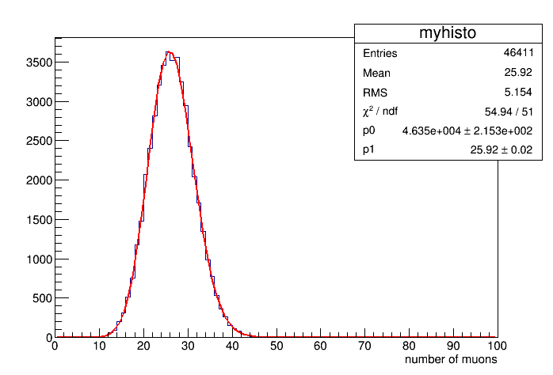
THE HISTOGRAMS
Range=5*10⁸ ns
𝜆=25,92

Slide 21
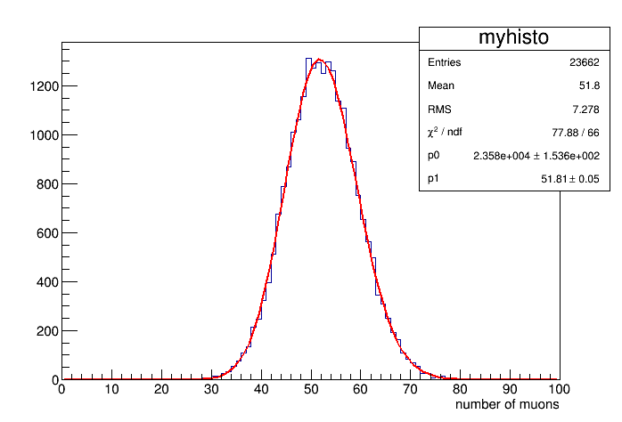
THE HISTOGRAMS
Increasing the range, the number of muons in each interval increases
Range=10⁹ ns
𝜆=51,81
The histogram approaches a Gaussian

Slide 22
time differences

Slide 23
EXPONENTIAL DISTRIBUTION
If the data are distributed according to the Poisson statistics, as we saw before, we expect the distribution of the time between two consecutive muons to follow the exponential distribution
It is a continuous probability distribution
The probability density associated is given by:
f(t)= re^{-rt}, where r represents the number of events per unit time and t represents the time variable

Slide 24
TIME INTERVALS
n=1
As we set the parameter n to different values (1,5,50) we obtained different histograms and the fit followed different distributions.
Δt1
Δt2
Δt3
Δt4
n=5
Δt1
Δt2

Slide 25
CODE: time differences
void LeggiDati(TString filename, int n=1)
{
double tempo,differenza,precedente=0;
for (long long int i=0; i<nMuons;i+=n)
{
long long int ientry = ReadNewEvent(myTree, i);
if (ientry < 0) break;
precedente=tempo;
tempo=Seconds+(Nanoseconds*1E-09);
differenza=tempo-precedente;
isto->Fill(differenza);
}
}
Defining the variables and the parameter n.
Computing the differences of the muons’ arrival times.
Filling histogram

Slide 26
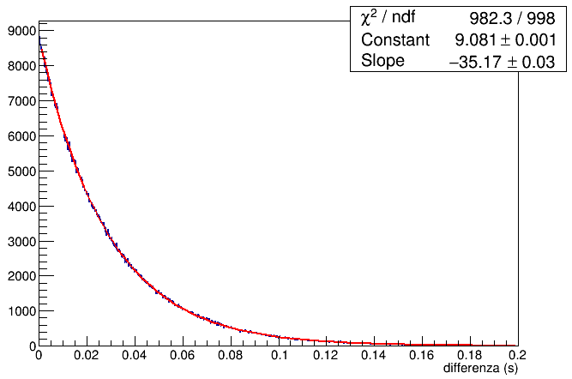
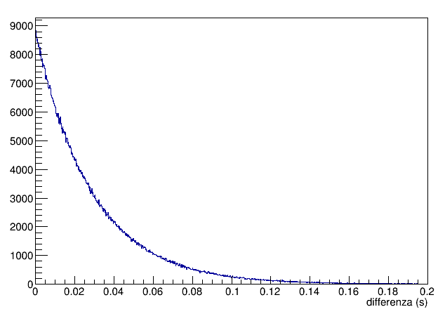
EXPONENTIAL
In this histograms the parameter n is set to 1 and the fit function is an exponential.
r= 35,17±0,03 Hz

Slide 27
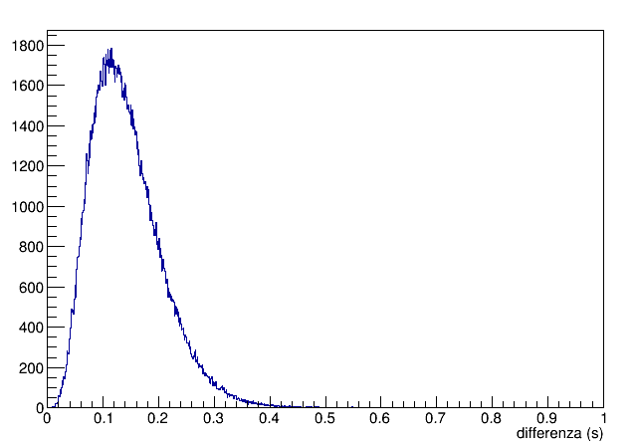
In this histogram the parameter n is set to 5 and the distribution is not exponential anymore

Slide 28
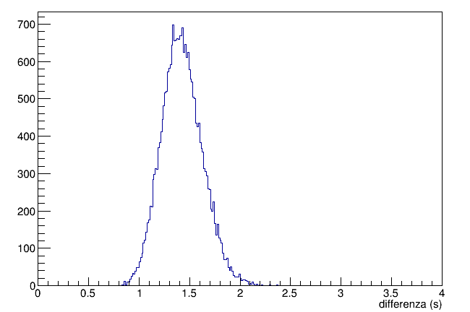
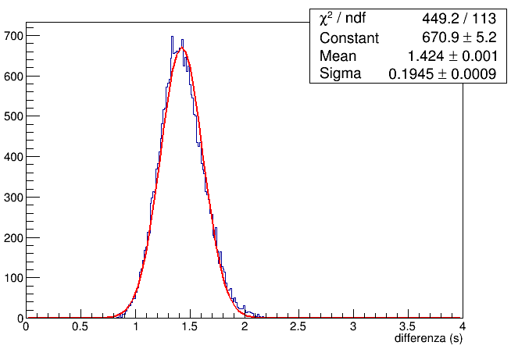
GAUSS-DISTRIBUTION
In this histogram the parameter n is set to 50 and the fit function is a gauss distribution

Slide 29
COINCIDENCES

Slide 30
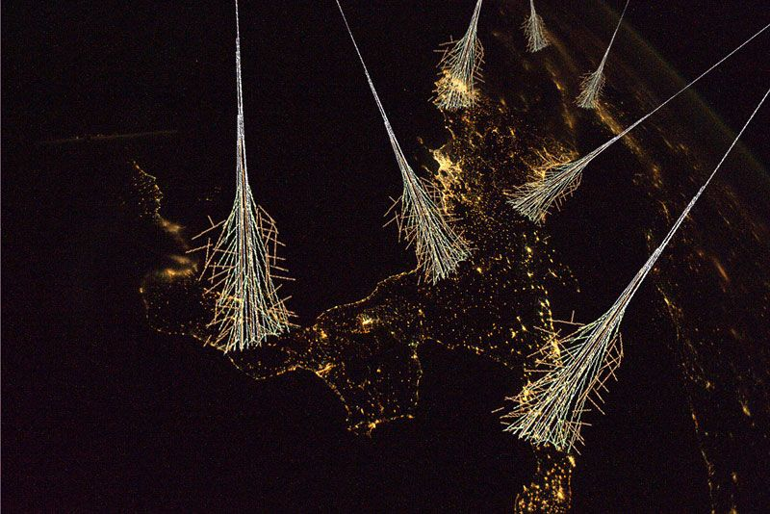
COINCIDENCES
The program compares the data collected by two distinct detectors and establishes whether they originate from the same primary ray, comparing the different times.

Slide 31
CODE: creating/filling vectors
void coincidenze(TString filename1,TString filename2,
int rnge=1000,int bin=300,int graphmn=0,int graphmx=600){
TTree* file1=GetTree(filename1);
TTree* file2=GetTree(filename2);
if(!file1) return;
if(!file2) return;
long long int evindx1=0,evindx2=0,ientry,time1,time2,
dif,time01,time02,time0;
ReadNewEvent(file1, 0);
time01=Seconds;
ReadNewEvent(file2, 0);
time02=Seconds;
time0=min(time01,time02);
TH1F* histo=new TH1F("histo","",bin,graphmn,graphmx);
Function declaration
File scan
File existence check
Variable declaration
Variable “time0” creation
Histogram generation

Slide 32
CODE: coincidence discovery tool
while (true){
ientry = ReadNewEvent(file1,evindx1);
if (ientry < 0) break;
time1=(Seconds-time0)*1E09+Nanoseconds;
ientry = ReadNewEvent(file2,evindx2);
if (ientry < 0) break;
time2=(Seconds-time0)*1E09+Nanoseconds;
dif=time1-time2;
if(abs(dif)<=rnge){
histo->Fill(dif);
evindx2++;
}else if(time2 > time1+rnge) evindx1++;
else if(time1 > time2+rnge) evindx2++;
}
histo->Fit("gaus");
histo->Draw();
}
Loop start
Reading first time variable
Reading second time variable
Determining time difference
Inserting difference into histo
Elapsed time for two files of 6.25 million events each is 2 seconds.
Increasing the indices
Drawing histo

Slide 33
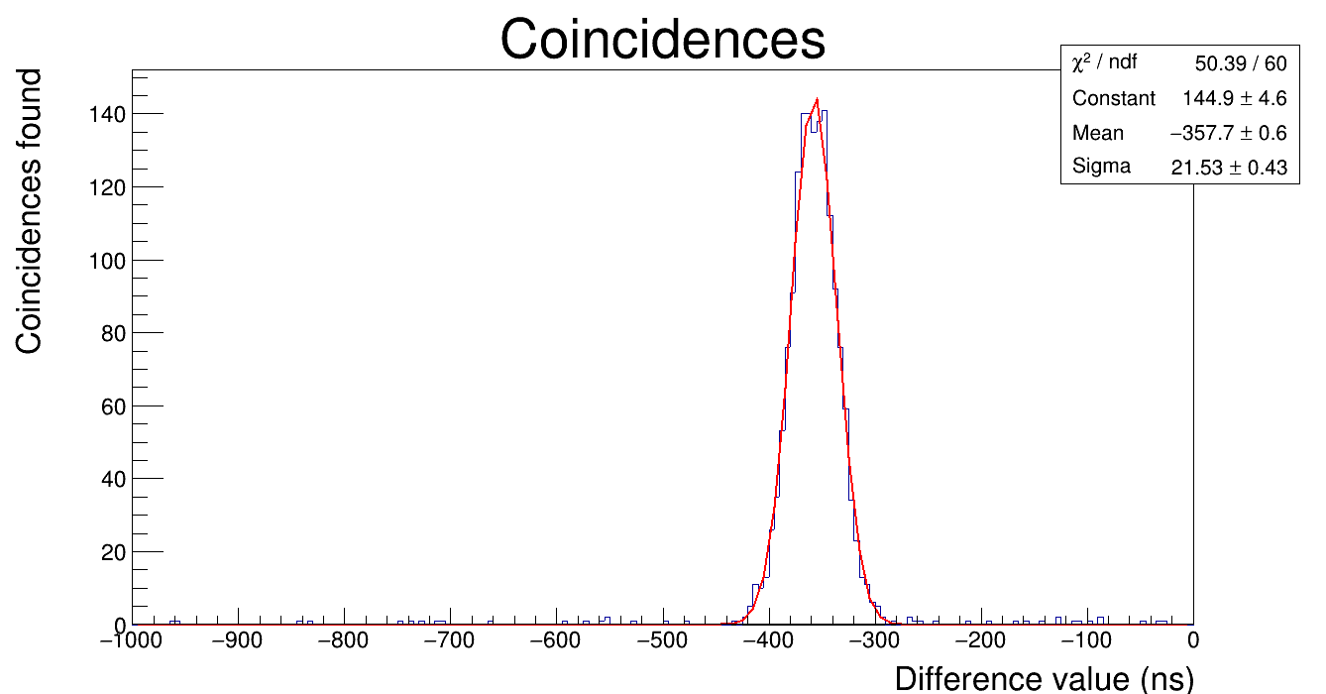
Cern data
This is the histogram of the data from CERN; there is a noticeable spike at different values ranging from -280 to -440, while the noise floor is very low since the detectors are only 15 metres apart.

Slide 34
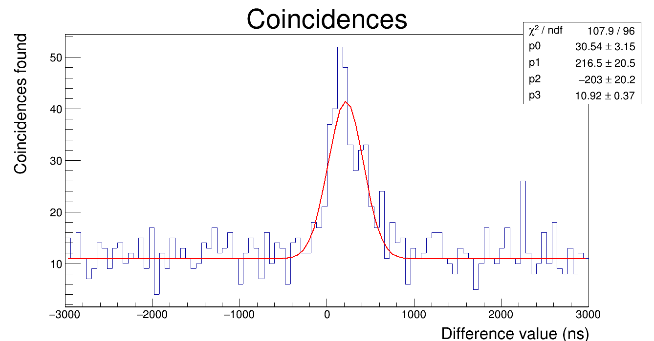
Lodi data
This histogram contains the data from the detectors in Lodi; being the detectors farther away (165m ) false positives see a substantial increase.

Slide 35
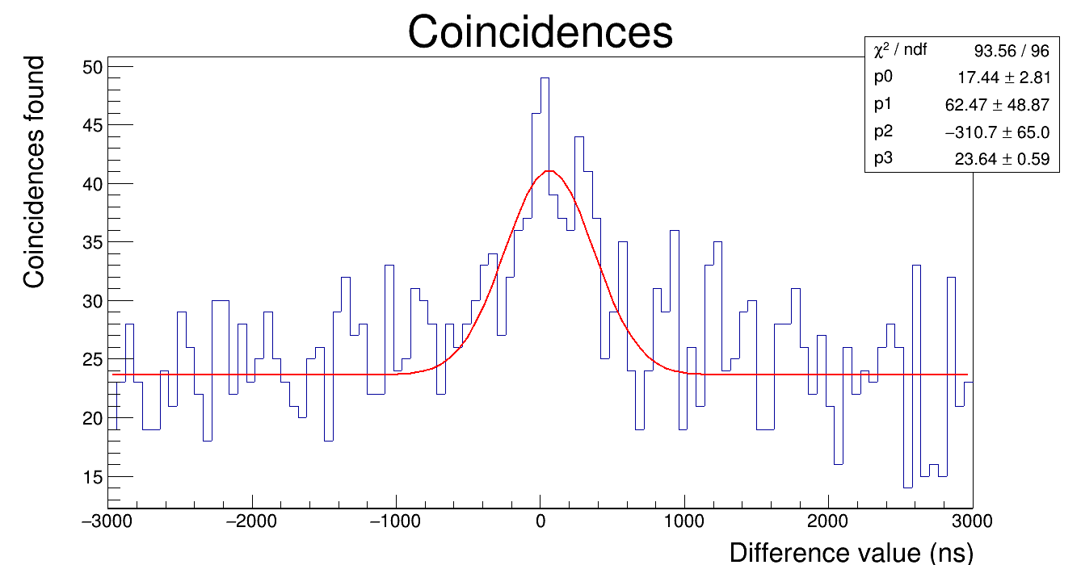
L’aquila data
This is the data collected in L'Aquila, where the two sensors were 204m apart. False positives were even more bothersome here, but with some tweaking we managed to get a reasonably clean plot.

Slide 36
That’s all folks!
A special thanks to
Edoardo Bossini
Daniele De Gruttola

