Slide 1
COSMIC RAYS MEASUEMENT UNDERGROUND
Stefano Boi

Slide 2
WHY MEASUREMENTS UNDERGROUND?
It is a study of muon flux attenuation (same process of altitude measurements, but with different materials)
Many studies of muon flux underground
It could be an interesting information for the particular experimental site (Nuraxi Figus - Seruci mine complex)

Slide 3
WHY NURAXI FIGUS?
More than 30 km of galleries available
Coal extraction has been interrupted
Electric power (almost!) stable
Possibility to acces both by car and by elevator
Technical support by Carbosulcis s.p.a. (technicians, safety, geologists, engineers , …)
INFN support: ARIA project

Slide 4
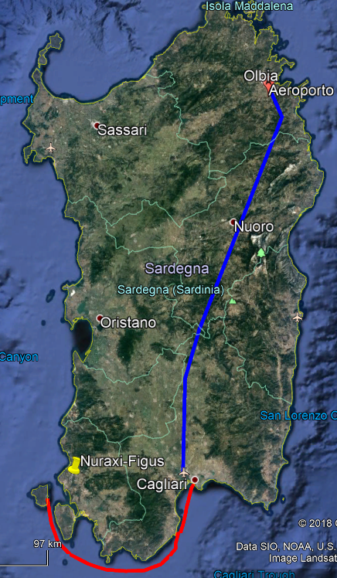
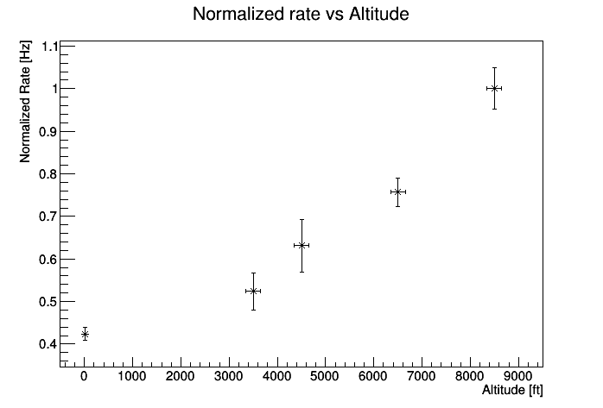
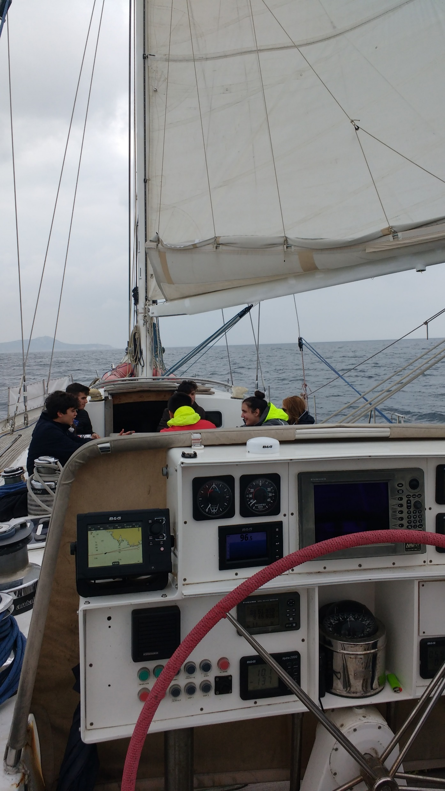
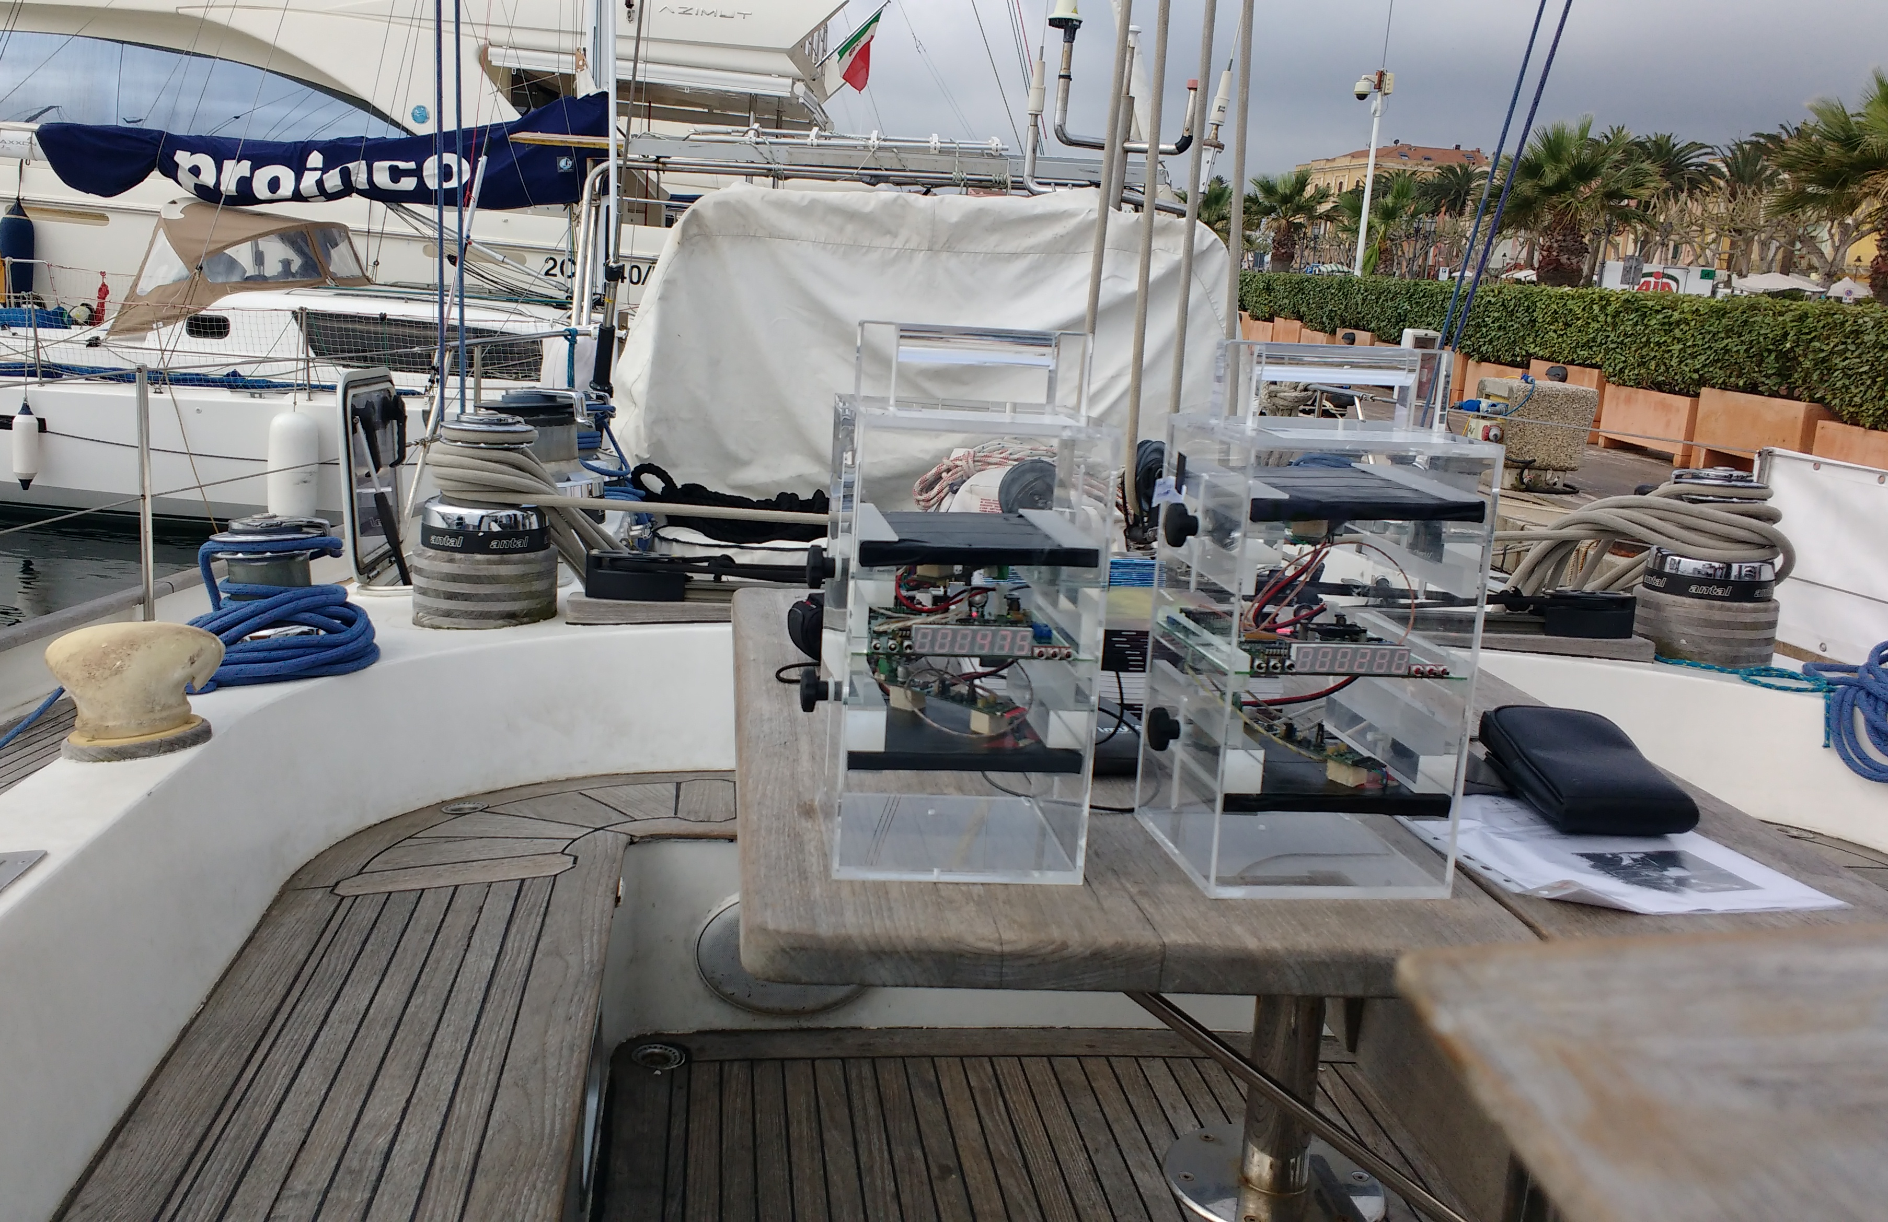
SAILING AND FLYING WITH CB

Slide 5
SAILING AND FLYING WITH CB

Slide 6
SAILING AND FLYING WITH CB

Slide 7
SAILING AND FLYING WITH CB

Slide 8
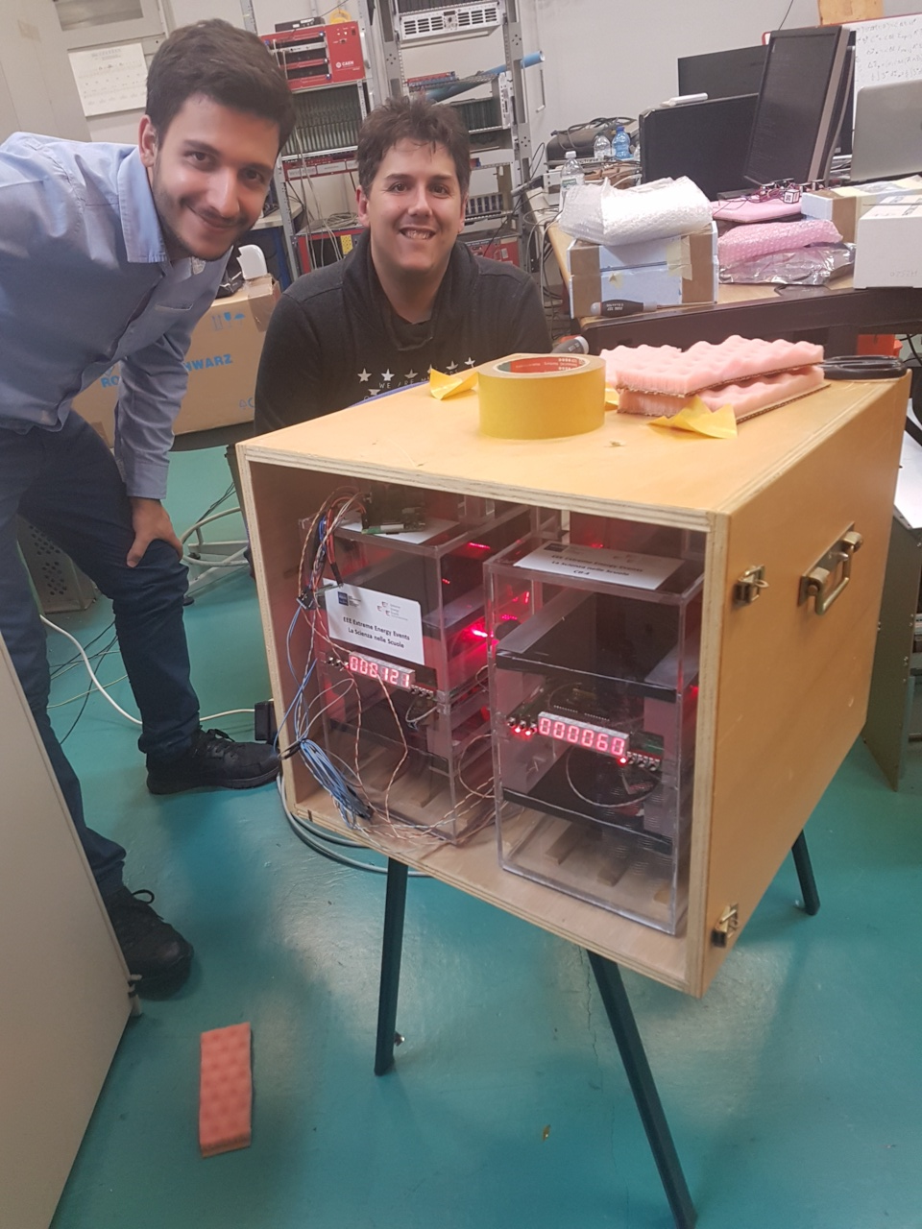
EXPERIMENTAL SETUP
Cosmic Box
3 CB enclosed in a wooden box
1 Raspberry Pi for DAQ
  One channel per CB
  Timestamp
  Temperature, pressure and umidity
1 backup UPS

Slide 9
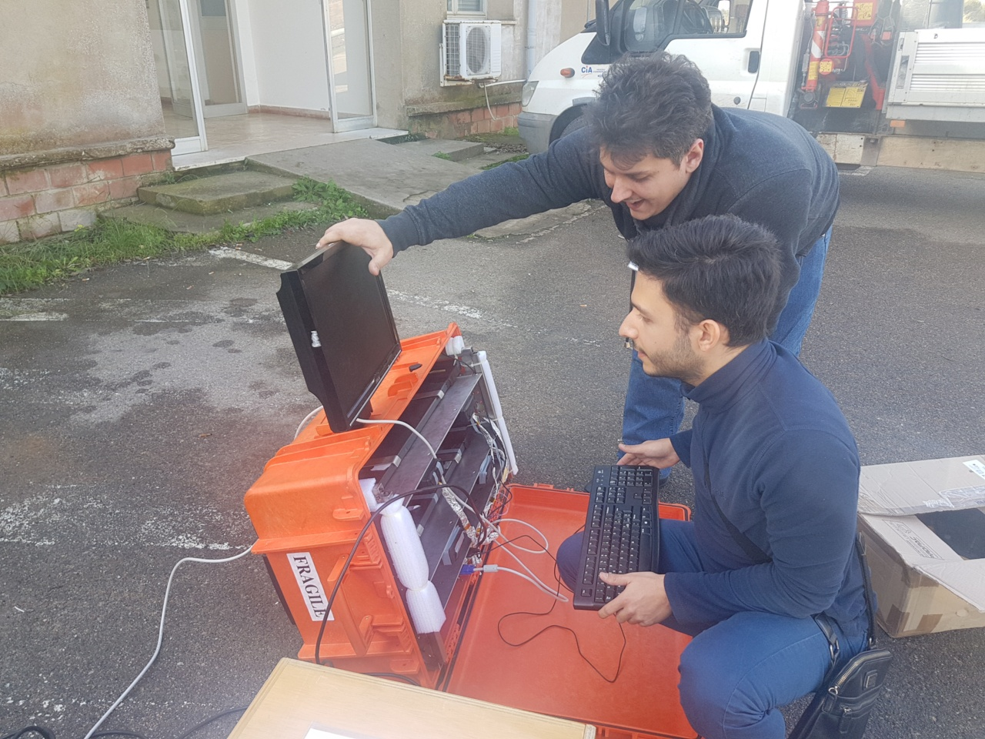
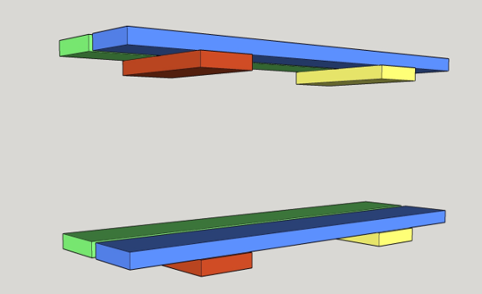
EXPERIMENTAL SETUP
AstrO
8 plastic scintillator
Enclosed in a waterproof case
FPGA for DAQ
Temperature correction
Whether station
GPS
Integrated backup battery

Slide 10
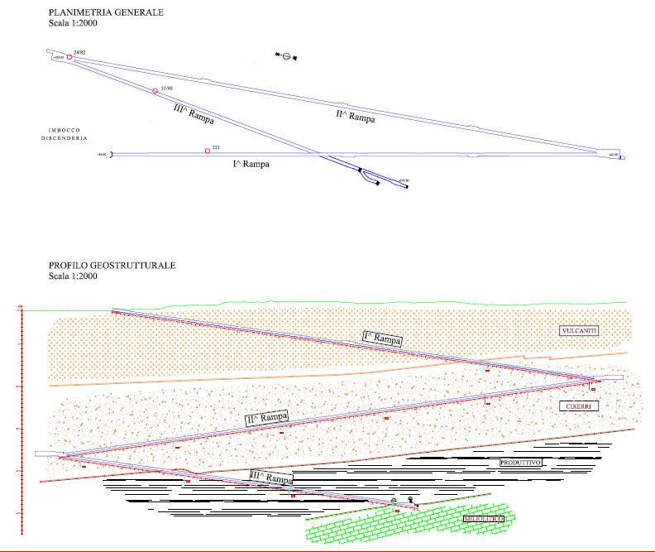
NURAXI FIGUS MEASUEMENTS
External measurement
  ~48 minutes
3 underground measurements
  174 m: ~71,5 h ~3 days
  339 m: ~214,3 h ~9 days
  512 m: ~1989,9 h ~83 days

Slide 11
NURAXI FIGUS MEASUEMENTS
External measurement
  ~48 minutes
3 underground measurements
  174 m: ~71,5 h ~3 days
  339 m: ~214,3 h ~9 days
  512 m: ~1989,9 h ~83 days
~174 m underground

Slide 12
NURAXI FIGUS MEASUEMENTS
External measurement
  ~48 minutes
3 underground measurements
  174 m: ~71,5 h ~3 days
  339 m: ~214,3 h ~9 days
  512 m: ~1989,9 h ~83 days
~339 m underground

Slide 13
NURAXI FIGUS MEASUEMENTS
External measurement
  ~48 minutes
3 underground measurements
  174 m: ~71,5 h ~3 days
  339 m: ~214,3 h ~9 days
  512 m: ~1989,9 h ~83 days
~512 m underground

Slide 14
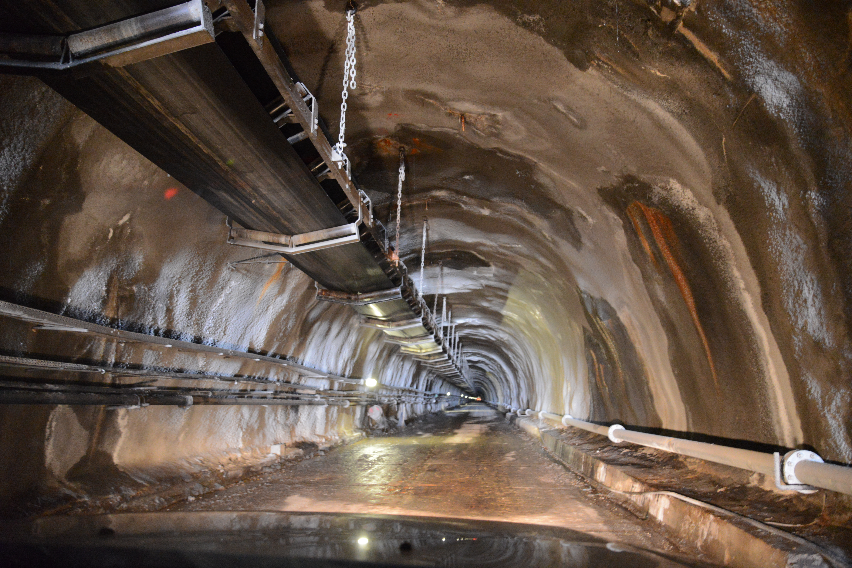
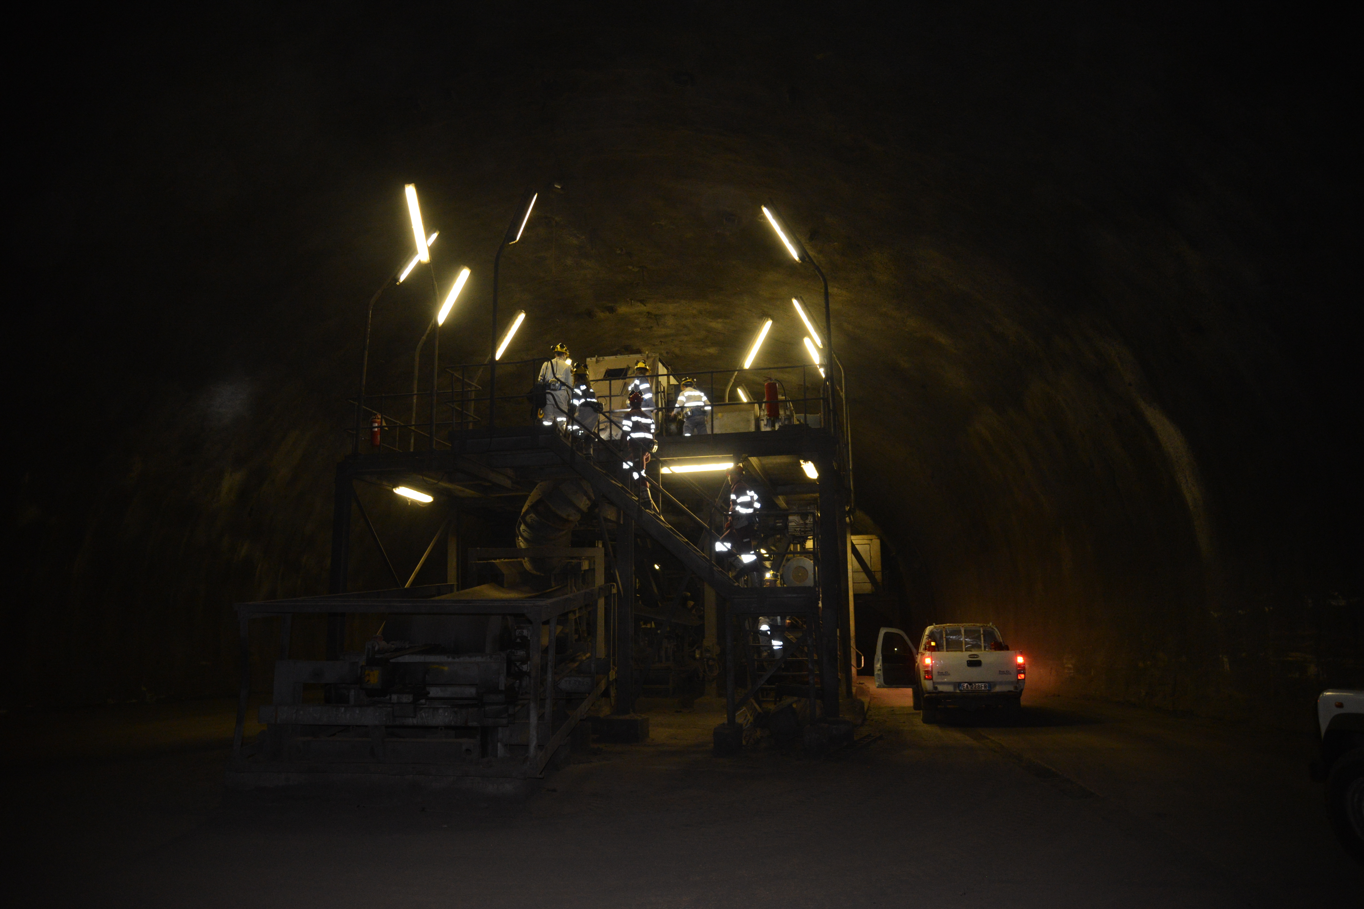
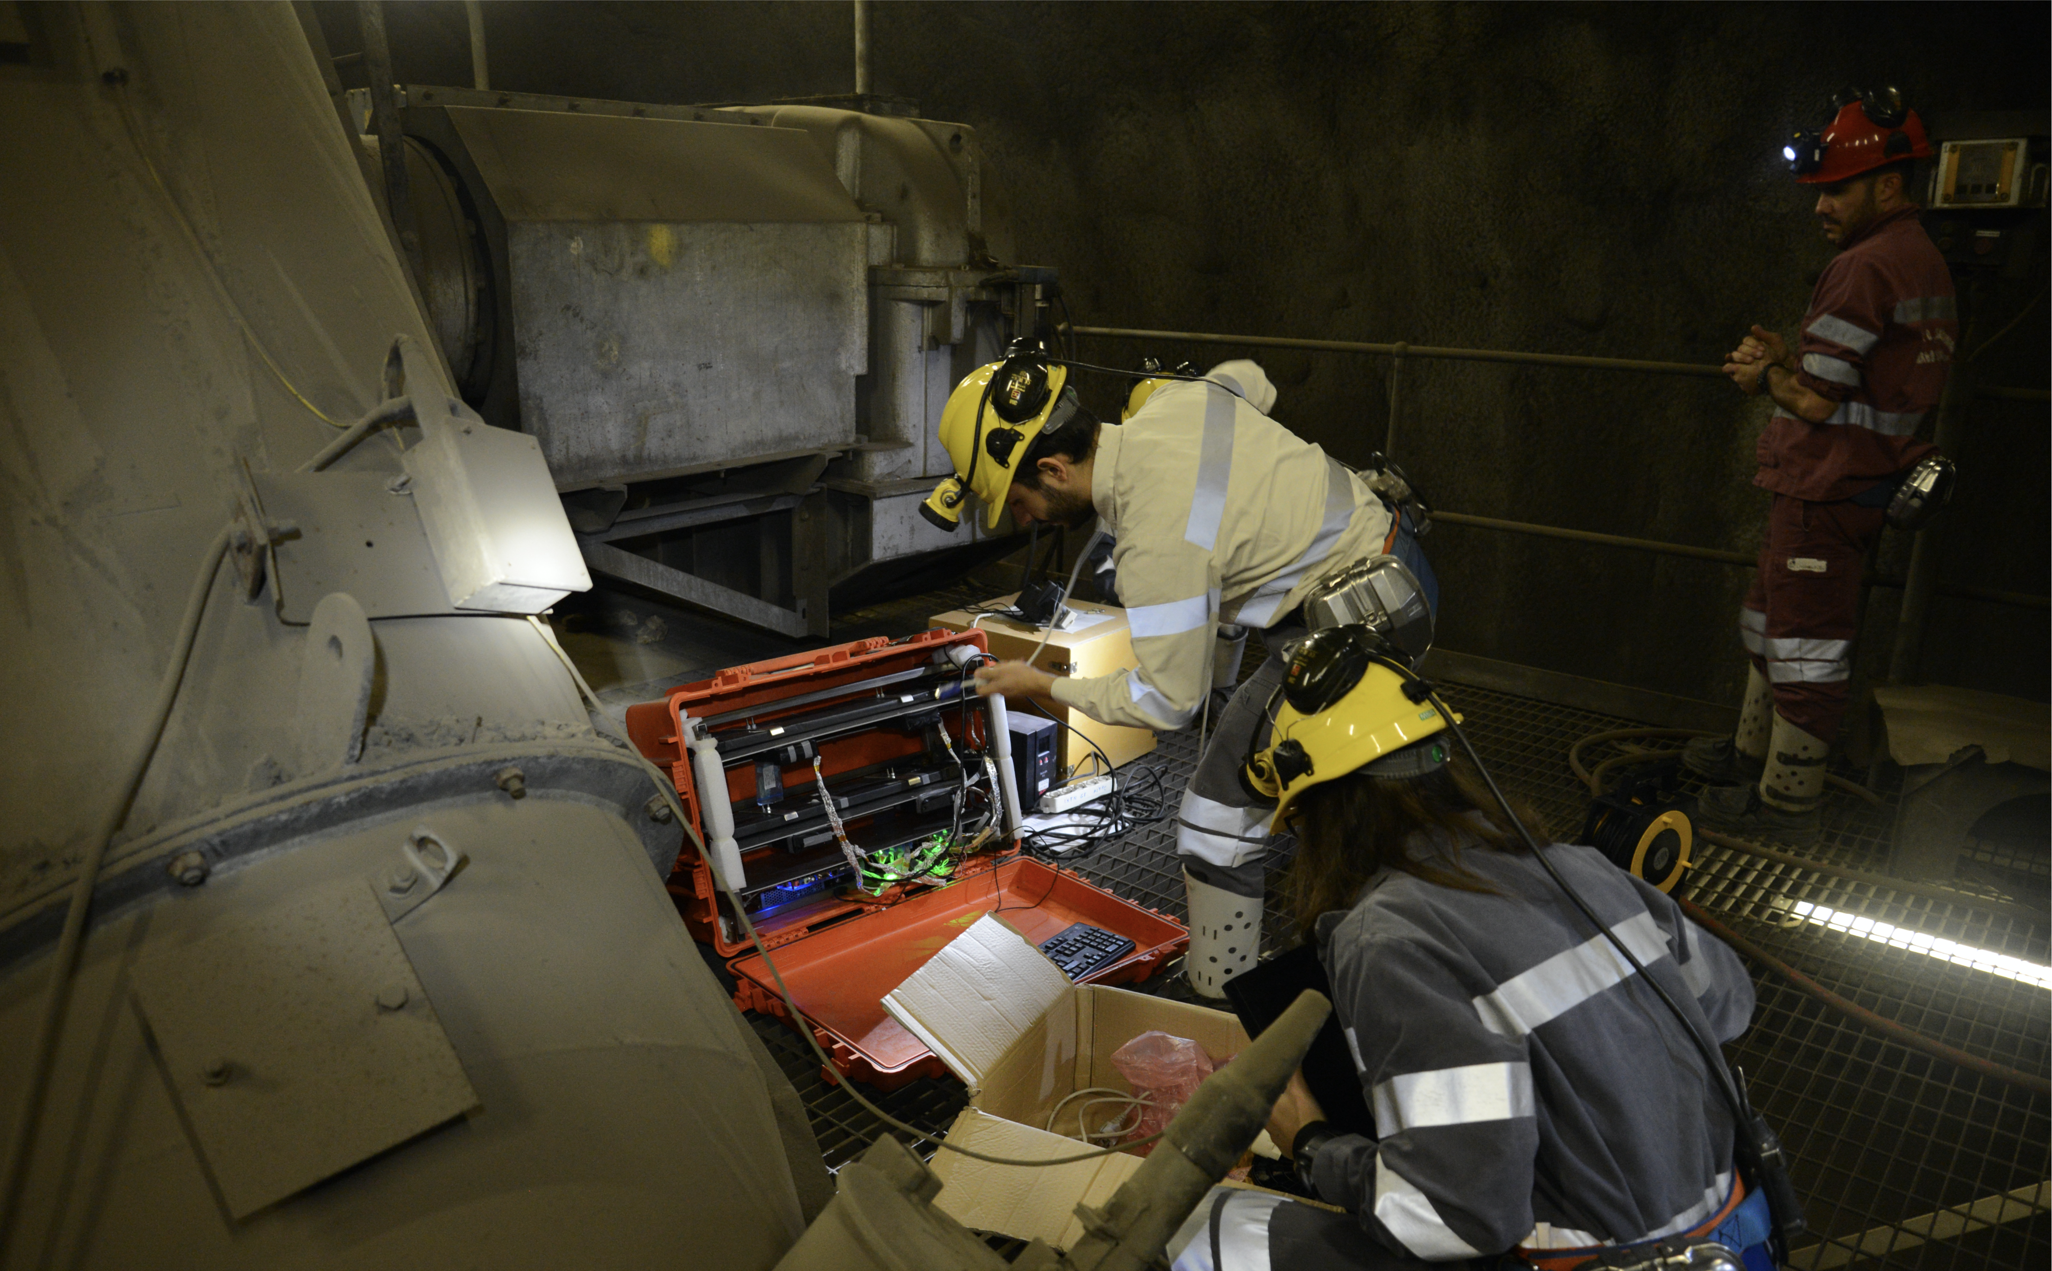
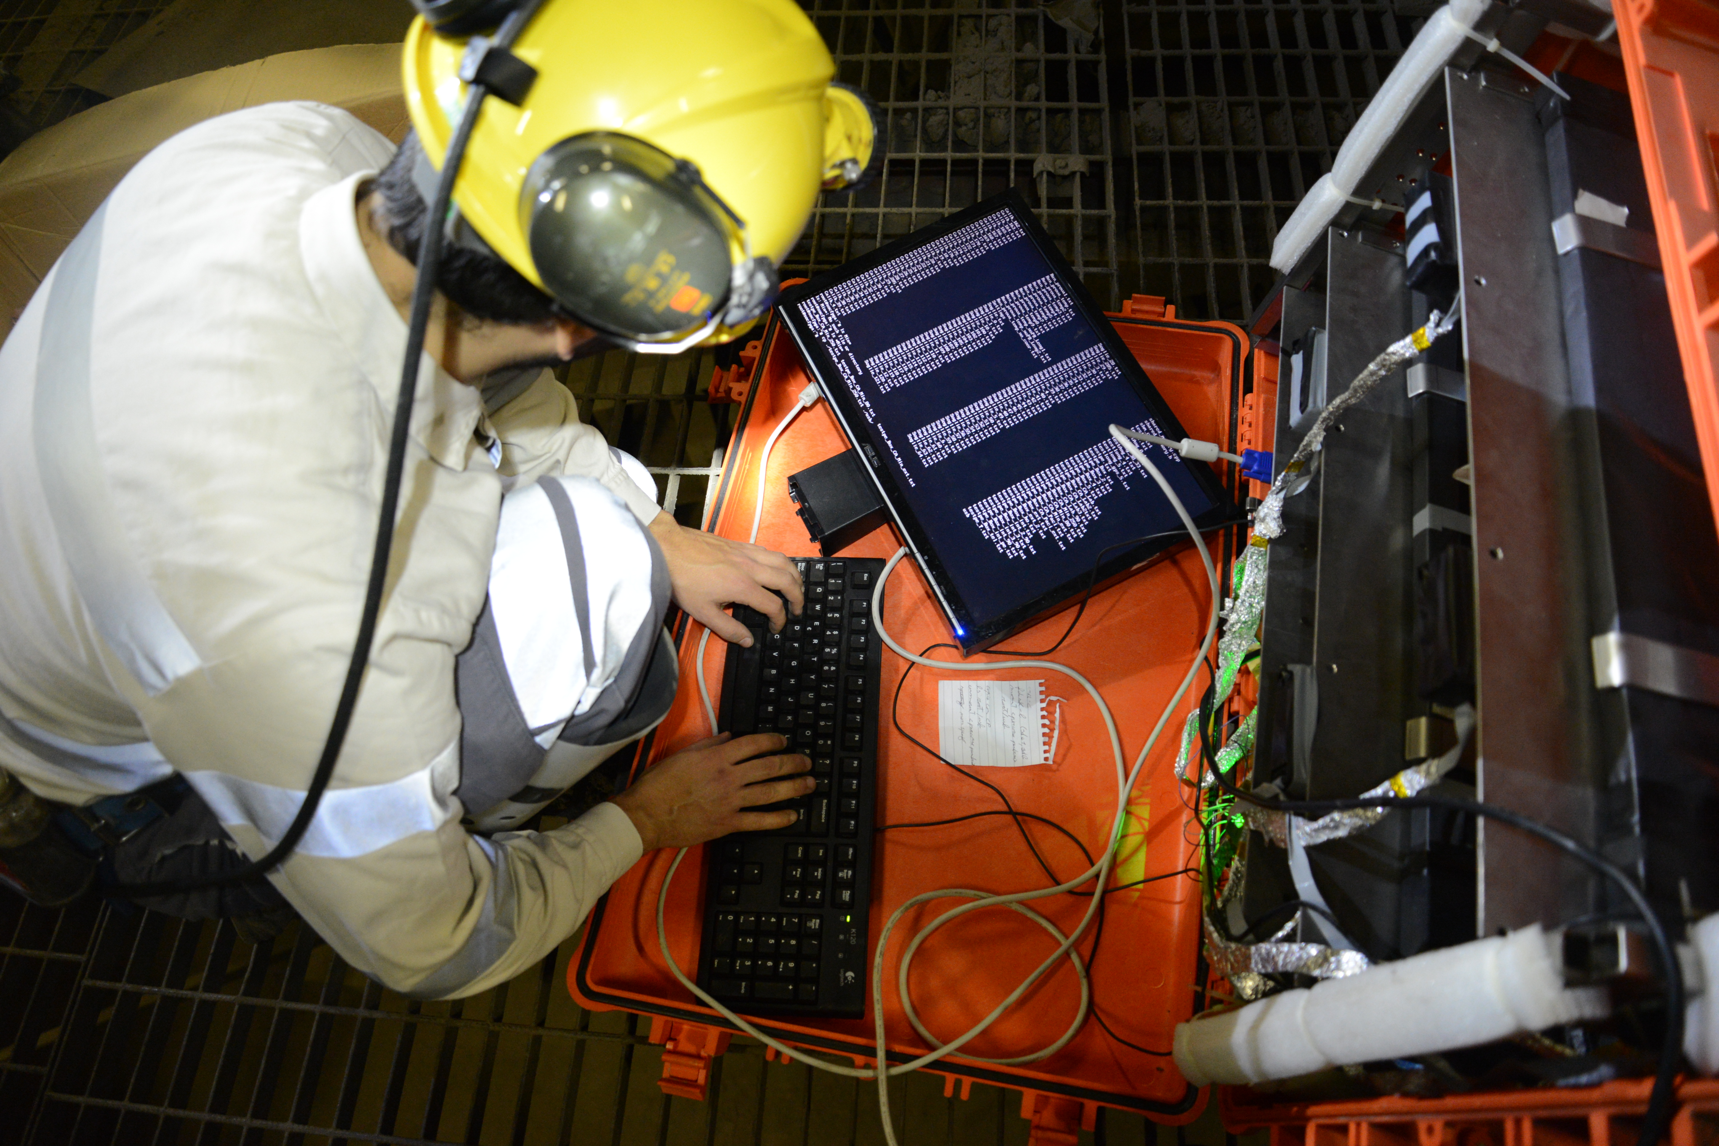

Slide 15
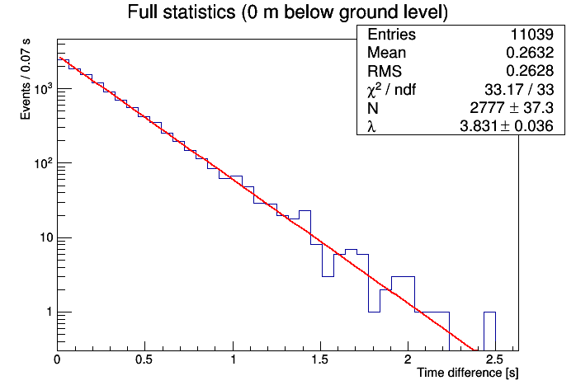
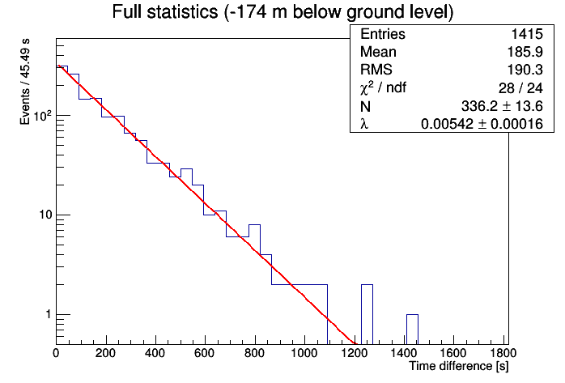
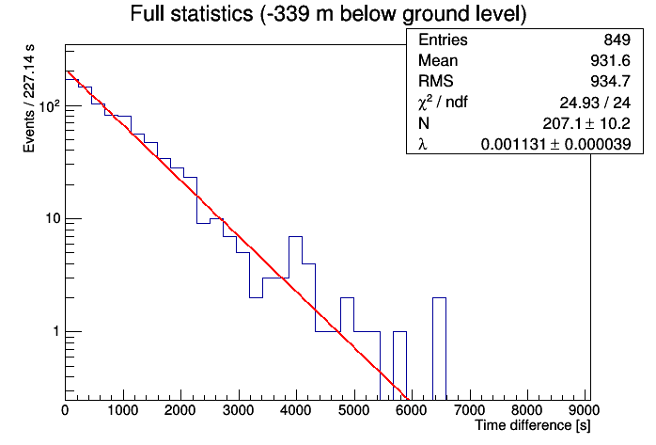
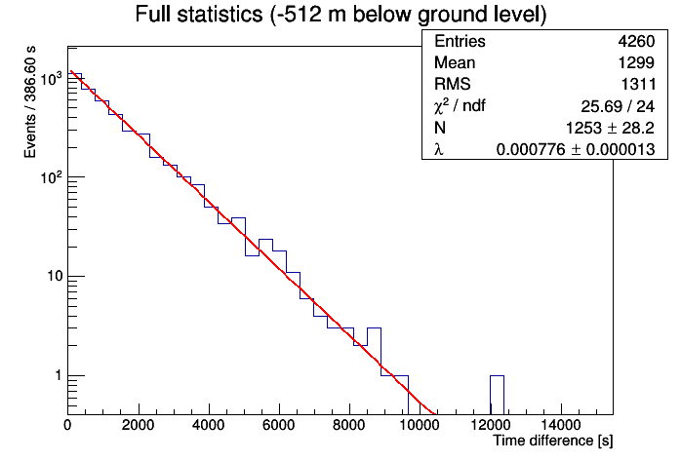




RESULTS
$$\left(3,83±0,04\right)Hz$$
$$\left(5,42±0,016\right)⋅{10}^{−3}Hz$$
$$\left(1,13±0,04\right)⋅{10}^{−3}Hz$$
$$\left(0,776±0,013\right)⋅{10}^{−3}Hz$$

Slide 16
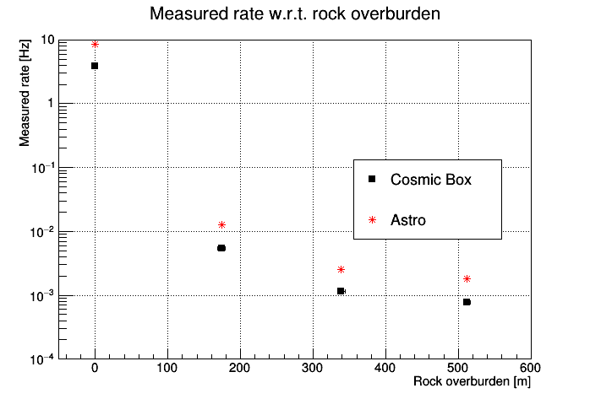
RESULTS

Slide 17
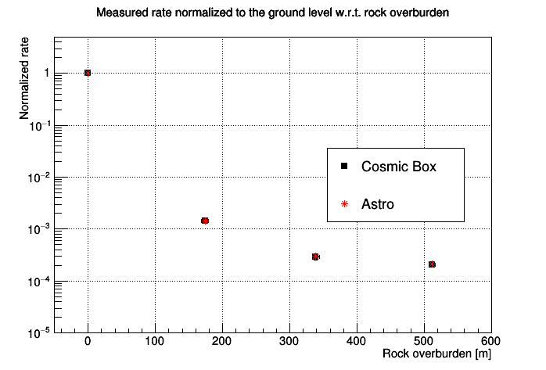

RESULTS
$$R_{N}=\frac{R\left(d\right)}{R(0)}$$

Slide 18
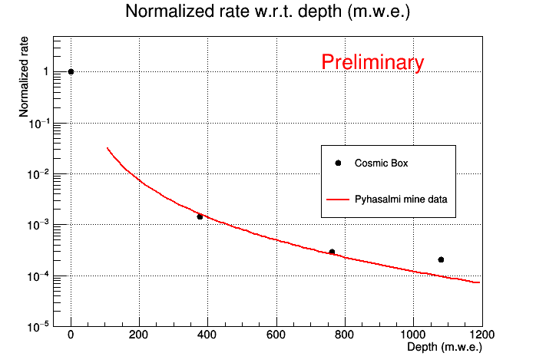
COMPARISON WITH PHYÄSALMI MINE (FINLAND)

Slide 19
TO DO LIST
At least another measurement in Nuragi Figus
A set of measurements in Seruci
MC simulations to correct data for the detector acceptance

