Slide 1
Articolo PolarquEEEst per GREAL
Laura Perasso, Ombretta Pinazza e Marina Trimarchi
Collaborazione EEE
13 Maggio 2020

Slide 2
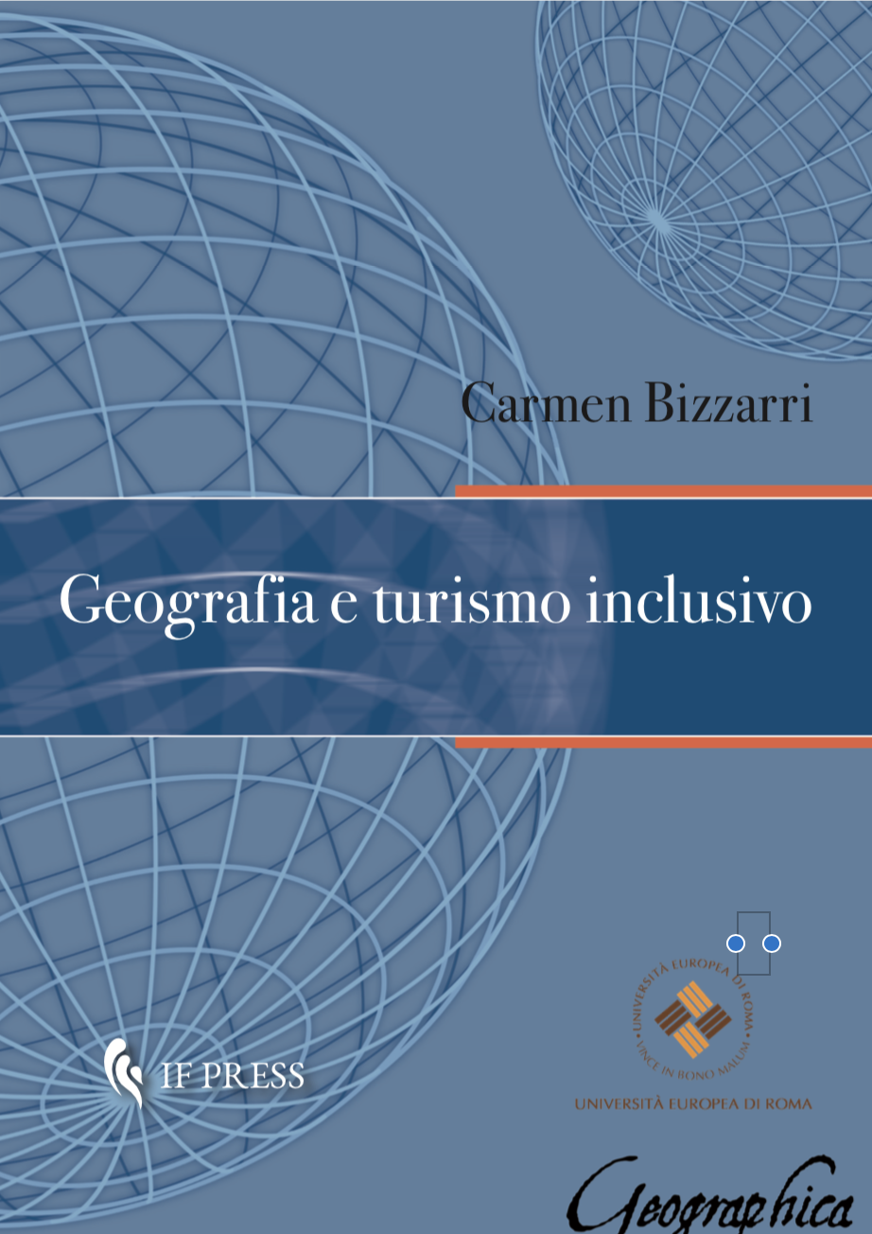
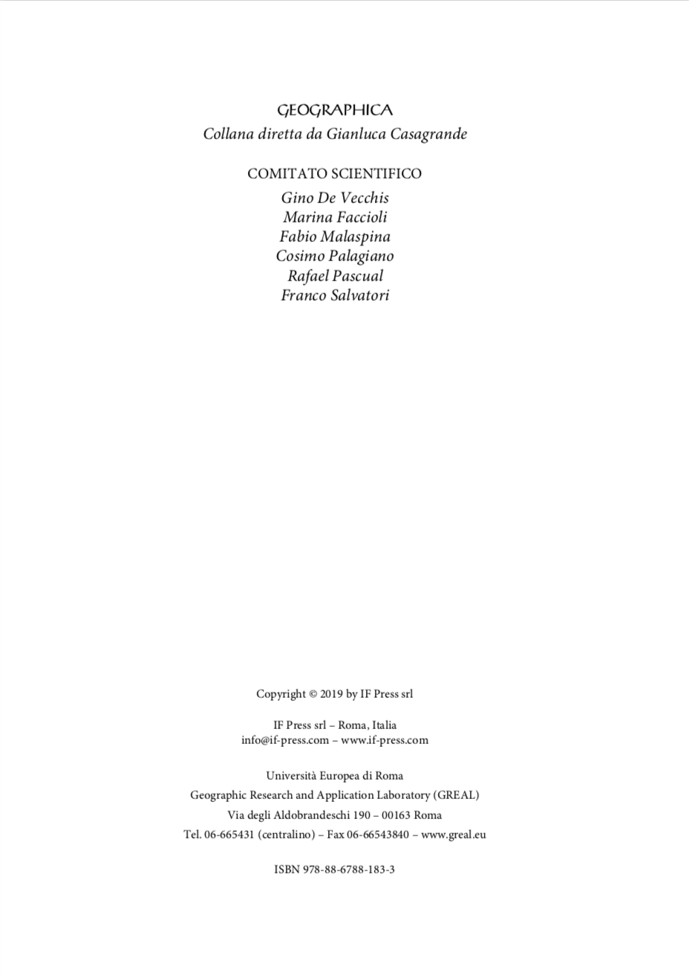
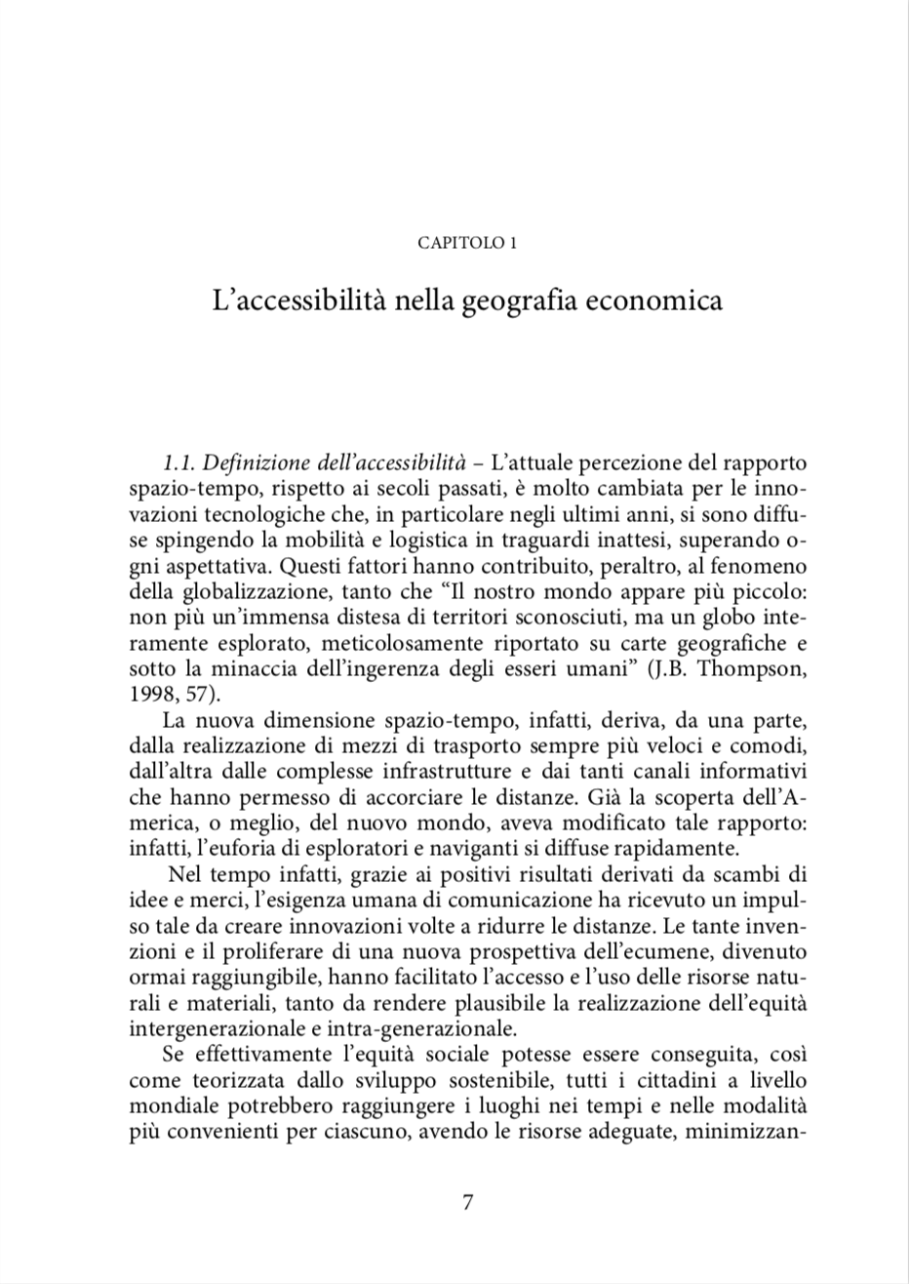
September 2019: we received the invitation to present a contribution from prof. Gianluca Casagrande, Polarquest team member
Geographic Research and Application Laboratory (GREAL) of the European University of Rome greal.eu
"Geographica" University Press booklet series
Thematic collections of scientific and technical reports published as open-access PDF documents

Slide 3
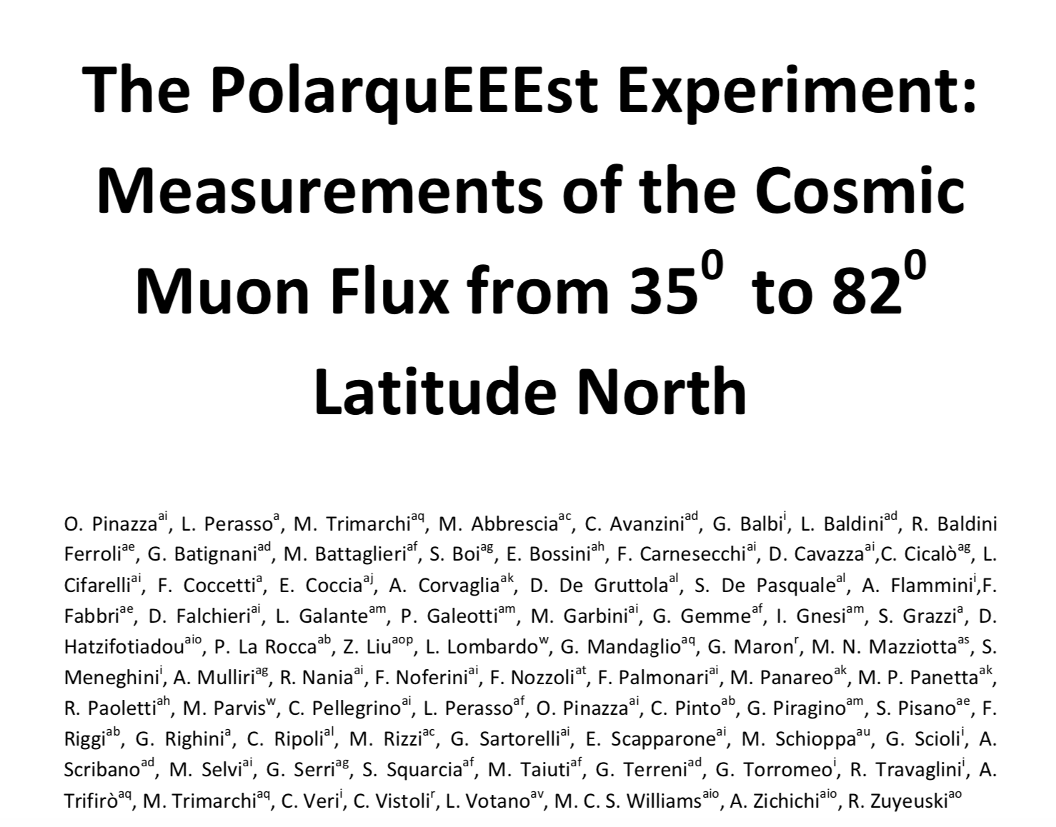
Core team: Laura Perasso, Marina Trimarchi, Ombretta Pinazza
The paper is strongly inspired by the main PolarquEEEst paper
Submission date 21/1/2020

Slide 4
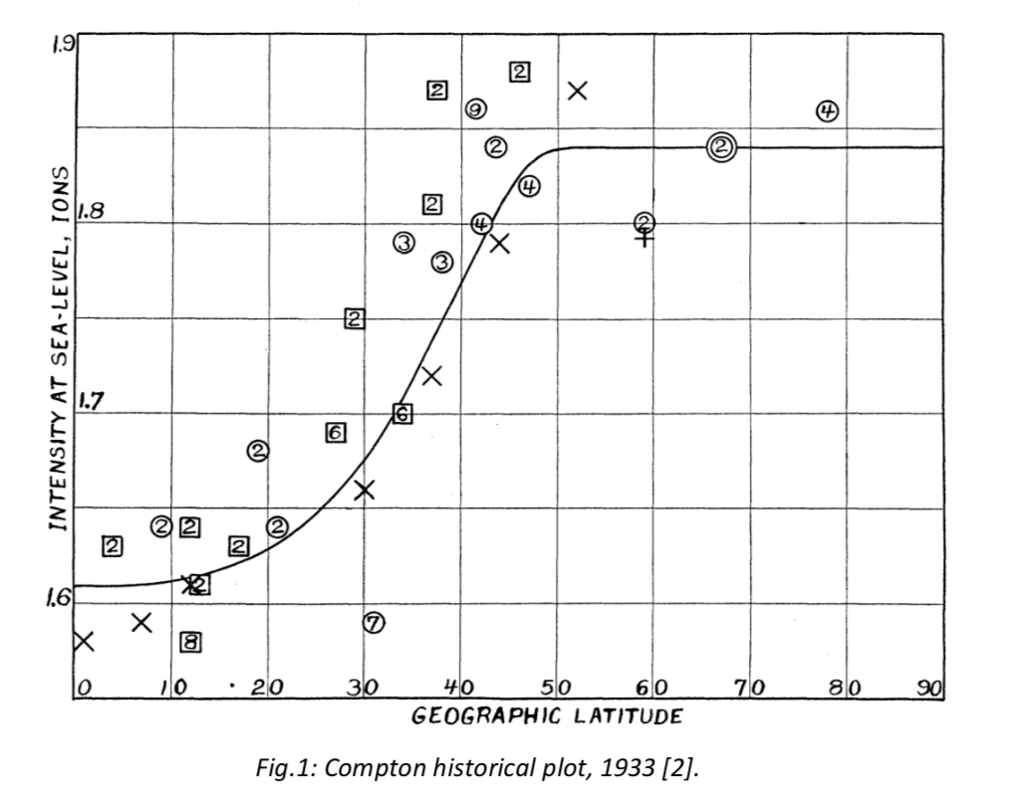
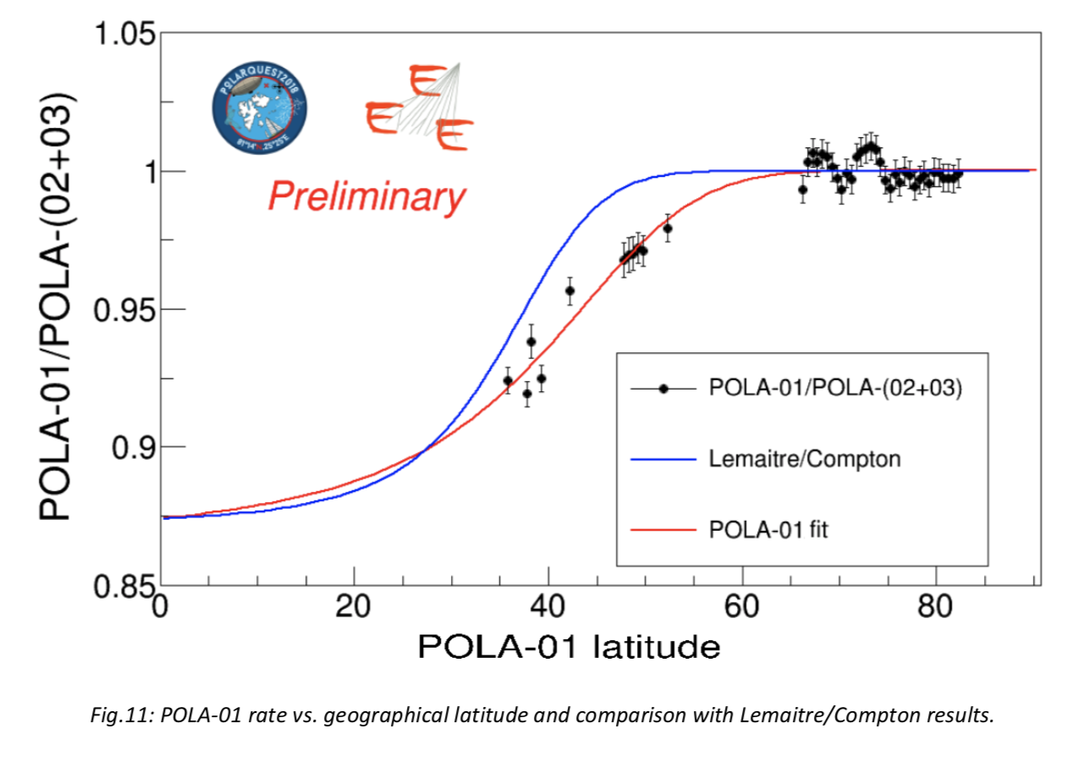
No undisclosed results, only approved plots
We aimed to focus on the geographical aspects of POLA measurements, and presented this plot as main result

