Slide 1
Luigi Amodio
Director of the Science Centre – Città della Scienza, Naples
Rome, Centro Fermi, 19 may 2017
SCIENCE CENTRES, SCIENCE MUSEUMS,
INNOVATION PARKS: THE "HOUSES" OF SCIENTIFIC COMMUNICATION IN THE KNOWLEDGE SOCIETY
Notes:
Una ricerca tuttora in corso… cui tutti dovremmo partecipare

Slide 2
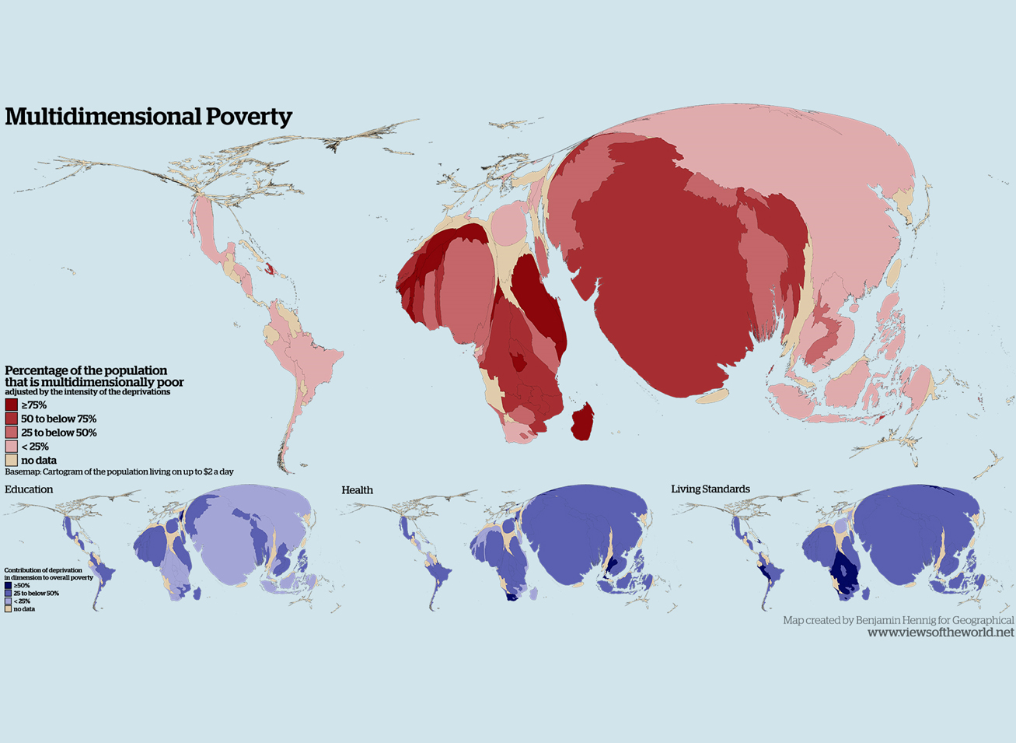

Slide 3
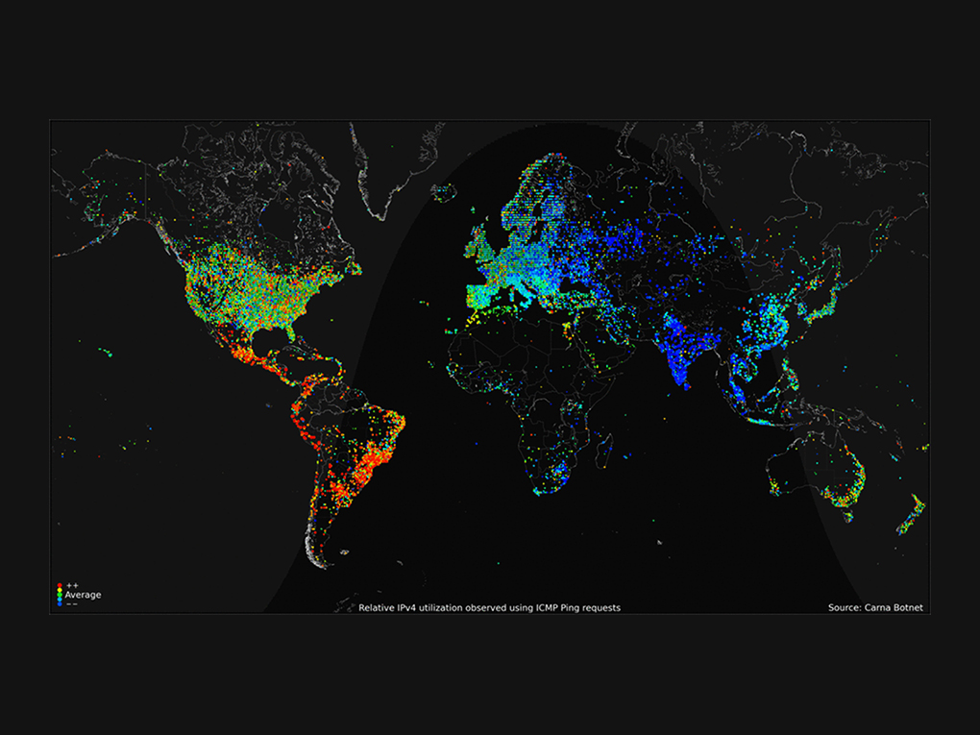

Slide 4
In recent years, our societies have witnessed great epochal transformations in the way they produce and consume, with in the background a real new industrial revolution.
The challenge: to manage the transition from the economy “of the matter” to the knowledge economy, ensuring quality of development, cognitive democracy and respect for sustainability.
"There is no way out of the difficulties that arise, unless we start from a ruthless criticism and a profound review of the scale of values ​​that our civilization has adopted today, especially with regard to ways of consuming. The first engine driving the development of our civilization is the scientific knowledge and the technological innovation that follows. There can be no fair development - no complete democracy - until this great immaterial resource will belong to all peoples and to all citizens of every country."
Vittorio Silvestrini

Slide 5
WHAT IS
CITTÀ DELLA SCIENZA
Notes:
Una ricerca tuttora in corso… cui tutti dovremmo partecipare

Slide 6
Fondazione Idis-Città della Scienza activities aim at building a new economy based on knowledge in order to create a greater social cohesion. Our mission is based on the valorisation of territorial resources with a particular attention to the European and Mediterranean contexts.
Fondazione Idis supports its local stakeholders (school networks, companies, enterprises, local bodies and associations) which become partners by contributing to test new cultural products and spread their effects through local actions.
Moreover, Fondazione Idis plays its role in European and Euro –Mediterranean contexts, thanks both to its knowledge of the real condition of contemporary scientific and technology research and for the strategic position of Naples and Southern Italy.

Slide 7
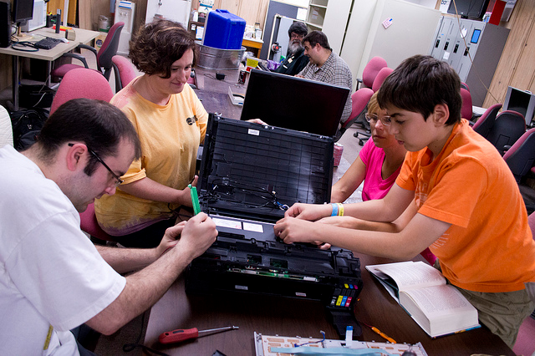
Science museums in the XXI century
Multiform
Inclusive and collaborative
Platform of scientific citizenship
Professional ecosystems

Slide 8
The multiform museum
Material basis: experiments, simulations, objects, etc.
Incorporeal basis: phenomena, history, information (Internet)
Laboratory basis: laboratory, making, tinkering, ecc.
Evenemential basis: events, sometimes outside the museum in the city or elsewhere

Slide 9
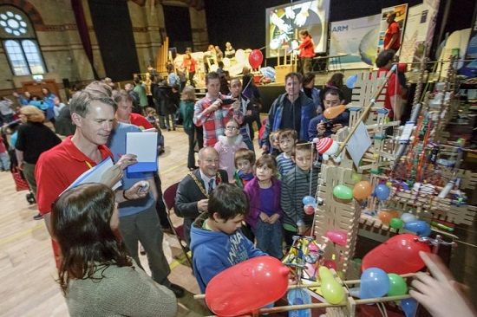
The inclusive and collaborative museum
Publics are everyone!
Kids: stimulating curiosity
Students/teen agers: supporting teaching through non formal learning
Young adults: orienteering to future careers, making
Adults: discussing on scientific actuality, growing culture in their own family, tourism
…and finally disadvantaged social groups

Slide 10
The museum as a platform of scientific citizenship
Direct social role (i.e. health prevention…)
Role of link between research and society (explaining what is research, its objectives, tools, methods, etc.)
Place to reflect on the evolution of society (knowledge, beliefs, critical thinking)
Place of debate on hot topics
Place for helping professional vocations

Slide 11
The museum as a professional ecosystem
The museum is a compaby, although a non-profit one
The museum needs an organization
Needs a lot of different professionalities to work well
The museum creates new jobs and competencies

Slide 12
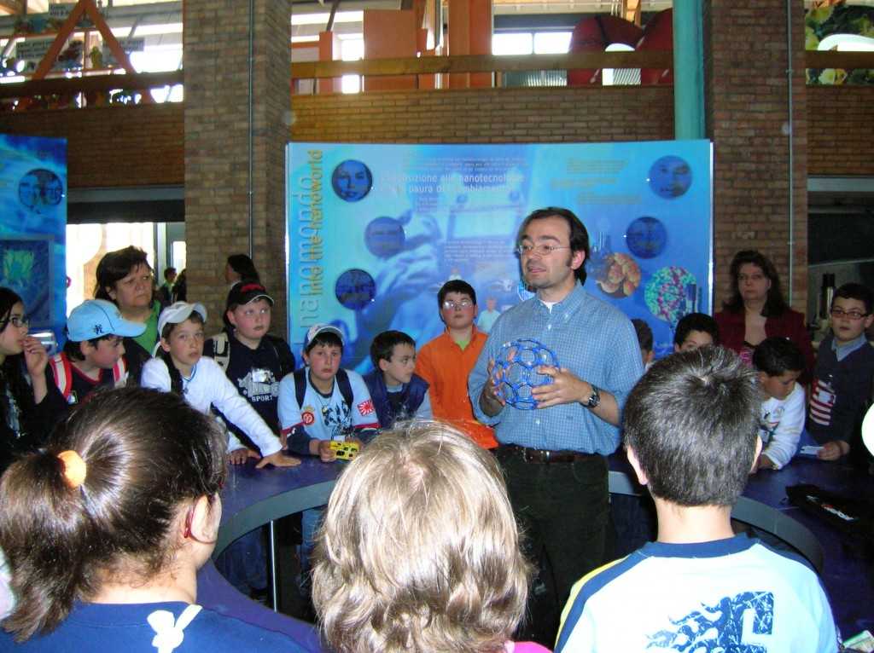
… pionieers on the topic of science and society …
Notes:
Scienza e società

Slide 13
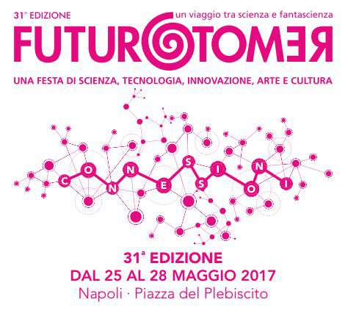
… an original interpretation of the relationship
between science and local context…
Notes:
Il rapporto col territorio

Slide 14
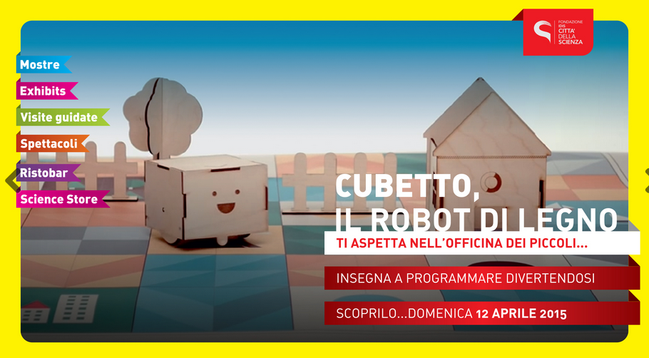
… unique in linking directly enterprise creation
(made in Città della Scienza) with science communication …
Notes:
Il BIC con le sue start up entra nel Museo

Slide 16
EXHIBITIONS
Notes:
Una ricerca tuttora in corso… cui tutti dovremmo partecipare

Slide 17
Objectives:
To involve scientists and publics in the production of contents (hands on approach) but also in the “governance” of the museum
The museum «house» for innovation
Notes:
Una ricerca tuttora in corso… cui tutti dovremmo partecipare

Slide 18
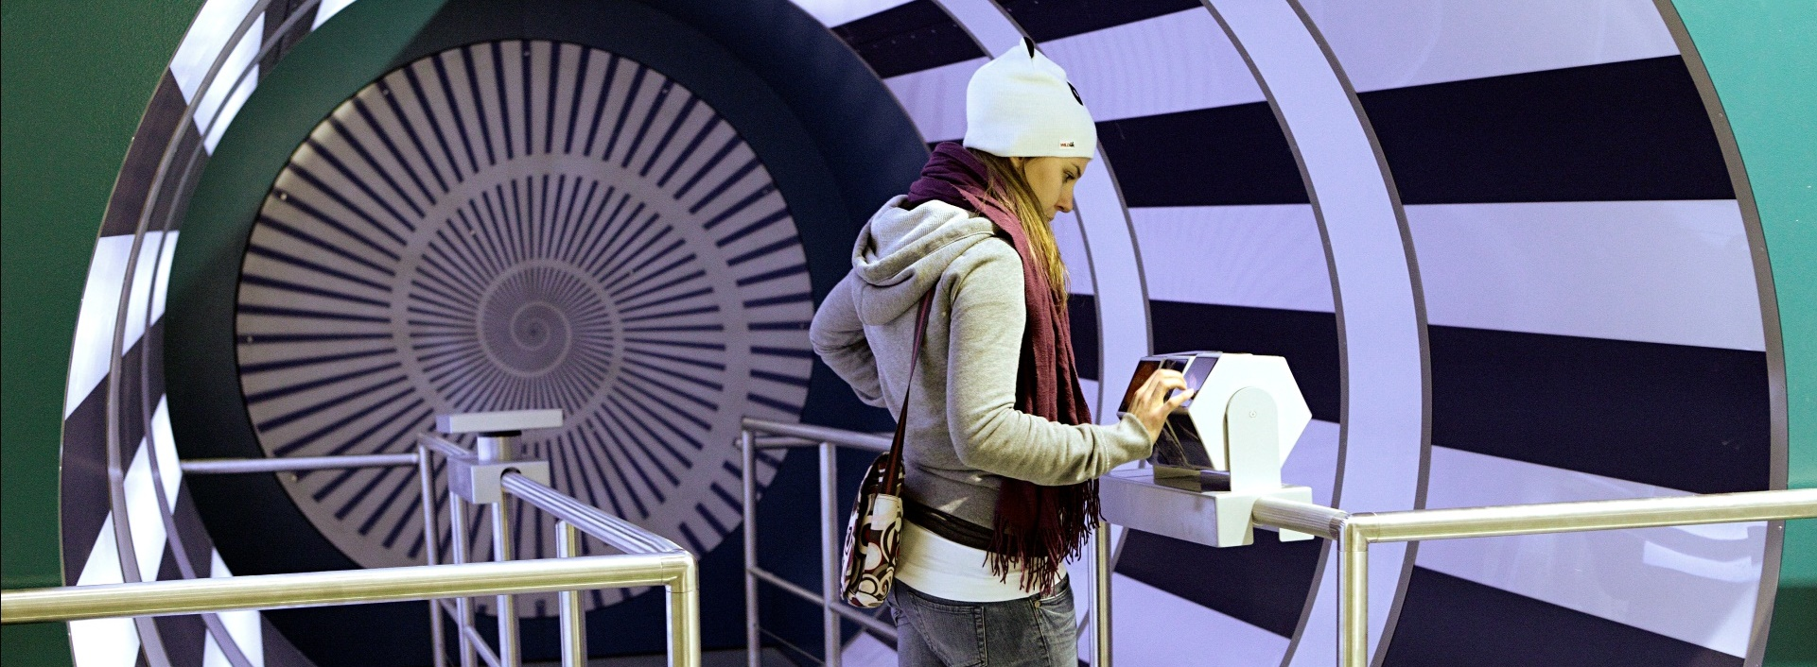
Corporea is the first interactive museum in Europe dedicated entirely to the theme of health, biomedical sciences and biomedical technologies and prevention, based on direct experimentation of phenomena by visitors.
Corporea, over 5,000 square meters, is a journey dedicated to deepening the knowledge of the human body and biomedical sciences, but also an active place in the field of promoting health, healthy lifestyles as well as scientific research and technology.

Slide 19
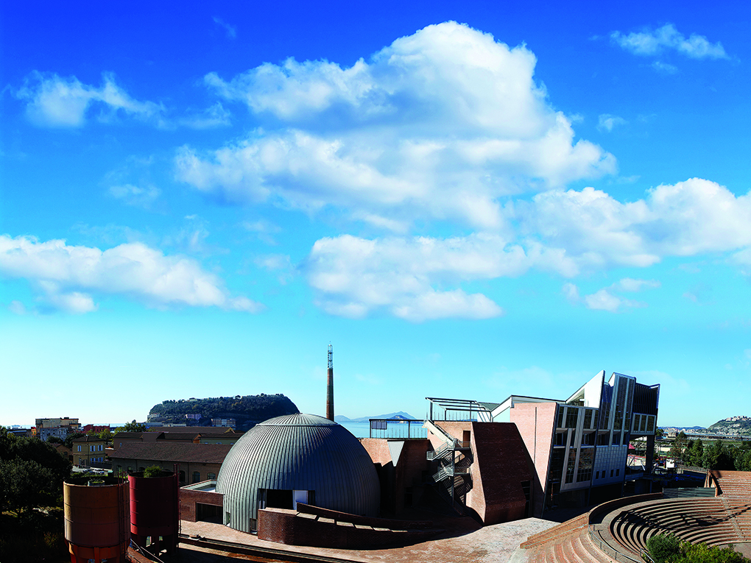

Slide 20
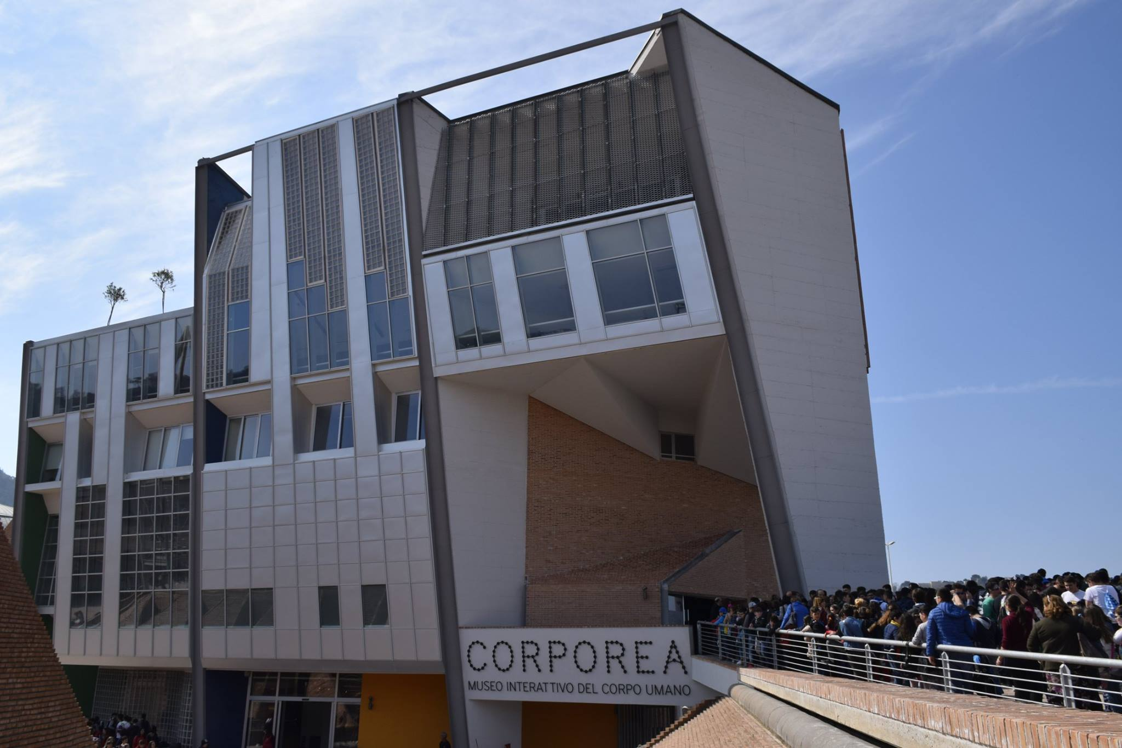

Slide 22
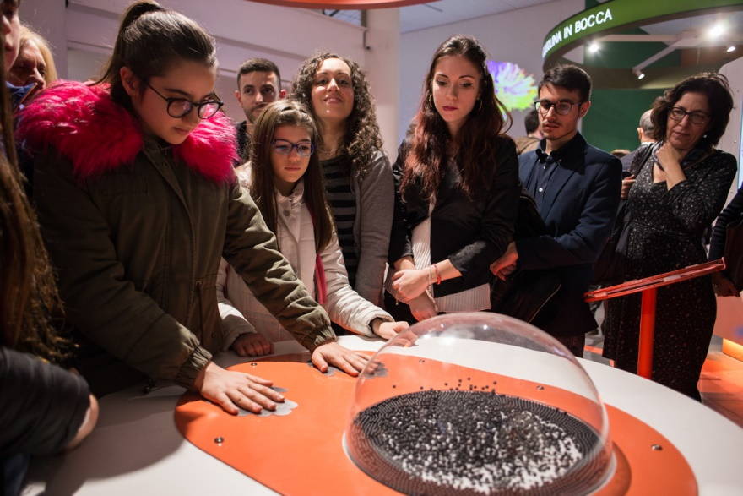

Slide 23
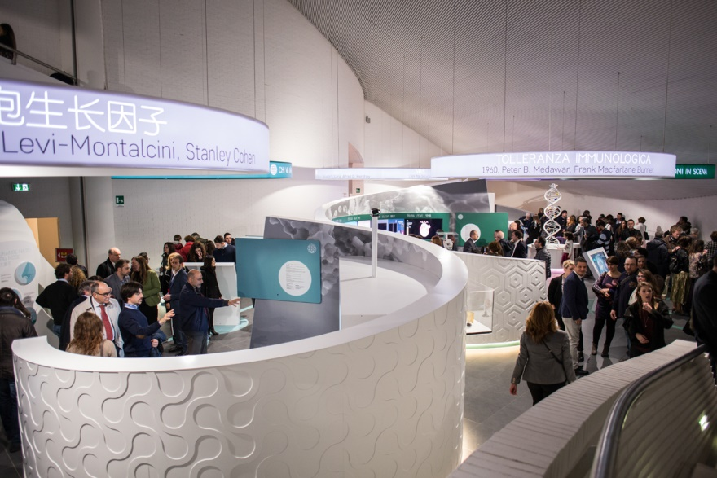

Slide 24
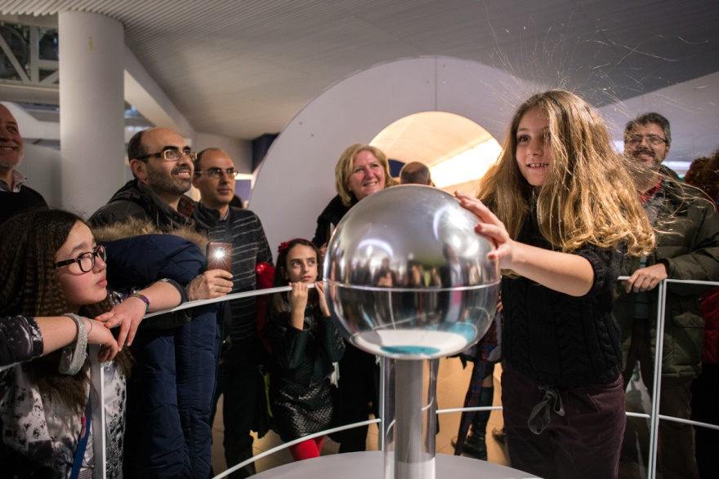

Slide 25
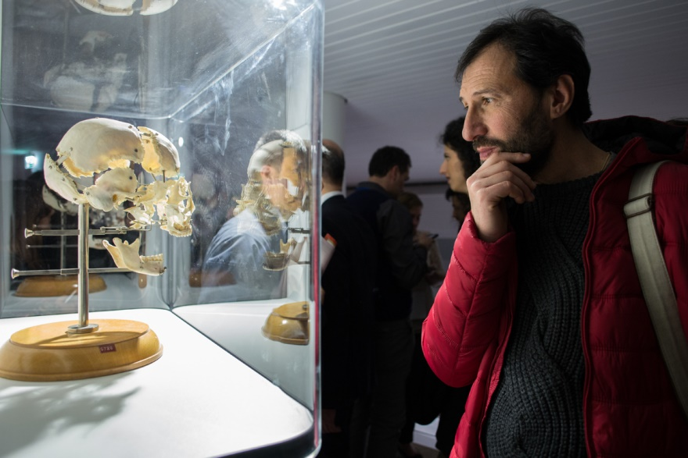

Slide 27
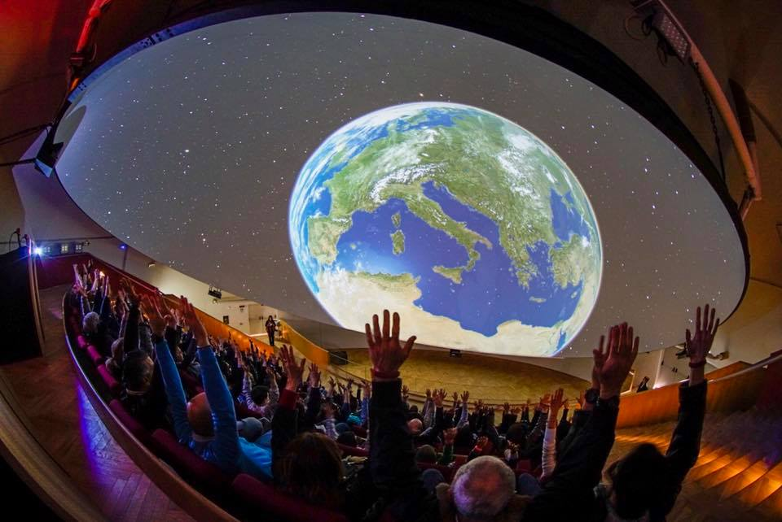

Slide 28
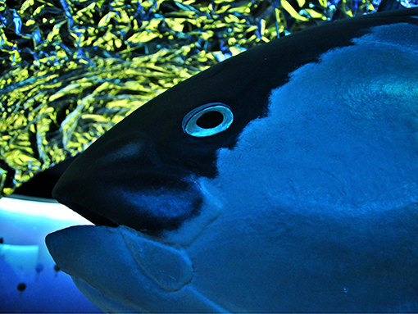
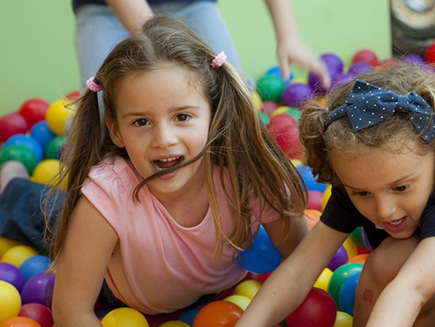
OTHER EXHIBITIONS…
Sea…
Marine biology, ecology and environment, RRI responsible research and innovation.
The Childrens’ Workshop, a big lab to play with themselves, with the others and to discover the world around.

Slide 29
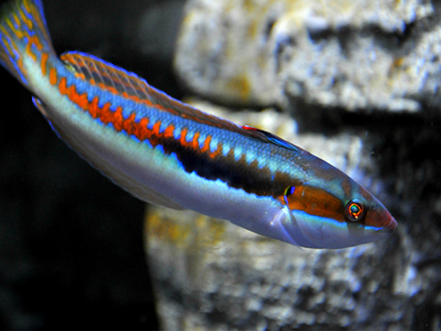
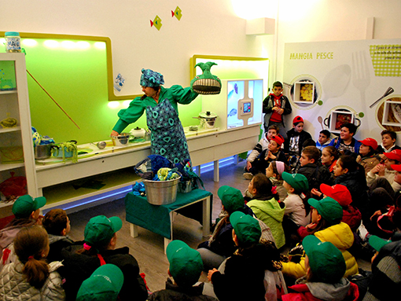
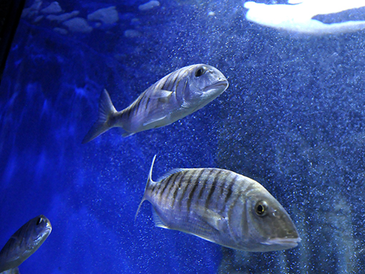
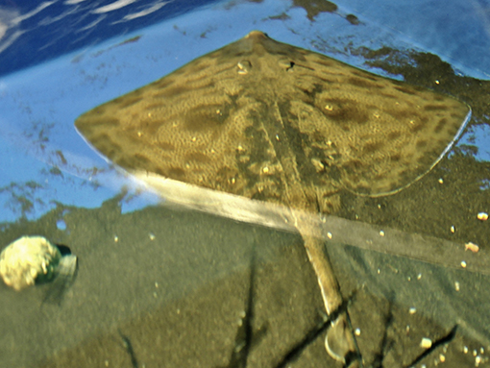

Slide 30
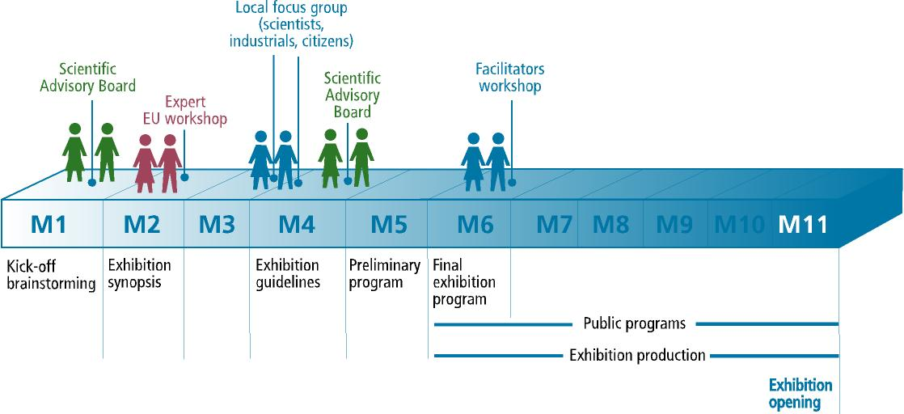

Slide 31
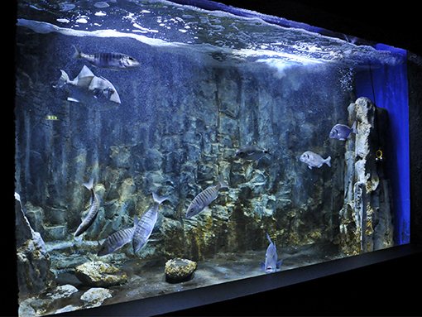
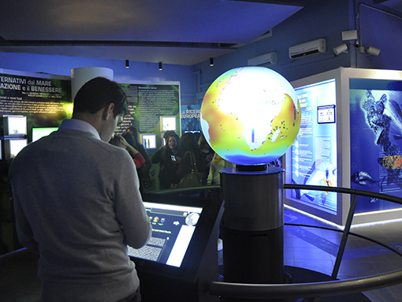
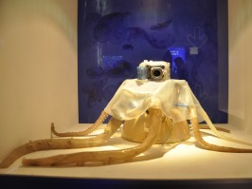
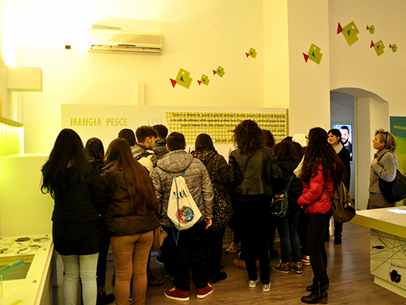

Slide 32
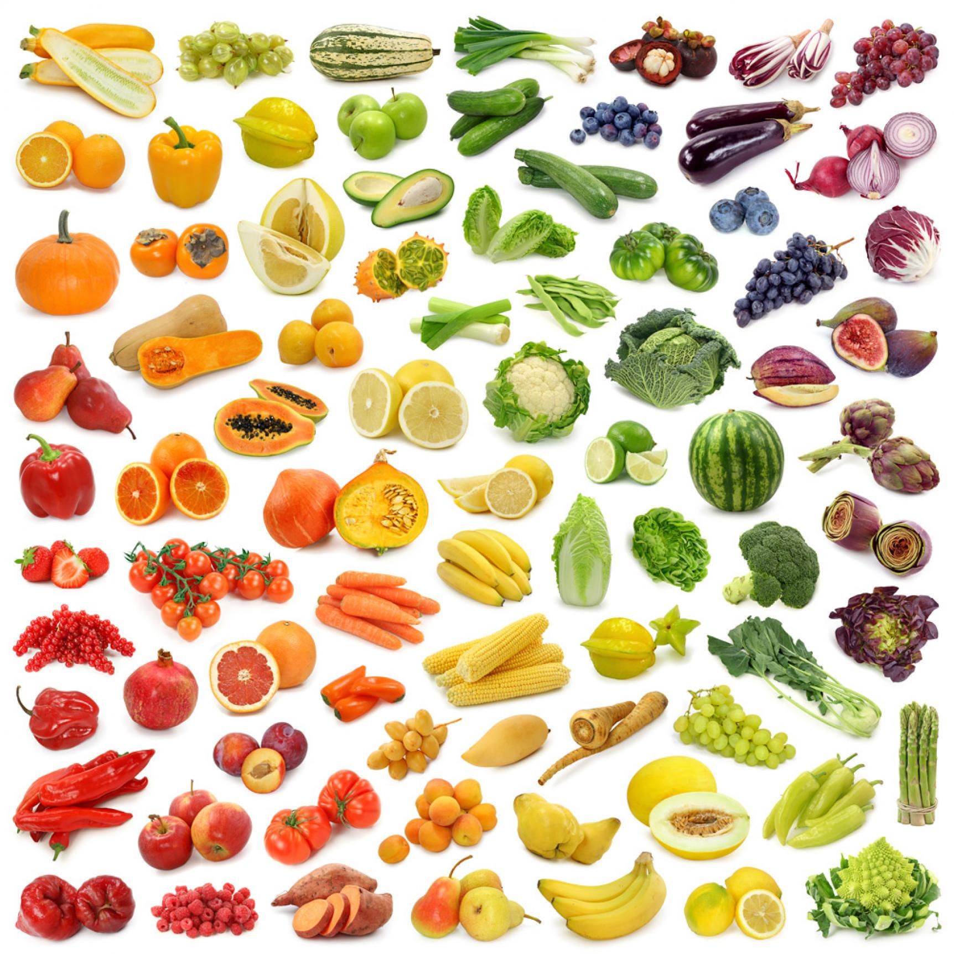
THE VILLAGE OF MEDITERRANEAN DIET AND BIODIVERSITY
Exhibitions, educational labs, meetings on science, nature and technology; the topics of food education and of agriculture as a central resource for the economy of the south of Italy.

Slide 34
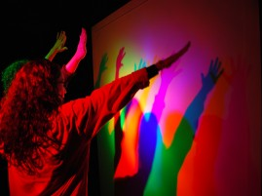
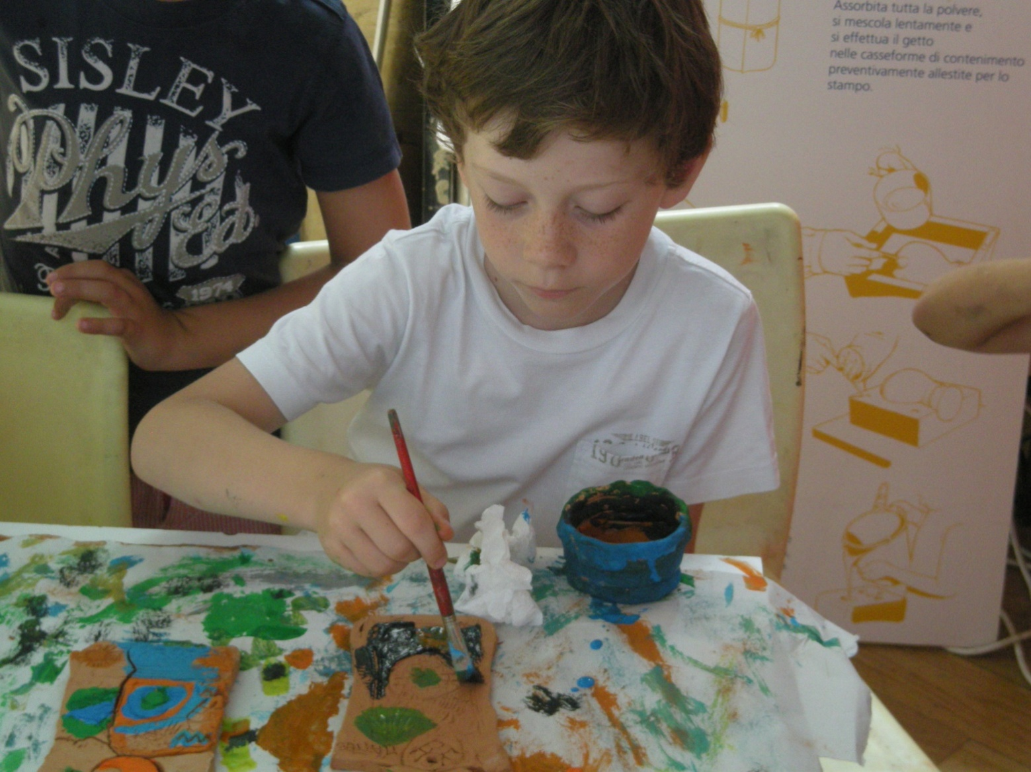
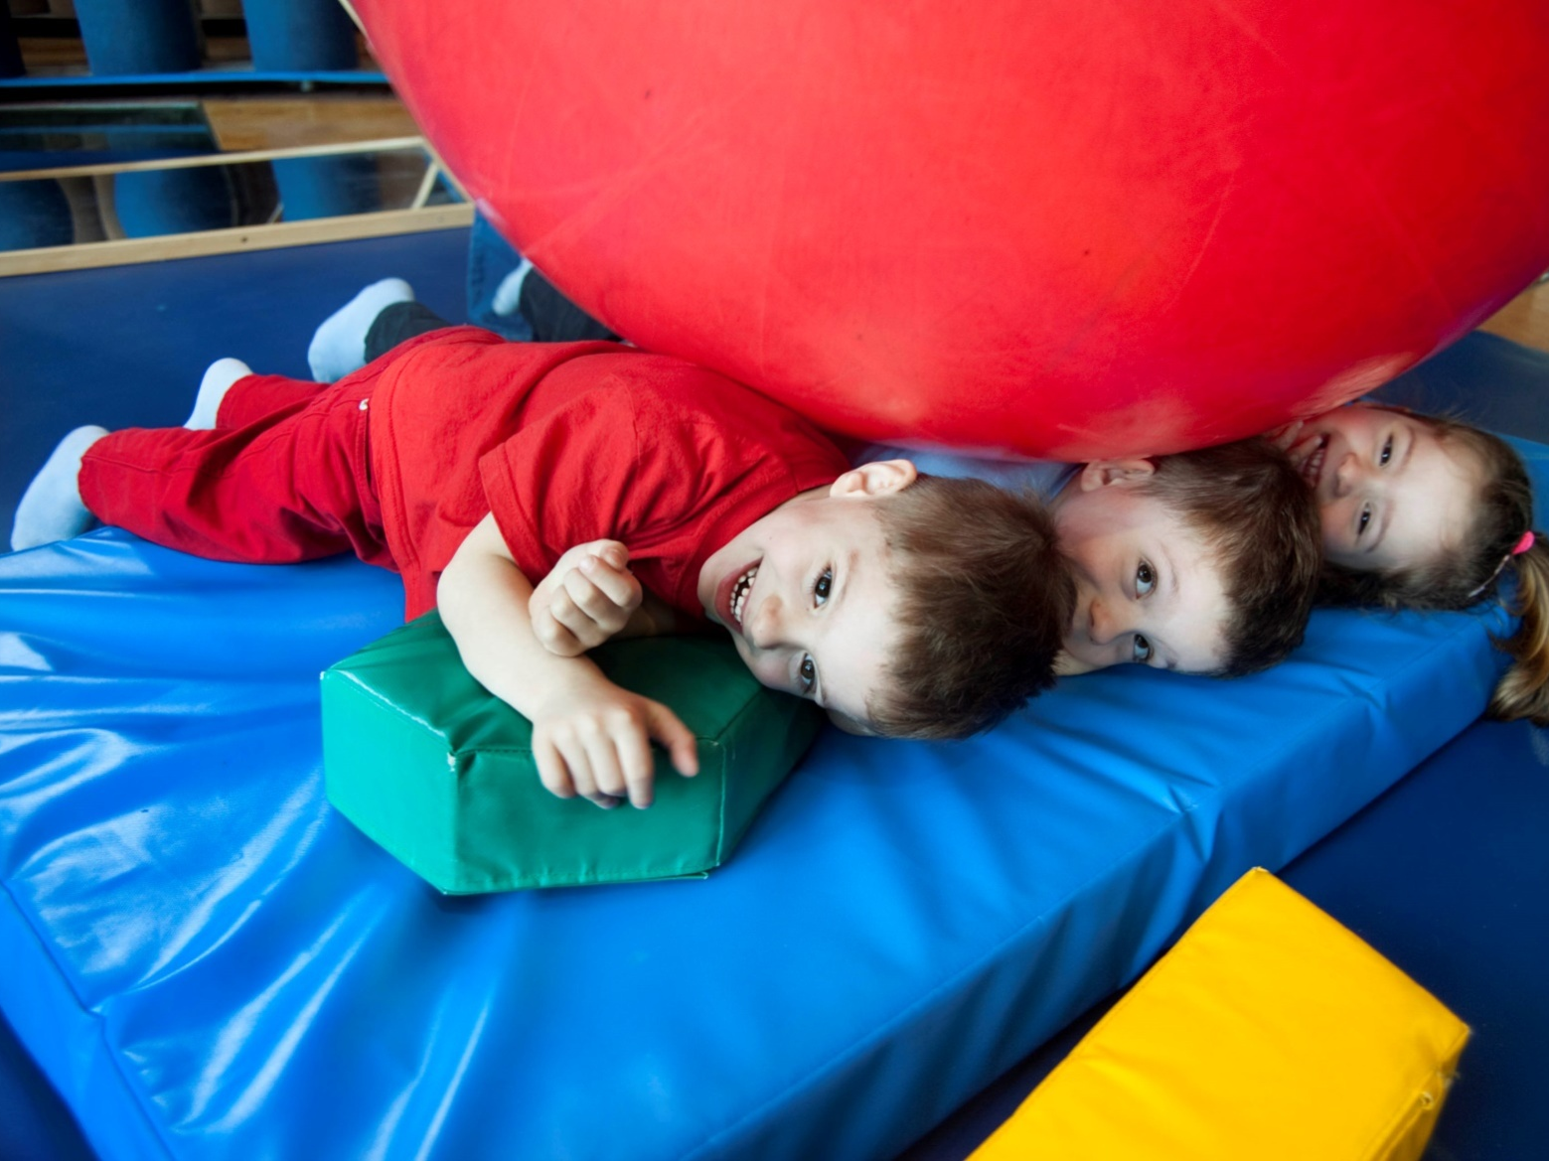
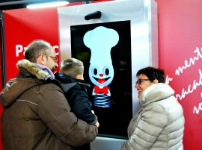

Slide 35
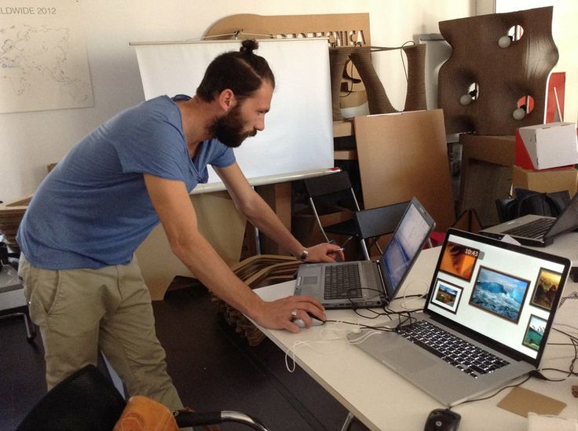

Slide 37
INNOVATION IN EDUCATION
Notes:
Una ricerca tuttora in corso… cui tutti dovremmo partecipare

Slide 38
Objective:
The museum as a platform for experimenting science teaching of the future
Notes:
Una ricerca tuttora in corso… cui tutti dovremmo partecipare

Slide 39
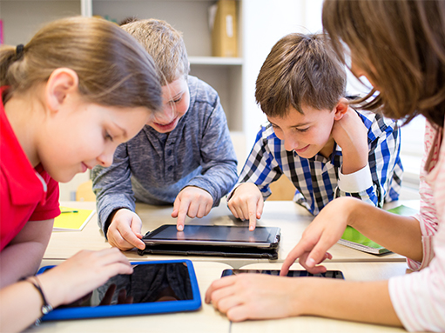
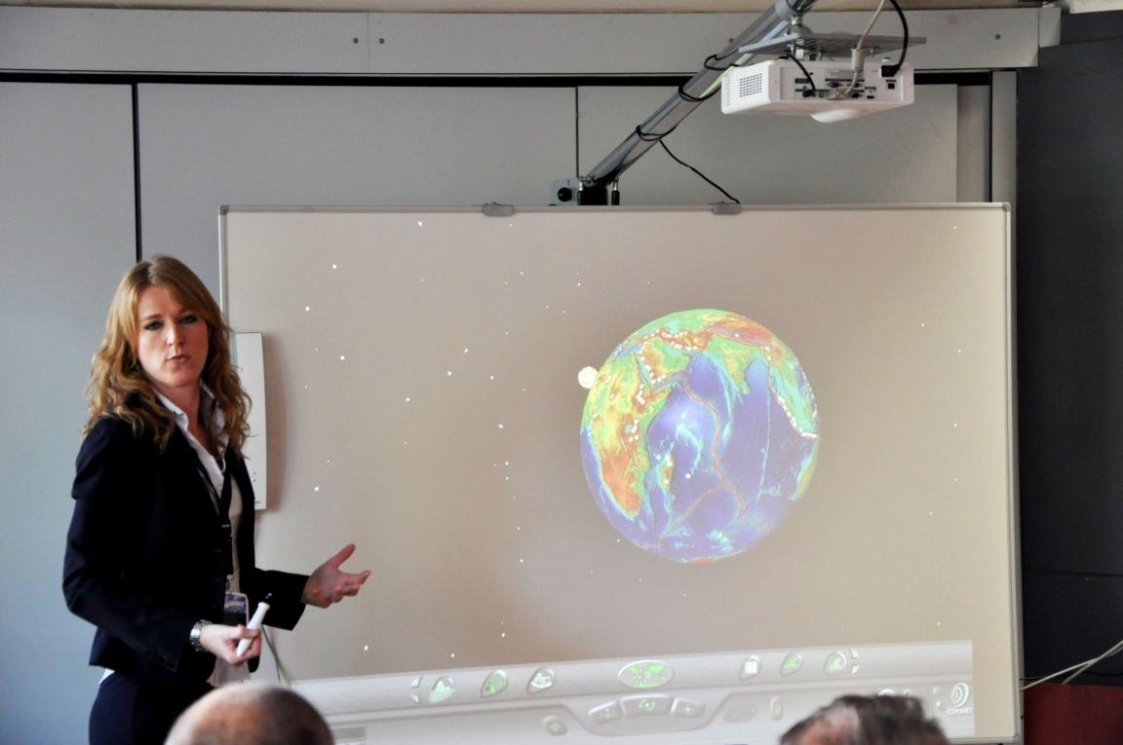
MEETING NEW TECHNOLOGIES
Programmes, labs,
professional upgrade and debate to experiment the new ways of making school…
…because the school of “digital natives” is deeply different by that we knew and lived.

Slide 40
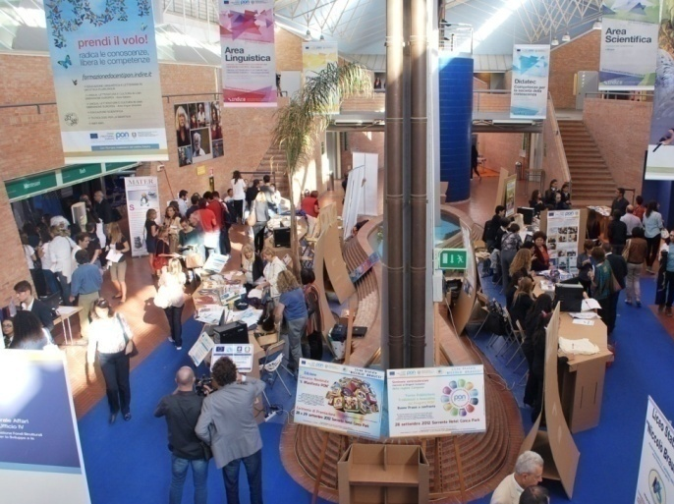
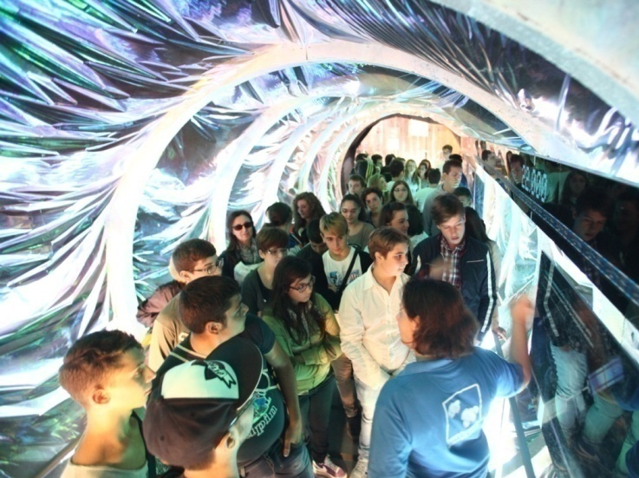
MEMORANDUM OF UNDERSTANDING WITH THE MINISTRY OF EDUCATION
In march 2012 Città della Scienza and the MIUR signed a MoU to give a common frame to the educational activities of Città della Scienza and in particular:
● Smart Education and
Technology Days
● Educational projects
● Futuro Remoto

Slide 41
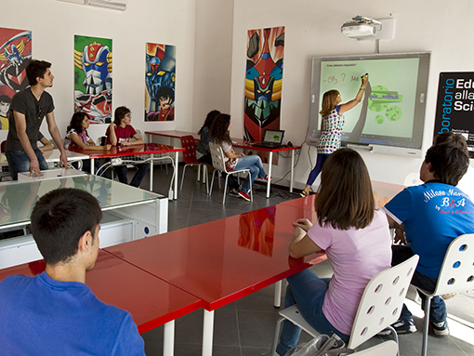
A SYSTEM OF EIGHT CLASSROOMS EQUIPPED WITH THE MOST ADVANCED TECHNOLOGIES FOR CARRYING OUT UNITS IN ALL DISCIPLINES (PHYSICS, CHEMISTRY, GEOLOGY, BIOLOGY, ETC.)

Slide 42
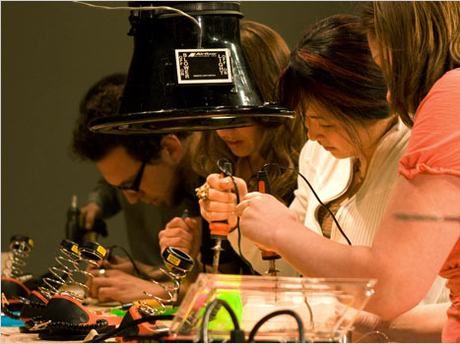
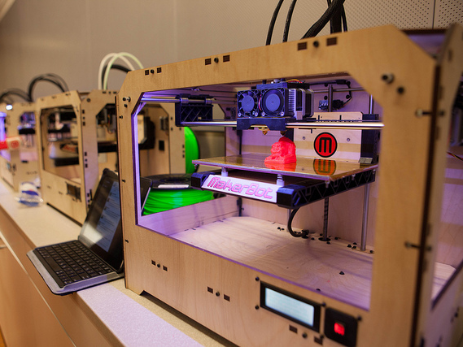
A FABLAB IN EVERY SCHOOL
To encourage the encounter between schools and the world of makers who are innovating the processes of producing objects, new materials and quality craftsmanship through the use of digital design and production technologies, such as 3D printers.
Schools can use our FabLab and learn how to realize their own.
Notes:
Apprendimento percettivo motorio

Slide 43
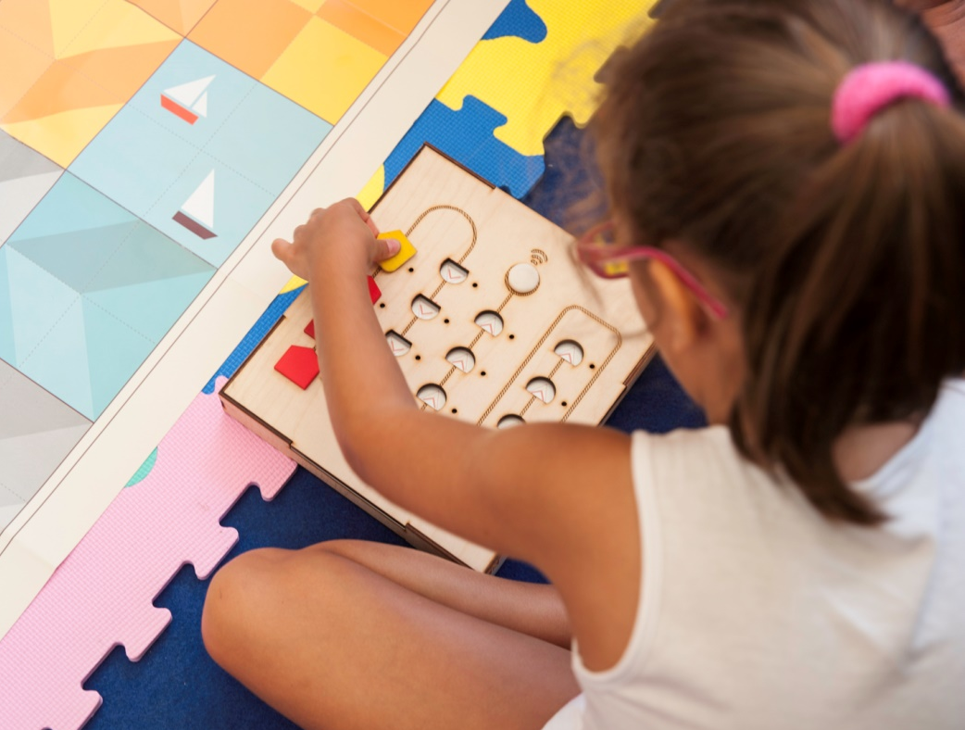
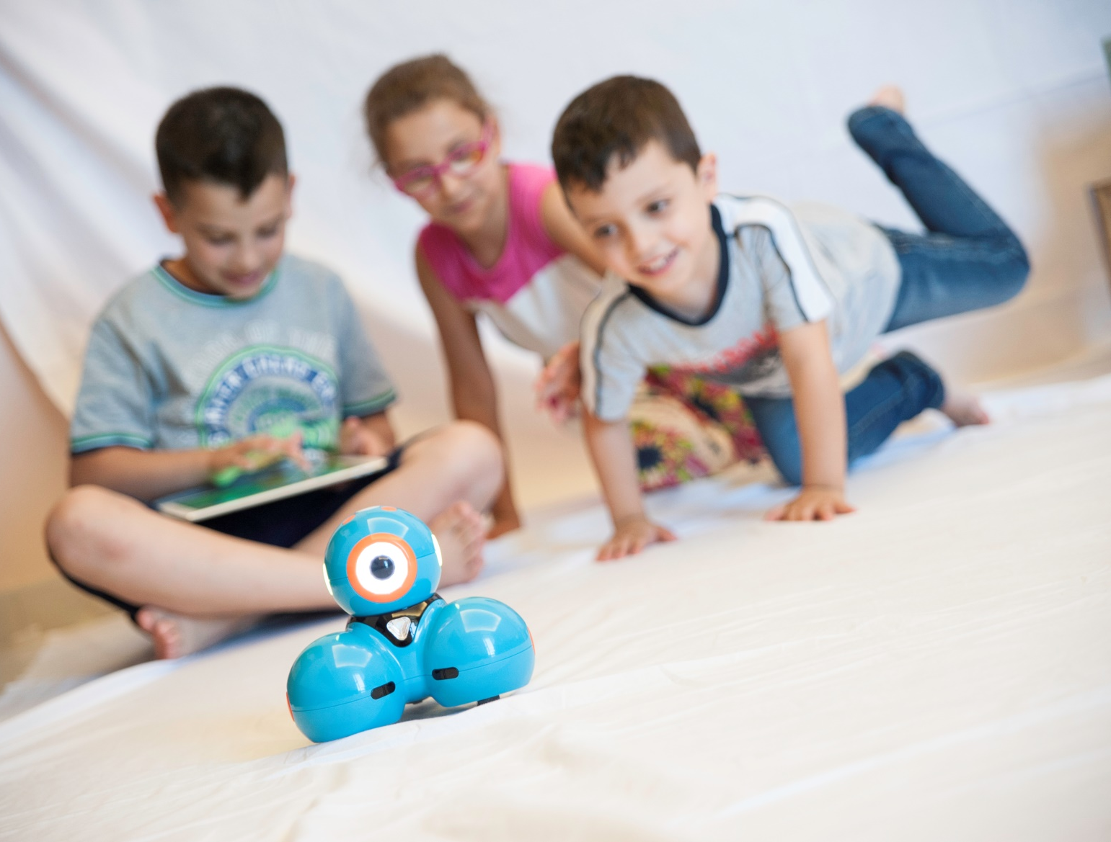
THE NEW LAB FOR EDUCATIONAL ROBOTICS, CODING AND 3D PRINTING FOR KIDS
A new proposal for kids and students up to 13 y.o.

Slide 44
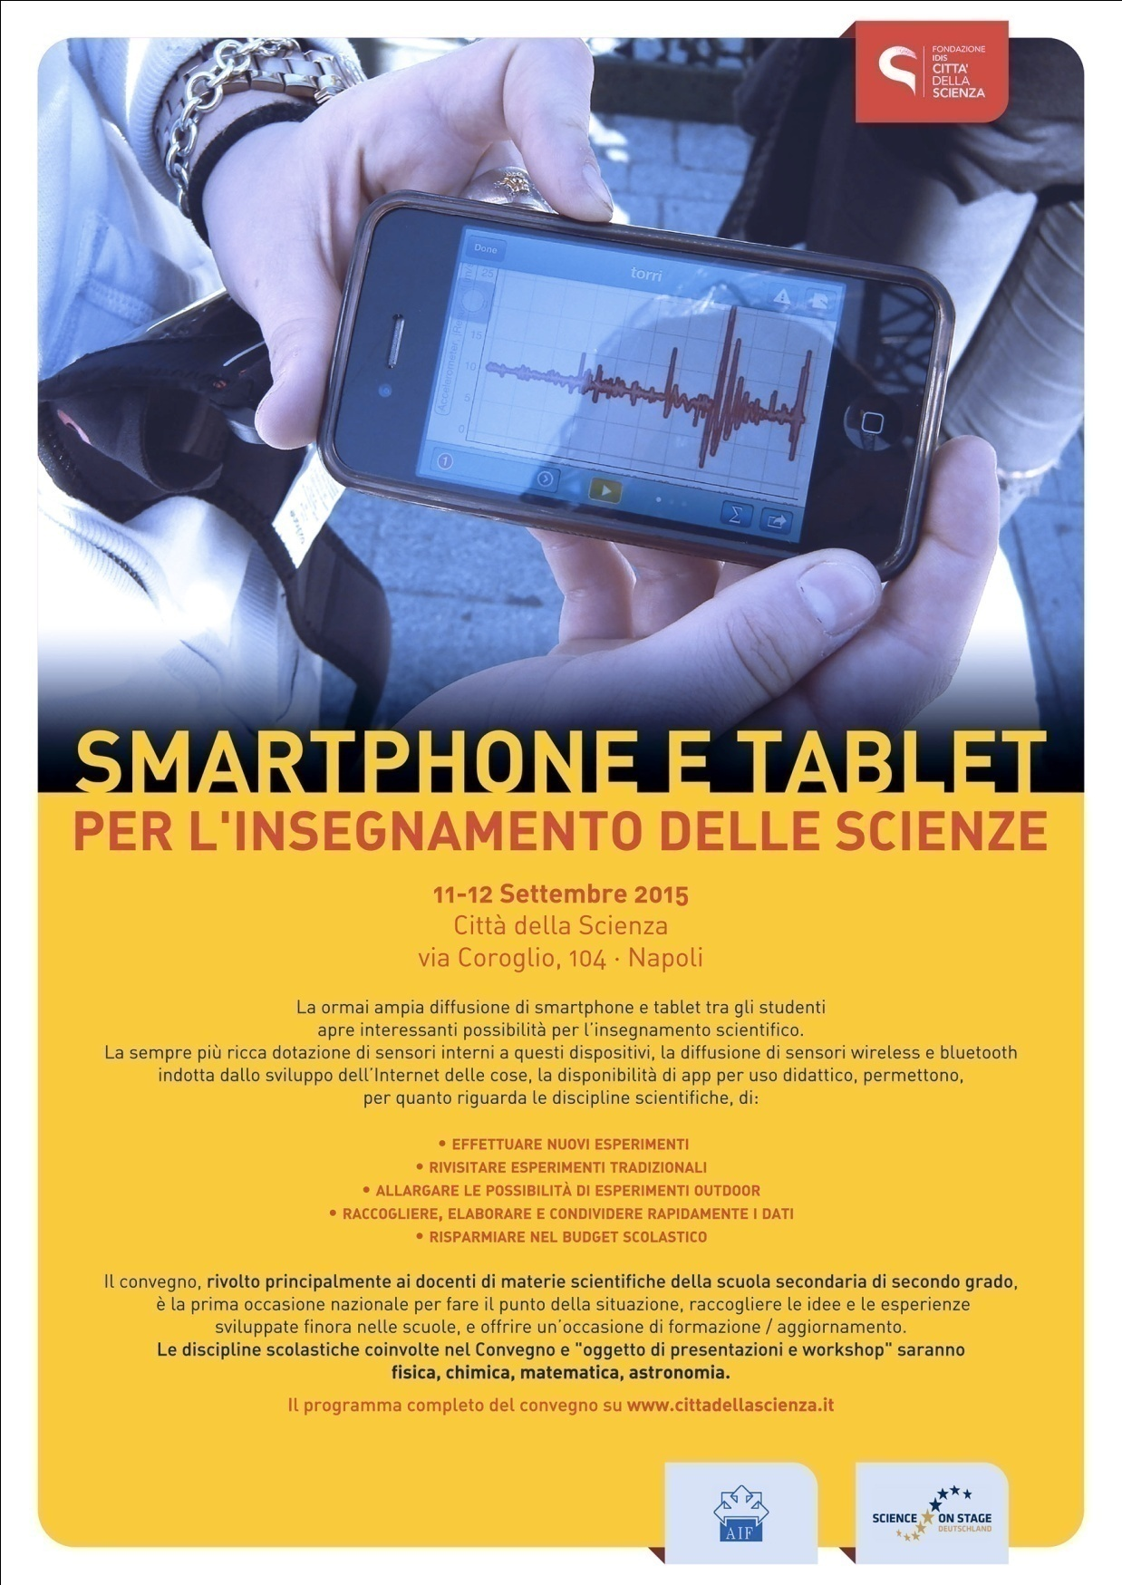
COURSE FOR TEACHERS: I.E. THE USE OF SMARTPHONES TO TEACH SCIENCE
The use of an object that has now entered our everyday life to teach physics, maths, earth sciences, astronomical geography...
Each smartphone is also an accelerometer, a compass, a light and sound intensity sensor; and also contains many useful apps for teaching.

Slide 45
THE BIG EVENTS
Notes:
Una ricerca tuttora in corso… cui tutti dovremmo partecipare

Slide 46
Objectives:
The festival: from “science in the square” to “social innovation in the square”
Exchange of best practices
Notes:
Una ricerca tuttora in corso… cui tutti dovremmo partecipare

Slide 47
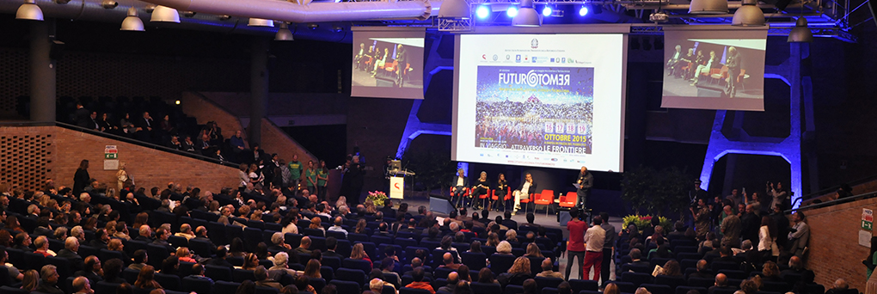
FROM 25 TO 28 MAY IN PIAZZA DEL PLEBISCITO, NAPLES,
A BIG SCIENCE EVENT IN COLLABORATION WITH UNIVERSITIES, RESEARCH CENTRES, SCHOOLS, ETC.

Slide 48
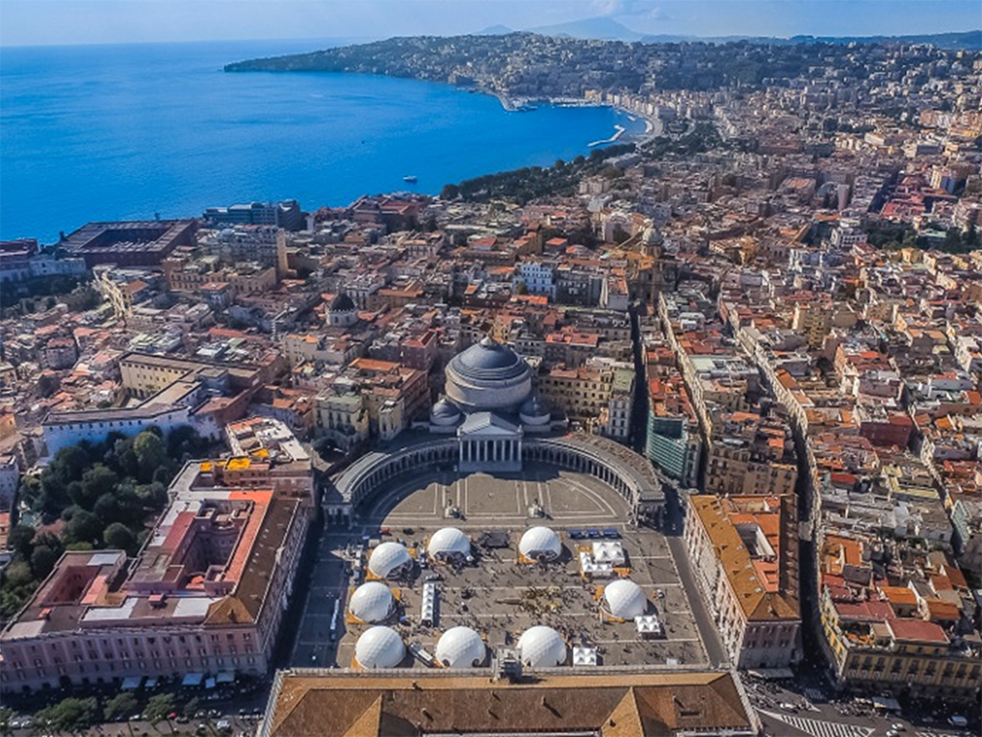

Slide 49
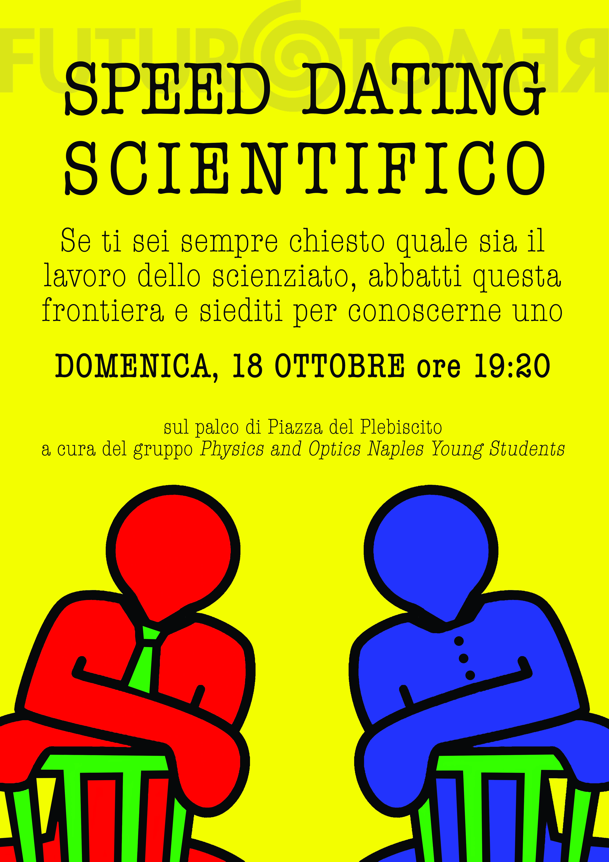
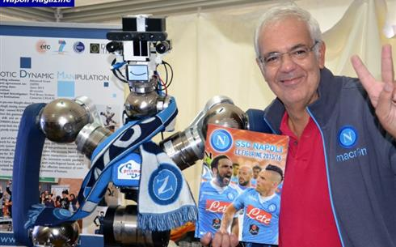

Slide 50
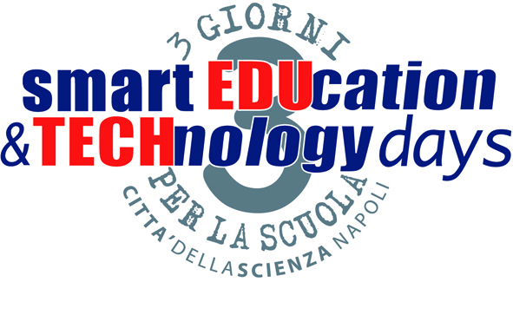
SMART EDUCATION & TECHNOLOGY DAYS
3 days for and with the schools
XV edition – 25-27 october 2017
Notes:
Una ricerca tuttora in corso… cui tutti dovremmo partecipare

Slide 51
THE GLOBAL DIMENSION
Notes:
Una ricerca tuttora in corso… cui tutti dovremmo partecipare

Slide 52
Objectives:
To confirm the global dimension of science and the role of science in facing the great challenges of our century
Science as a language of peace and mutual understanding
Notes:
Una ricerca tuttora in corso… cui tutti dovremmo partecipare

Slide 54
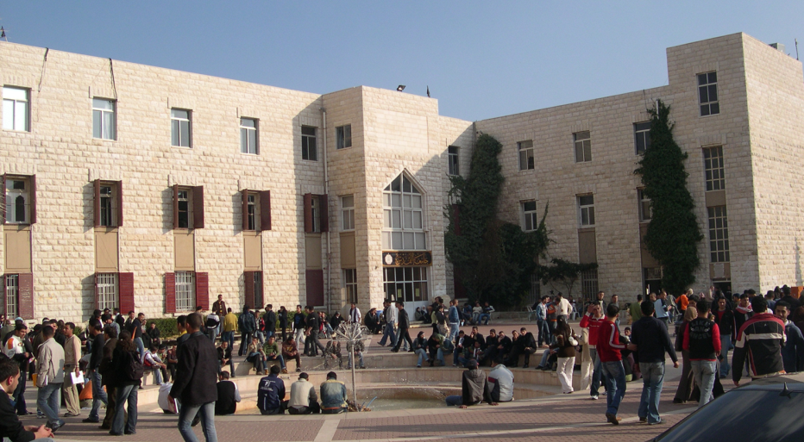
2002 – 2007
SCIENCE CENTRE IN PALESTINE
A collaboration between the Palestinian and Israeli scientific communities to create the first interactive museum in occupied territories, at the Abu Dis campus, in East Jerusalem.
The science centre, still operational, is focused on math.
Notes:
54
54
54

Slide 55
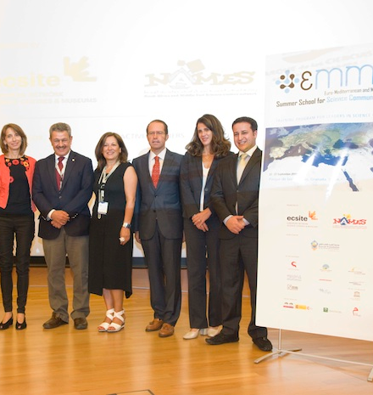
EMME / Euro-Mediterranean and Middle East Summer School for Science Communication
A summer school (Granada 2013, Alexandria 2015, Naples 2017) addressed to young managers of scientific communication on the two sides of the Mediterranean with the aim of creating links in the professional community to cultivate science as a language of peace and dialogue between cultures.
The next edition in Naples from 10 to 15 September 2017.
Notes:
55
55
55

Slide 56
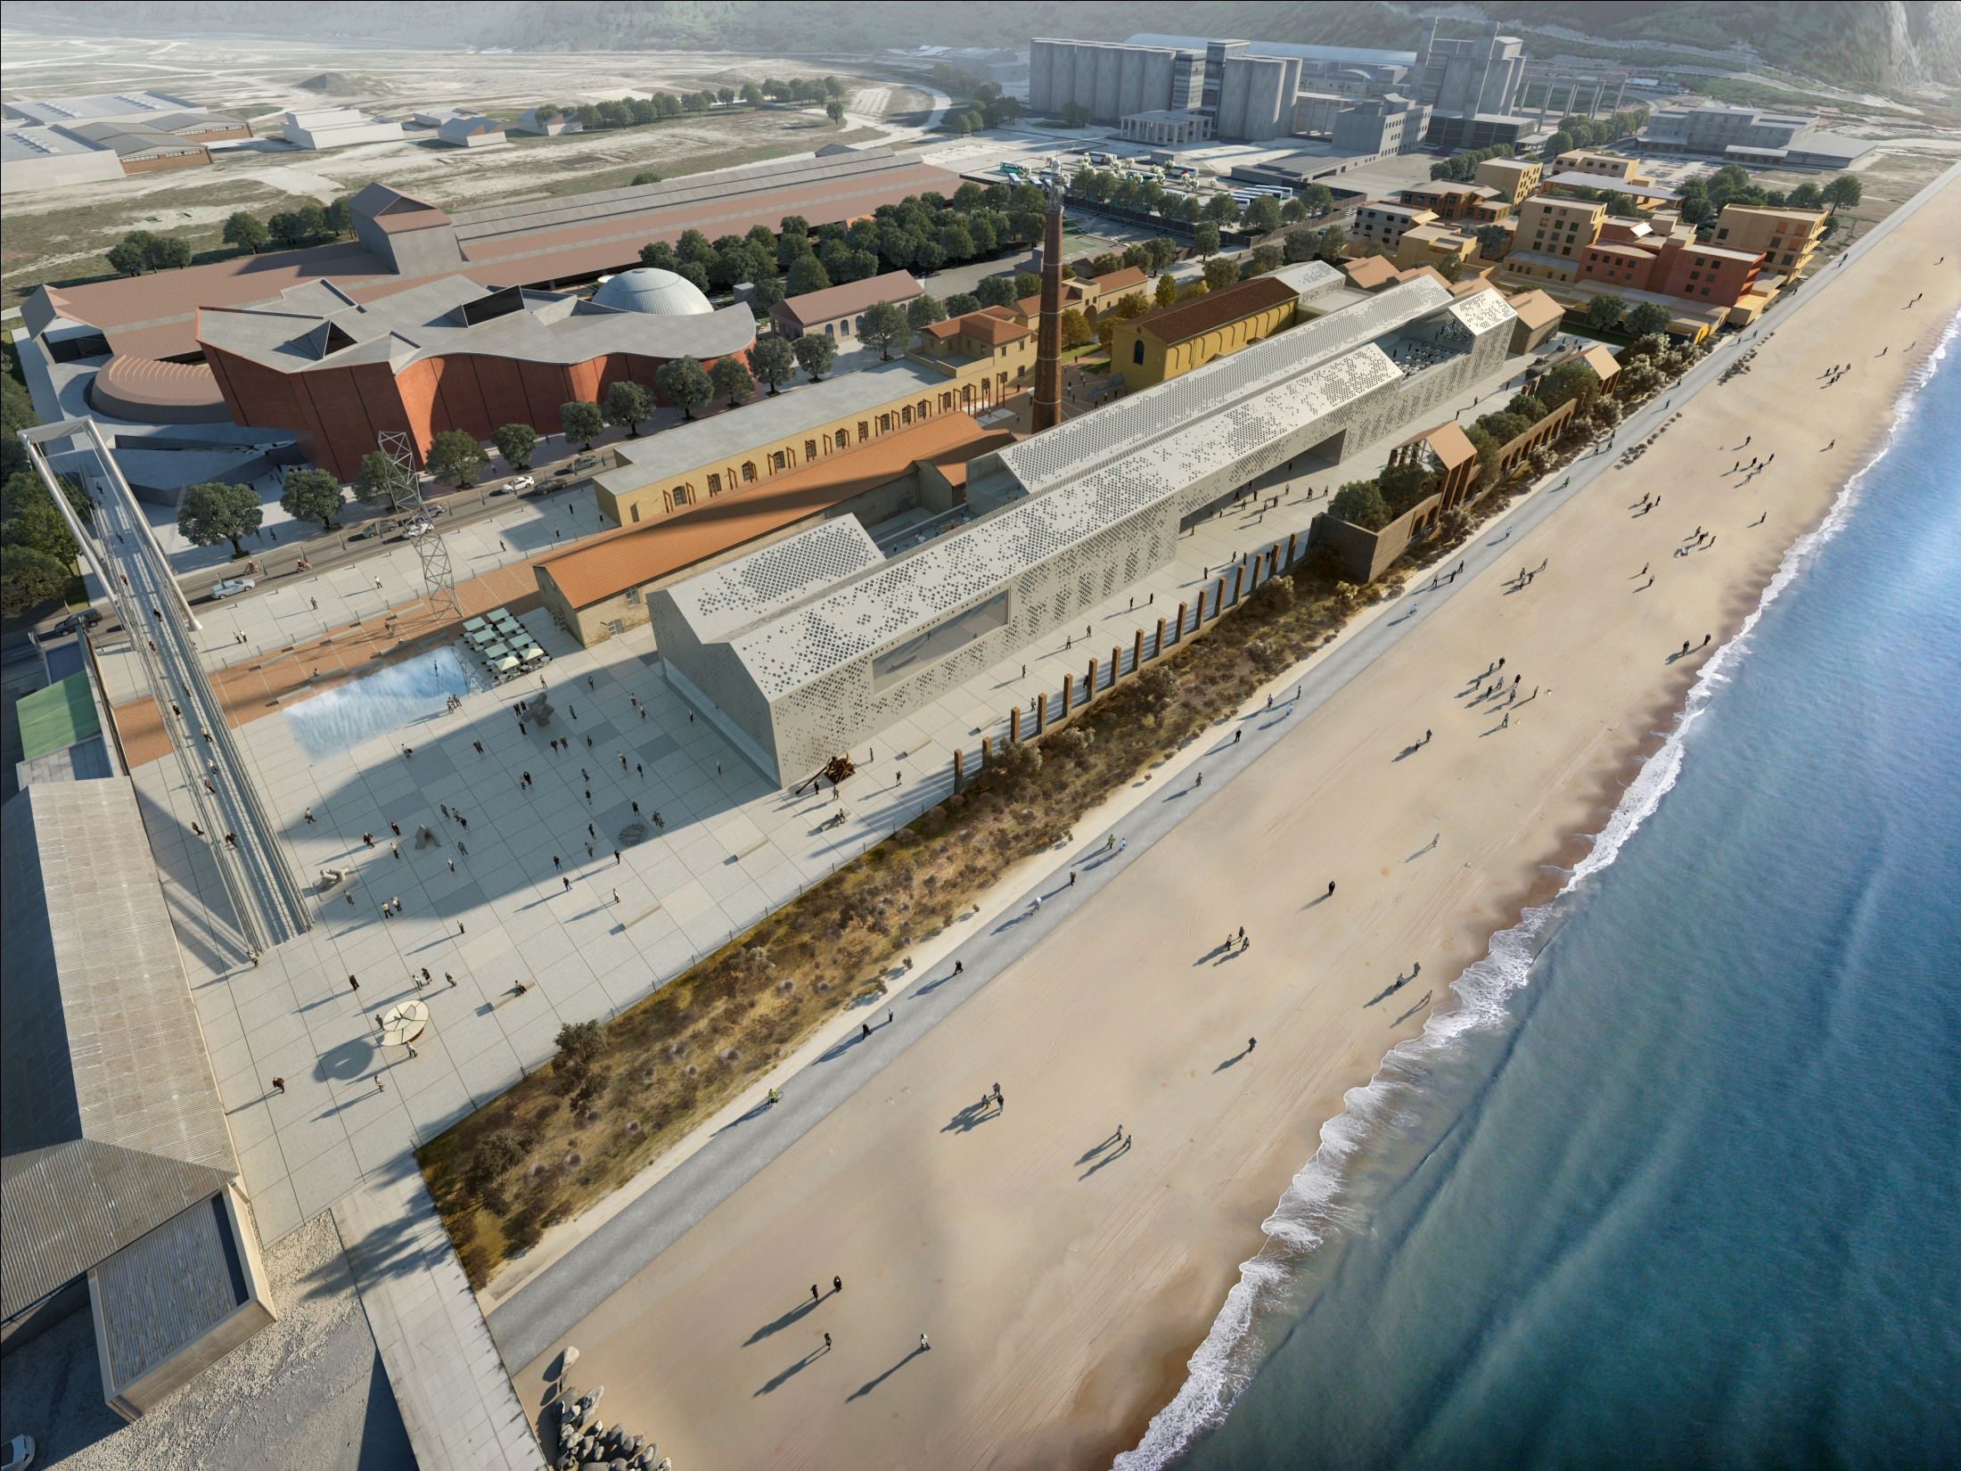

Slide 57
THANK YOU FOR YOUR ATTENTION
amodio@cittadellascienza.it
www.cittadellascienza.it
www.facebook.com/cittadellascienza
Notes:
Una ricerca tuttora in corso… cui tutti dovremmo partecipare

