Slide 1
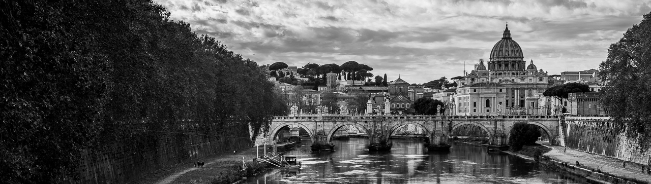




Use of the EEE MRPC telescopes to investigate possible instabilities of civil structures on a long time-scale
XV Workshop on Resistive Plate Chambers and Related Detectors RPC2020
Chiara Pinto* for the EEE Collaboration
*Centro Fermi, Rome; University and INFN, Catania

Slide 2
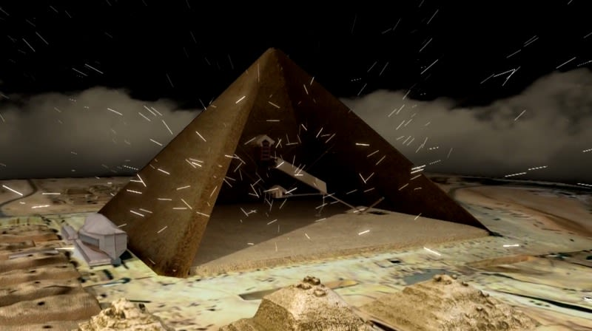
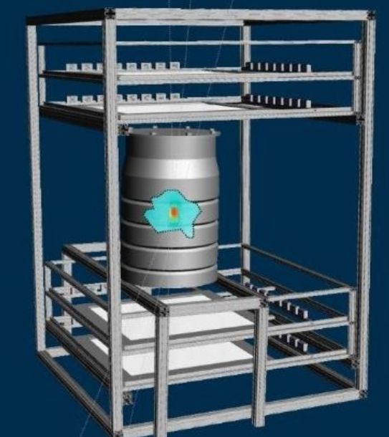
Applications of secondary cosmic rays
MUON ABSORPTION
Vulcanology
Underground measurements
Archaelogy
MUON SCATTERING
Homeland security
Safety – Nuclear reactor and waste
→ Long term building stability monitoring

Slide 3
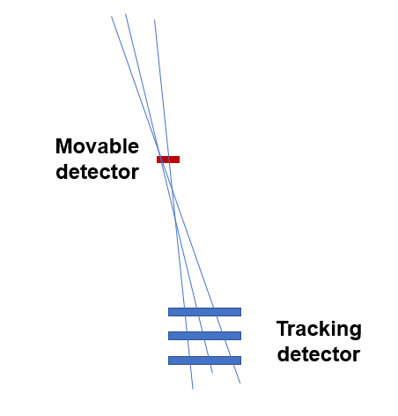
Cosmic muons as a tool to monitor the stability of civil structures on a long-time scale
THE IDEA
Muons passing through a tracking detector and additional detectors are used as a tool to monitor small (mm) shifts of parts of the structure over long time periods.
Moved to mimic possible deformations of the building
  Extensive simulations and prototype detectors by Brescia Pavia groups
  (G.Bonomi et al.)
Technique applied to “Palazzo della Loggia” in Brescia as a case study.
Depend on: capability of the main tracking detector, geometry and position of the additional detectors, constant response of detectors, acquisition time,..
PERFORMANCE
Notes:
Scintillator-> movable detector
Uniformity over time / constant response of detectors

Slide 4
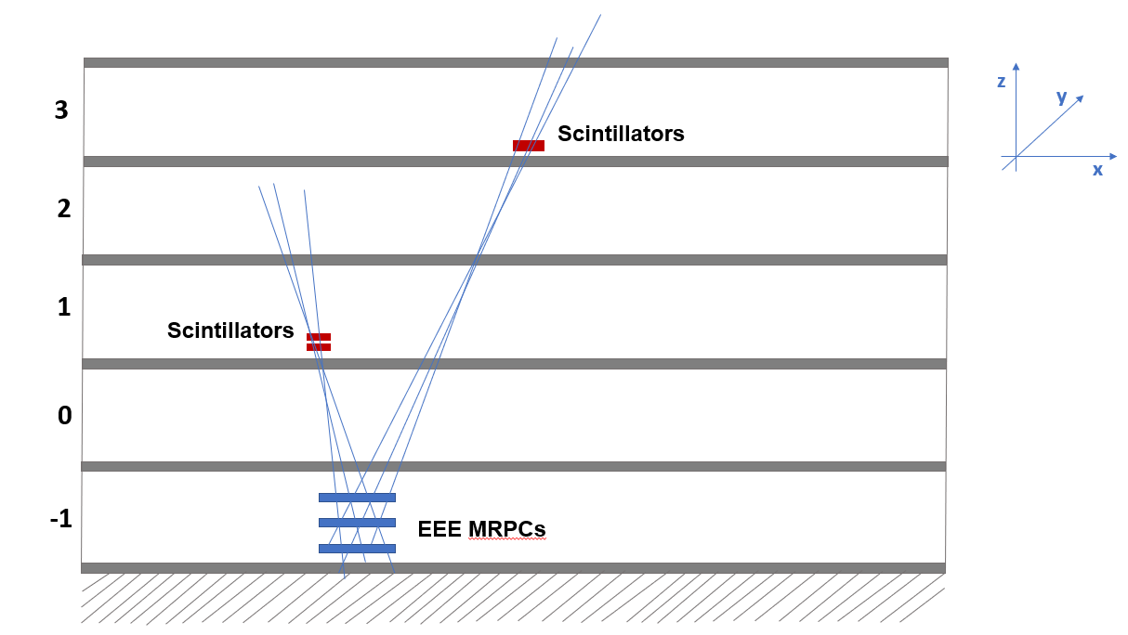
Experimental setup to monitor the building stability
In Catania → 2 experimental setup to test the possibility of monitoring the long term building stability
Dipartimento di Fisica e Astronomia
E. Majorana, CT
≈ 15 m
≈ 8 m
Notes:
Stesso nome
Distanze rivelatori

Slide 5
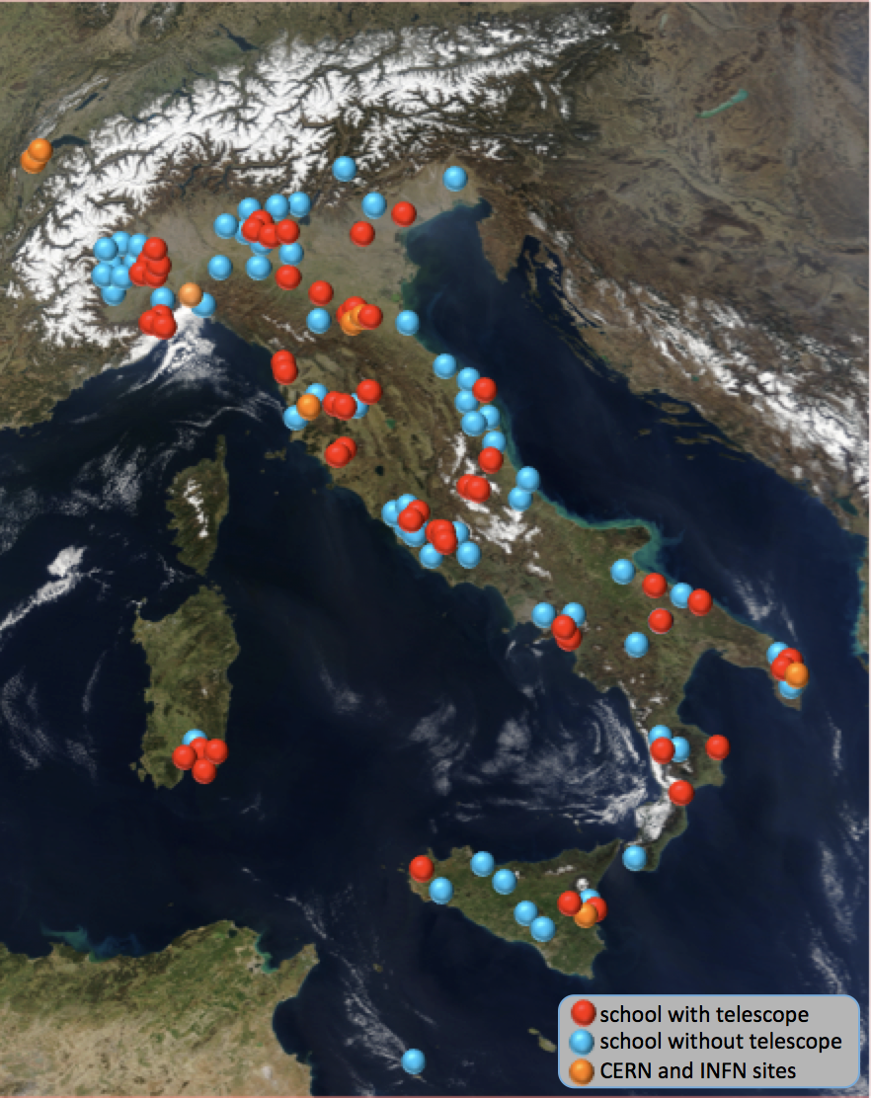
EEE Telescopes
See talks by F. Coccetti, G. Mandaglio & M.P. Panetta
Extreme Energy Events Project: collaboration of Centro Fermi, INFN, CERN & MIUR.
It aims at the detection of cosmic ray muons by means of a sparse array of telescopes, distributed all over the Italian territory.
Network of telescopes based on Multi-gap Resistive Plate Chambers (MRPC)
56 telescopes in high schools
2 telescopes at CERN
4 at INFN Sections
Total: 62 telescopes
(+50 institutes on the waiting list)

Slide 6
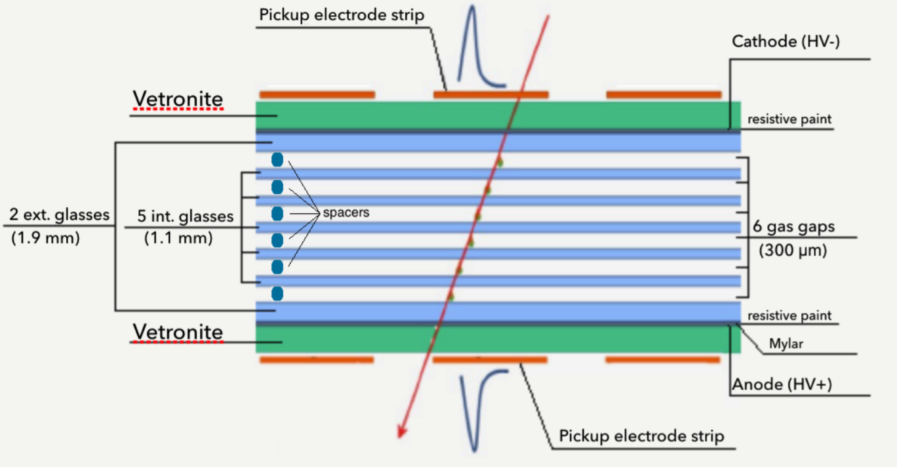
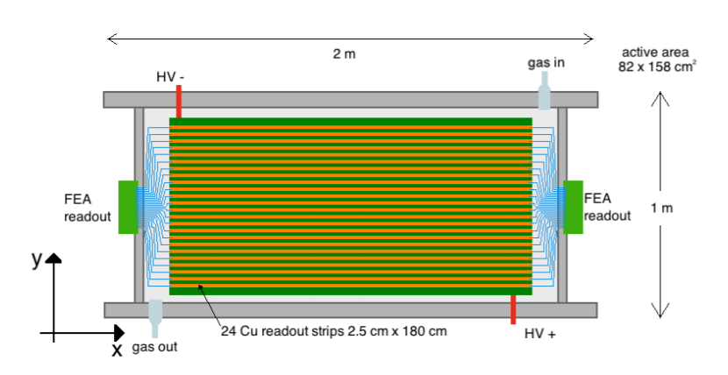
EEE Telescopes
Inner structure
Chambers built by students and teachers at CERN
Reasonable cost
Long term operation required
Reconstruction of muon orientation
TOF measurements
Chambers filled with a gas mixture 98% / 2% of Freon and SF₆, at a continuous flow of 1-2 l/h and atmospheric pressure
Top view
Notes:
MRPCs are a development of Resistive Plate Chambers (RPC), where the gas gap is divided
into sub-gaps. Particles passing through the detector may create avalanches in several or all gaps and
the signal collected on the external cathode and anode is the analogue sum of avalanches in all gaps,
with a time jitter in the rise time smaller than that expected from a single gap. As a consequence, a
much better time resolution and detection efficiency are obtained by the use of multi-gap devices.

Slide 7
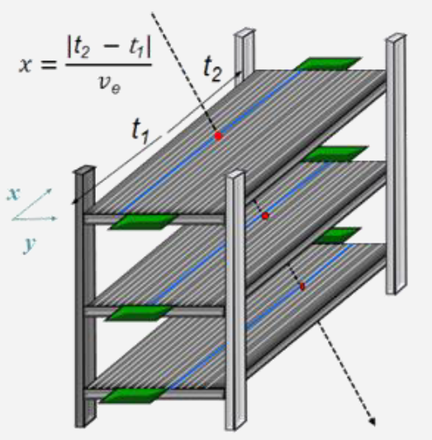
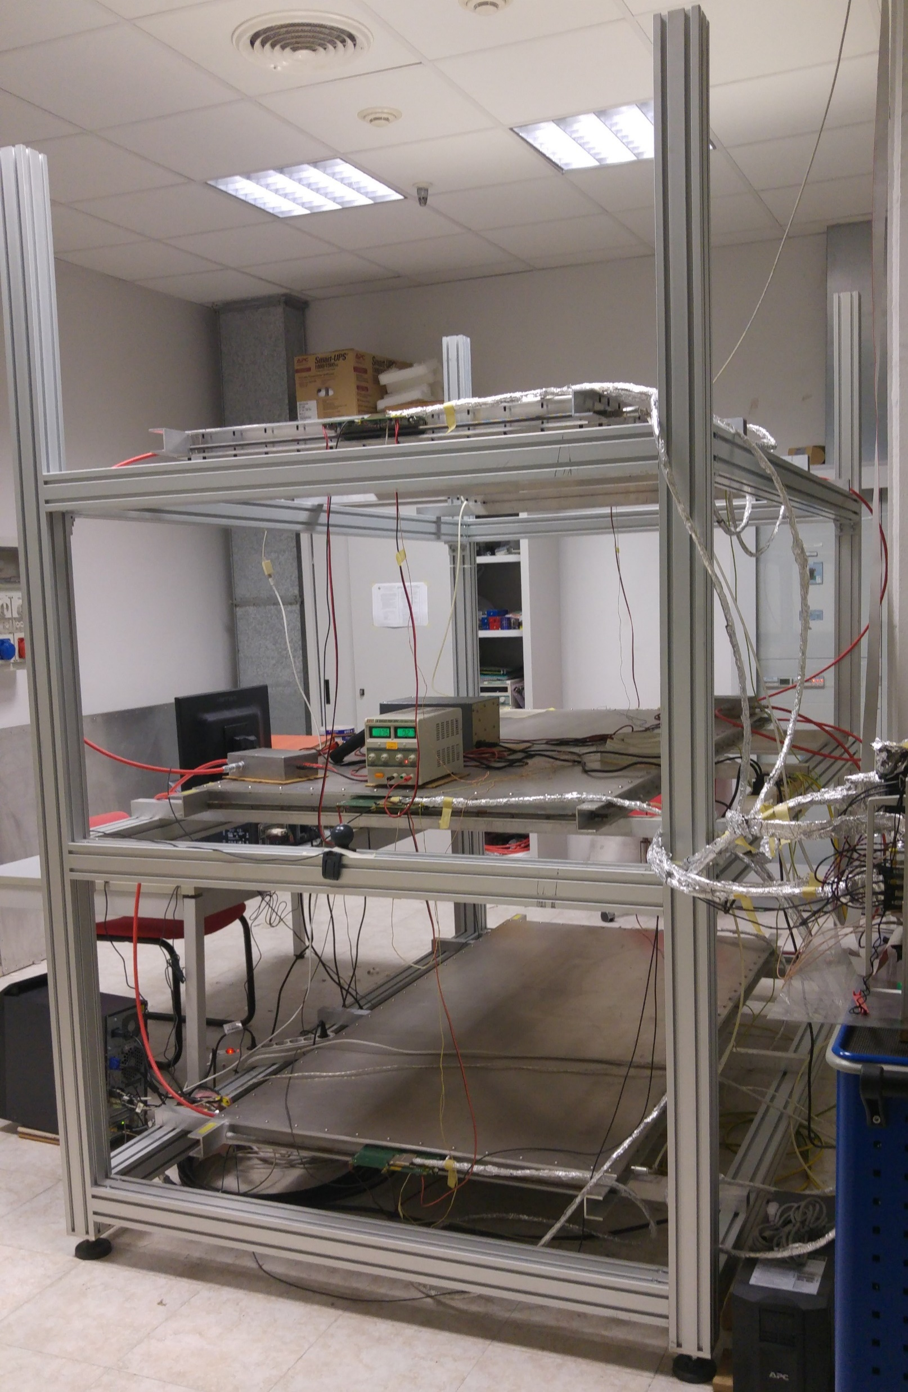
EEE Telescopes
Performance of the MRPCs:
Time Resolution ~ 240 ps
Longitudinal Spatial Resolution ~ 1.5 cm
Transverse Spatial Resolution ~ 0.9 cm
Average efficiency telescope network
~ 93 %
Trigger logic: six-fold coincidence of the OR signals from the FEA cards (→ triple coincidence of both ends of the chambers)
Synchronization guaranteed by a GPS unit that provides the event time stamp with precision of ≈ 40 ns
M. Abbrescia et al 2018 JINST 13 P08026
Notes:
V_drift= 15.8 cm/ns

Slide 8
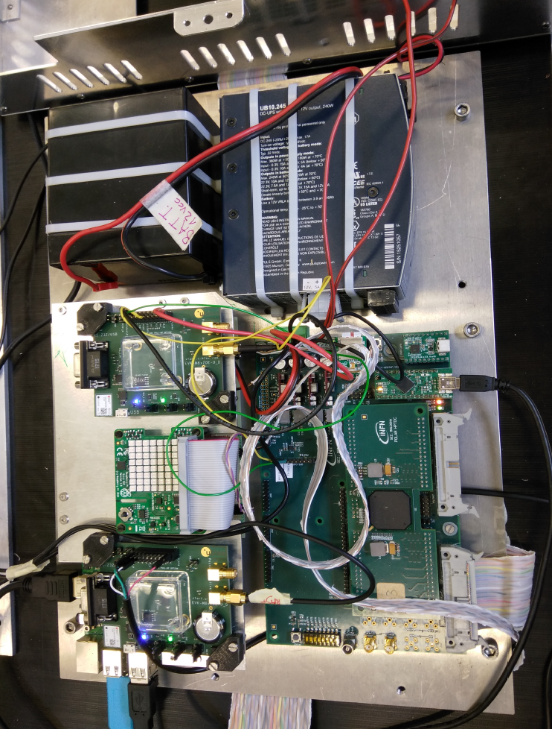
POLAR detector
Polar is one of the three detectors of the PolarquEEEst project by Centro Fermi
Assembled at CERN by high school students
2 Plastic scintillator planes
Distance between planes: 11 cm
4 Tiles for each plane: 30 cm x 20 cm
2 SiPMs per tile (16 SiPMs in total)
Nanuq
Genova
Vigna di Valle (Rome)
Cosenza
Messina
Cefalù (Palermo)
Erice (Trapani)
Catania-Etna
Lampedusa
Bologna
Munich
Hannover
Frankfurt am Main
CERN

Slide 9
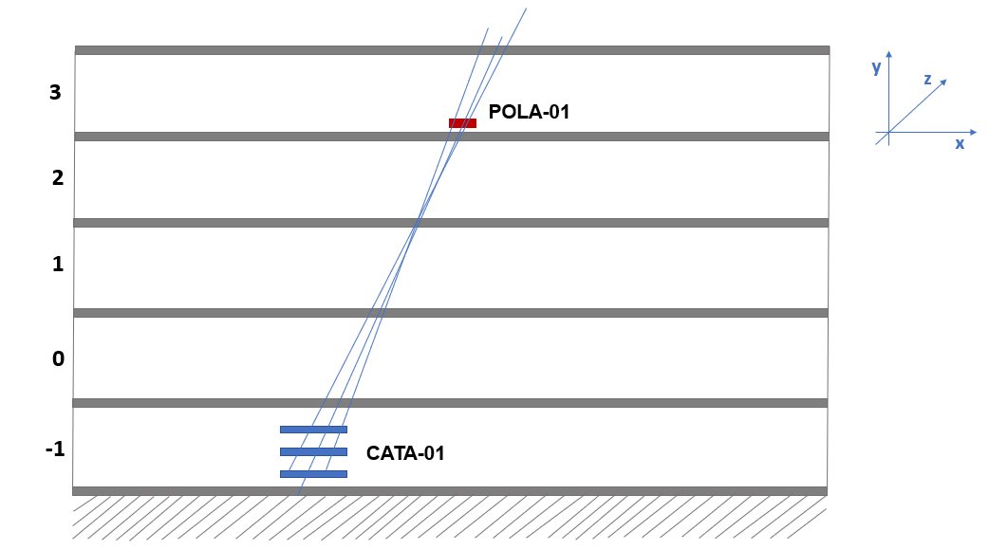
1st experimental setup @ DFA- UniCT
No visibility between detectors (4 layers of concrete)
GPS time tagging of events
Average count rate a.s.l. ~30 Hz
Detectors take data independently, then correlated by GPS information
Dipartimento di Fisica e Astronomia
E. Majorana, CT
GPS information

Slide 10
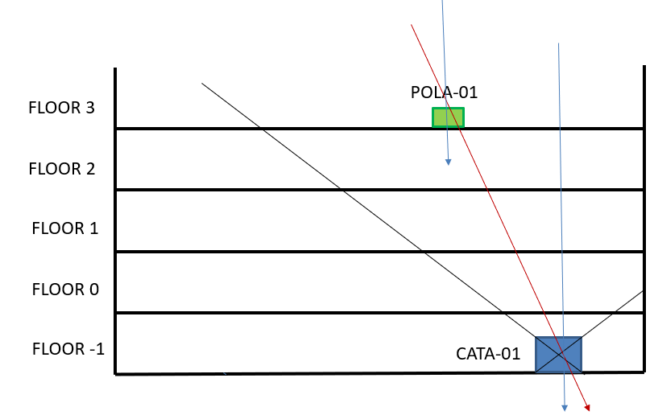
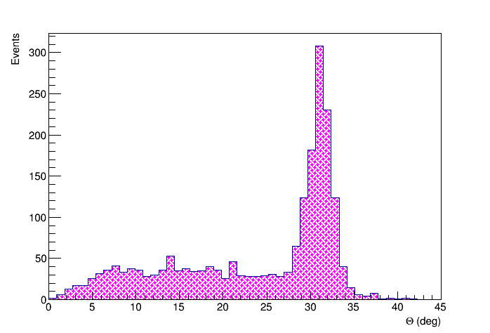
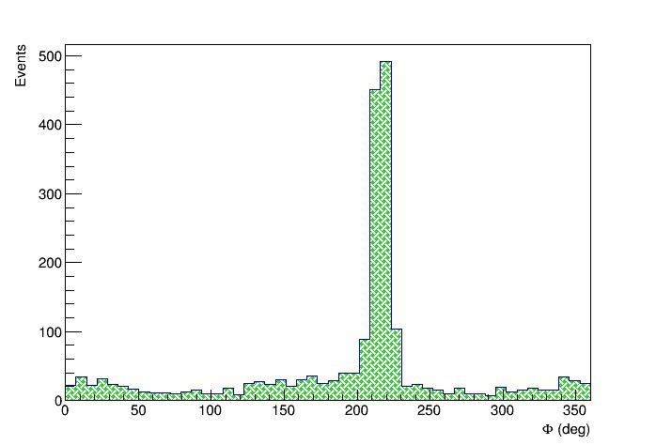
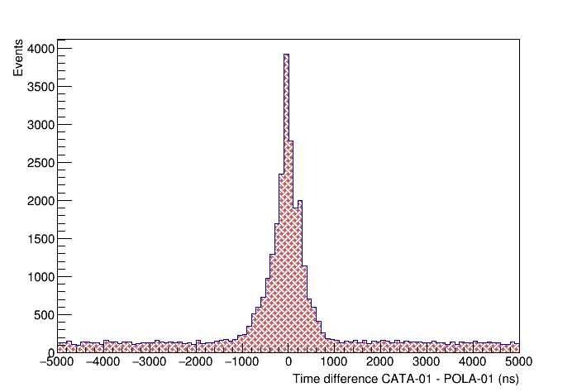
Commissioning measurements
Same muons passing through both detectors.
Inside the acceptance cone: ~ 47 days data acquisition in total
The track orientation (θ,φ) — as reconstructed by the MRPC EEE telescope — is considered
These distributions depend on the relative position of the movable scintillator w.r.t. the EEE telescope
Coincidence: 600 ns time window
M. Abbrescia et al 2019 JINST 14 P06035
Notes:
freccia

Slide 11
«Simulating» the building shifts
The scintillator was moved to mimic the building shift
POLA-01
Δx [cm] 20 10 5 0
Four sets of measurements:
Reference -> 0 cm
11

Slide 12
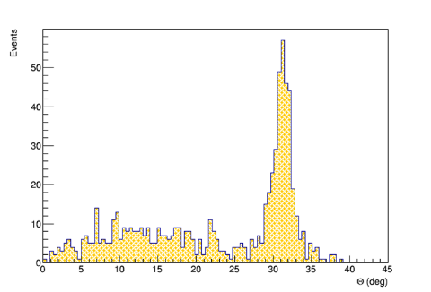
«Simulating» the building shifts
The scintillator was moved to mimic the building shift
+ 5 cm
POLA-01
Δx [cm] 20 10 5 0
Four sets of measurements:
Reference -> 0 cm
First shift -> 5 cm
11

Slide 13
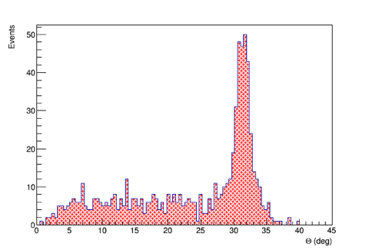
«Simulating» the building shifts
The scintillator was moved to mimic the building shift
+ 5 cm
POLA-01
Δx [cm] 20 10 5 0
+ 10 cm
Four sets of measurements:
Reference -> 0 cm
First shift -> 5 cm
Second shift -> 10 cm
11

Slide 14
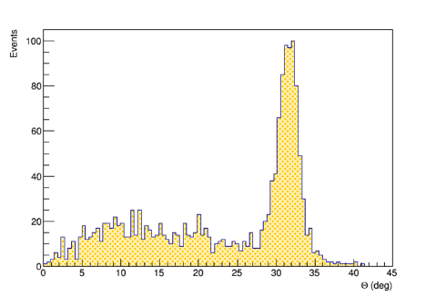
«Simulating» the building shifts
The scintillator was moved to mimic the building shift
+ 5 cm
POLA-01
Δx [cm] 20 10 5 0
+ 10 cm
Four sets of measurements:
Reference -> 0 cm
First shift -> 5 cm
Second shift -> 10 cm
Third shift -> 20 cm
Gaussian fit
x [cm] | < θ > ± Δ<θ> | < φ > ± Δ<φ>
0 | 31.03° ± 0.05° | 216.39° ± 0.16°
+5 | 31.18° ± 0.07° | 215.88° ± 0.33°
+10 | 31.36° ± 0.08° | 215.98° ± 0.30°
+20 | 31.45° ± 0.06° | 215,67° ± 0.20°
+ 20 cm
11

Slide 15
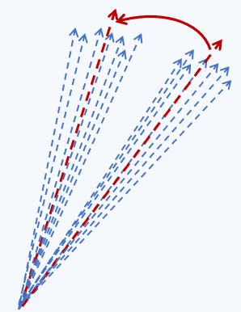

Shift of the average direction in space
Estimation of the average direction in space, summing on all the tracks, in 3 configurations (5 cm, 10 cm, 20 cm).
$$θ_{rel}$$
Relative distance | Relative angle shift
20 cm | 0.44°± 0.12
10 cm | 0.24°± 0.12
5 cm | 0.31° ± 0.16
5 cm measurement has a very short statistics – just 4 days
Use of the EEE MRPC telescopes to investigate possible instabilities of civil structures on a long time-scale C. Pinto for the EEE Collaboration, RPC20 - Roma
Notes:
Inserire errori

Slide 16
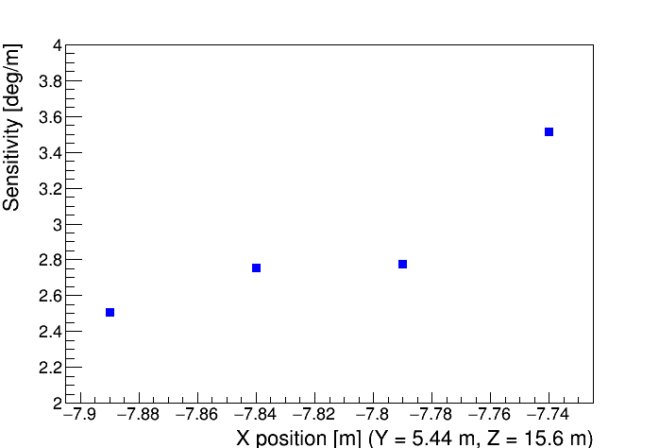
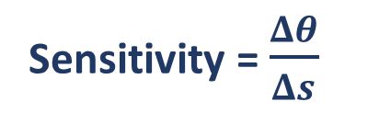
Geometrical simulations
Sensitivity = $\frac{Δθ}{Δs}$
Going closer to the vertical of the reference detector the sensitivity increases
13

Slide 17
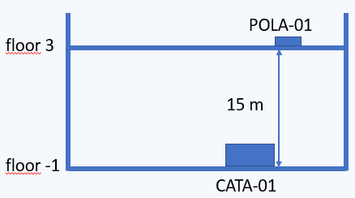
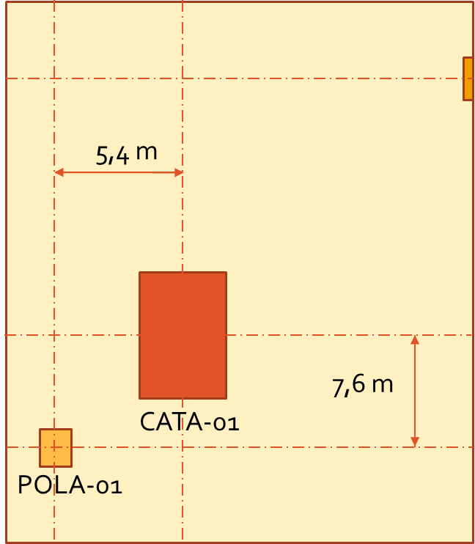
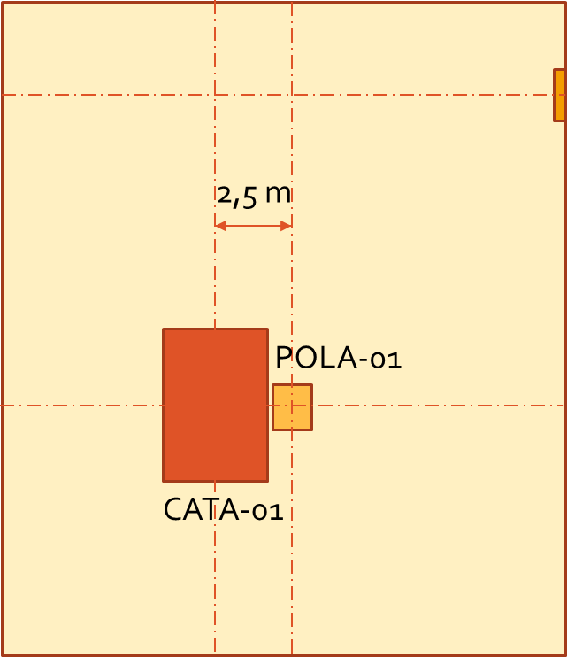
Position of detectors
y
x
POLA-01 was moved closer to the vertical of CATA-01

Slide 18
Effect of relative position
Relative horizontal distance between detectors | Acquisition time | # events
9,3 m | ~ 7 ∙ 10⁵ s | 757
2,5 m | ~ 6 ∙ 10⁵ s | 4305
Performance of the method at 2.5 m:
few cm in 1 week data taking
More commissioning measurements were performed
POLA-01 was moved closer to the vertical of CATA-01
Statistics increased by a factor ~ 7, in agreement with MC simulations.
To further investigate this possibility we arranged a second experimental setup, along the vertical direction of the EEE MRPC telescope

Slide 19
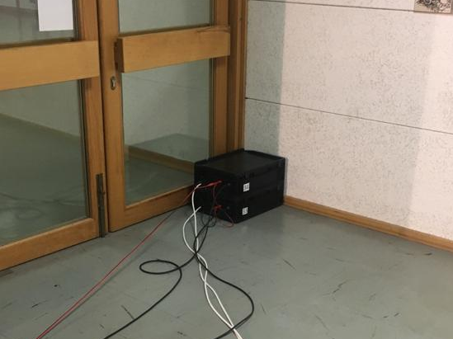
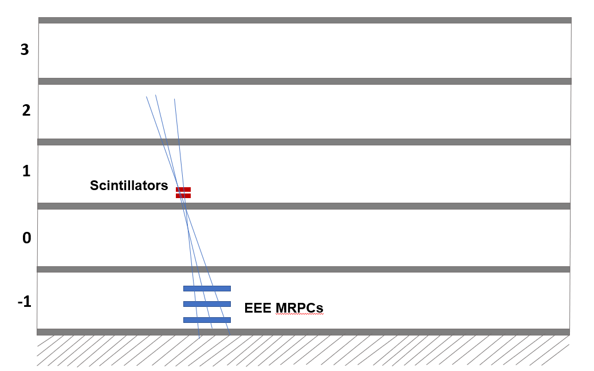
2nd experimental setup @ DFA- UniCT
GPS time tagging of events
Detector efficiency > 95%
No visibility between detectors (2 layers of concrete)
Dipartimento di Fisica e Astronomia
E. Majorana, CT
GPS information

Slide 20
Scintillator module
Extruded scintillator tile 20 x 20 x 1 cm³
1 x 1 x 20 cm³ WLS bar
GOALS:
Low dark rate count
High threshold
High efficiency
SiPM Hamamatsu 6x6 mm²
Light-tight box with:
Fast front-end amplifier
Discriminator/ TTL shaper
Power supply
P. La Rocca et al., 2019 JINST 14 T01003

Slide 21
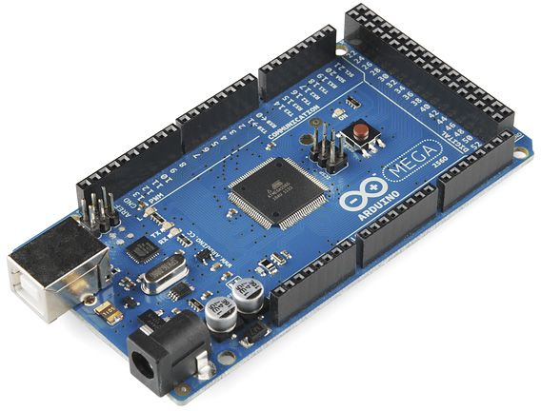
Electronics and data acquisition
TTL signals from each module are sent to the digital inputs of an Arduino MEGA board.
Fast digital readout →
≈ 800 ns per channel
Arduino MEGA
Digital Inputs
Temp & Press. sensors
GPS Antenna
1 PPS + Data Signals
GPS Time Stamping Information: 1 PPS + internal 16 MHz Arduino clock.
GPS Module
Notes:
To treat a large number of channels in coincidence, fast digital readout instructions were implemented. A time of 800 ns per channel was obtained, which allows to read out 30 channels in less than 30 µs.

Slide 22
«Simulating» the building shifts
Four sets of measurements:
Reference -> 0 cm
Δx [cm]
20
scintillator
telescope
Δy [cm] 20 10 5 0
19
Notes:
20 cm anche in y
Cambiare nomi assi x e y

Slide 23
«Simulating» the building shifts
Four sets of measurements:
Reference -> 0 cm
First shift -> 5 cm
Δx [cm]
20
scintillator
telescope
Δy [cm] 20 10 5 0
19
Notes:
20 cm anche in y
Cambiare nomi assi x e y

Slide 24
«Simulating» the building shifts
Four sets of measurements:
Reference -> 0 cm
First shift -> 5 cm
Second shift -> 10 cm
Δx [cm]
20
scintillator
telescope
Δy [cm] 20 10 5 0
19
Notes:
20 cm anche in y
Cambiare nomi assi x e y

Slide 25
«Simulating» the building shifts
Four sets of measurements:
Reference -> 0 cm
First shift -> 5 cm
Second shift -> 10 cm
Third shift (2D) -> (20 cm, 20 cm)
Δx [cm]
scintillator
telescope
20
Δy [cm] 20 10 5 0
19
Notes:
20 cm anche in y
Cambiare nomi assi x e y

Slide 26
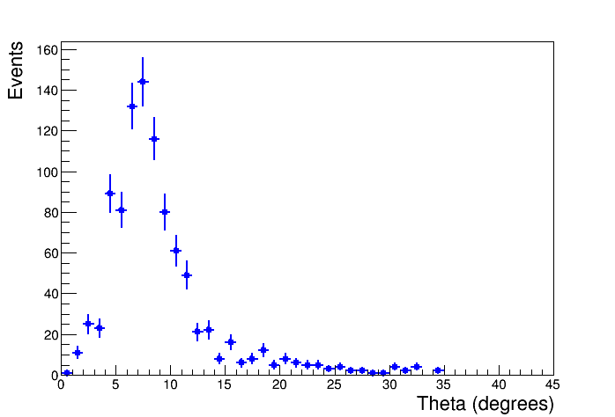
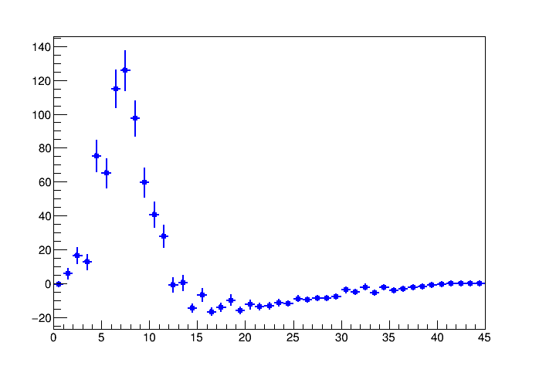
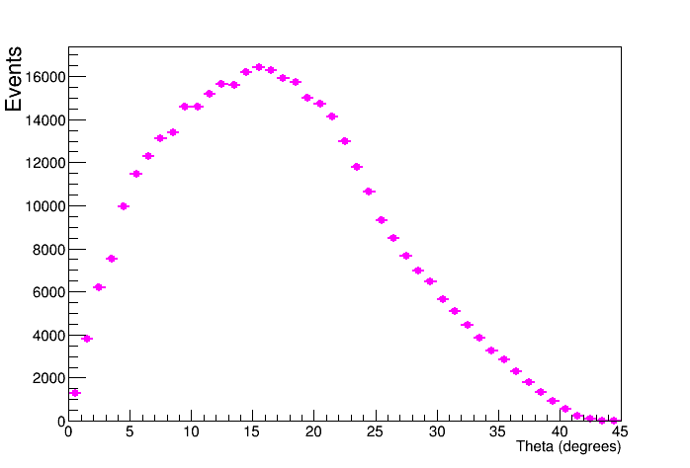
«Simulating» the building shifts
Four sets of measurements:
Reference -> 0 cm
First shift -> 5 cm
Second shift -> 10 cm
Third shift (2D) -> (20 cm, 20 cm)
Δx [cm]
scintillator
telescope
20
Gaussian fit
<θ>= 7.364 ± 0.114
Δy [cm] 20 10 5 0
Reference position
After BG subtraction
BACKGROUND
Theta (degrees)
19
Notes:
20 cm anche in y
Cambiare nomi assi x e y

Slide 27
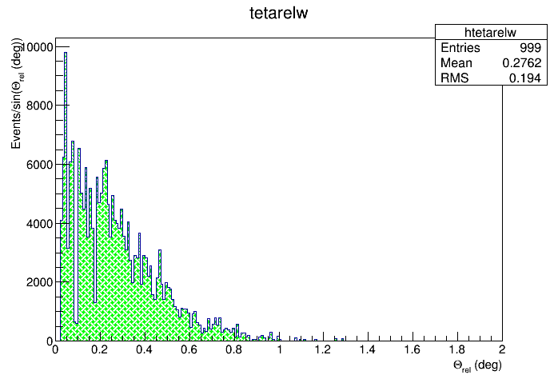

3D shifts
Each of the three shifts allows to get closer to the vertical of the reference detector
To estimate the uncertainty in the relative angle:
split the overall set of tracks in 2 subsets
evaluate their average direction
generate a large number of subsets
distribution of these differences
Position (x,y) | 3D shift
(0 cm, 5 cm) | 0.334 ± 0.21
(0 cm, 10 cm) | 0.523 ± 0.22
(20 cm, 20 cm) | 2.060 ± 0.21
$$θ_{rel}$$
20

Slide 28

Conclusions & Outlook
Coincidence measurements between MRPC EEE telescope & additional detectors were carried out to test the possibility of monitoring the long term building stability
The additional detector is moved in order to mimic possible deformations of the building
The sensitivity of the method depends on: capabilities of the main tracking detector, geometry and position of the additional detectors, uniformity over time of detectors response, acquisition time, ...
Performance of the method can be estimated of the order of few cm in 1 week data taking

Slide 29
BACKUP

Slide 30
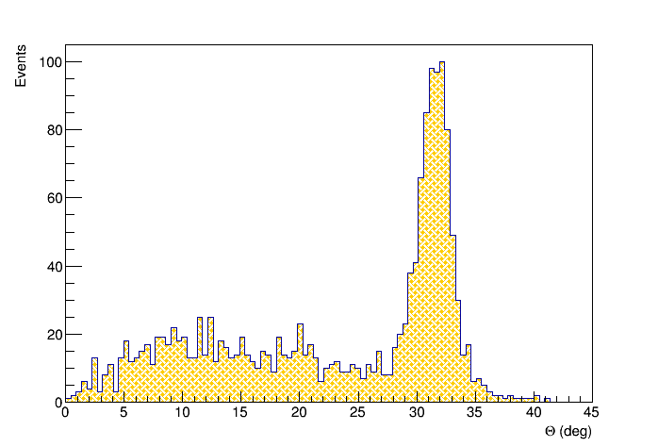
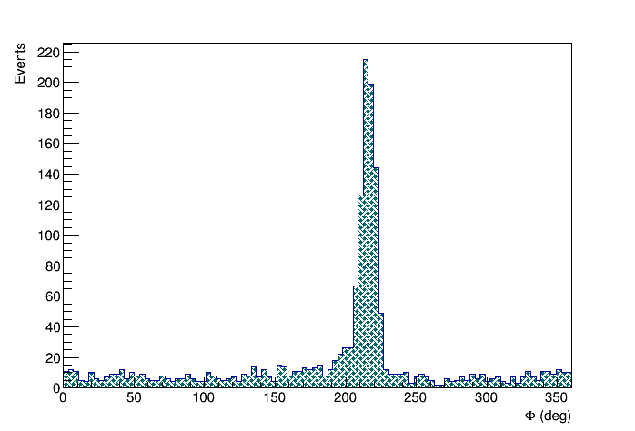
20 cm shift
x [cm] | < θ > ± Δ<θ> | < φ > ± Δ<φ>
0 | 31.03° ± 0.05° | 216.43° ± 0.20°
+20 | 31.45° ± 0.06° | 216.23° ± 0.32°
Use of the EEE MRPC telescopes to investigate possible instabilities of civil structures on a long time-scale C. Pinto for the EEE Collaboration, RPC20 - Roma
23

Slide 31

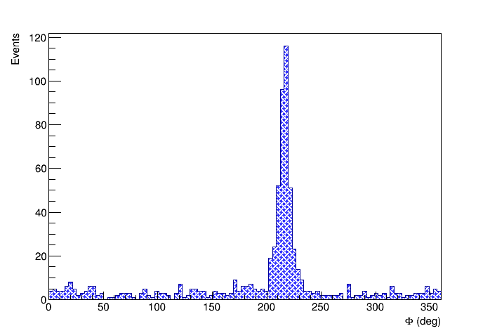
10 cm shift
x [cm] | < θ > ± Δ<θ> | < φ > ± Δ<φ>
0 | 31.03° ± 0.05° | 216.43° ± 0.20°
+10 | 31.36° ± 0.08° | 216.15° ± 0.29°
24

Slide 32
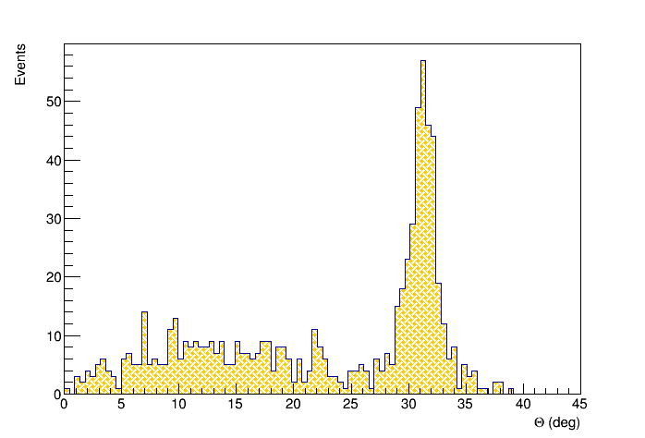
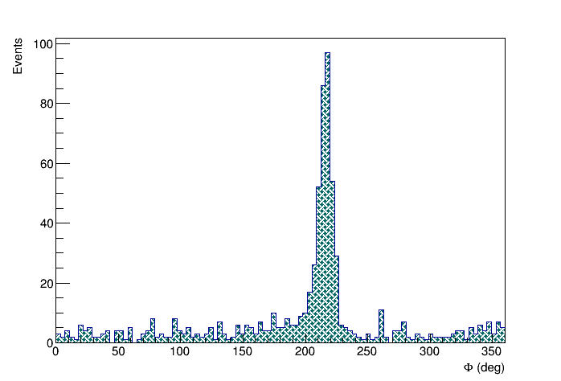
5 cm shift
x [cm] | < θ > ± Δ<θ> | < φ > ± Δ<φ>
0 | 31.03° ± 0.05° | 216.43° ± 0.20°
+5 | 31.18° ± 0.07° | 215.88° ± 0.33°
Use of the EEE MRPC telescopes to investigate possible instabilities of civil structures on a long time-scale C. Pinto for the EEE Collaboration, RPC20 - Roma
25

Slide 33
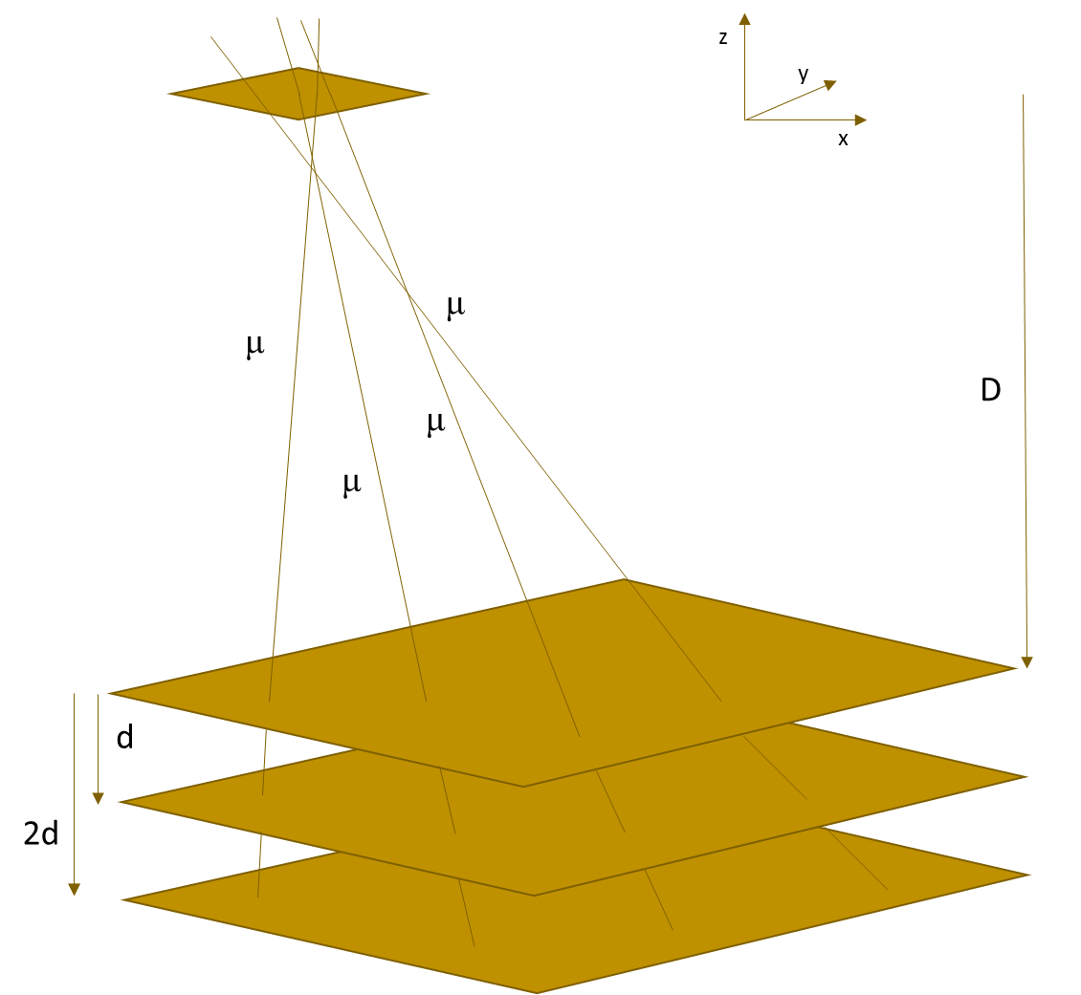
Coincidence measurements
Coincidence window
|(Δt + (t-int(t)) ∙ 2500 -1500) – 140| < 600 ns
Quality cuts
χ² < 10
-2 ns < ToF < 10 ns
Number of satellites POLA-01 ≥ 3
Number of satellites CATA-01 ≥ 3
Number of tracks POLA-01 = 1
Number of tracks CATA-01 = 1
Two detectors working separately
Coincidence measurement selected using the GPS information in a 600 ns time interval
Use of the EEE MRPC telescopes to investigate possible instabilities of civil structures on a long time-scale C. Pinto for the EEE Collaboration, RPC20 - Roma
26

Slide 34
3D shifts error estimation
To estimate the uncertainty in the relative angle:
split the overall set of tracks in 2 subsets
evaluate their average direction
generate a large number of subsets
distribution of these differences
27

Slide 35
3D shifts
Position (x,y) | 3D θ | 3D φ | 3D error
(0 cm, 0 cm) | 5.926 | 47.892 | 0.16
(0 cm, 5 cm) | 5.638 | 49.564 | 0.13
(0 cm, 10 cm) | 5.635 | 43.573 | 0.16
(20 cm, 20 cm) | 3.901 | 52.422 | 0.13
28

Slide 36
GEANT3 Simulations
Evaluation of multiple scattering effect due to the interposed material between the two detectors
60 cm of concrete-equivalent solid for the 4 layers
For p around 3-4 GeV/c → 0.1°-0.2° comparable to the observed uncertainty
Use of the EEE MRPC telescopes to investigate possible instabilities of civil structures on a long time-scale C. Pinto for the EEE Collaboration, RPC20 - Roma
29

