Slide 1


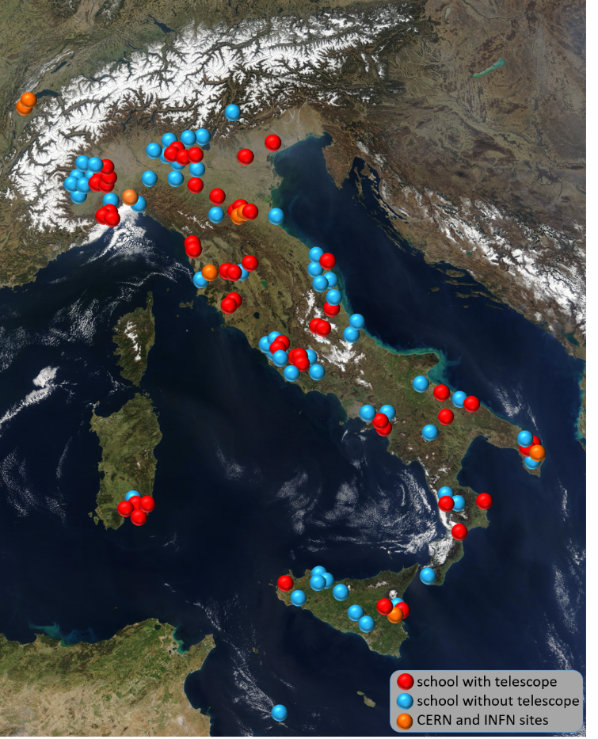
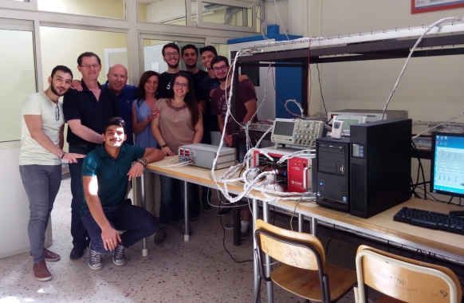
2nd DMEG Workshop – University of Gangneung
D. De Gruttola
for the EEE Collaboration
MRPC for a cosmic ray experiment:
Extreme Energy Events project (EEE)

Slide 2
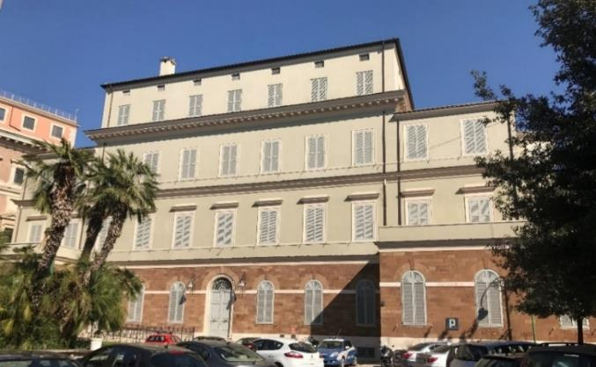

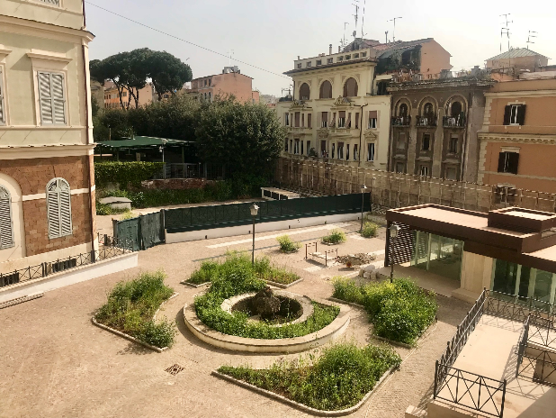
A Research Institute funded since 2001 by the Italian Ministero per Istruzione Università e Ricerca and dedicated to frontier research in physics and its wide applications for the benefit of humankind (Education and Outreach), in the spirit of E. Fermi legacy.
First President A. Zichichi
Three main focus points:
Grants for Junior/Senior researchers
Interdisciplinary Research Projects
Dissemination of Scientific Culture and Historic Memory also through the restoration of the “Monumental Complex” of Via Panisperna, to be used in part for the Museum dedicated to E. Fermi.
Researchers : 9 permanent , ≈40 Grants , > 100 associated
Present President L. Cifarelli

Slide 3

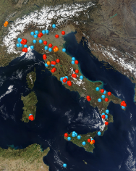
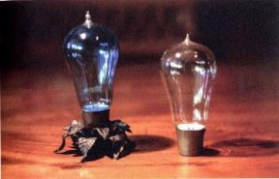
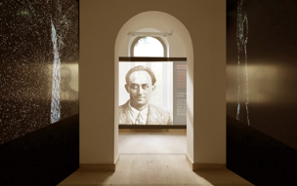
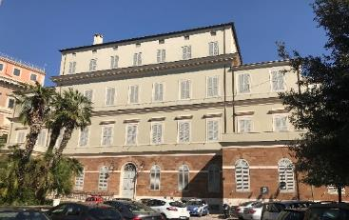
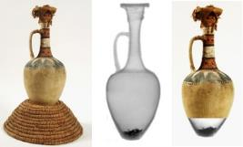
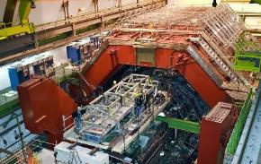
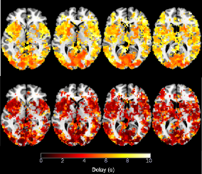
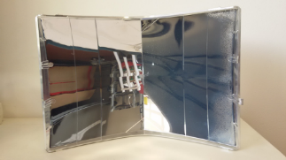
EEE
MUSEUM
HISTORY OF PHYSICS
Centro Fermi
CULTURAL HERITAGE
Fundamental
PHYSICS
MEDICINE
ENERGY

Slide 4


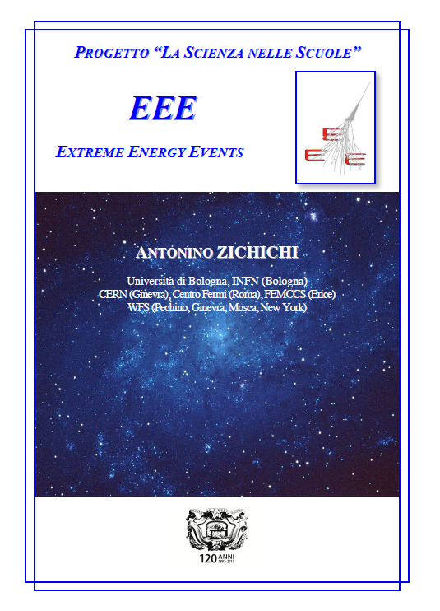
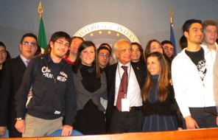
The Extreme Energy Events (EEE)
Science inside Schools
Project Leader A. Zichichi
Since 2004 , EEE conjugates a real experiment on Cosmic Rays, with the largest area coverage, with a direct participation of students and teachers in all aspects of the experiment, from building the detectors, to monitoring the operations/data taking and analyzing the data.
INFN, CERN, MIUR (Italian Ministero Istruzione e Università) collaborate to the project.

Slide 5
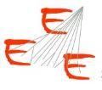
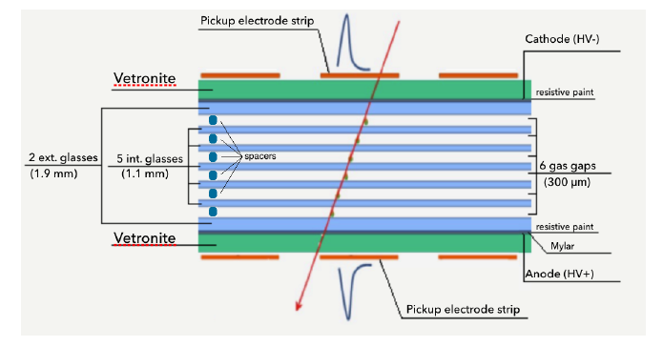
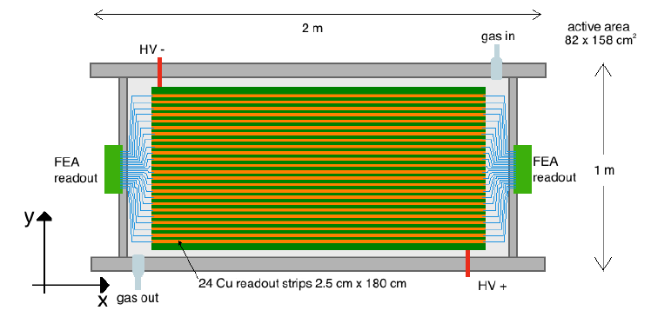
The Multigap Resistive Plate Chambers (MRPC) of EEE
An evolution of the ALICE TOF
Cross section
Top view

Slide 6

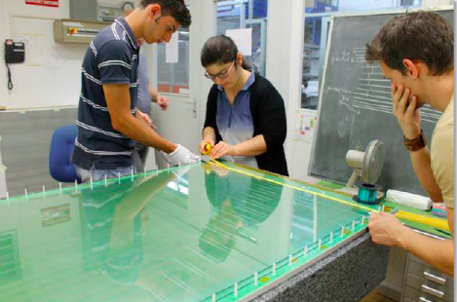
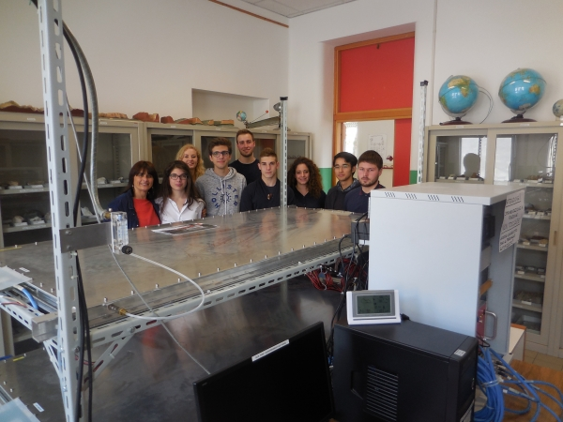
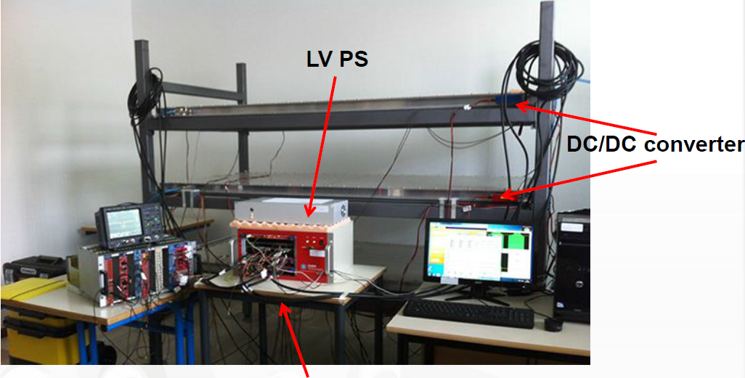
The EEE project
CNAF
Few numbers for EEE:
≈ 52 Institutes with a Telescope (+ 8 in Laboratories)
> 50 Institutes without Telescope
≈ 1000 students-teachers /year
Since 2004 more than ≈ 10000 participants
At CERN
At home institute

Slide 7
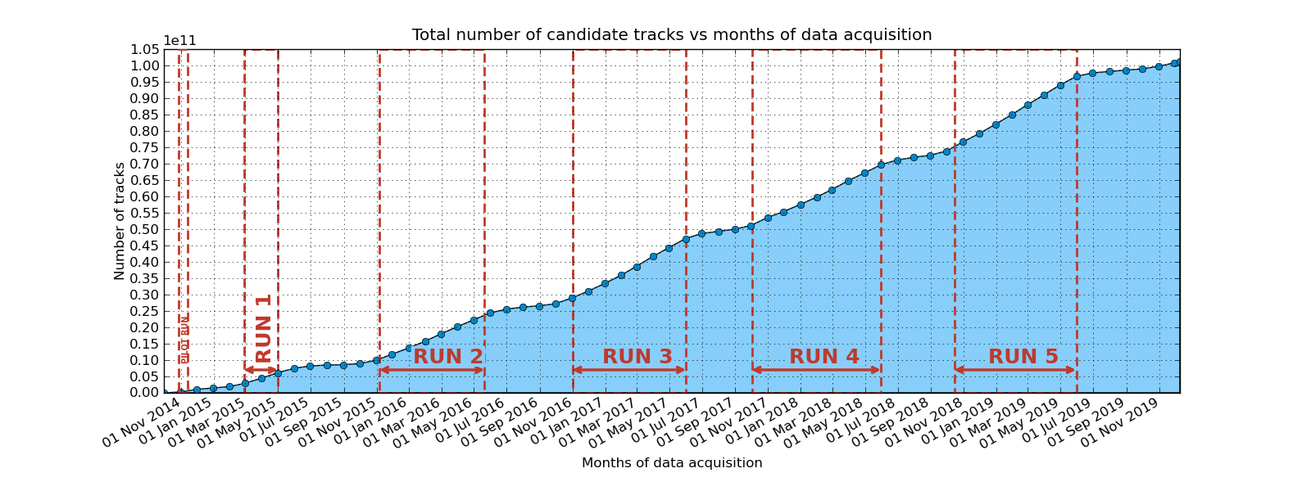
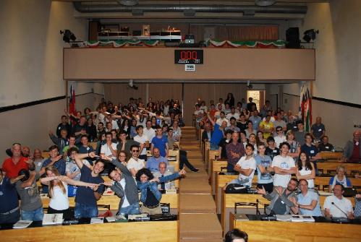
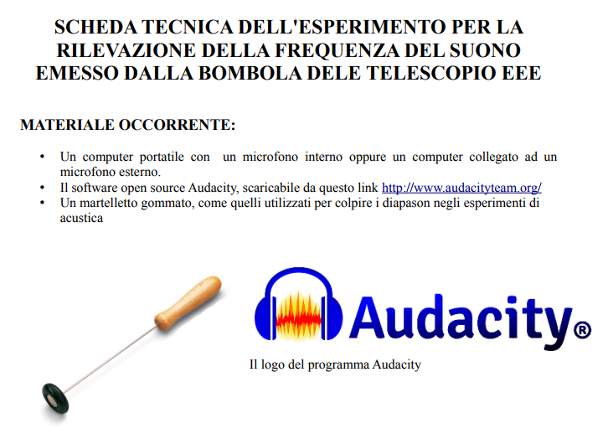
The EEE
Runs
>100 Billions tracks
2014
2019
Project Conferences
Monthly vidyo meetings
Institutes visits
Masterclasses ….
How to measure the amount of gas in a bottle by means of sound frequency
Liceo F. e M. Campana (Osimo)

Slide 8
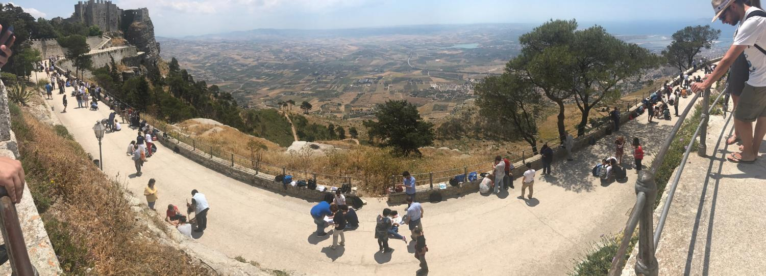
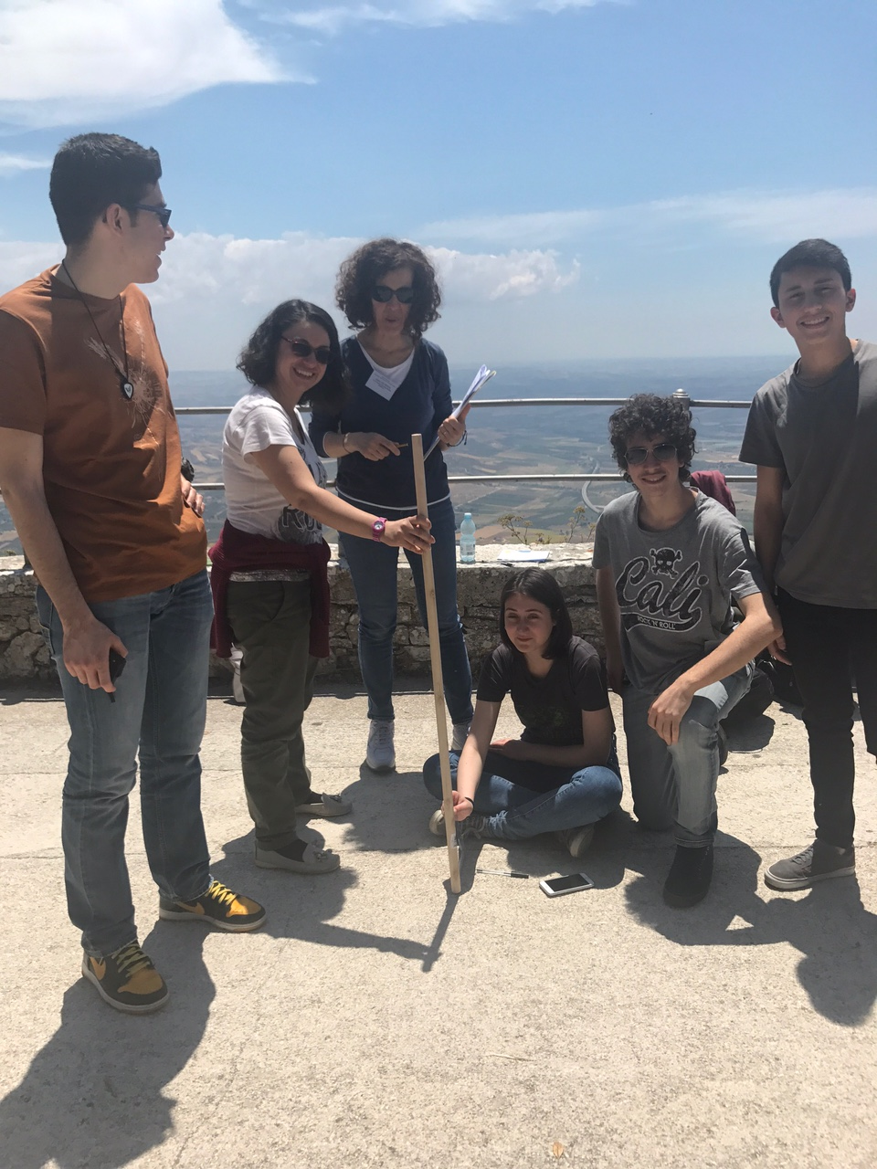
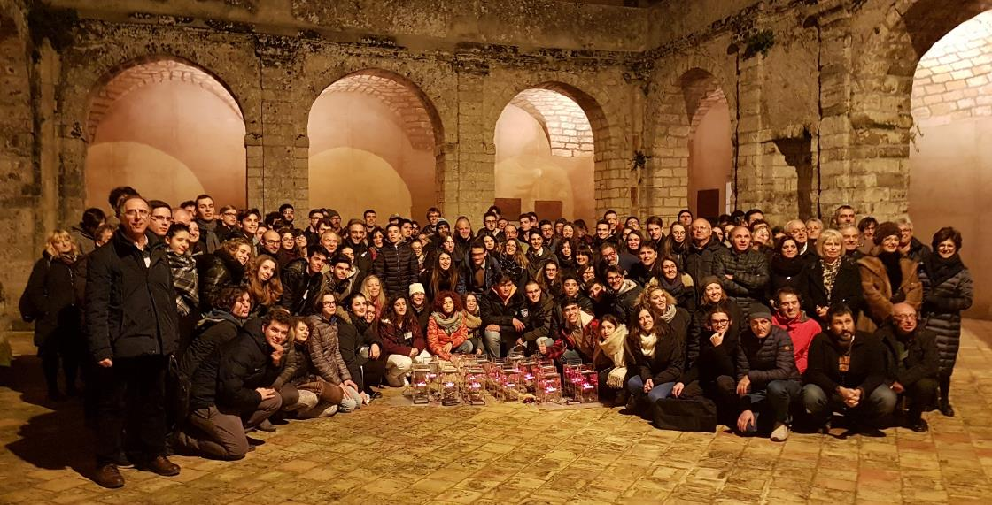
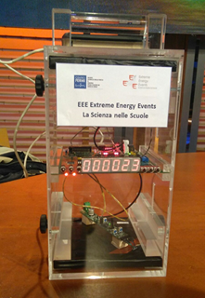
EEE in Erice 2017
Both measurements are published in the Giornale di Fisica with students’ signature.
Measurement of the Earth Radius
Measurement of Cosmic rays flux at different altitudes

Slide 9
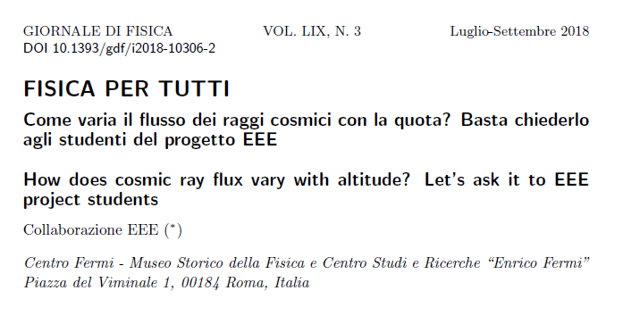
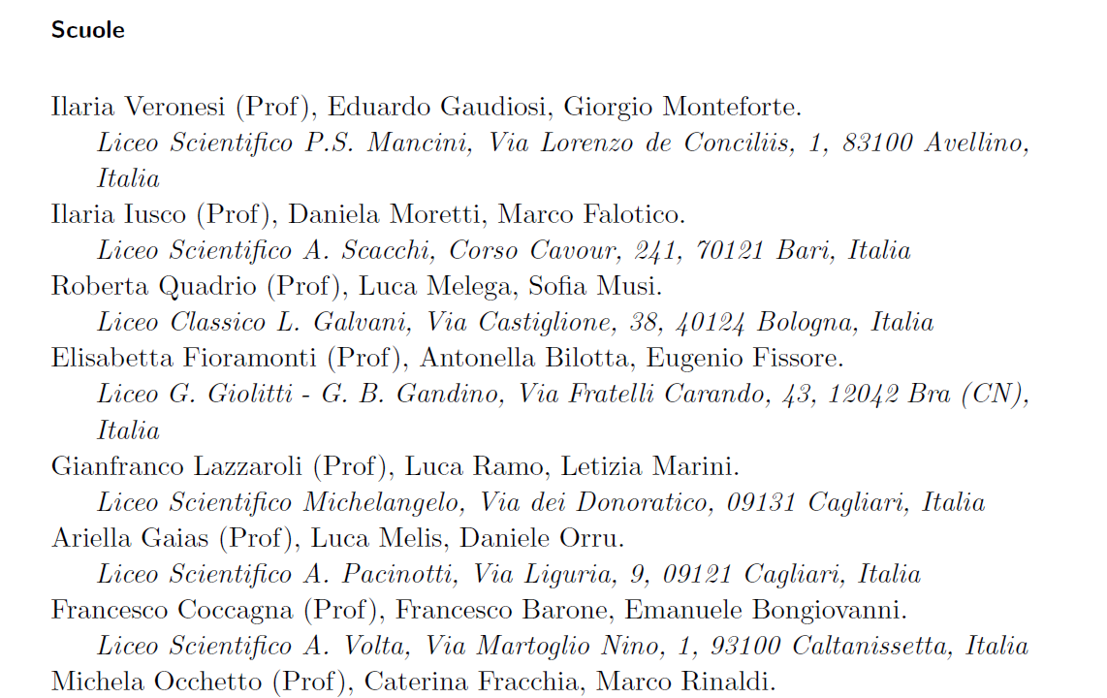
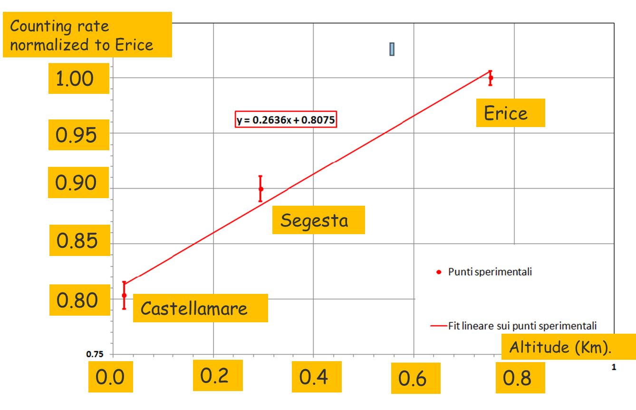
…..
Article signed by EEE collaboration and 140 students/teachers

Slide 10

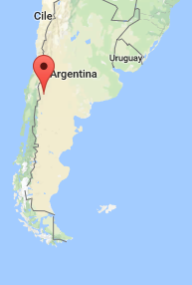

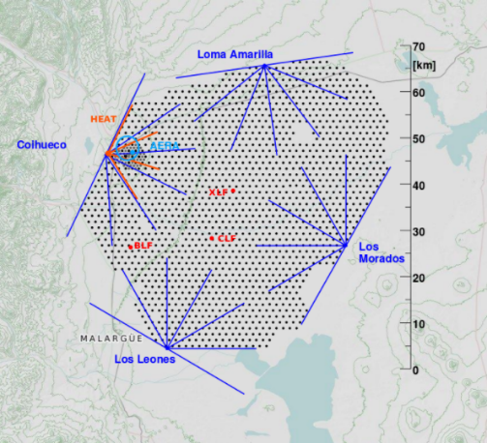
Very large area experiments for Cosmic Rays studies
Centro Fermi
Extreme Energy Events Project
EEE
Pierre Auger Observatory
70 km
with “Telescope”
without

Slide 11
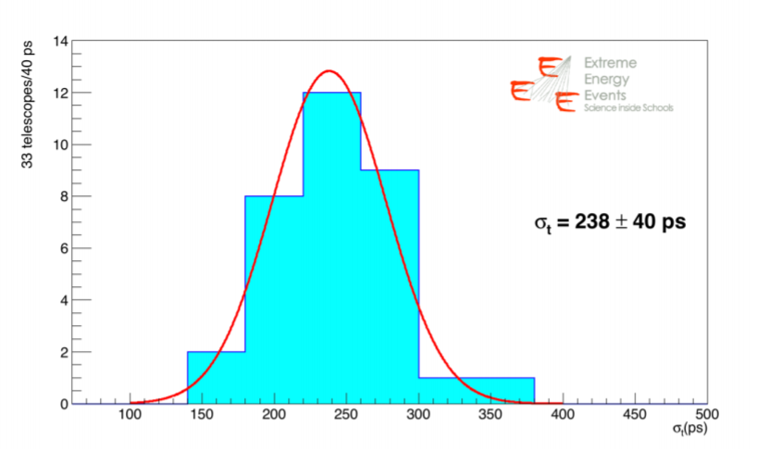
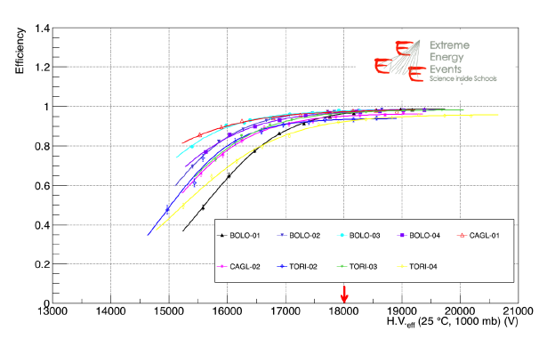
MRPC performances on the telescopes
EEE Collaboration 2018 JINST 13 P08026
Time resolution measured with data taken in Run 3, for 33 telescopes: Average σ_{t} = 238 ± 40 ps
Space resolution measured with data taken in Run 3, for 44 telescopes:
Transverse to strip σ_{y} = 0.92 ± 0.02 cm
Parallel to strips σ_{x} = 1.44 ± 0.23 cm
Efficiency measured with data taken in Run 3, for 9 telescopes:
Average efficiency over 31 telescopes : 93%

Slide 12
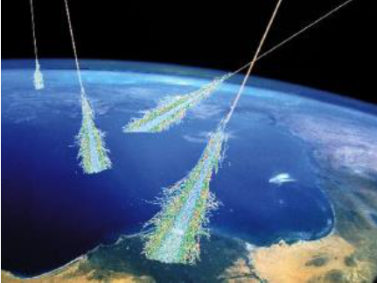
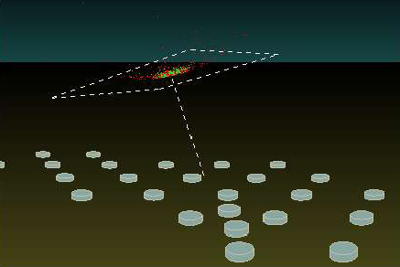
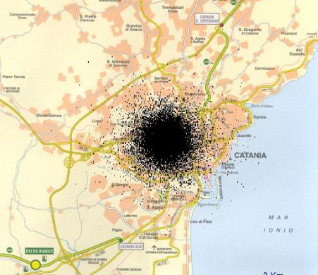
The EAS array
Detect muons arriving at the surface
Many, low cost, easy to operate stations
Simulation of the shower induced by a 10¹⁶eV proton
At ground level 1 million muons arrive, over an area with radius at least 2 km
City of Catania

Slide 13
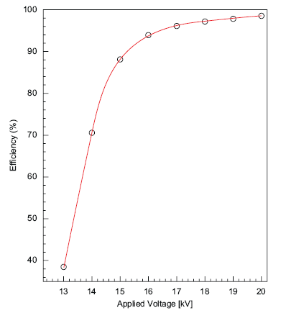
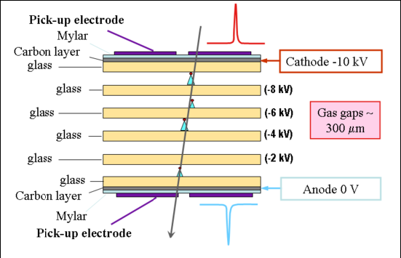
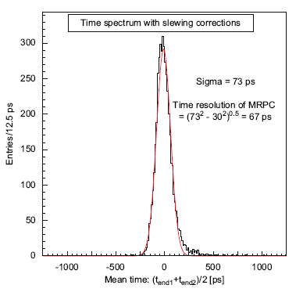
The detector used
Efficiency
(in dedicated beam tests)
Time resolution
(in dedicated beam tests)
It is a wider (~2 m²) and cheaper version of the Multi gap RPC developed for the ALICE TOF
Operated with a mixture of C₂H₂F₄/SF₆ 97/3
at a continuous flow in the order of 2 l/h

Slide 14
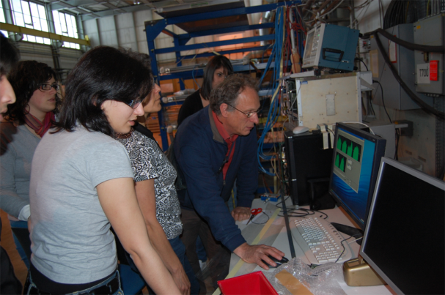
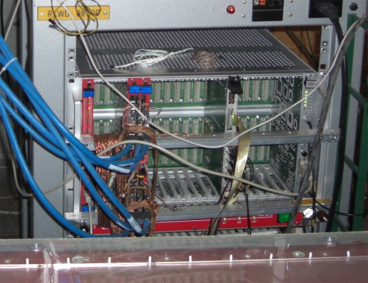
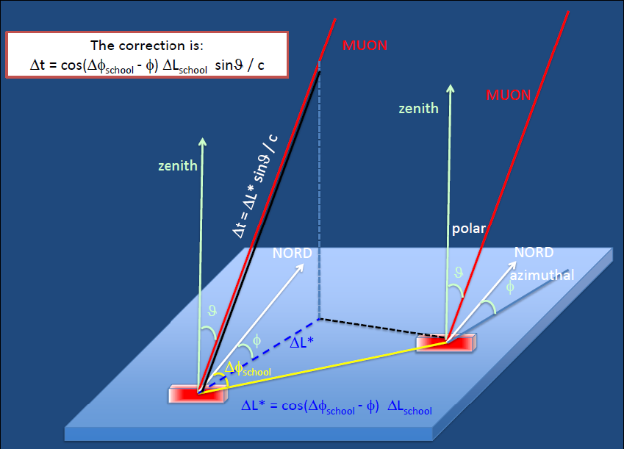
The EEE experiment structure
Each station consists of a telescope made out of 3 MRPC
  Exceptional tracking and timing performance
Coincidences among distant telescopes are searched for, to spot high energy showers
Corrections because of the propagation of the wave front of the shower, made possible thanks to the EEE telescopes directionality

Slide 15
Okay, this is all about detector stuff, but…
why is EEE so innovative?

Slide 16
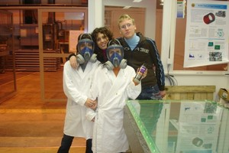
EEE is so innovative…
  because the experiment does not take place in scientific labs but…
in italian high schools
  because main actors of the experiment are not scientists but…
high schools students and teachers
  With the help of experts from the scientific world, students and teachers, they:
  Build their detectors at CERN
  Build the stations at their schools
  Take care of the data taking and relative analysis

Slide 17
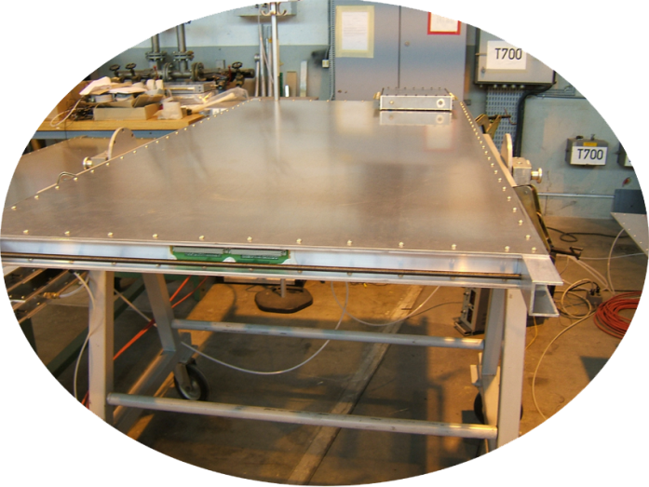
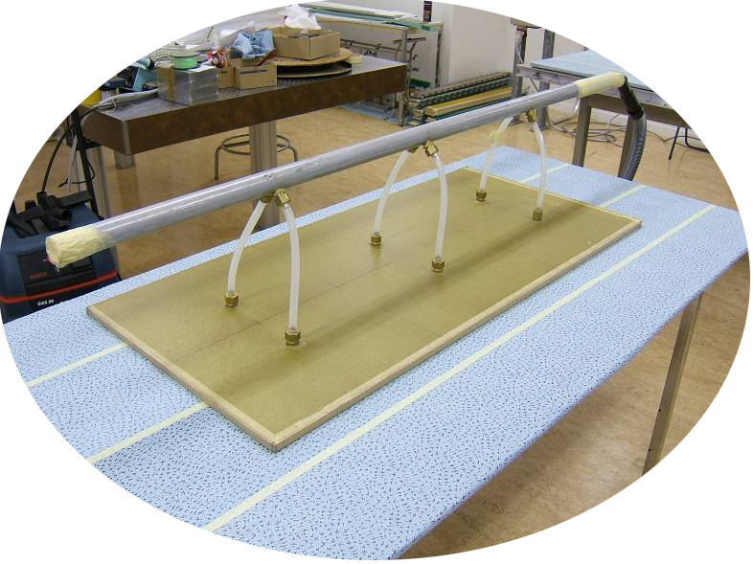
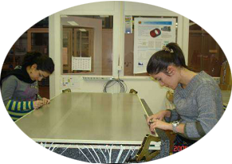
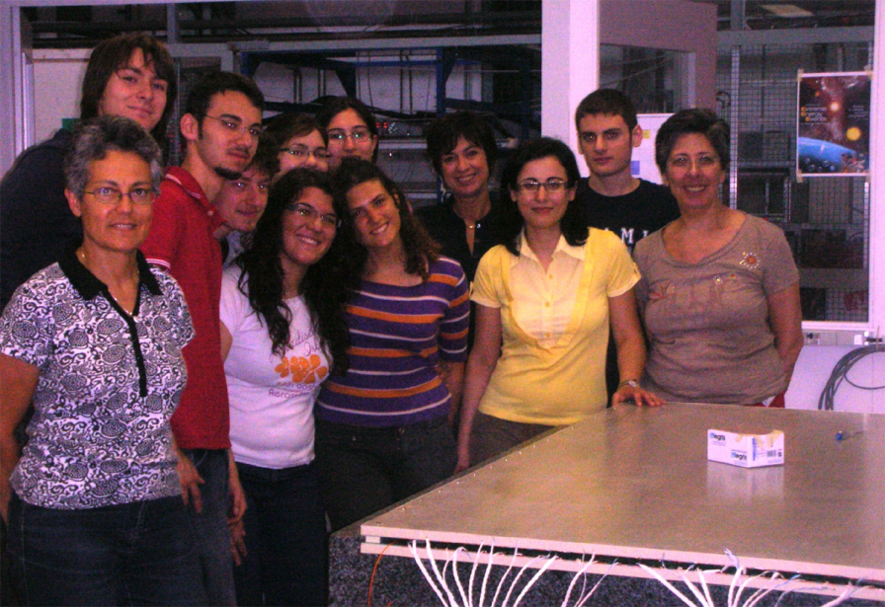
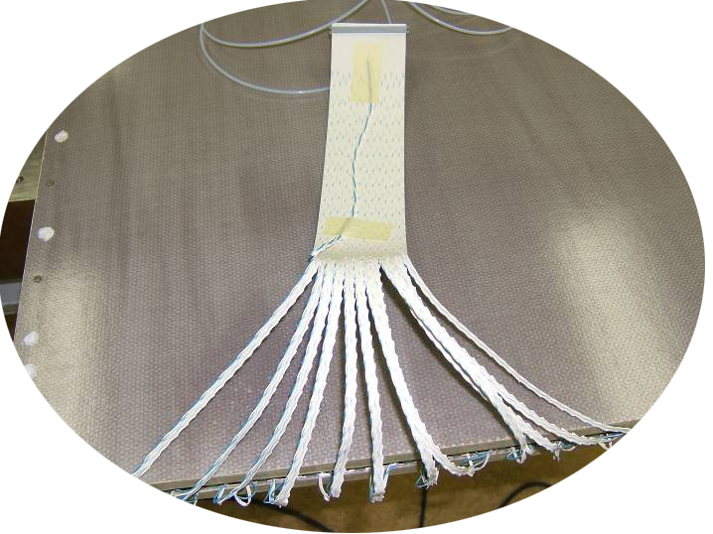
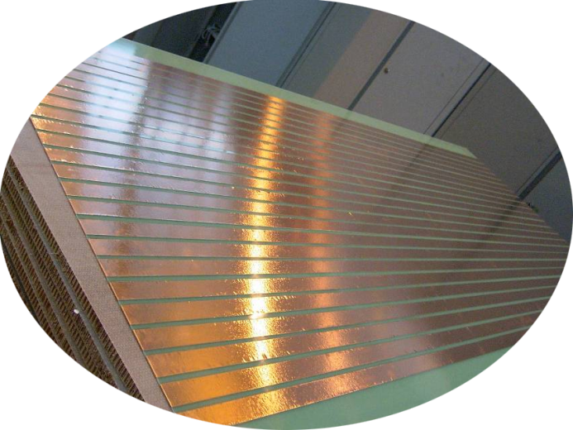

Phase 1: construction
Device for chamber movimentation
MRPC under test
Read-out strip panel
Flat cable connected and soldering to the strips
Fish wire positioning as plane spacers

Slide 18









Phase 2: assembling
Electronic readout system
The telescope assembled
Gas system
Chamber arrival

Slide 19

The schools involved
At present 52 High Schools
are involved:
They are mostly distributed in
clusters in the whole Italian territory
+ 2 telescopes at CERN
+ 6 in INFN Units
Total: 60 telescopes

Slide 20


The schools involved
At present, 52 High Schools
are involved:
They are mostly distributed in
clusters in the whole Italian territory
+ 2 telescopes at CERN
+ 6 in INFN Units
Total: 60 telescopes
… and many, many others in the waiting list

Slide 21


The largest MRPC systems
Largest system using MRPC at present:
EEE: 59 telescopes x 3 chambers ≈ 200 m² covered
Synchronized at o(10 ns) across whole Italy
Taking data at the same time
Data transferred to a central repository
Second largest system using MRPCs :
ALICE TOF: 144 m² covered
Future largest system using MRPCs:
CBM TOF: ≈ 110 m² covered
Upgrade of the CMS muon system
using (maybe) MRPCs:≈ 100 m² covered

Slide 22





Electronics and GPS
144 channels TDC
Trigger unit
GPS Unit
VME crate CAEN Mod.8010
USB connection to PC
VME Bridge CAEN Mod. V1718
Acquisition and control software based on Labview
FE cards (24 channels) – with NINO ASIC
Tot. # of readout channels = 144
Hytec or Spectracom GPS to synchronize stations at different location
Time stamps

Slide 23

(Our) New electronic
board
Joins the functionalities of the present trigger board and GPS (+GPS interface)
  Semplification of the system
  Cost reduction (almost a factor 10)
  More functionalities
  (clock distribution, VME remotely accessible)
Interest from firms to commercialize it
Plan to use it for new installations
  and progressively replace the old ones
Trigger/GPS board
Engine GPS

Slide 24



Monitor and control
Stations coordinated remotely
HV-LV system
DAQ & online analysis
Gas system
Data transfer
All remotely
controlled

Slide 25


EEE@CNAF
5-10 TB per year are expected
Full statistics from Pilot run to Run-1:
∼2.4 TB (raw: ∼2 TB, reco: ∼0.4 TB)
(+3 TB from past years)
A complex software architecture has been set-up to reconstruct the data and provide quasi-online (few hours) histograms on the web for monitoring purposes

Slide 26



Quasi online monitoring
eee.centrofermi.it/monitor
Fraction of reconstructed tracks
Trigger rate
Two e-logs!
Link to the day by day DQM
Link to the run by run DQM

Slide 27



Select High energy events via coincidences between distant telescopes
Mean energy
10¹⁵ eV
1.60
5 ev./day
20 ev./day
1.50
1.40
Corsika MC simulations
500
1500
627 m
Distance (m)
Notes:
Nearly 20% increase in energy but rate decreases by a factor 4

Slide 28


Select high energy events via multitrack
N=3
Single telescope
10¹⁵ eV →
Corsika MC simulations
Notes:
In our data N= 12-13 max
(detector limit allos 24, i.e. 1/strip)

Slide 29

Cosmic rays flux and EEE
Single track
Multiple tracks
Multi-telescope

Slide 30

Galactic Cosmic Ray Decrease (GCRD)
Among the non-periodic intensity variations, rapid (few hours) decreases of the galactic cosmic-ray (GCR) flux due to solar activity (the so-called Forbush decreases) followed by a slow recovery in a few days time range
Probably related to solar flares and the associated geomagnetic disturbances

Slide 31

GCDR with EEE
EEE Collaboration
Eur. Phys. J. Plus (2011) 126, 61.
Eur. Phys. J. Plus (2013) 128, 62.
Rome
Oulu
Rome
Altamura
Rome
Catania
Rome
BO Fermi
BO Galvani
BO INFN
Unprecedented with muons in High Schools !!!

Slide 32


Long distance shower correlations
One example:
Nuclear fragmentation via photodisintegration
(Gerasimova-Zatsepin effect
Soviet Phys., JETP, vol. 11, 899, 1960)
Number of pairs
EEE typical distances between
2 telescopes
Notes:
Gerasimova & Zatsepin, Soviet Phys. jetp, 11, 899, 1960
(53 x 52)/2 is the number of entries i.e. telescope pairs

Slide 33




Long Distance Shower Correlations - Clusters
Analysis searches for
coincidences of 2 EAS
over 10 clusters
Extensive Air Showers (EAS)
reconstructed via cluster signals
i.e. telescope-pair coincidences within 1 µs
Notes:
Run 1 + Run 2 → 15 billions of tracks
In a cluster: theta-relative < 40° among the 2 muons of the 2 telescopes

Slide 34


Long Distance Shower Correlations - Clusters
Eur. Phys. J. Plus (2018) 133: 34
Correlations between telescope pairs
Analyzed coincidences between the 45 pairs of the 10 EEE cluster sites
3968 days of time exposure
96 observed events against 77.8 estimated background
5 candidate events with a p-value < 0.05
Notes:
Run 1 + Run 2 → 15 billions of tracks
In a cluster: theta-relative < 40° among the 2 muons of the 2 telescopes

Slide 35

Long Distance Shower Correlations - multitrack
Preliminary results
816 days of time exposure
50 million events
11 observed events in a time window ≈ 10⁻⁵-10⁻⁴ s with expected background ≈ 5
Telescope 1
Telescope 2
Analysis searches for
coincidences of 2 EAS
over 39 telescopes + 5 clusters
Extensive Air Showers (EAS)
reconstructed via mutitrack events
i.e. telescope coincidences within 1 µs
Notes:
Run 1 + Run 2 → 15 billions of tracks
In a cluster: theta-relative < 40° among the 2 muons of the 2 telescopes

Slide 36


Search for Multi-messenger events with EEE telescopes
VERY PRELIMINARY analysis of GW events observed in August 2017
GW170814: First measurement of GW polarization
GW170817: First detection of EM counterpart of GW
Analysis strategy: search for multi-track events
Rate of multi-track events: 10-60 events in 1000 s
First analysis carried out in +/- 500 s around the GW event of interest with N_{track} $≥$3
CERN-02 telescope
GW170817
- 500 s
+ 500 s
No observation of any specific anomaly
but the analysis is still ongoing
Notes:
Only 6 telescopes on (in August schools are closed!)

Slide 37
Conclusions
The EEE project is an experiment based on scientific research AND dissemination of scientific culture for high school students
The EEE project has a very large area coverage, with 59 stations in high schools and laboratories distributed all over Italy and Switzerland
The EEE project detector performances have reached an exceptional level of quality and uniformity, considering its large extension and the involvement of high school students as for operation controls
The EEE project is an experiment exceeding Italian borders, with many and increasing international connections and extending its measurements up to the North Pole (not shown in these slides..)
The EEE project has developed/is developing several analysis on multi-messenger events (Solar Forbush, Long range EAS correlations, Gravitational waves, Blazar jets) and is looking for further and more precise contributions to these studies

