Slide 1

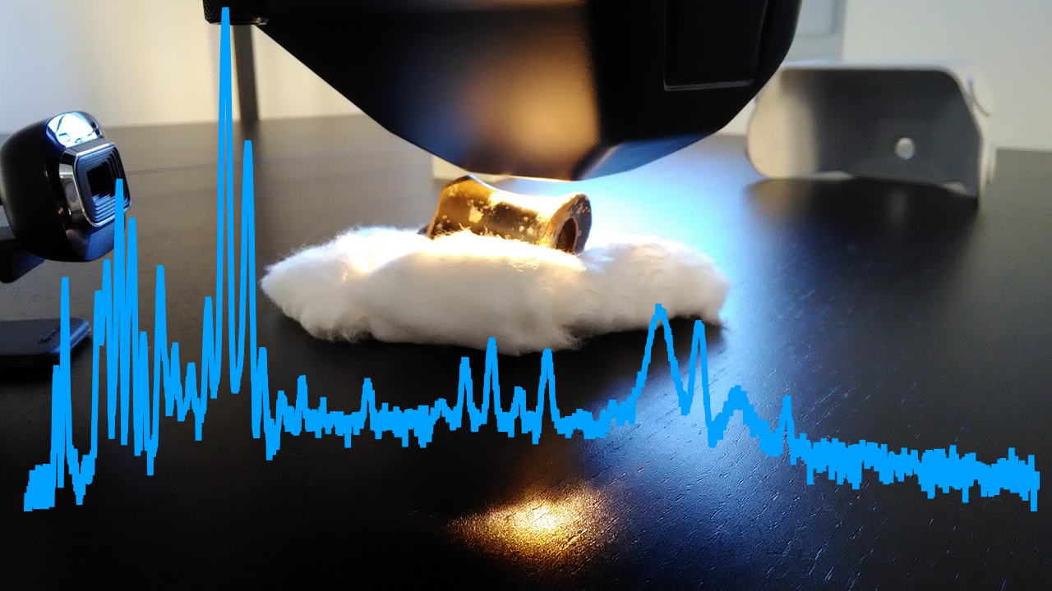
VIEWLAB:
Science and Cultural Heritage
Team:
Centro Fermi: G. Festa, F. Casali, F. Albertin, C. Scatigno, F. Coccetti, K. Piscicchia, M. Focaccia, F. Giove
Università di Bologna: M.P. Morigi, M. Bettuzzi, R. Brancaccio
Università Tor Vergata: R. Senesi
Giornate di Studio: Progetti del Centro Fermi 2020-2022, 11-12 December 2019

Slide 2
VIEWLAB:
Science and Cultural Heritage
A laboratory for the study of cultural heritage
@ Centro Fermi
Giornate di Studio: Progetti del Centro Fermi 2020-2022, 11-12 December 2019

Slide 3






VIEWLAB:
Science and Cultural Heritage
TRAINING AND DISSEMINATION
RESEARCH
R&D -Instrumentation
Measurements
on
Ancient Objects
TARGET
High School Student Internship (Altern. Scu. Lav. – ASL)
Visitors of the Centro Fermi Museum
THROUGH
Master and PhD Students (from Universities)
Fixed Instrumentation
Mobile Instrumentation
Students
Giornate di Studio: Progetti del Centro Fermi 2020-2022, 11-12 December 2019

Slide 4



VIEWLAB: Research
To solve archaeological and conservation problems
“Archaeometry: the use of science and modern technology in archaeology to examine and interpret archaeological remains” - Collins Dictionary
Application of scientific methods and technology to archaeological study.
Characterisation of materials: metals, woods, papers, bones, pottery, pigments, etc…
Why
How
Techniques under development at Centro Fermi:
Raman spectroscopy – AVAILABLE
X-ray fluorescence spectroscopy (XRF) – AVAILABLE
X-ray tomography – PLANNED
Fourier Infrared spectroscopy (FTIR) – PLANNED
What
Giornate di Studio: Progetti del Centro Fermi 2020-2022, 11-12 December 2019

Slide 5

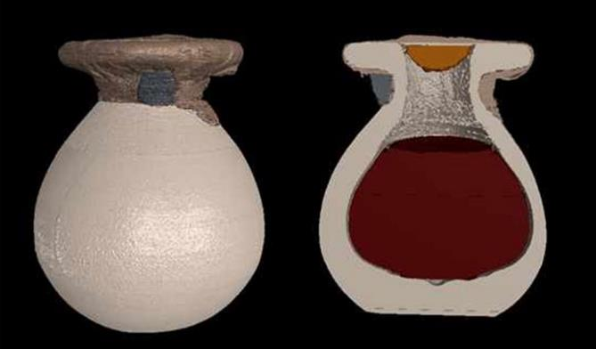
VIEWLAB:
Science and Cultural Heritage
ACCESS TO THE LARGE-SCALE FACILITIES FOR COMPLEMENTARY ANALYSIS
Neutron beams
Synchrotron radiation
Project for the construction of the distributed infrastructure ISIS@MACH
G. Festa et al, Angew. Chem. Int. Ed. 2018, 57, 1 – 6
I. Bukreeva et al, Scientific Reports 6:27227
Giornate di Studio: Progetti del Centro Fermi 2020-2022, 11-12 December 2019

Slide 6



VIEWLAB Activities
Giornate di Studio: Progetti del Centro Fermi 2020-2022, 11-12 December 2019

Slide 7
VIEWLAB 2019: Projects
«LILIBEO» PROJECT – IN PROGRESS
Agreement between Museo Archeologico Regionale di Lilibeo, University of Geneva and Centro Fermi – DONE
First experimental campaign in-situ (X-ray tomography) – DONE
First measurements of Lilibeo artifacts at Centro Fermi – DONE
First experimental campaign in-situ (XRF+ Raman) – PLANNED
Giornate di Studio: Progetti del Centro Fermi 2020-2022, 11-12 December 2019

Slide 8
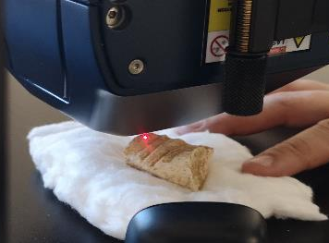
VIEWLAB 2019: Projects
«INVISIBLE COLOUR» PROJECT – FINANCED by European Physical Society (EPS)
IN PROGRESS
Invisible Colours will increase the visibility and active engagement of the general public with multidisciplinary scientific research activities at the Regional Archaeological Museum of Lilibeo - Baglio Anselmi
Giornate di Studio: Progetti del Centro Fermi 2020-2022, 11-12 December 2019

Slide 9
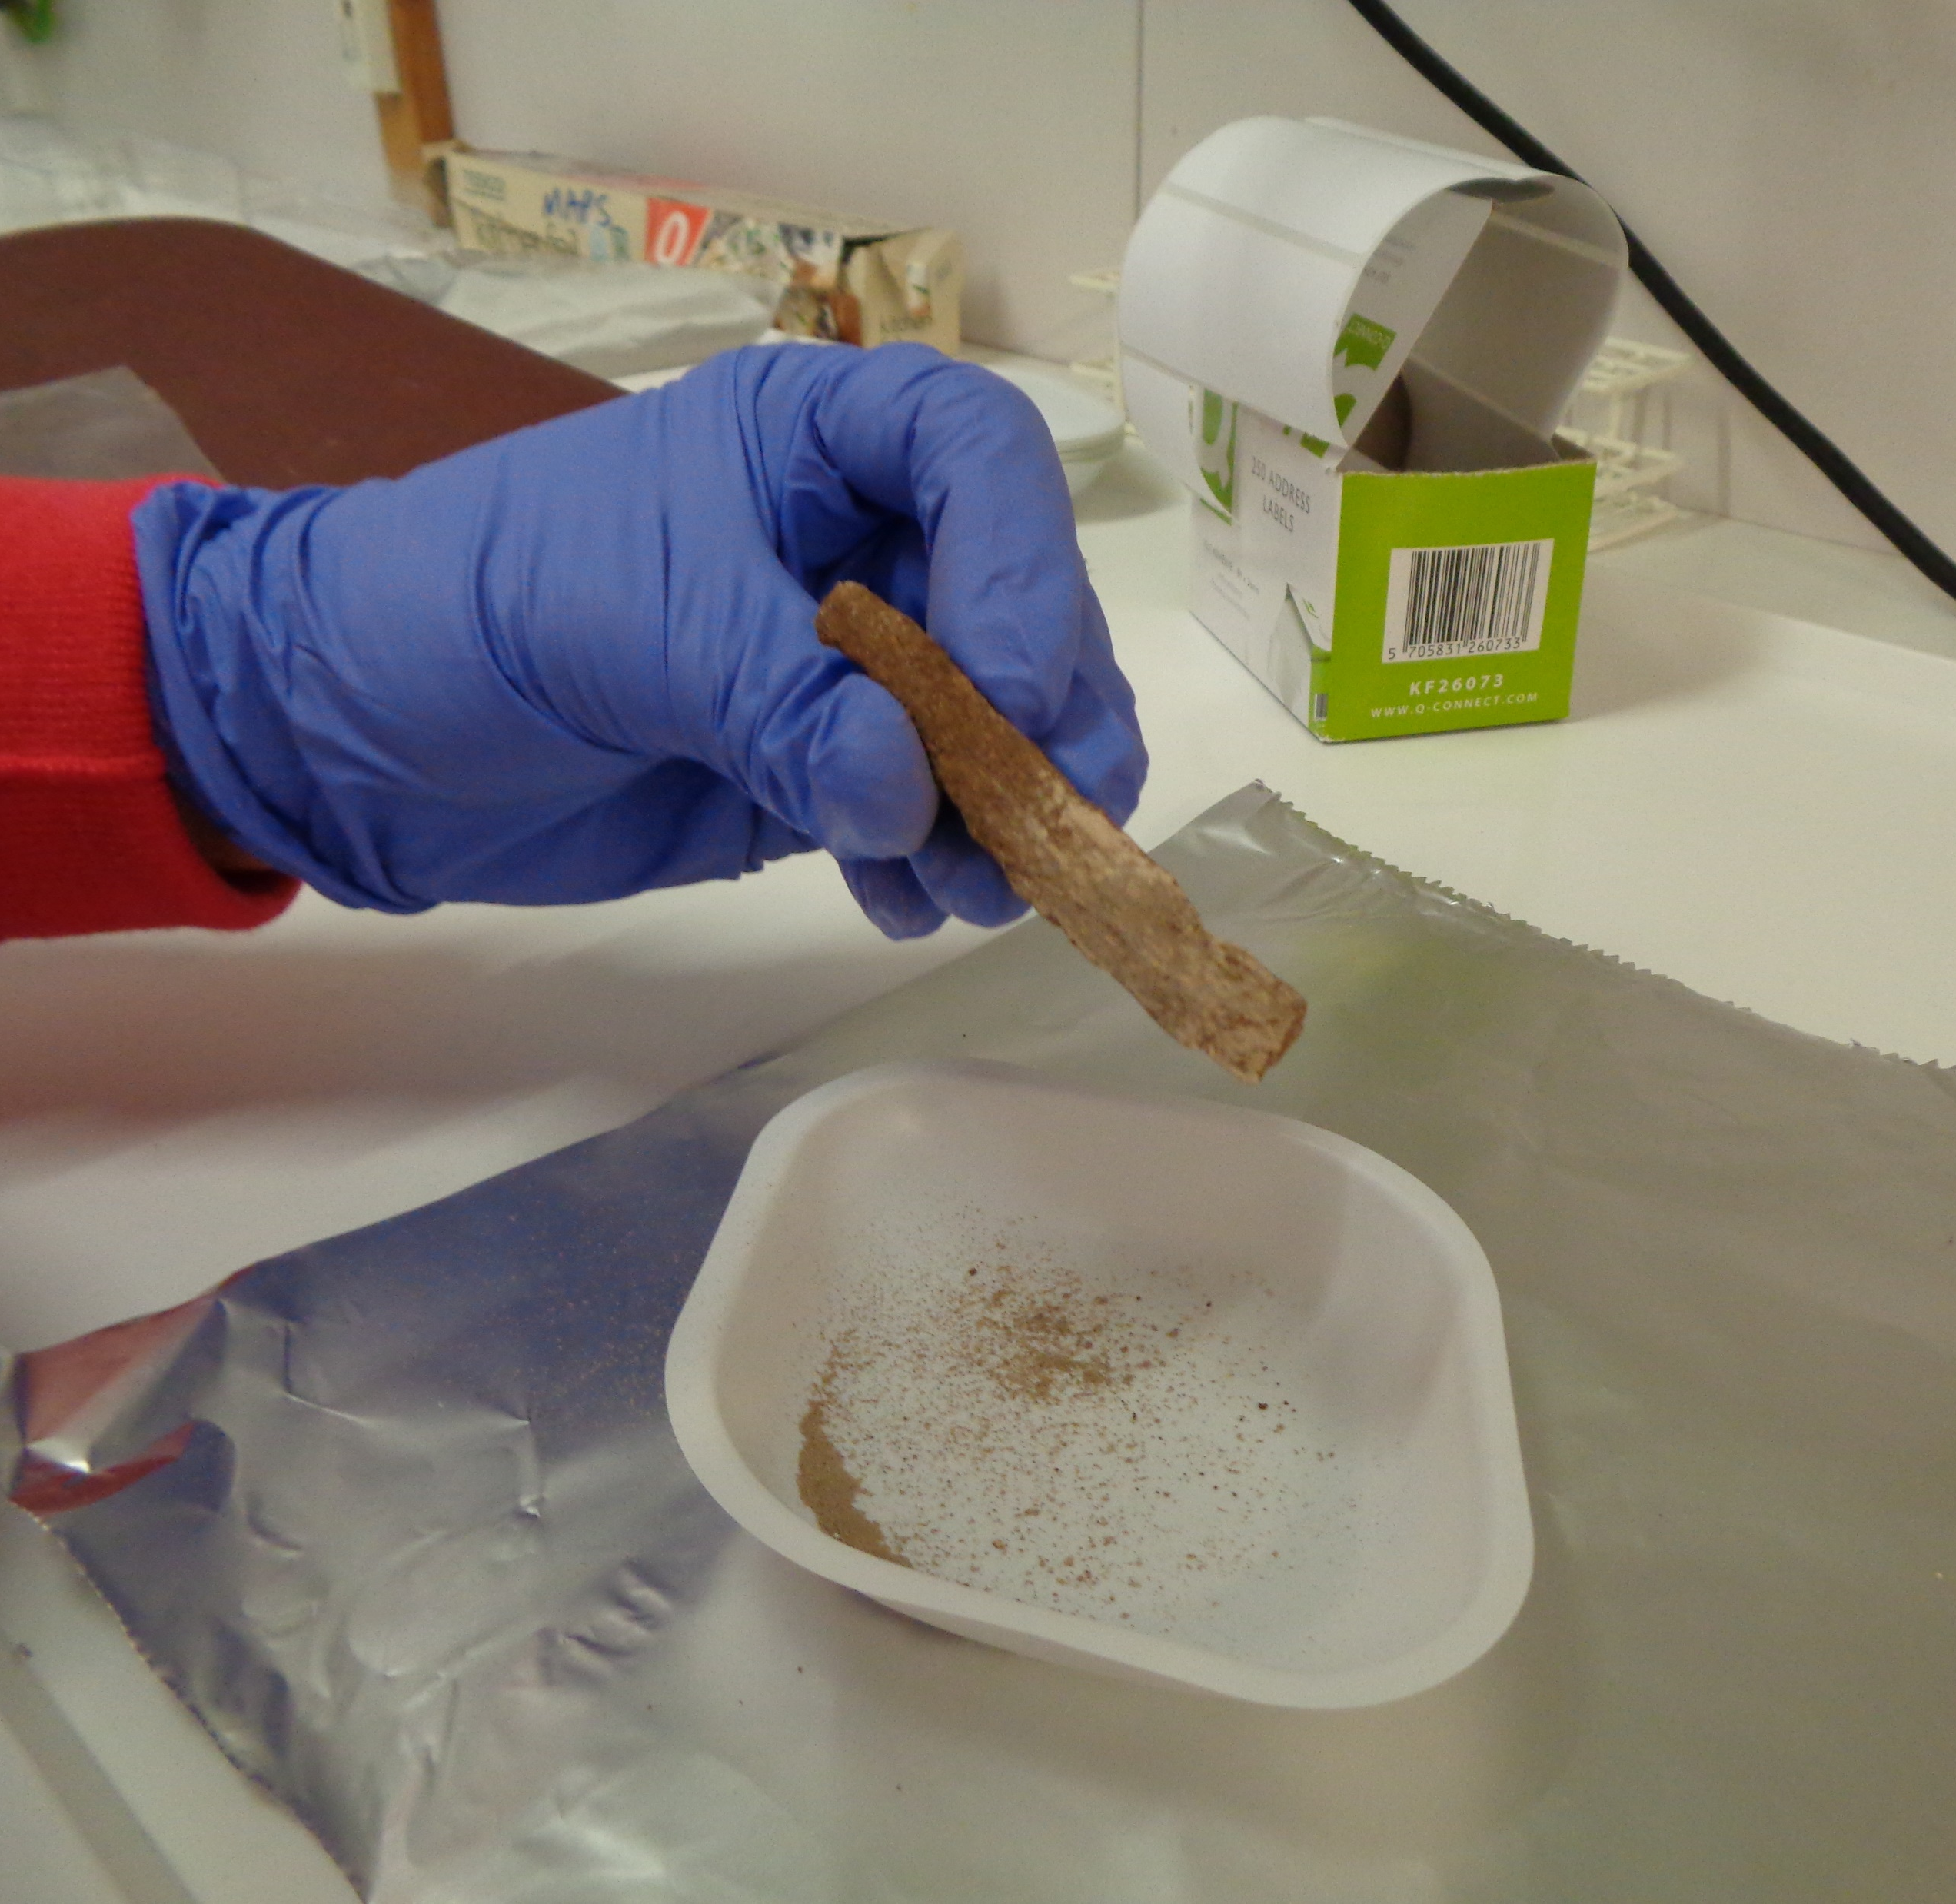
VIEWLAB 2019: Projects
ISIS@MACH (MAterials Characterisation Hub) PROJECT – FINANCED [PARTNERS: TOV (coord), Centro Fermi]
A new Research Infrastructure based in Italy, acting as a Hub of the UK based ISIS pulsed neutron and muon source. ISIS@MACH is a Research Infrastructure for carrying out multidisciplinary research at the nanoscale, enabling coordinated access of users to the infrastructures needed for different aspects of nanoscience research
New equipment for VIEWLAB is planned (X-ray tomograph, FTIR, data analysis hardware and software)
Giornate di Studio: Progetti del Centro Fermi 2020-2022, 11-12 December 2019

Slide 10
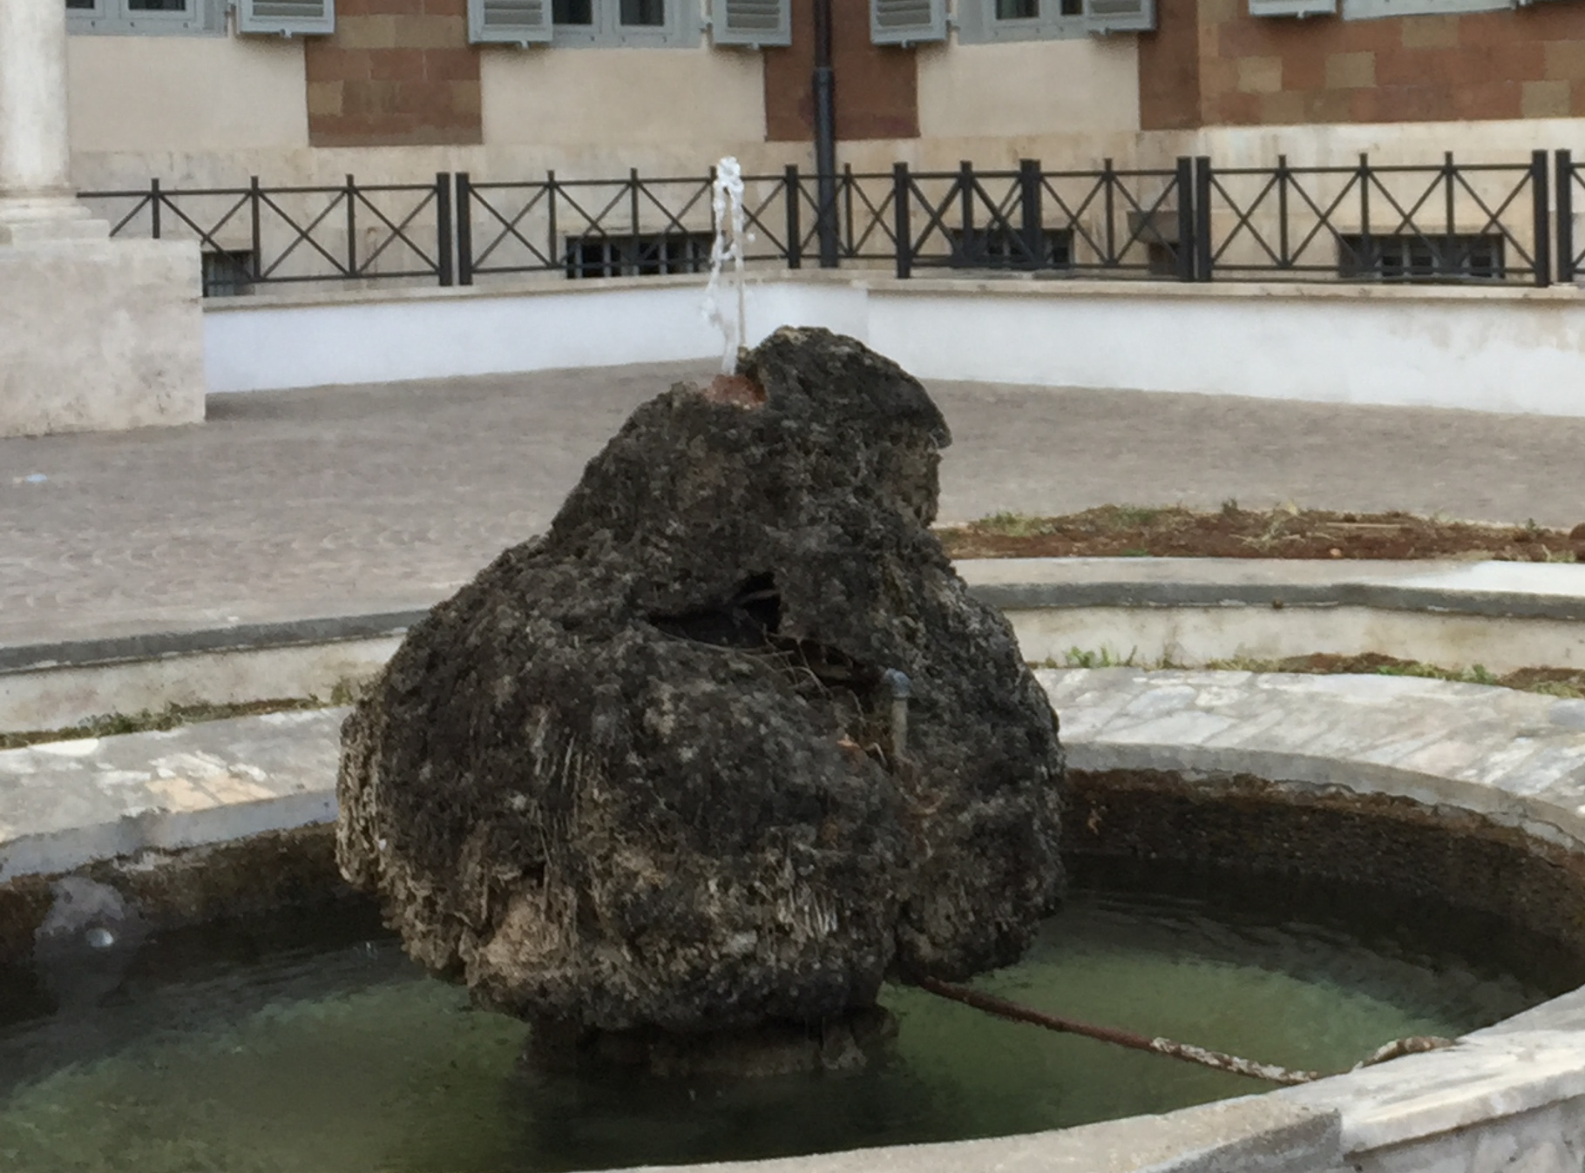
VIEWLAB 2019: Projects
In the framework of the Museum activities
VEROSH – Virtual EploRation Of Science History. Regione Lazio project for “Virtual Imaging to better understand the history of the via Panisperna Historical building, interacting with avatars of the most important people who worked at the Institute of Physics.”
PARTNER: Centro Fermi - in contact with the Scuola Normale Superiore (Pisa) for technical aspects.
FRAMEWORK: bando Regione Lazio “Tecnologie per la valorizzazione del patrimonio culturale” del Distretto Tecnologico per le nuove Tecnologie (DTC) applicate ai Beni e alle attività Culturali.
Waiting news
Giornate di Studio: Progetti del Centro Fermi 2020-2022, 11-12 December 2019

Slide 11

VIEWLAB Activities
Giornate di Studio: Progetti del Centro Fermi 2020-2022, 11-12 December 2019

Slide 12
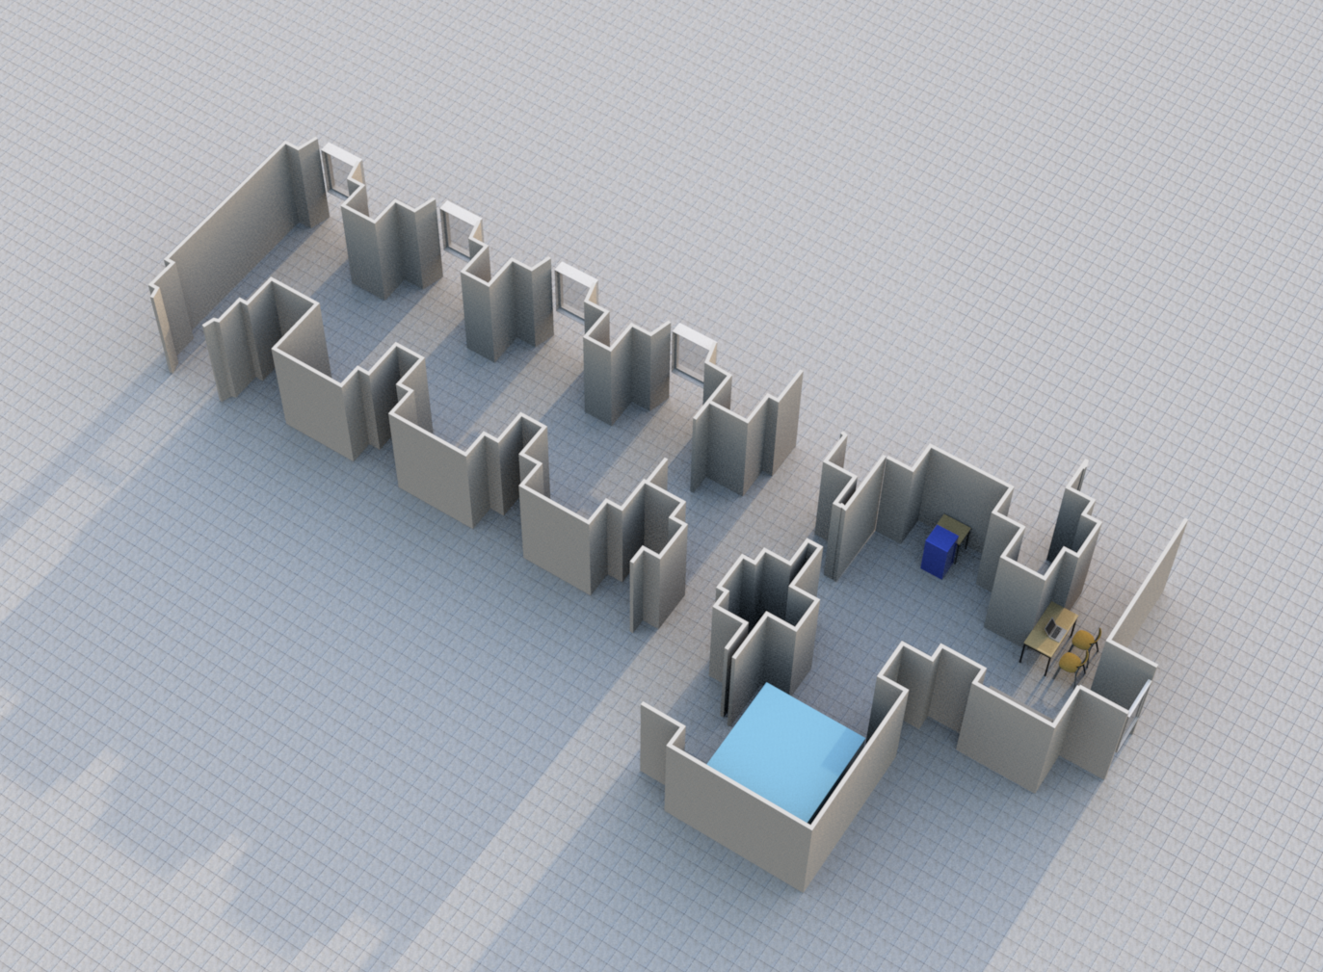
VIEWLAB:
Development of the laboratory
Dissemination and
control room
XRF Raman
X-Ray tomograph
Giornate di Studio: Progetti del Centro Fermi 2020-2022, 11-12 December 2019

Slide 13
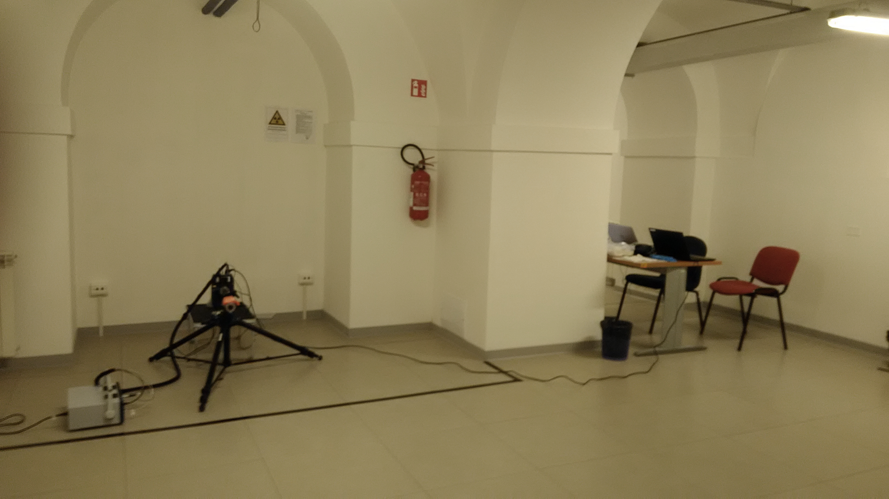
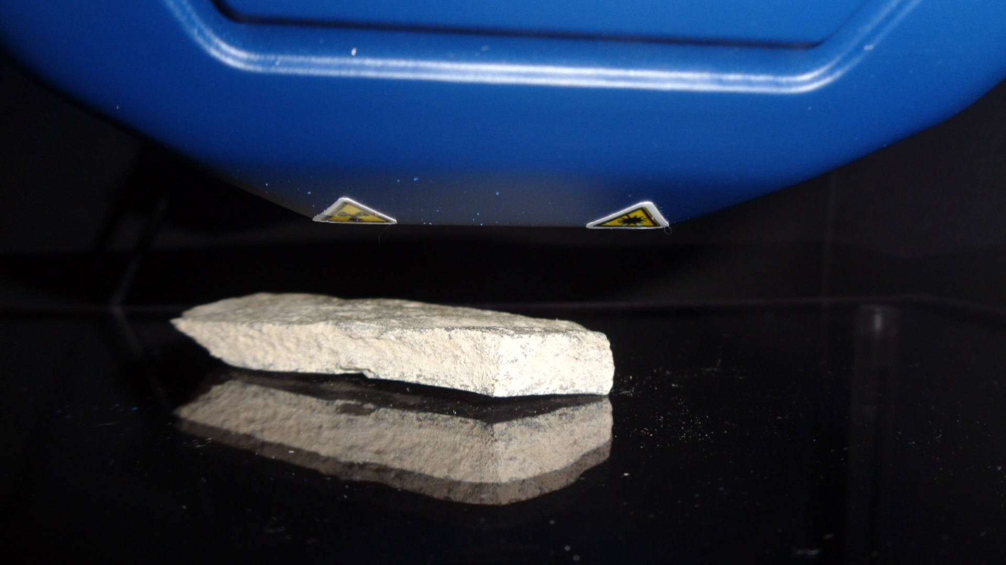
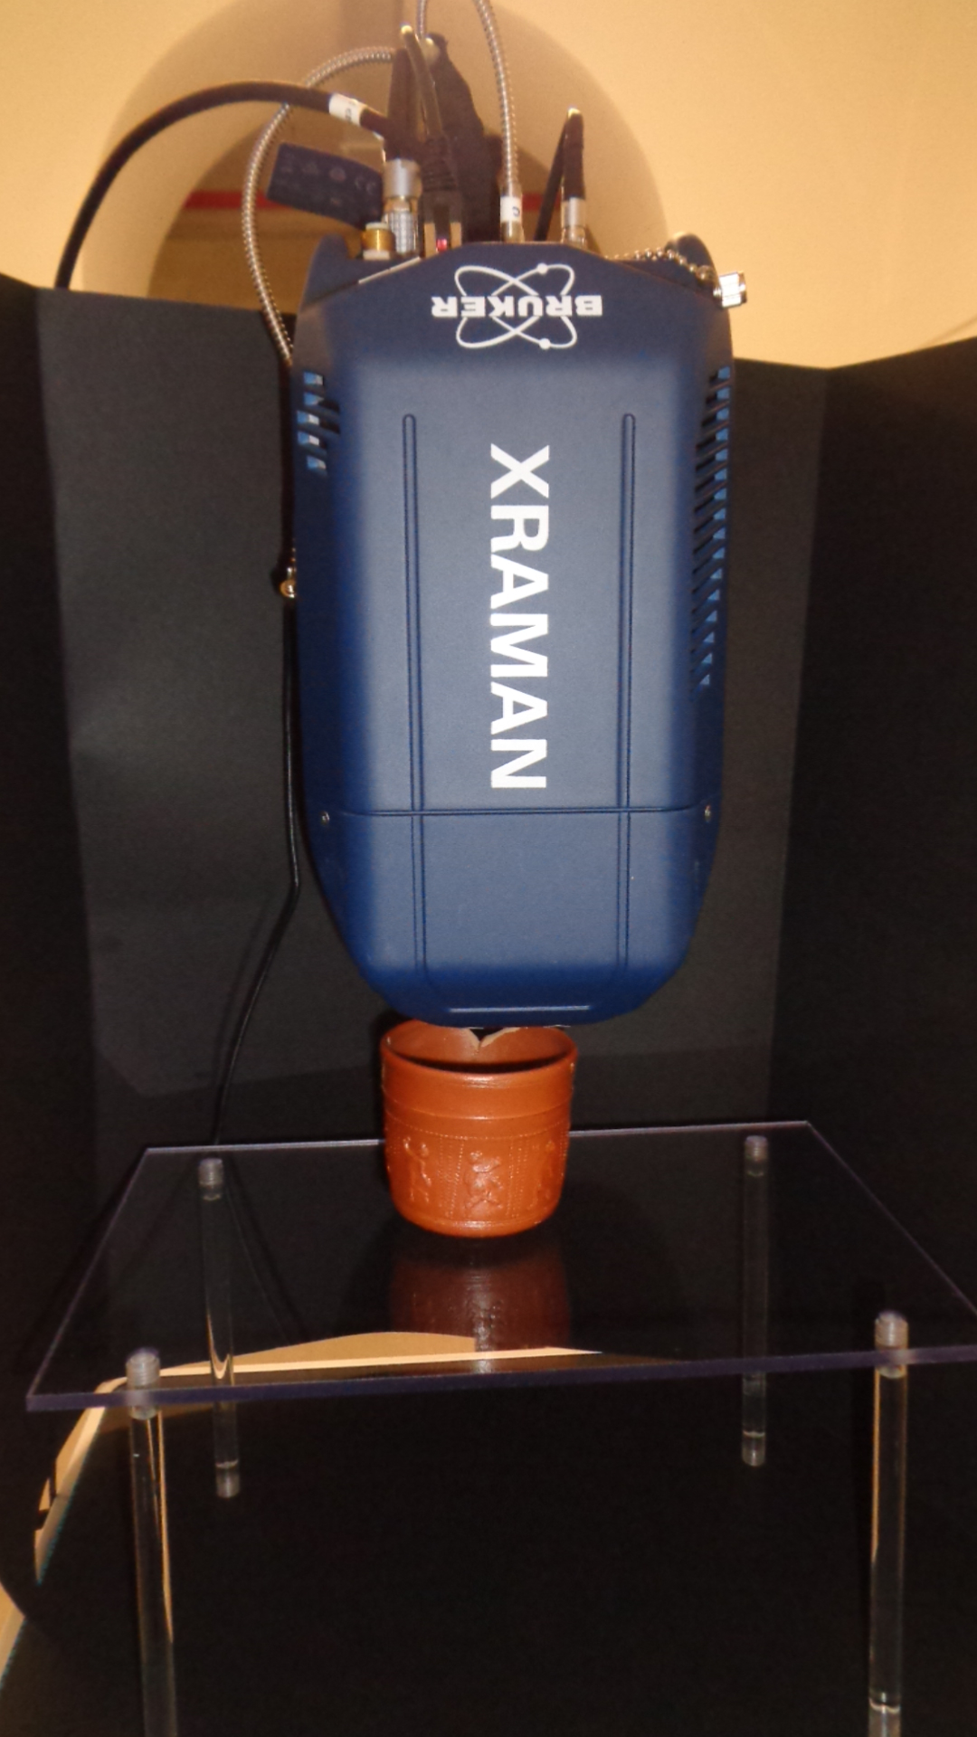
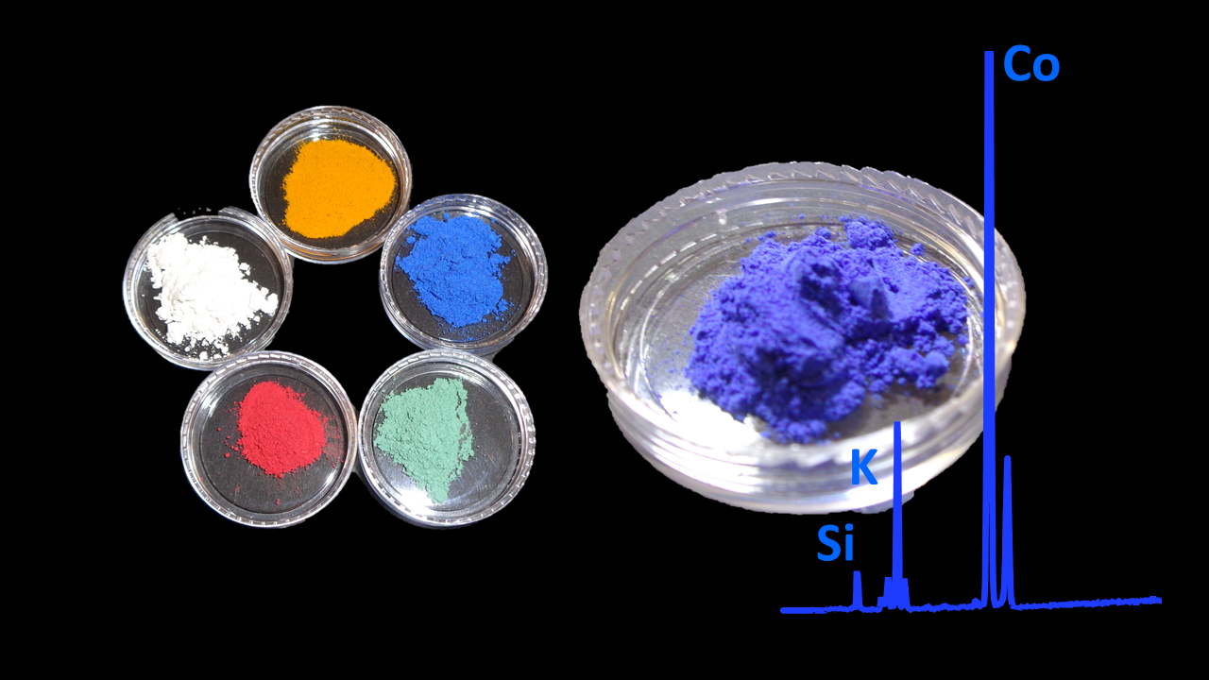
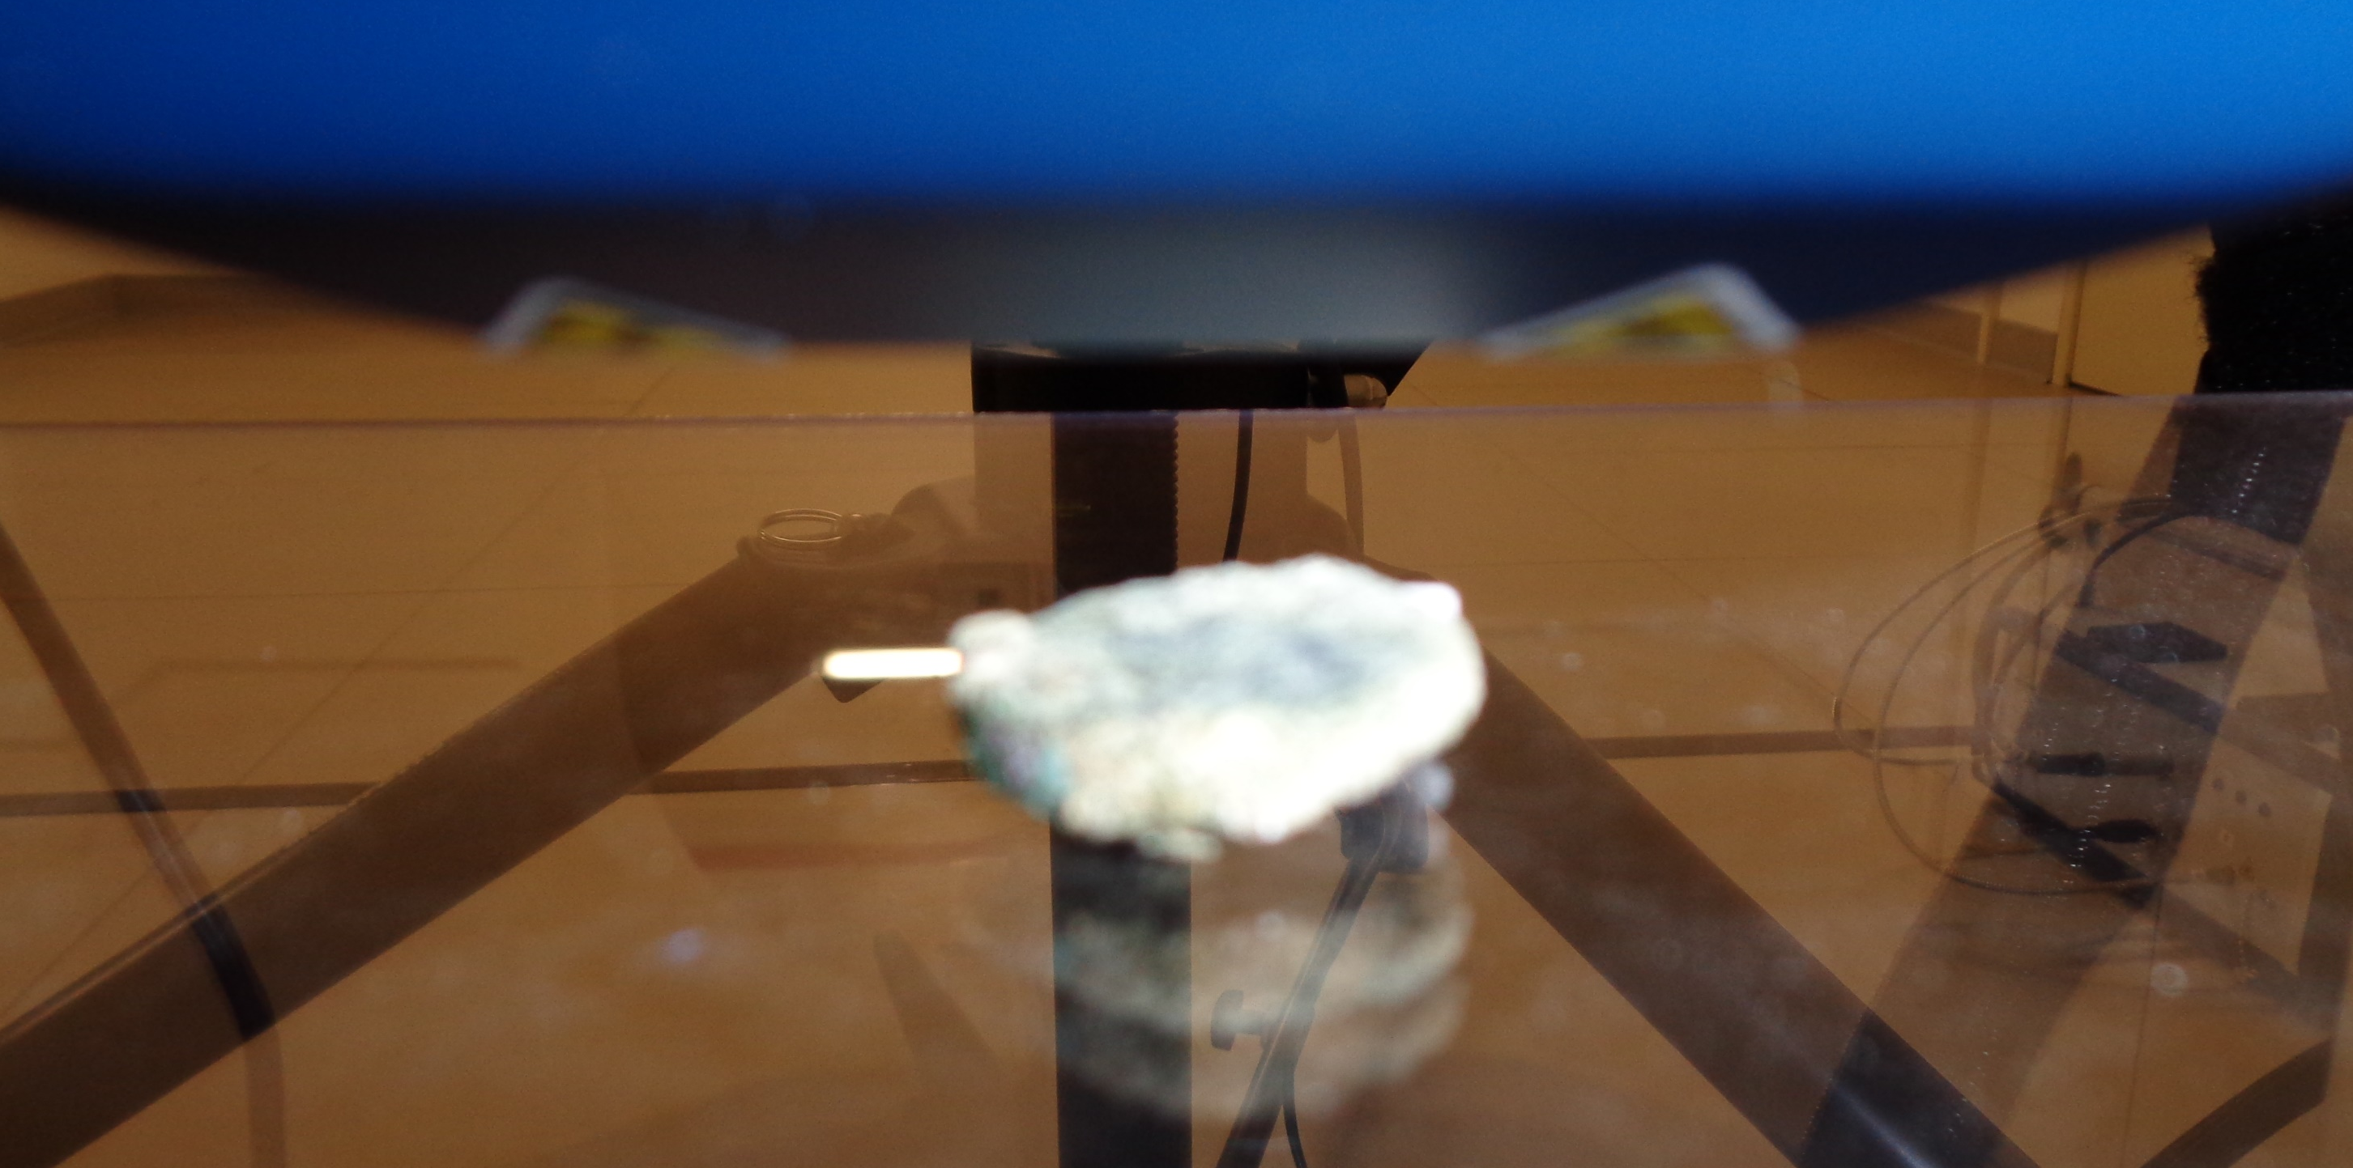
VIEWLAB:
Science and Cultural Heritage
Giornate di Studio: Progetti del Centro Fermi 2020-2022, 11-12 December 2019

Slide 14

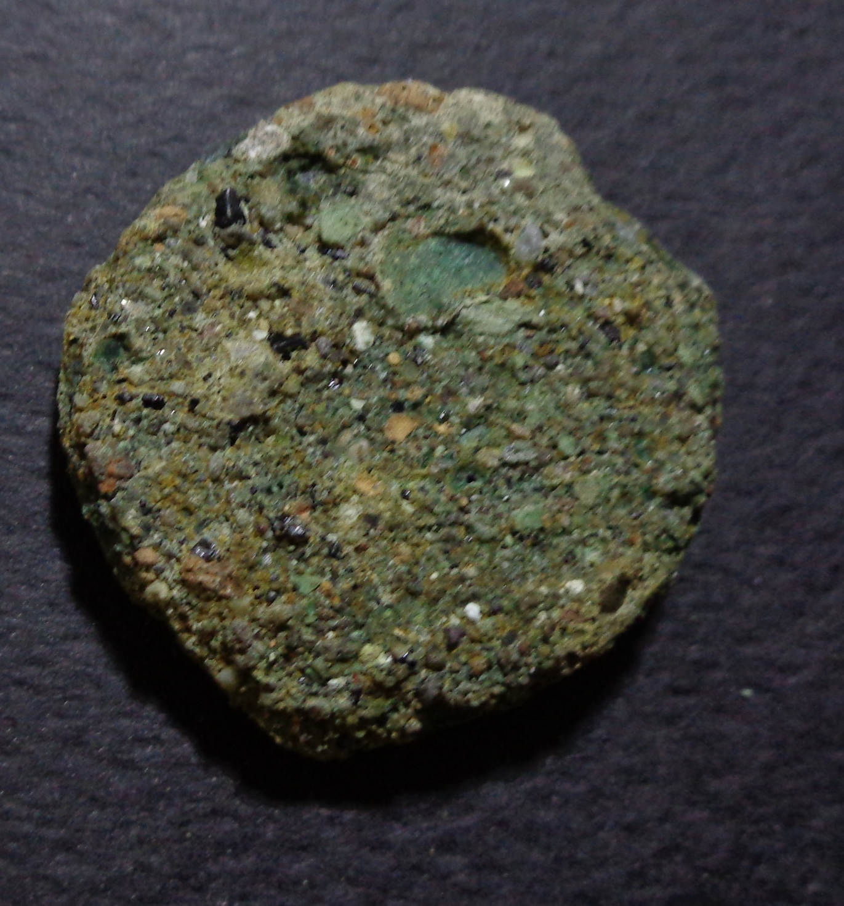
VIEWLAB:
DEVELOPMENT OF THE LABORATORY
Milestones reached in 2019:
Radioprotection issues (Xraman at the Centro Fermi) – DONE
Radioprotection issues (Xraman outside the Centro Fermi) – completed at 95%
Testing of the instrumentation and set-up optimisation – DONE
Cabinet design (tomography) – 95%

Slide 15
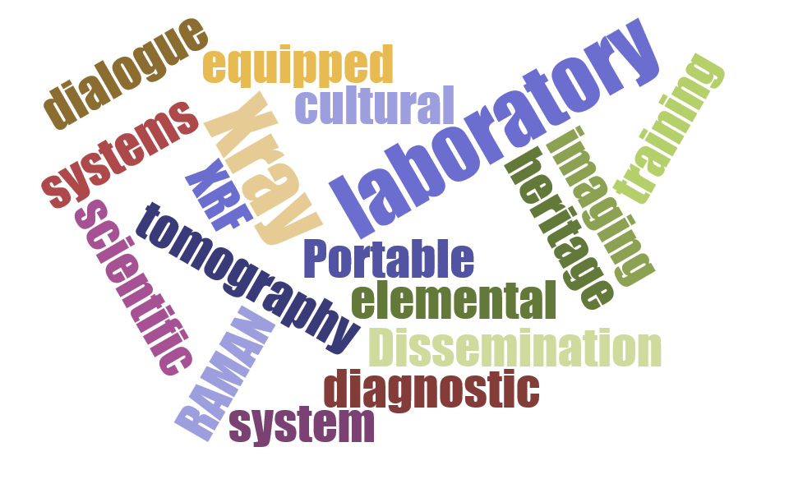
VIEWLAB:
DEVELOPMENT OF THE LABORATORY
Plan of activities 2020-2022:
Radioprotection issues (use outside the Centro Fermi)
Activities about instrumentation within the ISIS@MACH project:
Development of the X-Ray tomography
Acquisition and testing of the FTIR
Acquisition and testing of the data analysis hardware and software
Giornate di Studio: Progetti del Centro Fermi 2020-2022, 11-12 December 2019

Slide 16

VIEWLAB Activities
Giornate di Studio: Progetti del Centro Fermi 2020-2022, 11-12 December 2019

Slide 17
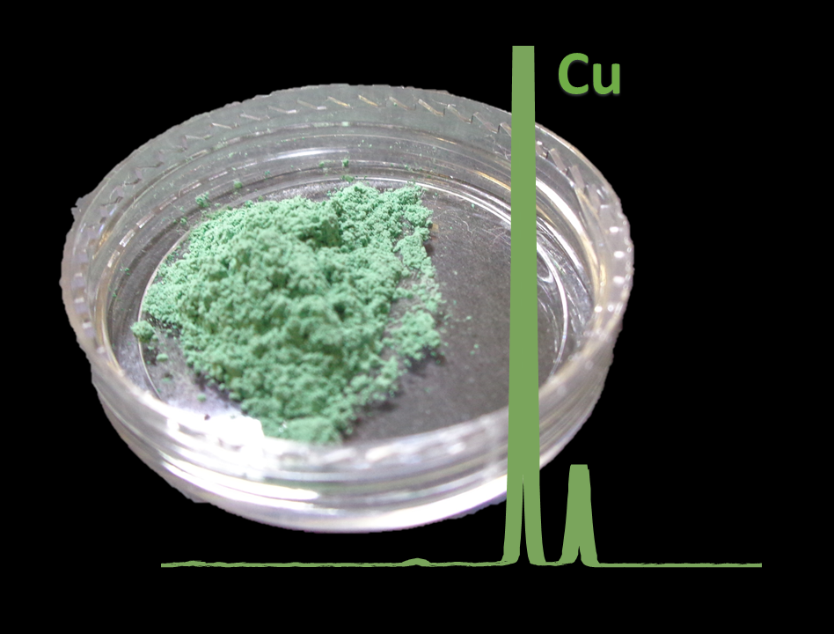
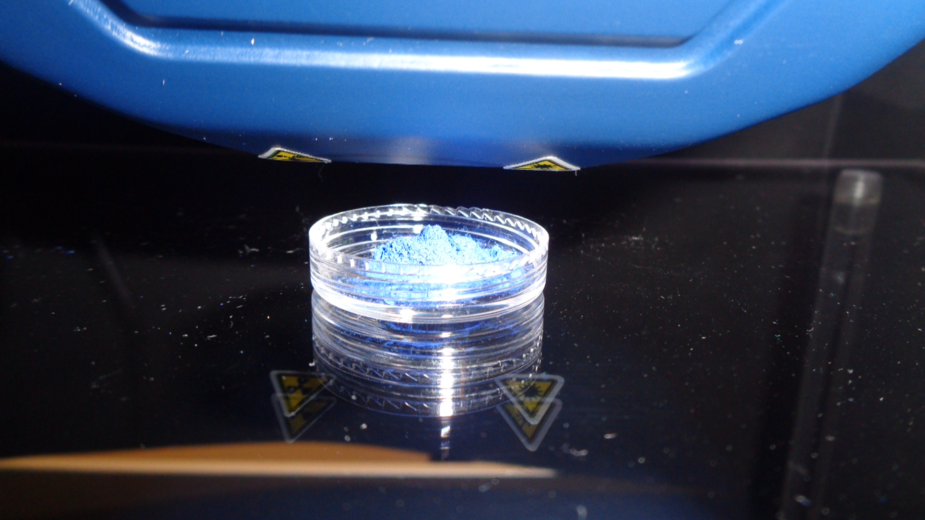
VIEWLAB:
RESEARCH
Milestones reached in 2019:
Measurements of materials (metals, ceramics, stones, powders, etc…) – DONE
Measurements of real case objects – DONE
Roman coins
Punic glass vases
Punic coloured artifacts
Giornate di Studio: Progetti del Centro Fermi 2020-2022, 11-12 December 2019

Slide 18
VIEWLAB:
RESEARCH
Plan of activities 2020-2022:
Systematic characterisation of the XRF/Raman performances through the analysis of standard samples
New measurements of materials and real cases
Construction of the own databases for the XRF and Raman instrumentation
Activation of new collaborations with Museums
Giornate di Studio: Progetti del Centro Fermi 2020-2022, 11-12 December 2019

Slide 19

VIEWLAB Activities
Giornate di Studio: Progetti del Centro Fermi 2020-2022, 11-12 December 2019

Slide 20
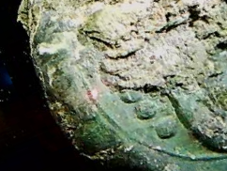
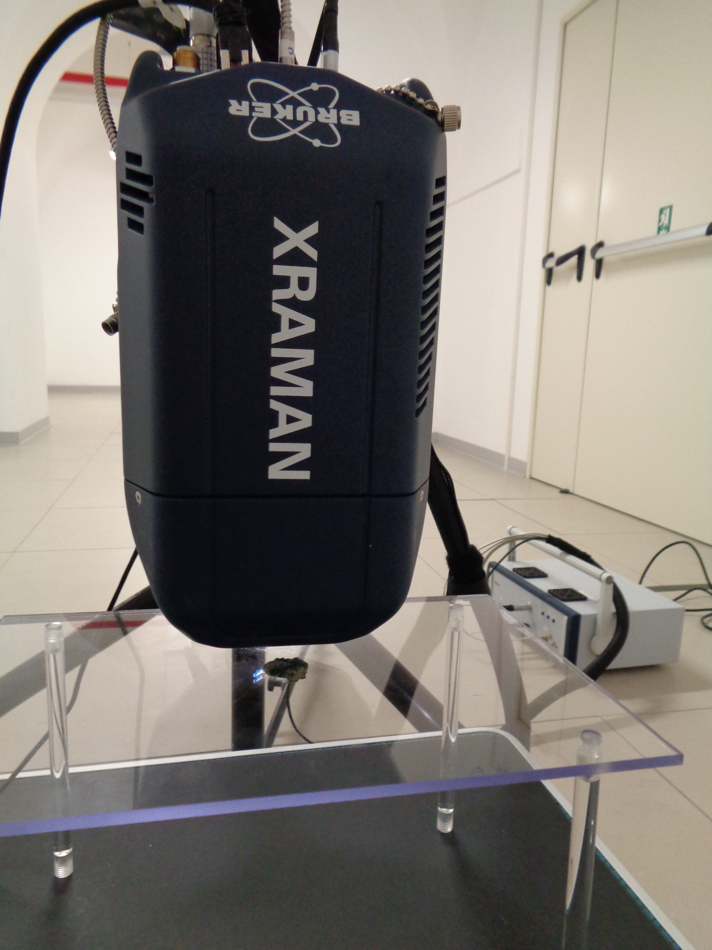
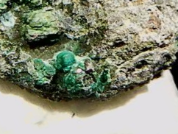
VIEWLAB:
TRAINING ACTIVITIES AND OUTREACH
Milestones reached in 2019:
First master student of the University of Bologna – XRF training and measurements on roman coins
Giornate di Studio: Progetti del Centro Fermi 2020-2022, 11-12 December 2019

Slide 21
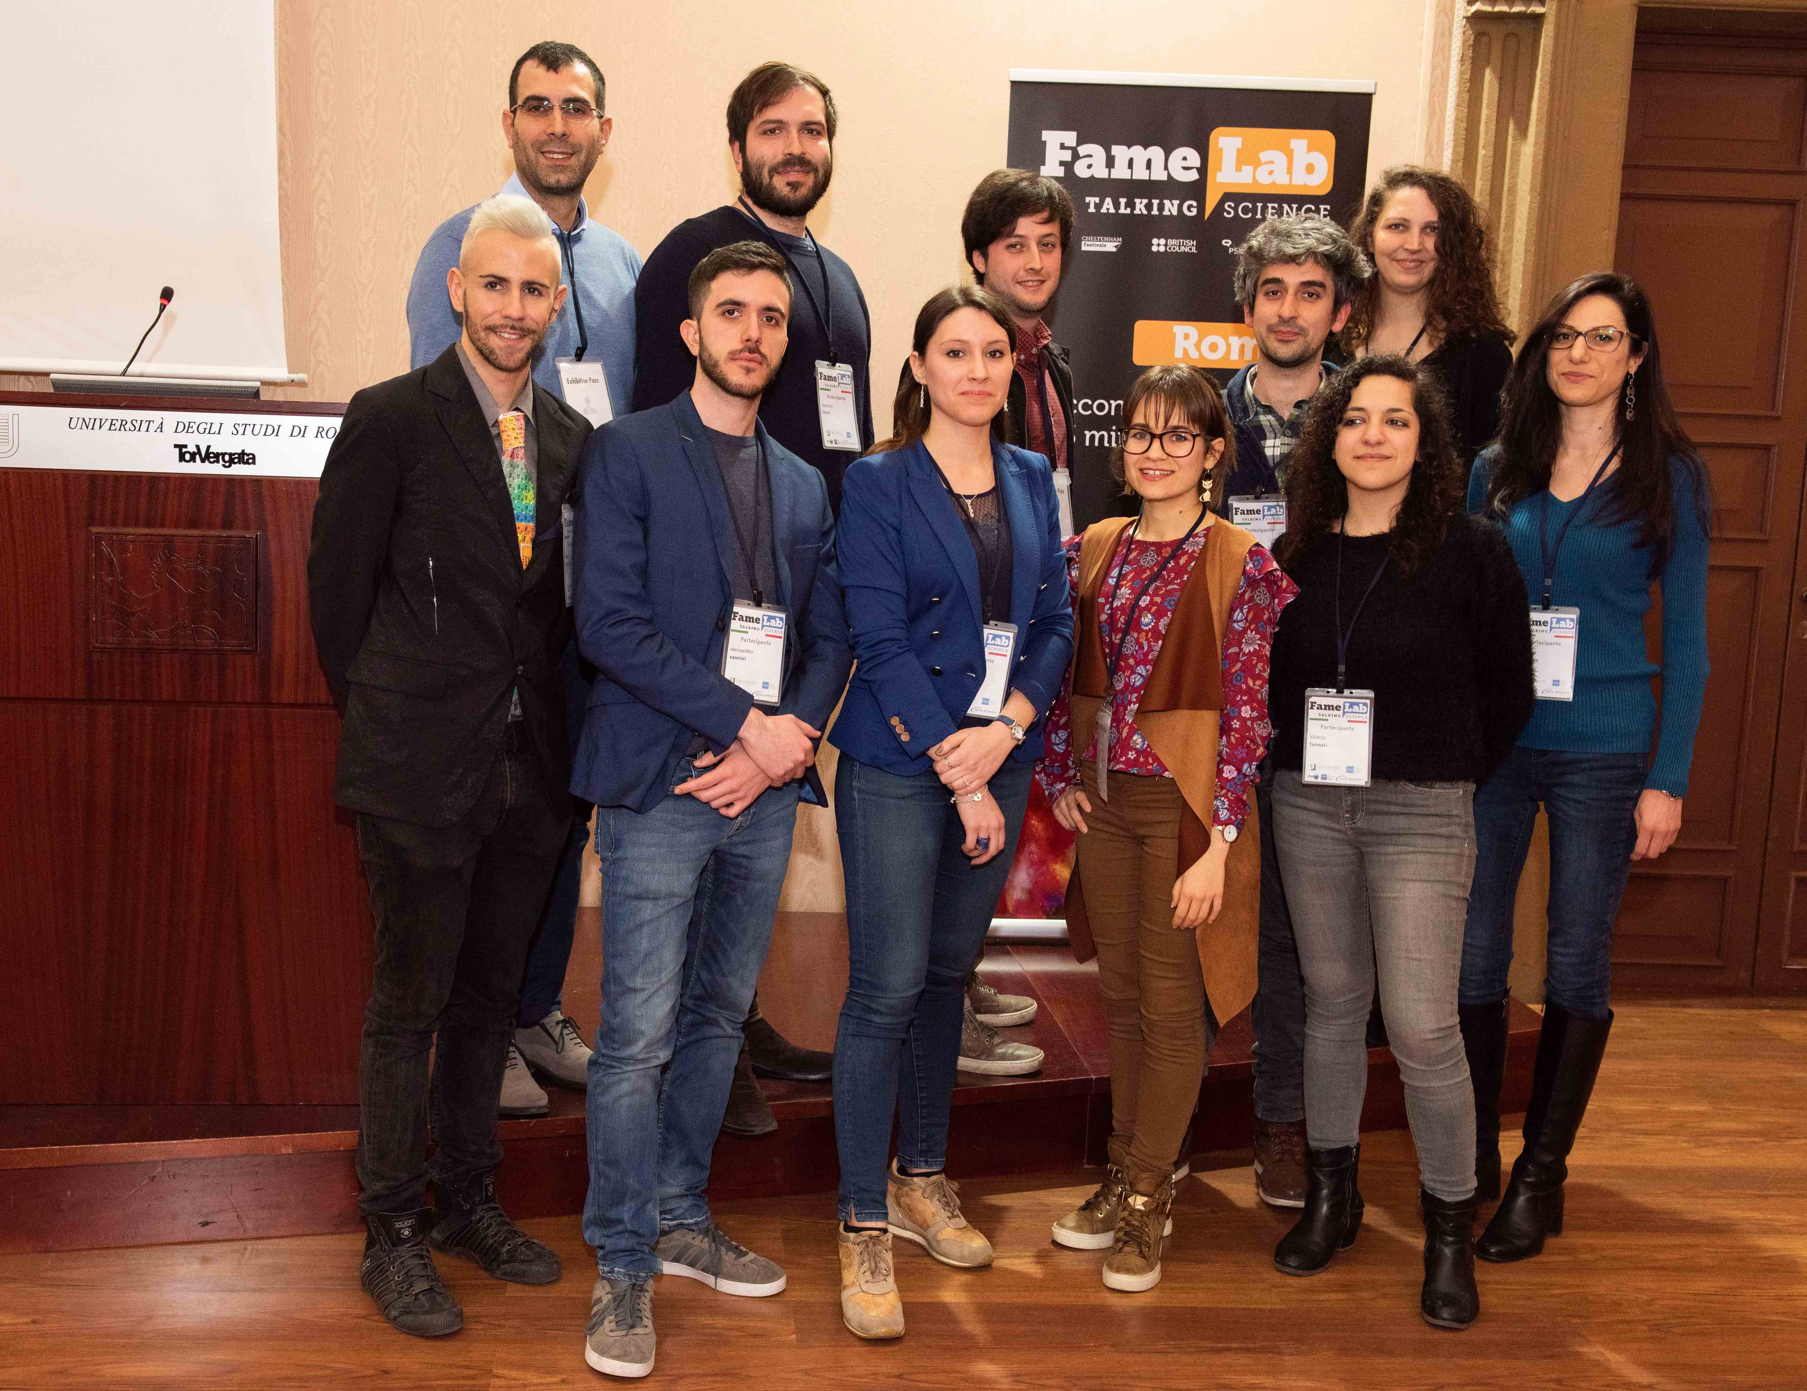
VIEWLAB:
TRAINING ACTIVITIES AND OUTREACH
Milestones reached in 2019:
FAMELAB 2019 (Rome, local selection) – organisation of the event [PARTNERS: TOV(coord), Centro Fermi, INFN, AiRI]
“FameLab is the world’s leading science communication competition. Participants have just three minutes to win over the judges and crowd with a scientific talk that excels for its content, clarity and charisma. If you are a scientist, researcher or university student and would like to put your talent as a communicator to the test, then take part in FameLab.”
Giornate di Studio: Progetti del Centro Fermi 2020-2022, 11-12 December 2019

Slide 22

VIEWLAB:
TRAINING ACTIVITIES AND OUTREACH
Plan of activities 2020-2022:
Training activities for PhD and master students from universities
First visitors of the Museum at VIEWLAB (January - February 2020)
Archaeometry conference at Centro Fermi in 2020 (in collaboration with Alessia Mistretta)
Summer school at Erice about “Analytical Probing with Neutrons”
Giornate di Studio: Progetti del Centro Fermi 2020-2022, 11-12 December 2019

Slide 23
The LILIBEO PROJECT
The pilot project of the
VIEWLAB laboratory
Giornate di Studio: Progetti del Centro Fermi 2020-2022, 11-12 December 2019

Slide 24

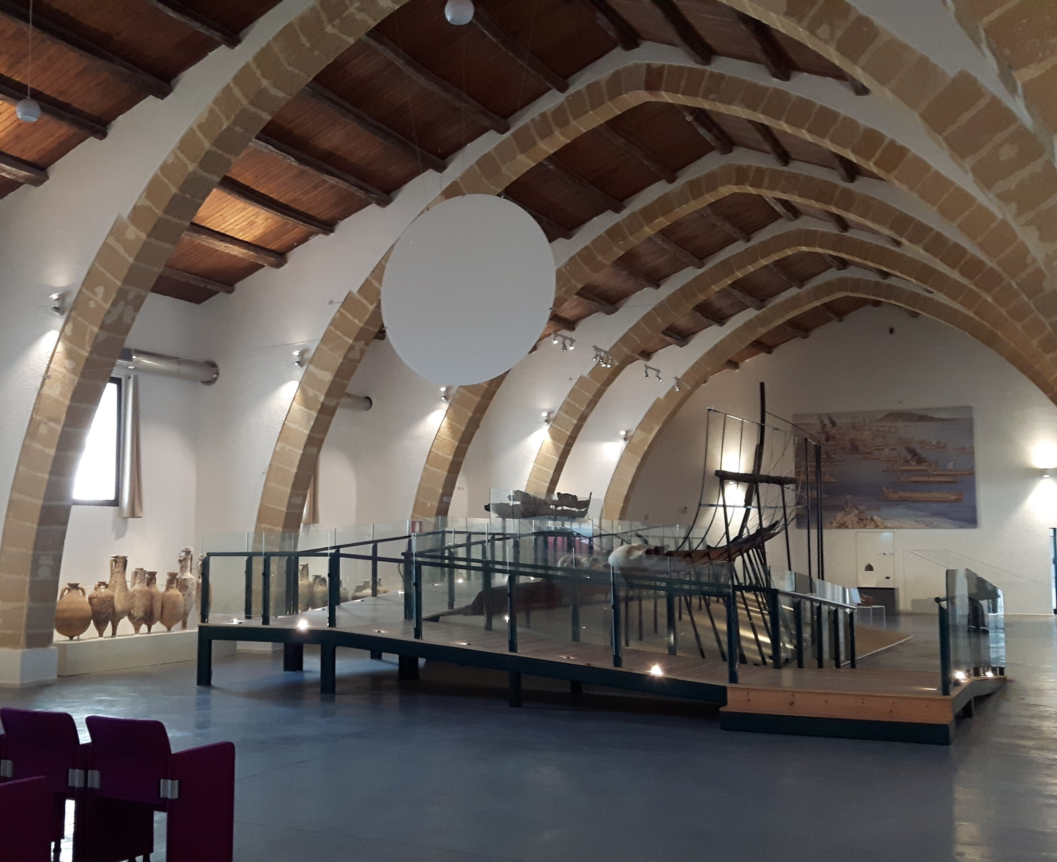
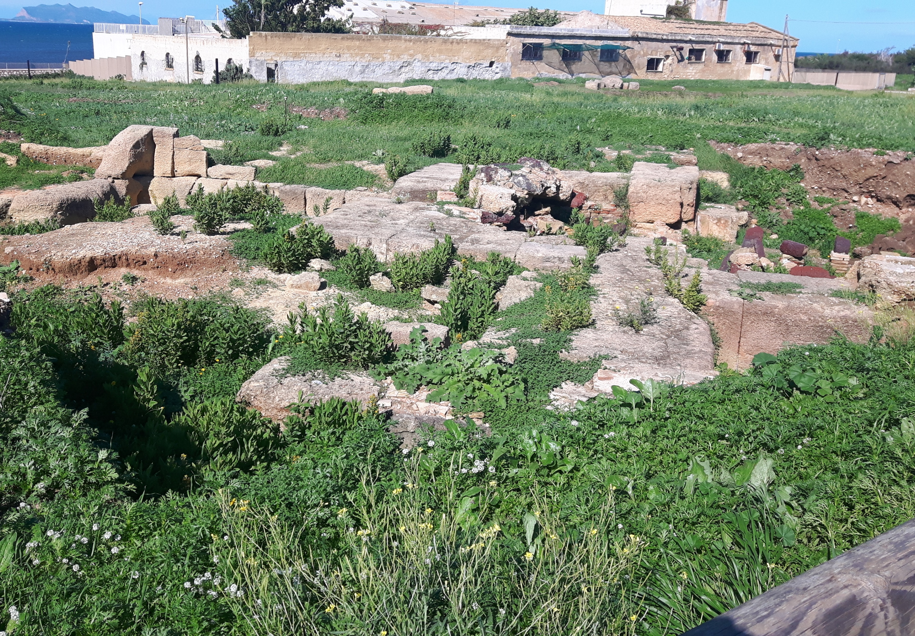

The LILIBEO PROJECT
Within the research agreement between Museo Archeologico Regionale di Lilibeo, University of Geneva and Centro Fermi
Archaeological excavations
(Univ. of Geneva)
Museo Archeologico
Regionale Lilibeo
Lilibeo Museum
Giornate di Studio: Progetti del Centro Fermi 2020-2022, 11-12 December 2019

Slide 25
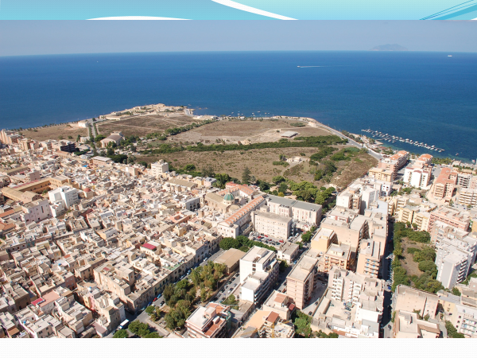
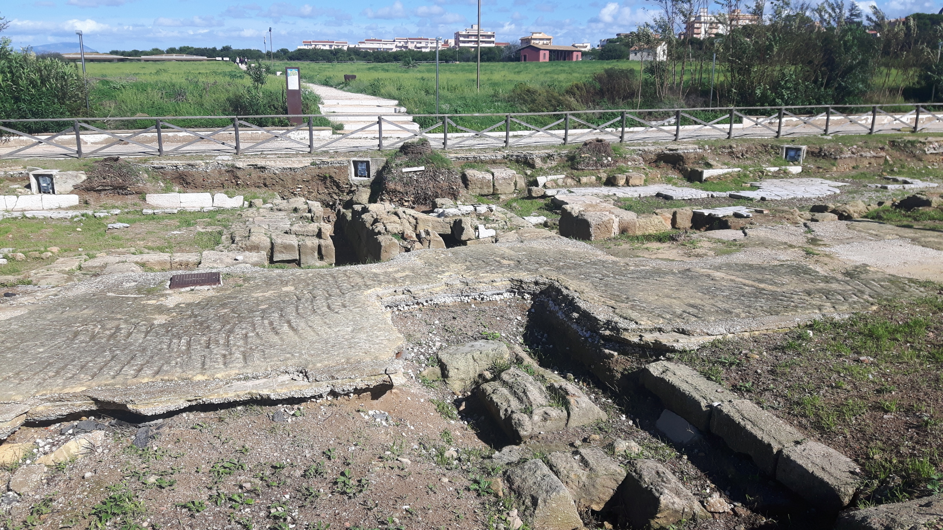
LILIBEO archaeological site
Lilibeo was founded by the Punic exiles from the Mothia island (according to the testimony of Diodoro), destroyed by Dionysius of Syracuse in 397 BC
Lilibeo, thanks to its strategic position in the Mediterranean, assumed great importance in the centuries
The LILIBEO PROJECT
Giornate di Studio: Progetti del Centro Fermi 2020-2022, 11-12 December 2019

Slide 26

LILIBEO PROJECT
URBAN AND FUNERARY ARCHAEOLOGY
MARINE ARCHAEOLOGY
MA
UFA
Giornate di Studio: Progetti del Centro Fermi 2020-2022, 11-12 December 2019

Slide 27
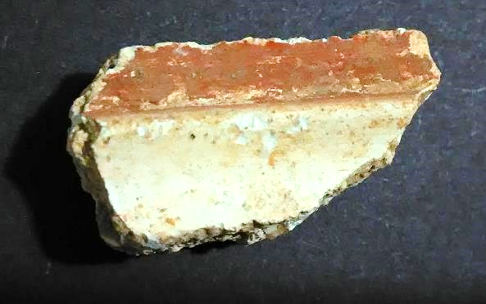
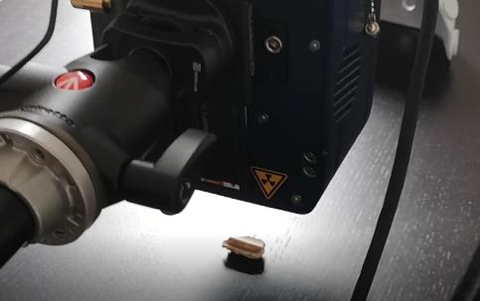
UFA
The LILIBEO PROJECT
Ca
Fe
K
PL US104 N.11994
S
Compton
Si
Sr
Rh
Ti
As
XRF spectra of a plasterwork
Giornate di Studio: Progetti del Centro Fermi 2020-2022, 11-12 December 2019

Slide 28
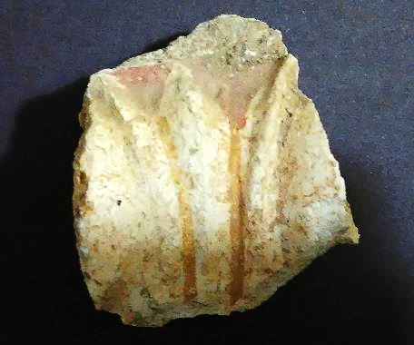
UFA
The LILIBEO PROJECT
Preliminary results:
Red areas: As, S, Si/P, Al, Cu, Fe, Mn, Ti, Sr, Ca, K , Mg
White areas: S, Si, Fe, Ti, Sr, Ca, K
Red: Fe-oxides, Ti and As
White: based on calcium carbonate (CaCO₃)
Giornate di Studio: Progetti del Centro Fermi 2020-2022, 11-12 December 2019

Slide 29
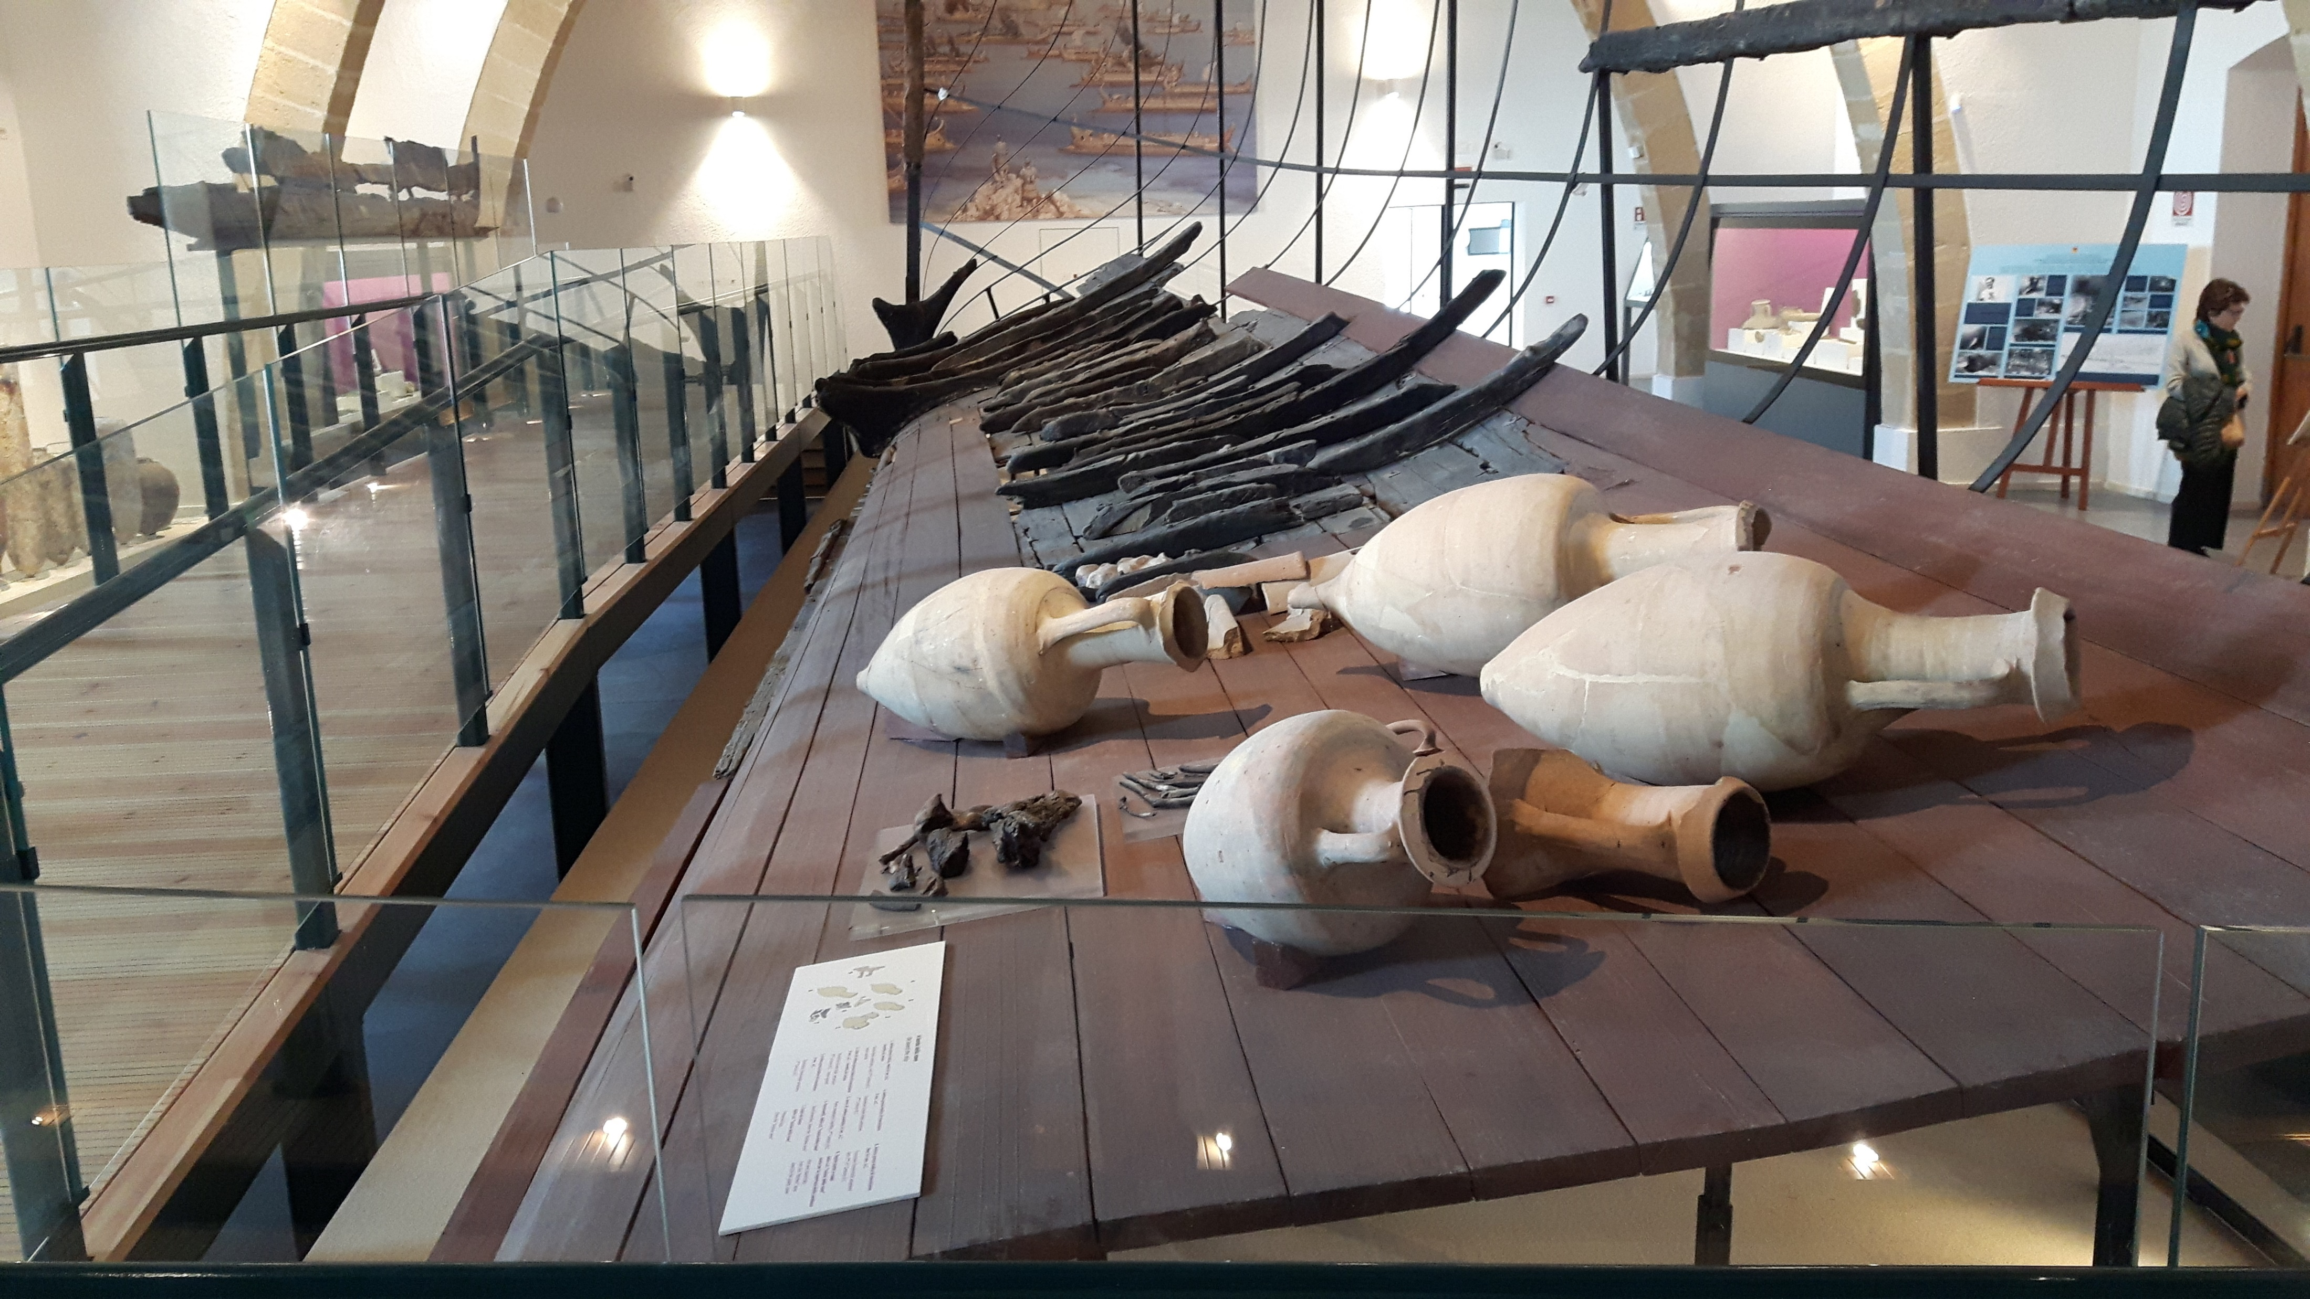
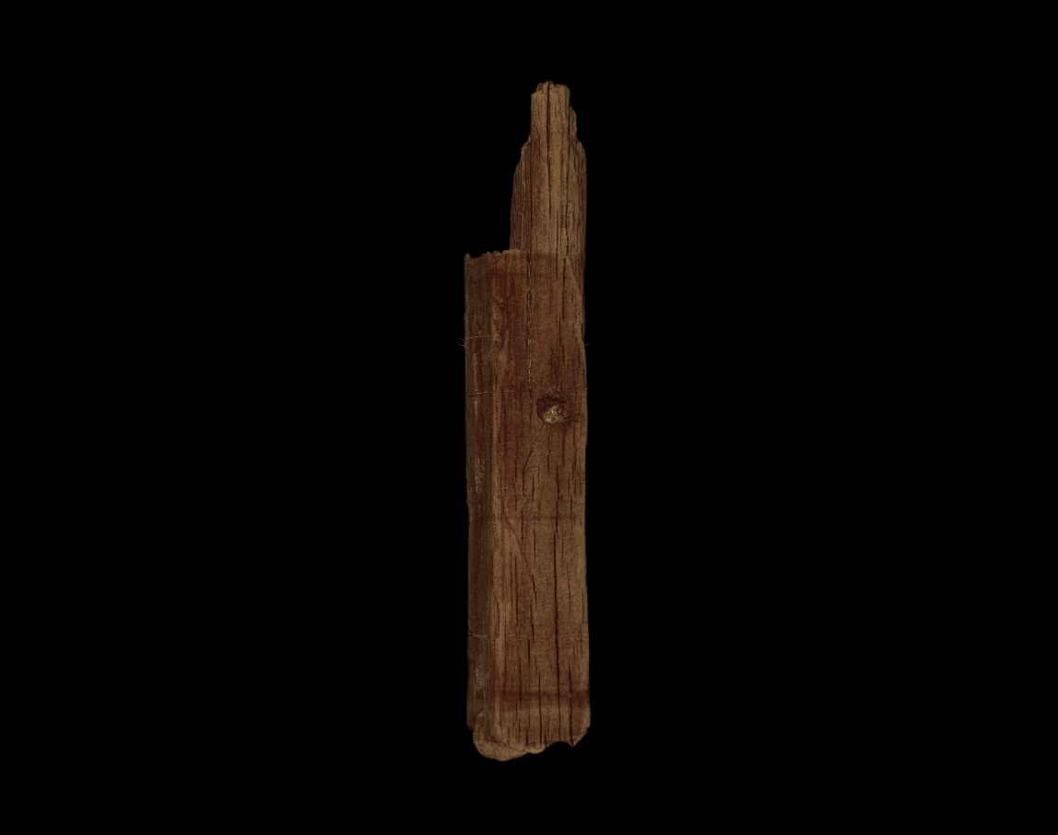
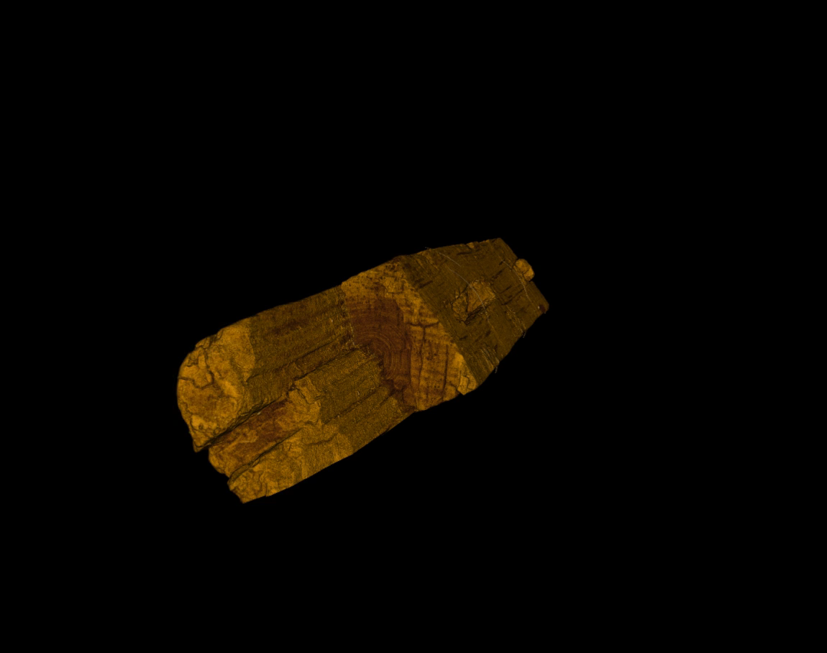
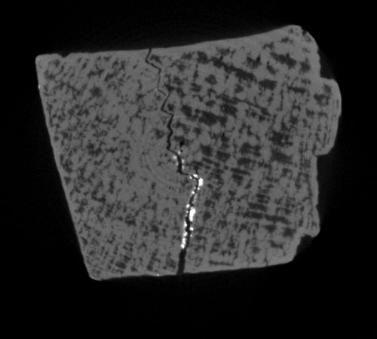
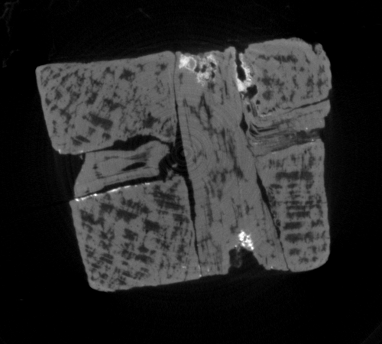
MA
The LILIBEO PROJECT
Tomography of a fragment of the Punic ship
Tomography - Bologna instrumentation TTRX
Giornate di Studio: Progetti del Centro Fermi 2020-2022, 11-12 December 2019

Slide 30
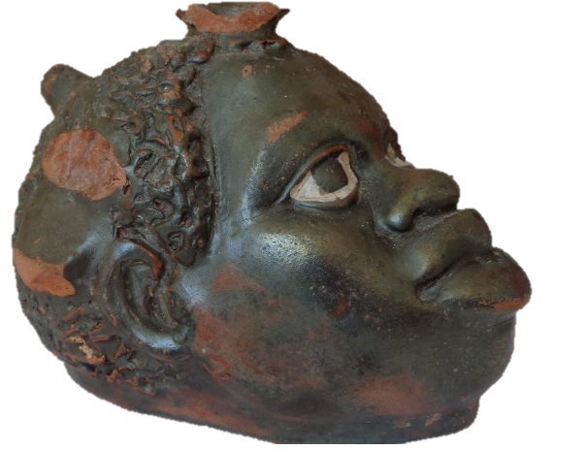
The LILIBEO PROJECT
UFA
Pottery vase – Lilibeo Museum
Giornate di Studio: Progetti del Centro Fermi 2020-2022, 11-12 December 2019

Slide 31

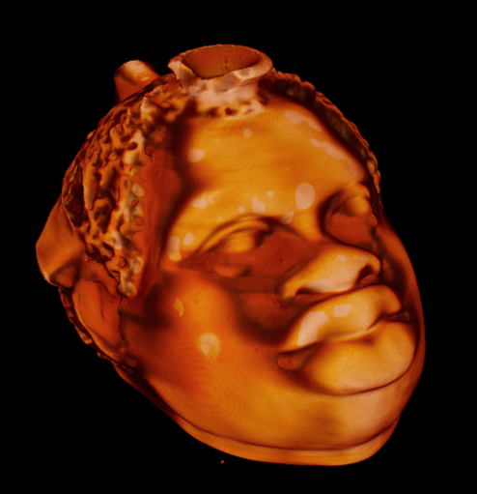
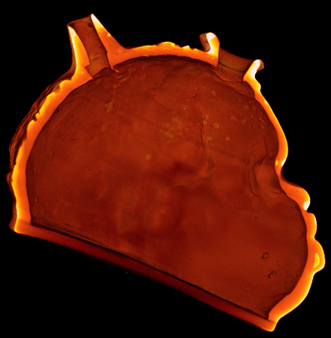
UFA
The LILIBEO PROJECT
X-Ray tomography: 3D Rendering in false-colour of the pottery vase – Lilibeo Museum
Tomography - Bologna instrumentation TTRX
Giornate di Studio: Progetti del Centro Fermi 2020-2022, 11-12 December 2019

Slide 32
The LILIBEO PROJECT
Milestones reached in 2019:
Agreement between Museo Archeologico Regionale di Lilibeo, University of Geneva and Centro Fermi – DONE
Tomographies of some Lilibeo findings at Univ. of Bologna – DONE
First experimental campaign in-situ (X-ray tomography) – DONE
First measurements of Lilibeo artifacts at Centro Fermi – DONE
Giornate di Studio: Progetti del Centro Fermi 2020-2022, 11-12 December 2019

Slide 33
The LILIBEO PROJECT
Plan of activities 2020:
First experimental campaign in-situ (XRF+Raman) – PLANNED
XRF+Raman data analysis – IN PROGRESS
Outreach event about archaeometric investigations at Lilibeo (“Invisible colours”) – PLANNED
Giornate di Studio: Progetti del Centro Fermi 2020-2022, 11-12 December 2019

Slide 34
VIEWLAB:
Science and Cultural Heritage
Thank you for your attention

