Slide 1
Progetto: Microcavità Fotoniche (MiFo)
Photonic Microcavities
Linea di ricerca: Tecniche Avanzate per la Fisica Fondamentale
Project Leader: Giancarlo Righini
Coordinator: Gualtiero Nunzi Conti
Participants:
assegnisti (research fellows):
Gabriele Frigenti (03/2019-02/2022)
associati (associates):
Maurizio Ferrari CNR-IFN, research director
Gualtiero Nunzi Conti CNR-IFAC, senior researcher
Stefano Pelli CNR-IFAC, senior researcher
Giancarlo Righini CNR-IFAC, former research director
Research activities take place at:
Istituto di Fisica Applicata “N. Carrara” (IFAC-CNR)
Istituto di Fotonica e Nanotecnologie (IFN-CNR, CSMFO Lab Trento)

Slide 2
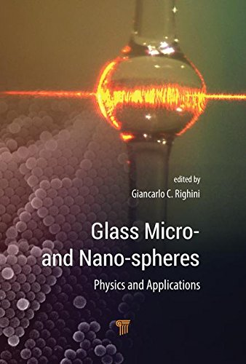
MiFo: milestones and publications 2019
Milestones 2019:
Analysis of nanoparticle (NP) suspensions by using the developed photoacustic (PA) system and excitation spectroscopy with a pulsed supercontinuum source (100 % accomplished)
Study of Whispering Gallery Modes (WGM) resonator-based optical systems with EIT and of variable gain microcavities (study not performed: it was subordinated to the availability of a second fellowship)
Transparent SiO₂-SnO₂ nano-glass-ceramic: (a) use of its photorefractive properties for the implementation of integrated laser sources; (100 % accomplished) (b) preliminary drawing tests of SiO₂-SnO₂ preforms (60 % accomplished: glass ceramics cylindrical preforms were prepared but were not suitably processed for drawing fibers)
RE-doped activated photonic microcavities for the engineering of the emission properties, of the absorption and of the energy transfer of donor-acceptor systems (100 % accomplished)
Publications 2019:
13 papers on ISI Journals,
2 books
International Conferences 2019:
10 presentations (6 invited)

Slide 3
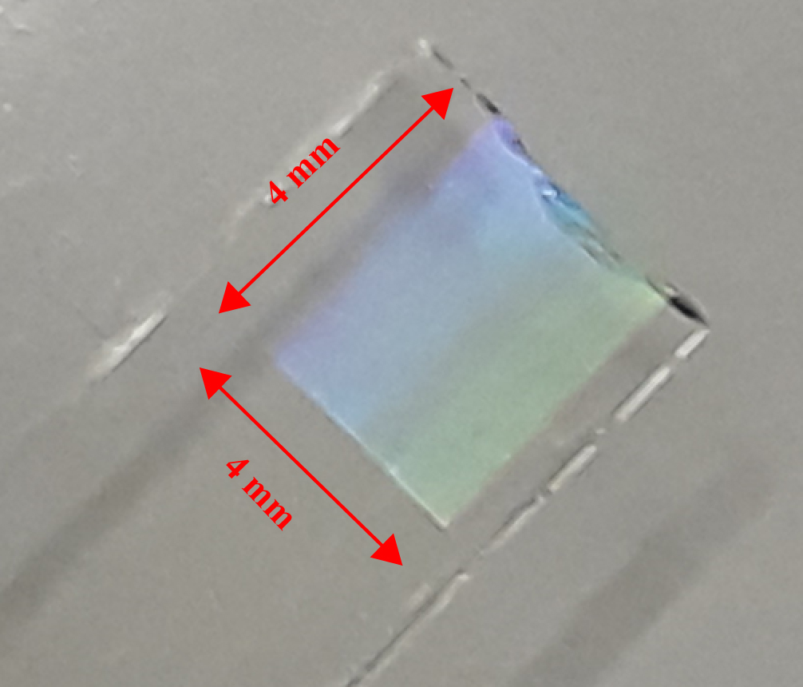
MiFo @ IFN: photonic materials
The activity of IFN-CNR in Trento concerns photonic materials:
metamaterials;
nanostructured and nanocomposite systems, transparent glass ceramics
confined geometries such as photonic crystals, integrated optics, fibers
Outcomes 2019
Fabrication of rare-earth-activated transparent SiO₂-SnO₂ glass ceramics, both massive and thin films. Variation of the refractive index ≈ 10⁻³ was obtained upon UV irradiation. Exploiting this photorefractivity, the fabrication of gratings in these glass-ceramics is 10-15 times more energy-efficient than for the commercial glasses.
Manufacture of 1D microcavities for lasers with very low threshold power
Development of mechanochromic sensors based on colloidal systems and of photonic crystals activated by trivalent lanthanide ions.
uv-written grating in SiO₂-SnO₂ films

Slide 4
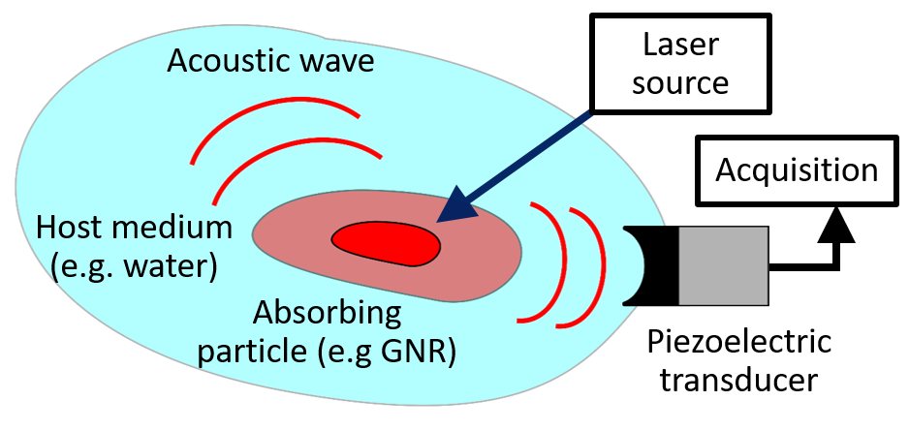
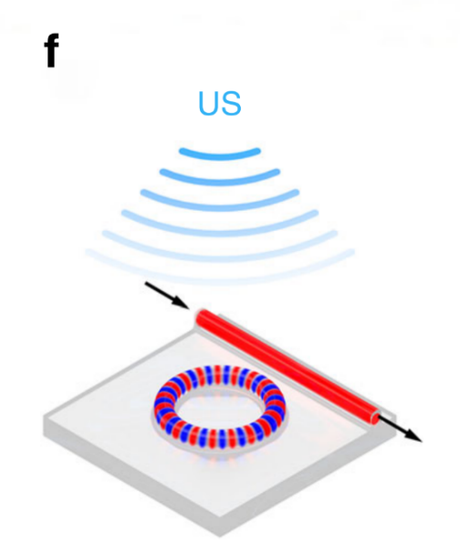
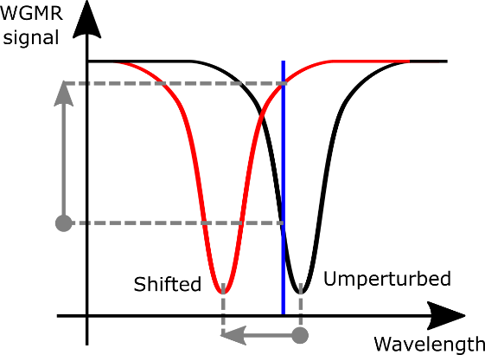
MiFo @ IFAC: photoacoustics (I)
Physical process: absorption of resonant light by nanoparticles and emission of ultrasonic shockwave
Applications: absorption spectroscopy (non-radiative detection), theranostics for specific illness (combination of therapy and diagnosis), biomedical imaging (unhindered propagation)
Challenge: typical detectors are piezoelectric, which are difficult to miniaturize
Solution: Moving to optical detection of the acoustic wave
Important results in biomedical applications through photoacoustic imaging
G. Wissmeyer et al., Looking at sound: optoacoustics with all-optical ultrasound detection, Light: Science & Applications 7, 53 (2018)
B. Dong et al., Isometric multimodal photoacoustic microscopy based on optically transparent micro-ring ultrasonic detection, Optica 2, 169-176 (2015)

Slide 5
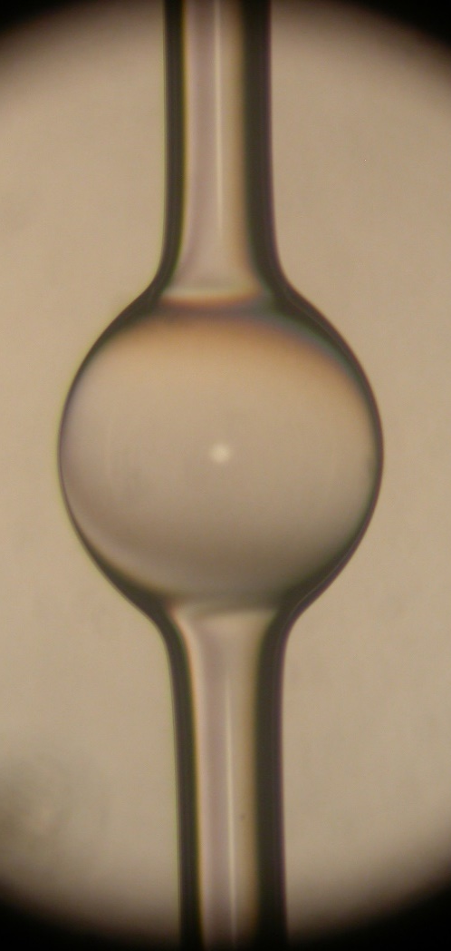
MiFo @ IFAC: photoacoustics (II)
Our optical transducer: hollow Whispering Gallery Mode (WGM) resonator, i.e. microbubble resonator (MBR)
Glass-based technology: MBR are manufactured in-house by heating a pressurized silica capillary. Optical quality factors exceeds 10⁶
Extreme compactness: MBR diameters are around 0.5 mm. The MBR is the optical transducer and also the vial containing the nanoparticles
Unique features:
since the MBR is the vial, the acoustic source is within the resonator
MBR are also mechanical resonator with quality factors exceeding 10³, leading to mechanical enhancement through constructive interference and lowering of the detection limit
WGM
Golden NanoRods
Silica
capillary
Characterization of nanoparticles by photoacoustic (PA) response: nanoparticles can be excited by different wavelengths (absorption spectroscopy) or fluences (photostability) while reading the WGM signal
Application range
Flow-cytometry: MBR is easy to connect to a microfluidic circuit in order to perform measurements while particles move through. Example: estimate hemoglobin level in a biological sample

Slide 6
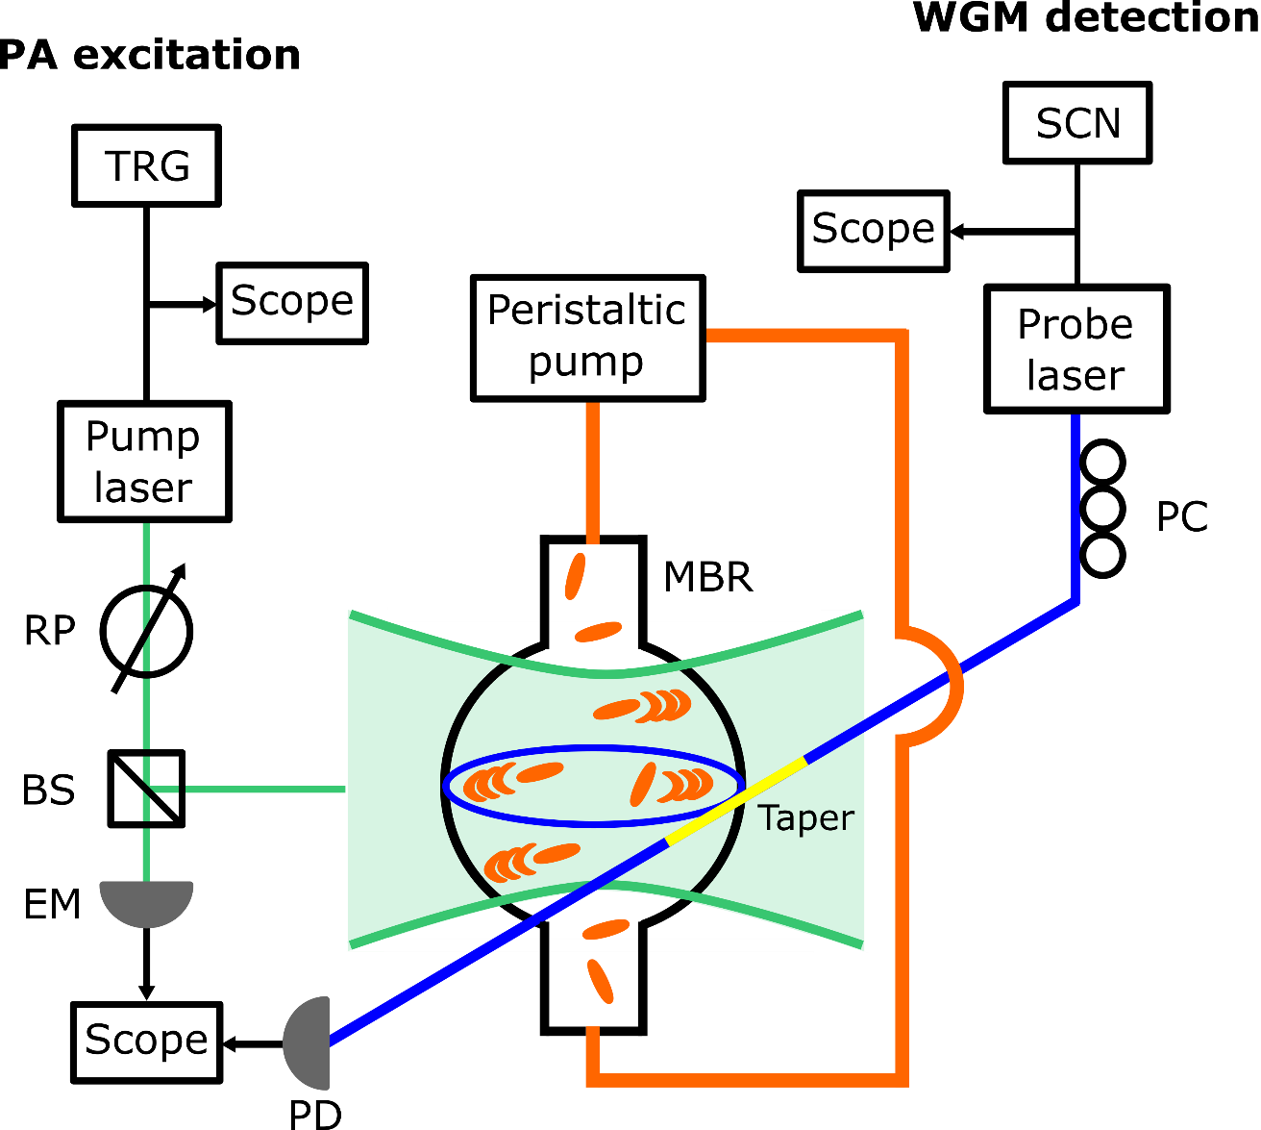
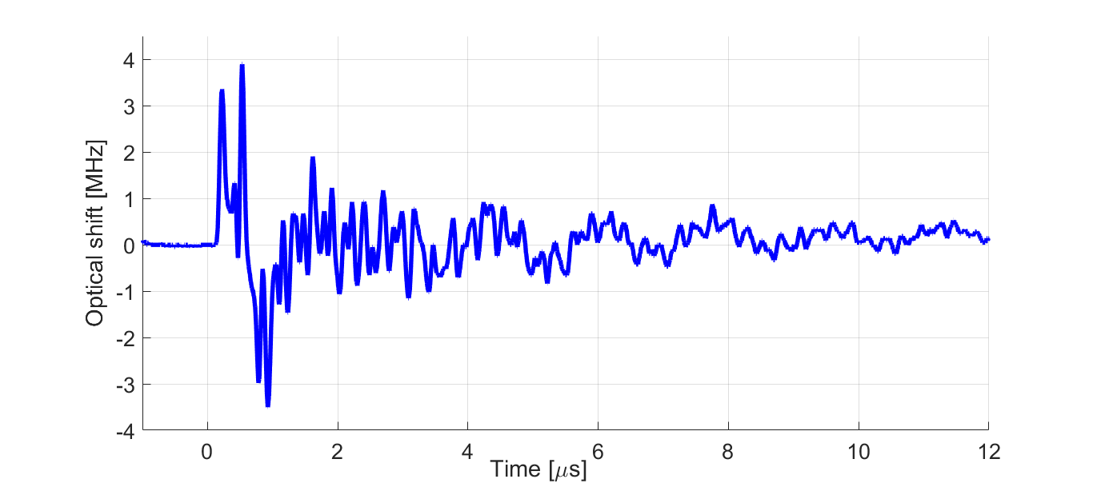
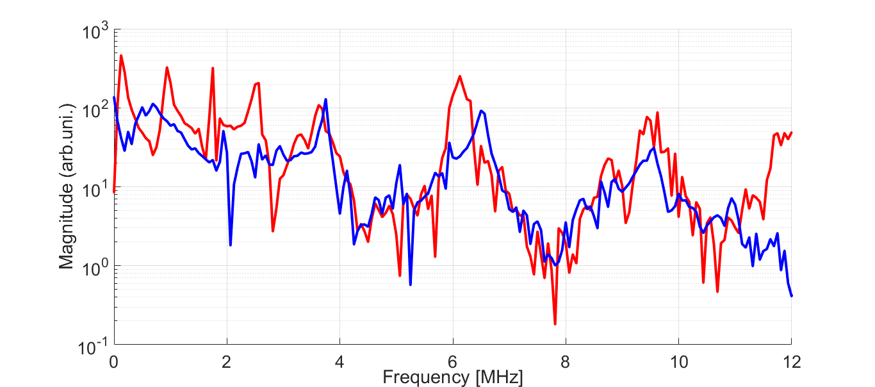
MiFo @ IFAC: photoacoustics (III)
Proof-of-concept experiment:
detection of PA signal generated by golden nano-rods (known contrast agents)
reconstruction of photostability curve via different excitation fluences (confirms photostability characterization)
ab-inizio COMSOL simulation confirms WGM read-out signal
in-flow detection via spectral fingerprint analysis [article in preparation] (confirms cytometry feasibility)
Time domain signal
Fourier spectrum
Simulation
Experiment
G. Frigenti, et al., (APS journal): Resonant Microbubble as a Microfluidic Stage for All-Optical Photoacoustic Sensing, Physical Review Applied 12.014062 (2019)

Slide 7
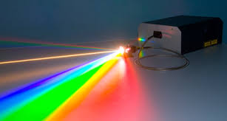
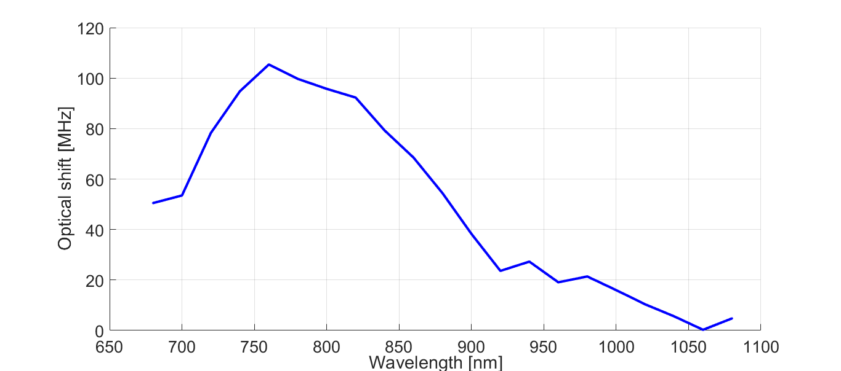
MiFo @ IFAC: from photoacoustics to photothermometry
Experiment goal: measure absorption spectrum via PA response using a supercontinuum source
Challenge: single pulse detection needs very high sensitivity due to low energy pulses from our supercontinuum source
Alternative approach: study cumulative response of the system (high repetition rate instead of single pulse), switching from photoacoustics to photothermometry
➔ Resonance shift is due to thermal heating of the cavity after NP absorption!
Preliminary results: photothermometry seems promising and enough sensitive

Slide 8
MiFo: milestones 2020
Analisi di nanoparticelle mediante spettroscopia di eccitazione fototermica con una sorgente supercontinua
Analysis of NP suspensions by using photothermal excitation spectroscopy with a supercontinuum source
Studio dell’accoppiamento tra modi ottici e meccanici in “hollow resonators” con particolare riferimento al trasferimento di moto caotico tra due campi ottici di pump and probe
Study of the coupling between mechanical and optical modes in hollow resonators focusing on chaotic mode tranfer between optical pump and probes
Sviluppo di processi di deposizione di film vetrosi su substrati flessibili polimerici e vetrosi con l’obiettivo di dimostrare la fattibilità di fotonica flessibile in vetro
Development of thin film glass deposition techniques on polimeric flexible substrates aiming demonstrating the feasibility of glass flexible photonics

Slide 9
MiFo Project @ IFN-CNR Trento (2020-2022)
Objective: fabrication of new flexible photonic devices by means of RF sputtering and sol-gel deposition techniques to provide a technological solution for transforming intrinsically rigid or fragile materials into a mechanically flexible and optically functional geometry.
Applications: optical interconnection, infrastructural and civil environments sensors, coherent and incoherent light sources, functional biomedical materials and devices.
The activity will be developed along the following lines:
design and manufacture of suitable flexible substrates exploiting the opportunities offered by the sol-gel technology to go beyond standard polymers;
realization of planar waveguides and photonic crystals deposited on flexible substrates reducing radiative losses and maintaining constant adhesion under mechanical deformation;
develop a predictive model of optical dependence of the flexible photonic device on the mechanical behavior.

Slide 10
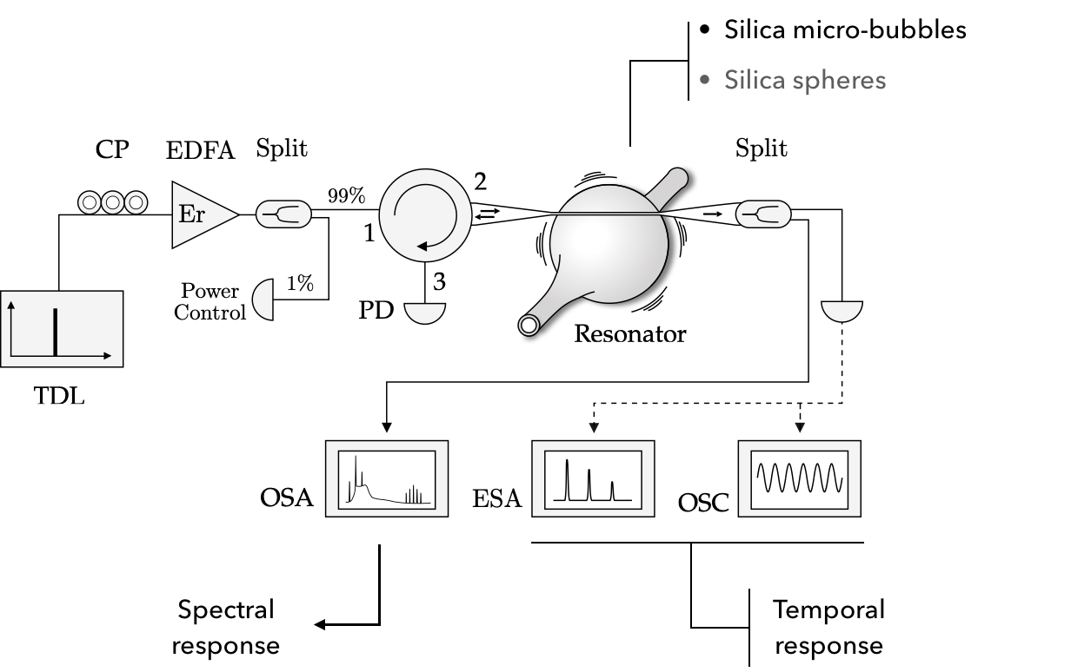
MiFo: optomechanics
(2020-2022)
Optomechanical oscillations in optofluidic resonators: optical vs mechanical NL effects

Slide 11
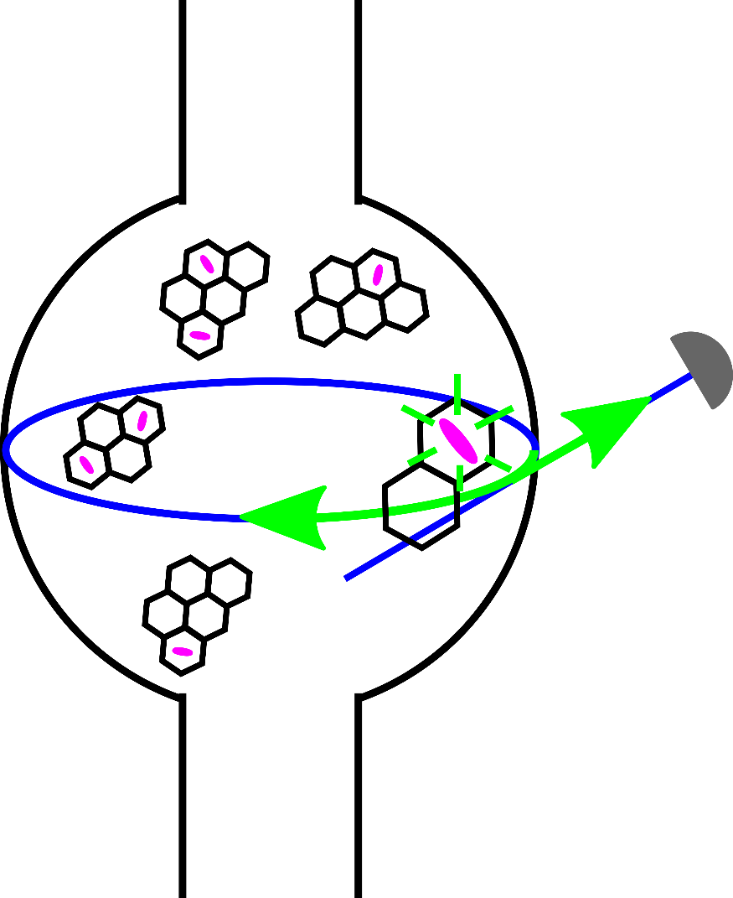
MiFo: quantum sources
(2020-2022)
Goal: control single-photon quantum emitters by coupling to the hollow resonators Whispering Gallery Modes
DBT molecules in anthracene crystals
single photon
detector
Advantages: redirection of free-space emission into WGMs, improving spatial and spectral photon harvesting
WGM mode coupled to emitting DBT
Candidate quantum soruce: DBT molecules (organic nanocrystals made of anthracene and doped with dibenzoterrylene molecules) show good single-photon emission at “high” temperatures (room temperature) and cryogenic temperatures
taper coupled to WGM
Tailored theory: experiment results needs a specific model to extract physical information. Main goal here is predicting the coupling between the WGM and the molecule through modal structure and molecular emission
In collaboration with Prof. F.S. Cataliotti and Dr. C. Toninelli from LENS-UNIFI and INO-CNR

Slide 12
MiFo: grants and funding 2020-2022
Expected funding in the 3-year period:
Request of funding by Centro Fermi
Grants (number and period requested):
1 Junior Grant (2019-2022) – continuation -
consumables/inventory per year:
20,000 € in 2020, 2021 and 2022
External funding
Collaborating CNR Institutes will co-fund the research by covering the cost of their personnel (besides the listed collaborators) and of the laboratories which are made available for the research activities (estimated total 40 K€/year).
Contribution from EU-Photonics Sensing SafeWater project (On Chip Whispering Gallery Mode Optical Microcavities for Emerging Contaminant Determination in Waters, 2018-2020)

