Slide 1
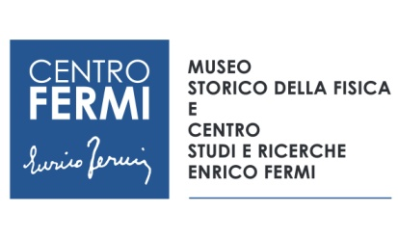

SAPIENS
Microtomografia per l’Archeologia e la Paleoanthropologia
Other Logo
Leader: Claudio Tuniz
Coordinator: Sandro Scandolo
Participants: Federico Bernardini
Place of Work & Collaborations:
Abdus Salam International Centre for Theoretical Physics
Elettra Sincrotrone Trieste
University of Trieste, Roma, Chieti, Torino, Siena, Bologna
INFN: LANDIS-LNS
Institute for Anthropological Research, Rudjer Boskovic Institute - Croatia
U. of California Irvine; U. Arizona - USA
U. Wollongong; ANU; Griffith; ANSTO – Australia
Budapest Neutron Centre
Institut Català de Paleontologia Miquel Crusafont, Barcellona
Museums: Trieste, Udine, Trento (MUSE), Pigorini, San Daniele del Po

Slide 2
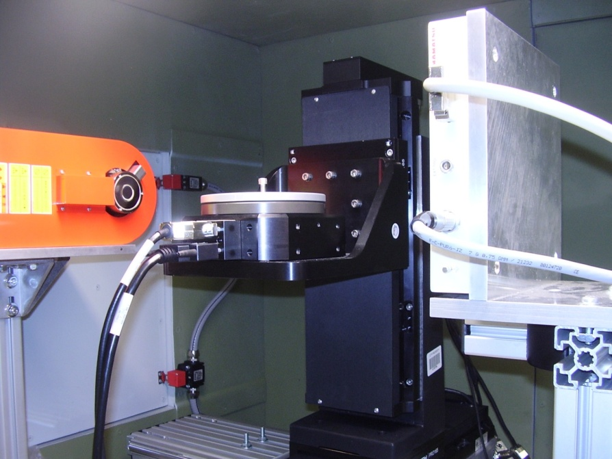
S.A.P.I.E.N.S
Scienze per l'Archeologia e la Paleoantropologia: InterpretareE la Nostra Storia
Other Logo
Project main goals and results achieved in 2019
Contribute to the development and application of advanced physical methods (including 3D neutron and x-ray imaging, remote sensing, dating, isotope characterisation) in archaeological and palaeoanthropological studies.
During 2019 the lab has been included in the Advanced Technology Lab For Cultural Heritage (ATLACH), a consortium including also the Universities of Udine and Trieste and Elettra Sincrotrone Trieste and other institutions of FVG region. The consortium has funded a new X-ray tube and a reconstruction PC (40 kilo euro).
x-ray microCT – ICTP Trieste
SR microCT – ELETTRA Trieste

Slide 3
Papers (2019)
Journals
1. F. Bernardini F. et al. 2019, X-ray computed microtomography of Late Copper Age decorated bowls with cross-shaped foots from central Slovenia and the Trieste Karst (North-Eastern Italy): technology and paste characterisation. Archaeological and Anthropological Sciences 11: 4711-4728. DOI: 10.1007/s12520-019-00811-w.
2. M. Fernández-Coll, T. Arbez, F. Bernardini, J. Fortuny 2019, Cranial anatomy of the Early Triassic trematosaurine Angusaurus (Temnospondyli: Stereospondyli): 3D endocranial insights and phylogenetic implications, Journal of Iberian Geology 45, 269–286. https://doi.org/10.1007/s41513-018-0064-4.
3. R. Duches et al. 2019, Archeological bone injuries by lithic backed projectiles: new evidence on bear hunting from the Late Epigravettian site of Cornafessa rock shelter (Italy). Archaeological and Anthropological Sciences n11, 2249–2270. DOI: 10.1007/s12520-018-0674-y.
5. F. Bernardini et al. 2019, Polished stone axes from Varna/Nössingbühel and Castelrotto/Grondlboden, South Tyrol (Italy). Archaeological and Anthropological Sciences 11, 1519–1531. DOI: 10.1007/s12520-018-0612-z.
6. A. Villa et al. 2019, Comparative cranial osteology of Blanus (Squamata: Amphisbaenia). Zoological Journal of the Linnean Society 185, 693–716. https://doi.org/10.1093/zoolinnean/zly082.
7. A. Baucon et al. 2019, Ethology of the trace fossil Chondrites: form, function and environment. Earth-Science Reviews. https://doi.org/10.1016/j.earscirev.2019.102989.
8. P. Cruzado-Caballero et al. 2019, First nearly complete skull of Gallotia auaritae (lower-middle Pleistocene, Squamata, Gallotiinae) and a morphological phylogenetic analysis of the genus Gallotia. Scientific Reports 9, article number 16629. https://doi.org/10.1038/s41598-019-52244-z (2019).
9. G. Vinci, F. Bernardini, S. Furlani 2019, Geo-archaeology of the Grozzana area (N-E Italy), J. of Maps, 15, 697-707. https://doi.org/10.1080/17445647.2019.1659866.
Books or Book chapters
1. F. Bernardini, C. Tuniz, F. Zanini 2019, Chapter 2 - X-ray Computed Microtomography for Paleoanthropology, Archaeology, and Cultural Heritage. Nanotechnologies and Nanomaterials for Diagnostic, Conservation and Restoration of Cultural Heritage, 25-45, Elsevier. DOI: 10.1016/B978-0-12-813910-3.00002-1.
2. F. Bernardini 2019, Fortificazioni militari repubblicane nell’area di Trieste (Italia nord-orientale): materiali archeologici da Grociana piccola e San Rocco rinvenuti nel corso della prima campagna di ricognizioni, in: Accampamenti, guarnigioni e assedi durante la Seconda Guerra Punica e la conquista romana (secoli III-I aC): prospettive archeologiche, Quasar.
3 C. Tuniz, P. Tiberi Vipraio, From apes to cyborgs. New perspecives in human evolution, Springer/Nature and Praxis, 2020.

Slide 4
S.A.P.I.E.N.S
Scienze per l'Archeologia e la Paleoantropologia: InterpretareE la Nostra Storia
Other Logo
Milestones 2019
Publication: paper on microCT application to the study of ancient pottery
Publication: paper on dog domestication in Italy during Upper Palaeolithic
Publication: palaeomedical paper on Ceprano skull or another paleoanthropological paper
Publication: other study in palaeoanthropology, palaeontology and archaeology

Slide 5
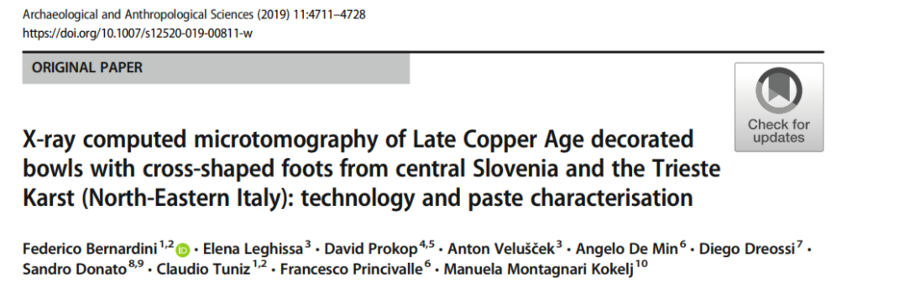
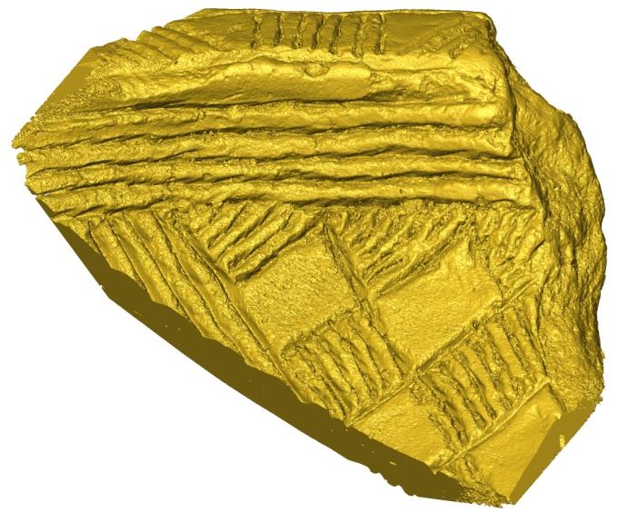
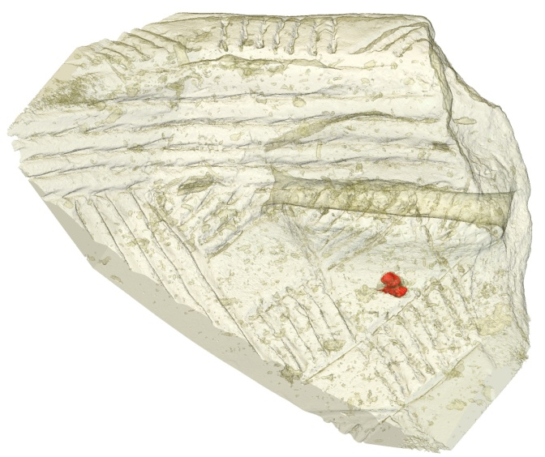
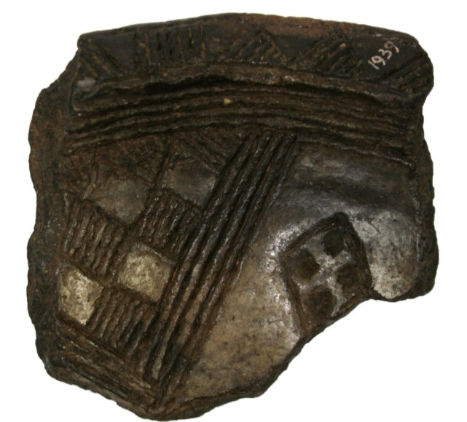
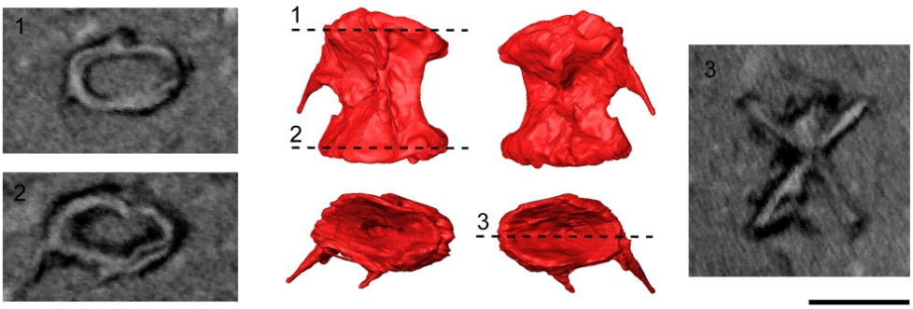

Slide 6
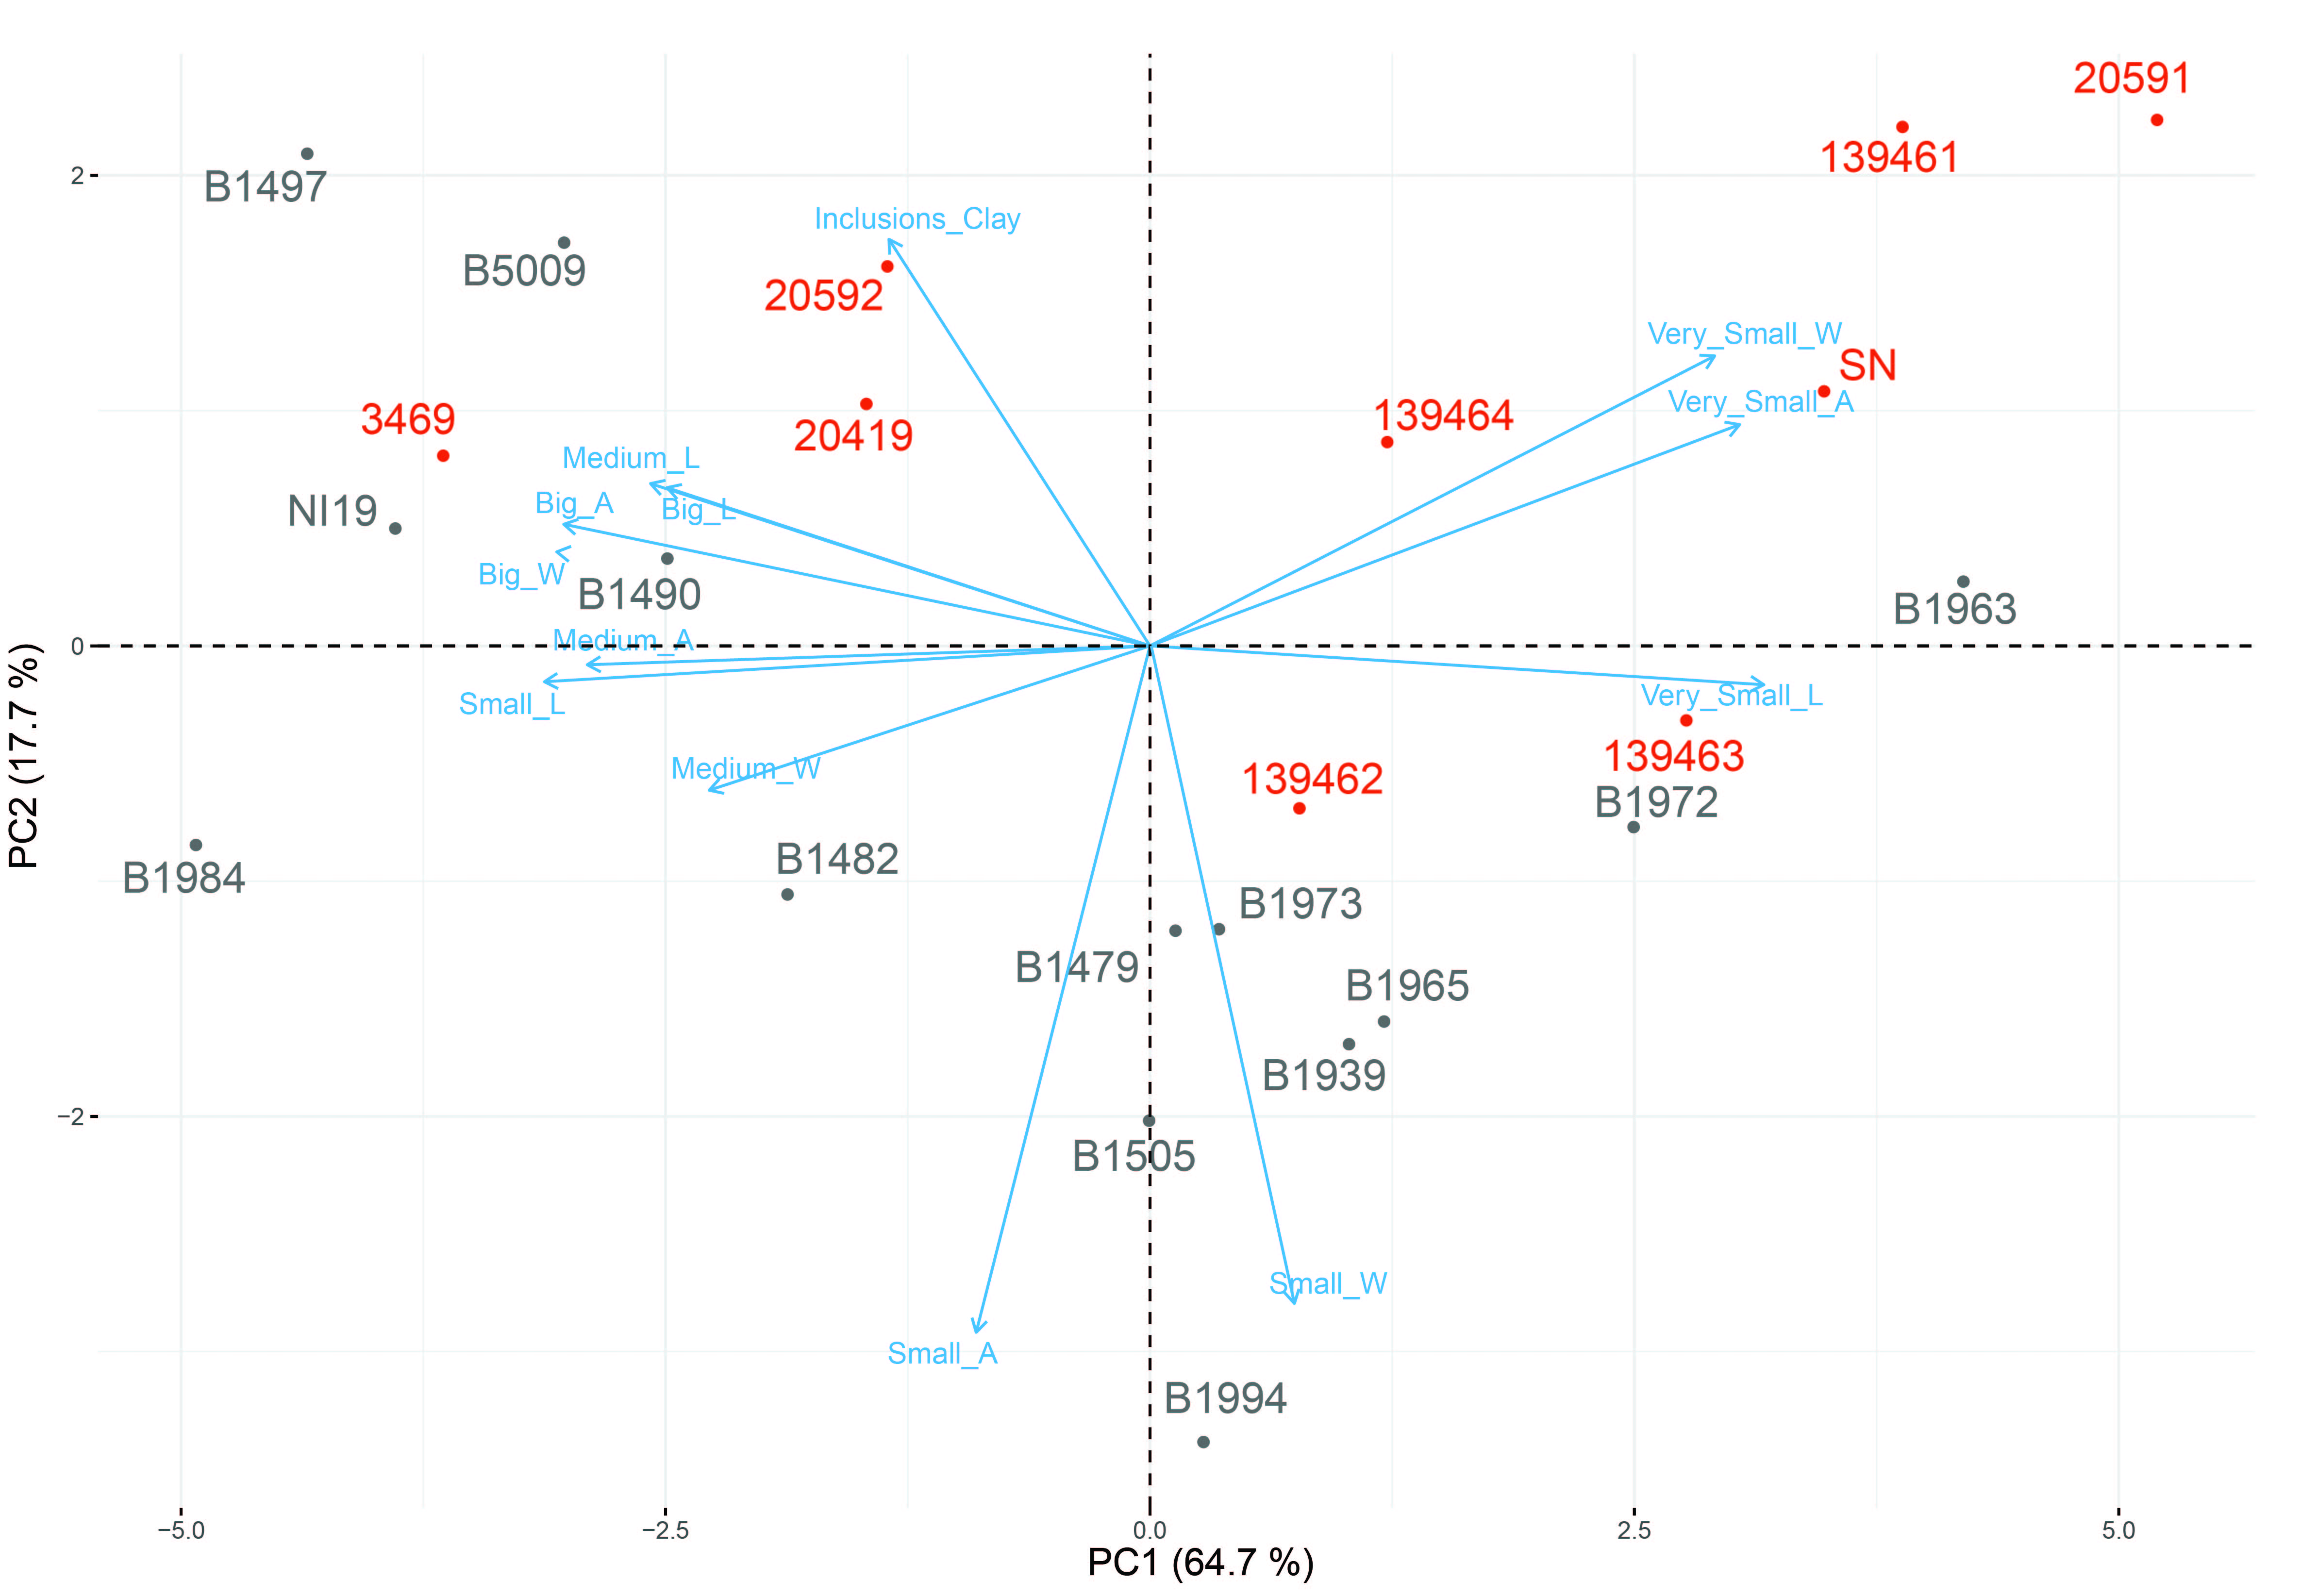
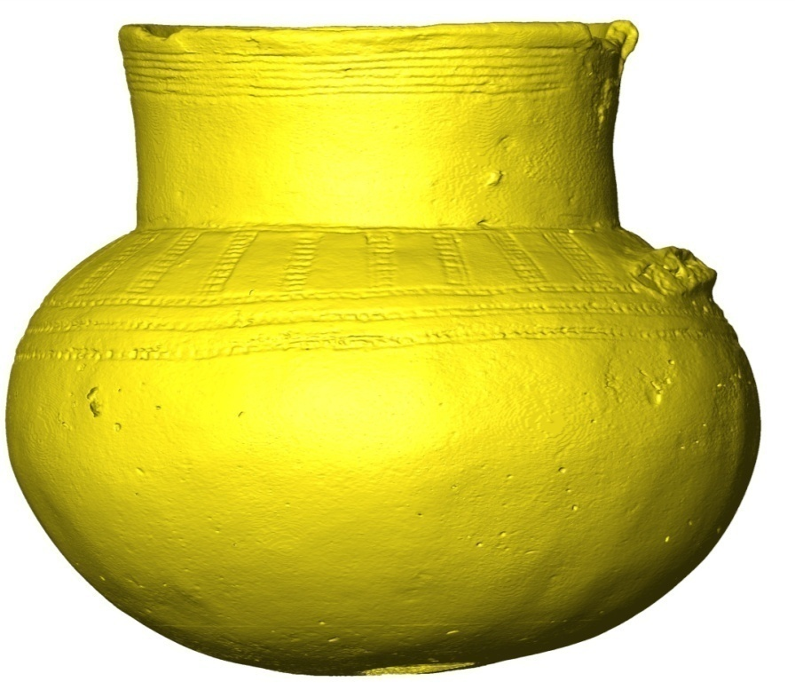
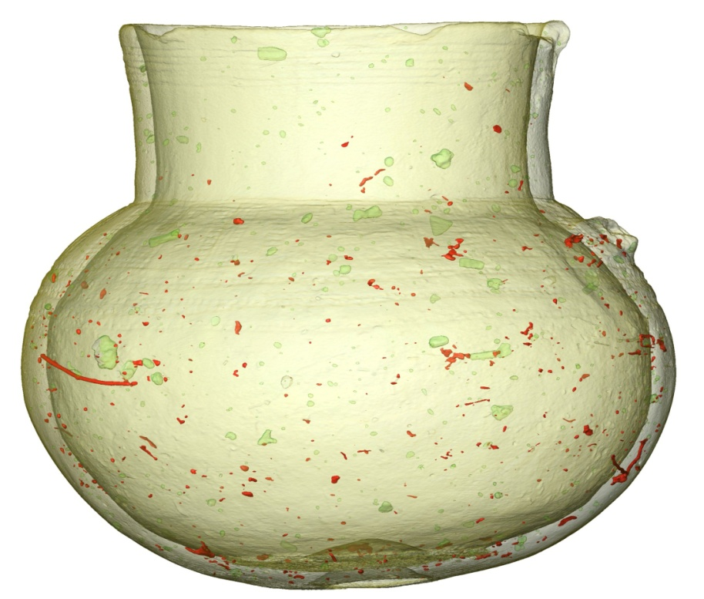
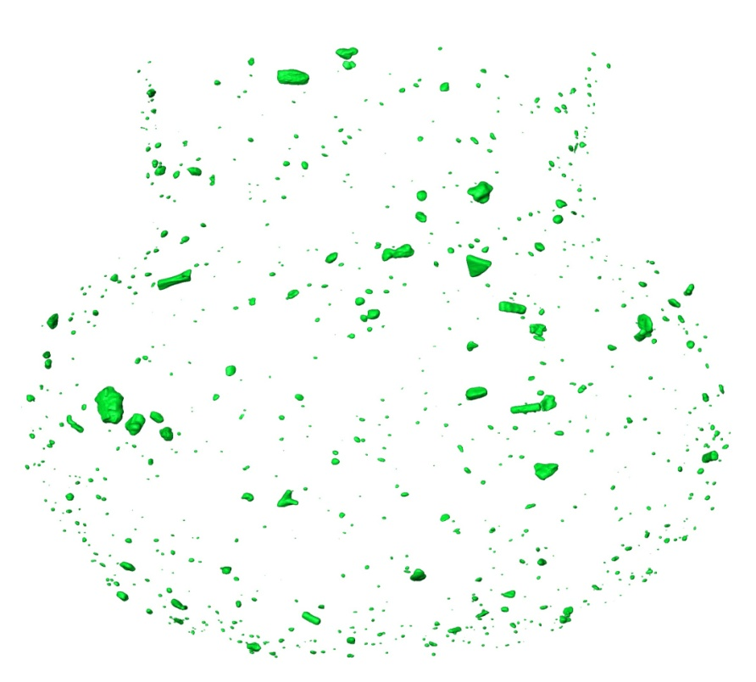
3D Paste characterization
MicroCT-derived images: rendering of a late Copper Age vessel (a), rendering of the same vessel with clay in transparency, lithic inclusions in green and pores in red (b) and virtual extraction of lithic inclusions (c).

Slide 7
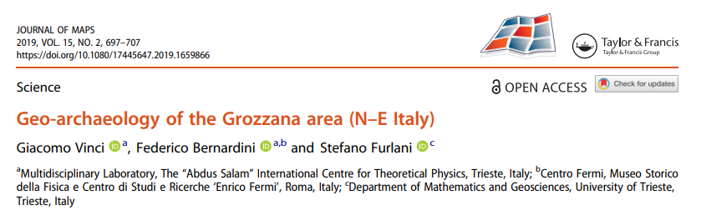
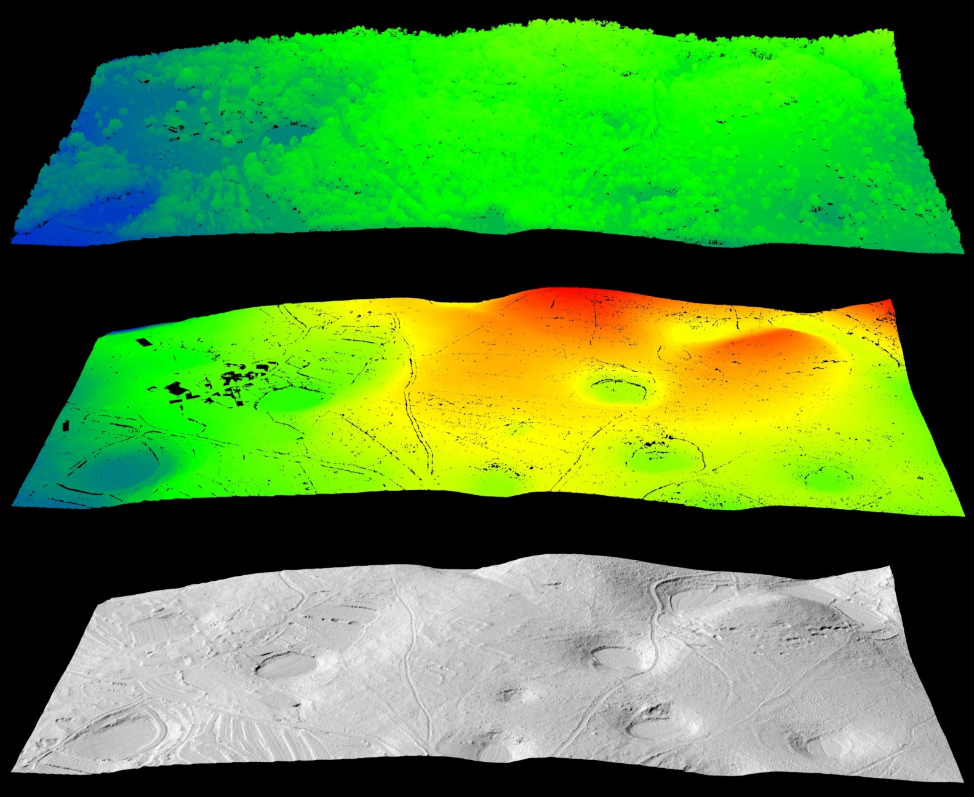

Slide 8
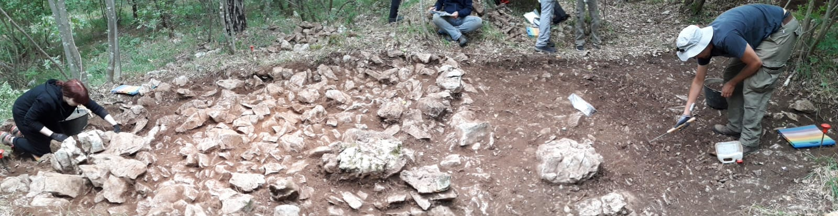
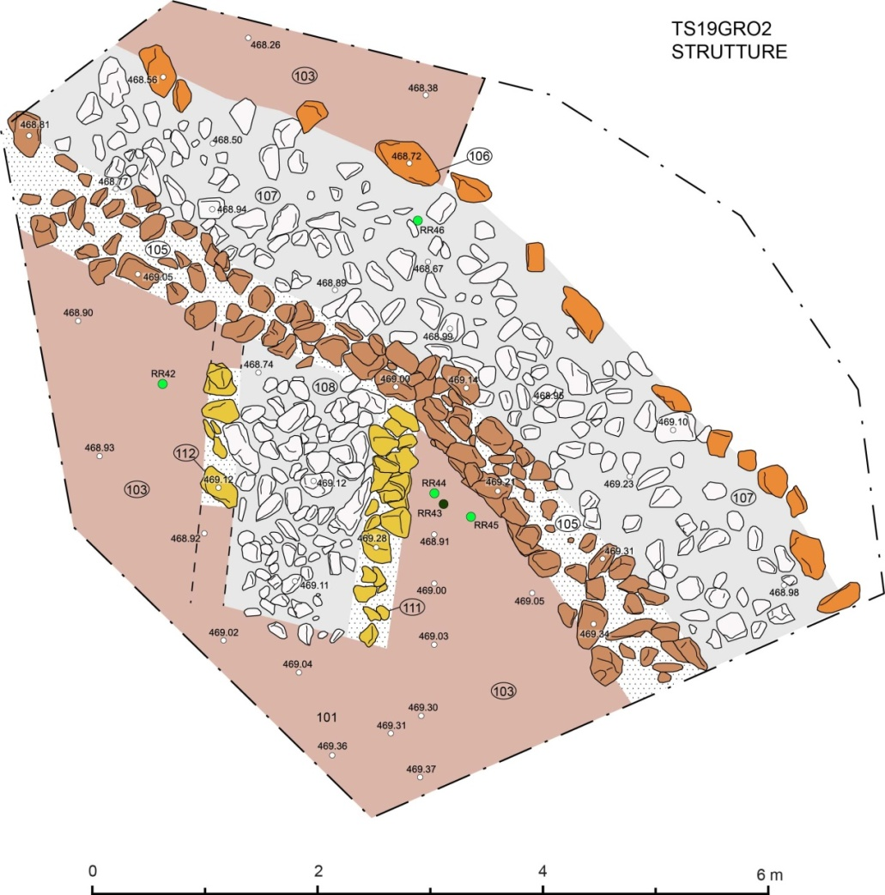
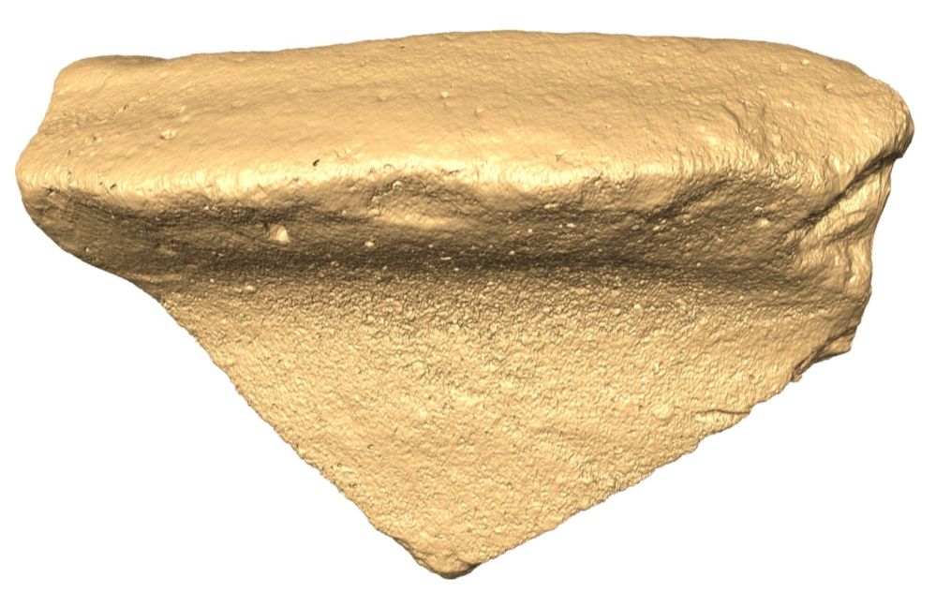
Archaeological excavations in the Trieste Roman military camps
Greco-italic amphora rim, II century BC

Slide 9
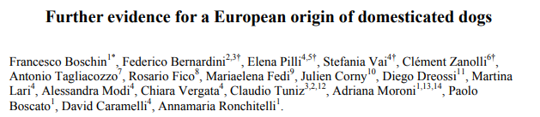
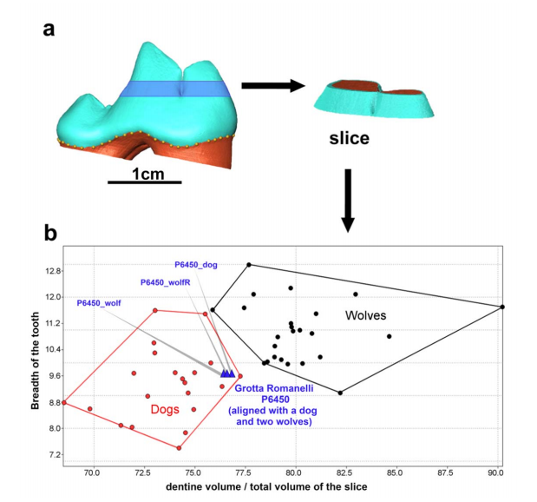
submitted to Scientific Reports

Slide 10
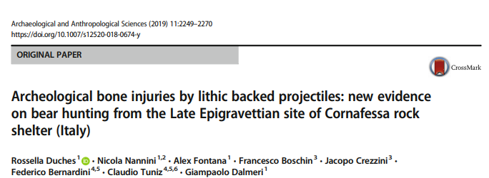
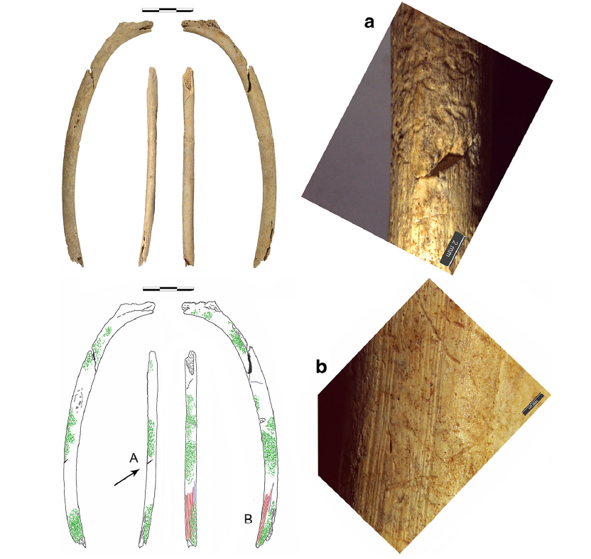
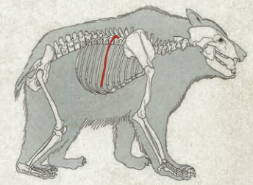
Projectile impact mark, found on a rib of Ursus arctos from the Late Epigravettian site of Cornafessa rock shelter (Trentino).
Ursus arctos rib from Cornafessa rock shelter with taphonomic features highlighted. Green lines: roots marks; red lines: scraping marks; blue lines: trampling marks; black arrow: PIM. a: PIM and root etchings; b: scraping marks.
Notes:
Here, we present the detailed analysis of a projectile impact mark, found on a rib of Ursus arctos from the Late Epigravettian site of Cornafessa rock shelter (about 12ky). The injury, located on the rib’s external surface, consists of a drag with several flint fragments embedded.

Slide 11
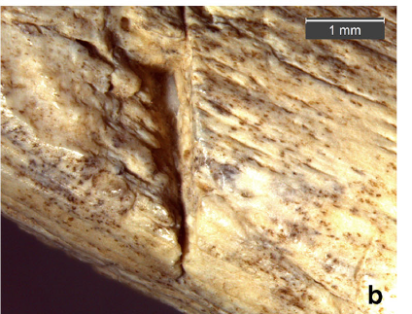
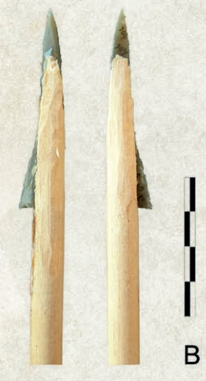
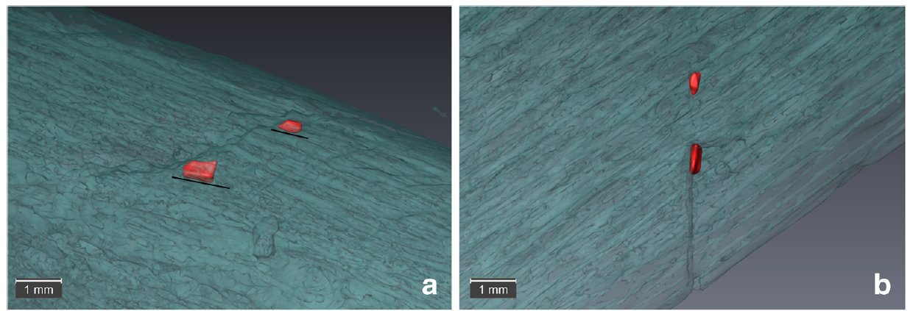
The drag’s morphometric features are consistent with the experimental ones, connecting this mark to Late Epigravettian composite projectiles and declaring this evidence as the first direct proof of a bear hunted by using bow and arrow.

Slide 12
S.A.P.I.E.N.S
Scienze per l'Archeologia e la Paleoantropologia: InterpretareE la Nostra Storia
Other Logo
Plan of activities 2020 - 2022
Instrument development
- Test of the upgraded microCT system (new detector, new x-ray tube and new computer), in collaboration with ELETTRA sincrotrone Trieste
Archaeology
- Development of new non-destructive protocols to study archaeological materials, mainly pottery and wood, through combined use of microCT and chemical methods, such as PGAA (in collaboration with Budapest Neutron Centre)
- Study of ancient landscapes through geophysical and remote sensing techniques in Italy and Croatia
- Field work in two Roman camps (Trieste) and in Croatia
- Exhibition in London about Istrian landscape (at Croatian Embassy)
Palaeoanthroplogy
- New collaborations with Australian National University and Arizona State University (project proposals submitted to Australian Research Council and National Science Foundation)
- Radiocarbon dating and DNA analysis of Bronze Age population in Croatian Istria
- MicroCT study of various samples in collaboration with national and international institutes
Paleontology
- microCT study of various samples on collaboration with MUSE and other institutes

Slide 13
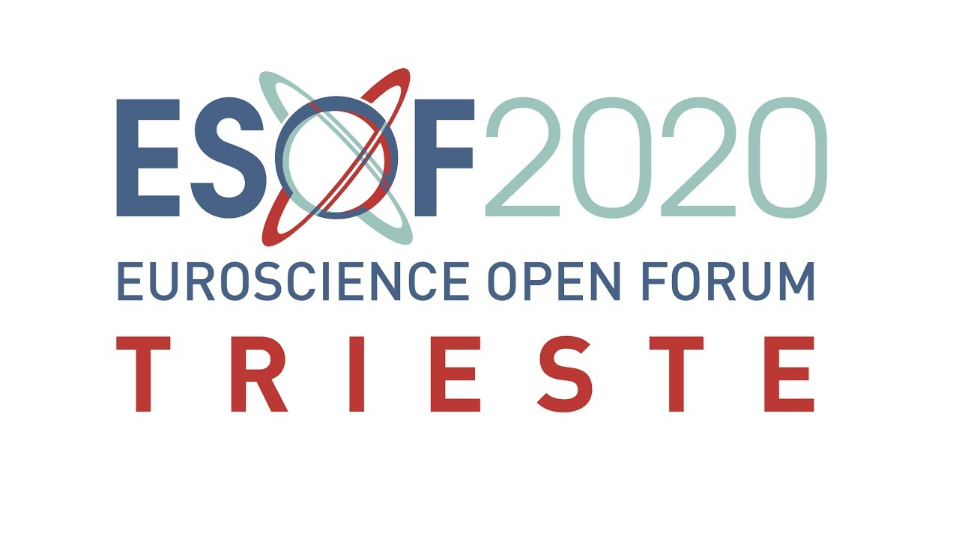
This panel discussion will provide a new emerging perspective which requires a multidisciplinary approach based on comparative neuroanatomy, cognitive science, archaeology and paleoanthropology, psychology, informatics and engineering.

Slide 14
S.A.P.I.E.N.S
Scienze per l'Archeologia e la Paleoantropologia: InterpretareE la Nostra Storia
Other Logo
Milestones 2020
Publication: paper on microCT application to the study of ancient pottery, combined with non-destructive chemical analysis.
Publication paper on microCT study of a medioeval sword
Publication: paper on study of the ancient Istrian landscapes using geophysical and LIDAR analyses
Publication: other study in palaeoanthropology, palaeontology and archaeology

Slide 15
S.A.P.I.E.N.S
Scienze per l'Archeologia e la Paleoantropologia: InterpretareE la Nostra Storia
Other Logo
Expected funding in the 3-year period:
Request of funding by Centro Fermi
One Assegno di Ricerca grant, 3 years
Specific Consumables/Inventory per year Euro10.000
External funding
Consorzio regione FVG Advanced Technology Lab for Cultural Heitage (40 kilo euro)
Monton MMS, Croatia (private, 50 kilo euro)
ICTP-OGS-SAG AVATR project (10 kilo euro)
Croatian Science Fundation (2 kilo euro)
Australian Reserch Council (Australia)
National Science Fundation (USA)

