Slide 1

TNAAF – Neutron techniques for
Archaeology and Forensic Science; ISIS@MACH infrastructure
Tecniche Neutroniche per Archeologia ed Analisi Forense
Coordinator: Roberto Senesi, Università degli Studi di Roma Tor Vergata, Centro NAST
Participants:
Università Tor Vergata – C. Andreani, R. Senesi, C. M. Labarga, O. Rickards L. Arcidiacono (Centro NAST).
Centro Fermi – G. Festa, C. Scatigno (since November 2019)
Università di Firenze - P. Baglioni; Università di Milano-Bicocca – G. Gorini ; Università di Teramo – C. Piperno
University College London (UK) Science and Engineering in Art, Heritage and Archaeology (SEAHA) Centre for Doctoral Training - Marcos Martinon-Torres
Place of work & Collaborations:
Place of Work
Centro Fermi - Research and Heritage Institution
ISIS Spallation Neutron Source (Harwell, UK) – Research Institution
University College London (UK) – SEAHA, http://www.seaha-cdt.ac.uk - Research Institution
Università degli Studi di Roma Tor Vergata - Research Institution
Collaborations
  Research Institutions: Consiglio Nazionale delle Ricerche (CNR-IBAM Catania and CNR-IPCF Messina) ; MOLAB (I), Oak Ridge National Laboratory (USA), Helmholtz-Zentrum Berlin (G), Argonne National Laboratory (USA); Sapienza Università di Roma (I); Universita’ di Milano Bicocca (I) ; Scuola Normale Superiore (I); Universita’ di Palermo (I); University of Coimbra (PT); Università degli Studi di Firenze (I).
  Heritage Institutions: Anthropological Service, Soprintendenza Archeologia del Lazio e dell‘Etruria Meridionale - (MIBACT, I) Museo Egizio, Torino (I) ; Tarisio – Fine Instrumentations & Bows (UK), Fondazione Pro Canale (I); University of Coimbra (PT); Scuola Normale Superiore (I).

Slide 2

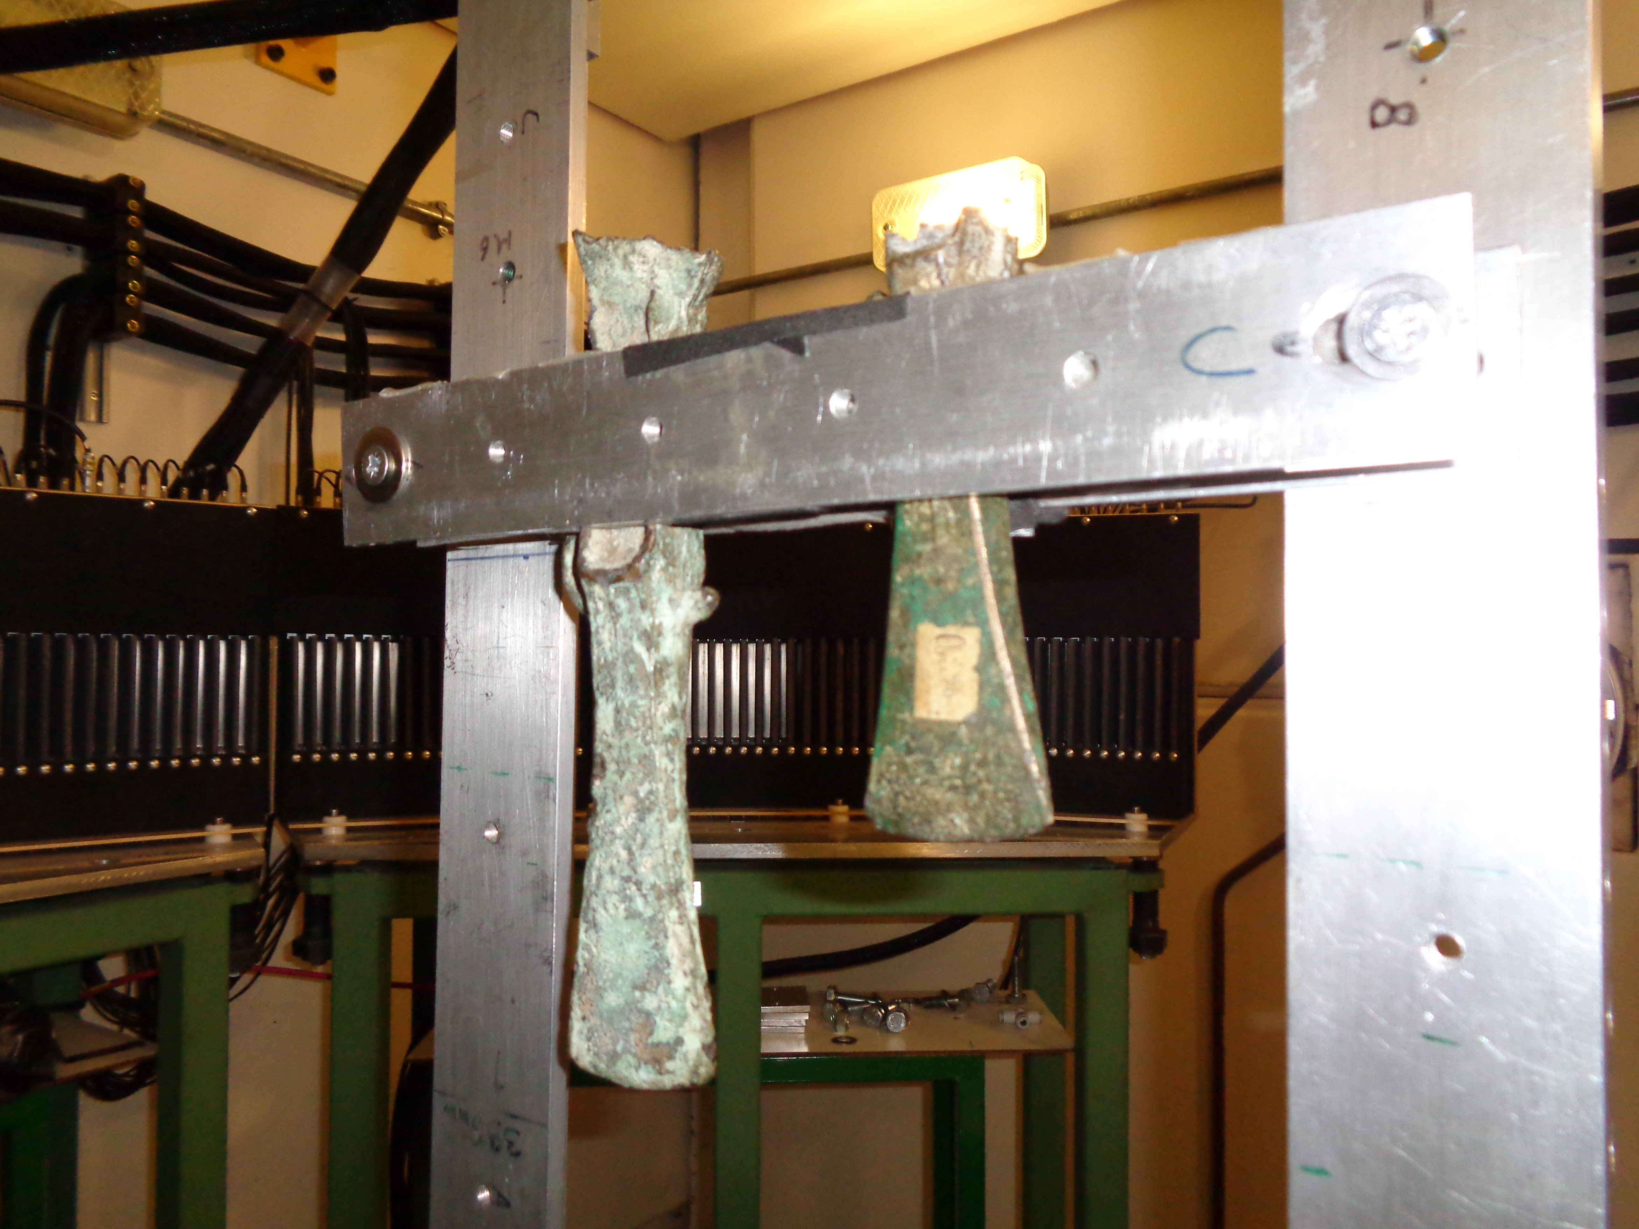
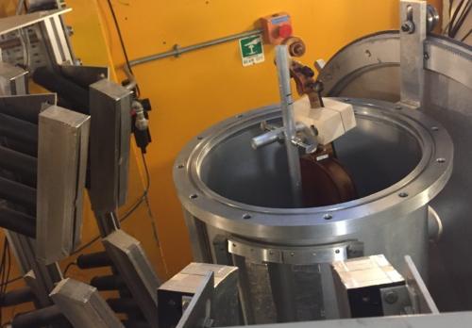
TNAAF - Neutron techniques for
Archaeology and Forensic Science
Project main goals and results achieved in 2019
Project goals: Element/isotope analysis, microstructure and spectroscopy on samples of archaeological and forensic relevance.
Instrumentation development: Time-Resolved Prompt Gamma Activation Analysis (T-PGAA) at Spallation Neutron Sources→ broaden the scope of chemical/isotope analysis for cultural heritage and forensic studies.
To create an outpost in UK of the Centro Fermi - TNAAF team (under the CNR-STFC Agreement) for interdisciplinary research activities and projects: Harwell, London.
To integrate advanced neutron techniques with molecular and atomic spectroscopy techniques for the study of cultural heritage artefacts, materials and forensic samples.

Slide 3
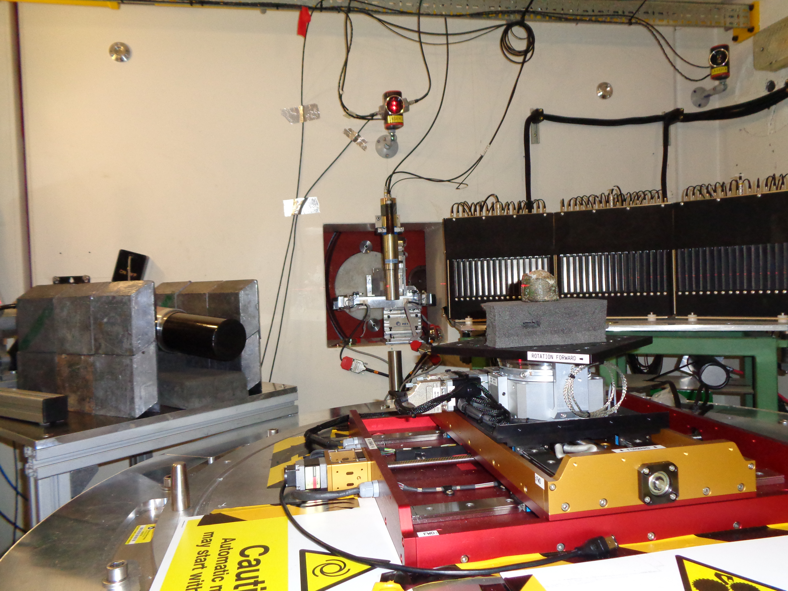
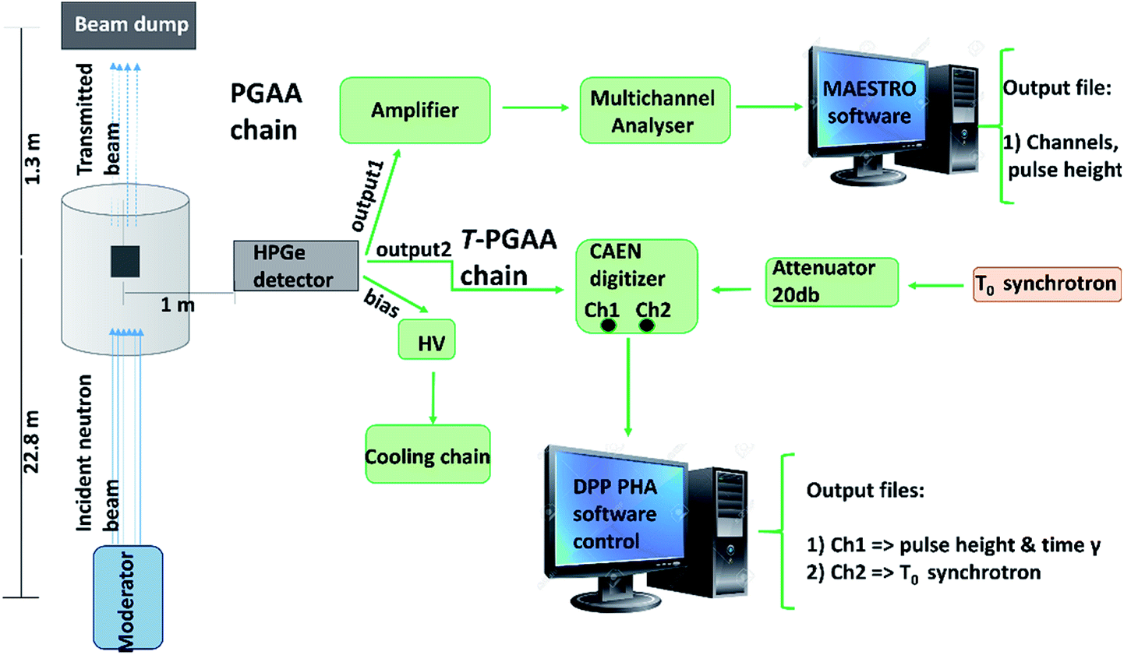
TNAAF - Neutron techniques for
Archaeology and Forensic Science
Project main goals and results achieved in 2019
Instrumentation development: Time-Resolved Prompt Gamma Activation Analysis (T-PGAA) at Spallation Neutron Sources

Slide 4
TNAAF - Neutron techniques for
Archaeology and Forensic Science
Project main goals and results achieved in 2019
Instrumentation development: Time-Resolved Prompt Gamma Activation Analysis (T-PGAA) at Spallation Neutron Sources

Slide 5
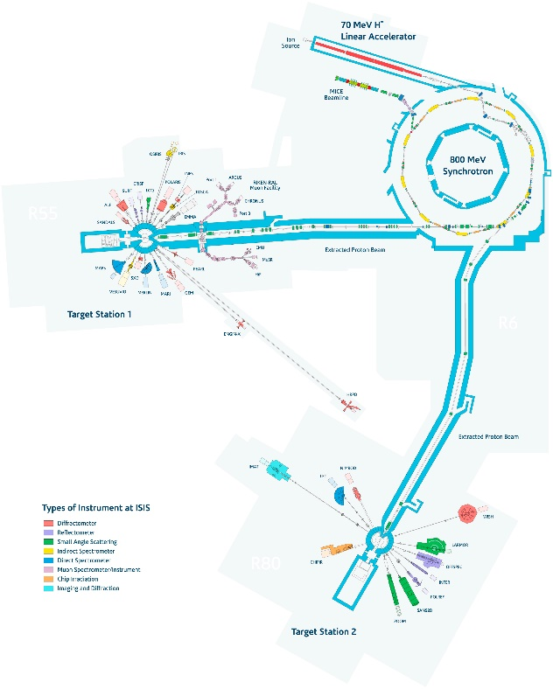
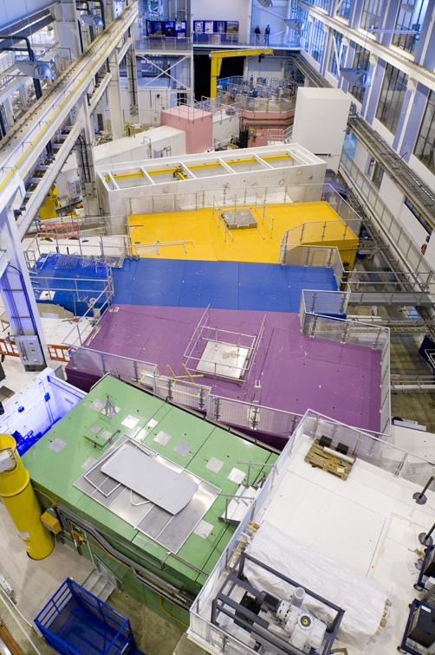
TNAAF - Neutron techniques for
Archaeology and Forensic Science

Slide 6
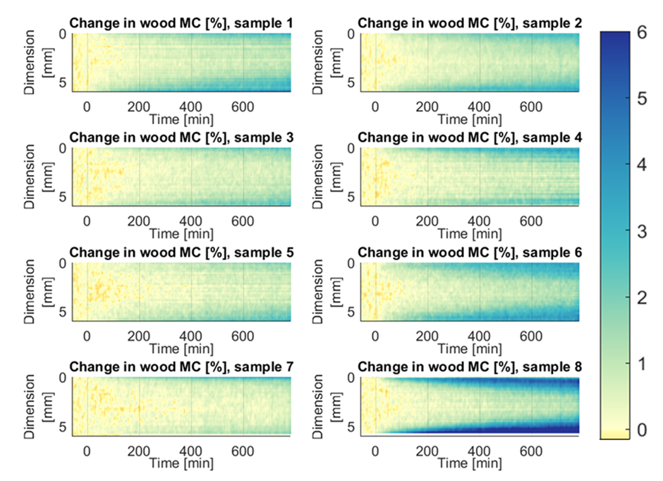
TNAAF - Neutron techniques for
Archaeology and Forensic Science
Project results achieved in 2019
1) Varnish, humidity and violins
Neutron imaging at Paul Scherrer Institute on varnish treated maple components
Varnish recipes from 17th – 18th centuries for violin surface coatings
Varnish with casein-oil pre treatment and oil-based varnish is the most protective against moisture
L. Arcidiacono, 2- nd year PhD Thesis at UCL Centre for Doctoral Training in Science and Engineering in Arts, Heritage and Archaeology , within Centro FERMI- Tor Vergata-UCL agreement

Slide 7
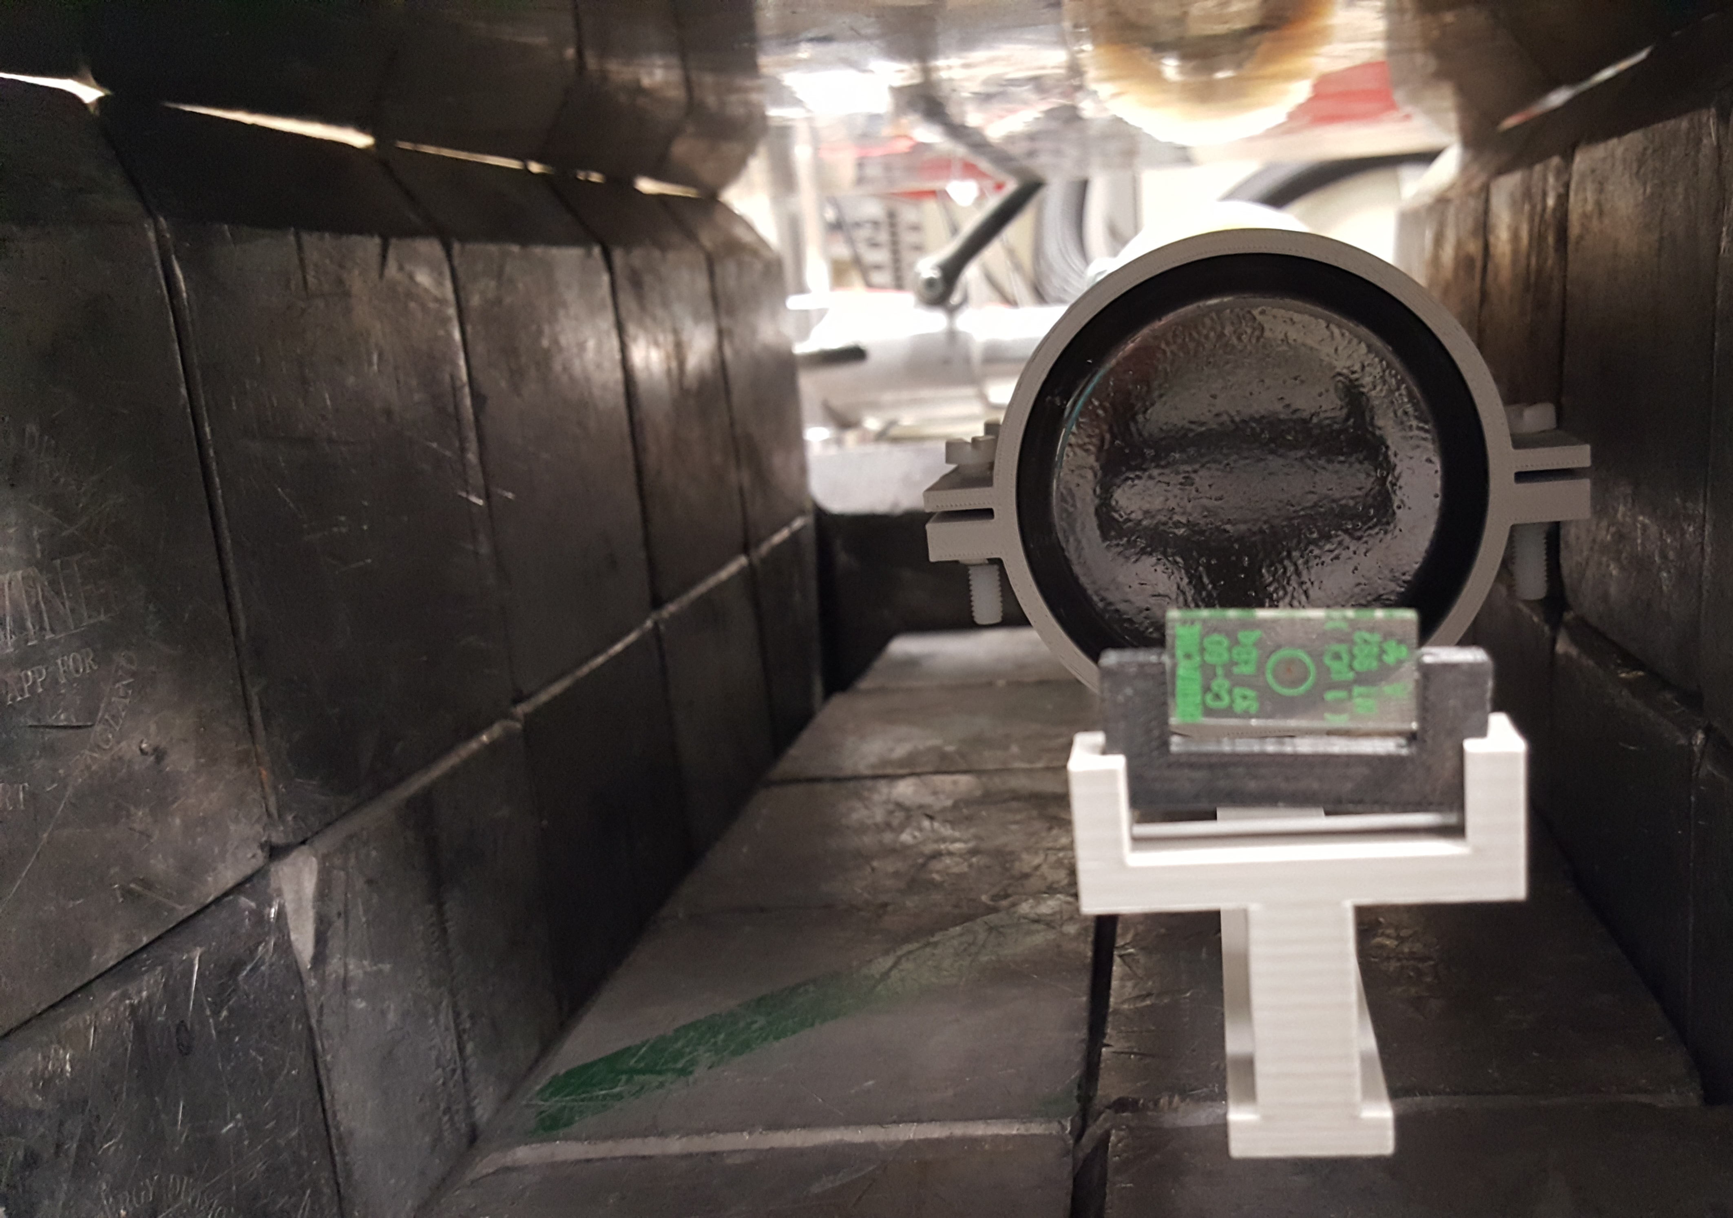
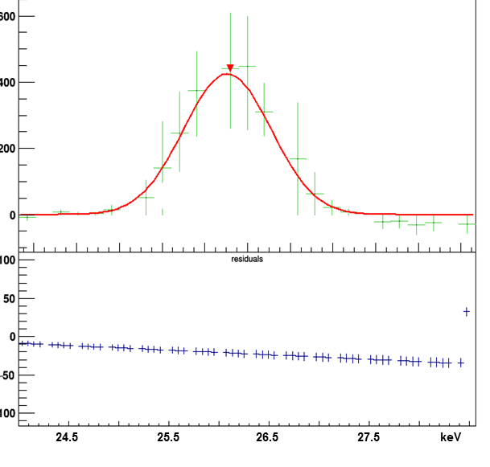
TNAAF - Neutron techniques for
Archaeology and Forensic Science
Project results achieved in 2019
2)Time of flight resolved Prompt Gamma Activation Analysis
Consolidation of quantitative analysis capability
Assessment of software for data analysis using standard sources, low energy emissions recording
Neutron measurements carried out at ISIS
L. Arcidiacono, 2- nd year PhD Thesis at UCL Centre for Doctoral Training in Science and Engineering in Arts, Heritage and Archaeology , within Centro FERMI- Tor Vergata-UCL agreement

Slide 8
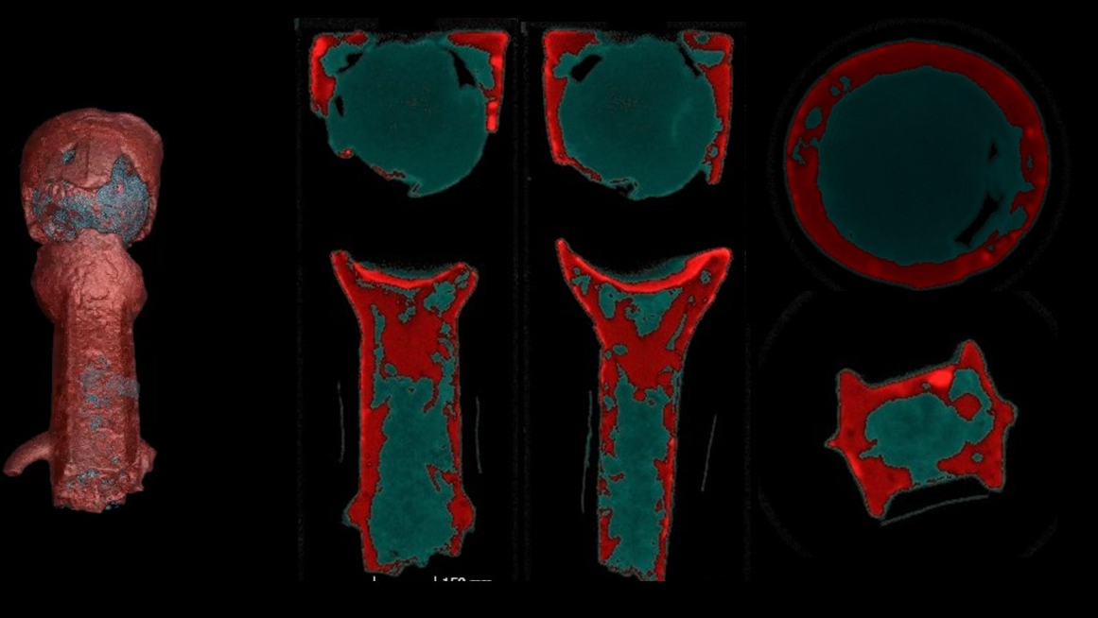
TNAAF - Neutron techniques for
Archaeology and Forensic Science
Project results achieved in 2019
3) Integrated neutron investigations on prehistoric axes at ISIS
Tomography, diffraction, neutron resonance capture analysis, Time of flight –resolved prompt gamma activation analysis. Carried out at ISIS
L. Arcidiacono, 2- nd year PhD Thesis at UCL Centre for Doctoral Training in Science and Engineering in Arts, Heritage and Archaeology , within Centro FERMI- Tor Vergata-UCL agreement

Slide 9
TNAAF - Neutron techniques for
Archaeology and Forensic Science
Project results achieved in 2019- two main publications
1) G. Festa, T. Christiansen, V. Turina, M. Borla, J. Kelleher, L. Arcidiacono, L. Cartechini, R. C. Ponterio, C. Scatigno, R. Senesi & C. Andreani, “Egyptian metallic inks on textiles from the 15th century BCE unravelled by non-invasive techniques and chemometric analysis”, Scientific Reports 9, 7310 (2019).
2) G. Festa, C. Andreani, M. Baldoni, V. Cipollari, C. Martínez-Labarga, F. Martini, O. Rickards, M. F. Rolfo, L. Sarti, N. Volante, R. Senesi1,, F. R. Stasolla, S. F. Parker, A. R. Vassalo, A. P. Mamede, L. A. E. Batista de Carvalho, M. P. Marques,“First analysis of ancient burned human skeletal remains probed by neutron and optical vibrational spectroscopy”, Science Advances 5, eaaw1292(2019)

Slide 10
TNAAF - Neutron techniques for
Archaeology and Forensic Science
Milestones 2019
1) Compton suppression and background optimization systems for T-PGAA (90% completion- Design completed, implementation to be completed)
2) 3 Articles on the project results (100% completion-, 5 published)
3) T-PGAA interface(100% completion-)
4) Three (at least) experiment proposals to be submitted to the ISIS Facility Access procedure on archaeometric standards, ancient books, oricalchos. (100%)

Slide 11
TNAAF - Neutron techniques for
Archaeology and Forensic Science
Plan of activities 2020 – 2022 (Milestones)
Instrumentation procurement and commissioning within ISIS@MACH infrastructure for VIEWLAB
Detector/cabinet for Tomography
Portable FTIR

Slide 12
TNAAF - Neutron techniques for
Archaeology and Forensic Science
Plan of activities 2020 - 2022
2a) Limit Of Detection and Limit Of Quantification for the Xraman (collaboration to VIEWLAB)
2b) Hardware completion for the T-PGAA system
3) Three experiments at large scale infrastructures
4) Four articles on the project results

Slide 13
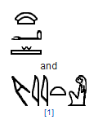
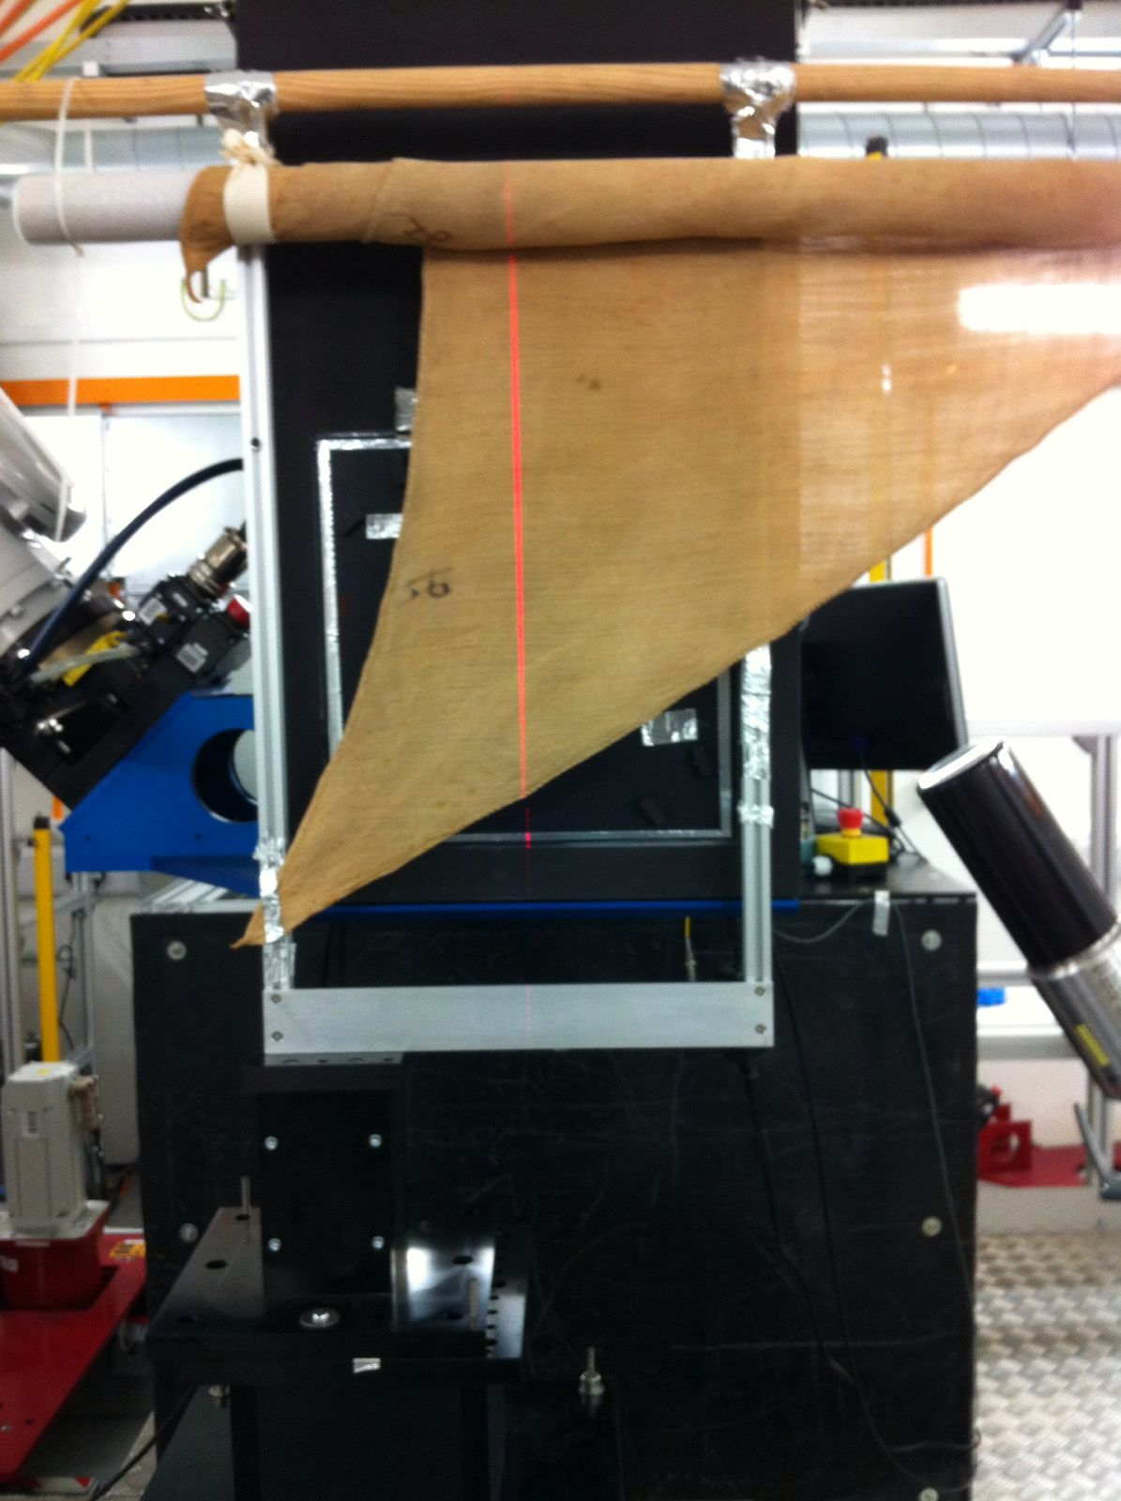
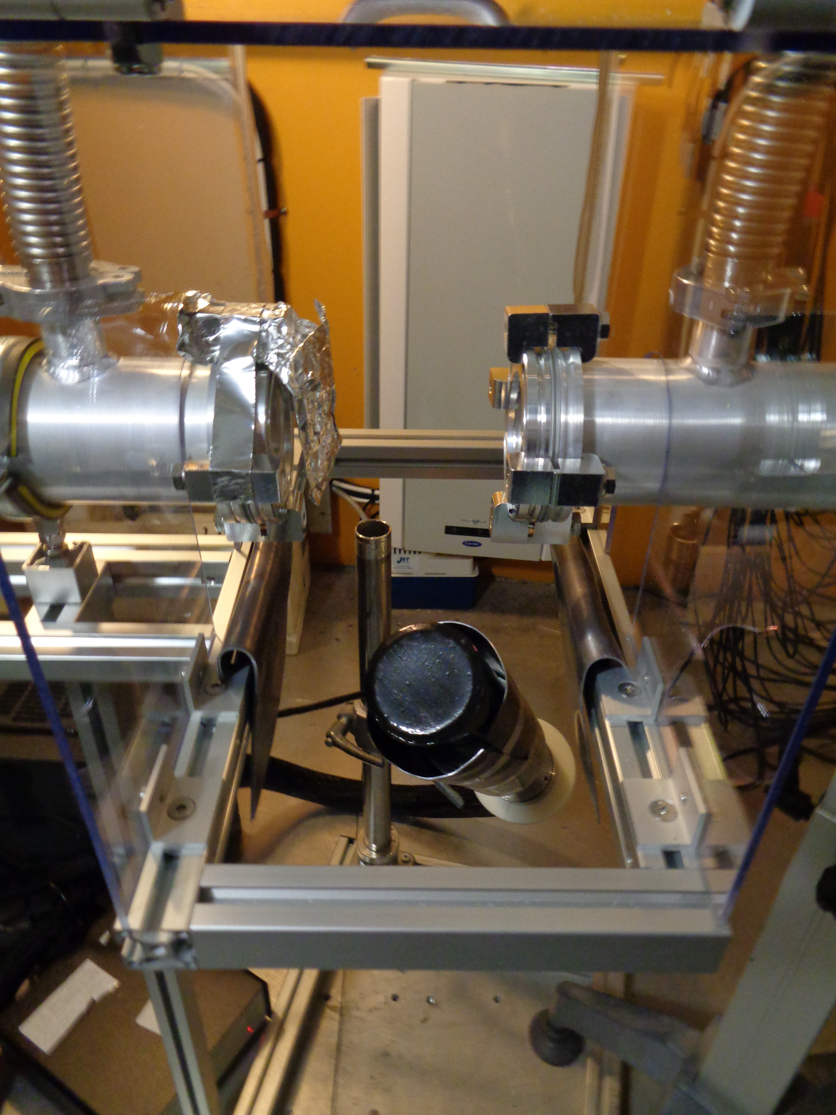
TNAAF - Neutron techniques for
Archaeology and Forensic Science
Requested funding in the 3-year period:
Grants: 1 grant for 2022 (assegno di ricerca, 25 keuro); Consumables (15keuro), 1 detector (30keuro for Compton suppression completion)
Travel/missions: 15 keuro/year for the years 2020,2021,2022

Slide 14
Activities set within ISIS@MACH
Research Infrastructure from the alliance of Centro FERMI and the University of Rome Tor Vergata
A node of the Global Infrastructure ISIS
ISIS@MACH will provide essential tools for comprehensive multidisciplinary projects from nano-characterisation to synthesis and technique development , to strengthen links between Italian researchers and the wider neutron and muon communities. This is the first ISIS hub outside of the UK
The users’ access at ISIS@MACH includes a “network of instrumentation"
Approved user projects will have access to ISIS@MACH suite of instruments and support for performing services and analysis of materials (for Heath, Space, Environment, Energy, Cultural heritage, ICT) at both the Hub in the Region Lazio and STFC's ISIS neutron and muon source

Slide 15
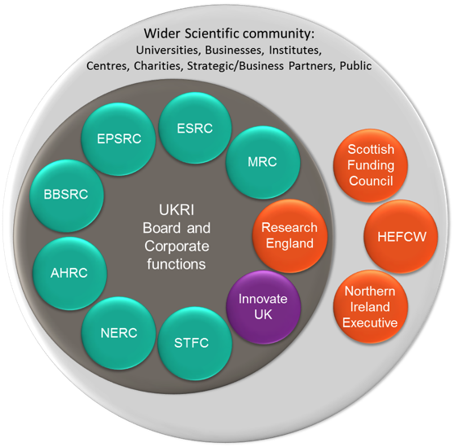
What is ISIS@MACH Research and Innovation?
Energy
Particle & light probe Instrumentation
OBJECTIVES
Knowledge
Innovation
Economy
Society
USER OFFICE
Green Economy
ISIS@MACH functions
Artificial Intelligence
ICT
Health
Cultural heritage
Space
Courtesy of STFC

