Slide 1
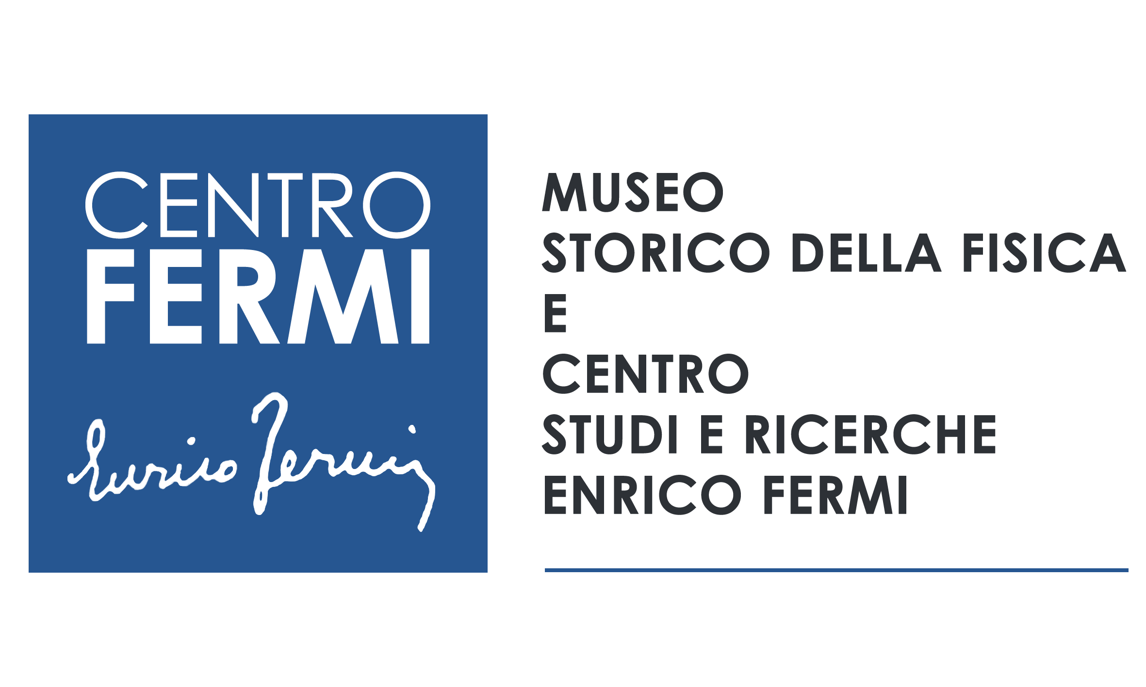
The Fermi Center, the youngest Italian research Institute, is also an Historical Museum of Physics.
Its mission is also to preserve and spread in Italy and in the world the historical memory of the life and works of Enrico Fermi through the setting up of a new historical museum of physics and to favor a wide dissemination and communication of scientific culture.

Slide 2
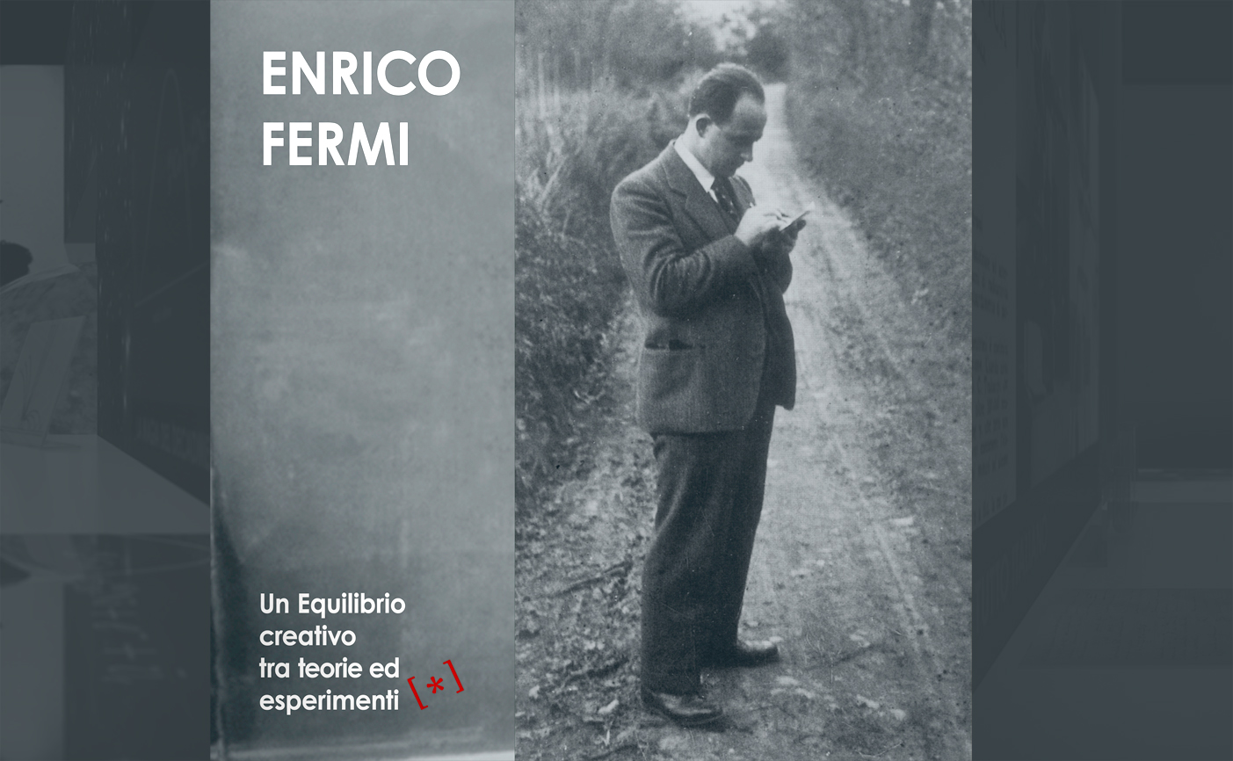
Genova, 2015
Bologna, 2016

Slide 5
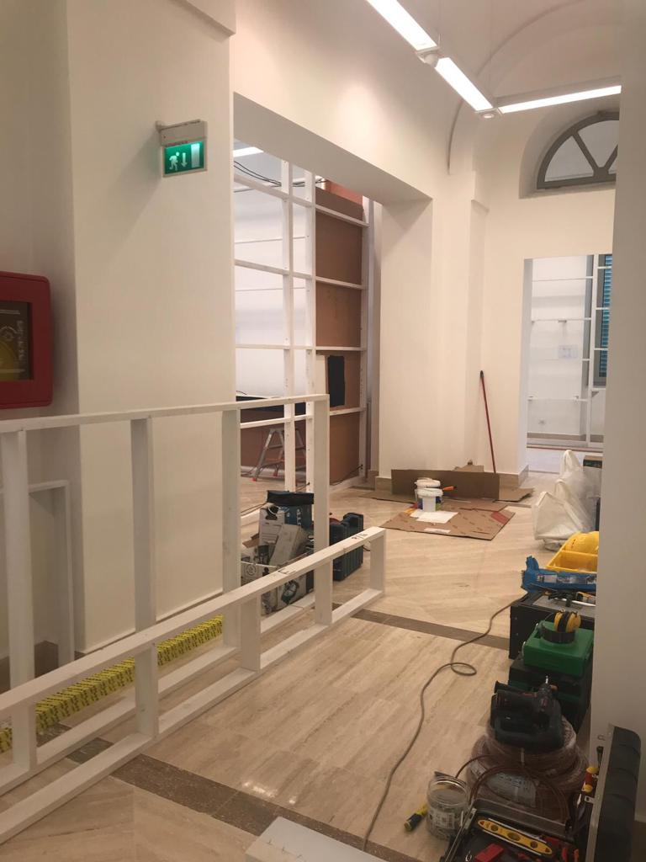
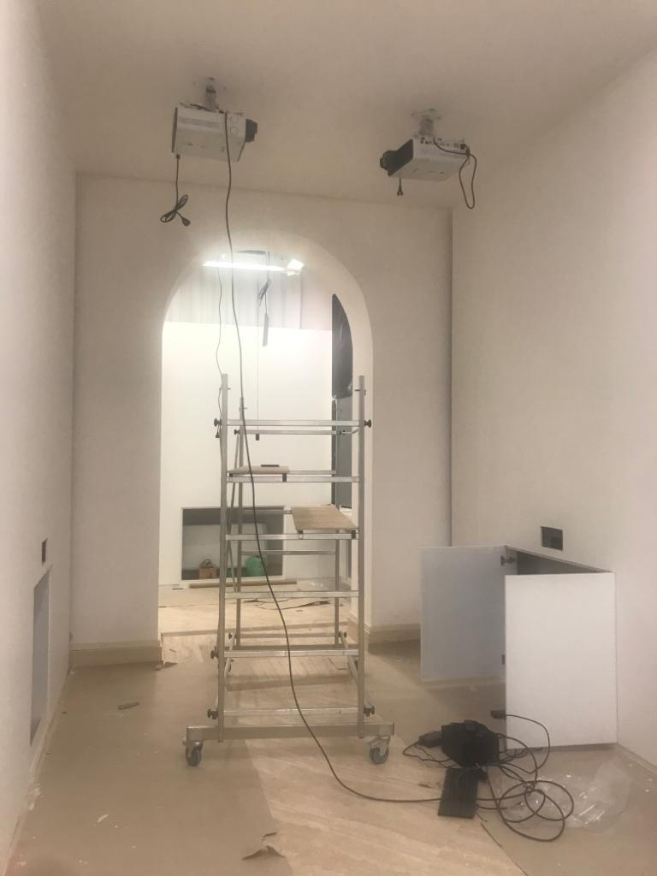

Slide 6
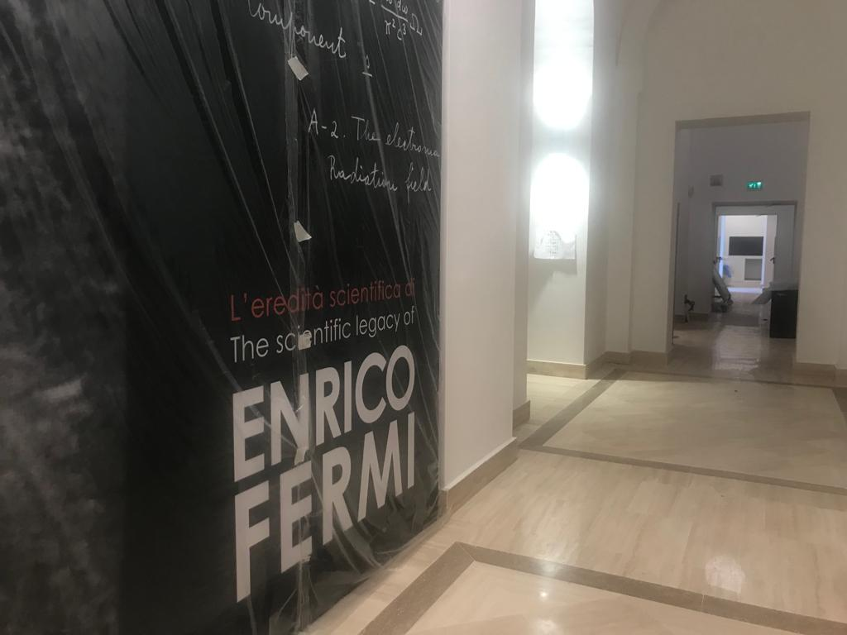
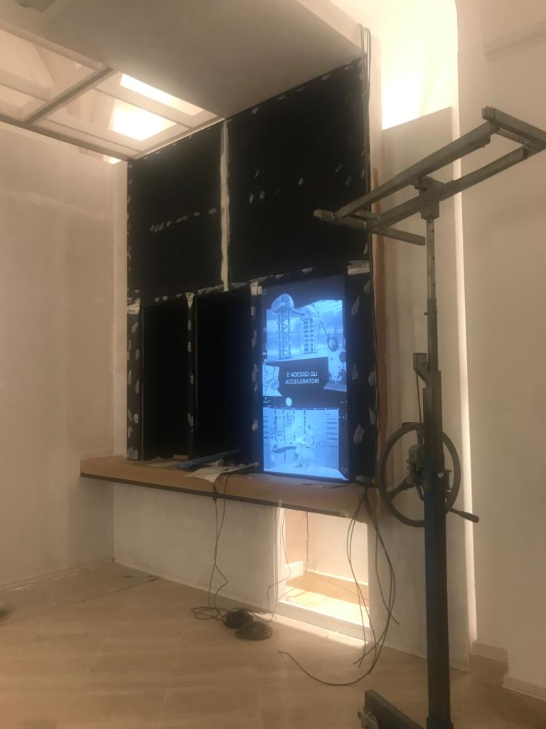

Slide 7
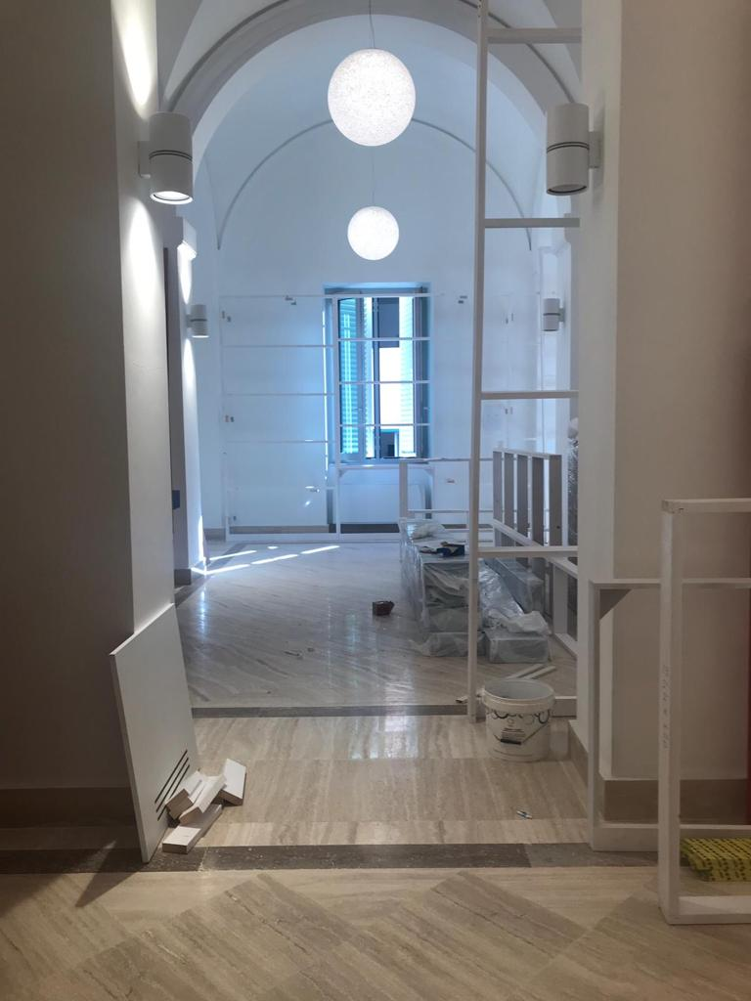

Slide 8
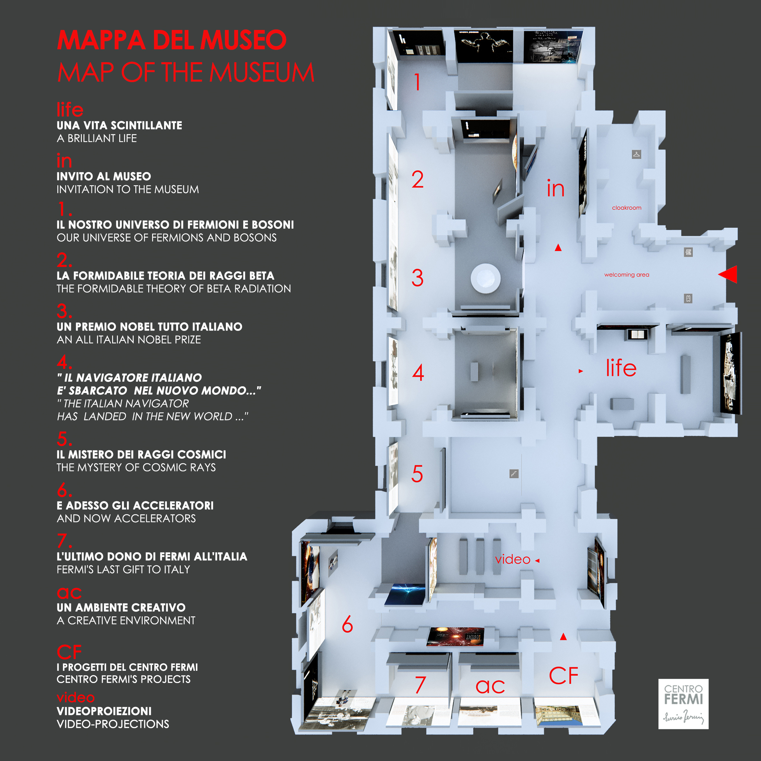

Slide 9
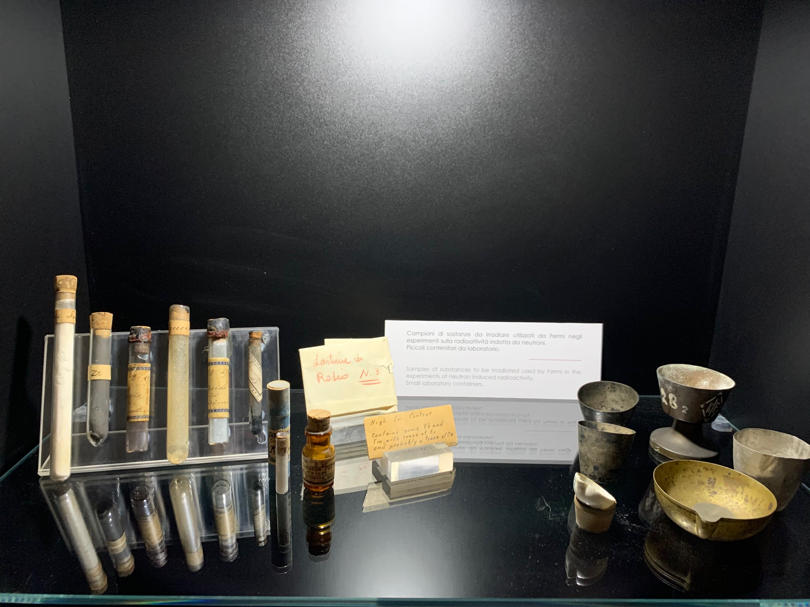
Laboratory tools used within this building by Fermi and his team of collaborators

Slide 10
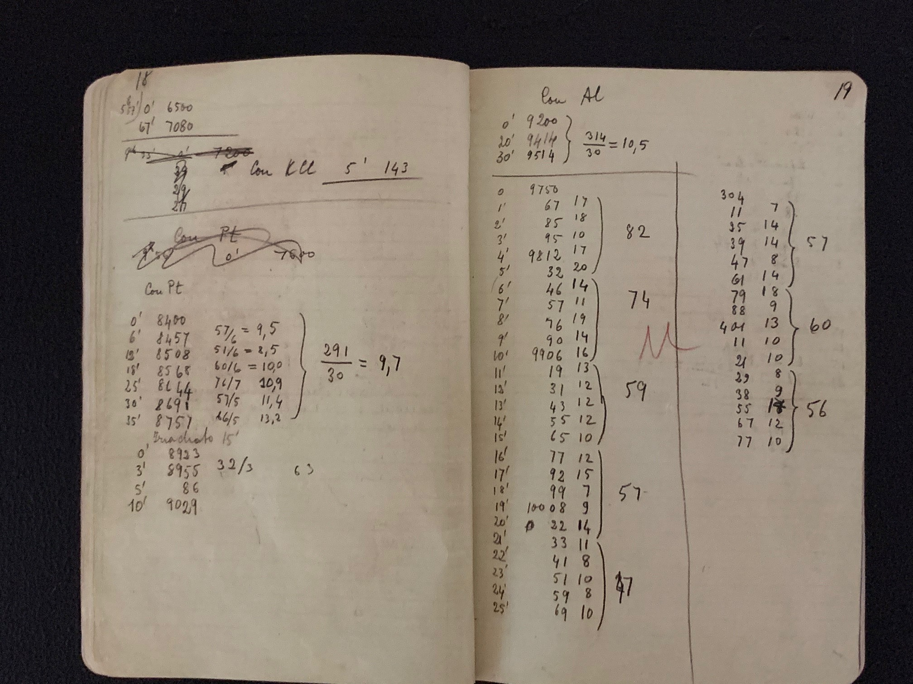
Autograph and unpublished documents

Slide 11
Frac
The frac worn in 1938 on the occasion of the withdrawal of the Nobel Prize for Physics

Slide 12
Goals
Agreements and collaborations
Access to the greatest number of visitors.
Innovative research activities - in various scientific fields - linked to the Museum
"Tonight at the Museum”
Playful approach to science
Itineraries and routes….

Slide 13
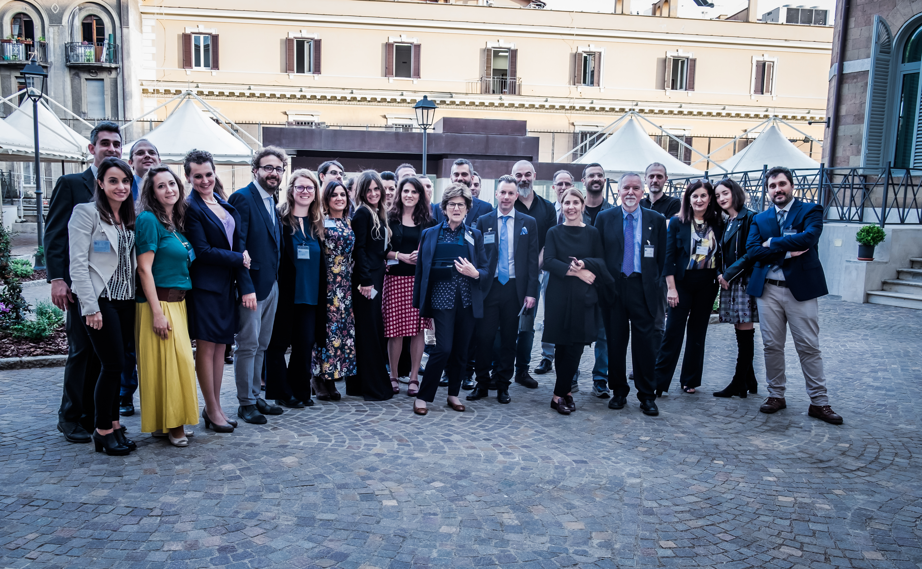

Slide 14
THANK YOU FOR YOUR ATTENTION !

