Slide 1
How to install CERN ROOT on Mac OS X
Fabrizio Coccetti
Museo Storico della Fisica e Centro Studi e Ricerche ‘Enrico Fermi’
Oct 16, 2019

Slide 2
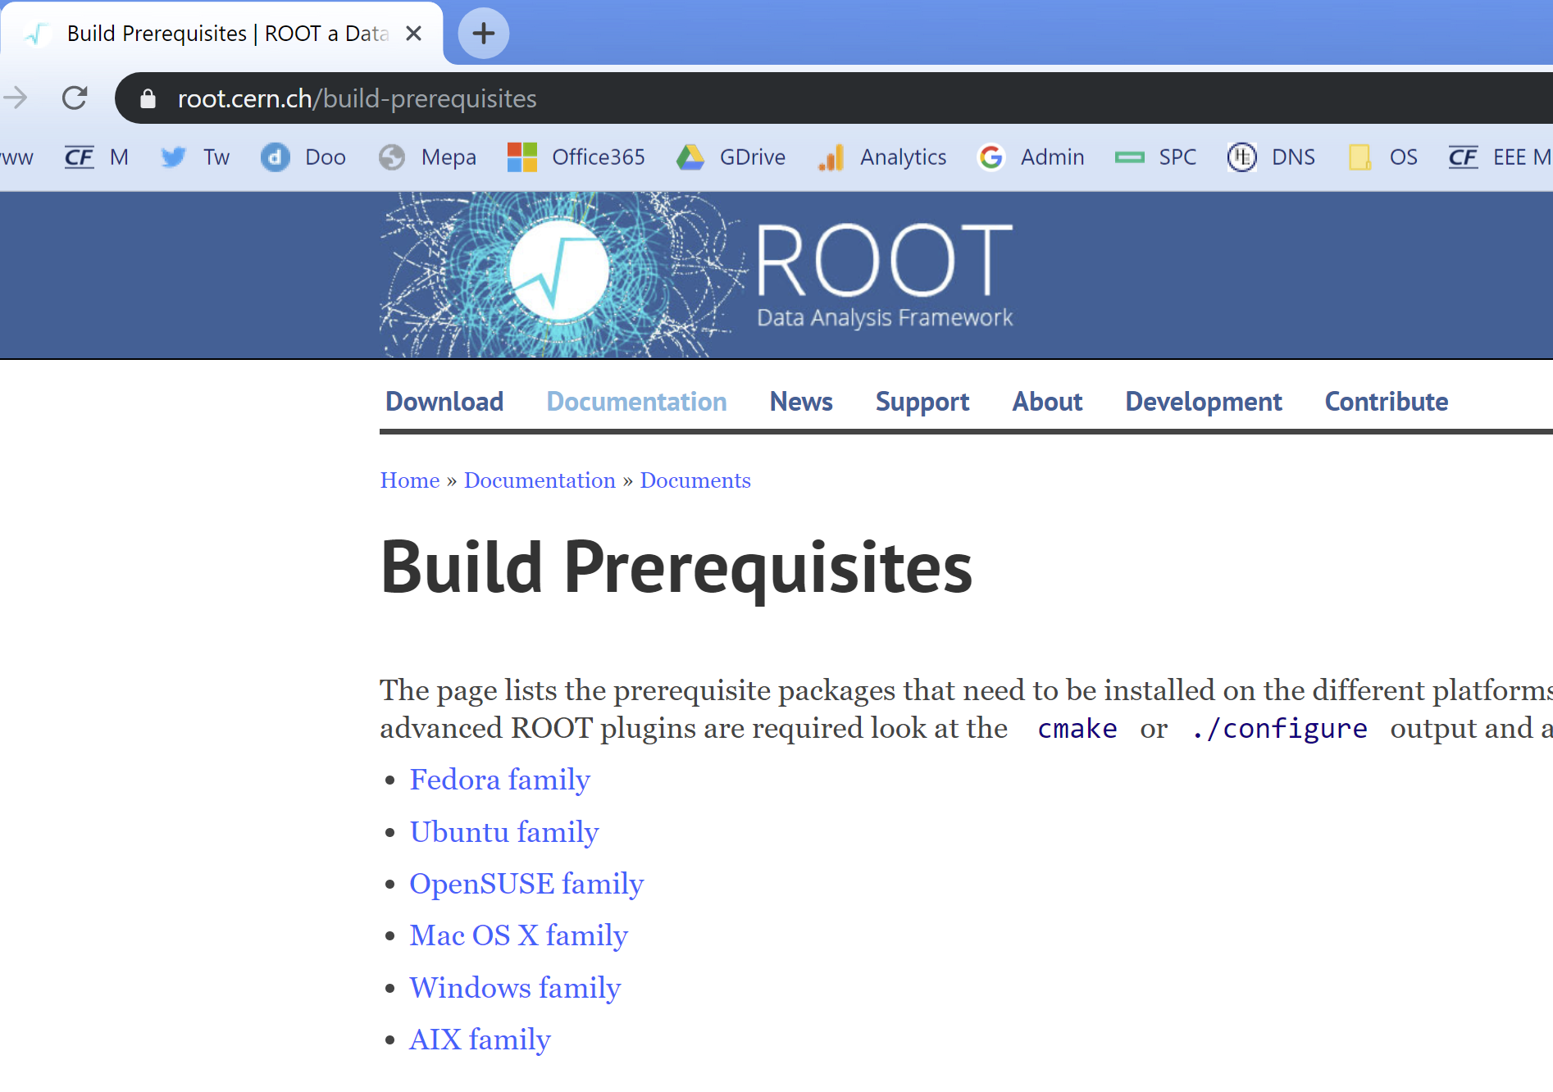
Prerequisites
Prerequisites are mandatory if you plan to install CERN-ROOT
Please check the webpage:
https://root.cern.ch/build-prerequisites

Slide 3
In particular, for Mac OS X

Slide 4
Search for xcode in the App Store and press INSTALL

Slide 5
To install ROOT, first you should check which Mac OS X version you have

Slide 6
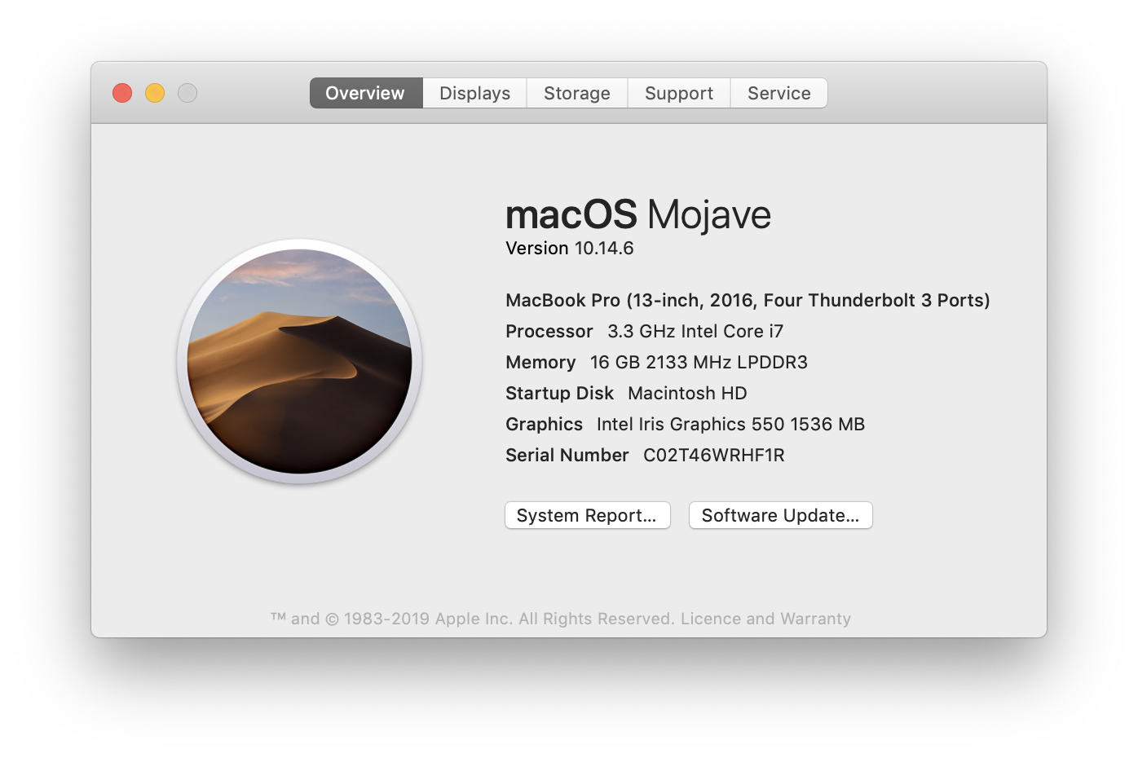
MacOS X version number

Slide 7
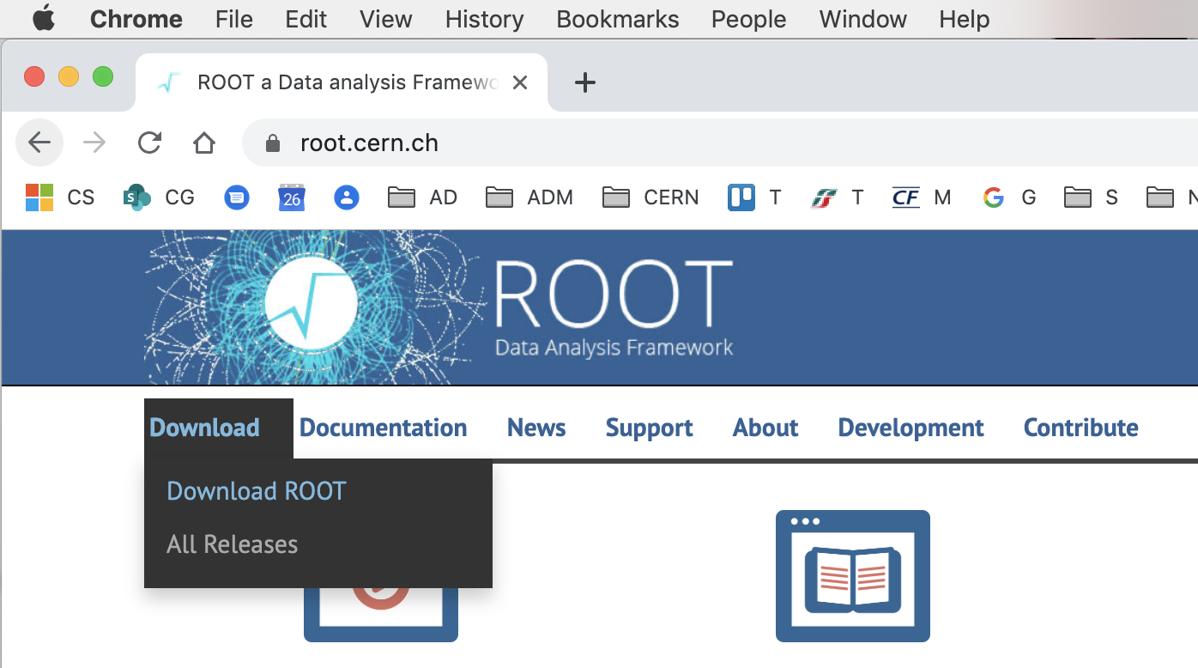
Now you can download ROOT

Slide 8
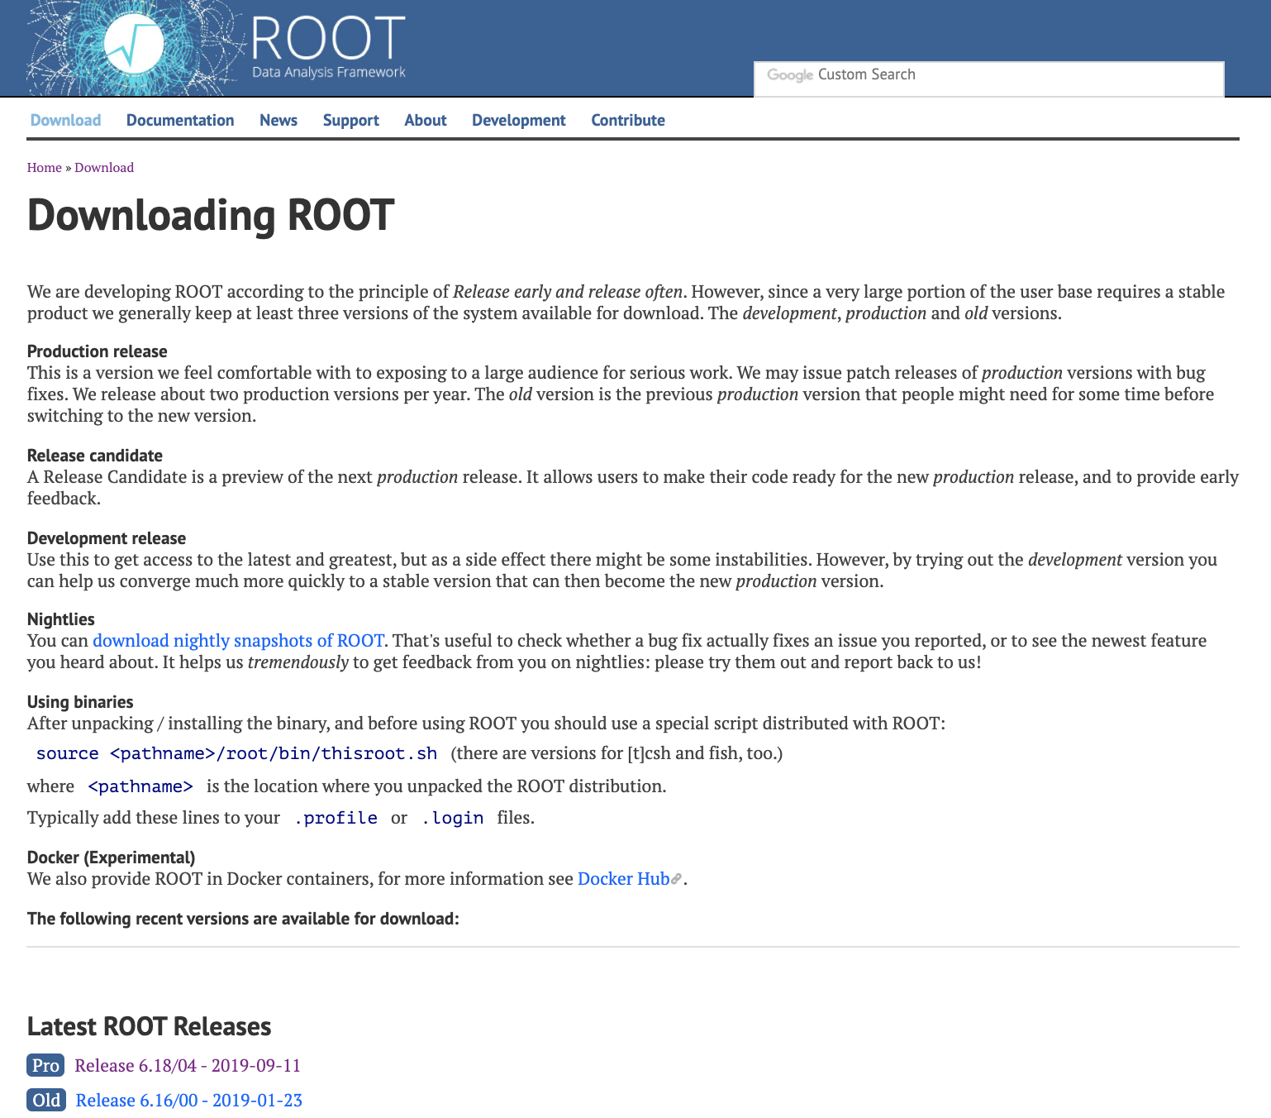
You can download the “Latest ROOT Release”

Slide 9
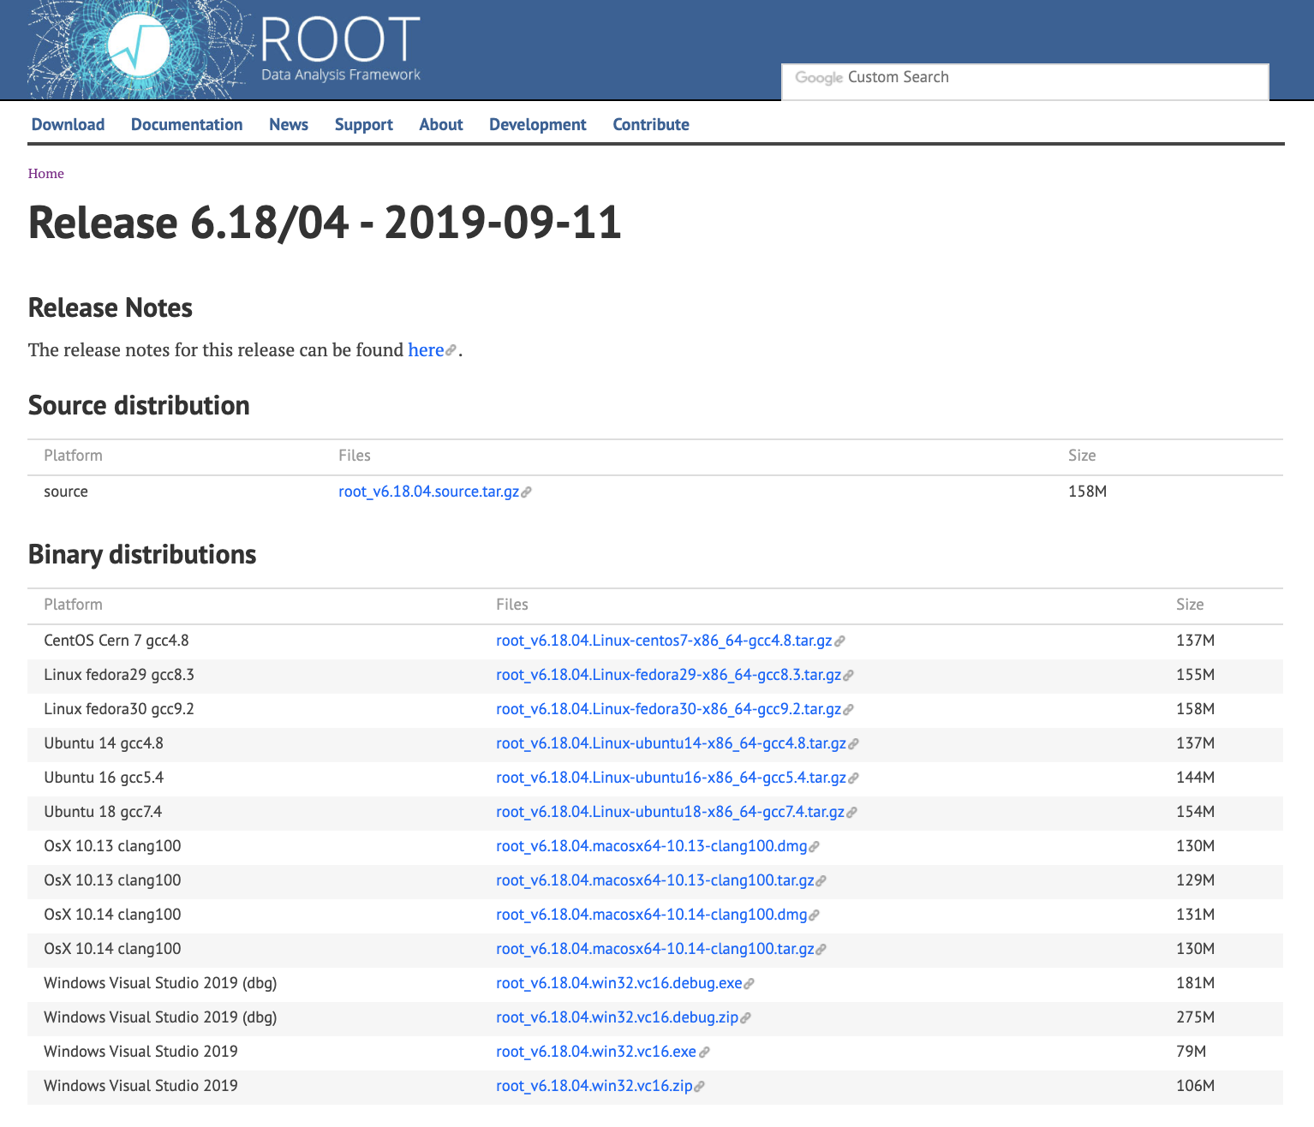
Download the “.dmg” version that matches your MacOS version

Slide 10
If you have linux, you can compile from source distribution, or you can download your own binaries

Slide 11
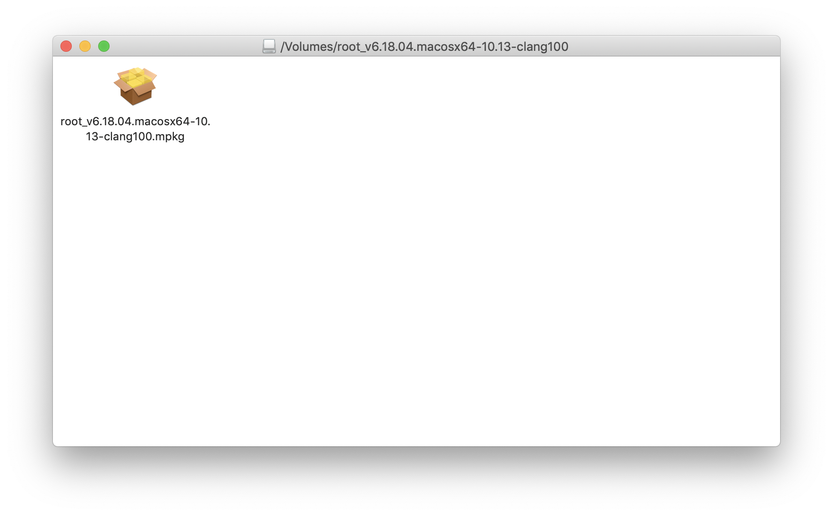
After you downloaded the “.dmg” file on Mac, just double click on it to see this window

Slide 12
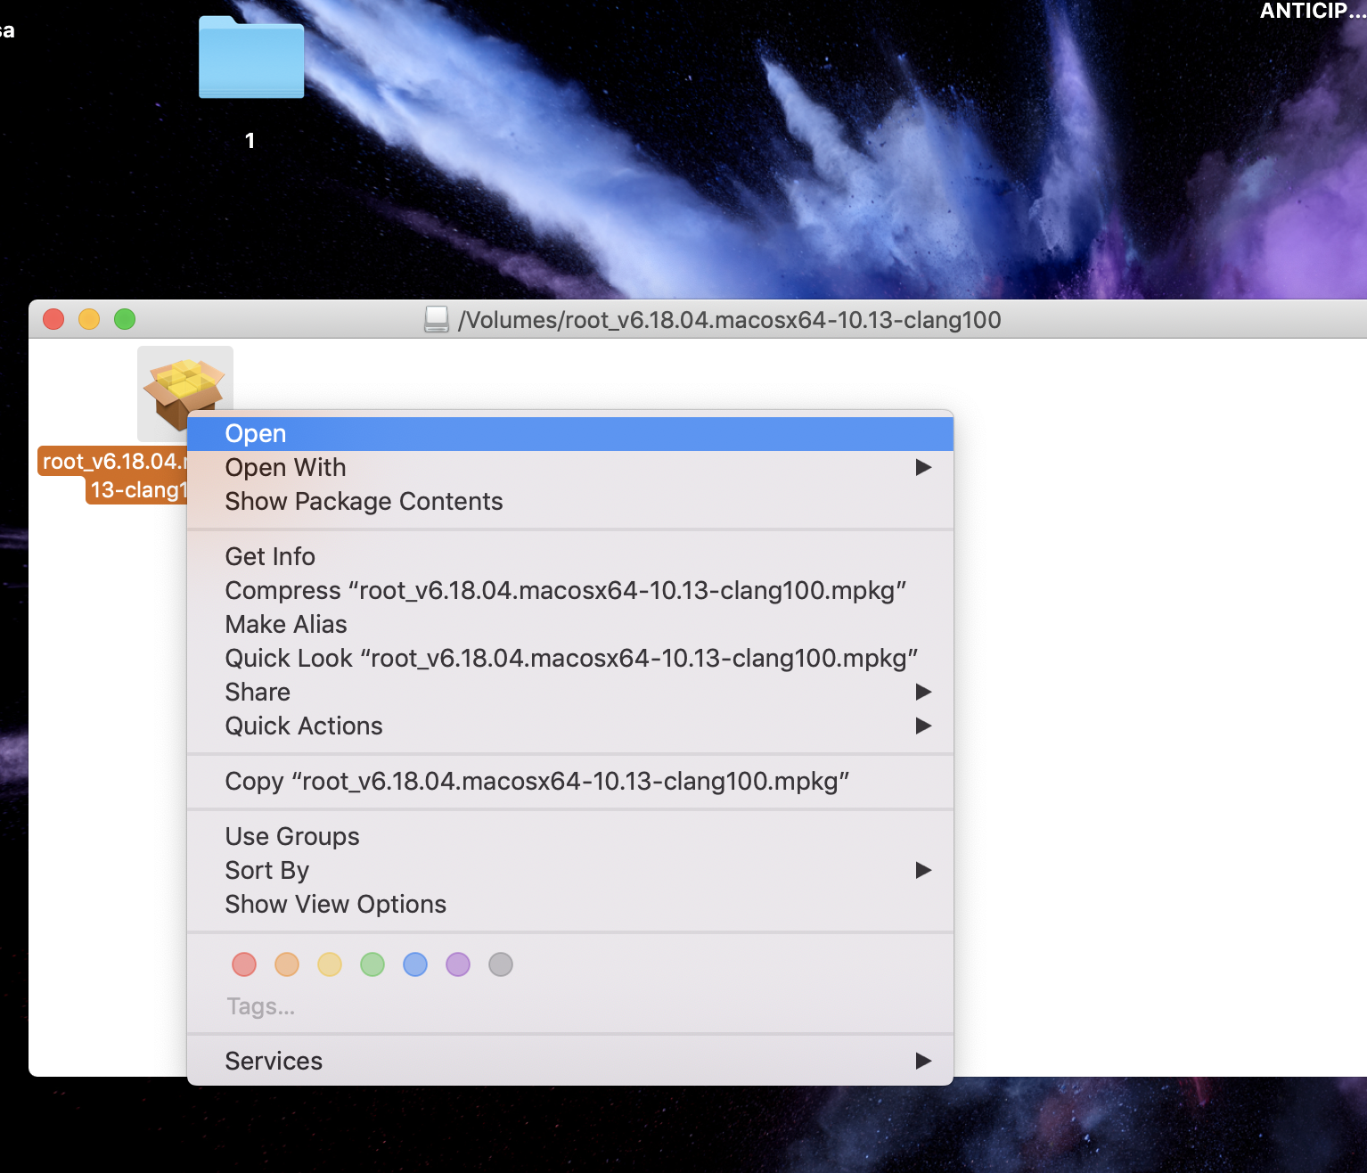
Do not double click on the “.pkg” file. Instead, right click on it and choose open

Slide 13
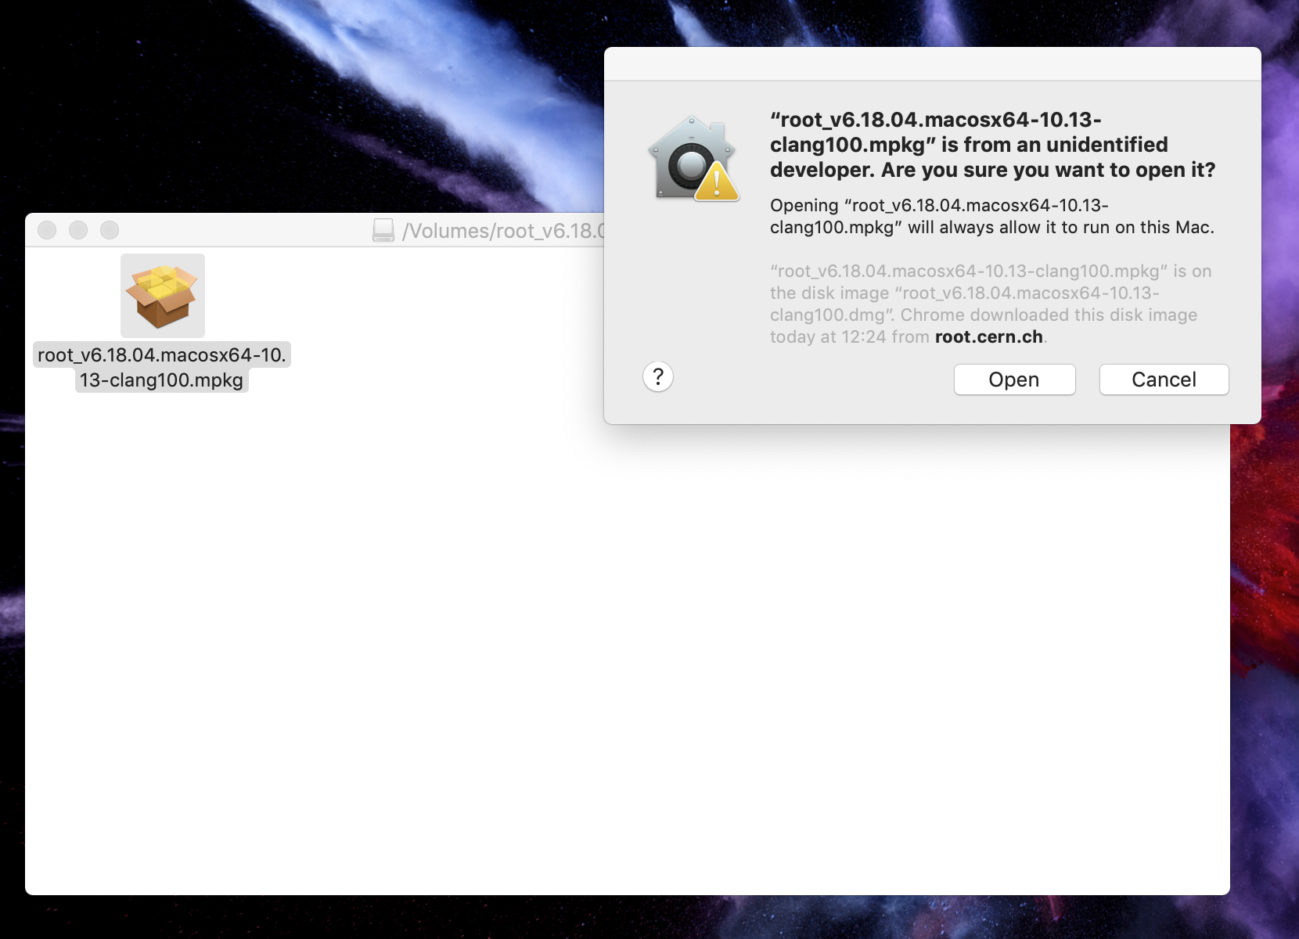
Choose “open” to authorize root.cern.ch

Slide 14
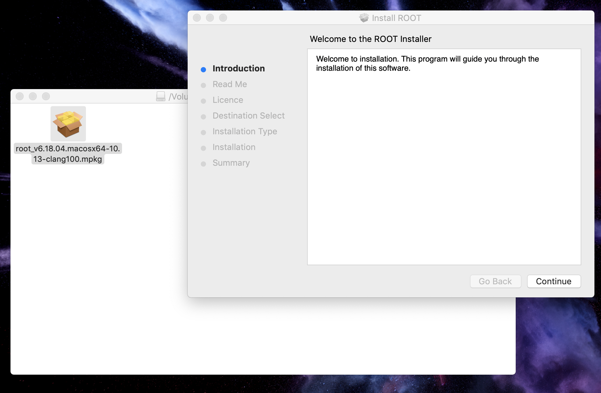
Installing ROOT on Mac OS X

Slide 15
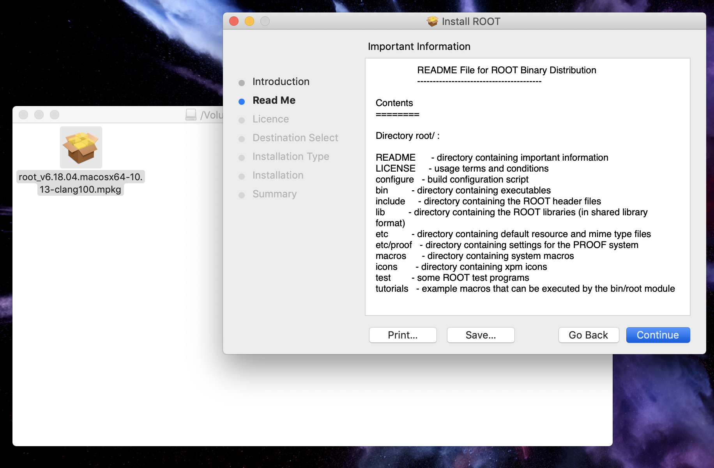
Installing ROOT on Mac OS X

Slide 16
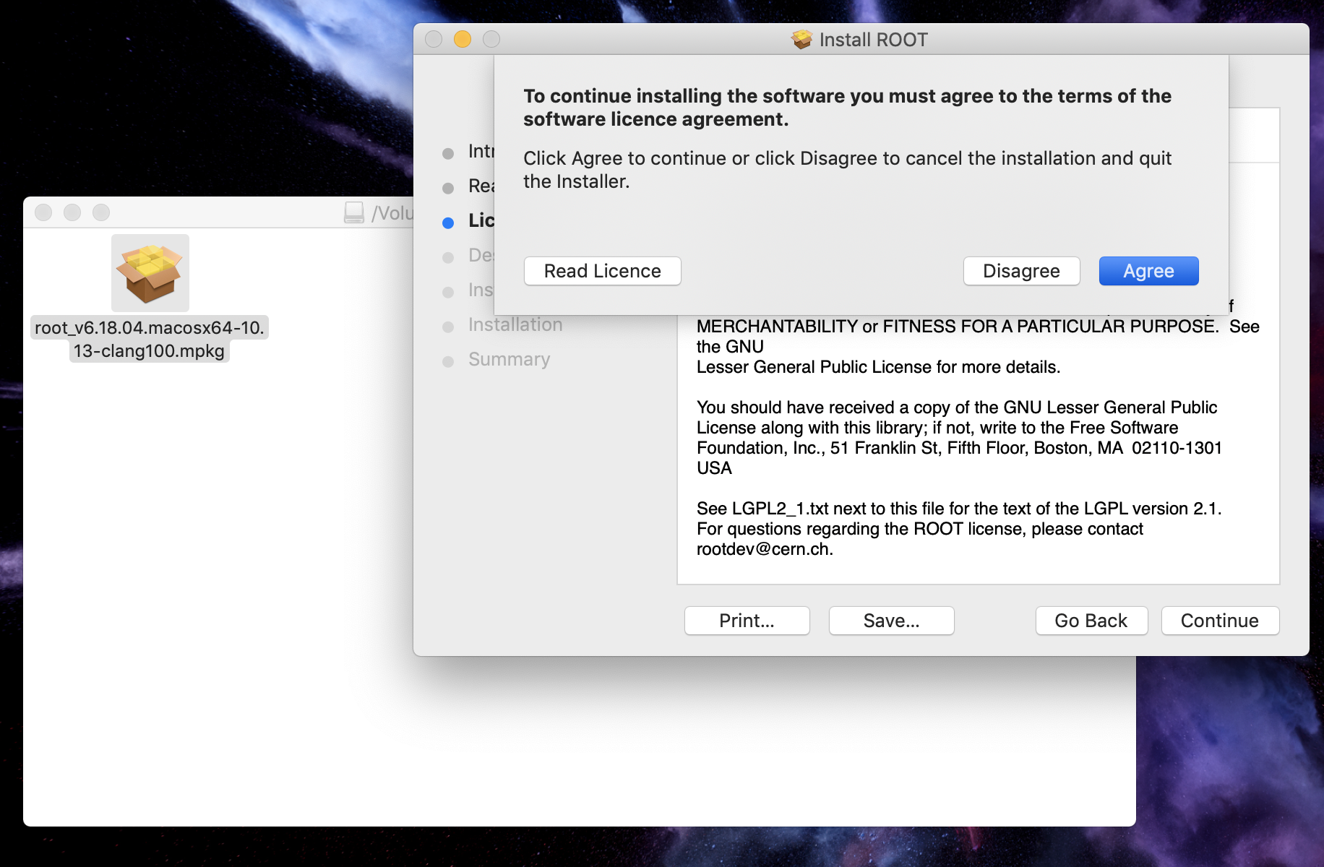
Installing ROOT on Mac OS X

Slide 17
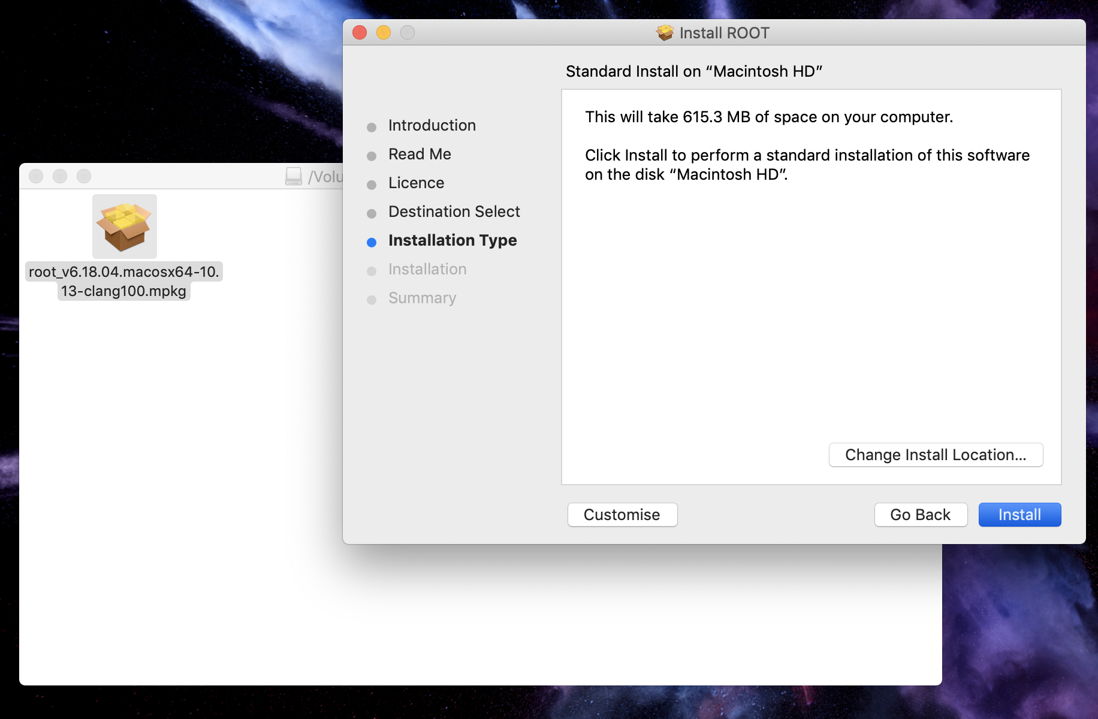
Installing ROOT on Mac OS X

Slide 18
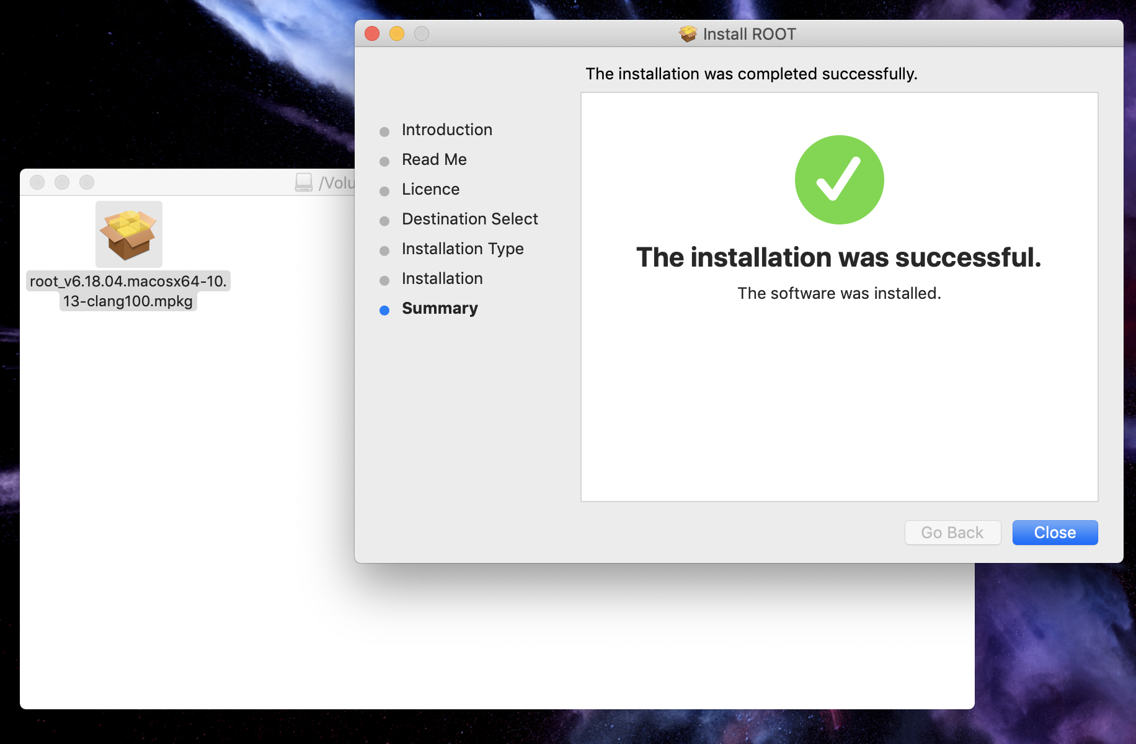
Installing ROOT on Mac OS X

Slide 19
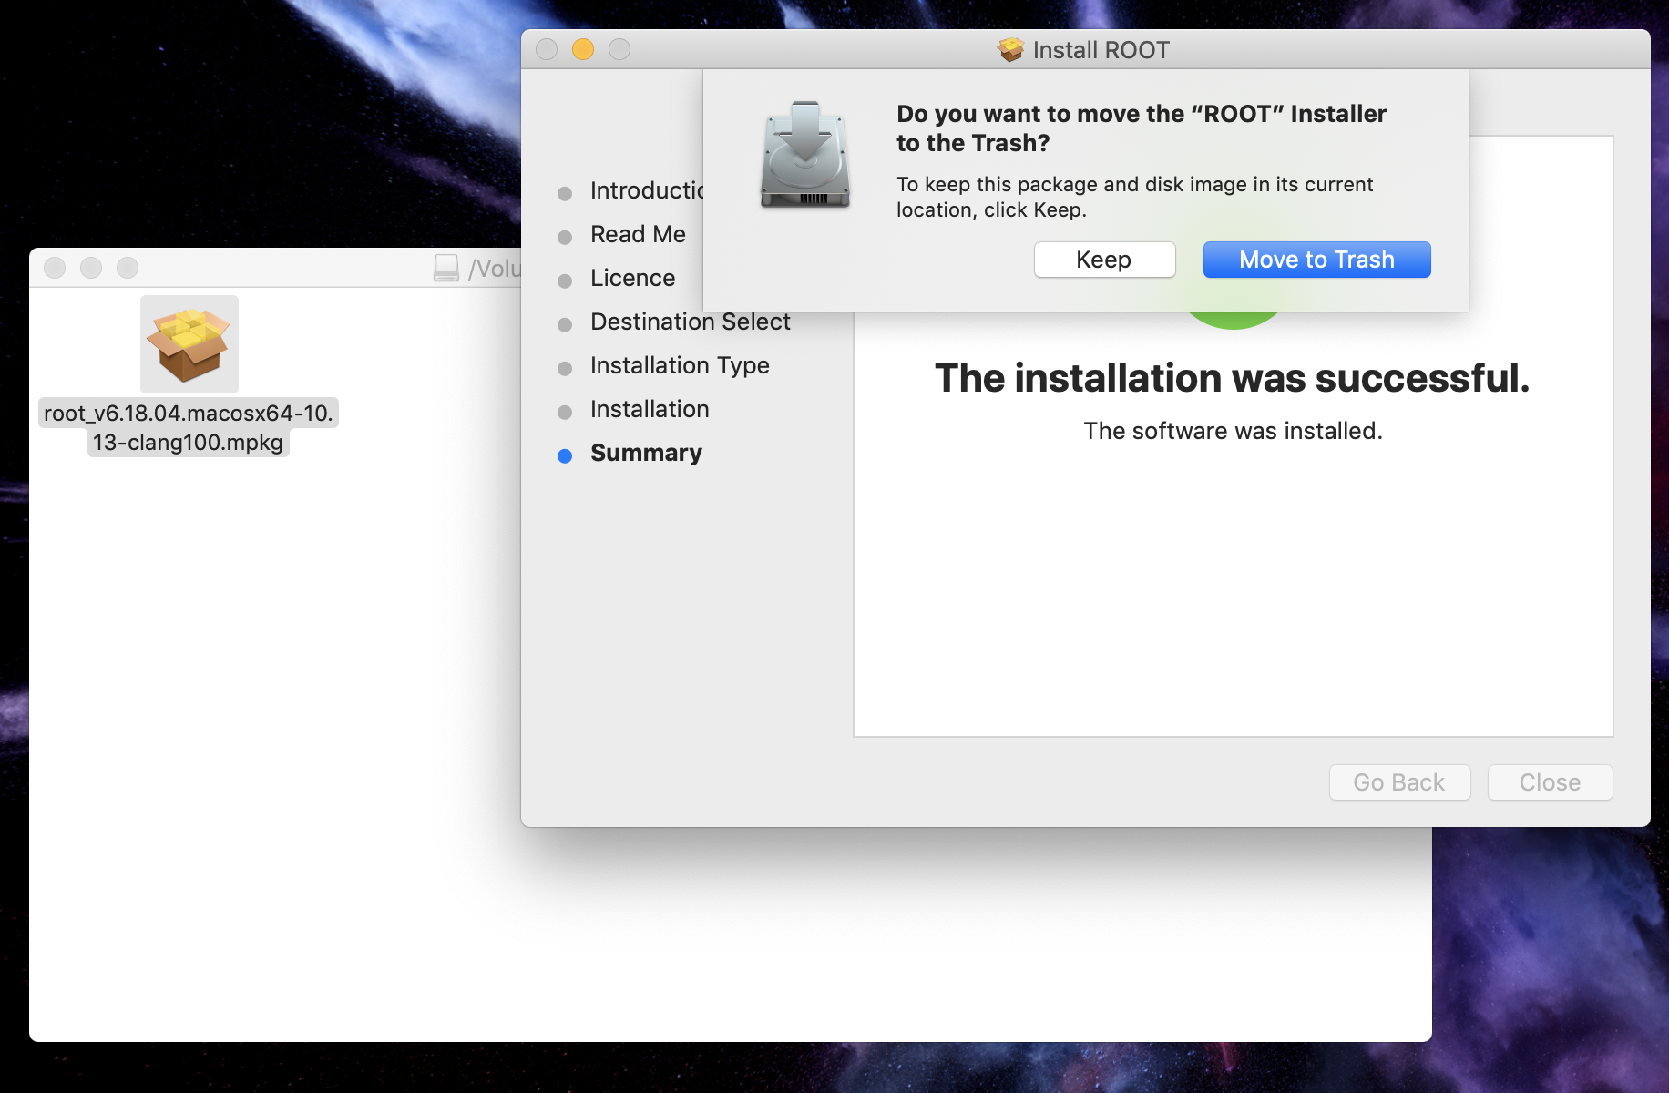
Installing ROOT on Mac OS X

Slide 20
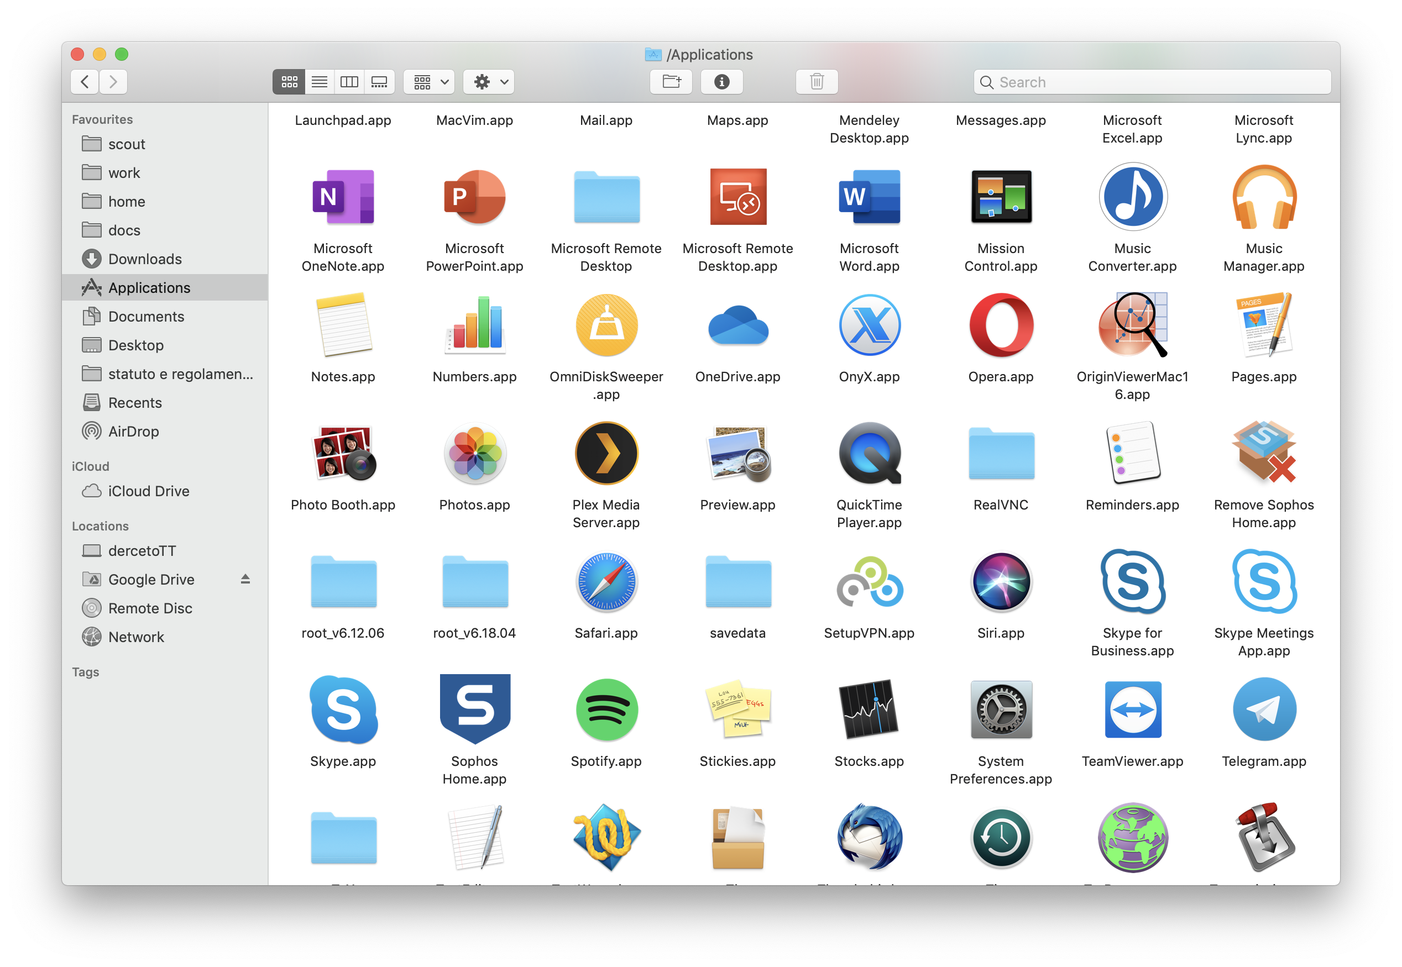
Installing ROOT on Mac OS X

Slide 21
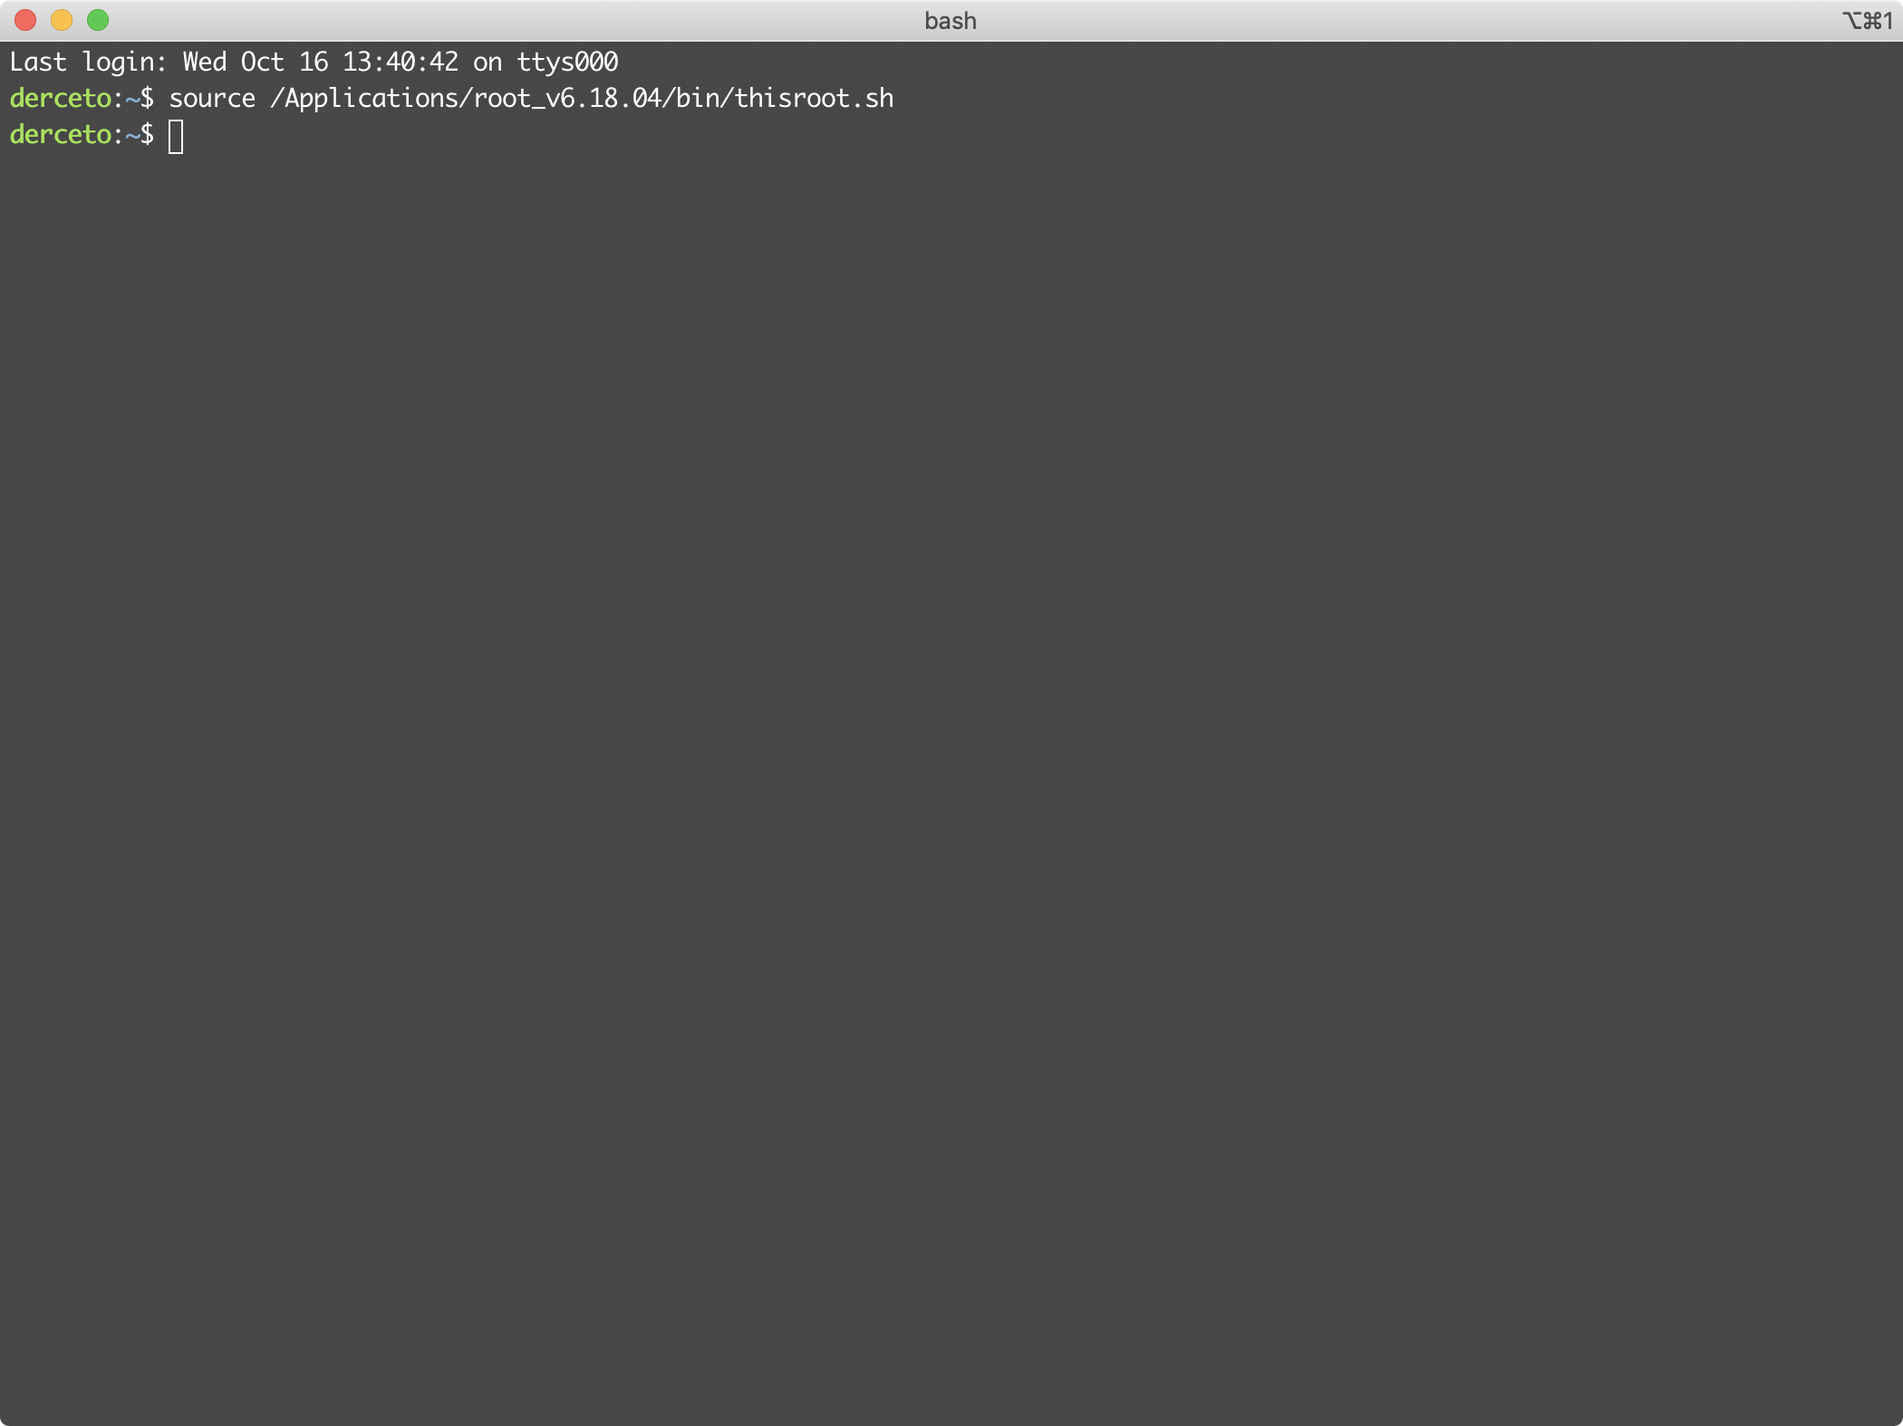
Installing ROOT on Mac OS X

Slide 22
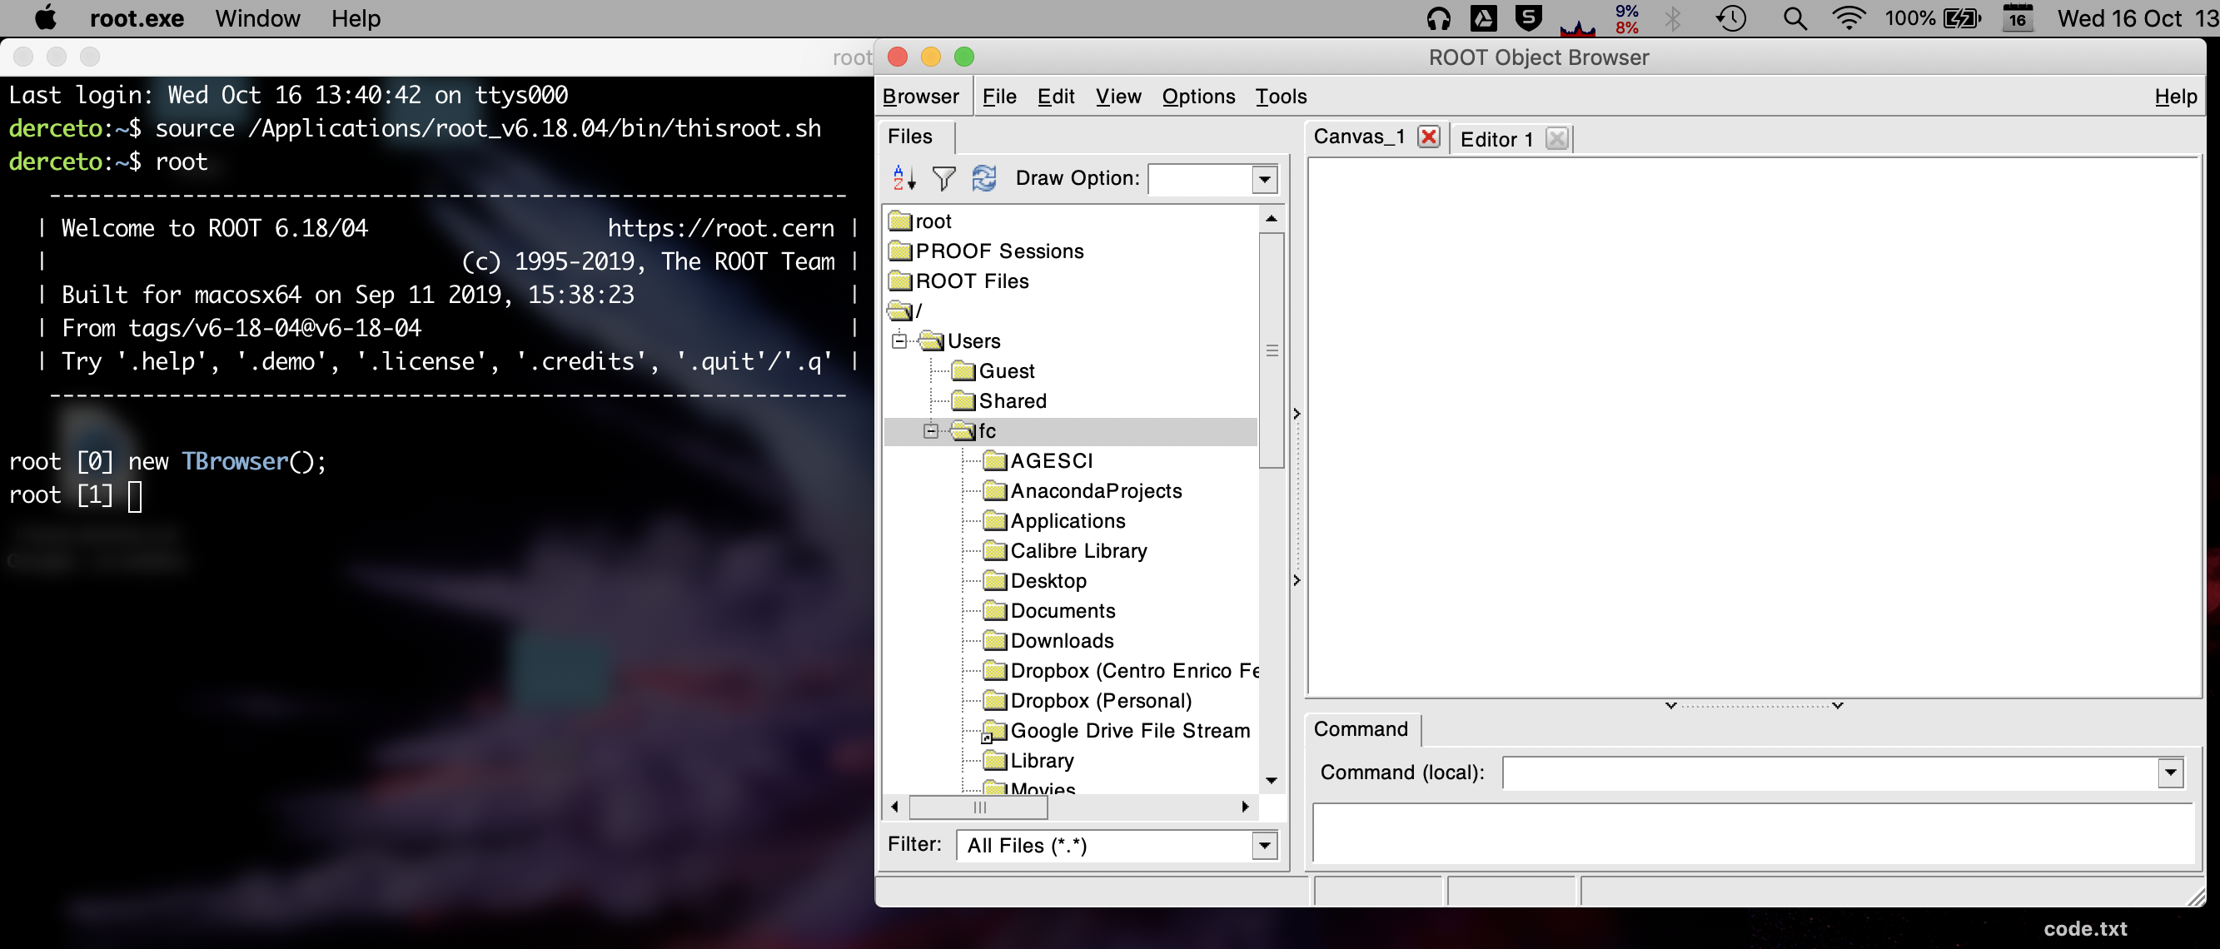
Installing ROOT on Mac OS X

