Slide 1
Chamber construction activities at CERN - autumn 2019
Despina Hatzifotiadou
INFN Bologna – Centro Fermi - CERN

Slide 2
HSSIP : High School Students Internship Programmes
Launched at CERN in 2017
5 national programmes each year
24 high-school students (>16) spend two weeks at CERN
Visits – lectures – work on project (groups of 2)
All students present reports on their projects at the end
EEE at CERN has hosted students from
HSSIP 2017 France 22 October – 3 November (4 students)
HSSIP 2019 Sweden 10 -23 June (3 students)
Each group constructed an EEE chamber : pool of spare MRPCs
https://www.vt.se/nyheter/vastervik/fick-praktisera-pa-varldskanda-cern-om5351328.aspx interview by Lucas Vacha on local paper

Slide 3
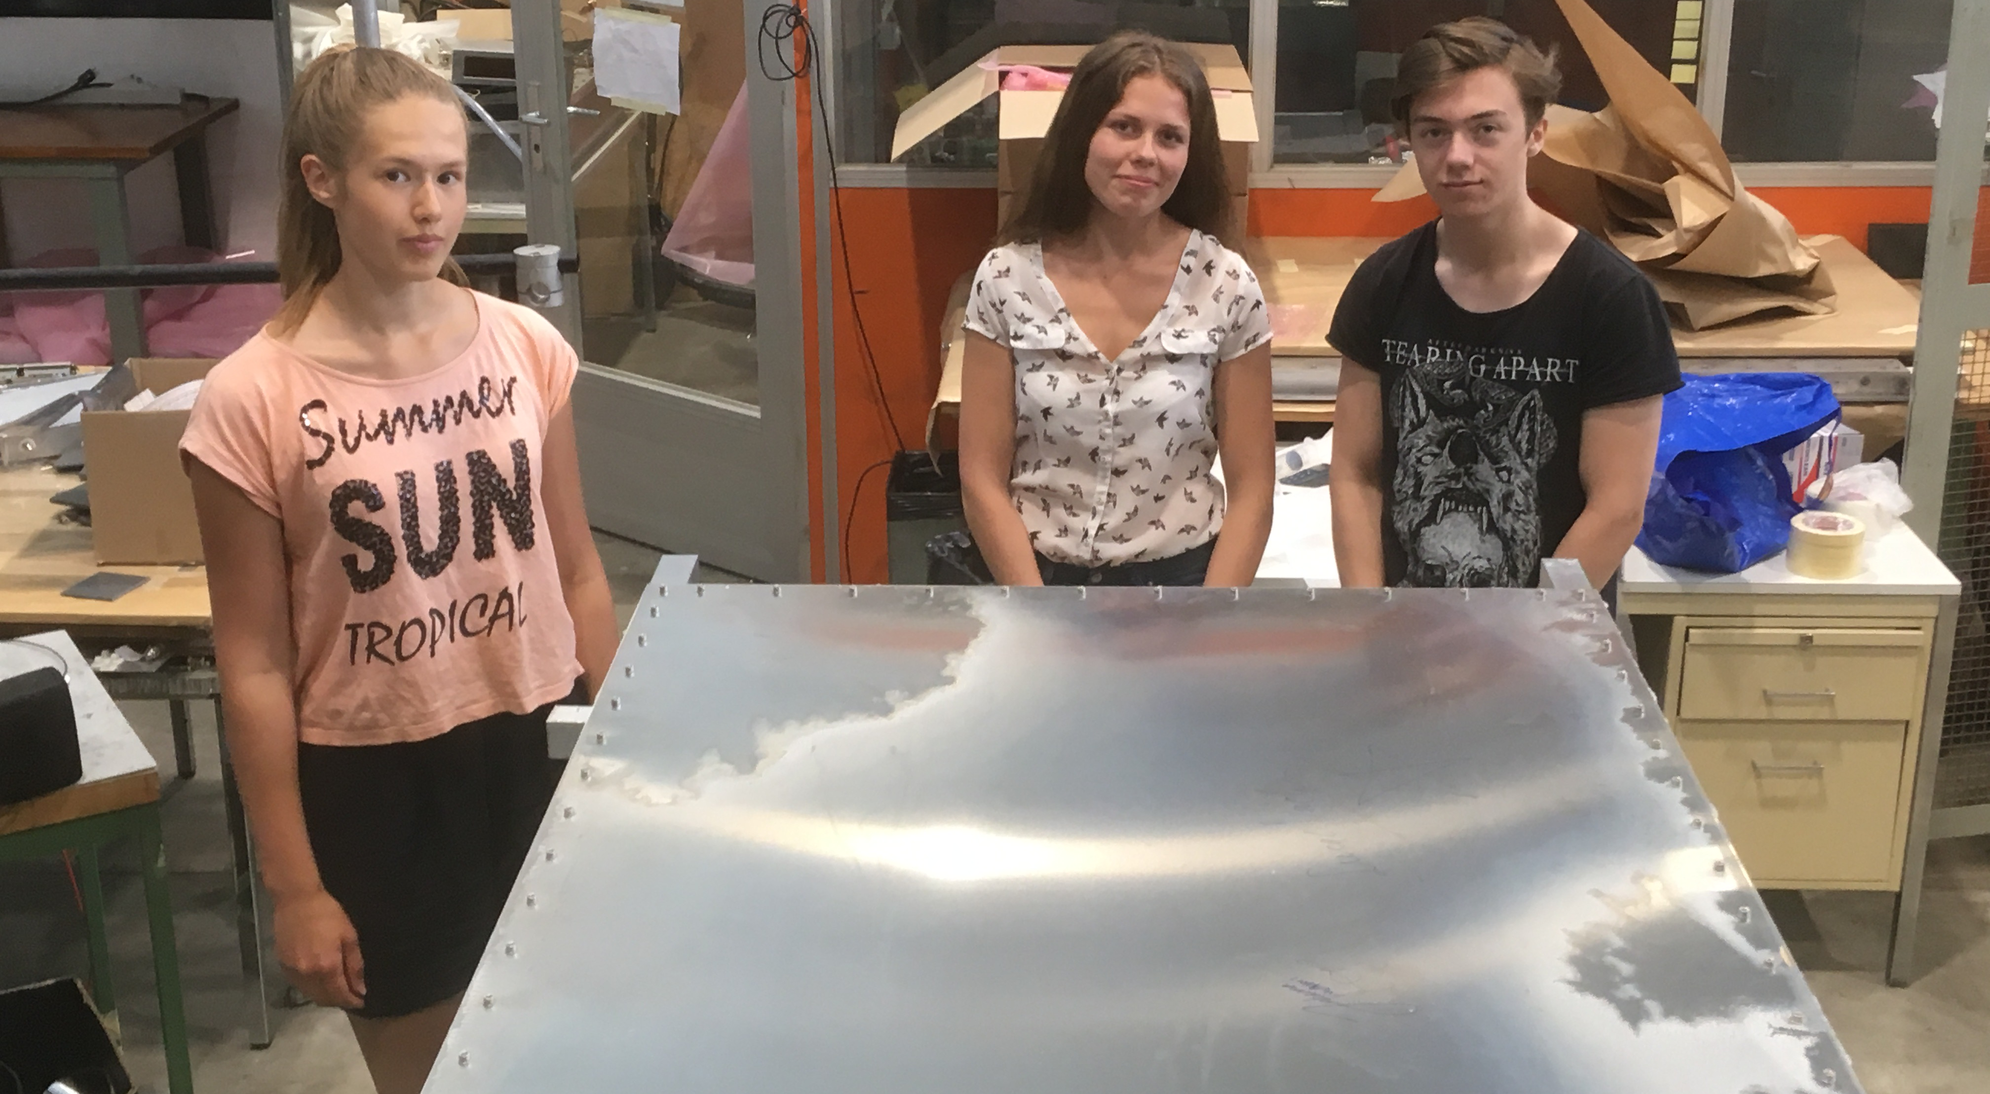
HSSIP : High School Students Internship Programmes
Swedish students HSSIP 2018

Slide 4
Activities in autumn 2019
HSSIP 2019 : Austria 20 October – 2 November
We asked for 4 students – negotiations from Austrian student to send 5
They will build a chamber and test it
In addition
Liceo Pascal (Giaveno, Torino) : 20 students and 2 teachers
Internship at CERN 4 – 10 November 2019
They will construct 1 or 2 chambers

