Slide 1
FIRST INTERNATIONAL WORKSHOP ON MRPC OPERATED WITH ECOLOGICAL GASES - 10/11 06 2019
Performance of the Multigap Resistive Plate Chambers
of the Extreme Energy Events Project
M. P. Panetta for the EEE Collaboration
Notes:
Riicent risalts ne_work p’rformance ri’sistiv
Ixtreme Energy Events Project

Slide 2
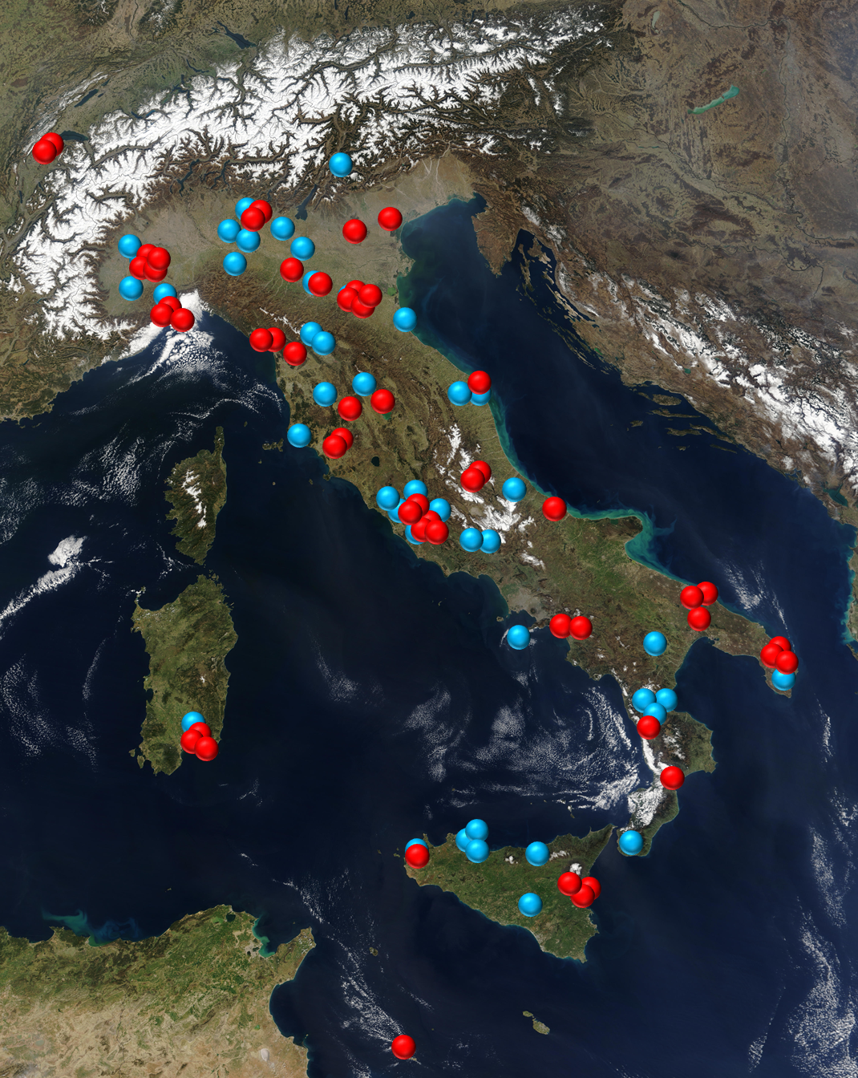
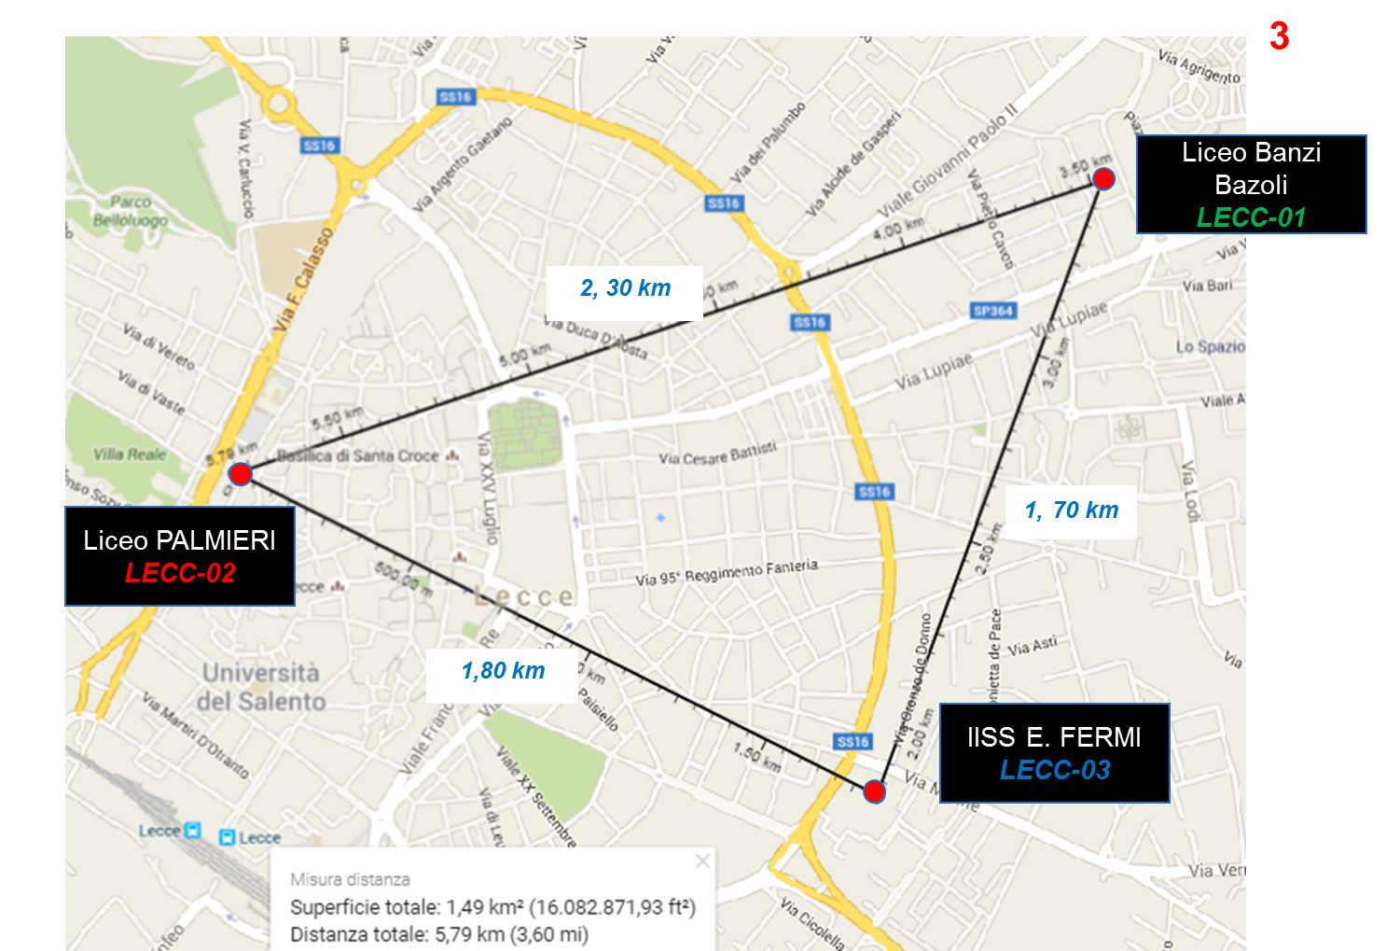
The EEE Project
The Extreme Energy Events (EEE) Project is an experiment for the detection of Extensive Air Showers (EAS). It is a joint scientific and educational initiative by Centro Fermi
in collaboration with
and CERN
The detection of an EAS is achieved by measuring the coincidences recorded at the different sites of the EEE Telescopes Array. It consists of tracking detectors hosted in High Schools spread on the Italian territory, each made of 3 Multi-gap Resistive Plate Chambers (MRPCs).
In 2004
Today
Pilot project: 7 towns with EEE telescopes in High Schools
59 Stations (working during RUN5)
51 EEE Stations in school buildings
6 at INFN sections
2 at CERN
11 deg Latitude
Telescopes are organized in clusters (20m -4 km d.) and single telescope stations
10 deg Longitude
Notes:
Icsplein _rrey teerri_trì ditecion
achieved by measuring the cooincidences in time among events recorded at different sites of the EEE network errei
the stations are located in High Schools buildings, in INFN sections, and at CERN.
half million km2
The EEE network telesopes are organized in clusters with relatives distances from 10 m to 4 km, and in single telescopes stations
The EEE network telescopes relative distances are ranging from a few hundred meters for clusters of 2, 3 and 4 telescopes in the same city, to more than 1000 km for the farthest stations. spanning

Slide 3
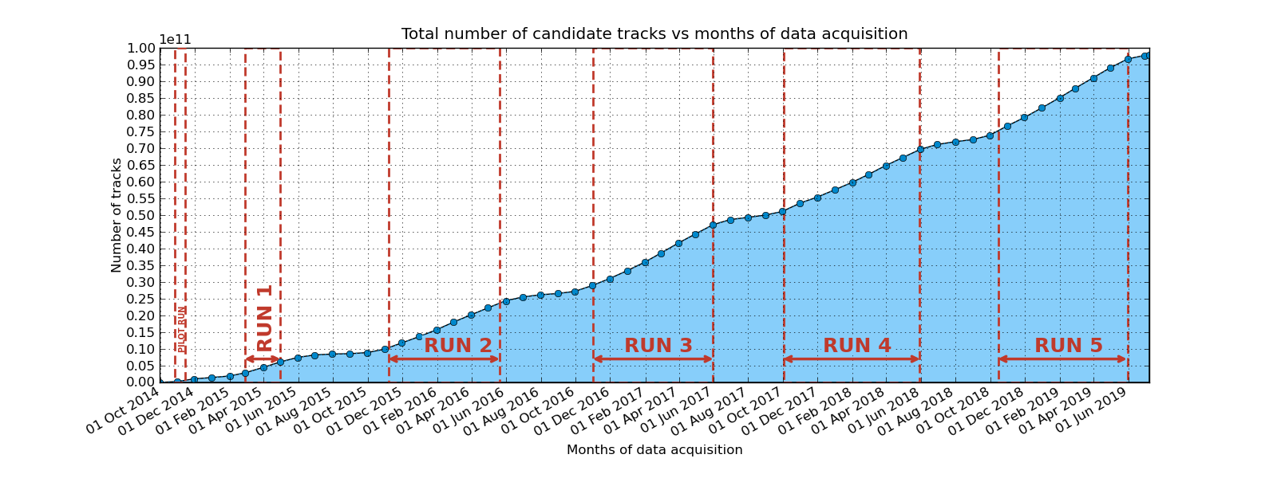
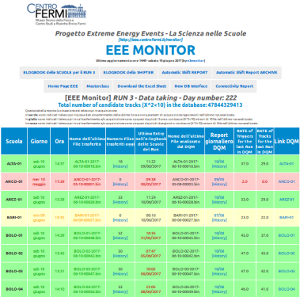
Run : the coordinate DATA acquisition
Since November 2014
Close to 100 x 10⁹ candidate tracks (X²<10)
Collected in its database at CNAF
Notes:
I show here some The results obtained at cern, Many years ago…. Me’sgiured
The results of the test beam obtained at cern, Many years ago….
Proton syncrotron facility
After a slewing correction (charge corrections), and the scint. Time res. Corrections
Time res becomes 94 ps, and

Slide 4
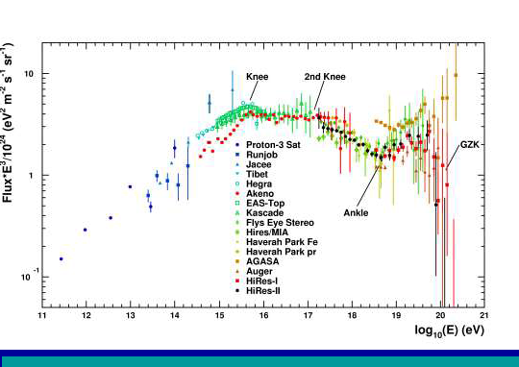
The EEE Project : a dual role
Scientific instrument for physicists
EEE Collaboration involves $\sim 7$0 physicists. Many different topic in the cosmic ray physics: Search of coincidences, Long distance correlation
Correlations to solar activity, Upgoing tracks, Large scale anisotropy, …
As a single detector : the EEE telescope is a high precision tracking detector that can study the flux of secondary cosmic muons.
As telescopes cluster: in the same town, it aims to study the properties of the EAS in which muons are originated,
As an array using sites far apart:
it makes possible to investigate time correlations between different EAS events (es. Gerasimova-Zatsepin effect)
4
Notes:
Far apart

Slide 5
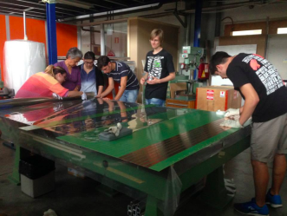
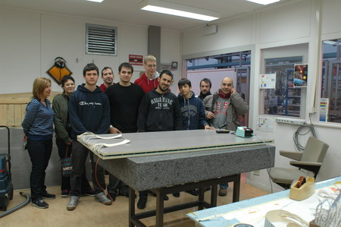
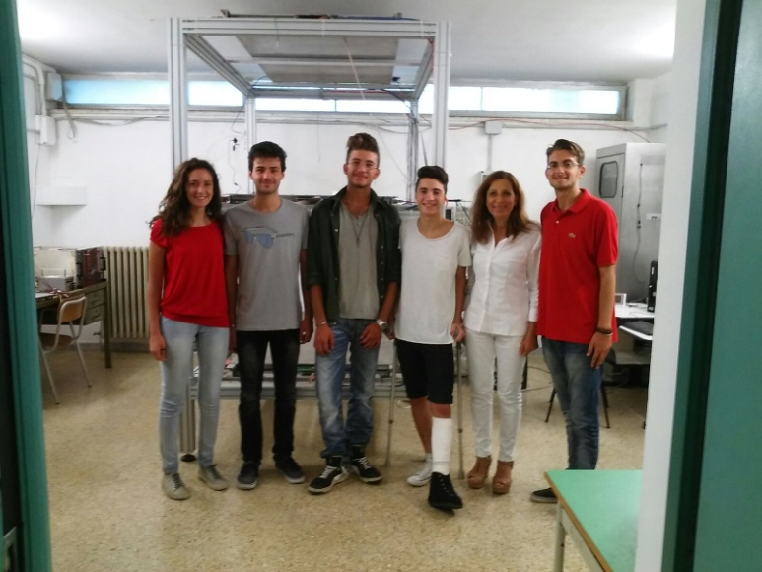
The EEE Project : a dual role
Education instrument for students
The MRPCs are built and managed at CERN by small teams of students and teachers.
In their schools $\sim 10$00 students and teachers are directly involved in operating and monitoring EEE stations, with the aim to introduce them in an advanced physics research.
5

Slide 6
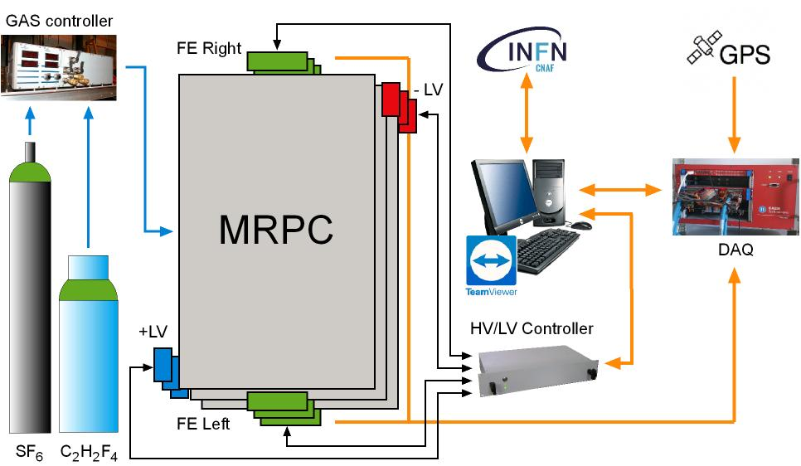
The EEE Telescopes
Notes:
The stack o MRPC, gas tanks

Slide 7
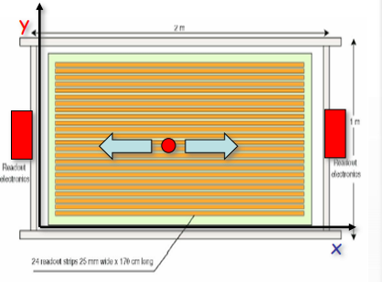
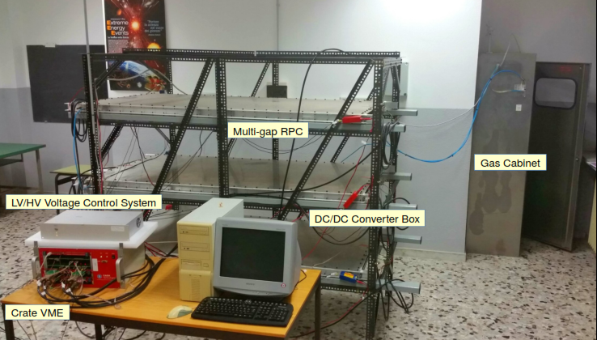
The EEE Telescopes
Three Multi-Gap Resistive Plate Chambers (MRPCs)
6 Front-End boards (FEAs) with 24 channels to process readout signal
VME bridge. DAQ connected to a PC via USB, controlled by LabView program
1 Multi-Trigger Card: a six-fold coincidence of both FEAs of the 3 MRPCs generates the Data Acquisition (DAQ) trigger
2 Multi-hits Time to Digital Converters (TDCs 128 + 64 channels) to reconstruct the particle impact point
GPS unit provides the event time stamp (UTC time) to record and synchronize informations
Voltage control System (VCS) in the MRPCs, DC/DC Converters and FEAs
Weather Station to monitor the temperature and the pressure inside and outside the telescopes building
Notes:
cembers

Slide 8
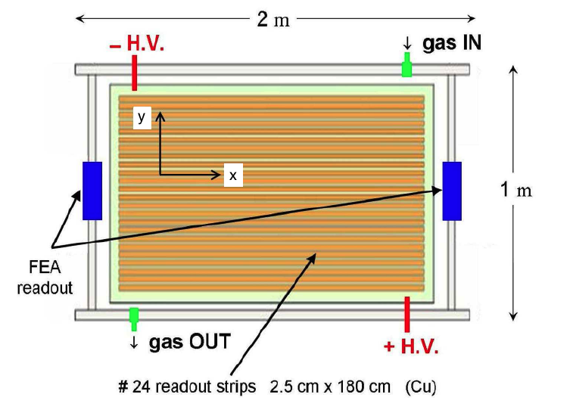
The EEE Telescopes
Three Multi-Gap Resistive Plate Chambers (MRPCs) of 1.60x0.80 m2, for tracking particles
6 Front-End boards (FEAs) with 24 channels to process readout signal
VME bridge. DAQ connected to a PC via USB, controlled by LabView program
1 Multi-Trigger Card: a six-fold coincidence of both FEAs of the 3 MRPCs generates the Data AcQuisition (DAQ) trigger
2 Multi-hits Time to Digital Converters (TDCs 128 + 64 channels) to reconstruct the particle impact point
GPS unit provides the event time stamp (UTC time) to record and synchronize informations
Voltage controls System (VCS) in the MRPCs DC/DC Converters and FEAs
Weather Station to monitor the temperature and the pressure inside and outside the telescopes building
103° Congresso SIF M. P. Panetta Trento 15/09/2017
Notes:
Tetra fluoriteeine
Sulfur hexafluoride
The eee project makes use of MRPC each MRPC consist of six gas gap obtained interleaving two glasses on the vetronite panels with 5 floating glasses, spaced by the chambers are fill_d with a mixture of 98% freon gas and 2% sf6 tetrafluoretano

Slide 9
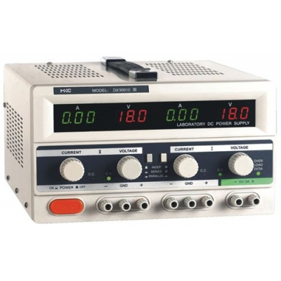
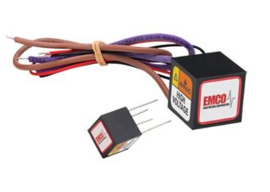
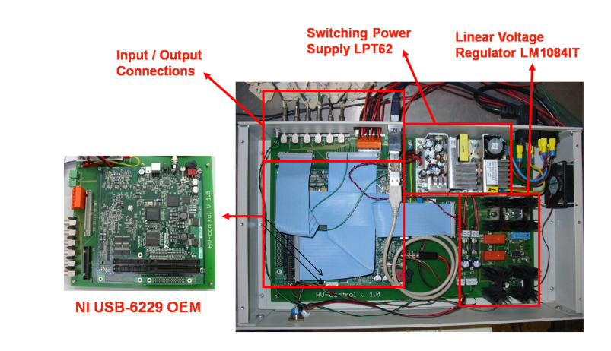
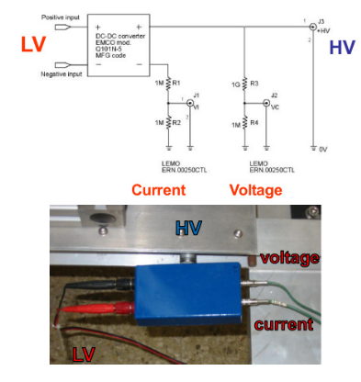
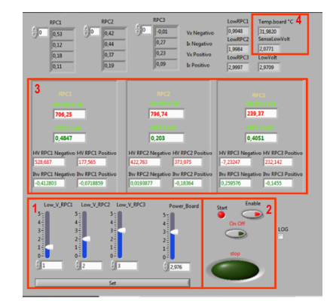
EEE power supply
Notes:
Voltage control system - Power supply iMCO dc /dc converter – volteige divaider controlled by a proper HV/LV supplai, r’motly controllable -- monitor

Slide 10
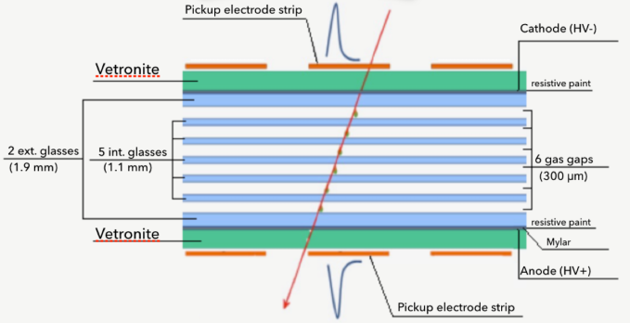
The EEE MRPCs
3 Multigap Resistive Plate Chambers (MRPCs) Layers for tracking particles
- Large chambers 1.58x0.82 m²
6 Gas Gaps: 2 vetronite panels with 5 floating glass plates, 300µm spaced by fishing line
50 New Chambers → 6 Gas Gaps, 250µm spaced
Notes:
D’tectos

Slide 11
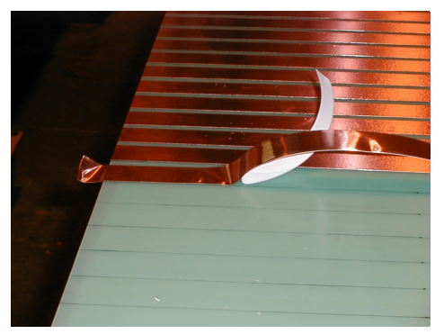
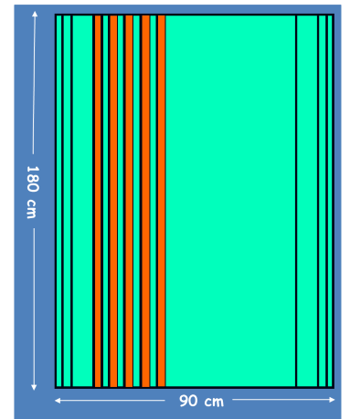
The EEE MRPCs
3 Multigap Resistive Plate Chamber (MRPCs) Layers for tracking particles
- Large chambers 1.58x0.82 m²
24 readout copper strips 1.58 m x 25mm, spaced 7 mm
6 Gas Gaps: 2 vetronite panels with 5 floating glass plates, 300µm spaced by fishing line
2017 : 27 New Chambers → 6 Gas Gaps, 250µm spaced
Two external glass sheets (anode and cathode) 1.60x0.85 m2 covered with resistive paint (5-20 MΩ/m2)
HV working point around 18 kV in avalanche mode supplied by 2 DC/DC converters (up to 20 kV)

Slide 12
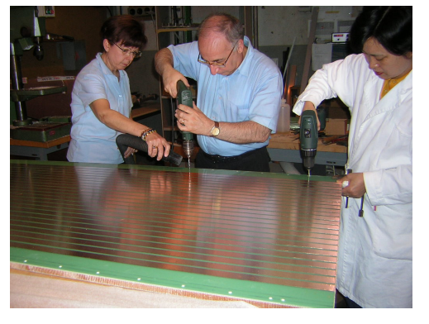
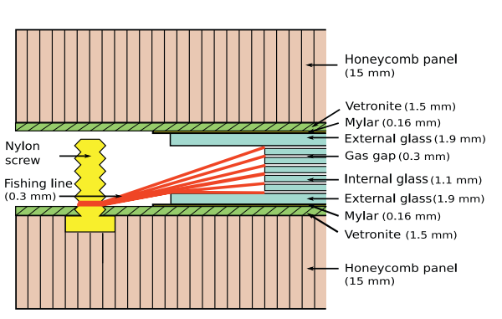
The EEE MRPCs
3 Multigap Resistive Plate Chamber (MRPCs) Layers for tracking particles
- Large chambers 1.58x0.82 m²
24 readout copper strips 1.58 m x 25mm, spaced 7 mm
6 Gas Gaps: 2 vetronite panels with 5 floating glass plates, 300µm spaced by fishing line
2017 –Today : 50 New Chambers →
6 Gas Gaps, 250µm spaced
Two external glass sheets (anode and cathode) 1.60x0.85 m2 covered with resistive paint (5-20 MΩ/m2)
HV working point around 18 kV in avalanche mode supplied by 2 DC/DC converters (up to 20 kV)
New chambers lower (less than 17 kV)
Notes:
avalache

Slide 13
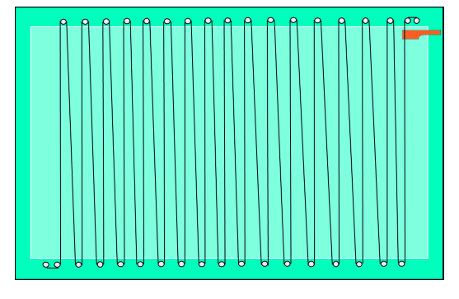
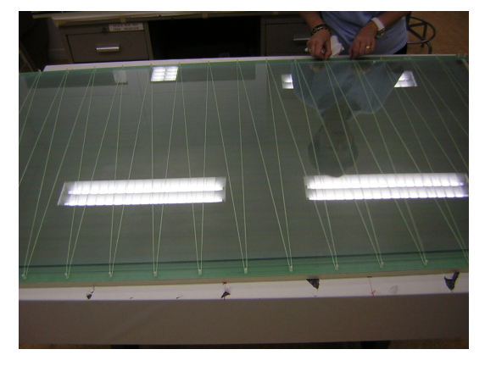
The EEE MRPCs
3 Multigap Resistive Plate Chamber (MRPCs) Layers for tracking particles
- Large chambers 1.58x0.82 m²
24 readout copper strips 1.58 m x 25mm, spaced 7 mm
6 Gas Gaps: 2 vetronite panels with 5 floating glass plates, 300µm spaced by fishing line
2017 –Today : 48 New Chambers →
6 Gas Gaps, 250µm spaced
Two external glass sheets (anode and cathode) 1.60x0.85 m2 covered with resistive paint (5-20 MΩ/m2)
HV working point around 18 kV in avalanche mode supplied by 2 DC/DC converters (up to 20 kV)
New chambers lower (less than 17 kV)

Slide 14
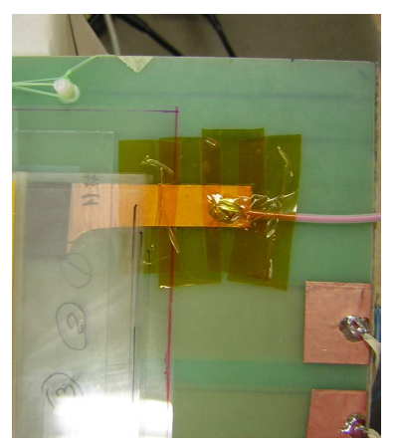
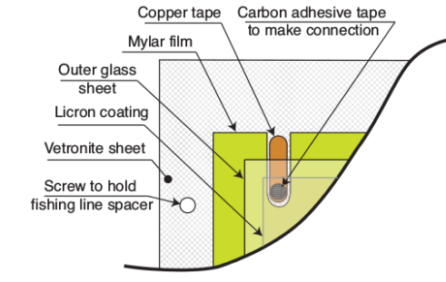
The EEE MRPCs
3 Multigap Resistive Plate Chamber (MRPCs) Layers for tracking particles
- Large chambers 1.58x0.82 m²
24 readout copper strips 1.58 m x 25mm, spaced 7 mm
6 Gas Gaps: 2 vetronite panels with 5 floating glass plates, 300µm spaced by fishing line
2017 –Today : 48 New Chambers →
6 Gas Gaps, 250µm spaced
Two external glass sheets (anode and cathode) 1.60x0.85 m2 covered with resistive paint (5-20 MΩ/m2)
HV working point around 18 kV in avalanche mode supplied by 2 DC/DC converters (up to 20 kV)
New chambers lower (less than 17 kV)

Slide 15
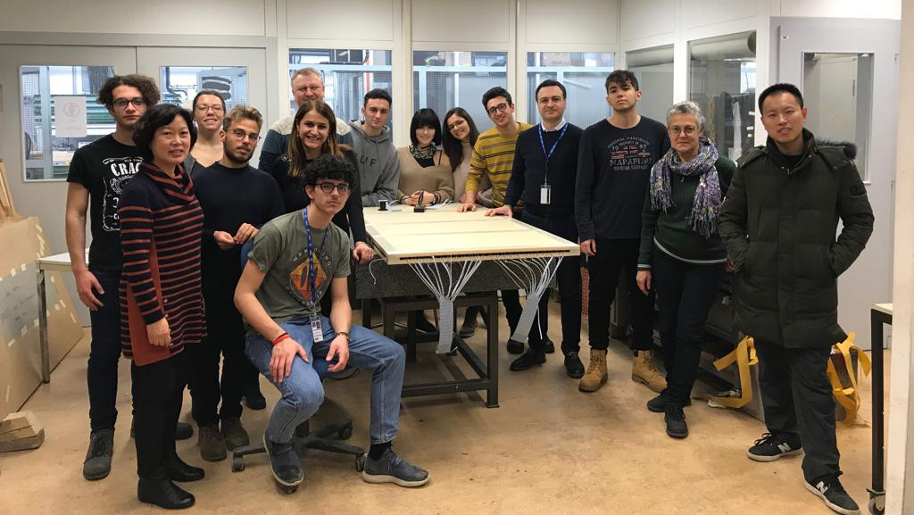
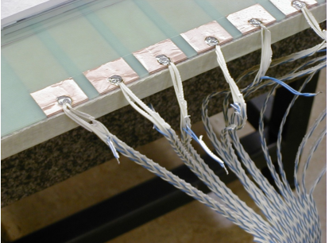
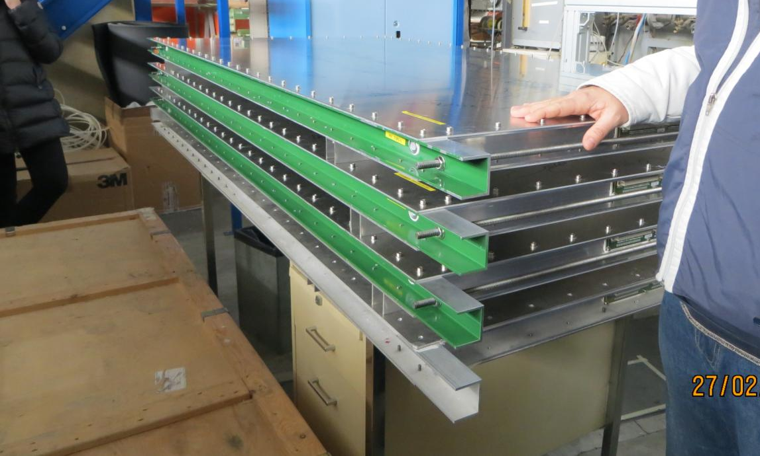
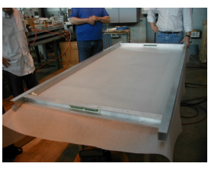
The EEE MRPCs
3 Multigap Resistive Plate Chamber (MRPCs) Layers for tracking particles
- Large chambers 1.58x0.82 m²
24 readout copper strips 1.58 m x 25mm, spaced 7 mm
6 Gas Gaps: 2 vetronite panels with 5 floating glass plates, 300µm spaced by fishing line
2017 : 27 New Chambers → 6 Gas Gaps, 250µm spaced
Two external glass sheets (anode and cathode) 1.60x0.85 m2 covered with resistive paint (5-20 MΩ/m2)
HV working point around 18 kV in avalanche mode supplied by 2 DC/DC converters (up to 20 kV)

Slide 16
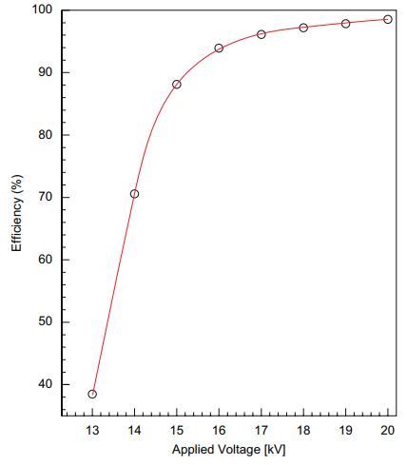
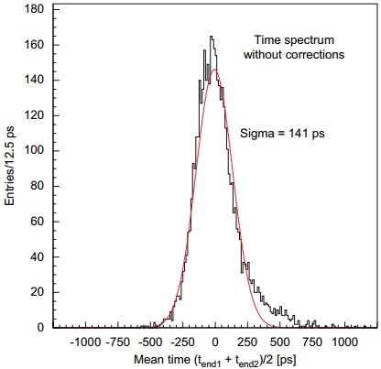
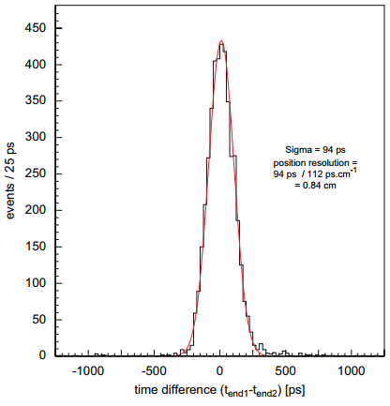
Single MRP Chamber
TEST BEAM at CERN
Efficiency vs HV for a single MRPChamber
(Triggered by scintillators) Efficiency plateau$\sim$100%
(TDCs 25ps bins , scintillators system time resolution 30 ps)
In the middle of the strip lenght
Time resolution $\sim$141 ps
+ corrections (slewing -Time over Threshold- correction , scint. time res.)
Time resolution $\sim 94$ ps
Spatial resolution along strips $\sim$8 mm
Notes:
I show here some Me’sgiured The results of the test beam obtained at cern, Many years ago….
Proton syncrotron facility After a slewing correction (charge corrections), and the scint. Time res. Corrections Time res becomes 94 ps, and

Slide 17
The MRPC Telescopes
At CNAF where an all data reconstruction algorithm is applied to all telescopes raw data.
Tracking procedure: “Good” events are selected by quality cuts: lowest χ2, track length, ToF
The particle impact point is reconstructed by :
the fired strip (y)
the difference of signal arrival times at the strip ends measured by TDCs (x)
$x= \frac{TLeft−Tright}{2 }$ $vDrift$
t₂
t₁
x
y
The impact time in each MRPC is reconstructed as the average of signal arrival times at the strip ends (right and left side)
$$T\text{Hit}=\frac{TRIGH+T\text{LEFT}}{2}$$
17
Notes:
Kai squared prosidguire wai ecs impaact
Algorid_m applaid
the second is obtained by the time difference of the arrival signals at the opposite ends in each strip.

Slide 18
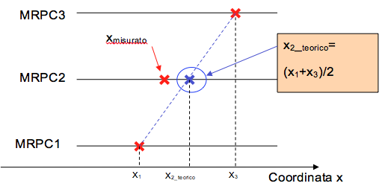
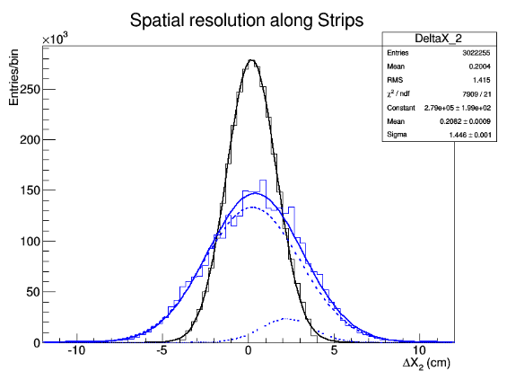
The MRPC Telescopes
Spatial resolution for the Telescopes
measured with cosmic particles in the EEE stations
Long side Chamber coordinate (X)
$$ΔX2=\frac{X1Bot+\text{X} \text{3}\text{T}\text{op} }{2} −X_{2Mid}$$
$${σ_{ΔX}}_{}=σ_{X Res.}\sqrt{\frac{3}{2}}{ ; σ}_{X Res.}=\sqrt{\frac{2}{3}}σ_{ΔX}\sim 1,89 cm$$
Strip by strip calibration
The x distribution on each strip appears not centered at zero, as the distribution δ_{T} = $TLeft−Tright$, because of some differences in the single signal paths in the FEA, in the TDC channels, or in the amphenol cables
The mean value M_{strip} is used for compensating the x-position on the strip$xcorr$
$$σ_{X Res.}=\sim 1,2 cm$$
Spatial resolution improved of 40%
Notes:
Factors that can affect the space resolution: spetial r_solution allaineament
We use external chambers for as a track –a line and check a point in the middle chamber
In our fit, here there are another contribution, for clusters and “not well reconstructed”
Strip non centered, impedence problems, no slewing corrections
Time Calibration
15,8 cm per ns

Slide 19
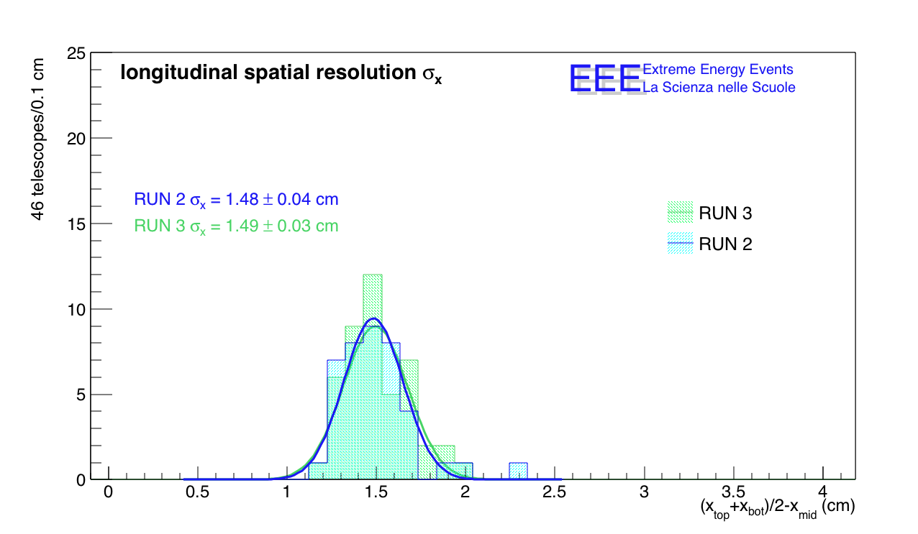
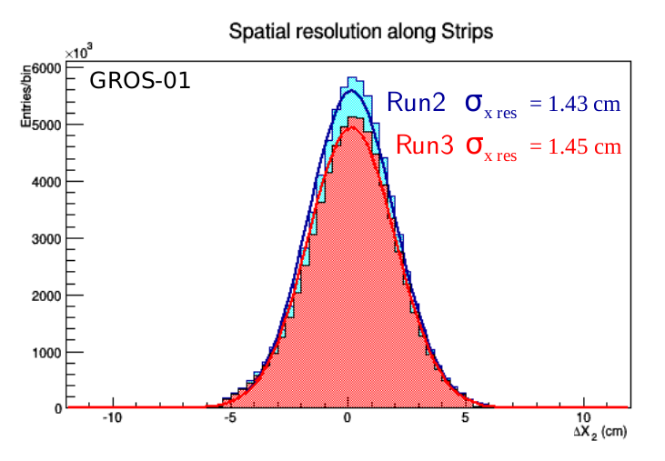
Spatial Resolution (long side)
Spatial resolution for All Telescopes
$$ΔX2=\frac{X1Bot+\text{X}\text{3}\text{T}\text{op} }{2} −X_{2Mid} σ_{X Res.}=\sqrt{\frac{2}{3}}σ_{ΔX}\sim 1,5 cm$$
Strip by strip calibration
$$σ_{X Exp.}=\sqrt{{σ_{TDC}+σ}_{TDC}}\frac{vDrift }{2}\sim 1,1 cm$$
30 days during Run2 vs 30 days during Run3
Resolution compatible with the requirements
x
Notes:
Factors that can affect the space resolution: spetial r_solution allaineament
Meanwhile the minimum value In our fit, here there are another contribution, for clusters and “not well reconstructed”
Strip non centered, impedence problems, no slewing corrections
Time Calibration
15,8 cm per ns

Slide 20
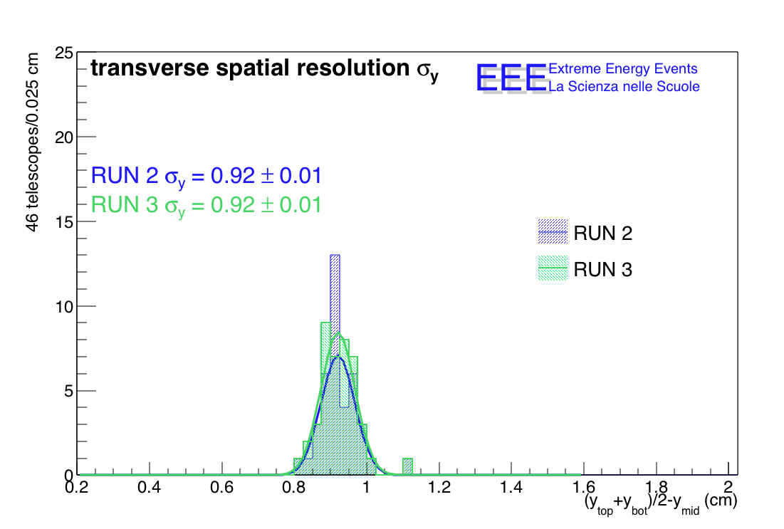
Spatial Resolution (short side)
Transverse Spatial resolution for the 3 MRPCs
measured with cosmic particles in the EEE stations
Y coordinate: the direction transverse to the strips chambers
$$ΔY2=\frac{YBot+\text{Y}\text{T}\text{op} }{2} −Y_{Mid}$$
$${RMS}_{Y Res.}=\sqrt{\frac{3}{2}}σ_{ΔY}=0,92 cm$$
Spatial resolution for All Telescopes
Resolution compatible with the requirements
x
Notes:
Strip non centered, impedence problems, no slewing corrections
3.2 is the strip-pich
Time Calibration

Slide 21
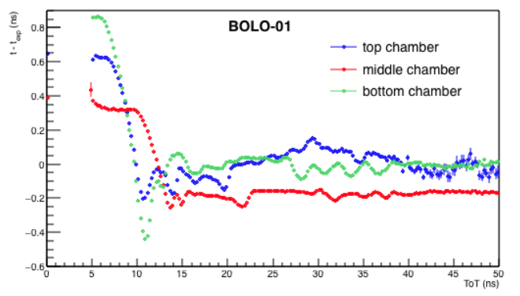
Time Resolution
Time resolution for the 3 MRPCs
measured with cosmic particles $ΔT\text{Hit}=\frac{TH_Bot+T\text{H}\text{_}\text{T}\text{op} }{2} −T_{H_Mid}$
$$σ_{Time Res.}=\sqrt{\frac{2}{3}}σ_{ΔT} \sim 220 ps$$
Time slewing corrections (without an ADC)
The hit time depends on signal amplitude, Time Over Threshold, TOT, measured byTDCs .
Correlation between TOT and the different T _{exp} - T _{corr} , fitted by a polynomial ( 3th)
TDCs 100 ps
x
Notes:
Factors that can affect the time resolution: time calibration
- Propagation of the signal along the strips ( time calibrations Propagation of the signal along the strips
- TDC resolution Strip non centered, impedence problems, no slewing corrections
produced by these reflected pulses.
Impedence problems (FEA)

Slide 22
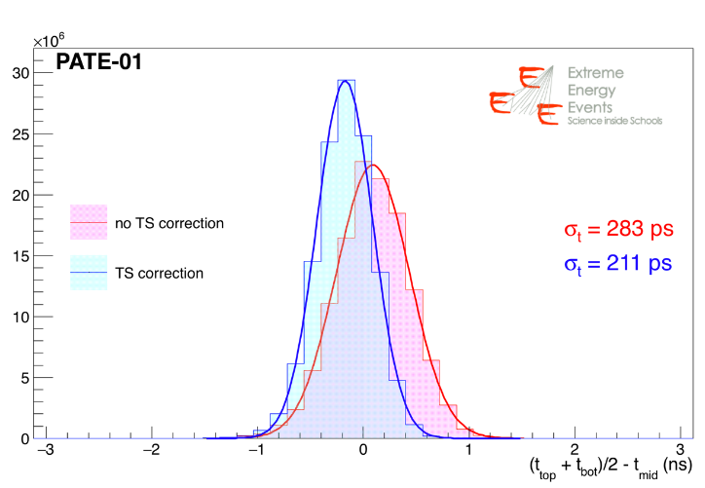
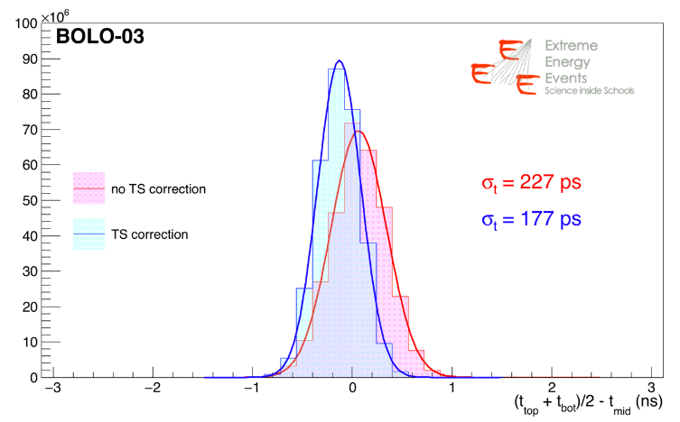
Time Resolution
Time slewing correction
Correlation between TOT and the different T _{exp} - T _{corr} , fitted by a polynomial ( 3th)
Time resolution for the 3 MRPCs
$$σ_{Time Res.}=\sqrt{\frac{2}{3}}σ_{ΔT} \sim 180 ps$$
20% improvevemts.
Resolution range from 178 ps to 295 ps
x
Notes:
Factors that can affect the time resolution: time calibration
- Propagation of the signal along
the strips
- TDC resolution Strip non centered, impedence problems, no slewing corrections
produced by these reflected pulses.
Impedence problems (FEA)

Slide 23
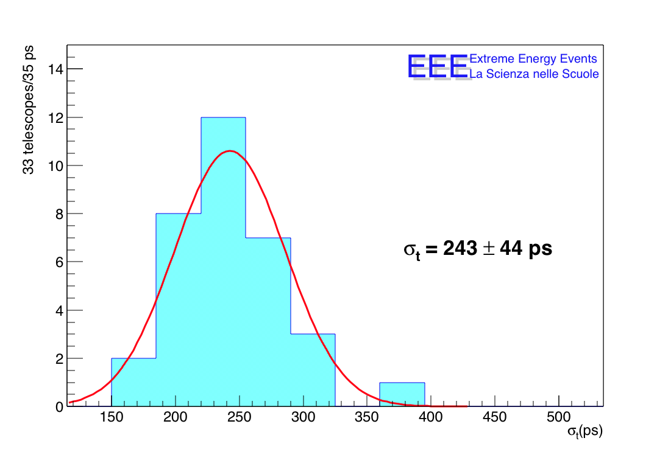
Time Resolution
Time slewing correction
Correlation between TOT and the different T _{exp} - T _{corr} , fitted by a polynomial ( 3th)
Time resolution for the 3 MRPCs
20% improvevemts.
Resolution range from 178 ps to 295 ps
x
Notes:
Factors that can affect the time resolution: time calibration
- Propagation of the signal along the strips - TDC resolution Strip non centered, impedence problems, no slewing corrections produced by these reflected pulses.
Impedence problems (FEA)
TDCs resolution
Chambers alignment
Multiple scattering
Strip calibrations
Propagation of the signal along the strips

Slide 24
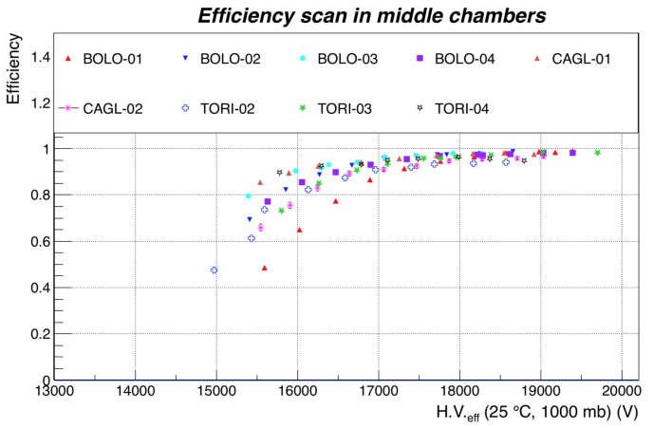
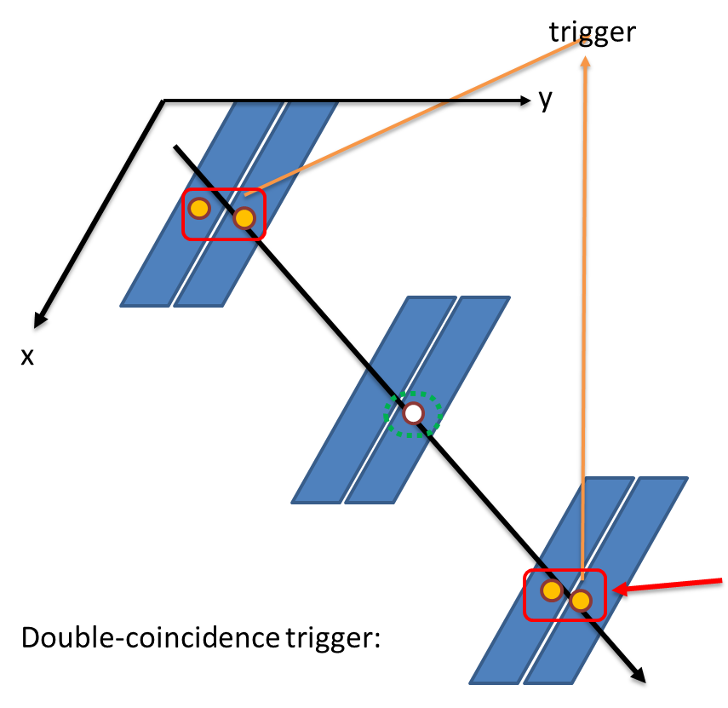
The MRPC Telescopes
The EEE MRPCs Telescopes measured with cosmic particles in the EEE stations inside school building
Efficiency of the Middle Chameber using External Chamber as trigger
Using the 2fold coincidence.
To reduce the noise due to the trigger condition we use events with 2-hit clusters in both the triggering chambers ( <2% of the events) and check the middle chamber.
Efficency vs HV
HV $>$17 kV 95%
˜
24
x
Notes:
average

Slide 25
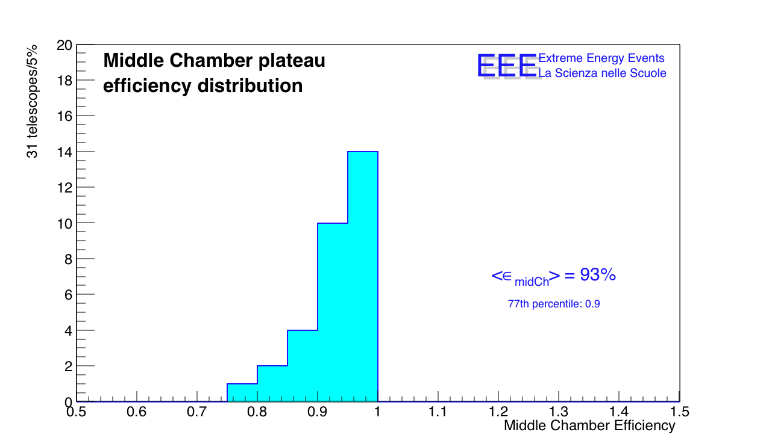
The MRPC Telescopes
The EEE MRPCs Telescopes measured with cosmic particles in the EEE stations inside school building
Efficiency of the Middle Chameber using External Chamber as trigger
Efficiency > 93% reached by 77% of the telescope array
25
x

Slide 26
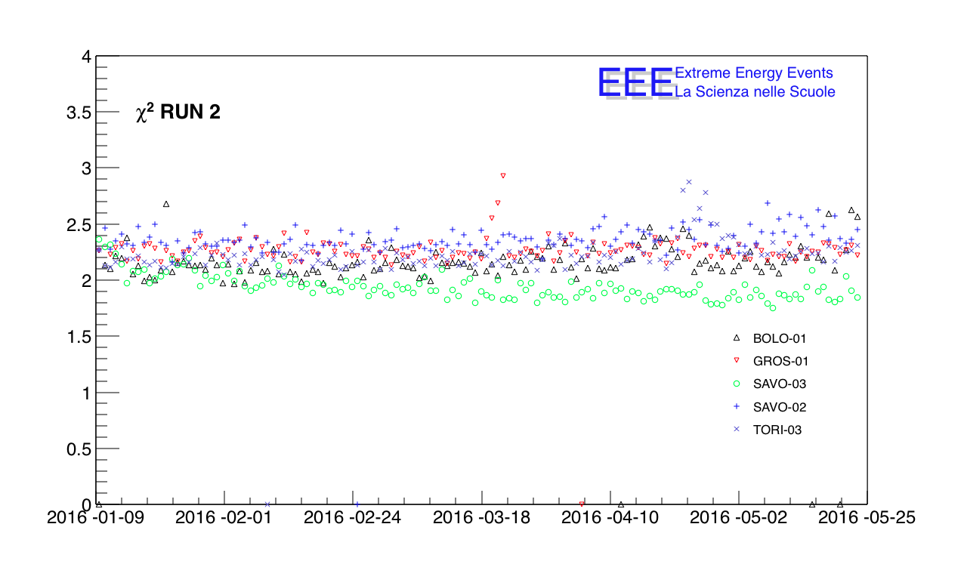
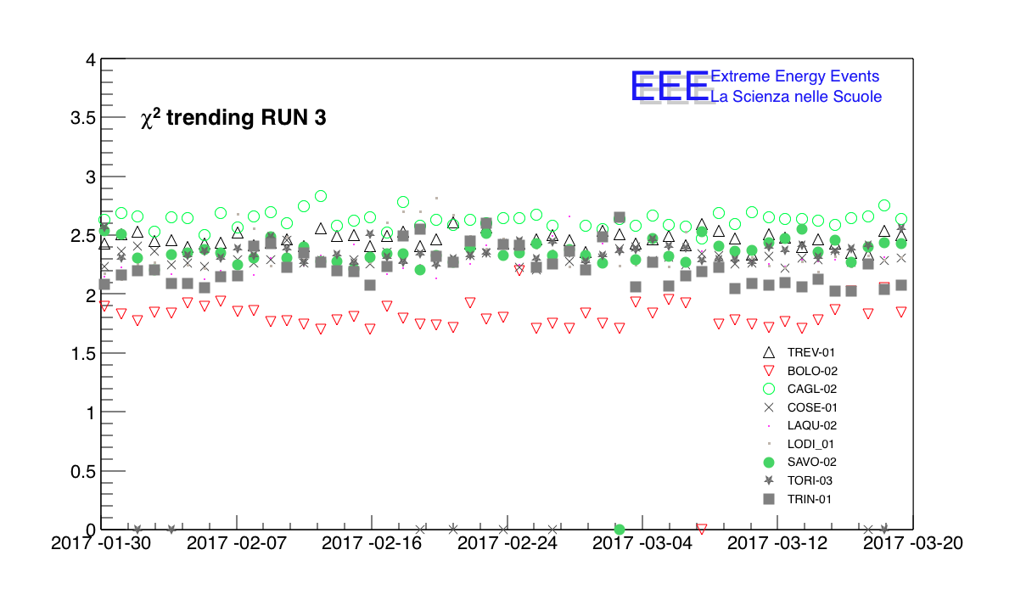
Long Term Stability
Average track X^2 – computed as the best track in the event if at least on hit on each chamber is recorded

Slide 27
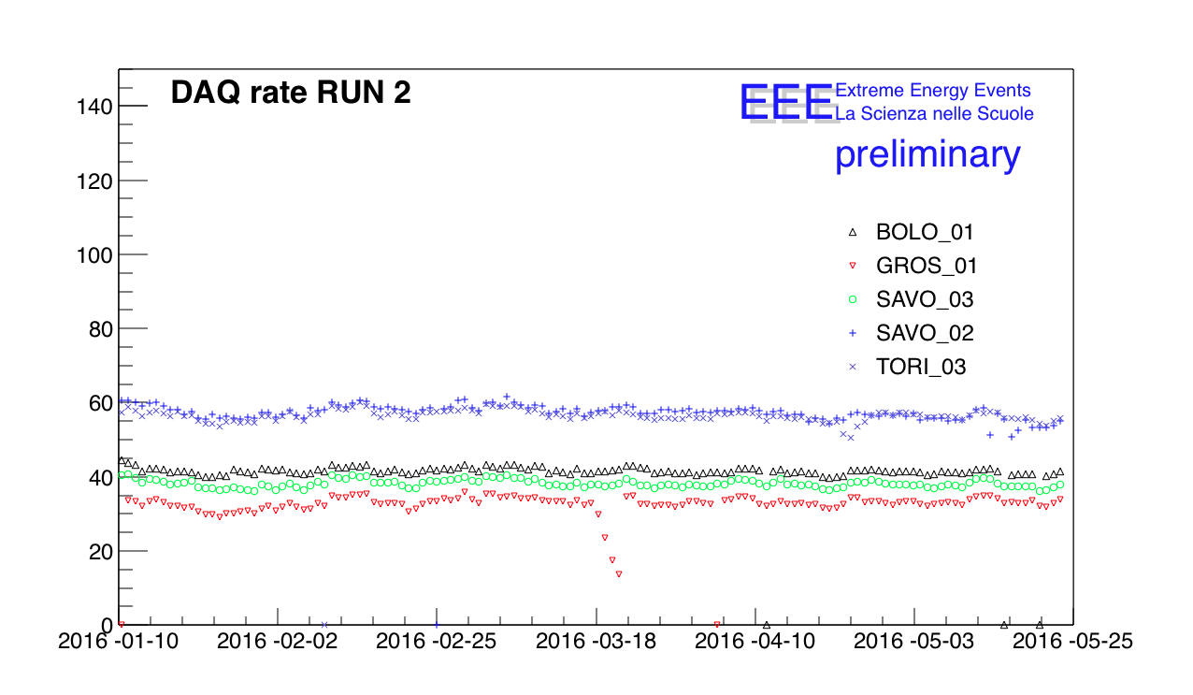
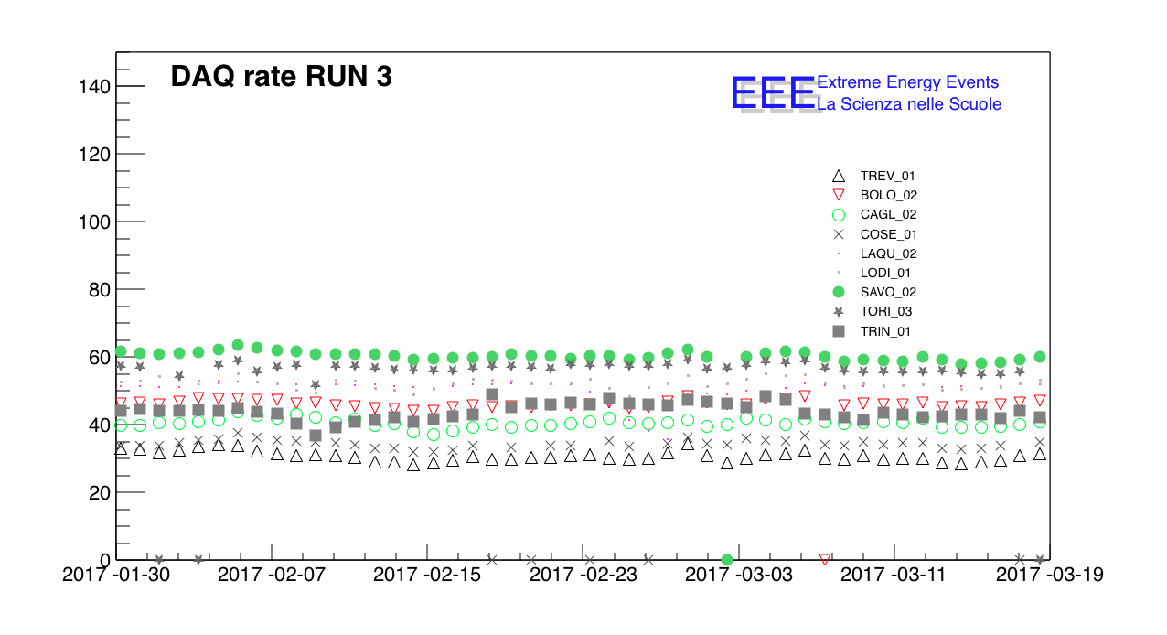
Long Term Stability
DAQ rates
Raw acquisition rate

Slide 28
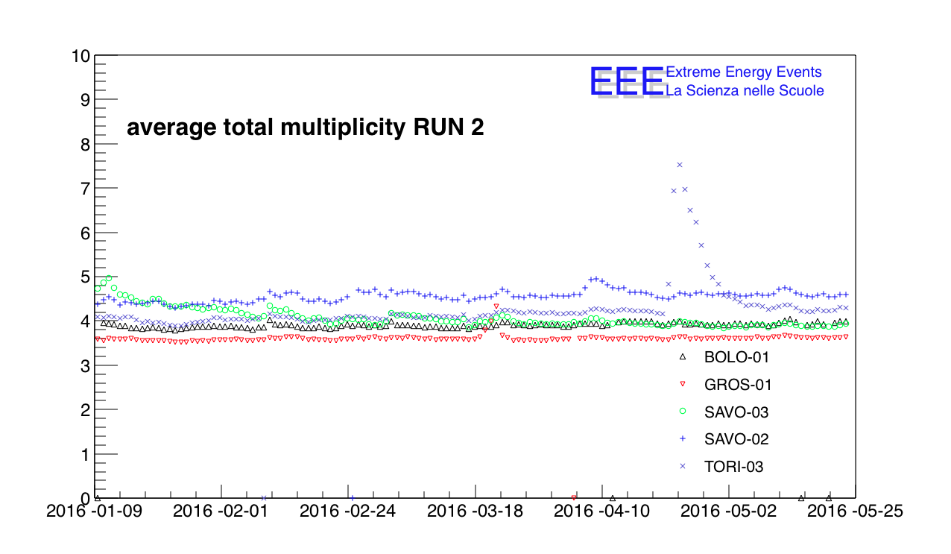
Long Term Stability
Multiplicity
Average number of the hits on the 3 chambers for each event

Slide 29
Working Point less than 17 kV using the standard Mixture

Slide 30
The New Trigger/GPS Module
A novel VME trigger unit for the EEE telescopes was developed, including an embedded GPS engine (TRIMBLE) for timing application. That allows extracting the event time stamping at level of the trigger unit, avoiding time drifts.
A 6-fold coincidence (within a 500 ns window) of the OR-signals from both FRONT-END cards of the 3 MRPCs, generates the data acquisition Trigger
The absolute time of an event is built as the TDCs event time plus the GPS timestamp for each 1PPS.
Notes:
It contains in the same module the functionalities of the old trigger cards, those of the GPS units and of the Clock, which are therefore no more needed.

Slide 31
Trigger Efficiency
The trigger efficiency stays constant at 100%, and then sharply decreases when one of the signals goes out of the 50 ns time window.
The unit achieves a full efficiency with a minimum separation in time of 100 ns, It is not able to discriminate when their delay is < 80 ns. This time interval can be easily changed by modifying the
FPGA ﬁrmware.

Slide 32
The New Trigger/GPS Module
(Test on the Field)
2 Telescopes at CERN, at a relative distance of 18 m
CERN-01
Time resolution for coincidences < 23 ns

Slide 33
Efficiency Test set up
[ In the EEE telescope a six-fold coincidence of both side of the 3 MRPCs generates the event trigger ]
The telescope at CERN (CERN-01) has been used as trigger for the Test chamber (Gaps 250 µm spaced ) placed above CERN-01 layers fluxed.
The particle track is determinated from the event recostructed using only two chambers of CERN-01 and the test chamber.
With the aim to reject background due to the noise, we select only the events with a double hit (clusters) in the triggering chambers (both, < 2% of the tracks),
This basically remove all the noise (we are requiring 2 pairs of hits, each pair should be close in time and space).
CERN-01

Slide 34
Thightness Test
V(ml) = a P(mbar) ² + b P + c

Slide 35
Thightness Test
INFLATING CURVE (parabolic fit parameters)
Time vs Leakage
33 New Chambers
Leakage (l/h) at ~ 1 mbar
around 0,04 l/h

Slide 36
Summary
Study of the EEE MRPC Telescopes Performance
Network continuously growing and successfully operating since many years
(Performance measured with cosmic particles in the EEE stations inside school building)
Excellent performance in terms of time and spatial resolution
Very high efficiency
High School student strongly involved in the Project
Coordinated data taking periods ongoing , 97 billion tracks collected
Notes:
I show here some The results obtained at cern, Many years ago…. Me’sgiured
The results of the test beam obtained at cern, Many years ago….
Proton syncrotron facility
After a slewing correction (charge corrections), and the scint. Time res. Corrections
Time res becomes 94 ps, and

Slide 37
Thanks for your attention
Notes:
perfoormance

Slide 39
The GWP reduction
The Global Warming Potential is a measure of the « greenhouse effect ». It compares the amount of heat trapped by 1 kg of a gas in the atmosphere to the amount of heat trapped by 1 kg of CO₂ (CO₂ GWP is standardized to 1)
EU decides to ban the gas mixture with GWP > 150 (2015 → 2020)
Mixture adopted in the EEE MRPCs :
R134a (98%) + SF₆ (2%) → GWP 1990
~
To support this GWP reductions, several gas mixtures have been tested in the EEE Telescope, with a new MRPChamber using cosmic muons ( → low rate 30 Hz)
~
The MRPC efficiency, current, cluster size has been studied with different
« ecofriendly » mixtures as a function of applied high voltage
Pure C₃H₂F₄ (R1234ze)
R1234ze + CO₂
R1234ze + SF₆
Pure CO₂
CO₂ + SF₆

Slide 40
Experimental set up
[ In the EEE telescope a six-fold coincidence of both side of the 3 MRPCs generates the event trigger ]
The telescope at CERN (CERN-01) has been used as trigger for the Test chamber (Gaps 250 µm spaced ) placed above CERN-01 layers fluxed with the mixture under test.
The particle tarck is determinated from the event recostructed using only two chambers of CERN-01 and the test chamber.
CERN-01 operates with the nominal mixture
An external mixer provides the new mixures

Slide 41
100% Tetrafluoropropene C₃H₂F₄
Tetrafluoropropene C₃H₂F₄ ( R1234ze or HFO) with GWP = 4 could be a good candidate to substitute R134a (C₂H₂F_{4,} GWP = 1300 )
High rate measurements (in RPCs) show good results with mixtures of R1234ze + CO2 + …
Pure R1234ze
Efficiency vs HV_{eff}
Streamer fraction :
S = $\frac{\# TOT Hits with cluster size>5 strips}{\# TOT Hits in the chambers}$
Lower dark currents
Streamers < 5 %
HV working point, > 21 kV, is higher than the EEE nominal mixture (mean value 16-17 kV).
It is close to the upper HV limit supplied by DC/DC converters.
Efficiency / streamer fraction
→ good quencher
R1234ze 100%
EEE nominal
R134a 98%+ SF6 2%
HV_{eff} (kV)

Slide 42
Summary
Search for new gas mixtures for the EEE MRPC Telescopes
A new EEE MRPC has been tested with cosmic rays (mean rate 30 Hz, in avalanche mode)
The promising gas mixtures are:
R1234ze (50%) + CO₂ (50%)
R1234ze (99%) + SF₆ (1%)
Next steps:
R1234ze + He (He reduces the gas partial pressure → reduces HV working point )
R1234ze + CF₃I (as quencher)
R1234ze (99.5%) + SF₆ (0.5%)
R1234ze 50%
+ CO2 50%
R1234ze 99% + SF₆%
Efficiency / streamer fraction
EEE nominal
HV_{eff} (kV)

Slide 44
2 Clear signals TDCs
By means of a Waveform Generator we simulate the TTL Signals from the Bridge VME 40 μs lenght
Two ECL Signals of 25 ns length to the CLEAR TDCs

Slide 45
2 Clock Signals
2 Disciplinated Clock to the TDCs 40 MHz (25 ns period)

Slide 46
TDC Trigger signals
By means of the Pattern Generator we simulated 6 Trigger LVDS signals from the MRP Chambers and send it to the Trigger Board which generate 1 Triple coincidence and 3 Double coincidences
6 LVDS signals from MRPCs

