Slide 1
Test of new ECO-Gas Mixtures for the MRPC of the EEE project
Marina Trimarchi
on behalf of the EEE collaboration
Museo Storico della Fisica e Centro Studi e Ricerche “Enrico Fermi”, Roma
Dipartimento MIFT – Università degli Studi di Messina
INFN – Sezione di Catania

Slide 2
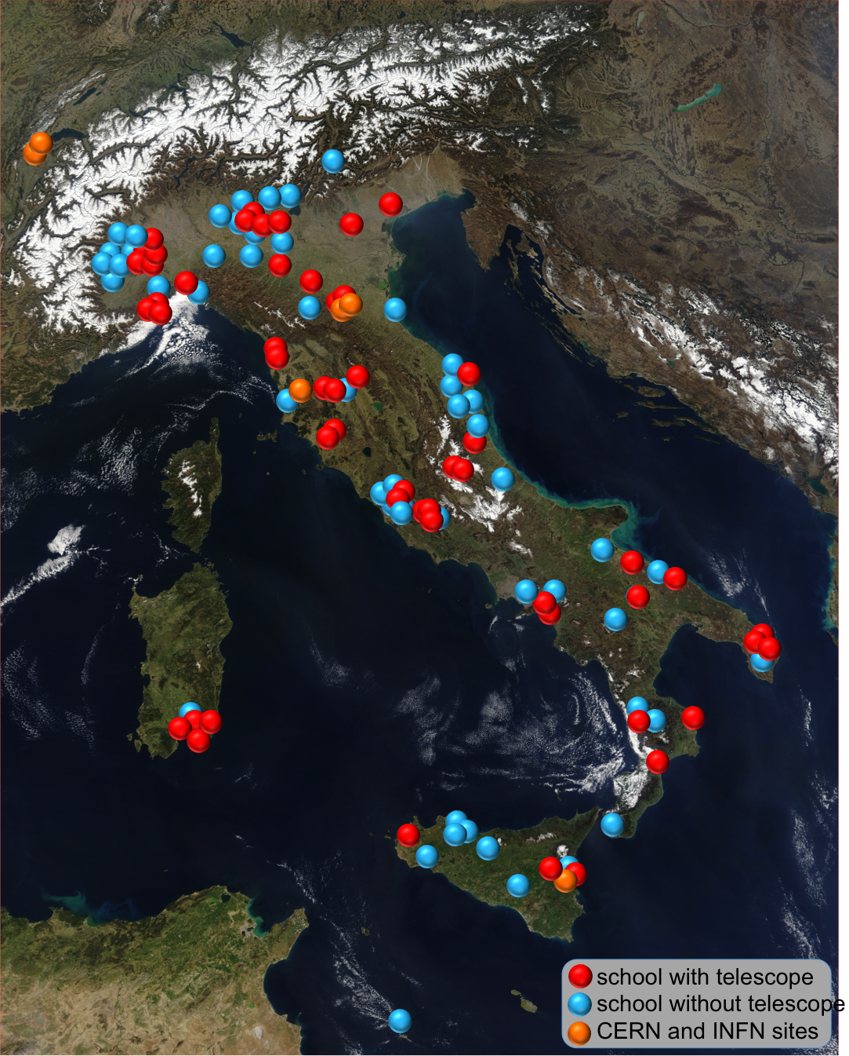
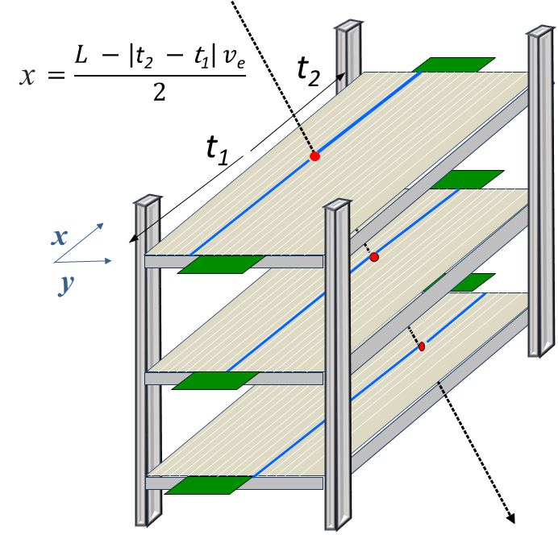
The EEE Project
Extreme Energy Events
Centro Fermi, INFN, CERN & MIUR
Study of Cosmic rays and related phenomena
A sinchronous sparse network of 59 tracking detectors installed in Italian High Schools
Each made of 3 Multigap Resistive Plate Chamber detector
More than 10° in latitude and 11° in longitude
More than 3 x 10⁵ km²
Three MRPC providing the impact coordinates of incoming muons
The reconstruction of their tracks, with high efficiency and good angular resolution
Detectors operate in avalanche mode
Characteristics similar to the ones built for the ALICE TOF array

Slide 3
The Global Warming Potential Reduction Problem
GWP measures the greenhouse effect of a gas
Normalized to CO₂ (GWP=1)
Recent EU restrictions on GWP → (max = 150)
EEE MRPC →R134a(98%) + SF₆(2%)
GWP = 1900
Extensive tests of several gas mixtures with cosmic muons detected by one of the telescopes installed at CERN
Detection efficiency, chamber current, cluster size as a function of the applied HV
Tested Gas Mixtures
Pure R1234ze (GWP=6) (tetrafluoropropene - C₃H₂F₄)
R1234ze(90%) + CO₂(10%)
R1234ze(80%) + CO₂(20%)
R1234ze(50%) + CO₂(50%)
R1234ze(95%) + SF₆(5%)
R1234ze(98%) + SF₆(2%)
R1234ze(99%) + SF₆(1%)
CO₂(100%)
CO₂(98%) + SF₆(2%)

Slide 4
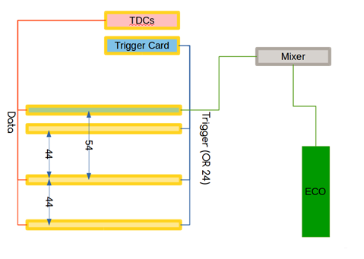
Test performed
CERN-01 chambers (operating with the nominal mixture)
Provide the trigger for the event acquisition
Good events: muons crossing the three chambers
Events readout
Two bottom-most chambers+ chamber under test
Operating with the new mixtures, provided by the external mixer

Slide 5
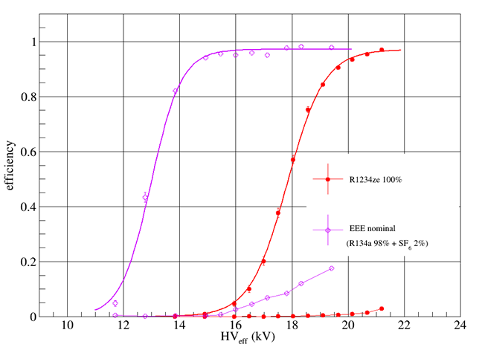
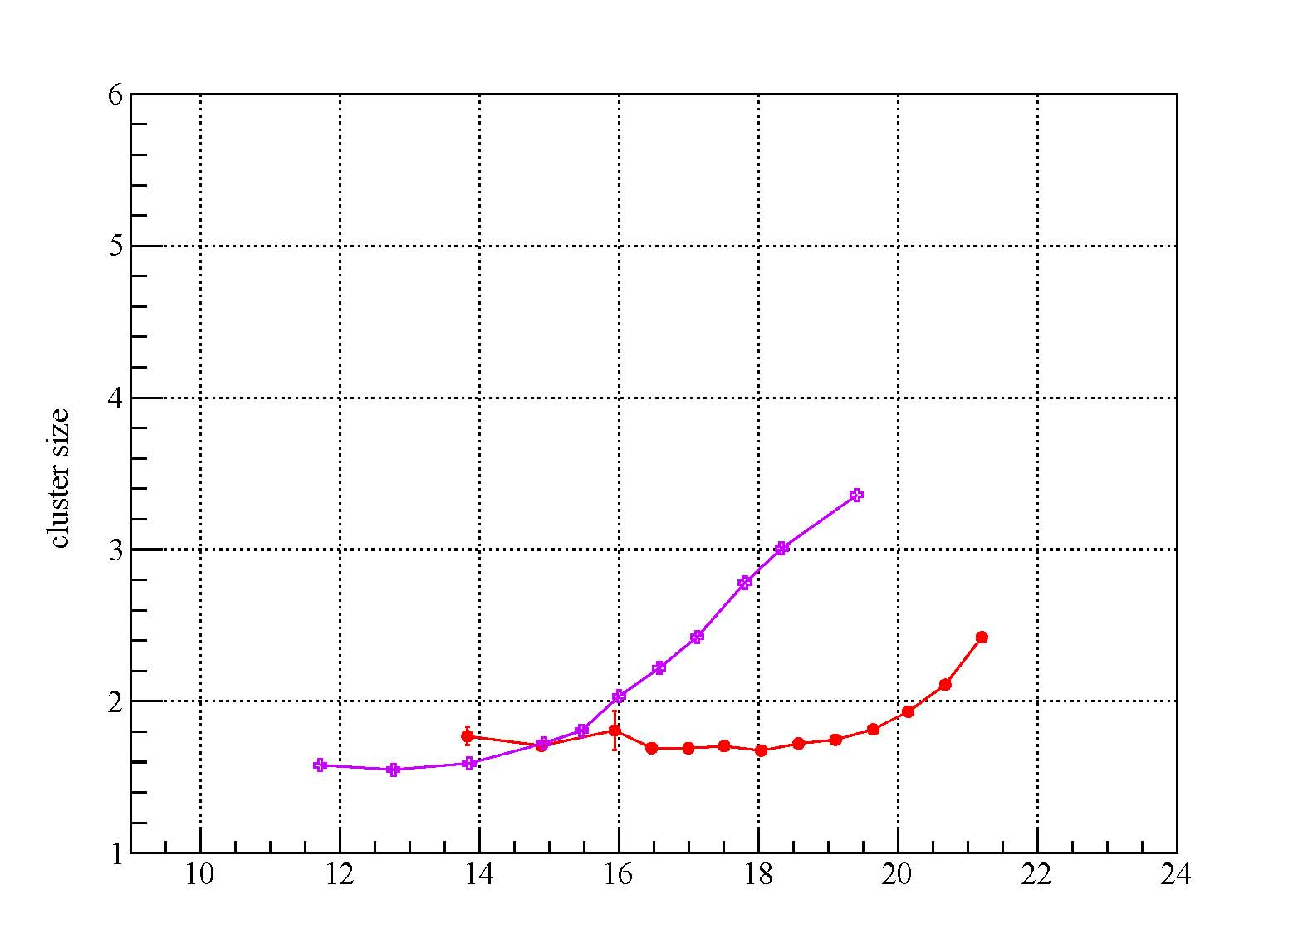
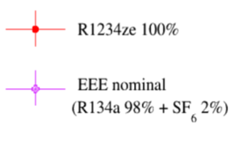
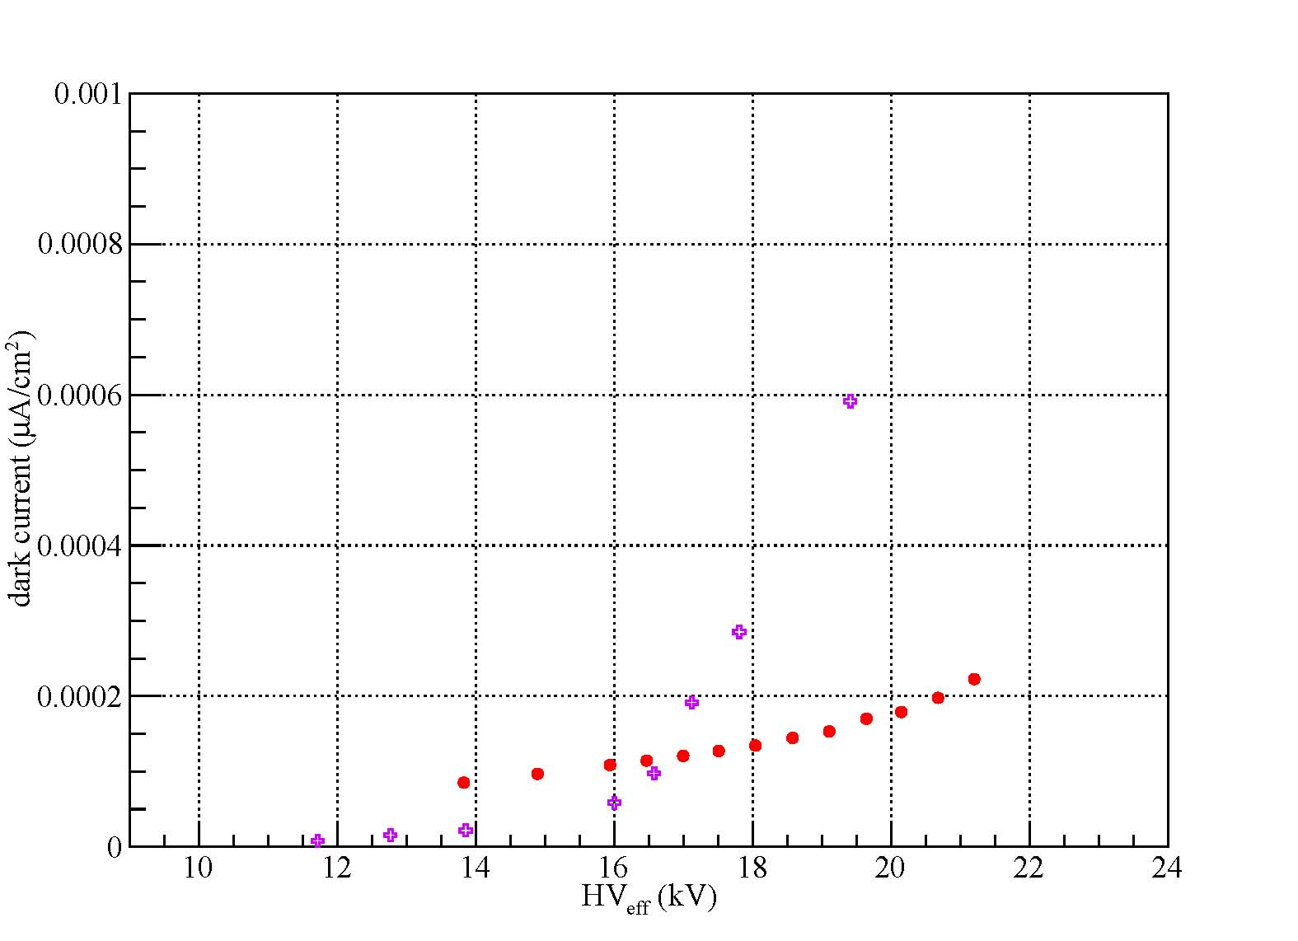
Pure tetrafluoropropene (R1234ze) (GWP=6)
preliminary
preliminary
Stable cluster size & low dark current
Streamer percentage below 5%
preliminary
Higher HV setting point!!!

Slide 6
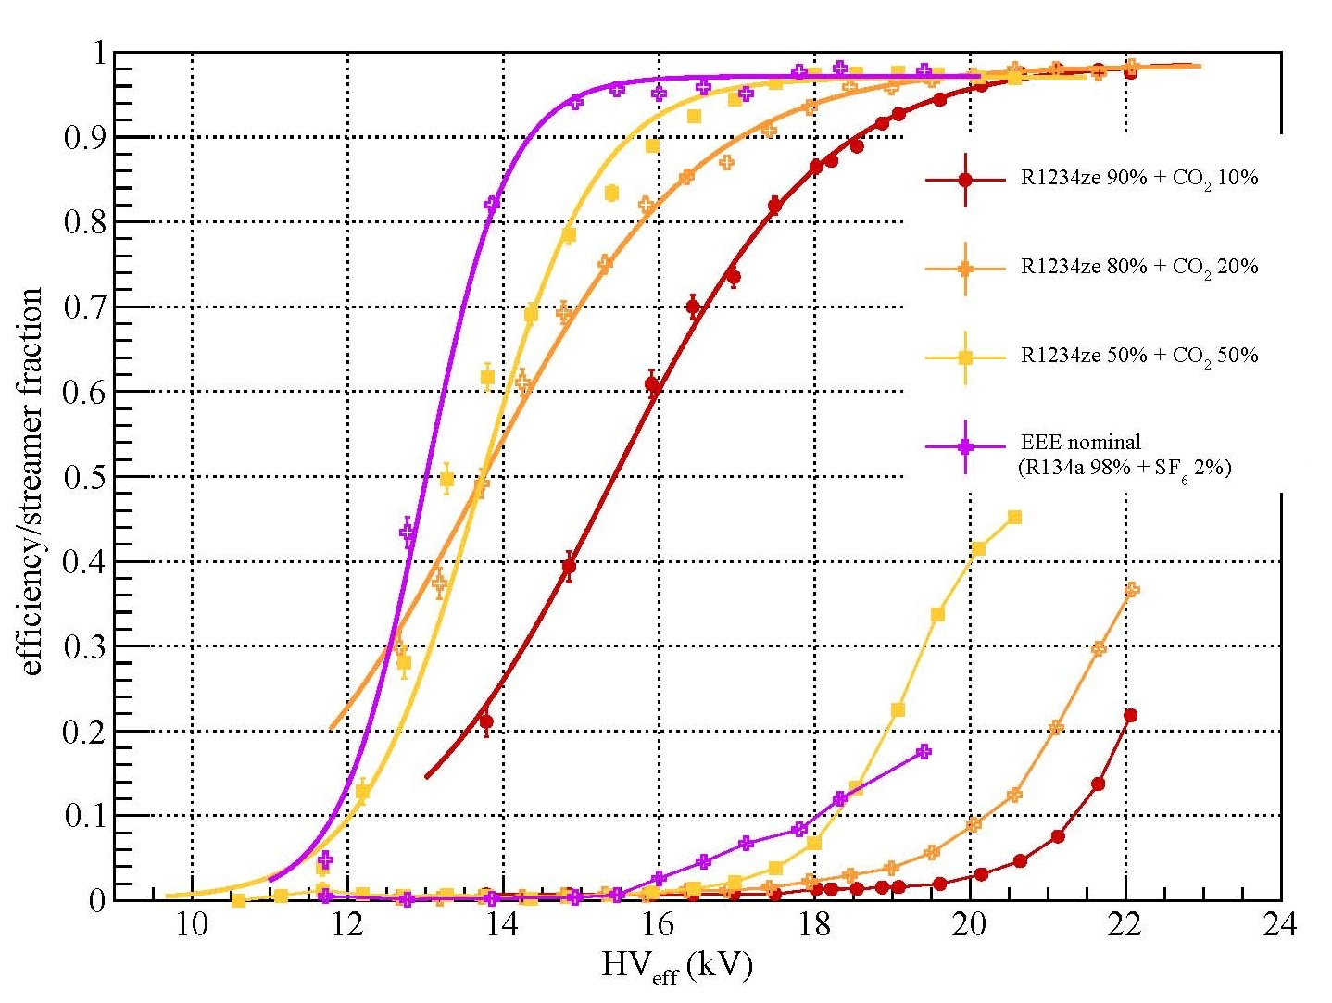
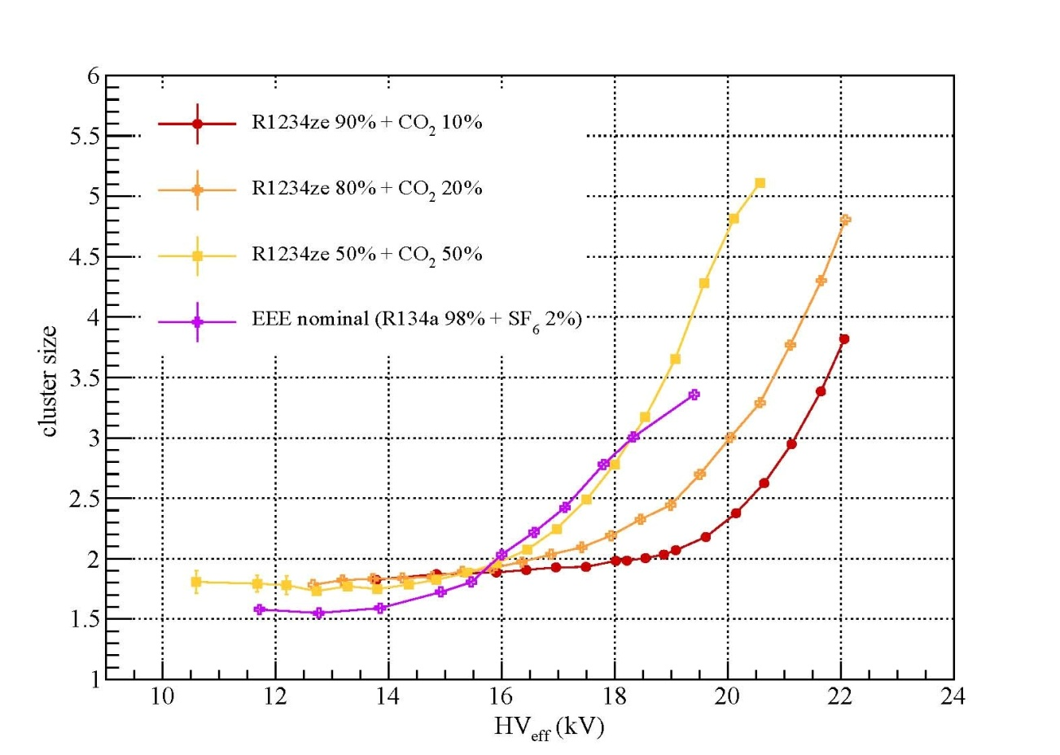
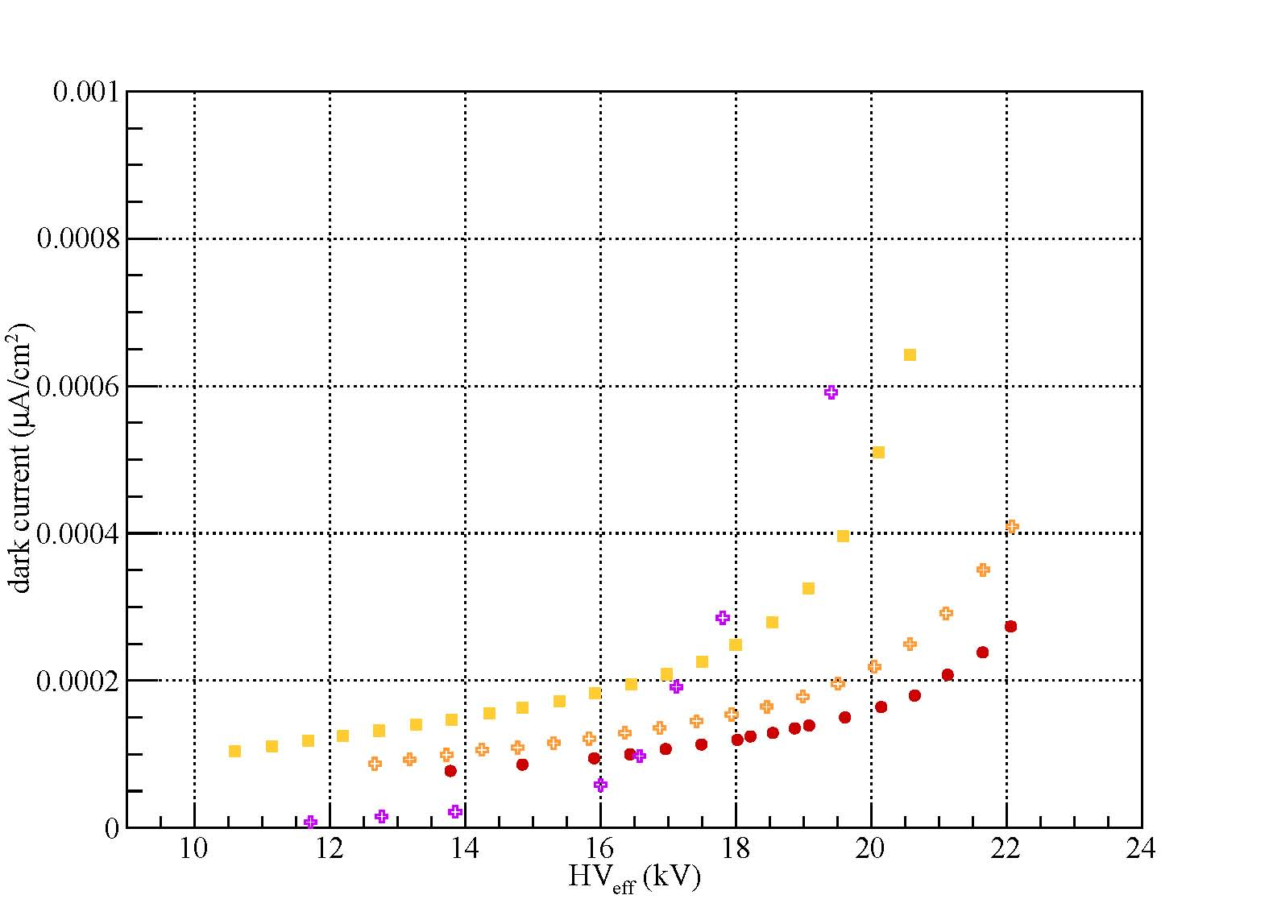
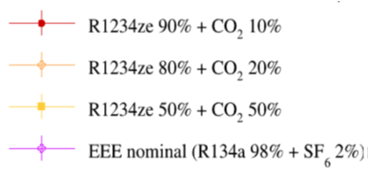
R1234ze + CO₂ (GWP=1)
preliminary
preliminary
High dark current & high cluster size
Lower HV setting point
Streamer percentage increases
preliminary

Slide 7
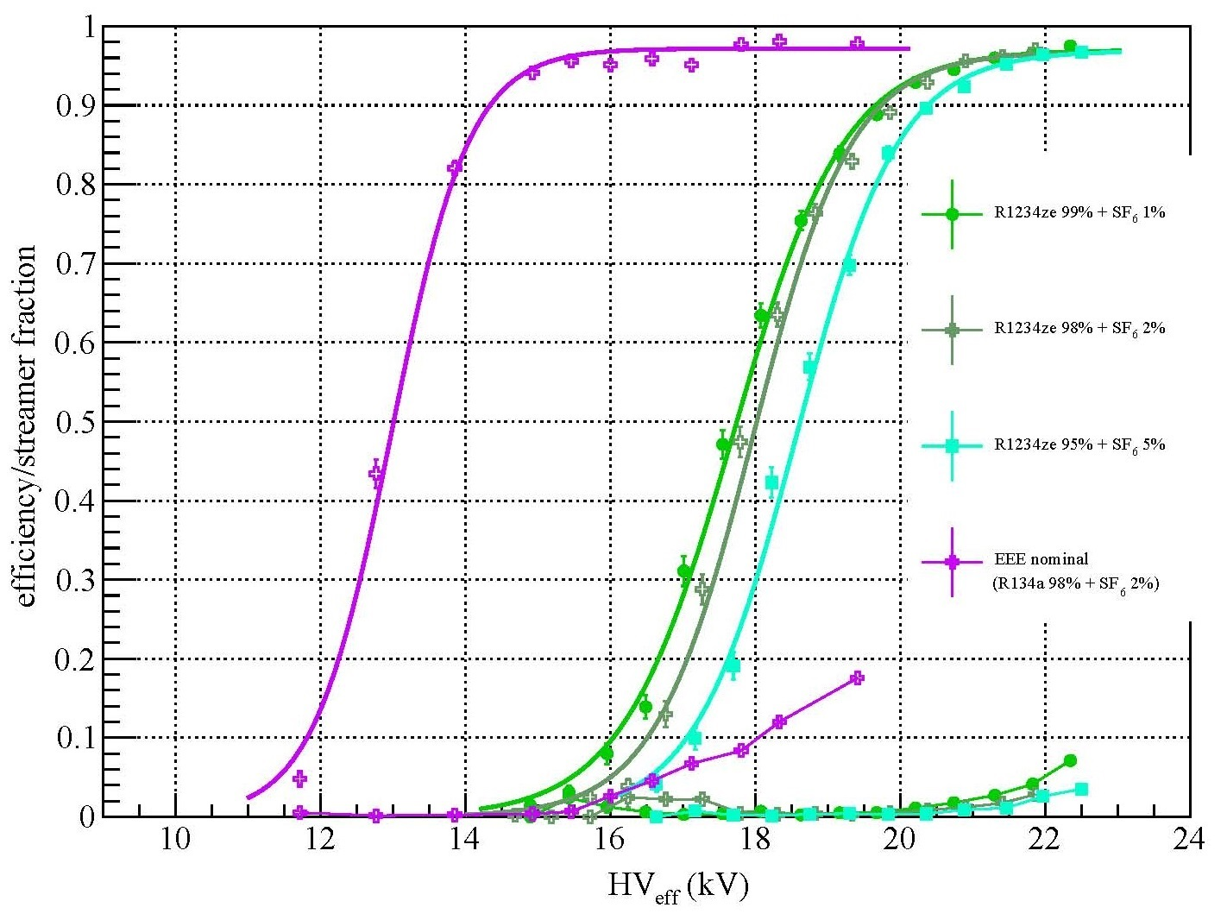
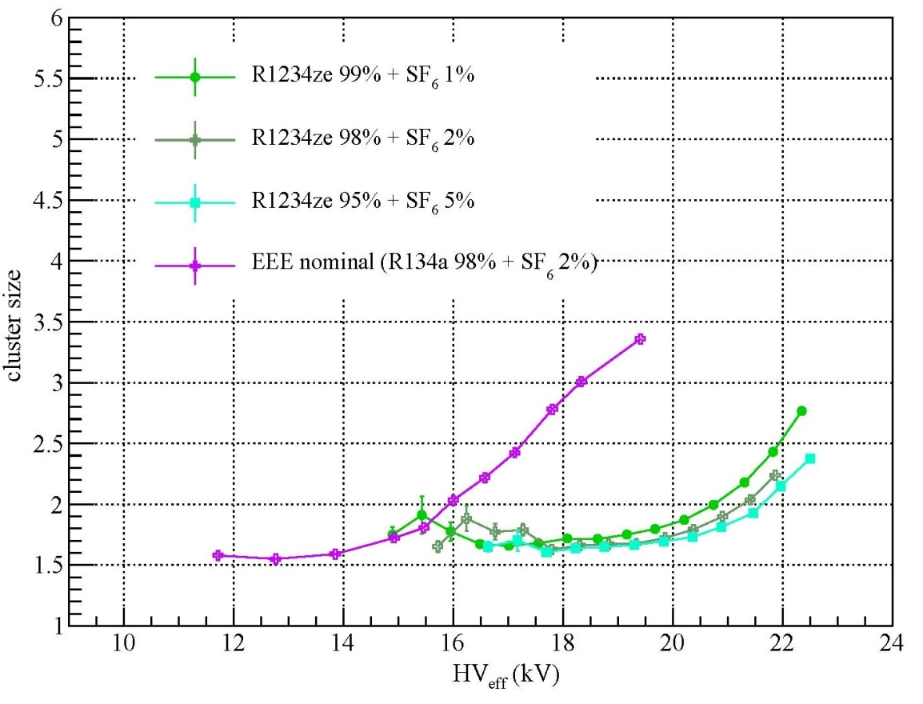
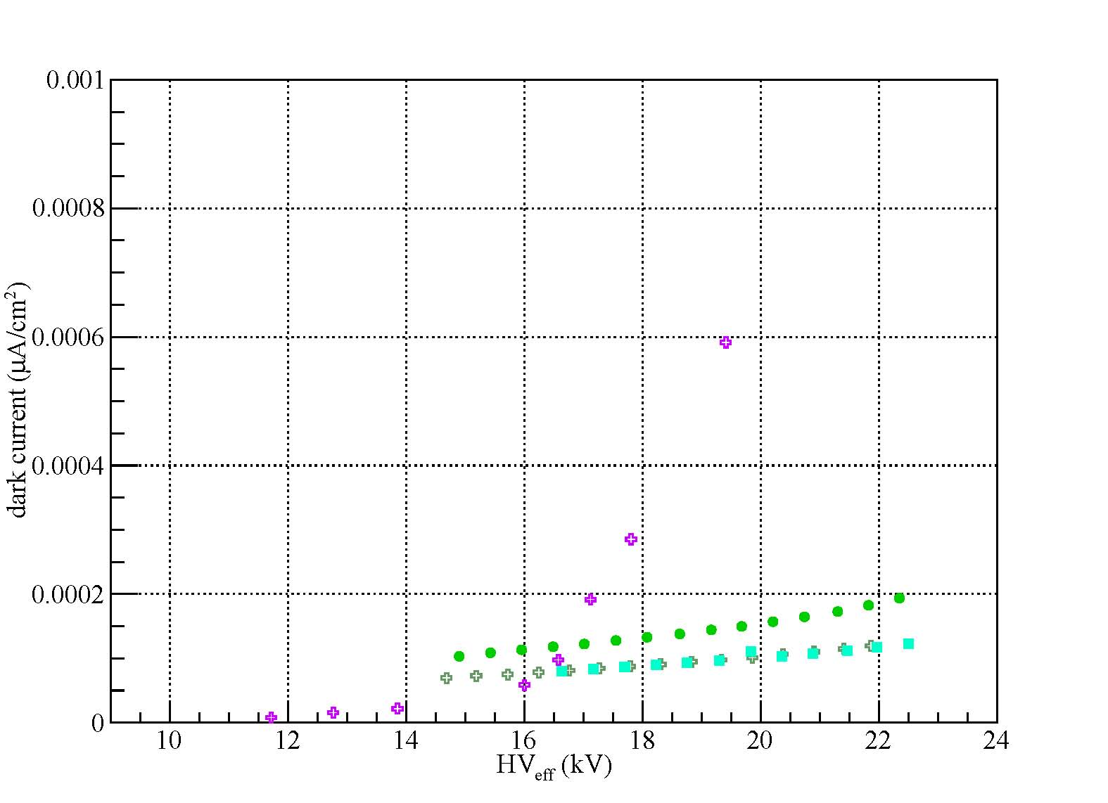
R1234ze+SF₆
preliminary
preliminary
High HV setting point
Satisfactory streamer percentage
Noise highly suppressed but SF6 % too high!!

Slide 8
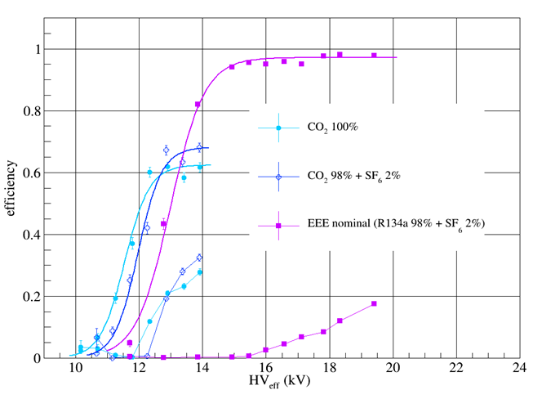
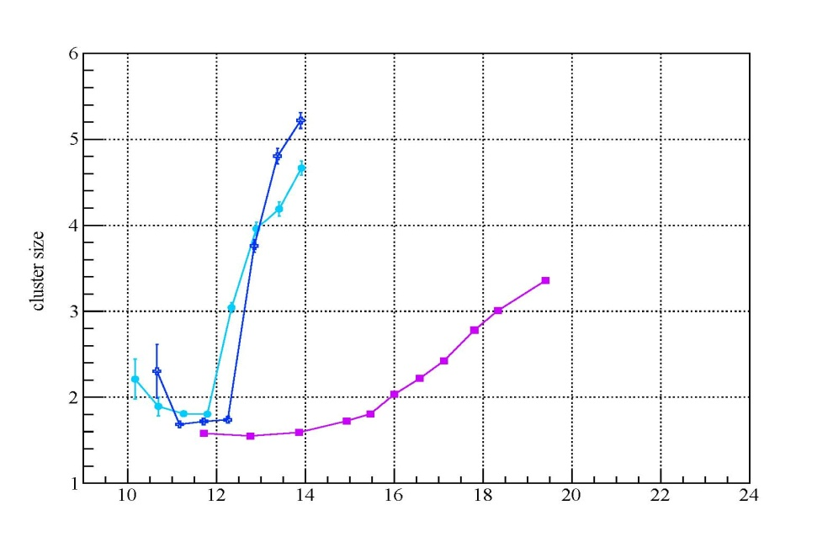
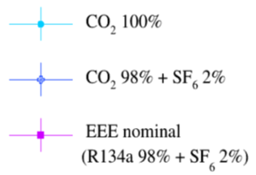
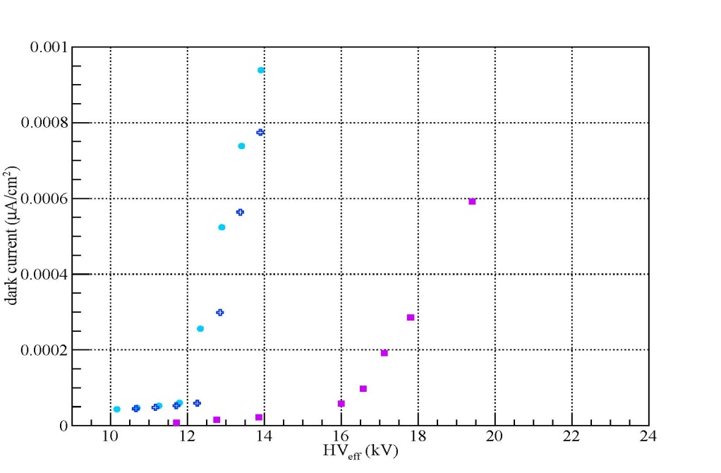
CO₂-based mixtures
preliminary
preliminary
Very noisy configuration!!
Very low HV setting point…
Efficiency too low!!!
preliminary

Slide 9
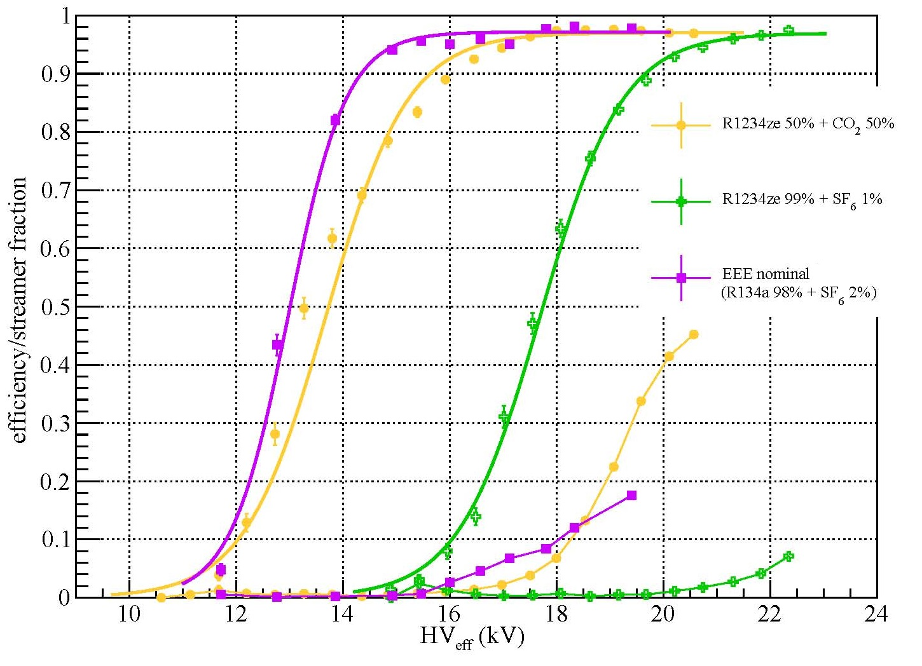
Conclusions
Most Promising configurations
Pure R1234ze
R1234ze(50%) + CO₂(50%)
preliminary
Future Plans
R134a+CO₂(5,10,20,50%)
Ar+CO₂(3,5,10,20%)
Ar+SF₆(1,2%)
N₂+CO₂(3,5,10,20%)
N₂+SF₆(1,2%)
preliminary

