Slide 1
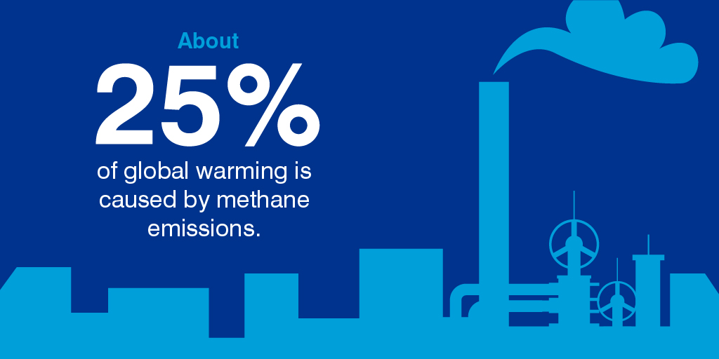
The gas crisis
First DMEG MAECI workshop, Salerno, 10 July 2019

Slide 2
Prodroms to the problem
European Community since long time issued regulations to reduce the emission of gas potentially harmful to the environment
In 1990s gases with a high Ozone Deplation Power were banned → CF3Br and CF4, used at the time for RPCs, were phased down and C2H2F4 (R134a) was introduced
Since a dozen of years EC is planning to progressively ban gases with a Global Warming Power (GWP) > 150 (where GWP(CO2)=1)
Scientific applications are extempted from this prohibition
The problem will progressively come from supply problems and high prices
CERN started in 2013 an R&D program to replace C2H2F4 (GWP=1240) and SF4 (GWP=13400) in the detectors of the experiments at LHC, where o(2000 l/h) are leaked out

Slide 3
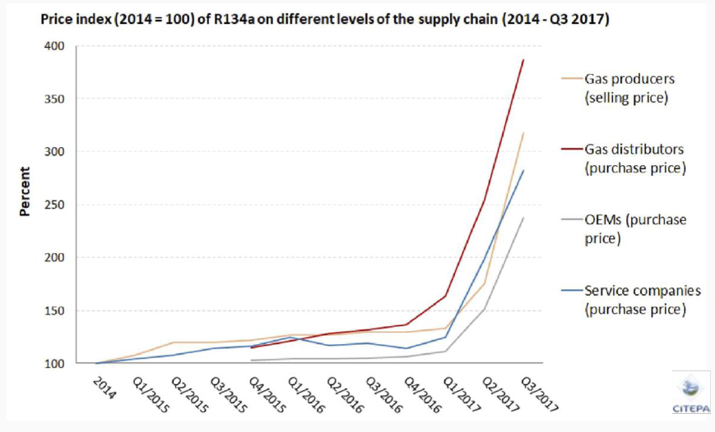
Monitoring of R134a price in EU
Price include information from 49 companies all over Europe: 2 gas producers, 2 gas distributors, 14 OEMs, 31 service companies

Slide 4
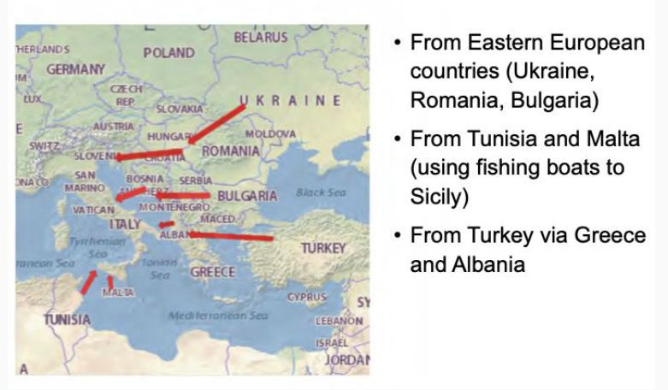
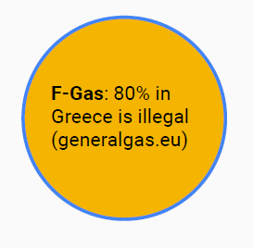
Origin of illegal imports to Italy

Slide 5
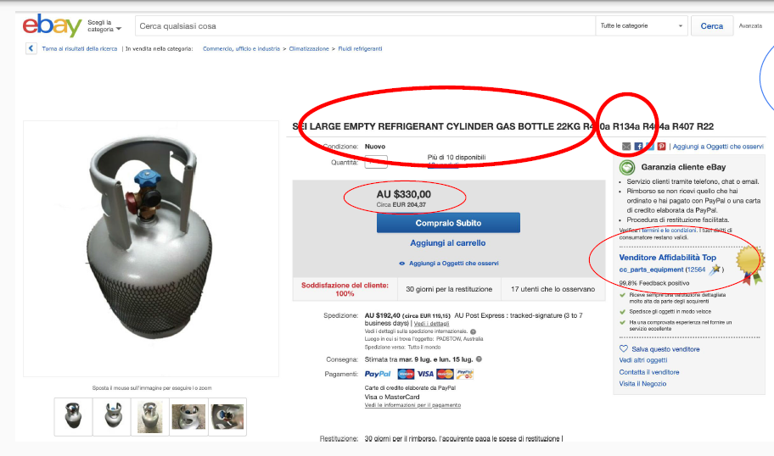
Ebay, Subito, Facebook
≈ 9 €/kg

Slide 6
The EEE gas problem
In EU price of one 40 kg bottle of R134a has increased from € 260 to around € 1100 → i.e. from 6.5 €/kg to around 27.5 €/kg
(Price of SF6 has stayed constant)
ATLAS and CMS consume o(1000 l/h) of C2H2F4
But R134a is sold at CERN by Pangas at 7.5 CHF/kg
Anyhow CMS and ATLAS RPC gas costs > 600 €/day
Chinese suppliers sell R134a at 1-2 €/kg → but importing in EU almost impossible

Slide 7
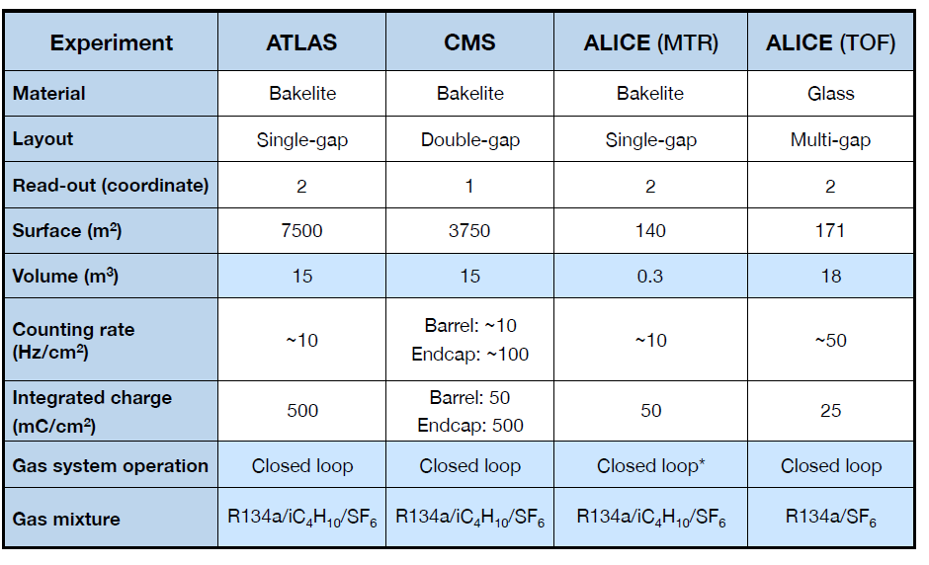
RPC detector at LHC experiments
From B. Mandelli, RPC2018

Slide 8
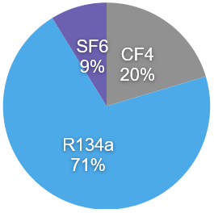
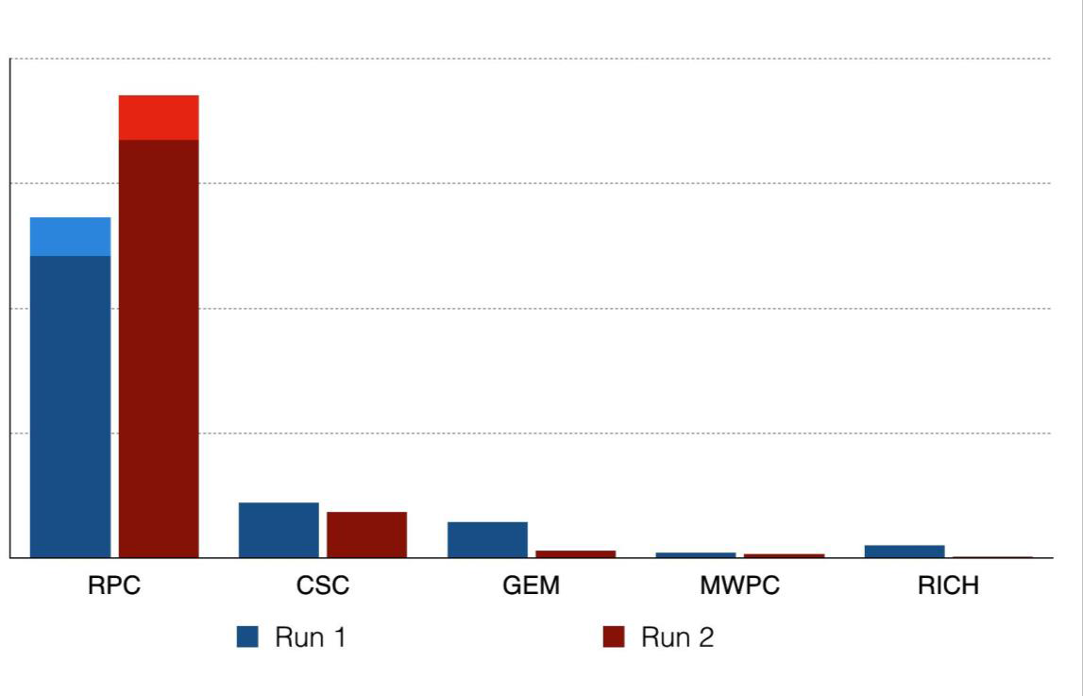
Not just an issue of cost
RPC detectors dominate the Greenhouse gas emission from particle detection at CERN
A greenhouse gas (GHG) absorbs and emits radiation within the thermal infrared
range (greenhouse effect).
The primary greenhouse gases in Earth's atmosphere are: H2O, CO2, CH4, N2O, O3.
SF6, C2H2F4, CF4gases used in particle detectors have high GWP
From Run2 all RPC system work with gas recirculation
ALICE MTR upgraded (2015)
(LHCb-GEM upgraded 2016)
Leaks at detector level difficult to be repaired
→ ATLAS and CMS-RPC
GHG emission per year
From R. Guida, RPC2018

Slide 9
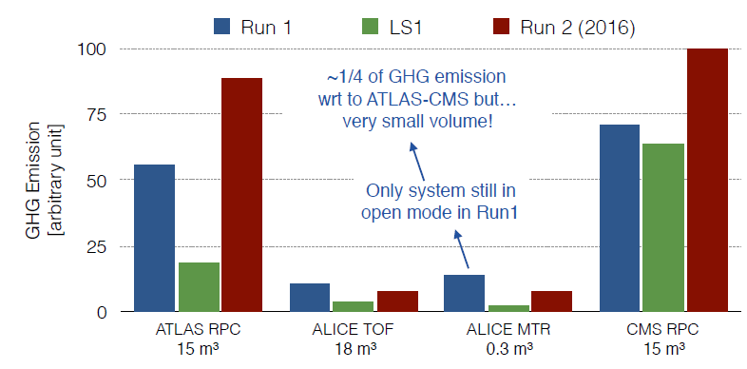
RPC GHG consumption at CERN
ATLAS and CMS: GHG emission due to leaks in the detectors
Maximum recirculation is set to ≈90% by leaks
ALICE TOF: recirculation > 90%
Practically no leaks at the detector level
ALICE MTR: in 2015 upgrade of the gas system from open to recirculation
Small system, but in open mode GHG emission very high wrt. other experiments
Now recirculation between 50 and 70%
From B. Mandelli, RPC2018

Slide 10
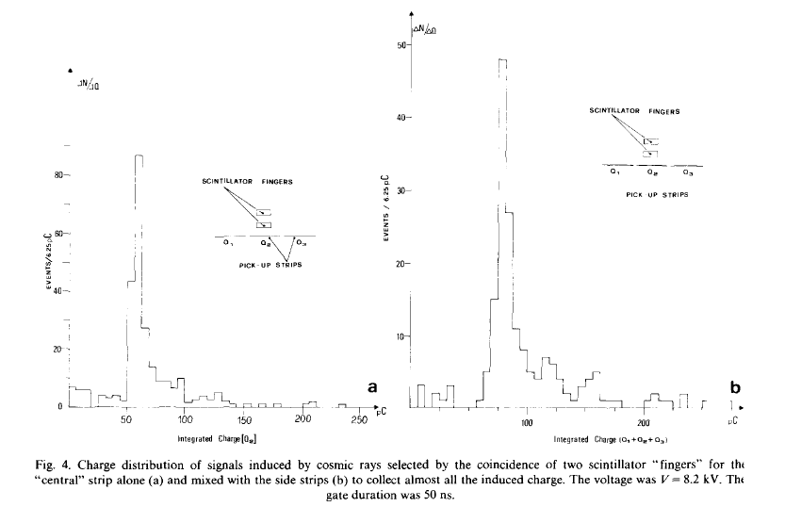
Why is Freon so important?
RPC originally coinceived to be operated in the so-called “streamer mode”, using Ar/isobutane/CF3Br gas mixtures
R. Cardarelli et al.,
≈100 pC

Slide 11
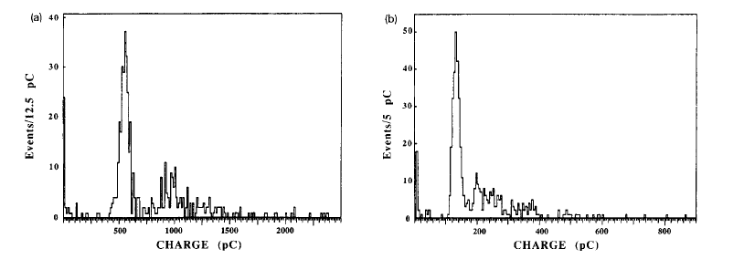
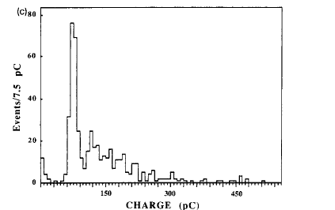
Why is Freon so important?
Good detectors, but not suitable for high rate [o(100 Hz/cm2)] applications
Ar/butane 60/40
0% CF3Br
Ar/butane 60/40
4% CF3Br
Ar/butane 60/40
8% CF3Br
Increasing the Freon percentage reduced the induced charge
Transfer part of the needed amplification from the gas to the front-end electronics
High-rate
R. Carderelli et al., Performance of a resistive plate chamber operated with pure CF3Br , NIMA 333 (1993), 399-403

Slide 12
A thorough model of what is happening
x_{sat}
Exponential growth
Saturation
μ
“Drift”
Exponential growth
Saturation
Note that most of the variables here are stochastic variables (q_{ind} is the convolution off all these probability distributions), so it is
not immediate to get analytical results…

Slide 13
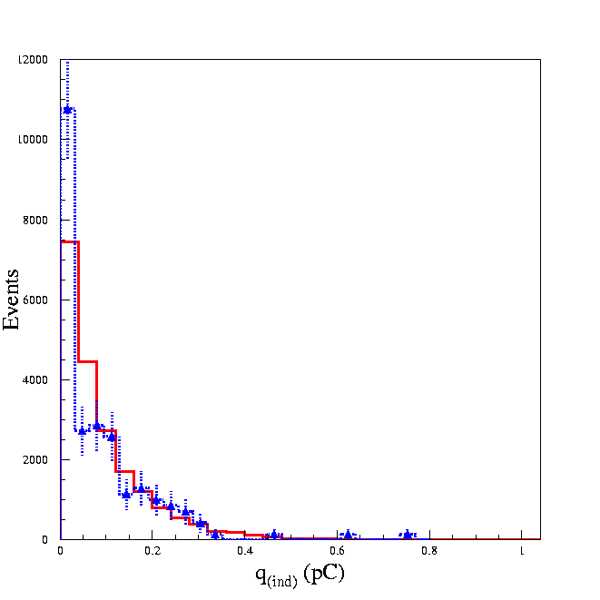
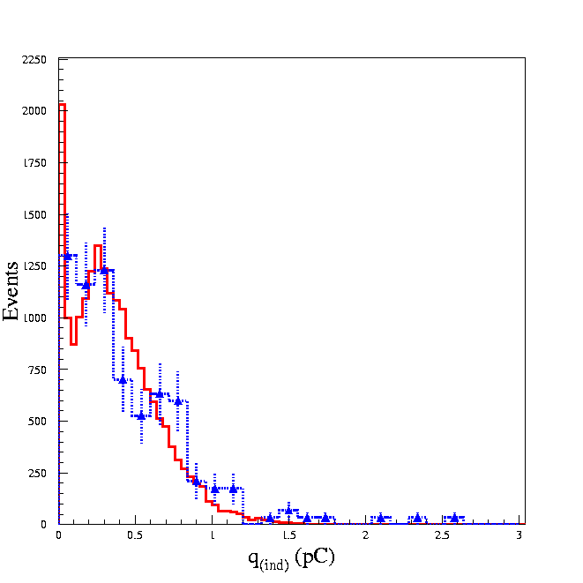
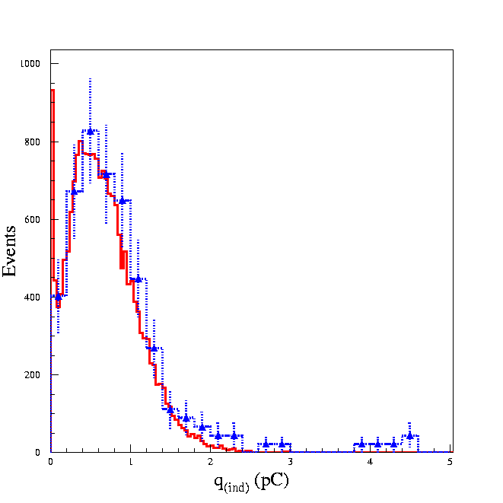
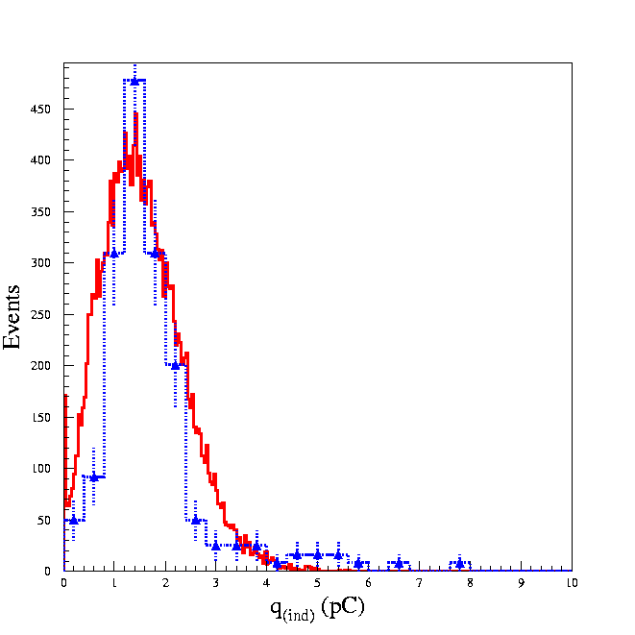
Quite a successful model
This is not a fit!
Simulation
Simulation
Experiment
Experiment
HV=9.2 kV
HV=9.5 kV
“Inefficiency”peak
“Saturation” peak
Simulation
Simulation
Experiment
Experiment
HV=9.7 kV
HV=10.1 kV
Input for simulation: Colucci et al., NIM A 425 (1999) 84-91
Gas mixture:
C₂H₂F₄/C₄H₁₀ 97/3 + SF₆ 2%
Experimental data from Camarri et al., NIM A 414 (1998) 317-324

Slide 14
Possibile strategies

Slide 15
Reduce leaks
Leaks control
Anyhow not so easy at the detector level: LHC experiments putting a lot of effort on it

Slide 16
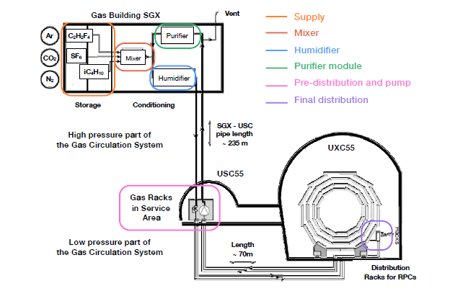
Recirculate the gas
Critical points in recirculation systems
Pressure and flow regulation for each chamber
Possible accumulation of impurities
Use of cleaning agents compulsory

Slide 17
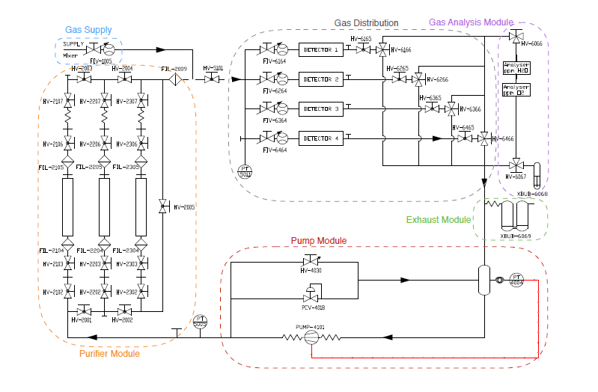
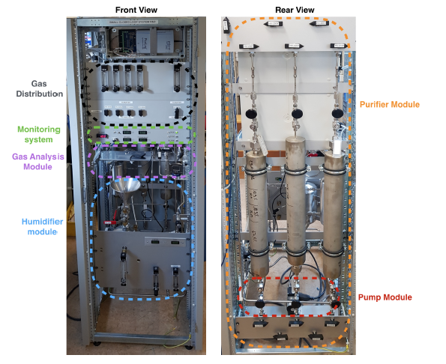
A small recirculation system
For small gas systems (universities, small research centers)
R. Guida and B. Mandelli, A portable gas recirculation unit for gaseous
Detectors, 2017 JINST 12 T10002

Slide 18
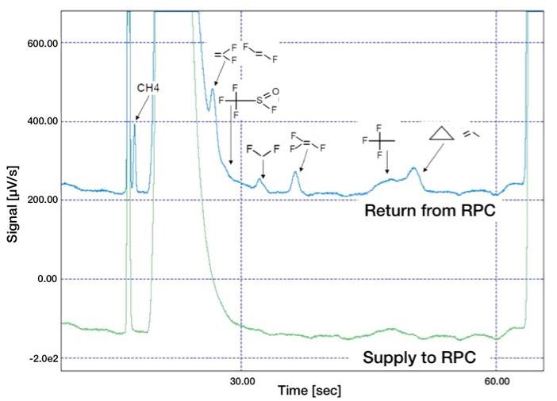
Production of impurities
Accumulation of impurities during mixture recirculation at GIF (2007-2011)
A lot of impurities are produced during RPC operation, which are to be identified and whose effect has to be investigated

Slide 19
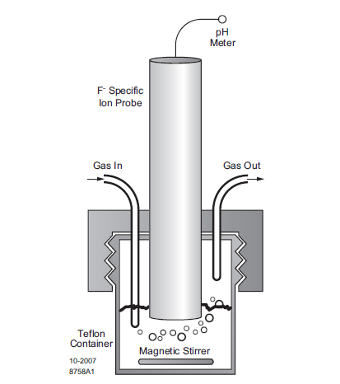
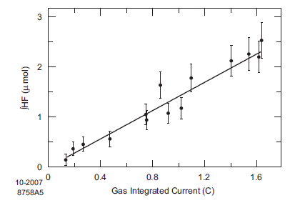
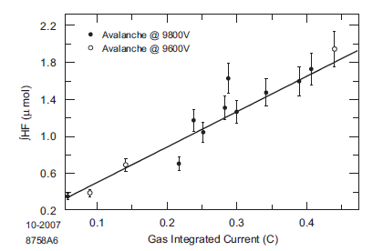
HF production in RPC
It is an old issue, dates back to BaBar
Streamer mode
In general, HF production seems to be proportional to the integrated current
Water vapour could play some role
H. R. Band et al., Study of HF production in BaBar Resistive Plate Chambers, NIM A 594 (2008) 33.38

Slide 20
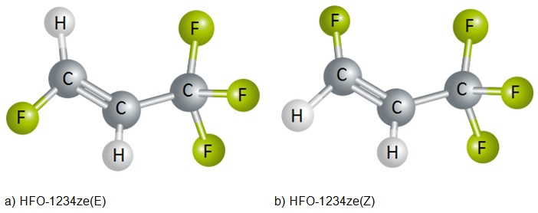
New gas mixtures
Candidate of election to replace C2H2F4
tetrafluoropropane , C3H2F4, HFO-R1234ze
It exists in three allotropic forms (yf, re)
the two others are flammable
GWP < 1
Two isomers of HFO-1234ze
It was chosen looking at the Freon table and locateing the gas most similar to R123a with a low GWP (not flammable, etc.)

Slide 21
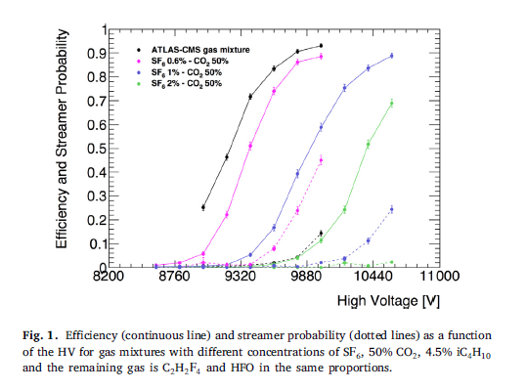
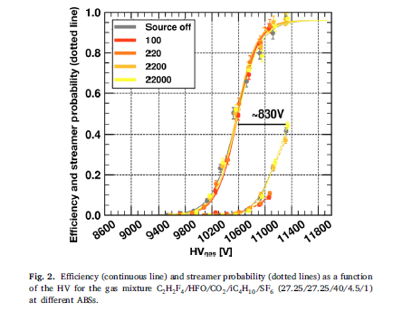
Tests on new gas mixtures
A lot are going on since four years now
Basically HFO is suitable but moves the operating point to higher voltages → use CO2 or He or else to lower the voltage
R. Guida et al., Performance studies of RPC detectors with new environmentally friendly gas mixtures in presence of LHC-like radiation background, https://doi.org/10.1016/j.nima.2019.04.027,
Maybe not a solution good for all. But…

Slide 22
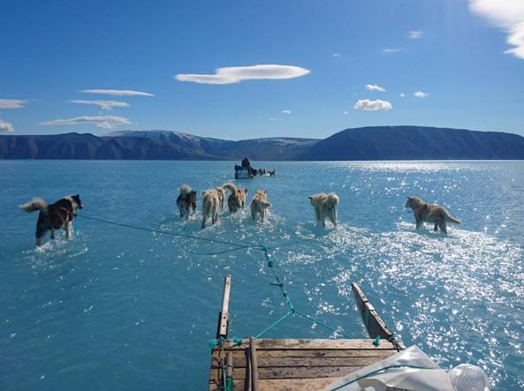
Let’s find a solution!

