Slide 1
What have we learned from studying the MRPC
Crispin Williams

Slide 2
OUTLINE
A brief outline of the development of the MRPC
Space charge
Importance of differential readout
Charge sharing and the resistivity layer
MRPC as a trigger device
MRPC with 16 ps time resolution
Summary

Slide 3
The Multigap RPC was born at the ‘95 RPC conference
Rinaldo Santonico explained a critical difference between the ‘wire chamber’ and the ‘parallel plate detector’.
electrons drift and arrive at the wire one after another - depending on drift distance
Example: Wire in a tube
b
Signal on wire comprises of a series of signals
+ kV
a
c
a b c
but only the first avalanche (produced by first arriving electron) is used for timing measurements

Slide 4
Parallel Plate Chamber
All electron avalanche processes start immediately: the induced signal (due to movement of charge) is the sum of all avalanches: thus all ionisation produced in chamber plays a role.
uniform
high electric field
+ kV
cathode
However: not so clear in practice: avalanche grows across full gap width (this means that only avalanches that originate close to cathode will ever grow sufficiently large to generate a signal).
2 mm
gap
anode
4

Slide 5
Putting in some numbers:
Set the gain for a single electron to be 10⁸ across a 2 mm gap (just below the transition to streamers)
fast signal/Total charge= 1/αD
fast signal is 800 fC
Now if initial electron is 0.5 mm from cathode: gain reduced to 10⁶:
fast signal is 8 fC
cathode
0.5 mm
2 mm
gap
anode
Only avalanches that start with some hundreds of micron of cathode will grow large enough to create detectable signal.
fast signal created movement of the electrons within 100 micron of anode

Slide 6
Going back to Santonico’s picture
To get these avalanches each producing a detectable signal at the start of the avalanche would require setting the gas gain extraordinary high - sparks,etc
uniform
high electric field
+ kV
Solution: add barriers within the gas gap to
stop development of the avalanche
+ kV
The Multigap Resistive Plate Chamber

Slide 7
MULTIGAP RESISTIVE PLATE CHAMBER
Stack of equally-spaced resistive plates with voltage applied to external surfaces (all internal plates electrically floating)
Pickup electrodes on external surfaces (resistive plates transparent to fast signal)
Internal plates take correct voltage - initially due to electrostatics but kept at correct voltage by flow of electrons and positive ions - feedback principle that dictates equal gain in all gas gaps
Signal electrode
Cathode -10 kV
(-8 kV)
(-6 kV)
(-4 kV)
(-2 kV)
Anode 0 V
Signal electrode

Slide 8
Note bene
The MRPC was inspired by an incorrect description of the physics of the RPC.
It has nothing to do with double gap RPC used in CMS.
Questions for students
Each gas gap contributes equally to signal on pick up strips - explain
Why do the ‘electrically floating’ resistive plates get fixed at the correct voltage

Slide 9
space charge
-HV
As the ‘avalanche’ grows - every time an ionising collision creates an electron, there is also a positive ion created. Since the positive ion is heavy - it is stationary (in time scale of avalanche formation). The charge of these positive ions reduces the electric field seen by the electrons in the ‘head’ of the avalanche.
+
+
+
+
+
+
+
+
+
+
+
+
+
+
-
+
+
-
-
-
-
-
+ HV
Low field region due to space charge

Slide 10
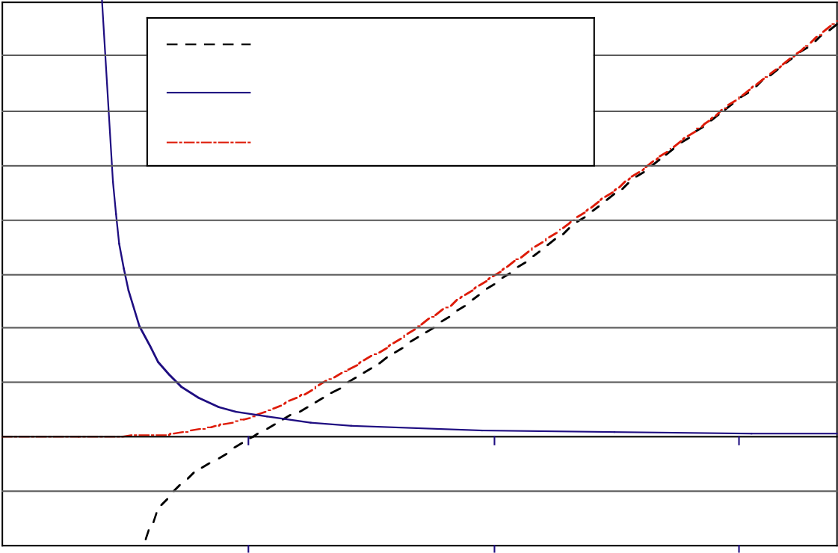
The role of space charge
Magboltz output for 90% C₂F₄H₂ 5% SF₆ 5% i-C₄H₁₀
400
Effective Townsend coefficient
Coefficient [mm-1]
Attachment coefficient
300
Townsend coefficient
250 micron gas gaps
ALICE mrpc’s operate here
200
100
0
-100
0
50
100
150
Electric field [V/cm]
N, the number of electrons in avalanche given by: Noe^{αx} where α is the Townsend coefficient
α 150 mm⁻¹, gap is 250 μm: 2.10¹⁶ electrons in avalanche when arrives at anode
This gas gain too high: so what is going on here??

Slide 11
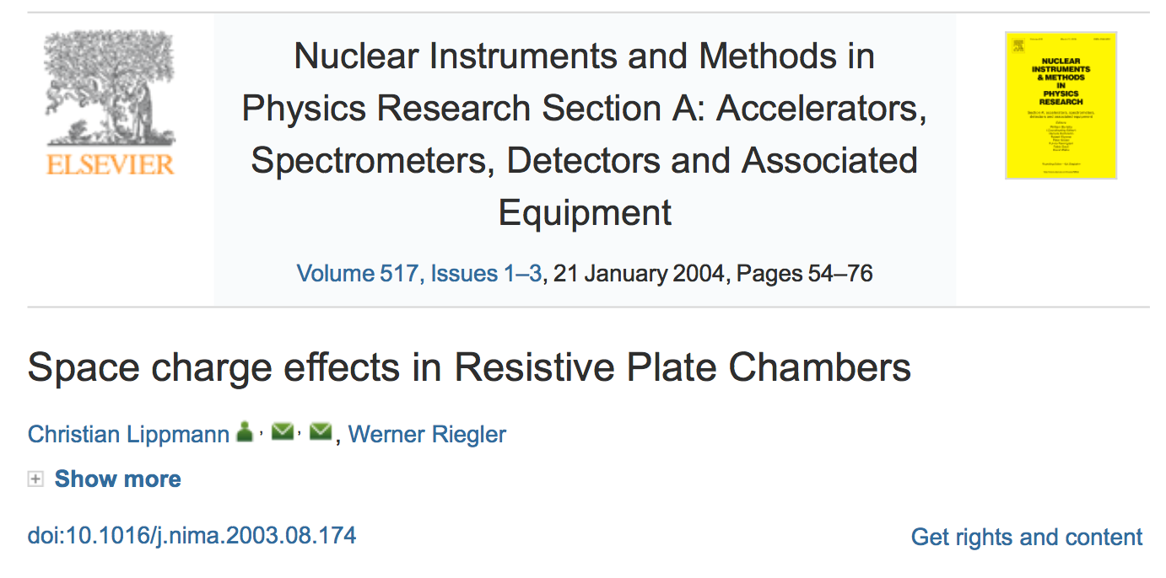
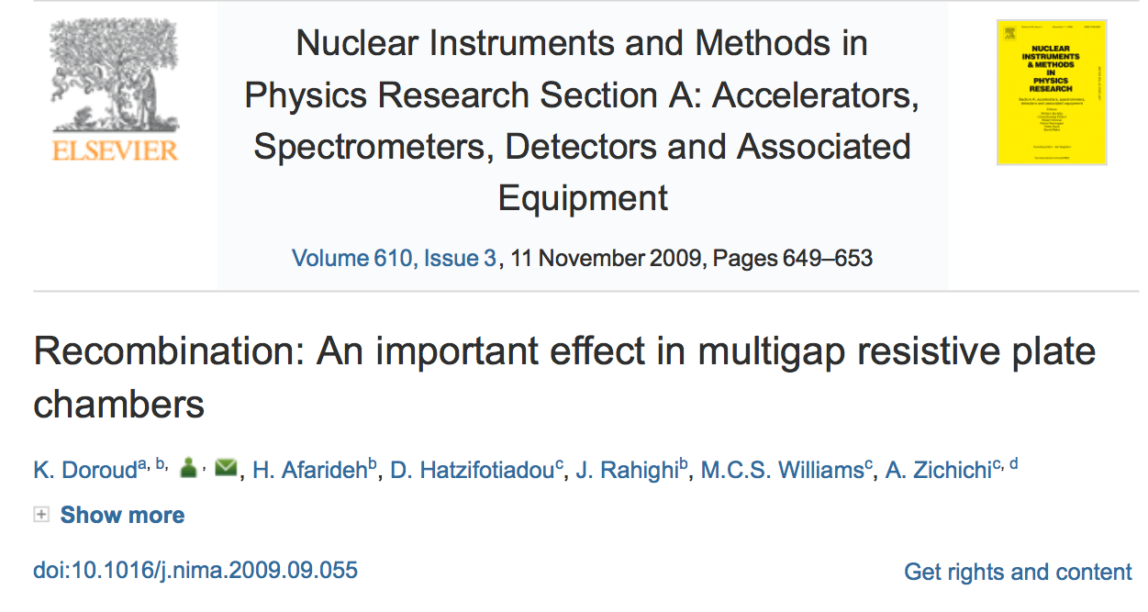
Modelling space charge is non-trivial
A very good description can be found here
An implementation of the Lippmann Riegler paper

Slide 12
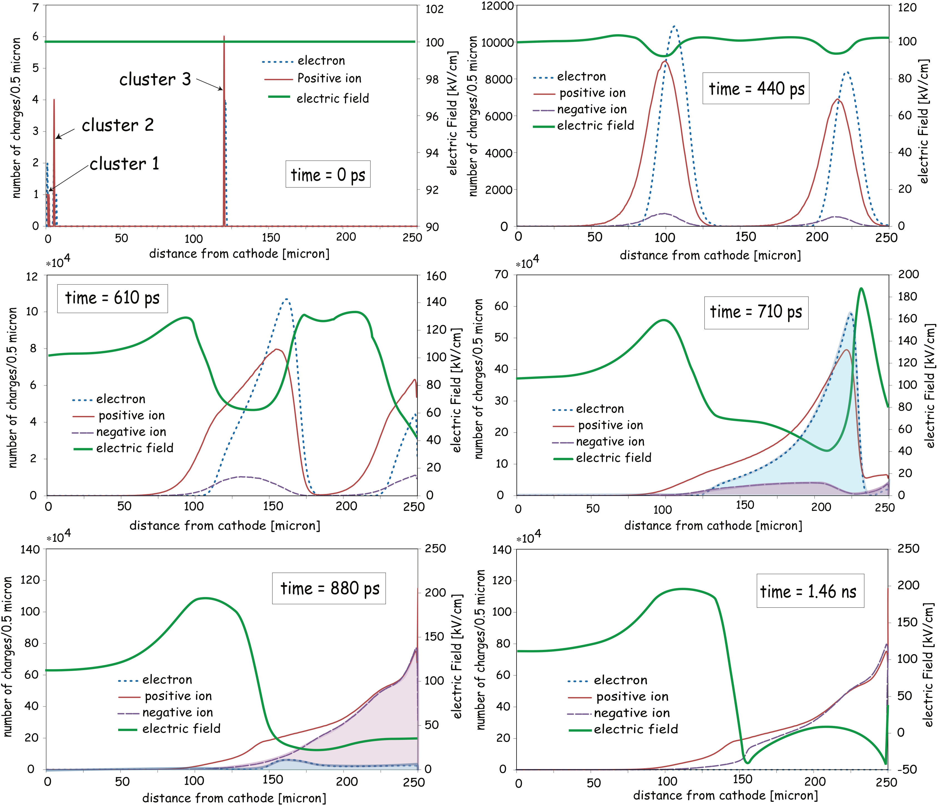
Time dependance of avalanche development
Notes
Avalanche that begins halfway through gap generates a large number of electrons
Electrons present in time 710 ps are captured - and negative ions created by time 880 ps (n.b. attachment coefficient = to Townsend coefficient at 50 kV/cm)
Electric field (100 kV/cm) is completely modified by space charge effects : varies between -40 kV/cm to 200 kV/cm

Slide 13
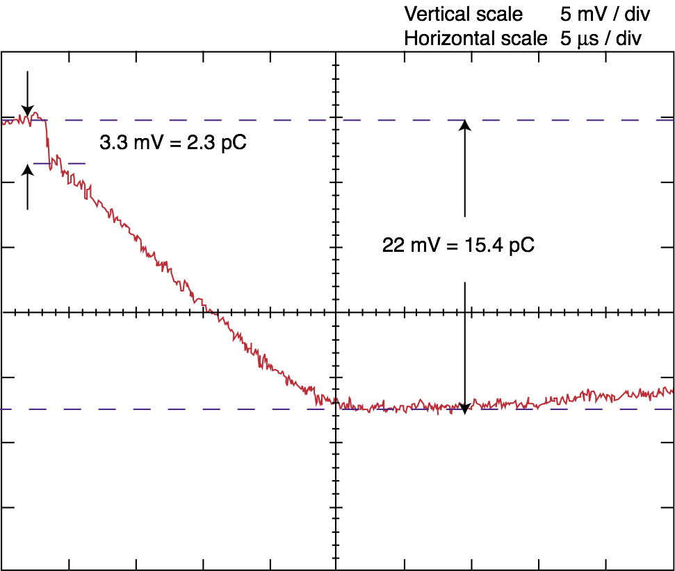
Reminder:
cathode
largest part of signal is generated by positive ions drifting back to cathode
RPC
High impedance
anode
Fast signal: electrons
move towards anode
Slow signal:
positive ion
cloud moves away
from anode
fast/total = 3.3/22 = 15 % in this case
2 mm gap RPC

Slide 14
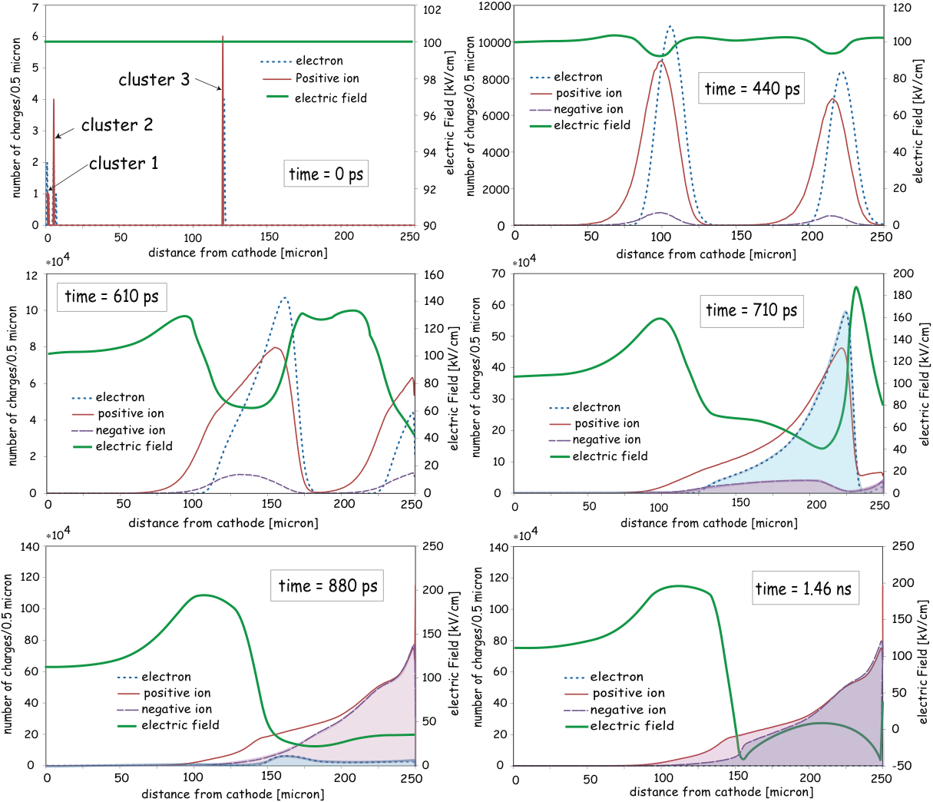
expect large signal from ions for MRPC
very large residue of positive and negative ions left in gas gap after avalanche

Slide 15
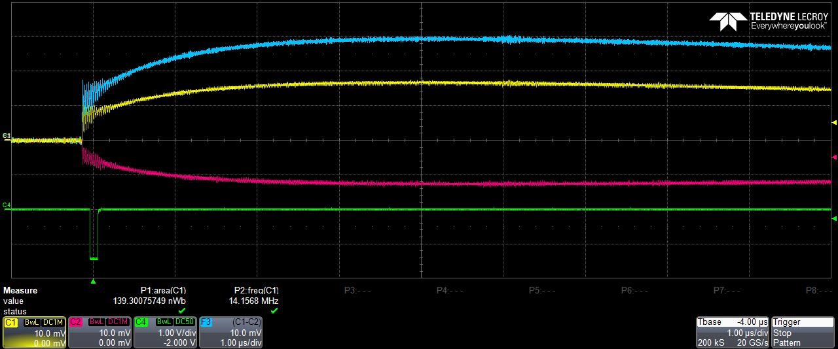
MRPC
fast/total =10/30 = 33%
Fast/Total has high value: no obvious presence of extra ions… ??

Slide 16
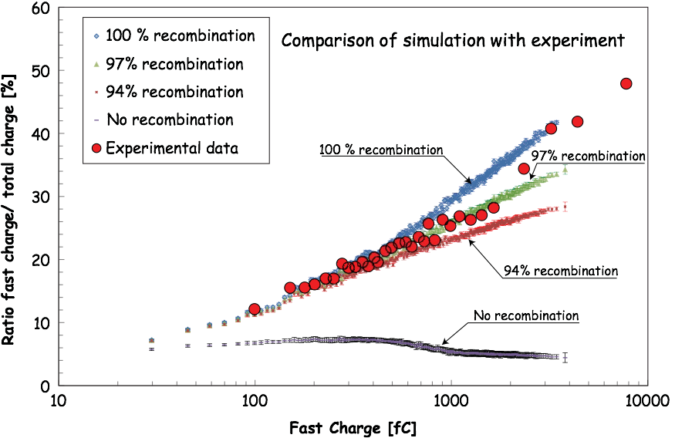
Recombination of positive and negative ions
Fast signal/total charge = 1/aD : around 5% for normal 2 mm gap RPC
Recombination very important effect - most negative/positive ions recombine and do not drift to anode

Slide 17
Stages of signal production in MRPC
Charged particle passes through the gas - primary clusters of ionisation
Electrons avalanche/multiply via Townsend process
Once the avalanche has grown above a certain size ( ~ 10⁷ electrons) - space charge effects kick in: free electrons are captured to form negative ions. This inhibits further growth of the avalanche (but need a strong electronegative gas as part of the mixture (SF6))
Once the avalanche has completed (all free electrons have moved to anode) : the positive and negative ions recombine (this is good otherwise this charge would have to flow through the resistive plates) but photons will be produced. These photons could liberate electrons from cathode surface - or maybe transparent glass just absorbed the photons - is a quenching gas required?
N.B. electron avalanches that start half way across gas gap can still produce detectable avalanches

Slide 18
The Multigap
In reality - the signal is the combination of many small avalanches, but
only because of powerful space charge effects
limits gain to < 10⁸ - and thus has long streamer free plateau
low dependance of gain on gap size
many extra positive and negative ions produced in avalanche - but they recombine and do not flow through resistive plates- thus does not degrade rate capability

Slide 19
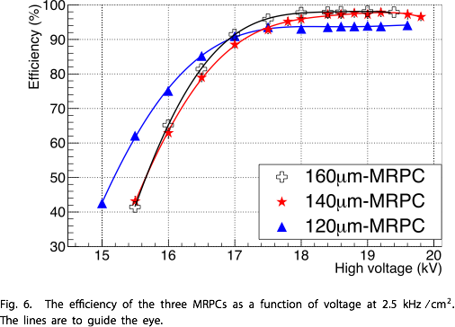
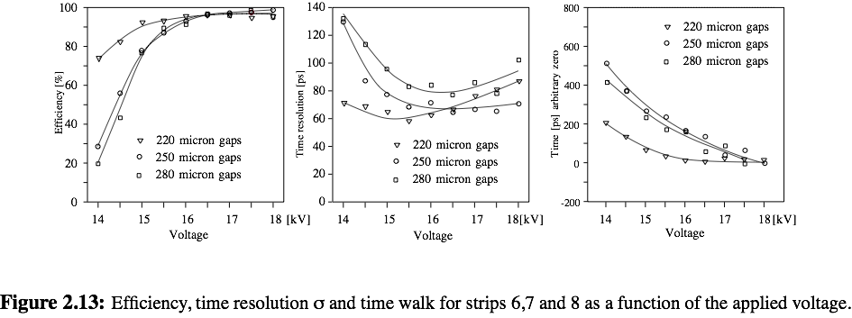
Efficiency plateau versus gap size
Recent R&D
ALICE TOF R&D

Slide 20
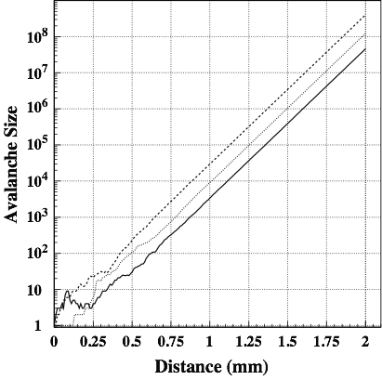
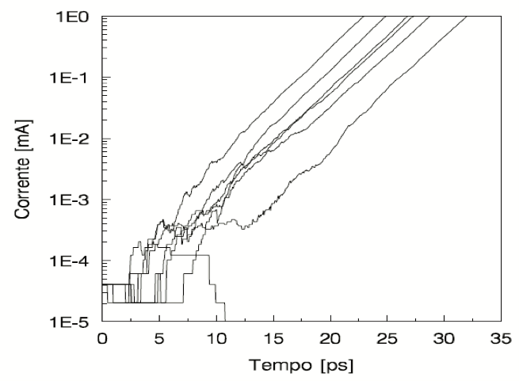
Time Development of avalanches
Detector physics and simulation of resistive plate chambers
Werner Riegler*, Christian Lippmann, Rob Veenhof NIMA 500 (2003) 144–162
Development of avalanche in 2 mm gap RPC
A. Spinelli Ph.D thesis (1996)
Development of avalanche in Silicon PM
In both cases the timing jitter is created during early development of avalanche

Slide 21
Summary
Signal from MRPC is really due to many small avalanches happening in ‘parallel’ (i.e. in time with one another)
space charge becomes a dominant effect for small gaps
Space charge suppresses streamer formation and reduces dependance on field strength
Extra ions produced are eliminated by recombination
very low dark count rate, low dark current and low consumption of gas
Differential readout essential for precise timing
Resistive layer : keep the resistivity above 1 MΩ/square
Future: low resistivity glass - etc will allow operation up to 100 kHz/cm²
TOF array with 10 ps timing is a realistic goal

Slide 22
Thank you for your attention

