Slide 1
On-going analyses of EEE data in Catania
F.Riggi, P.La Rocca, C. Pinto
Search for long distance correlations from multitrack events
2. Combined analysis of multi-telescope events
3. Muon speed systematics over the EEE network

Slide 2
Search for long distance correlations from multitrack events
Analysis strategy: Search for correlations between any telescope pair, looking at two- and multi-track events in both telescopes
Dataset: Full available statistics: 2013-2018
42 telescopes + 5 clusters
30M coincidence events (within ±2 s)
Info saved on ROOT file for further analysis:
Telescope code
Event time
Direction and χ² of individual tracks
Sum of scalar products between tracks (alignment between tracks)
Preselection cuts:
● χ² < 10
● Rough alignment between tracks in the same telescope
● Distance between telescopes > 5 km

Slide 3
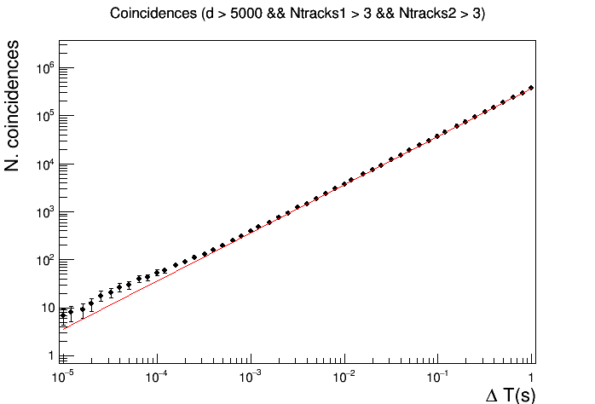
Search for long distance correlations from multitrack events
Ntracks > 3
p-value ∼10⁻³
40 coincident events observed (expected background ∼ 23.4 events)

Slide 4
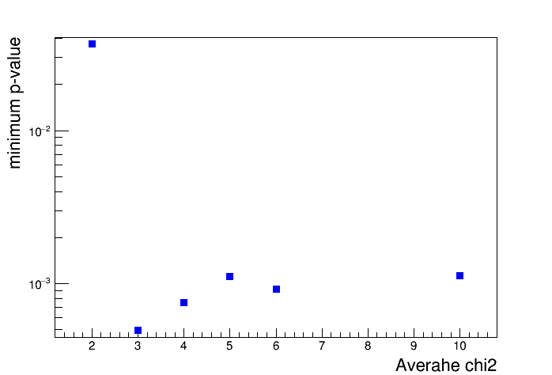
Search for long distance correlations from multitrack events
Several additional cuts investigated :
Effect of χ²
Average χ²

Slide 5
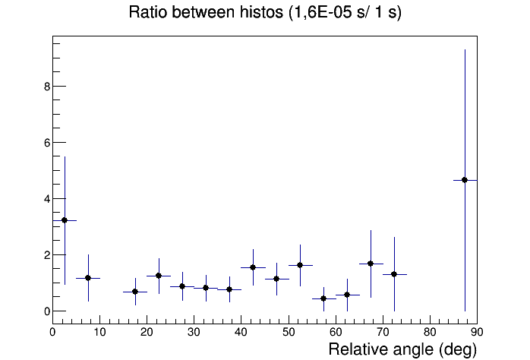
Search for long distance correlations from multitrack events
Several additional cuts investigated :
Effect of parallelism between average directions in the two sites
Ratio w.r.t. random coincidences:
No significant differences seen with the relative angle

Slide 6
Combined analysis of multi-telescope events
Search for anomalous coincidence events involving a large number of EEE telescopes within ms time interval
A nearly complete scan of all available statistics from RUN 5 (October 2018-June 2019, 244 days) carried out
Extraction of the raw multiplicity spectrum (number of coincident events as a function of the number of telescopes)

Slide 7
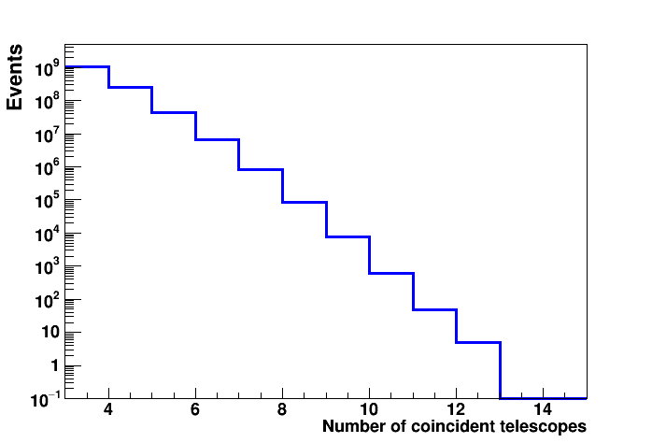
Combined analysis of multi-telescope events
● Highest multiplicity events observed: 5 evts with 12 telescopes
● Roughly a factor 10 decrease in the yield for every additional telescope
● Even with a much larger collection time (several years) only a few events
expected with n>12 telescopes
Exp. data

Slide 8
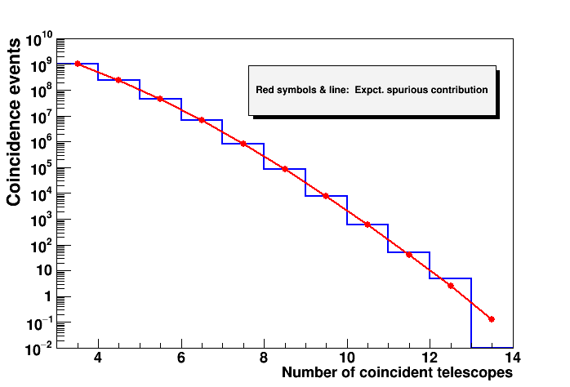
Combined analysis of multi-telescope events
Comparison to the expected spurious rate
Assumptions: Individual incoming muon rate
Detection efficiency
Number of working telescopes/day

Slide 9
Combined analysis of multi-telescope events
A reasonable agreement observed between raw data and spurious expected trend over 9 orders of magnitude.
Planned further checks on the effect of various assumptions on the spurious rate (average number of telescopes, individual rates, efficiency,…)
Basically, only an upper limit on the number of such events
may be established…

Slide 10
Muon speed systematics over the EEE network
Muon speed may be extracted from track length and time-of-flight information for each EEE telescope. A basic way is just the ratio <tracklength>/<Tof> as many students do..
This is not correct, for two reasons:
a) the distributions of tracklength and Tof are not Gaussian …
b) Time-of-flight information in many cases presents large mismatches due
to different/wrong cable length, offset problems…, leading to unrealistic
values of β
Event-by-event ratio tracklength/time-of-flight is better, but b) is still a problem
A better strategy is to look at the 2D correlation tracklength-Tof with proper quality cuts.
Goals of the present analysis:
- Check and correct the information provided by all EEE telescopes
- Investigate possible systematics of the muon speed for the
different sites (location, altitude, longitude, shielding from building,…)

Slide 11
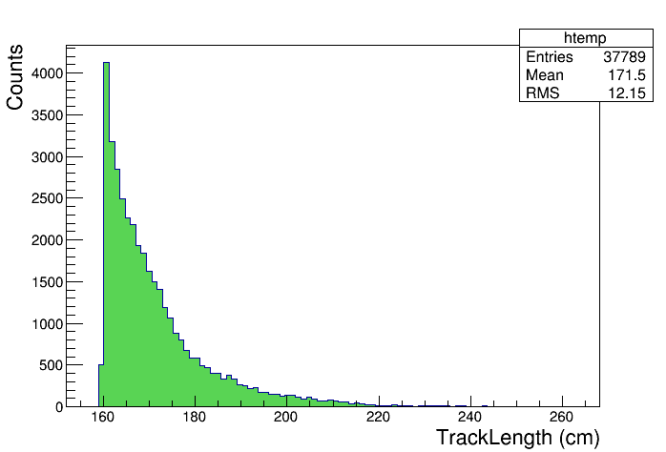
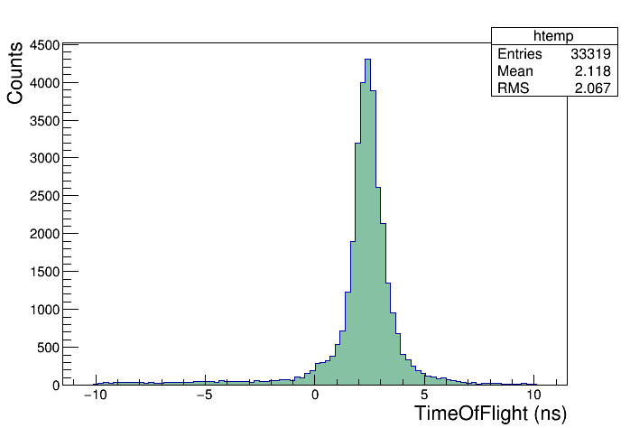
Muon speed systematics over the EEE network
Example of unrealistic muon speed (>c) from the track-by-track length/time-of-flight

Slide 12
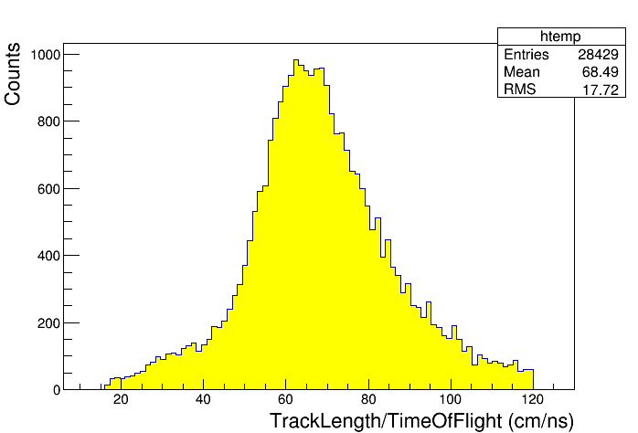
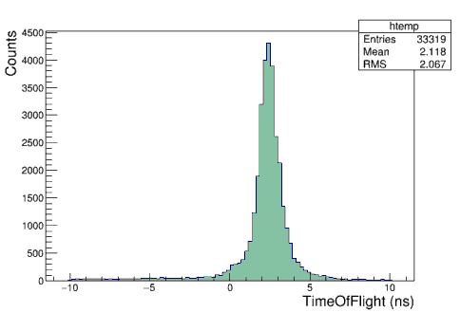
Muon speed systematics over the EEE network
Example of unrealistic muon speed (>c) from the track-by-track length/time-of-flight
Event-by-event ratio
Investigation of this problem over all the EEE installations and extraction of the beta values in progress

Slide 13
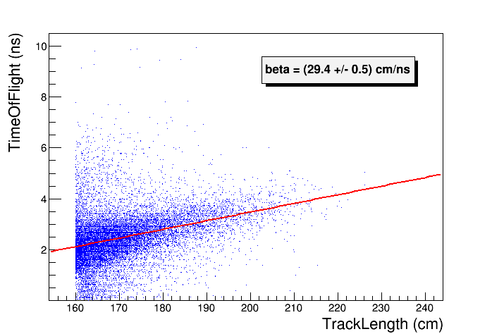
Muon speed systematics over the EEE network
Same data, analyzed by a 2D correlation

Slide 14
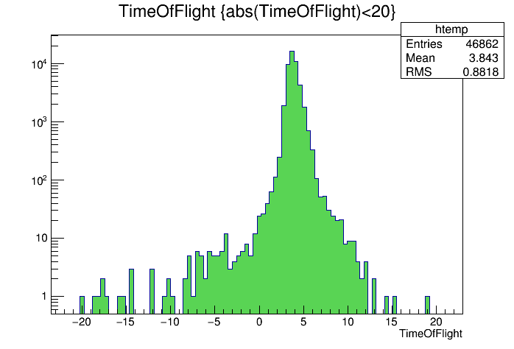
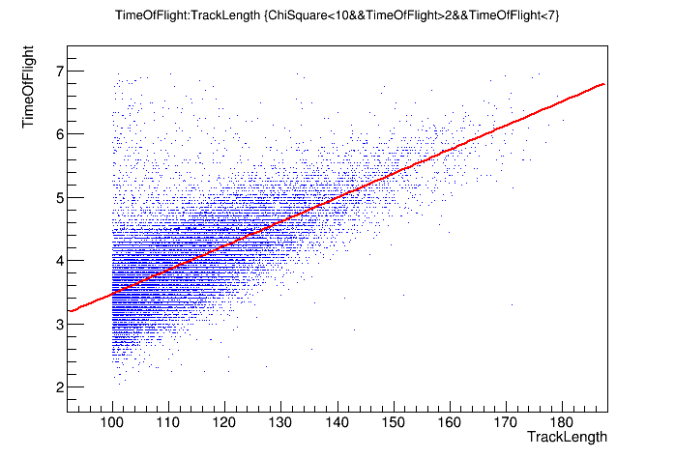
Muon speed systematics over the EEE network
In other cases, the information on the time-of-flight is reasonable and the two methods give comparable values
Over a few sites explored so far (limited statistics for each site), muon speeds between 26 and 30 cm/ns observed, with still large uncertainties, which however may be largely improved .

