Slide 1
CARI-01: behaviour at slow gas mixture flux
Marco Schioppa

Slide 2
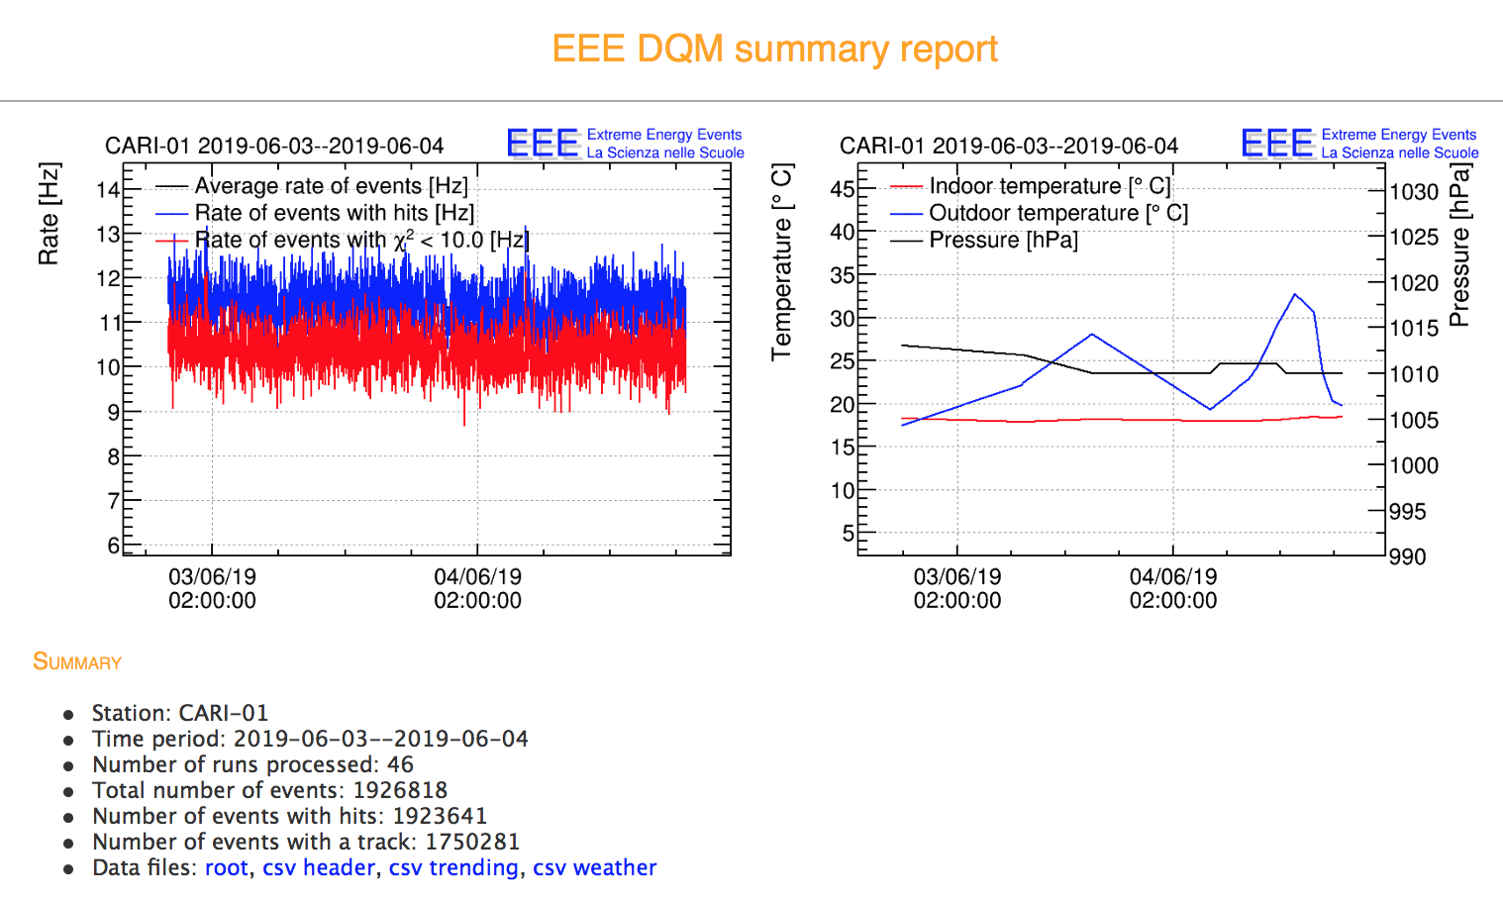
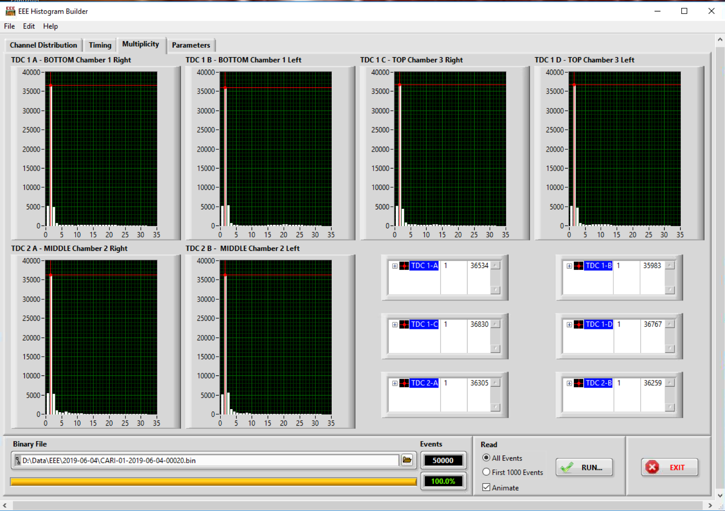
Behaviour @ normal gas mixture flux (1.8 l/h)
Track rate
Leak current @ 20 C
Multiplicity
Slightly less than 1 uA

Slide 3
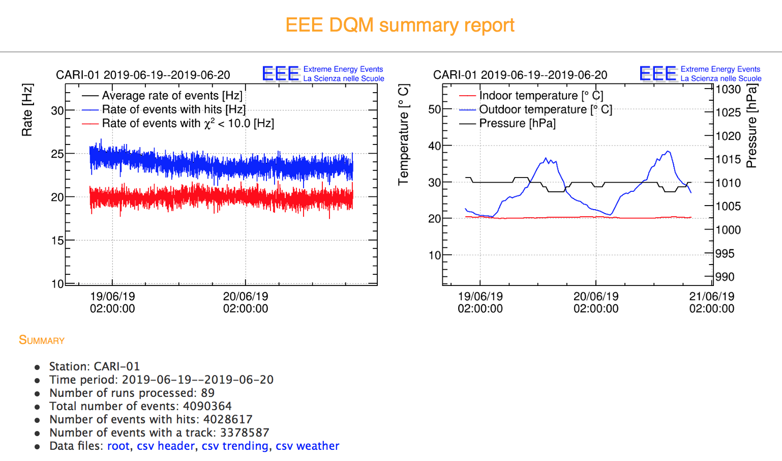
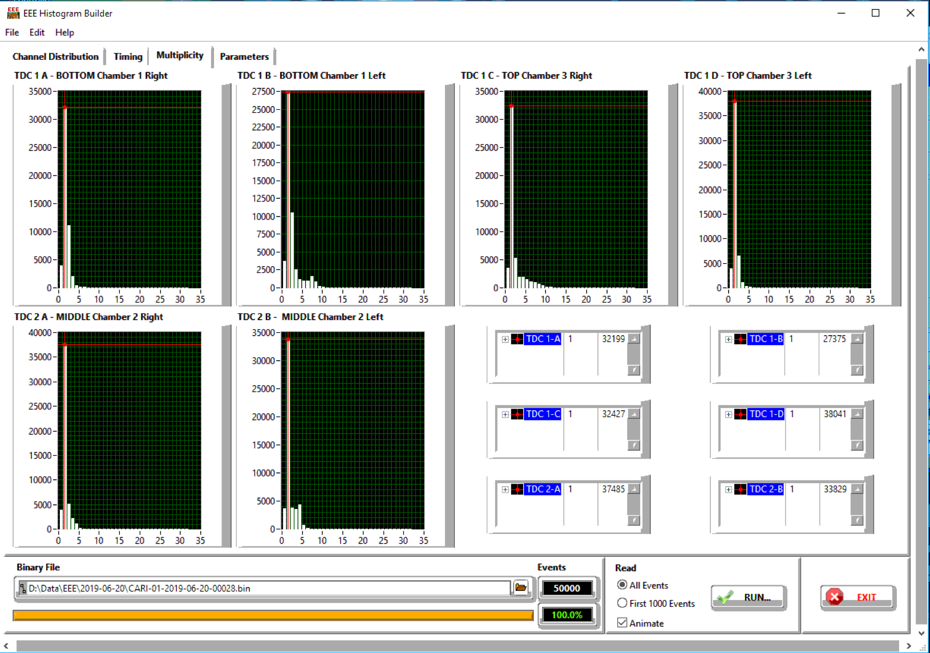
Behaviour @ reduced gas mixture flux (1 l/h)
10/6/2019 from 1.8 to 1 l/h
Track rate
Leak current @ 20 C
Multiplicity
Slightly less than 1 uA

Slide 4
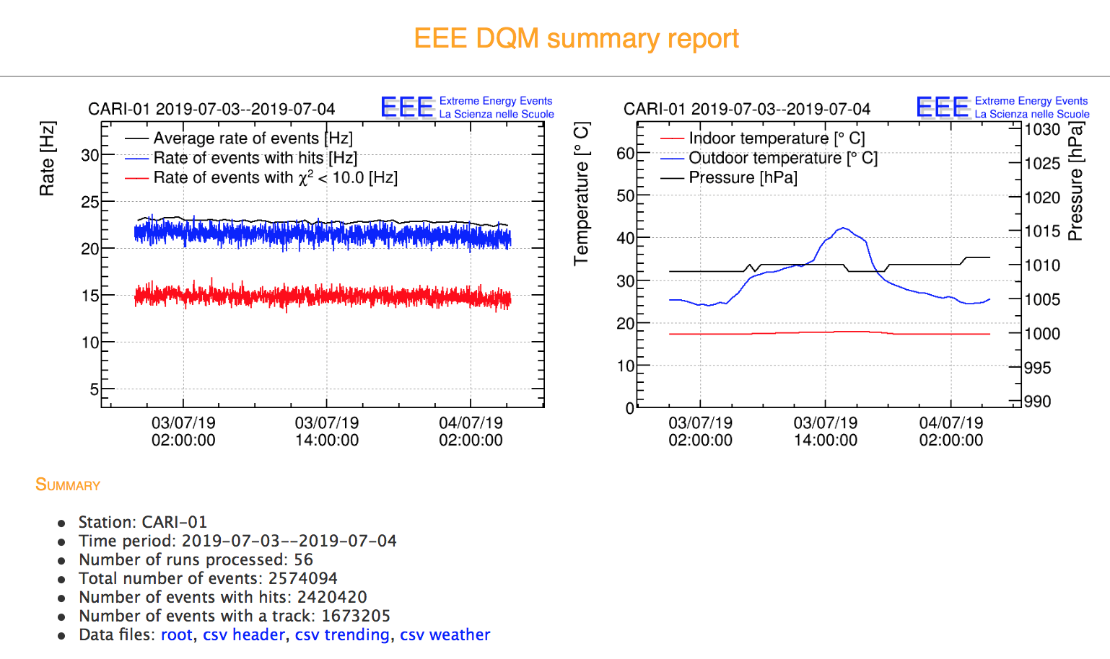
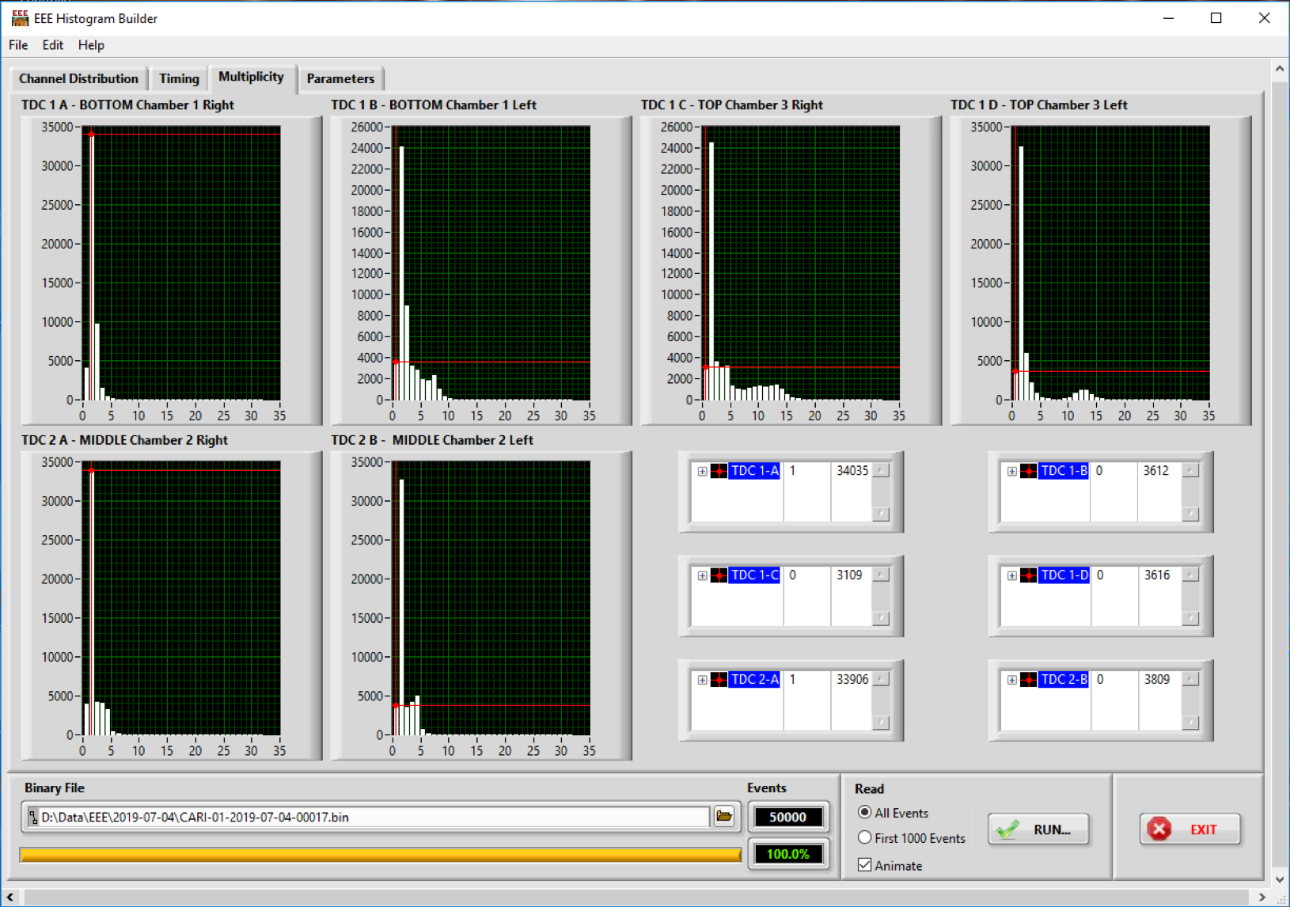
Behaviour @ reduced gas mixture flux (1 l/h)
10/6/2019 from 1.8 to 1 l/h
Track rate
Leak current @ 20 C
Multiplicity
Slightly less than 1 uA

