Slide 1
Report from the Editorial Board and Conference Committee
F.Riggi
EEE Meeting, Roma, July 4, 2019

Slide 2
EEE Editorial Board/Conference Committee
Some time ago it was suggested to have an Editorial Board and Conference Committee within the EEE Collaboration, to manage the questions concerned with publications and contributions to conferences.
Composition of the Board:
Francesco Riggi (chair), Marcello Abbrescia, Giovanni Batignani, Luisa Cifarelli, Rosario Nania
Report summary:
● Some statistics on EEE publications
● Latest and on-going papers
● 2019 and upcoming Conference Contributions
● Short comments and remarks

Slide 3
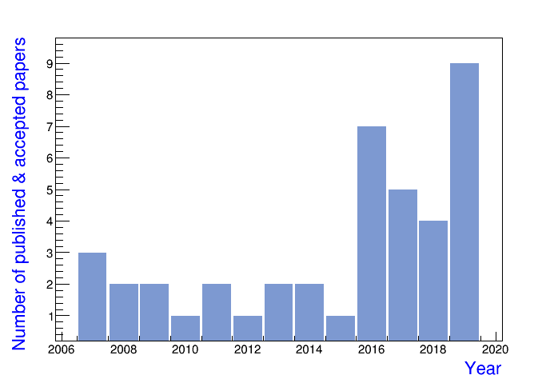
EEE Publications: some statistics
● Info from cross-checking EEE Web site, my personal curriculum, additional unofficial information…
● 41 in total (to my knowledge), also including Conference Proceedings in refereed Journals
● For 2019, the number also includes accepted papers

Slide 4
Latest publications: 2018-2019
Published papers in 2018: 4
Search for long distance correlations between
extensive air showers detected by the EEE network
EPJPlus 133(2018)34
Come varia il flusso dei raggi cosmici con la quota? Basta chiederlo agli studenti del progetto EEE
Giornale di Fisica 59(2018)229
The Extreme Energy Events experiment: an overview of
the telescopes performance
JINST 13(2018)P08026
Measuring cosmic ray showers near the North Pole with the Extreme Energy Events project
Nuovo Saggiatore 34(2018)27

Slide 5
Latest publications: 2018-2019
Already published papers in 2019: 4
The new trigger/GPS module for the EEE project
NIM A936(2019)376 (Elba Conf.)
Test of new eco-gas mixtures for the multigap resistive plate chambers of the EEE project
NIM A936(2019)493 (Elba Conf.)
Performance of the multigap resistive plate chambers of the Extreme Energy Events project
NIM A936(2019)474 (Elba Conf.)
The EEE MRPC telescopes as tracking tools to monitor building stability with cosmic muons
JINST 14(2019)P06035

Slide 6
Latest publications: 2018-2019
Papers in press (likely in 2019)
Search for coincident air showers over large scale distances
with the EEE network
Nucl.Phys.B (2019), in press (CRIS2018)
First results from the upgrade of the Extreme Energy
Events experiment
JINST (2019), in press (RPC2018)
Performance of the Multigap Resistive Plate Chambers of
the Extreme Energy Events Project
JINST(2019), in press (RPC2018)
New Eco-gas mixtures for the Extreme Energy Events
MRPCs: results and plans
JINST (2019), in press (RPC2018)
Misura del raggio della terra con gli studenti del progetto EEE Giornale di Fisica (2019), in press

Slide 7
On-going papers
Papers submitted/in preparation:
The New Trigger/GPS Module for the Extreme Energy Events Project
NIM A, already submitted, under review
Measurement of cosmic ray intensity with the PolarquEEEst
in preparation
GEANT4 Simulations of the EEE telescopes
Under discussion, reported to several meetings
Search for long distance correlation with multi-track events
Under discussion, reported to several meetings
Latitude dependence of the cosmic ray flux
Under discussion, reported to a recent meeting
Underground measurements
Under discussion, reported to several meetings

Slide 8
International Conference contributions in 2019
7 Contributions: 6 already accepted (2 posters, 4 talks), 1 submitted
- C.Pellegrino, First results from PolarquEEEst , ICRC36, July2019 (Poster)
- C.Cicalò, The EEE experiment, ICRC36, July2019 (Poster)
- I.Gnesi, Extreme Energy Events: an extended multi purpose cosmic ray observatory, TAUP2019, Sept.2019 (Talk)
- C.Pinto, EEE MRPC telescopes as tracking devices to monitoring the long term stability of civil buildings, DesyT-2019, Sept.2019 (Talk)
- P.La Rocca, Scientific and educational aspects of the EEE Project, DeSyT-Sept. 2019 (Talk)
- P.La Rocca, Search for long distance time correlations between cosmic air showers with the MRPC telescopes of the EEE network, EPS-HEP2019, July2019 (Talk)
- C.Pinto, Monitoring the long term stability of civil buildings through the MRPC telescopes of the EEE Project, IPRD2019, Oct.2019, submitted

Slide 9
SIF contributions in 2019
6 Contributions in different Sessions
- P.La Rocca: Search for long distance multitelescope correlations with the EEE network
- C.Pinto: Monitoring building stability with EEE MRPC telescopes
- G.Serri: Muon flux measurements underground with EEE Cosmic Box
- M.Abbrescia, Technological applications from the Extreme Energy Events experiment
- S.Grazzi, GEANT4 simulations of EEE MRPC telescopes
- F.Noferini, Flusso di raggi cosmici in funzione della latitudine con PolarquEEEst

Slide 10
Upcoming Conferences of interest
Conference | Place/Date | Abstract Deadline | Abstract(s) submitted
IPRD19 | Siena/14-17 Oct.2019 | July 10 | 1
DesyT | Messina/11-13 Sept.2019 | closed | 2
TAUP 2019 | Japan/9-13 Sept.2019 | closed | 1
ICRC 36 | USA/24-31 July 2019 | closed | 2
EPS-HEP2019 | Belgium, 10-17 July 2019 | closed | 1
CRIS 2020 | Naples?/2020 | ?
iWoRiD 2020 | ? /2020 | ?
ICRC 37 | ? /2020 | ?
RPC2020 | ?/2020 | ?

Slide 11
Remarks and comments
● EEE activity supported by publications and conference contributions
- Increasing trend over the last few years
- A total of about 41 publications and Conference Proceedings
- 13 in 2018-2019 (8 published, 5 in press)
- 7 contributions to international conferences + 6 to SIF Conference (2019)
● List of authors recently updated within the Editorial Board, taking into account suggestions/comments from the various sites.
● 62 authors in the last paper, about 50% directly involved in the analysis and participation to biweekly meetings
● Two minor remarks:
- The EEE web site in this respect needs to be updated and maintained
(Complete list of publications and contribution to conferences, full text,..)
- Deadlines for circulating abstracts and submission or acceptance of
papers: sometimes not properly taken into account…
● Looking forward to the future, also for publications and conf.contributions
- Finalizing the current analyses..
- New physics items of interest
- Technological developments
- Educational activities..

