Slide 1
Some Statistic about the EEE Runs
Update: 3 June 2019 (up to Run 5 included)
Fabrizio Coccetti
Centro Fermi – Museo Storico della Fisica e Centro Studi e Ricerche “Enrico Fermi”, Via Panisperna, Roma, IT

Slide 2
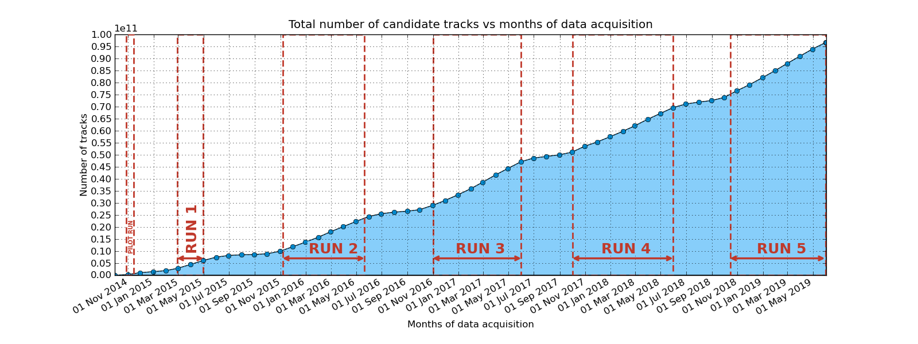
Total number of tracks
The network of the EEE telescopes acquired ~ 97 billions muons since 1/Oct/2014

Slide 3
Days of Data Taking (Runs)
Run[2,5] ~ 200 days of data taking each
Total number of days of data taking during Runs at the end of RUN 5: 741

Slide 4
Candidate Tracks per day – All RUNs
RUN 5: the EEE telescope network detects
more than 94 million muons per day

Slide 5
Performance
Performance = candidate_tracks / triggers

Slide 6
Duty Cycle – RUN 5
The Duty Cycle is the total amount of time when the telescope is taking good data

Slide 7
Duty Cycle – RUN 5
The Duty Cycle is the total amount of time when the telescope is taking good data

Slide 8
Triggers – All RUNs
RUN Number | Total number of Triggers | Triggers per day
Run 0 | 690029958 | 36317366.21
Run 1 | 3929628885 | 62375061.67
Run 2 | 16358442453 | 83461441.09
Run 3 | 22744780236 | 107286699.23
Run 4 | 23113691647 | 95907434.21
Run 5 | 26658283915 | 116411720.15

Slide 9
Candidate Tracks – All RUNs
RUN Number | Total number of Tracks | Tracks per day
Run 0 | 520418111 | 27390426.89
Run 1 | 3321758288 | 52726322.03
Run 2 | 13523368343 | 68996777.26
Run 3 | 18107812793 | 85414211.29
Run 4 | 18386090161 | 76290830.54
Run 5 | 21598446205 | 94316358.97

Slide 10
Performance – All RUNs
Performance = candidate_tracks / triggers
RUN Number | Performance
Run 0 | 0.754
Run 1 | 0.845
Run 2 | 0.827
Run 3 | 0.796
Run 4 | 0.795
Run 5 | 0.810

Slide 11
Run 0 (Pilot Run)
Start of Run 0 | 27/10/2014
End of Run 0 | 14/11/2014
Number of Days | 19

Slide 12
Run 1
Start of Run 1 | 27/2/2015
End of Run 1 | 30/4/2015
Number of Days | 63

Slide 13
Run 2
Start of Run 2 | 7/11/2015
End of Run 2 | 20/5/2016
Number of Days | 196

Slide 14
Run 3
Start of Run 3 | 1/11/2016
End of Run 3 | 31/5/2017
Number of Days | 212

Slide 15
Run 4
Start of Run 4 | 2/10/2017
End of Run 4 | 30/5/2018
Number of Days | 241

Slide 16
Run 5 (partial)
Start of Run 5 | 15/10/2018
Partial | 31/05/2019
Number of Days | 229

