Slide 1
Combined analysis of long distance correlations in EEE with >10 years overall statistics
F.Riggi
Dept. of Physics & Astronomy, Catania
EEE Meeting, January 11, 2017

Slide 2
Summary from previous presentation
Analysis of long distance correlations between EEE cluster sites in progress
● CERN- (any other site) correlation data analyzed ( 9 of 45 combinations)
● Relative distances probed so far: from 180 to 835 km
● Overall statistics roughly corresponding to 574 days live time

Slide 3
Progresses since last time
● Effect of cut on relative angle between showers investigated
● Analysis of all 45 combinations between 10 sites completed
● Overall statistics corresponding to ~ 11 years data taking

Slide 4
The role of the EEE network in this context
Possible strategies for searching long distance correlations:
● Correlations between single muons in individual telescopes
Single rate = 10-40 Hz from site to site
Spurious rate in 1 ms time window: ~1 Hz (10⁵ /day, too high!!)
● Correlations between single muons and 2 track events
Single rate = 10-40 Hz, 2tracks rate: 0.01 - 0.1 Hz
Spurious rate in 1 ms: 10⁻⁴ – 10⁻³ Hz (100-1000/day, still high)
● Correlations between 2track events in both telescopes
2tracks rate = 0.01 - 0.1 Hz
Spurious rate in 1 ms: 10⁻⁷ - 10⁻⁵ Hz (0.01 - 1 /day)
● Correlations between individual showers in cluster telescopes
Shower rate: 0.001 - 0.04 Hz (depending on cluster and S/N ratio)
Spurious rate in 1 ms: 10-⁸ - 10⁻⁷ Hz (0.001 - 0.01/day)

Slide 5
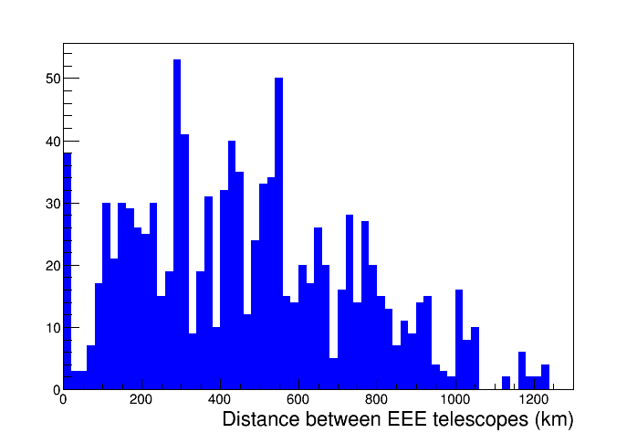
Distribution of distances between telescopes
Cluster sites (few km distances)

Slide 6
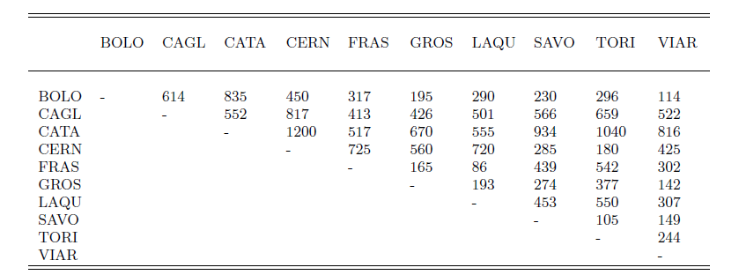
Distribution of distances between cluster sites
10 cluster sites with at least 2 telescopes
45 combinations possible, spanning between 86 and 1200 km
Distances in km

Slide 7
Dataset analyzed
Data from RUN1 & 2 analyzed, up to October 2016
Site | Approx.Distance between telescopes (m) | Live time (days)
BOLO_0104 | 100 | 176
CAGL_0102 | 530 | 474
CATA_0102 | 3030 | 127
CERN_0102 | 30 | 127
FRAS_0203 | 620 | 104
GROS_0102 | 500 | 67
LAQU_0102 | 200 | 105
SAVO_0102 | 1170 | 353
TORI_0304 | 1070 | 163
VIAR_0102 | 1340 | 160

Slide 8
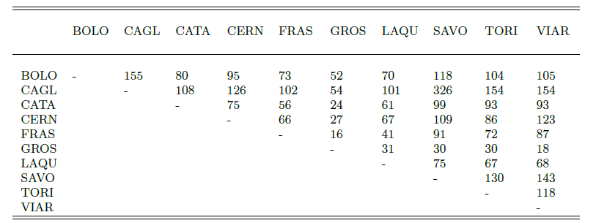
Common Live time between sites
Common time in days
Overall time: 3968 days (~ 11 years)

Slide 9
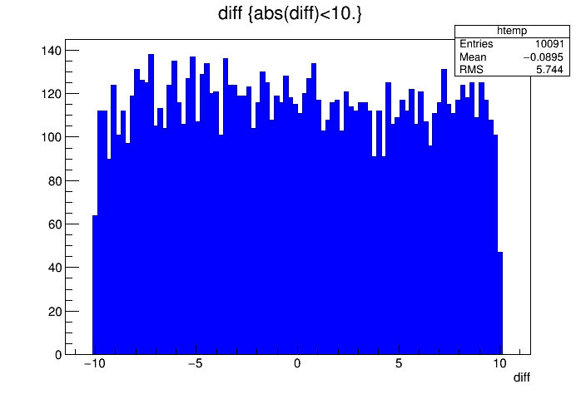
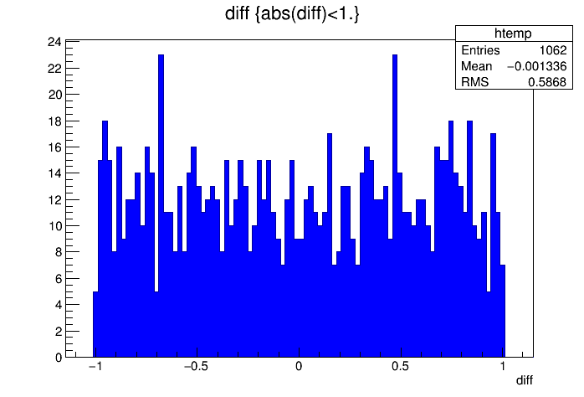
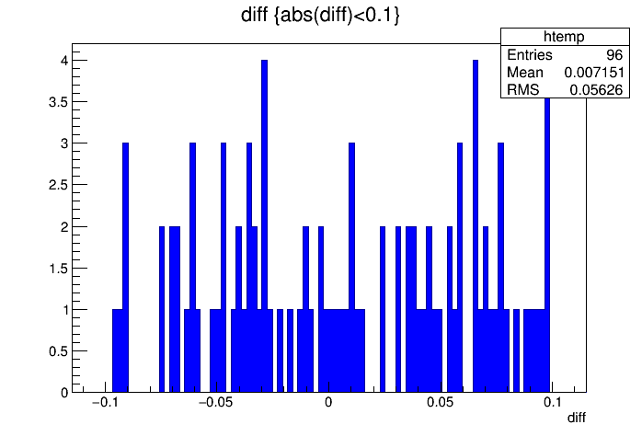
Coincidences between cluster sites
Δt = 10 s
… to Δt = 0.001 s
Δt = 1 s
Δt = 0.1 s

Slide 10
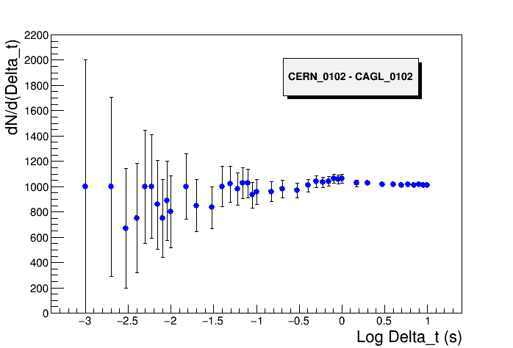
Coincident events between clusters
No cut on relative angle between showers
1 ms
10 ms
Number of events dN/d(Delta_t) for decreasing time window

Slide 11
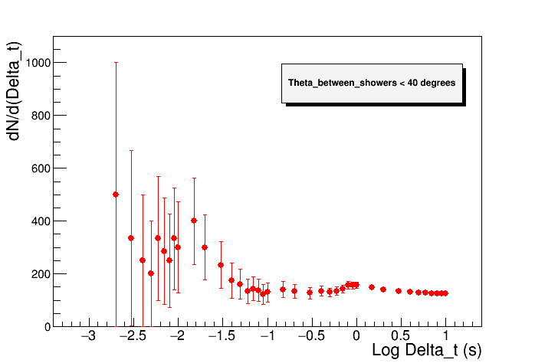
Effect of cut on relative angle between showers

Slide 12
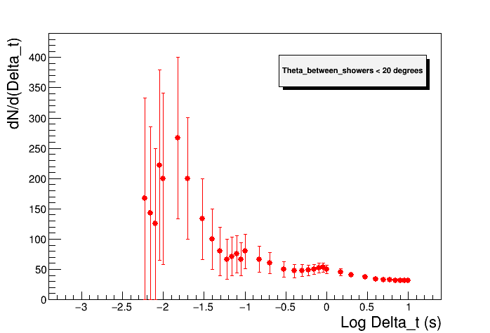
Effect of cut on relative angle between showers

Slide 13
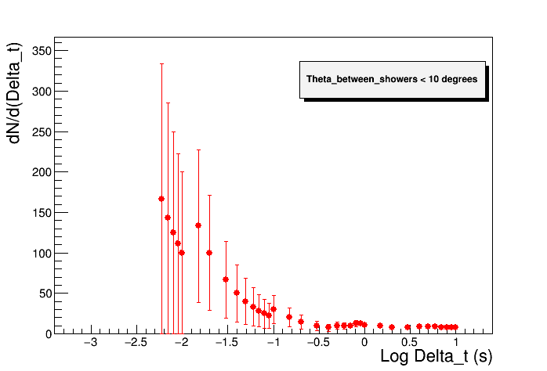
Effect of cut on relative angle between showers

Slide 14
Effect of cut on relative angle between showers
Systematic investigation carried out for different sites and cuts
In some cases small enhancements observed for Δt < 10 ms

Slide 15
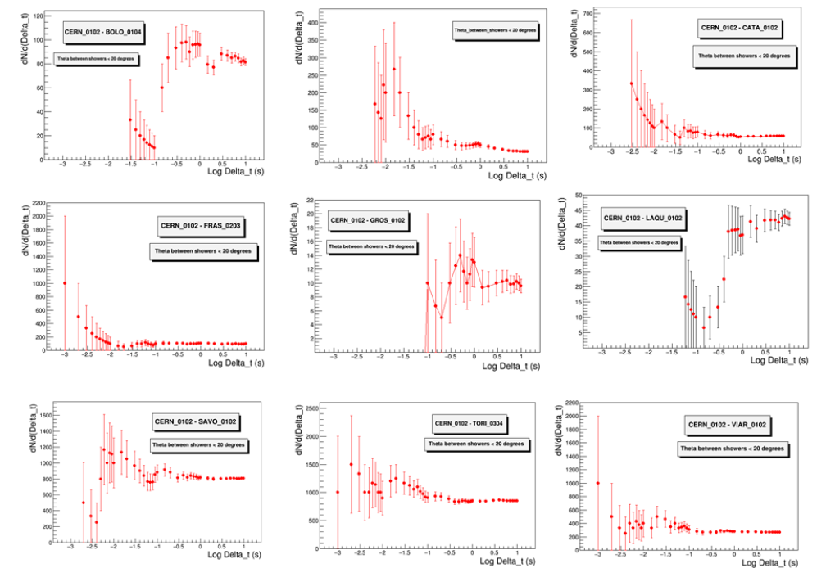
Effect of cut on relative angle between showers
Systematic investigation carried out for different sites and cuts
In some cases small enhancements observed for Δt < 10 ms
However, not a general trend…
CERN – XX combinations
Θ < 20°

Slide 16
Possible alternative strategy
Alternative strategy:
● Consider all coincident events observed within time limits
given by the mutual distance between sites
● For each candidate event, evaluate the expected number of
spurious events within the observed time difference
● Calculate the p-value (probability to observe >=1 events under
the NULL hypothesis) and set a confidence limit
● Retain only events with p-value < 0.05

Slide 17
Candidate events
Only events with p < 0.05 considered
7 candidate events found
Among these, 4 events with small angular distance (<15°)

Slide 18
Background estimation
Background was estimated in two ways:
Evaluate the number of coincident events in a large time window (10 s) and extrapolate to the time window where each candidate event was observed
B) Scan all the coincidence time spectrum and search for candidate events in a large number (1000) of time windows outside Δt=0
Similar results found with the two methods
Site | Background events estimated
BOLO-CAGL | 0.004
CAGL-SAVO | 0.050
CERN-CATA | 0.033
CERN-FRAS | 0.024
FRAS-SAVO | 0.018
LAQU-SAVO | 0.037
SAVO-VIAR | 0.030

Slide 19
Summary
● A comprehensive analysis to search for long distance
correlations between EEE cluster sites carried out
● An overall time exposure equivalent to about 11 years data
taking considered (roughly all EEE data up to October 2016)
● Wide range of mutual distances between sites explored (86-1200 km)
● Few candidate events with small (<0.05) p-value found
● If such events are true physical events, observed rate below 1 event/year,
compatible with estimates from LAAS Collaboration

Slide 20
Proposal for a paper
Additional statistics could come from:
- Larger number of sites with at least 2 telescopes
- A larger duty cycle
- A longer data taking period
A significant increase (x 5-10) would require however several years
Taking into account such results, it is proposed to write a paper, where:
To discuss the problem of possible long distance correlations
Survey the possible theoretical mechanisms and exp. approaches so far
Describe the potential of the EEE network in this respect
Discuss the possible analysis strategies to search for correlations
Present the results of the analysis on a large data sample
Report properties of candidate events found and their significance
Preliminary draft already in good shape, to be finalized in a few weeks:

Slide 21
Paper Draft

Slide 22
Paper Draft
Presently organized for EPJPlus
6-7 Figures
3 Tables

