Slide 1
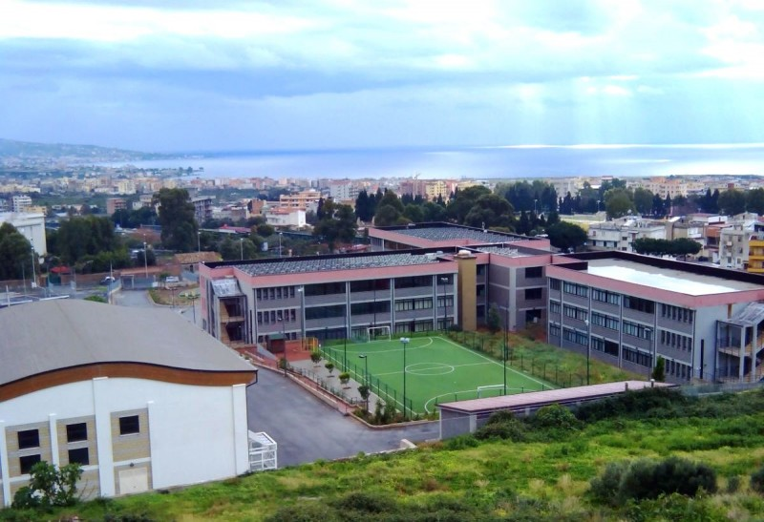
Liceo Scientifico “A. Volta”
Reggio Calabria
Referent teachers:
Prof.ssa Caterina Romeo
Prof.ssa Carmela Petronio
Students:
Giuseppe Alampi
Francesco Chirico
Chiara Fortugno
Maria Gattuso
Fortunato Martino
Francesco Modafferi

Slide 2
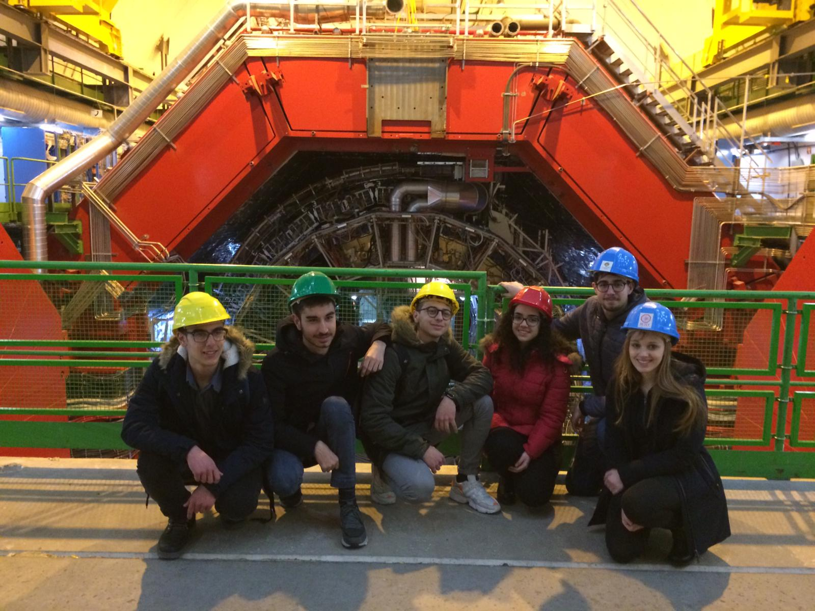
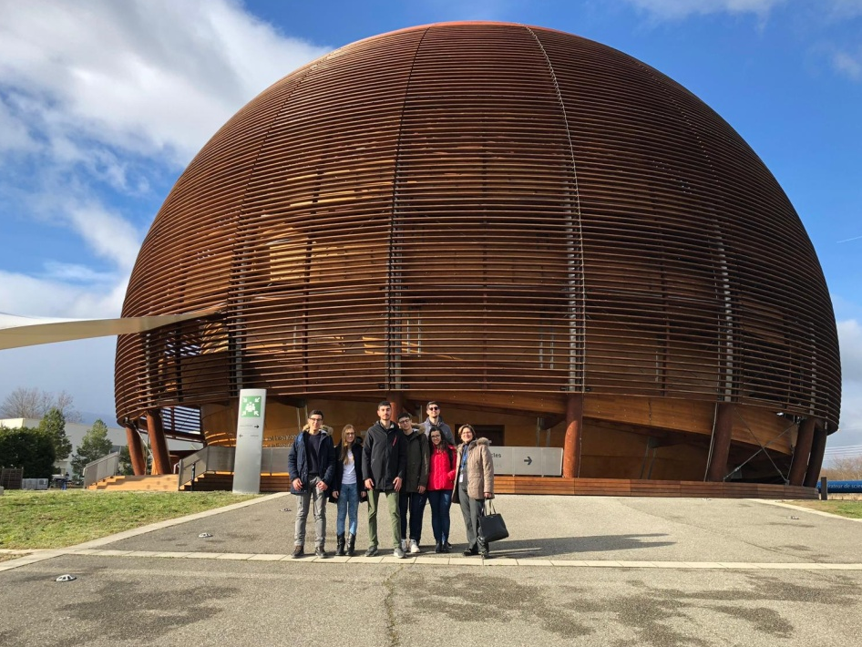
Our experience
From the 10th to the 16th of March 2019, a group of six students, attending the fourth class of the Scientific Lyceum “A. Volta” of Reggio Calabria, together with their teachers, prof.ssa Caterina Romeo and prof.ssa Carmela Petronio, went to CERN, in Geneva, in order to build a new cosmic-ray detector for their school. The detector will be sent by CERN by the end of June. The electronic part will be finished by these students at the University of Calabria, under the supervision of prof. Schioppa.
Hopefully, by the beginning of the next session, the telescope will be operative.

Slide 3
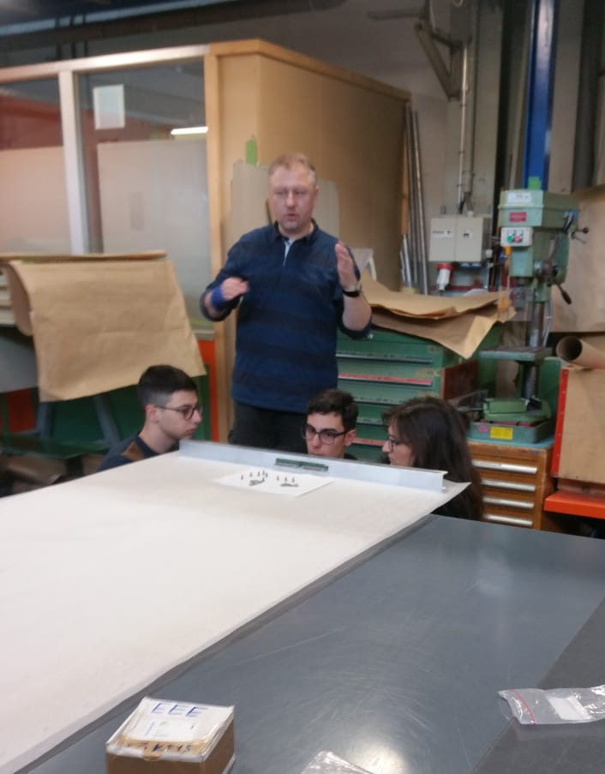
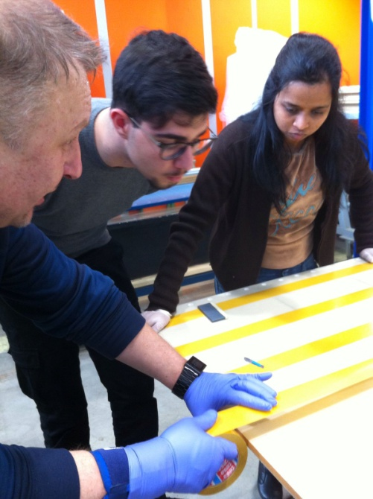
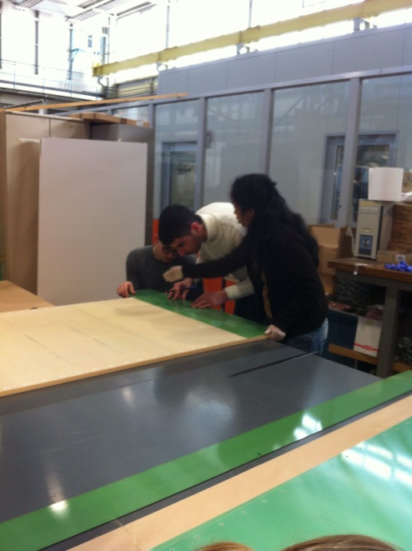
The building process
The external box, which contains the detector, is 2m x 1m and it is made by aluminium panels. The support base chosen for the chamber is made of honeycomb panel. We put some strips of double-sided tape on the honeycomb, on which we applied vetronite (a green material).
On the vetronite, we drew some lines on which we put copper strips in parallel, with a distance of 3 mm between every strip.

Slide 4
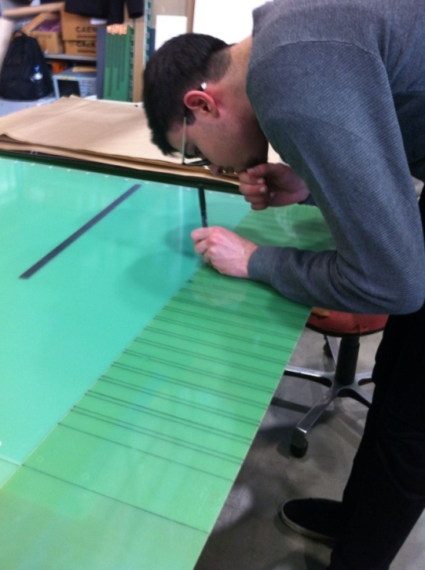
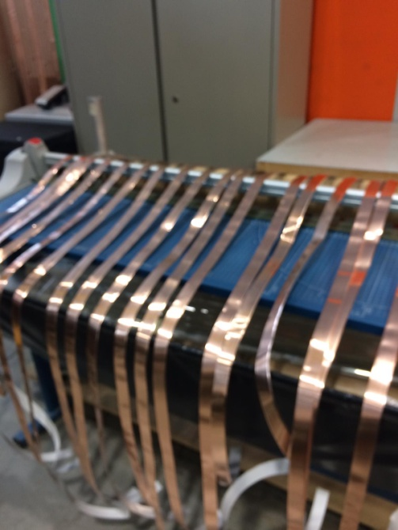
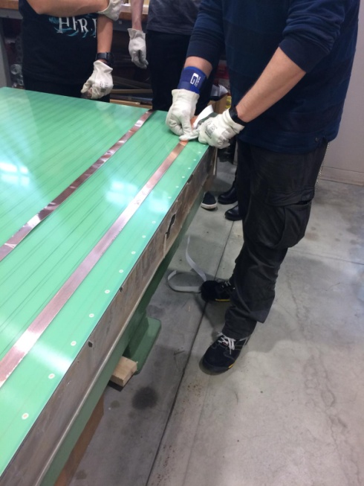
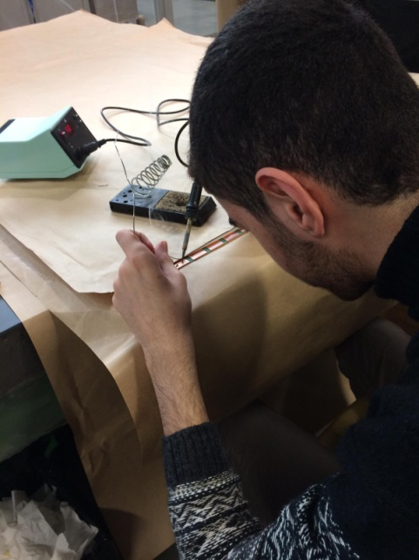
The strips are electrodes that reads signals: there are both anodic and cathodic strips, used for transmit the particles of signals at the edge of the layers.
We applied 24 strips, both on the top and the bottom of the chamber. At the end of each strip, we welded iron, to connect electric cables later.
The vetronite panel isolates the strips from the high voltage floor above them, that is a glass plate with a resistive coating.

Slide 5
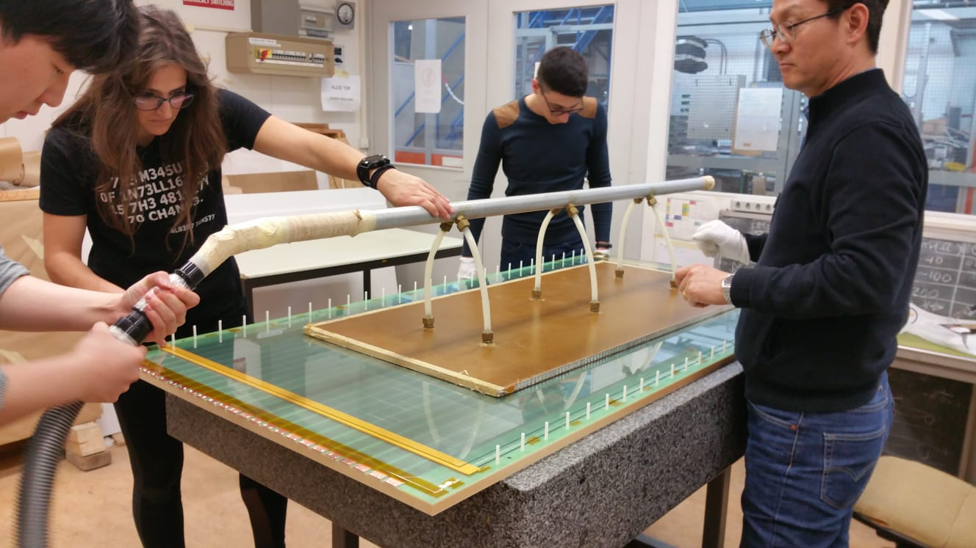
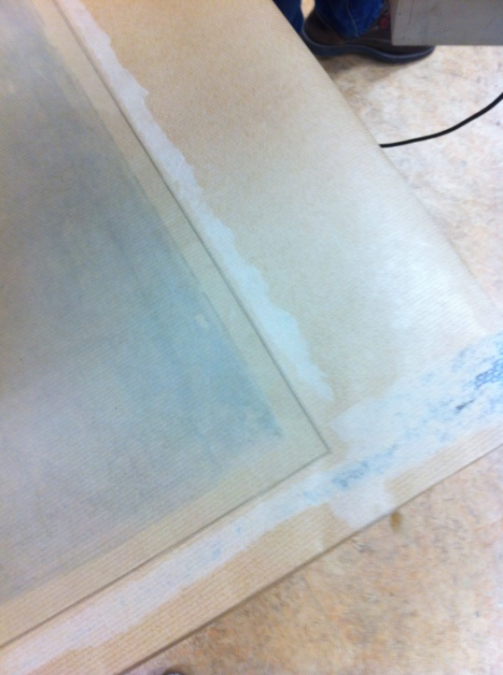
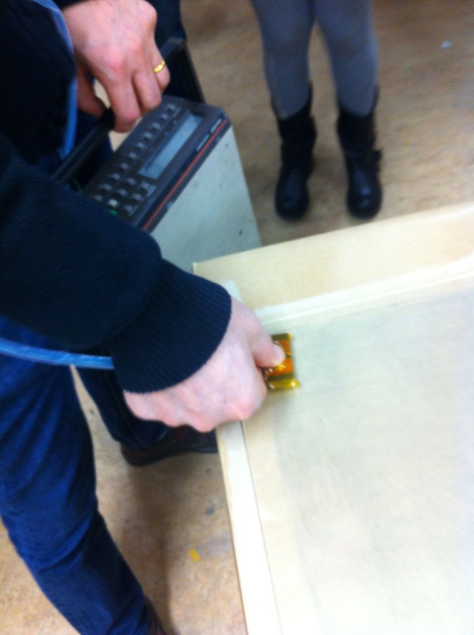
We had to clean the glass plates from wax and dust, before assembling the chamber.
Then, we moved each plate to the honeycomb, thanks to a vacuum transporter, which guarantee not to break the glass.
We applied a resistive coating on the inner part of the outer plates, to make high voltage floors.

Slide 6
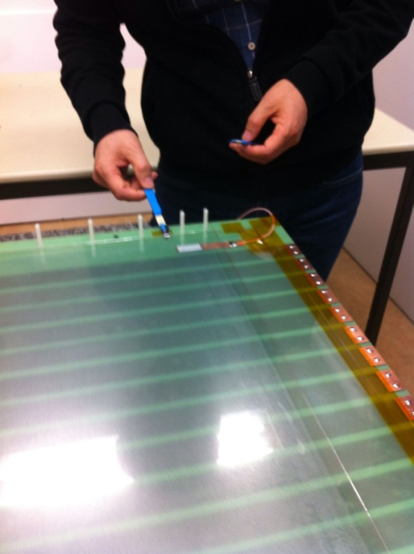
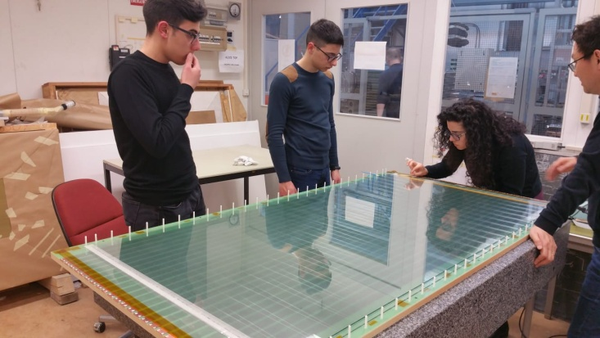
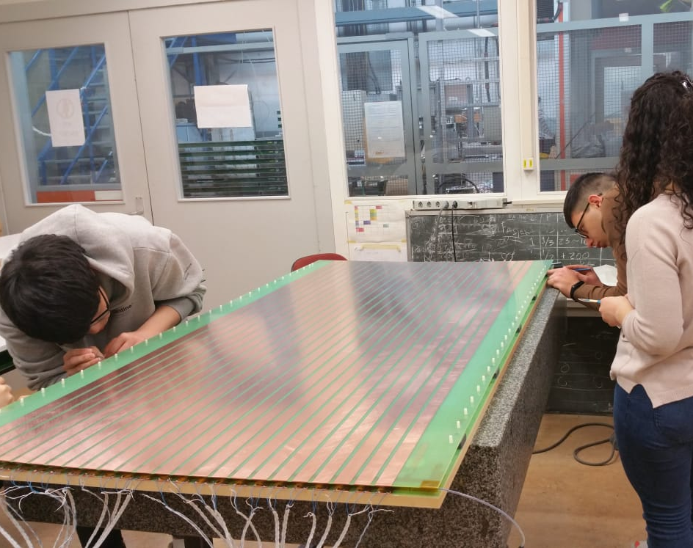
The structure of the detector consists of six gaps, that will be filled with gas. We made a space of 350 micron between each glass, using a fishing-line and fixing it around nails.
We put the glasses one upon the others and then pressed them in order to let them adhere to the tape. Then, we used a scalpel to remove the film of the tape.
When we finished applying the six glass plates, we closed the chamber with the top panel.

Slide 7
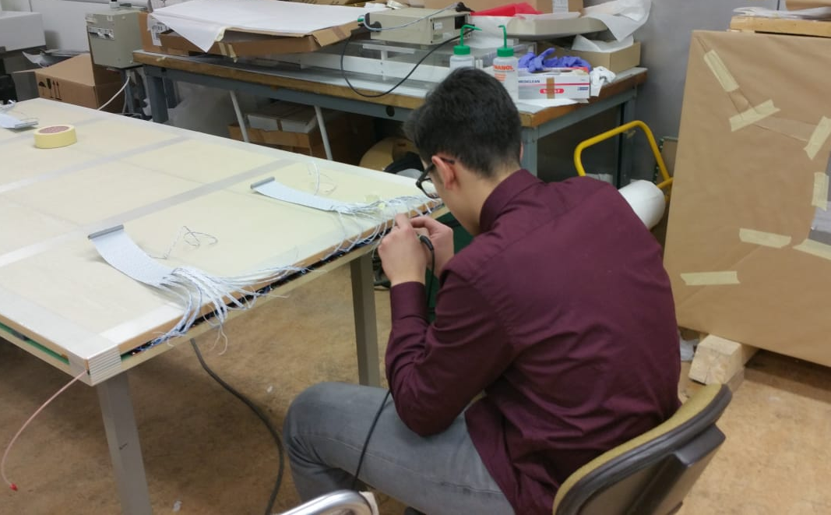
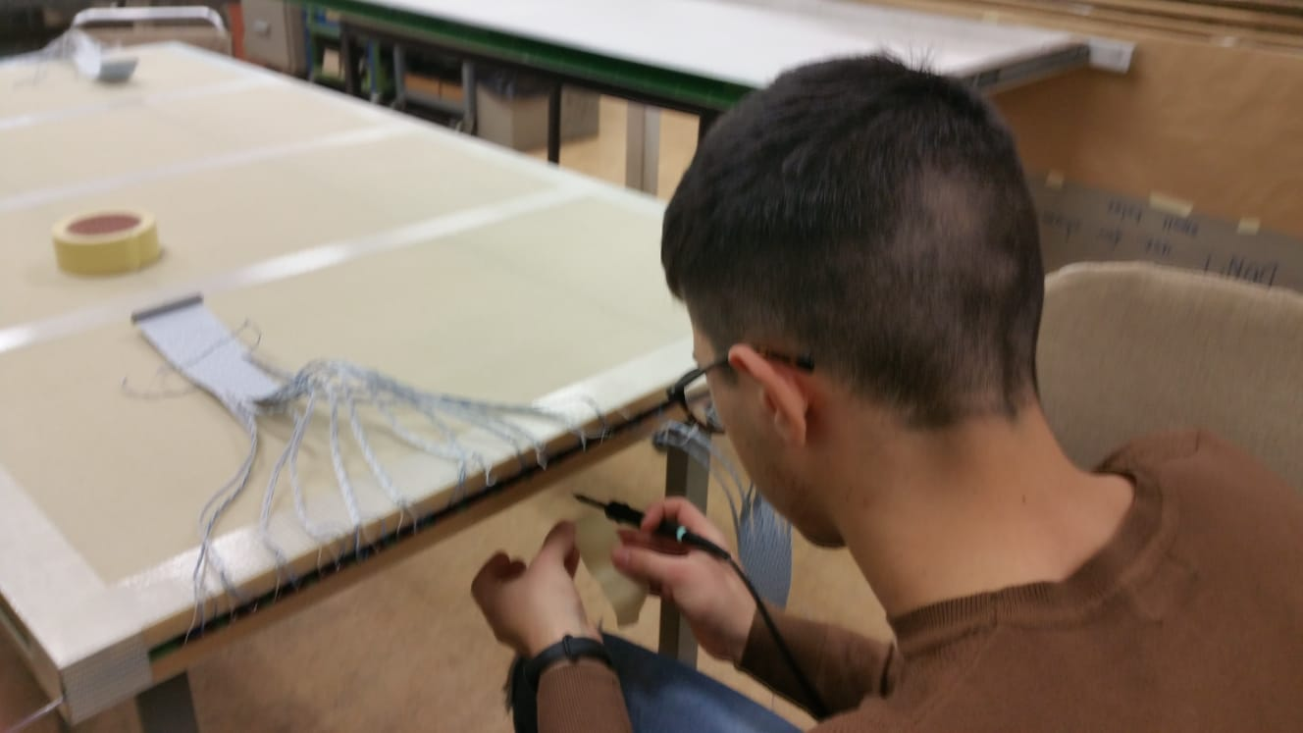
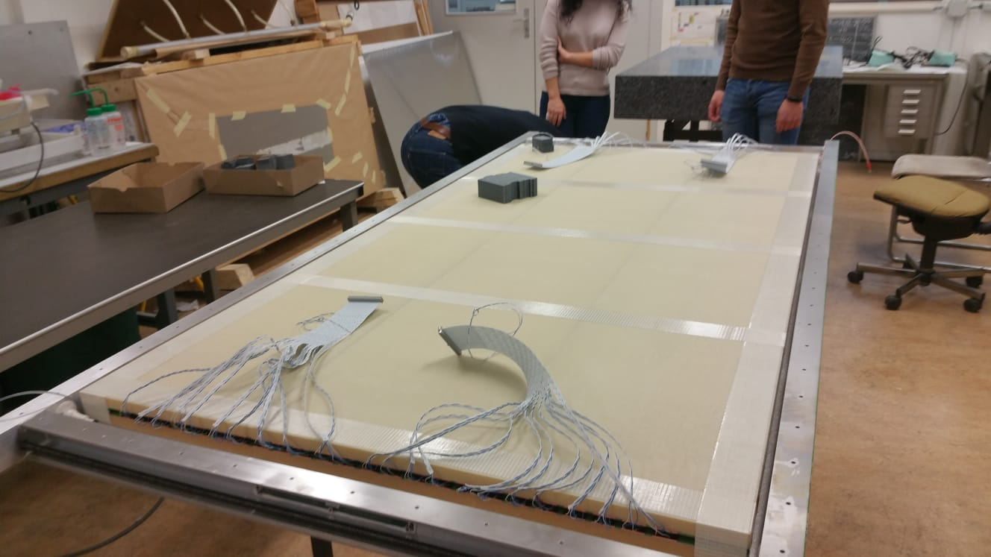
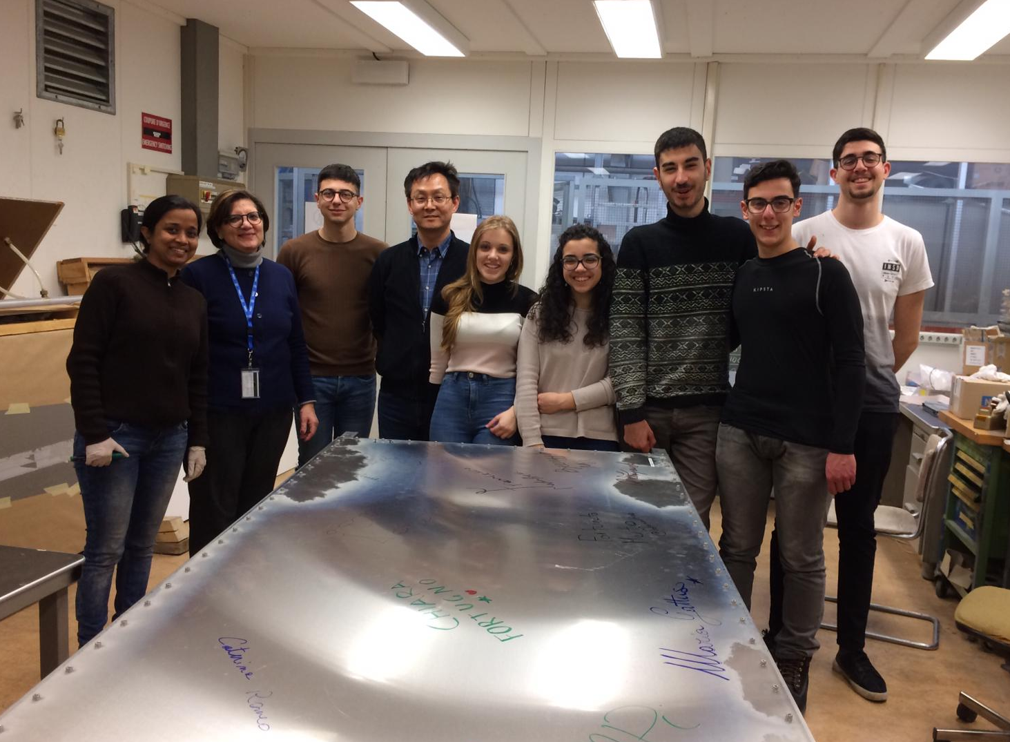
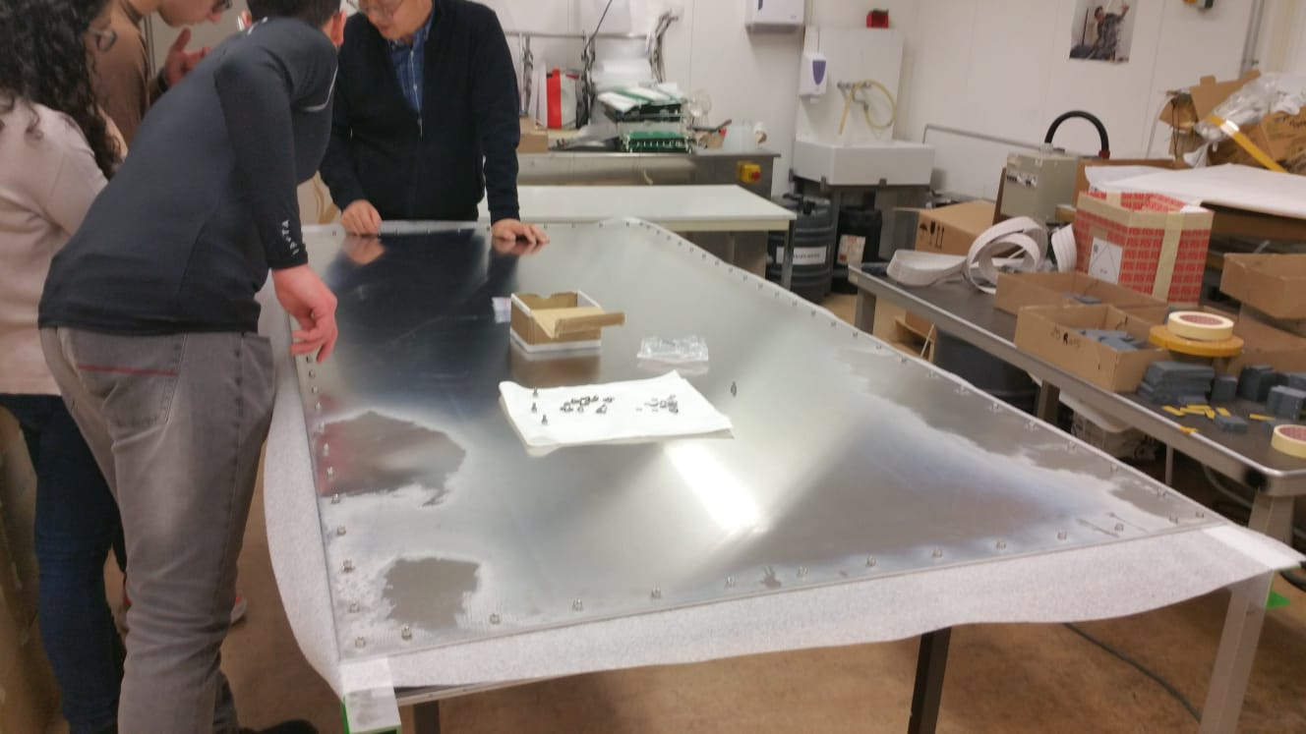
Then, we welded twisted-pair cables with the copper strips both on top and bottom panels.
The chamber was moved into the aluminium panel built before.
The building process was repeated three times, for each chamber.

Slide 8
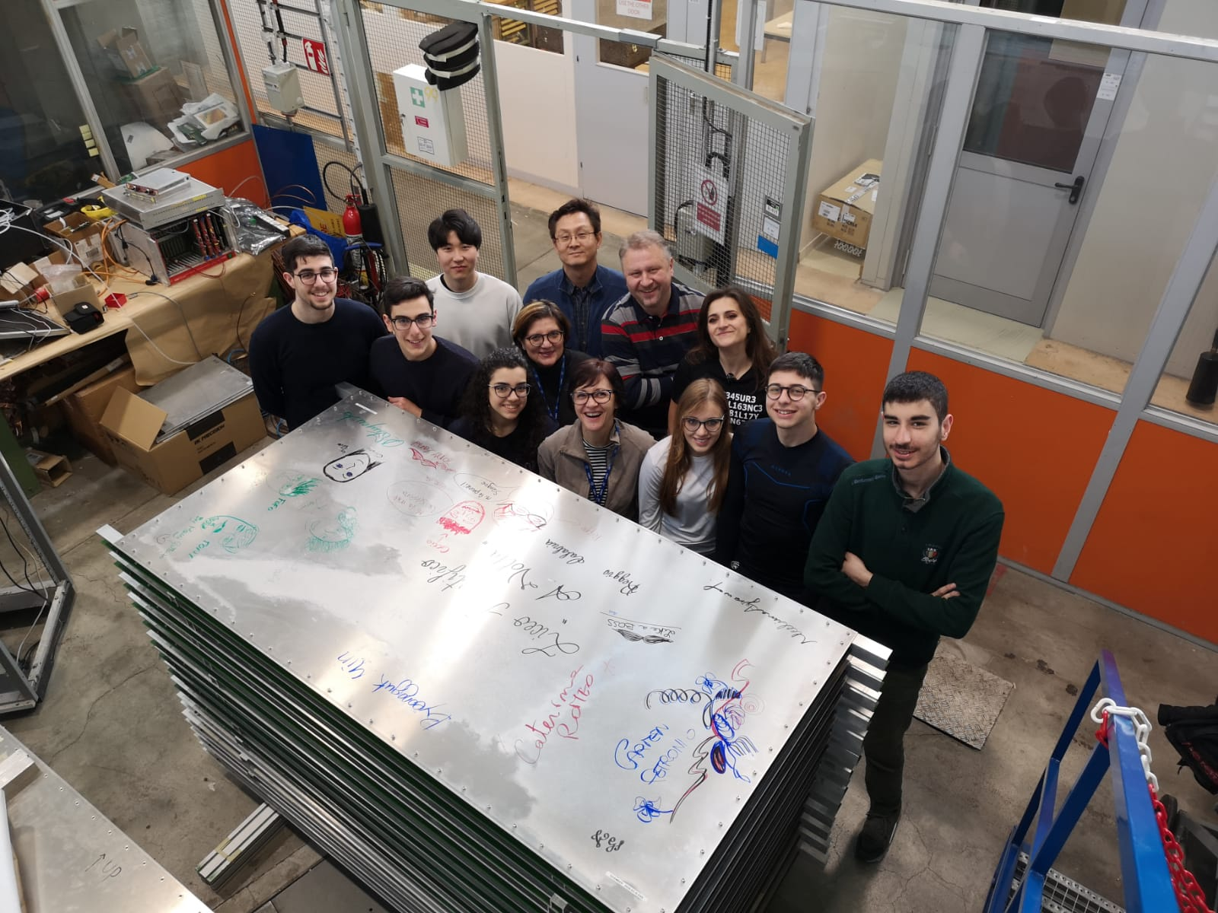
And that is our final product!

Slide 9
Thanks for
your attention!

