Slide 1
Detector stability studies
Stefano Boi
24-04-2019

Slide 2
CR flux stability
Points represent maximum flux variation (average value on one hour) during day
From 2019-10-15 to 2019-04-10

Slide 3
Detector stability – parameters
Rate variation (corrected for atmospheric pressure) – average on one hour (0,3% of statistical uncertainties with 30 Hz of rate)?
Two possibilities:
Average and RMS variation:
θ and φ
TOF
χ²
χ² test result w.r.t. to time on the same distributions
We need to define some reference values for each telescope

Slide 4
Detector stability – parameters
Rate variation (corrected for atmospheric pressure) – average on one hour (0,3% of statistical uncertainties with 30 Hz of rate)?
Two possibilities:
Average and RMS variation:
θ and φ
TOF
χ²
χ² test result w.r.t. to time on the same distributions
We need to define some reference values for each telescope

Slide 5
First step: χ² test of one run file w.r.t. to the previous one
Pro:
Simple to be implemented
Cons:
Is not sensitive to slow variations (pro: CR flux variation shouldn’t effect results)
χ² definition: $χ^{2}=\frac{\sum_{i=1}^{N_{bins}}{{\left(ν_{i}−N⋅\frac{ν_{prev, i}}{N_{prev}}\right)}^{2}}}{N⋅\frac{ν_{prev, i}}{N_{prev}}}$
Always χ²/n.d.f. is represented
Reference histograms define a kind of P.D.F.

Slide 6
CERN-01 example From 2019-01-01 to 2019-02-28

Slide 7
CERN-01 example From 2019-01-01 to 2019-02-28

Slide 8
CERN-01 example From 2019-01-01 to 2019-02-28

Slide 9
CERN-01 example From 2019-01-01 to 2019-02-28

Slide 10
CERN-01 example From 2019-01-01 to 2019-02-28

Slide 11
CERN-01 example From 2019-01-01 to 2019-02-28

Slide 12
CERN-01 example From 2019-01-01 to 2019-02-28

Slide 13
CERN-01 example From 2019-01-01 to 2019-02-28

Slide 14
CERN-01 example From 2019-01-01 to 2019-02-28

Slide 15
CERN-01 example From 2019-01-01 to 2019-02-28

Slide 16
CERN-01 example From 2019-01-01 to 2019-02-28

Slide 17
CERN-01 example From 2019-01-01 to 2019-02-28

Slide 18
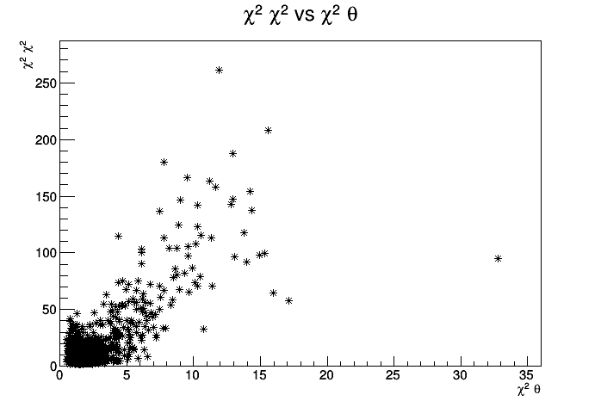
CERN-01 example From 2019-01-01 to 2019-02-28

