Slide 1
Update on PolarquEEEst analysis
F. Noferini
INFN Bologna

Slide 2
Outline
I will report on the “very preliminary” results of two bachelor theses on PolarquEEEst data in Bologna
Flavio Cacciari → seasonal variation of rates
Greta Bellagamba → rate vs latitude

Slide 3
Seasonal variation
Results are reported for POLA-02 (Norway) and POLA-03 (Bra) data from July 18 to March 19.
Data were corrected for:
Efficiency equalization wrt POLA-01 performed at CERN when the three telescopes collected data in identical conditions
Pressure
Building material for POLA-03 (by a comparison of indoor/outdoor rates)… waiting for a similar study for POLA-02

Slide 4
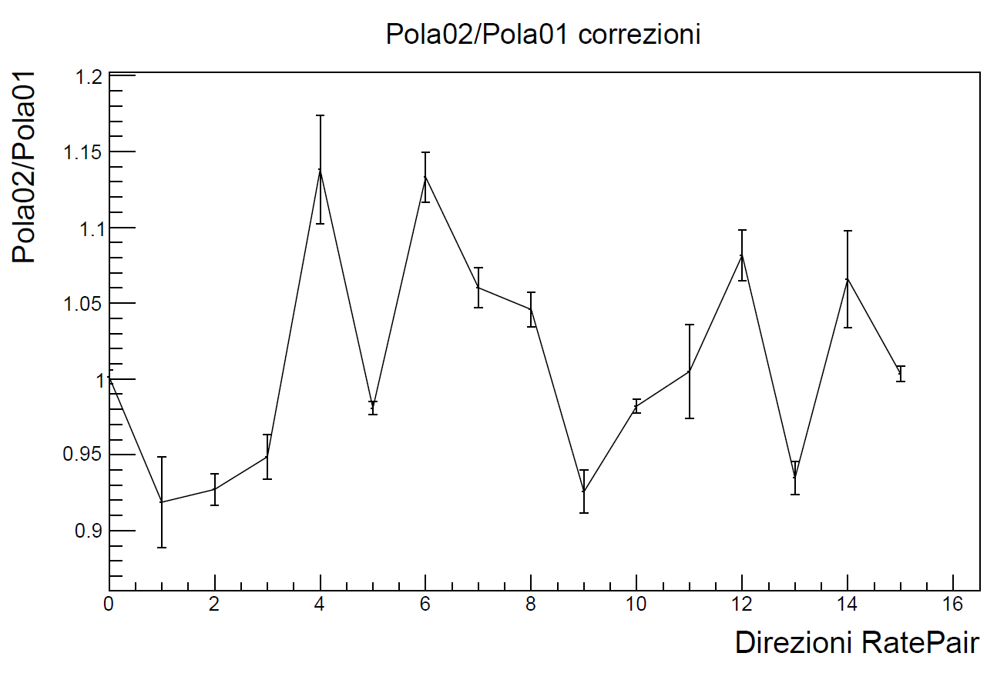
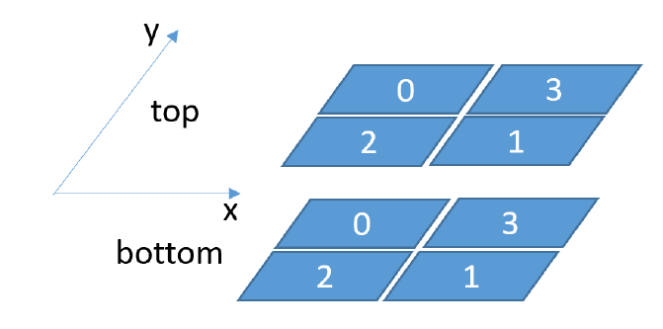
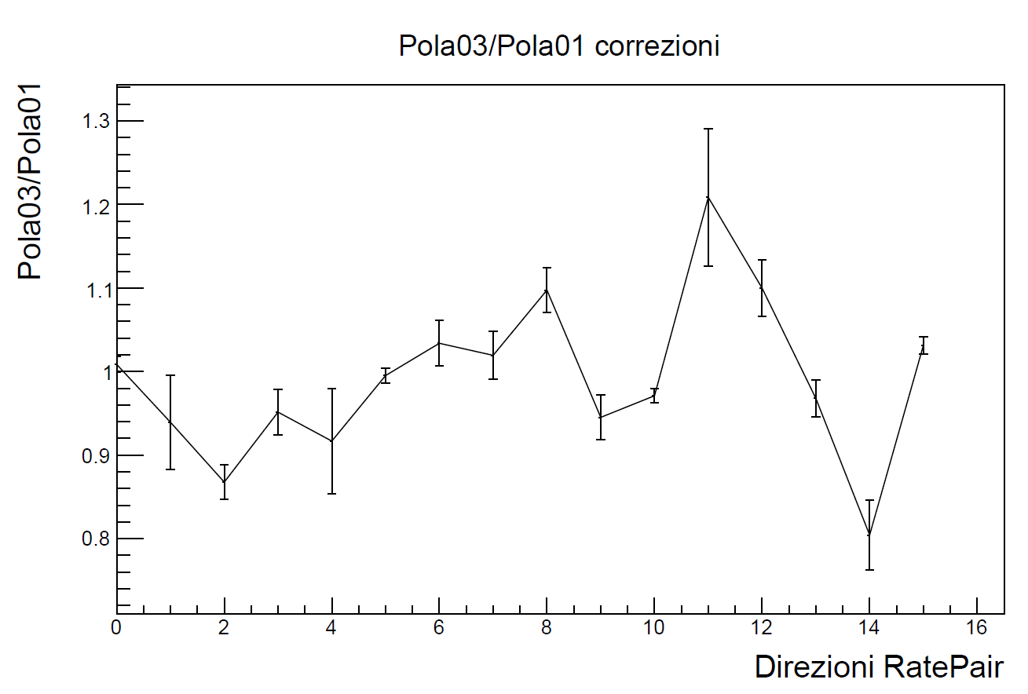
Equalization at CERN
Pair 1
Equalization performed for all 16 pairs of scintillators

Slide 5
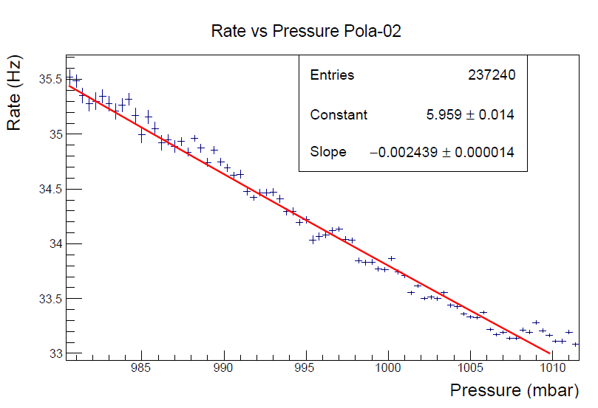
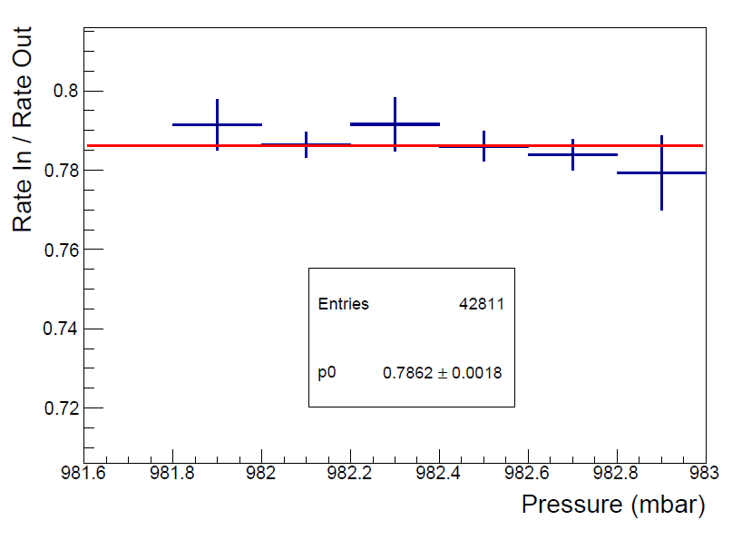
Other corrections
POLA-03 indoor vs outdoor

Slide 6
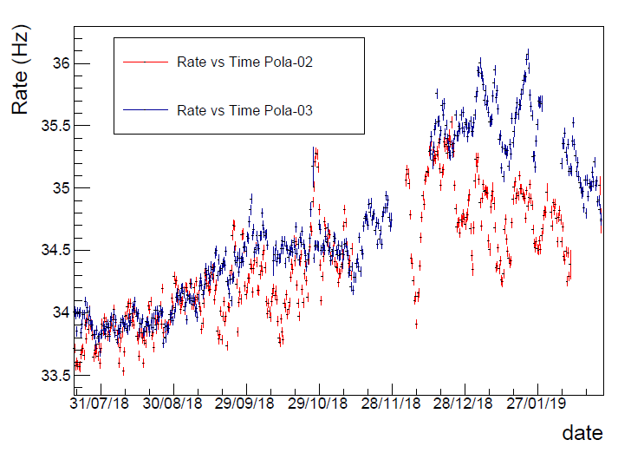
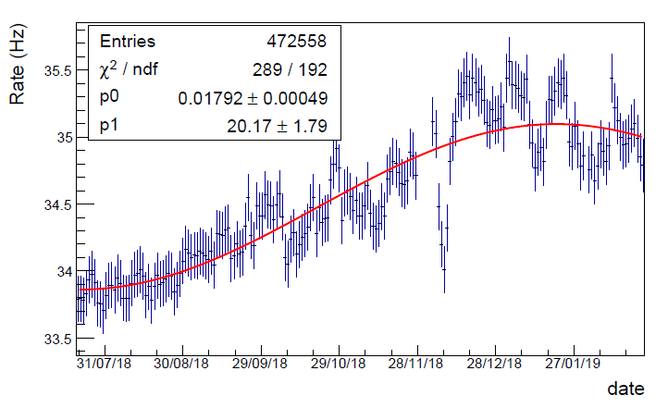
Seasonal variation
Combined
Consistent with
R. R. S. de Mendonca et al, The Astrophysical Journal, 830:88

Slide 7
POLA-01 data vs latitude
Correction applied:
Pressure
Orientation

Slide 8
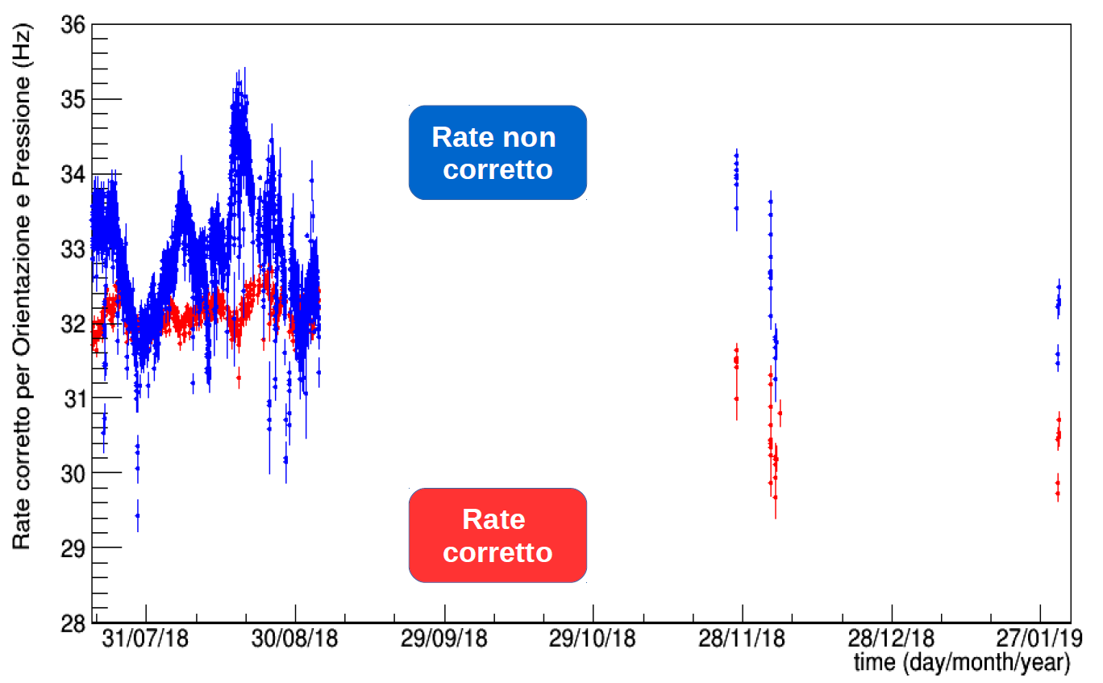
Rate vs time
Reference pressure used = 1024 mbar
Polar on the road (Italy)

Slide 9
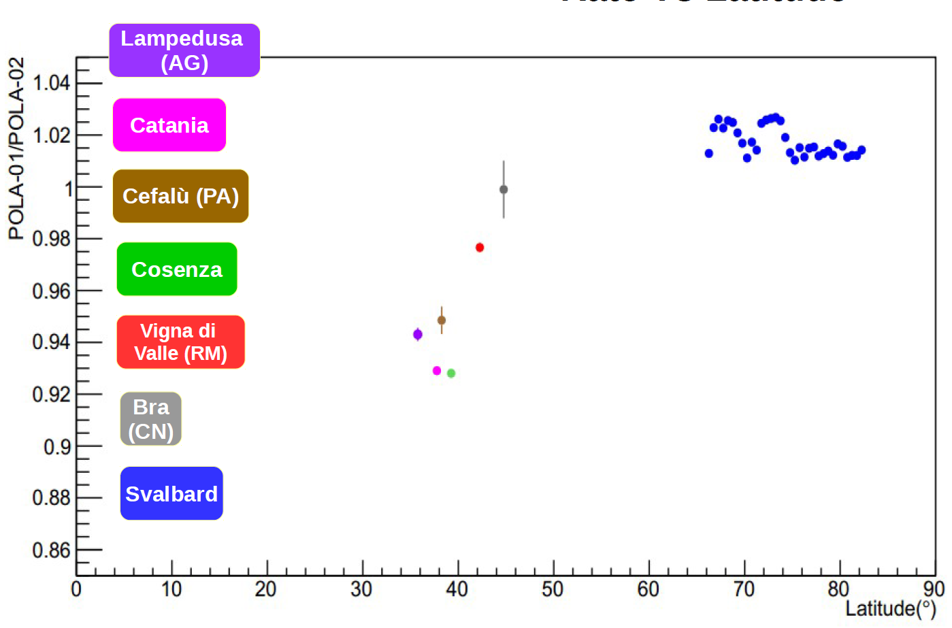
Rate vs latitude
POLA-01 rate divided by POLA-02 rate to remove seasonal effects!

Slide 10
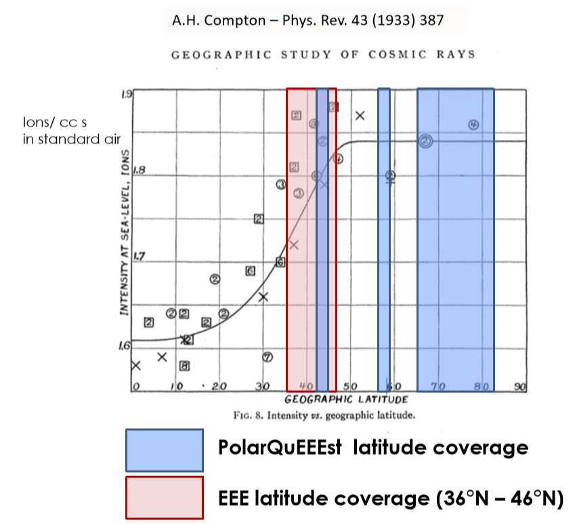
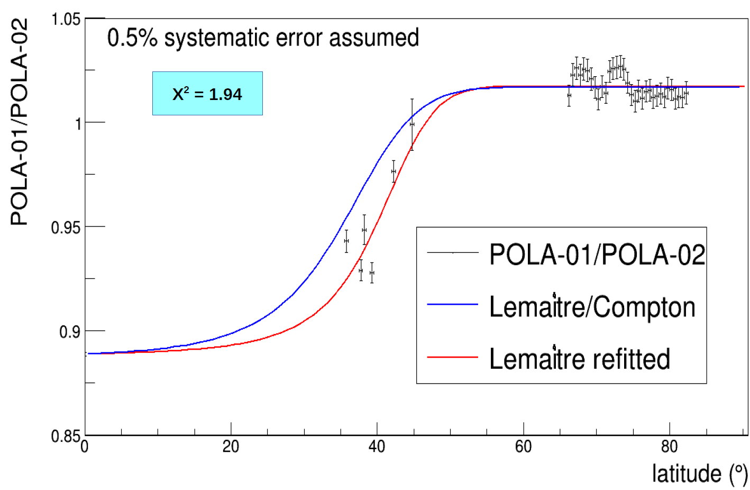
Comparison with previous results
PolarQuEEEst latitude coverage
EEE latitude coverage (36° N – 26° N)
and POLA-01 next measurements

Slide 11
Other info
We also collected data for other kinds of analysis:
Rate vs altitude: Erice (700 m), Etna (2 km)
East-West effect: 4 hours of outdoor data acquisition in Lampedusa with 4 different telescope orientations (North, East, South, West) → espected sensitivity 0.5%

