Slide 1
Search for anomalous EEE
multi-telescope events
F.Riggi
in collaboration with
P.La Rocca, C.Pinto, F.Noferini
EEE Meeting, March 6, 2019

Slide 2
Current strategies to search for long distance correlations
EEE as an extended network has the capability to search for long distance correlation through different analysis strategies:
● Correlation between local extensive air showers
detected by telescope pairs
Analysis already performed, few candidate events found,
Conference contributions and paper (EPJPlus) published
● Correlation between multi-track events detected in any two telescopes
Analysis partially done, in progress..
Conference contribution to CRIS2018, additional paper to be prepared?
● Correlation between single-track events detected in MANY telescopes
Analysis started, results from about 5 months data taking
(this contribution)

Slide 3
Correlation between MANY EEE telescopes
● No specific physical mechanism already known able to explain
the existence of multi-particle correlations over a huge area
● Underlying idea: Search for possible unexpected events
● Strategy: Consider all possible correlations between 2, 3, … N among N
telescopes working and look for events outside the expected spurious
rate
● Compare results to expected spurious rate between N telescopes
(not trivial)
● Integrate over long data taking periods (> months)

Slide 4
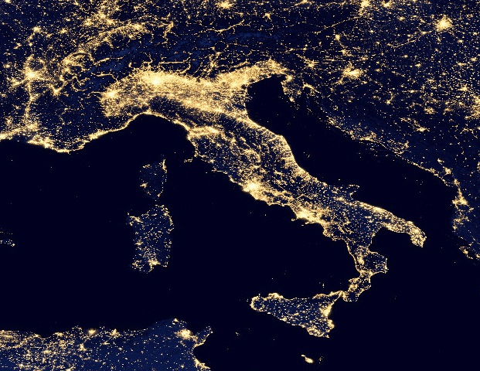

Slide 5
A first look at EEE data
Analysis of a recent EEE dataset (October 2018 – February 2019)
Computing strategies:
● Process all reconstructed data on a day-by-day basis (.dst files)
from all telescopes and build daily spectra of the number of
telescopes in coincidences within 1 ms
● Assumed a reasonable time window of 1 ms to check for coincidences
● Consider the number of active telescopes day-by-day
● Minimum bias requirement for event selection:
- Reliable GPS information (Nsatellites >3)
- At least a reconstructed track

Slide 6
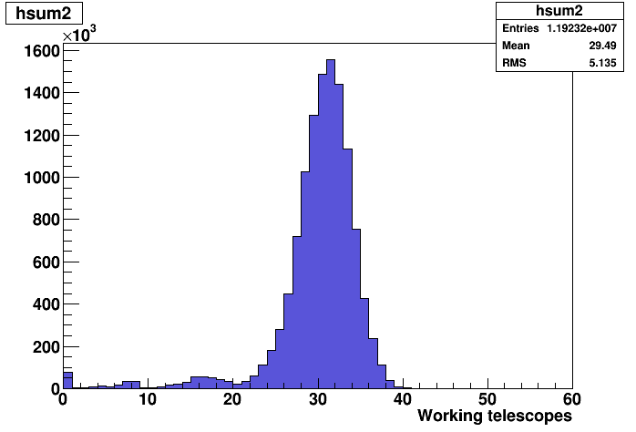
Operating telescopes
Distribution of operating telescopes over ~ 5 months data taking
Average number ~ 30

Slide 7
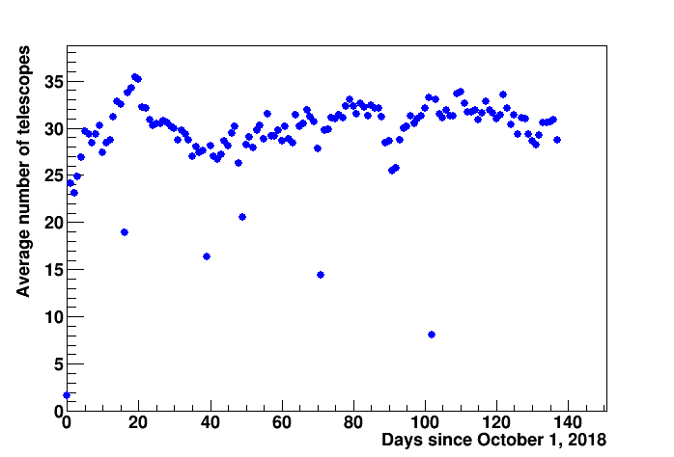
Operating telescopes
Average number of active telescopes as a function of time

Slide 8
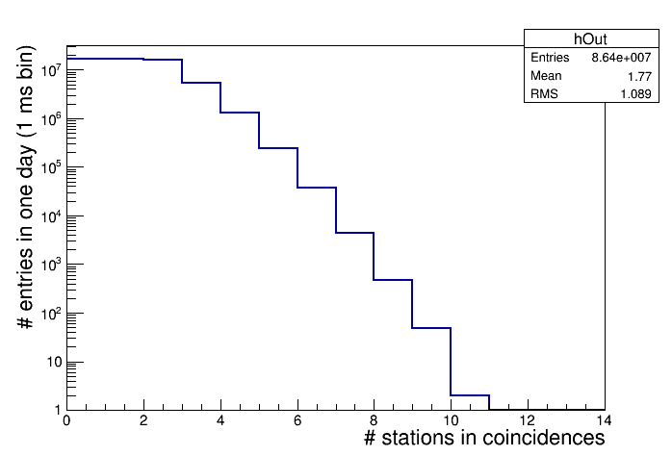
One day data taking
Distribution of the number of EEE telescopes in coincidences in a time interval of 1 ms (1 day data taking)
1 day = 86400*1000 1 ms-bins
Events with up to 10 coincident telescopes observed

Slide 9
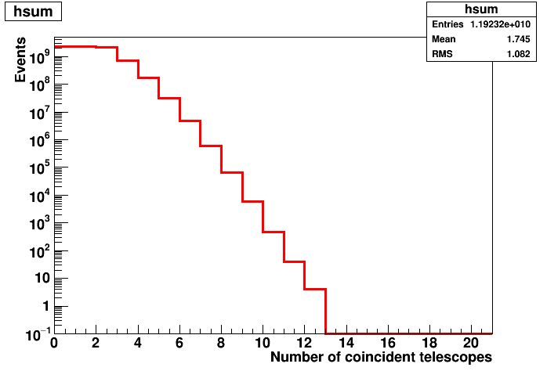
Statistics analyzed so far
5 months data taking
Events with up to 12 coincident telescopes observed
Event Rate for 12-fold coincidences between telescopes:
~(3-5) x 10 ⁻⁷ s

Slide 10
Estimate of spurious rates
Expected average spurious rate for a specific combination of k telescopes
R_spurious ~ N (R_single)^{k} x ∆t ^{k-1}
This should be multiplied by the number of possible combinations of k telescopes out of N working telescopes:

Slide 11
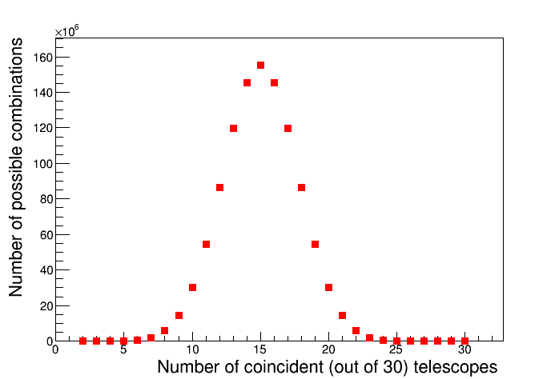
Estimate of spurious rates
Number of possible combination of telescopes out of 30 working

Slide 12
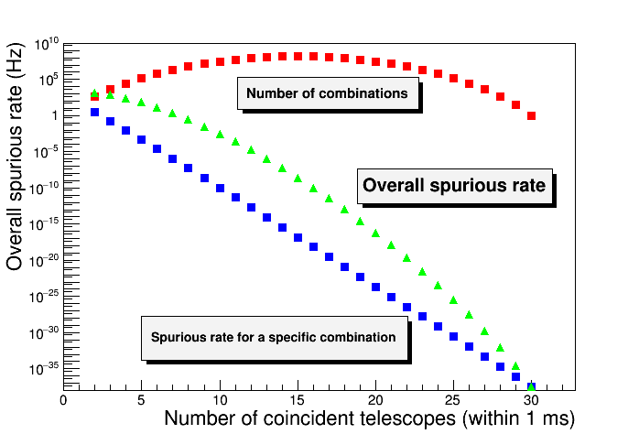
Estimate of spurious rates
Assumed: 30 working telescopes
Average single rate from all telescopes: 29 Hz (estimated on March 2nd)

Slide 13
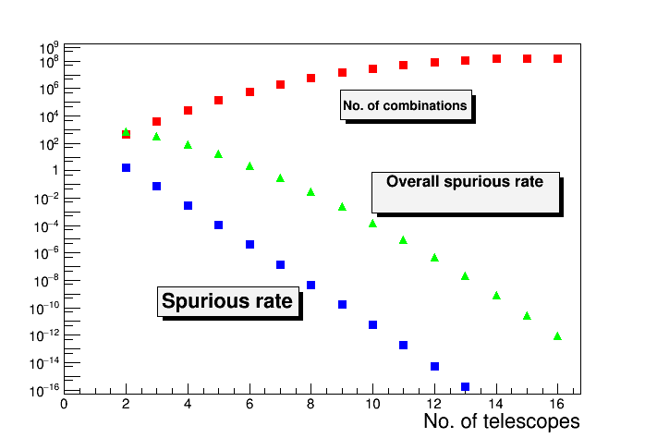
Estimate of spurious rates
Calculated: 4 10⁻⁷ Hz for 12 telescopes,
in agreement with observed rate

Slide 14
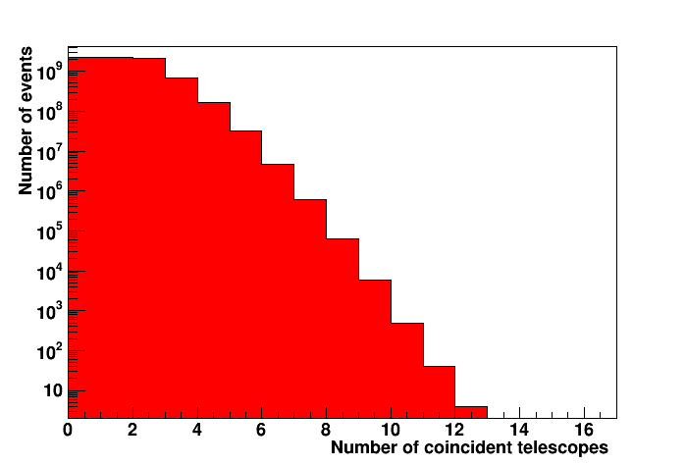
What we (un)expect……
Observing one or more events in this area (where the background is <0.01 events) would be an unusual signature!

Slide 15
Work in progress
Better estimation of average number of running telescopes day by day
Better estimation of average single rates
Estimate of expected rate distribution (as a function of N) and
comparison to experimental data
Scan additional statistics of previous data taking?
Put an upper limit for this topology of events

