Slide 1
Status report on CATA-01/POLA-01 coincidence measurements
F.Riggi
In collaboration with P. La Rocca and C.Pinto
EEE Meeting, Torino, March 06, 2019

Slide 2
SUMMARY OF ACTIVITY
(Off-line) coincidence measurements POLA-01 – CATA-01
About 60 days data taking
Various relative positions between the detectors
Possible use of these measurements to monitor civil structures stability
Analysis of results already carried out
Evaluation of sensitivity of the method under different scenarios
MC simulations and optimization of relative position between detectors
Results and analysis presented in various EEE meetings
Paper with the results progressing (ready in a few weeks from now?)
Possible target: JINST

Slide 3
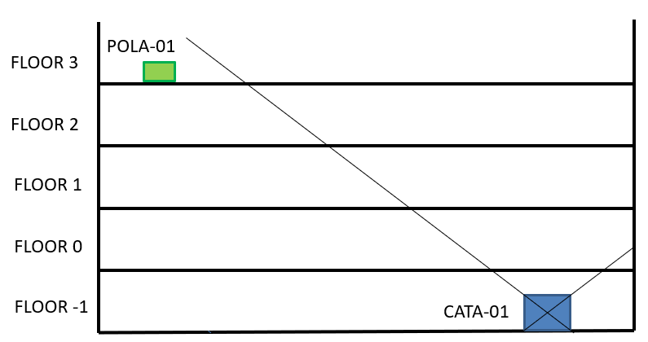
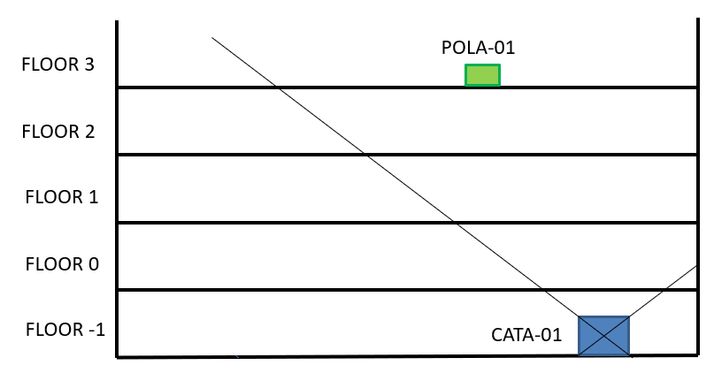
Outside the acceptance cone: two independent muons coming from the same shower. 13 days acquisition time
z
y
x
μ
μ
D
μ
Inside the acceptance cone: the same muon passing through both detectors. 47 days acquisition time
d
2d

Slide 4
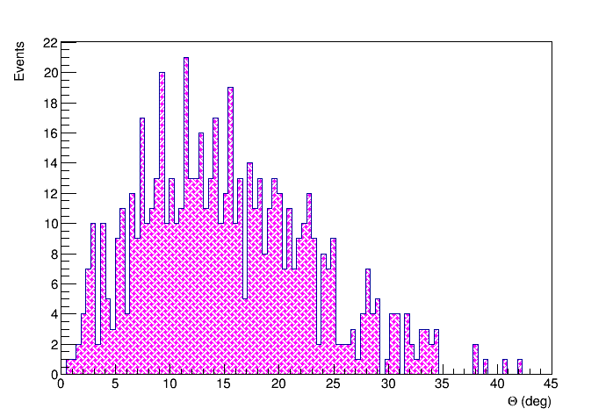
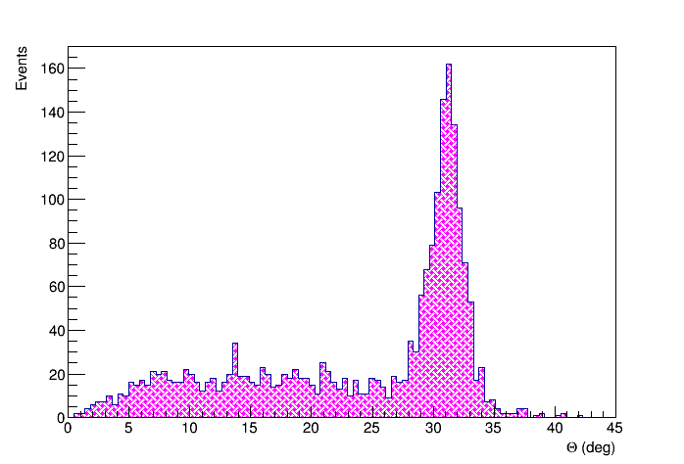
ZENITHAL ANGLE distribution
POLA-01 outside CATA-01 acceptance
POLA-01 inside CATA-01 acceptance
< θ > | Δ<θ>
31.03° | 0.05°

Slide 5
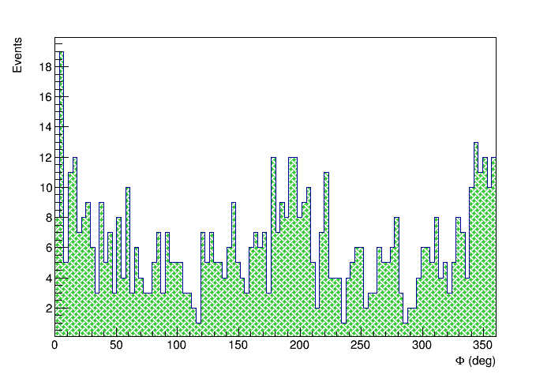
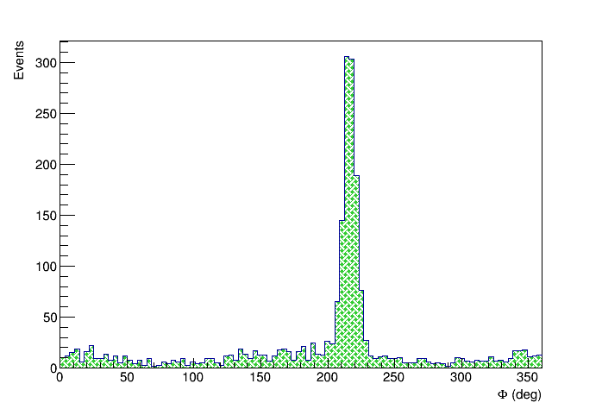
AZIMUTHAL ANGLE distribution
POLA-01 outside CATA-01 acceptance
POLA-01 inside CATA-01 acceptance
< φ > | Δ<φ>
216.43° | 0.20°

Slide 6
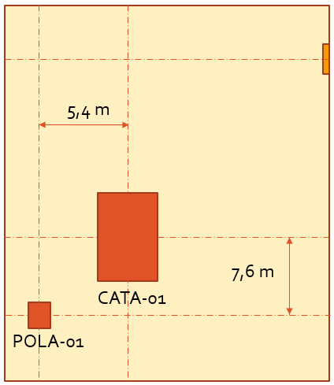
Measurements
Coincidence measurements with POLA-01 at 0, 5, 10 and 20 cm with respect to reference position
Several days data taking in each location
POLA-01
x [cm] 20 10 5 0

Slide 7
OBSERVED SHIFT IN Theta

Slide 8
Observed shift in theta
Gaussian fit
x [cm] | < θ > ± Δ<θ> | < φ > ± Δ<φ>
0 | 31.03° ± 0.05° | 216.39° ± 0.16°
5 | 31.18° ± 0.07° | 215.88° ± 0.33°
10 | 31.36° ± 0.08° | 215.98° ± 0.30°
20 | 31.45° ± 0.06° | 215.67° ± 0.20°

Slide 9
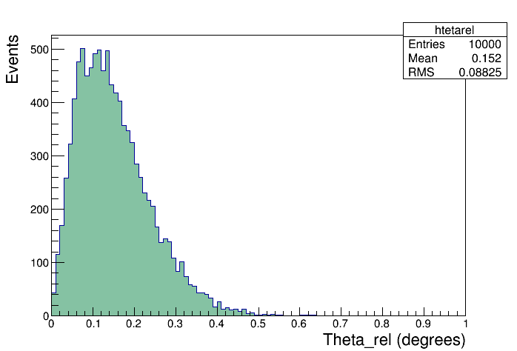
SHIFT of average direction in space
Average direction in space reconstructed from all tracks
Error estimate by splitting the dataset into many combinations of 2 equal subsets and evaluating the distribution of the differences
Relative distance | Relative angle shift
20 cm | 0.44° ± 0.07°
10 cm | 0.24° ± 0.07°
5 cm | 0.31° ± 0.07°
Only limited statistics (4 useful days) at 5 cm

Slide 10
Optimization of acceptance
Closer to the vertical…
2,5 m
POLA-01
CATA-01

Slide 11
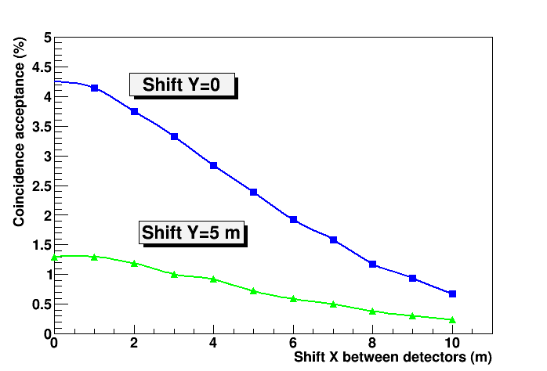
Optimization of acceptance
Relative horizontal distance between detectors | Acquisition time | # events
9,3 m | ~ 7 ∙ 10⁵ s | 757
2,5 m | ~ 6 ∙ 10⁵ s | 4305
Geometrical Monte Carlo simulation
of the acceptance
Statistics increased of a factor ~7, in agreement with MC simulations.
2,5 m
9,3 m

Slide 12
Conclusions
Sensitivity of the method: a few cm in 1 week data-taking in non-optimal conditions (i.e. far from the vertical and >15 m vertical distance)
Proper optimization of relative positions can increase statistics by at least a factor 10 and improve sensitivity of the method (a few cm in 1 day data-taking, hence a few mm for periods of ~months)

