Slide 1
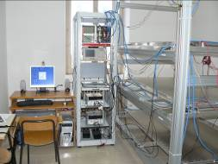
Liceo “Cagnazzi” ALTA - 01
Piazza G. Zanardelli, 30, 70022 Altamura (BA)
Turin March 6th-7th-8th 2019

Slide 2
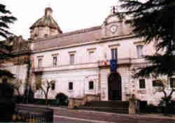
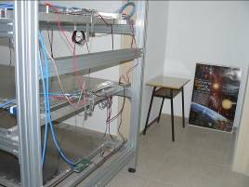
Following the official communication of prof. Zichichi, our school joins the EEE project in October 2005.
A preparatory phase opens with the selection of teachers and students to be involved in the project.
In June 2008 the system started to be operational.
Today there is the sharing of RUN files of all participating schools in the project through monthly video conferences.

Slide 3
TELESCOPE ORIENTATION MEASUREMENT
Geometric information:
Distance between highest chamber and lowest chamber 100 cm
Distance between highest chamber and ceiling 210 cm
Distance between lowest chamber and floor 36 cm
Telescope’s altitude: 475 m
In EEE project’s scope, telescope’s data analysis needs coordinates’ common system. It’s necessary to know exactly the orientation of each telescope compared to the True North

Slide 4
The True North is placed at an angular distance of 180° with respect to the Sun's position when this is at the maximum height on the horizon; This happens at "solar“ noon, which does not necessarily correspond to midday of local time. In the other hours, the plan that passes from the Sun and from the observer to the earth forms a different angle with the meridian plan of the observation site (moving from the True North). This angle, measured from the north to the east, is known as the azimuth of the Sun.

Slide 5
Since the sun's azimuth value for a given local time and coordinate can be obtained accurately using online databases (www.sunearthtools.com), exploiting the direction of a shadow projected by a rod planted perpendicular to the ground level, it is always possible, at any time of the day, to determine the location of the True North. Located in the North , then the angle formed with the reference vector of the telescope is easily measurable.

Slide 6
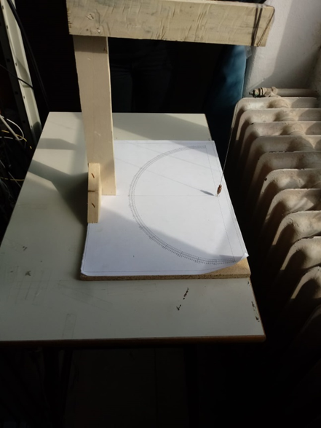
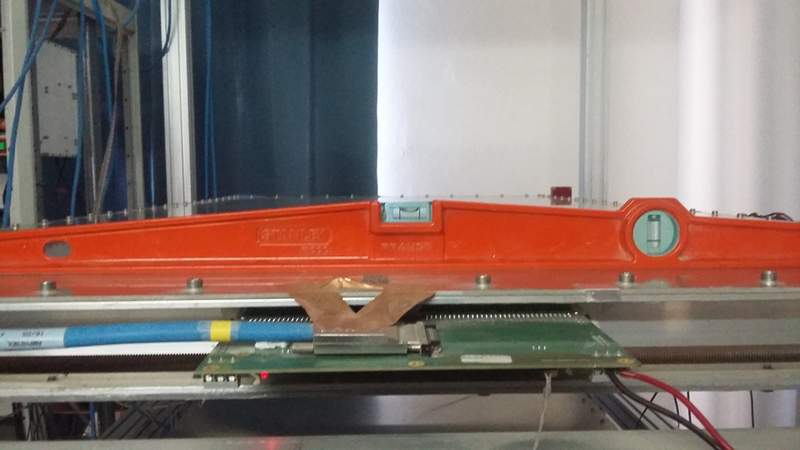
PROCEDURE TO MEASURE THE TELESCOPE’S ORIENTATION IN RELATION TO THE TRUE NORTH
Tools used:
a goniometer 0 ° -180 °;
- a spirit level;
a radio controlled computer clock;
A plumb line connected to a support made of wood.
We have controlled that the three chambers MPRC (multi gap resistive plate chambers) of the telescope were perfectly aligned. Then we have centered the bubble using a spirit level. We have put a plumb line connected to a support made of wood on a table, that was parallel in relation to the direction left-right.

Slide 7
RILEVAZIONE DEI DATI PER LA DETERMINAZIONE DEL NORD GEOGRAFICO
Coordinate geografiche del luogo
Latitudine N : 40° 49’ 24’’ / 40,823
Longitudine E : 16° 33’ 14’’ / 16,554
Data | ora(h min s) | alfa azimut (°) (ricavato online) | γ (°) (angolo dell’ombra letto sul goniometro) | Betasecondo=beta-betaprimo
26/02/2019 | 09:54:00 | 140,49 | 81,7 | 42,19
26/02/2019 | 10:10:00 | 144,65 | 77,4 | 42,05
26/02/2019 | 10:25:00 | 148,72 | 73,3 | 42,02
26/02/2019 | 10:35:00 | 151,53 | 70,7 | 42,23
26/02/2019 | 10:40:00 | 152,96 | 69 | 41,96
26/02/2019 | 11:30:00 | 168,17 | 53,5 | 41,67
26/02/2019 | 11:46:00 | 173,29 | 48,4 | 41,69
26/02/2019 | 12:00:00 | 177,82 | 44,18 | 42
26/02/2019 | 12:07:00 | 180,09 | 41,5 | 41,59
media |  |  |  | 41,93

Slide 8
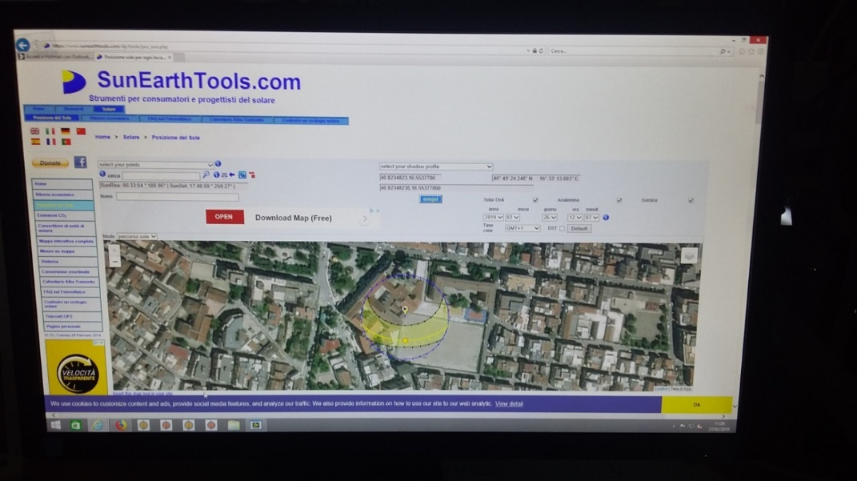
We have noticed on a table the values of the angle formed by the plumb line’s shadow, (plumb which was perpendicular to the centre of the goniometer) and azimut’s values which we have obtained using the online database of the site SunEarthTools.
To determine the direction of the True North , we have calculated the average of the obtained values, subtracting 180° to the sum of azimut’s values and the angles indicated on the goniometer (vedi schema allegato). We have obtained that the direction of the True North in relation to the zero of the goniometer is an average of 42,0°.
L’errore della misura corrisponde alla sensibilità del goniometro che è uguale a 0,5°.
So the value of the beta angle from north direction to the left-right direction in clockwise is 312° (vedi schema del goniometro).

Slide 9
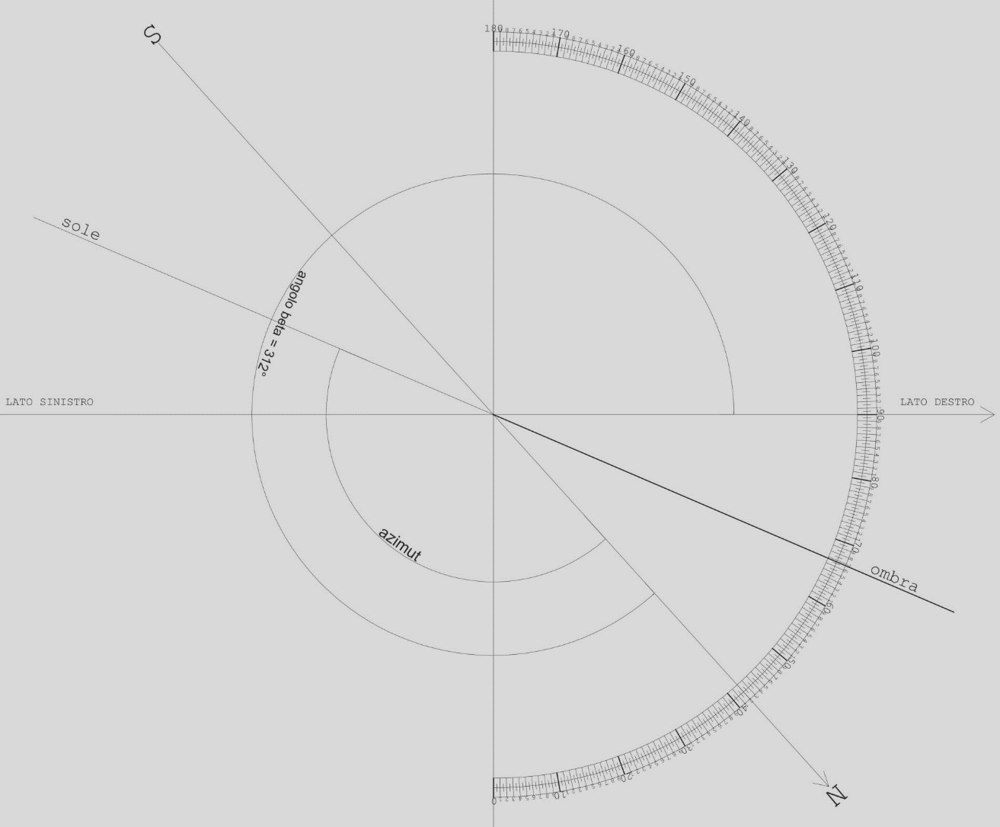

Slide 10
Realized by:
Stefano Colonna
Teresa Vicenti
Tutors:
Prof. Donato Dileo
Prof.ssa Maria Rosaria Cornacchia
.

