Slide 1


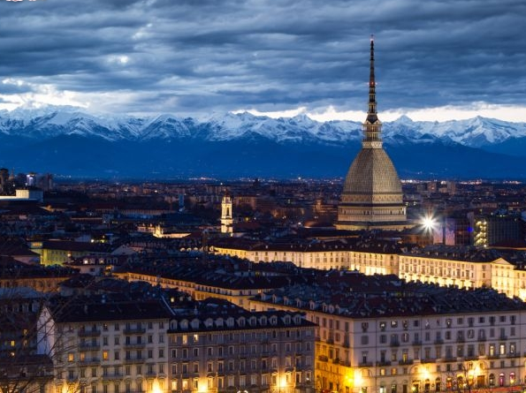
EEE: status and plans
EEE@Turin- 6-8 March 2019

Slide 2
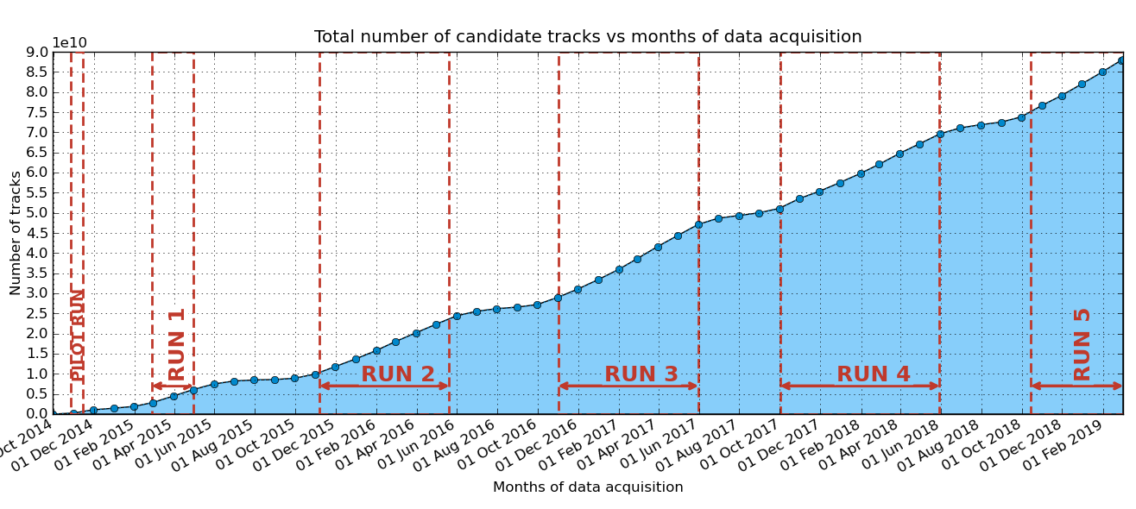
Total number of tracks
The network of the EEE telescopes
acquired almost 90 billions muons in 4 years!!!

Slide 3
# of reconstructed tracks/day
RUN 5: the EEE telescope network detects
more than 94 million muons per day!

Slide 4
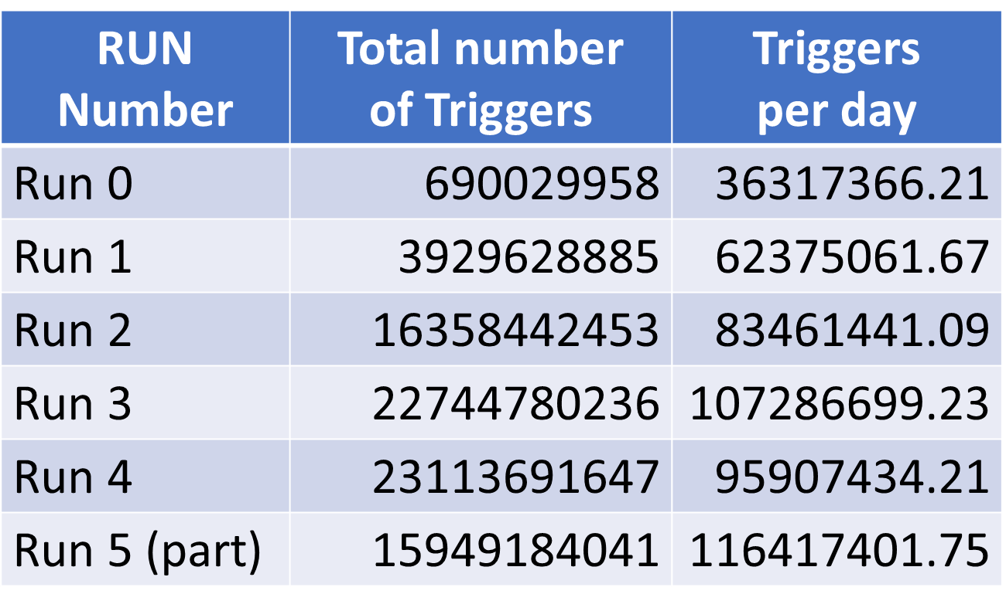
# of triggers for all runs

Slide 5
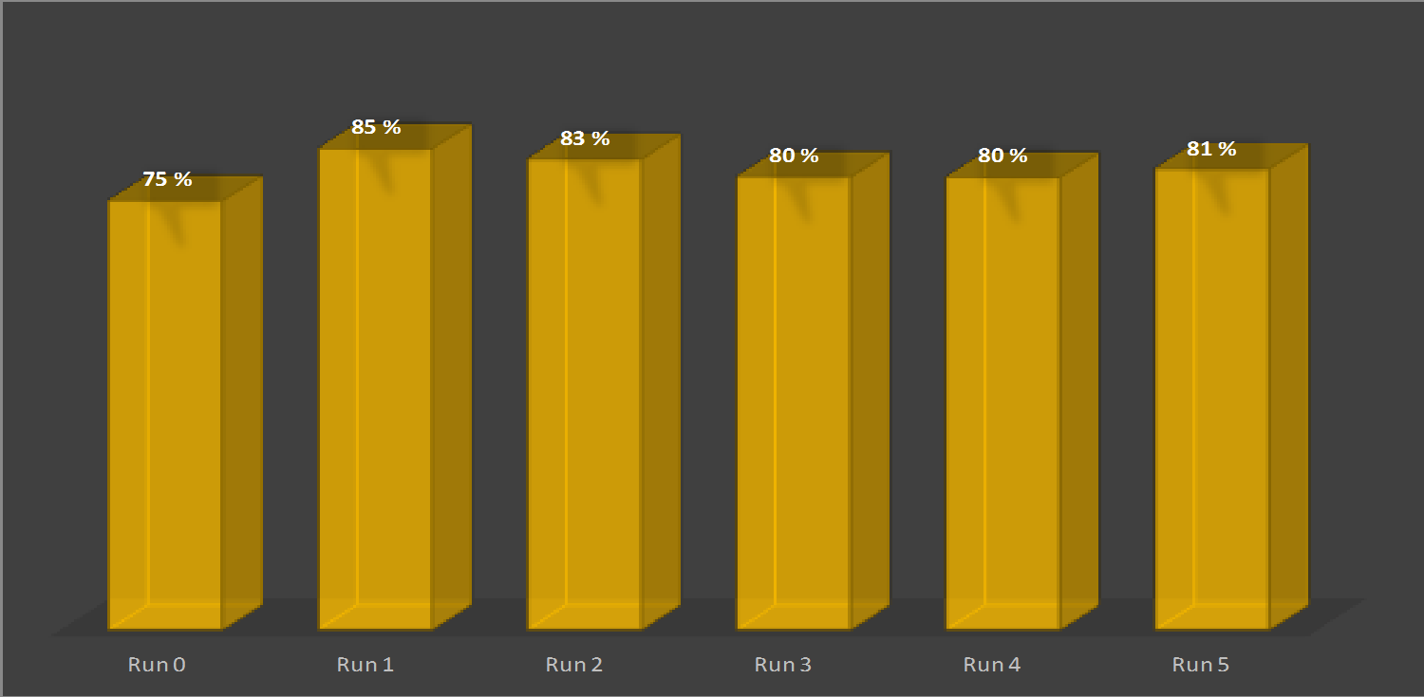
Triggers purity
Triggers purity = candidate_tracks / triggers

Slide 6
Days of data taking (Runs)
Run[2,5] ~ 200 days of data taking each
Total number of days of data taking during Runs at the end of RUN 5: 741
But remember: we are taking data every day, even when the Run is finished !!
PLEASE KEEP YOUR TELESCOPE ALWAYS UP AND RUNNING !!

Slide 7
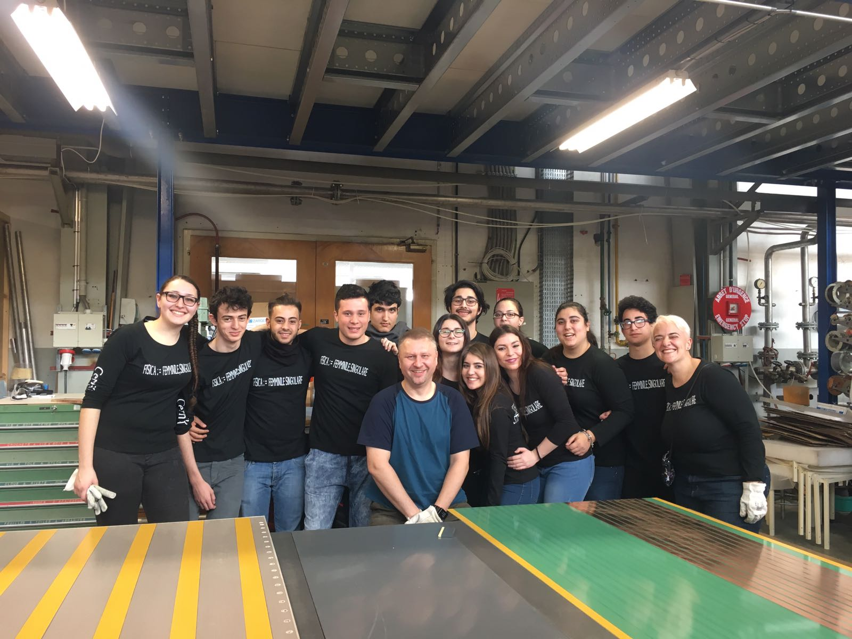
Chamber construction campaign 17/20
8 telescopes in 2017/18
LAMP-01, GENO-01, SIEN-02, CARI-01, TORI-05, LODI-03, CAGL-04, BOLO-05
12 spare chambers
New telescopes in 2019
first construction period Jan.-Mar.
Liceo «Amaldi» – Bitetto
Liceo «Calasanzio» – Carcare
Liceo «Giolitti Gandino» - Bra
Liceo «Volta» - Reggio Calabria
Welcome!

Slide 8

New stations
New batch of 7-8 telescopes end of 2019 + plus beginning of 2010
Call for application will be sent around soon

Slide 9
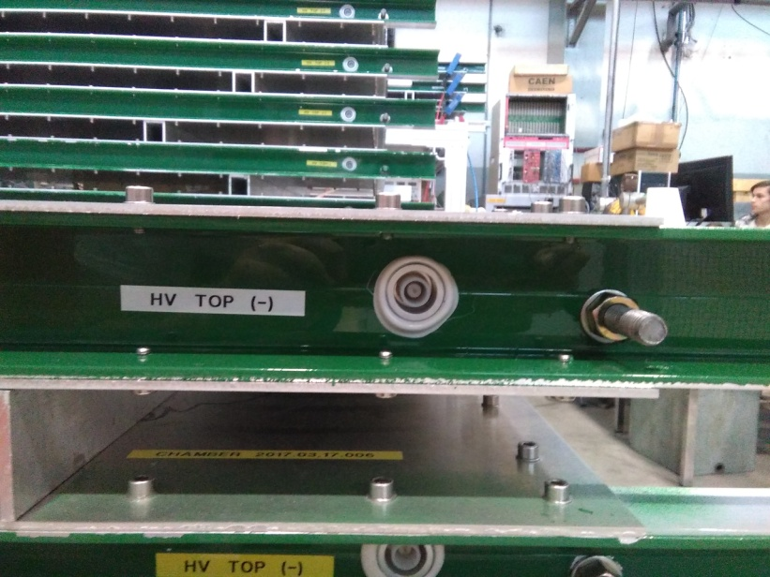
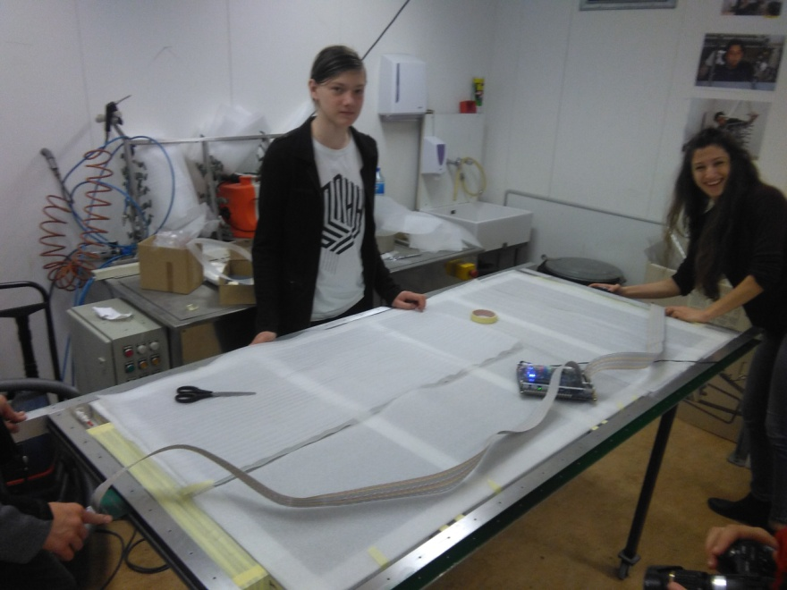
Tests after
construction:
- Gas tightness
- Efficiency
- Dark rates
- Dark currents
Tests chain
Test during construction:
- HV and
- Strips connectivity
Delivery
If any problem

Slide 10
Efficiency/counting rate/current tests
Efficiency is measured
for the 3 chambers
Above CERN-01 (green).
Chambers are fluxed
4 days before measurements
The trigger is the CERN-01.
The data sent to DAQ come from
CERN-01 bottom and middle chamber and one of the chambers under test.
By reconstructing tracks triggered by CERN-01,
hits on tested chamber are searched.
74
64
54
Data
44
Trigger (OR 24)
44

Slide 11
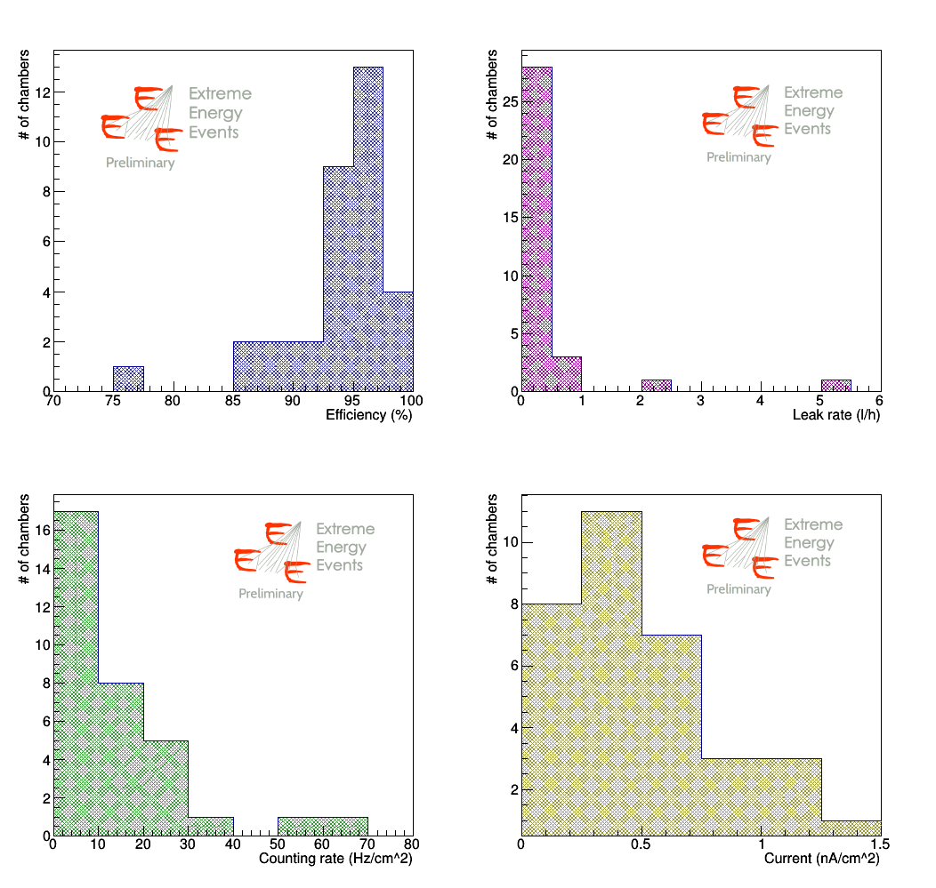
Results on the first 33 chambers

Slide 12
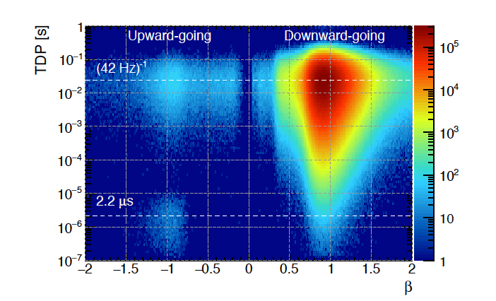
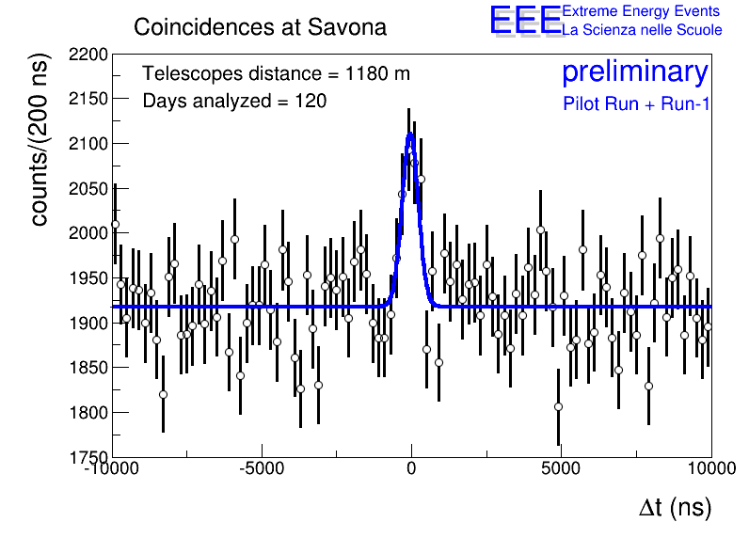
EEE physics goals
Examples of analyses carried out by the EEE Collaboration:
Forbush decrease
Upward going particles
Detection of Extensive Air Showers
Long Distance Correlations (LDC)

Slide 13
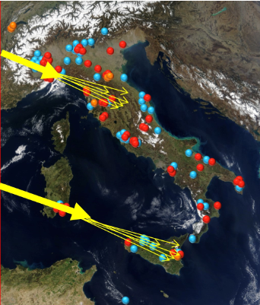
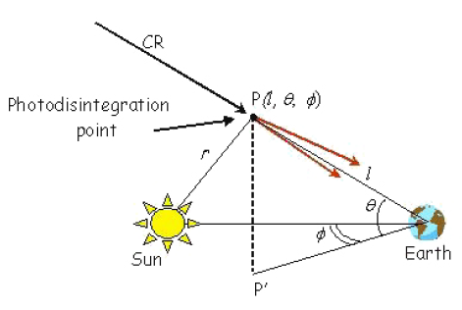
Search for long distance correlations
  EAS originating from cosmics emitted by the same source
  EAS originating from cosmics generated by the interaction of a primary cosmic with the interstellar medium
  EAS generated by the photodisintegration of primary cosmic rays in the solar field (GZ effect)

Slide 14
Rare events
Negligible background needed
Cluster 1
Cluster 2
. Coincidences between
clusters of telescopes
Telescope 1
Telescope 2
- Coincidences between multi-track in pairs of telescopes
Telescope 1
Telescope 4
Telescope 3
Multi coincidences of
single muons

Slide 15
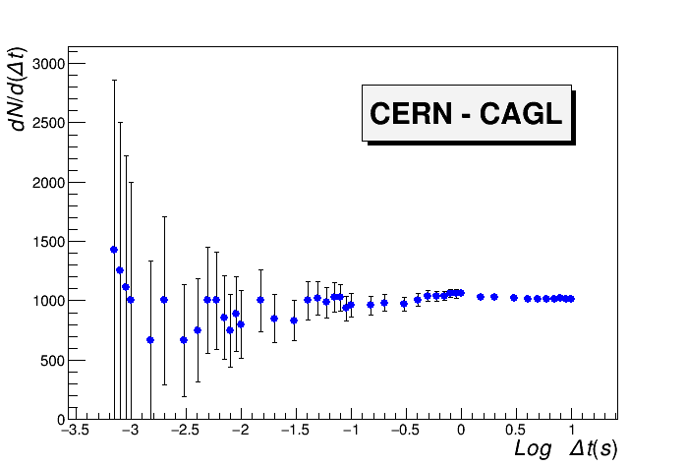
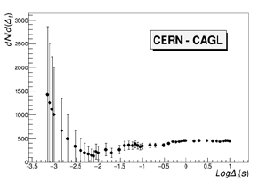
Coincidences among clusters
Not the same results for all pairs of clusters: studies ongoing!
Distribution of the events during the day
No cut on relative angle between showers
Cut on relative angle< 10
Cut on the relative angle
10 ms

Slide 16
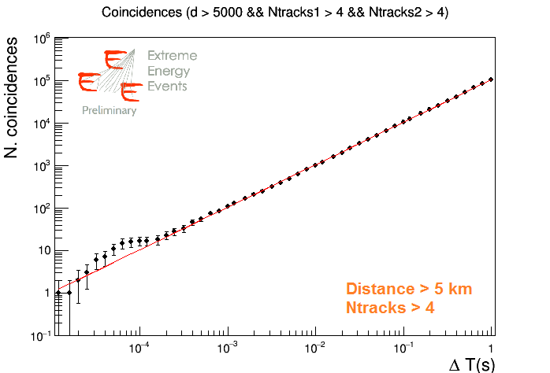
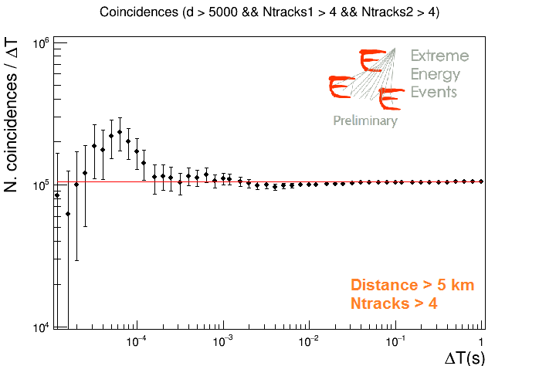
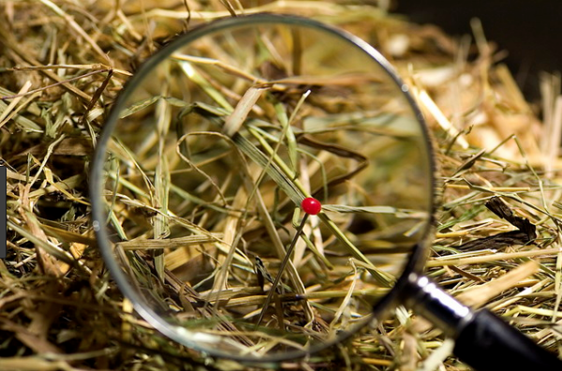
LDC with multi-tracks
# of coincidences between EEE sites as a function of the time coincidence window, compared with the expected accidental coincidence background (in red)
Possible LDC candidates?
Very few events among many, like a needle in a haystack

Slide 17
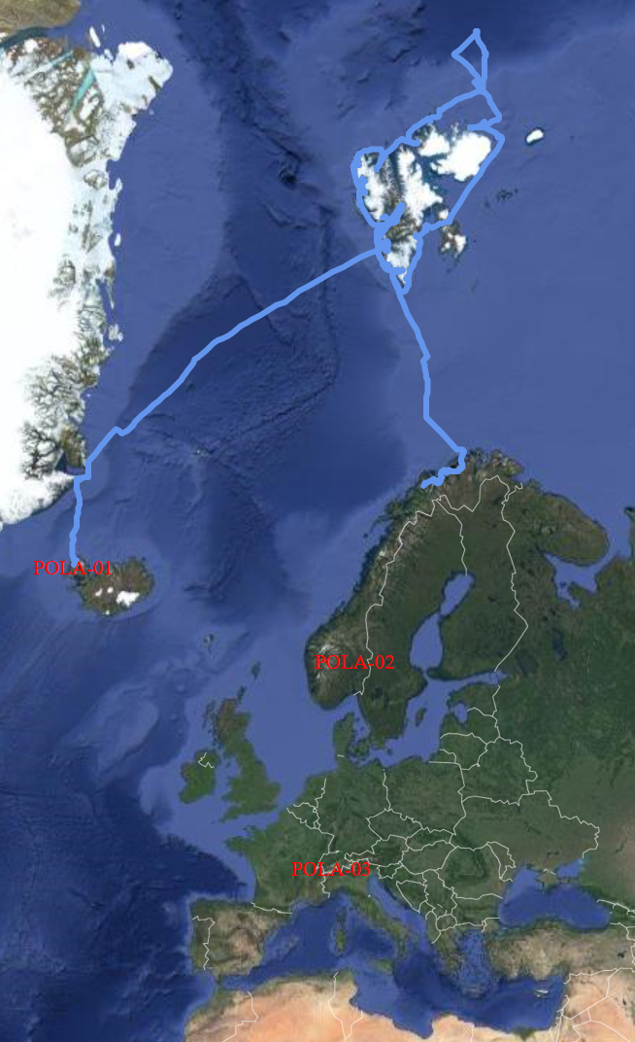
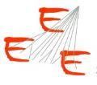
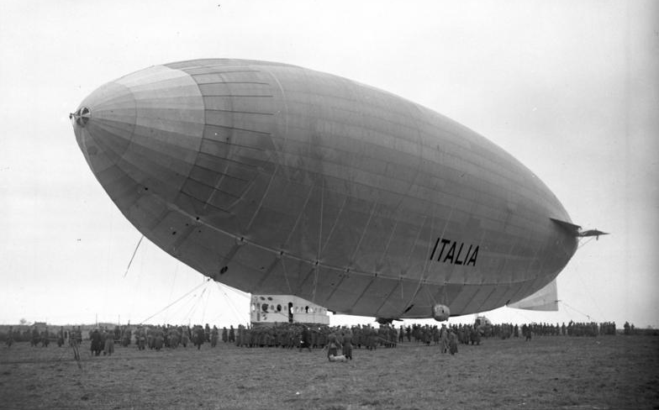
The «crazy» idea
Measure cosmic rays up to the North Pole
The PolarQuEEEst expedition started on the 22 July from Isafjordur and ended in Tromso on 3 September
PolarQuEEEst detector was hosted on Nanuq and sailed towards the North Pole
Two other identical detectors were installed in two high schools: one in Norway and one in Italy

Slide 18
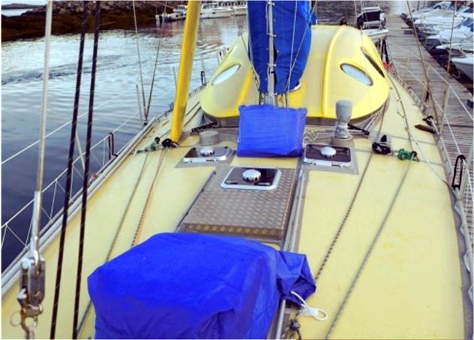
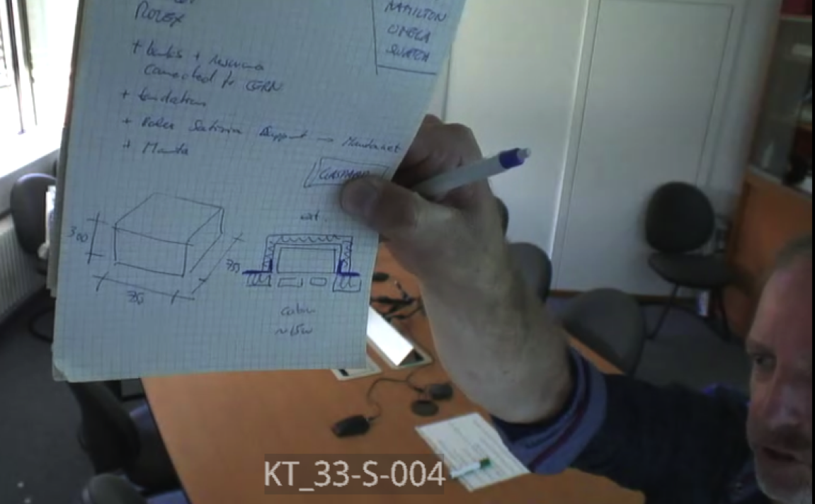
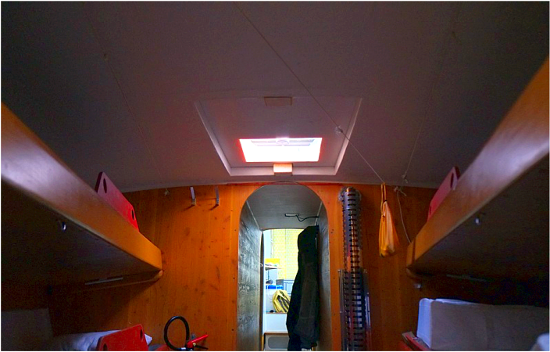
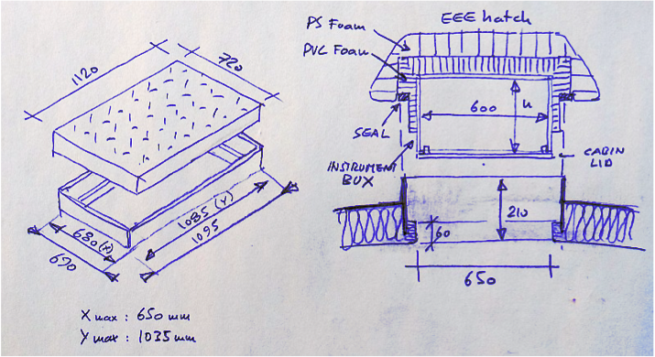
Requirements for the PolarquEEEst detector
The Detector on the Polar Nanuq has been designed to fulfill requests on:
Dimensions and weight (~ 50 kg)
Power consumption (< 15 W)
Robustness and reliability
Efficiency
Tag events at 20 ns precision!

Slide 19
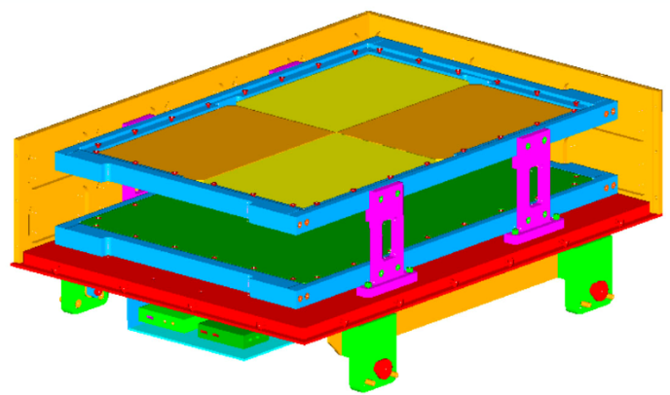
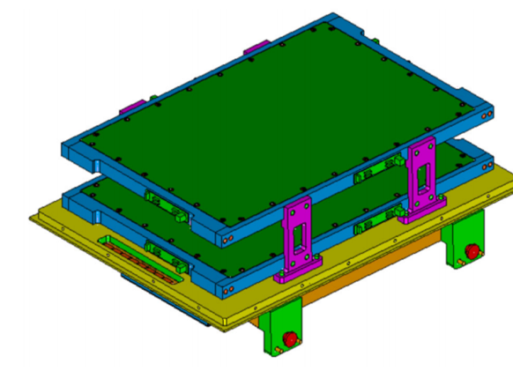
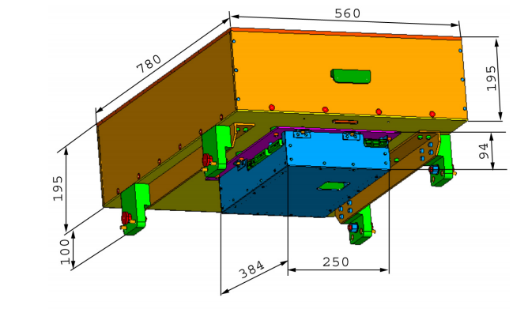
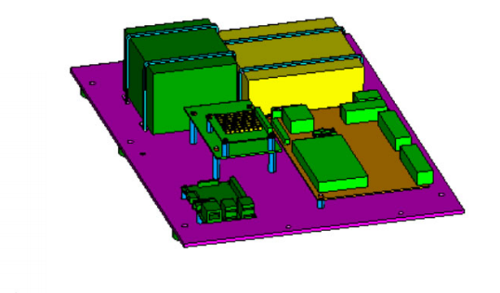
PolarquEEEst detector design
2 Plastic scintillator planes
Distance between planes: 11 cm
4 Tiles for each plane: 30 cm x 20 cm
2 SiPMs per tile (16 SiPMs in total)

Slide 20
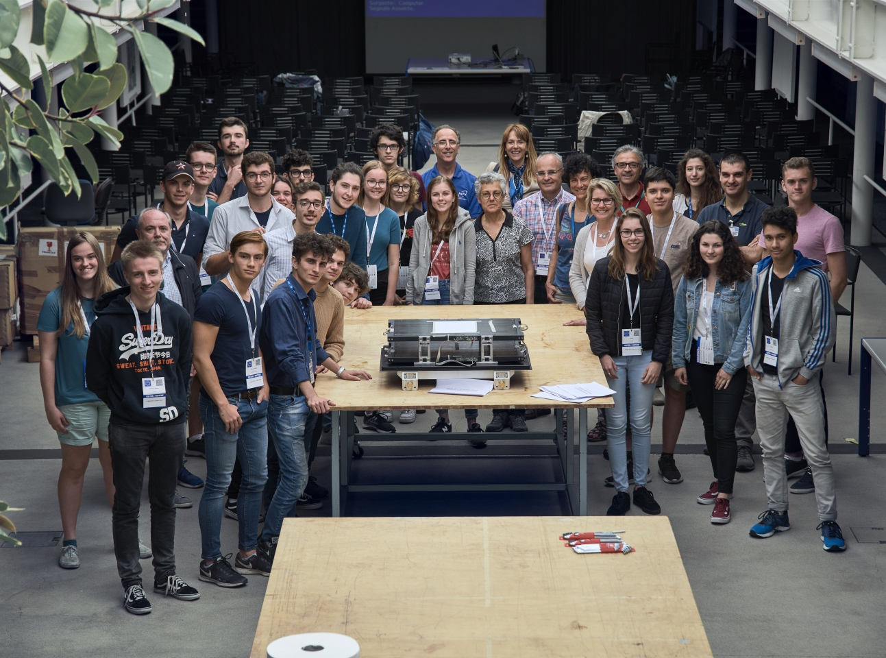
Assembling performed at CERN by high schools students from Italy, Switzerland and Norway

Slide 21
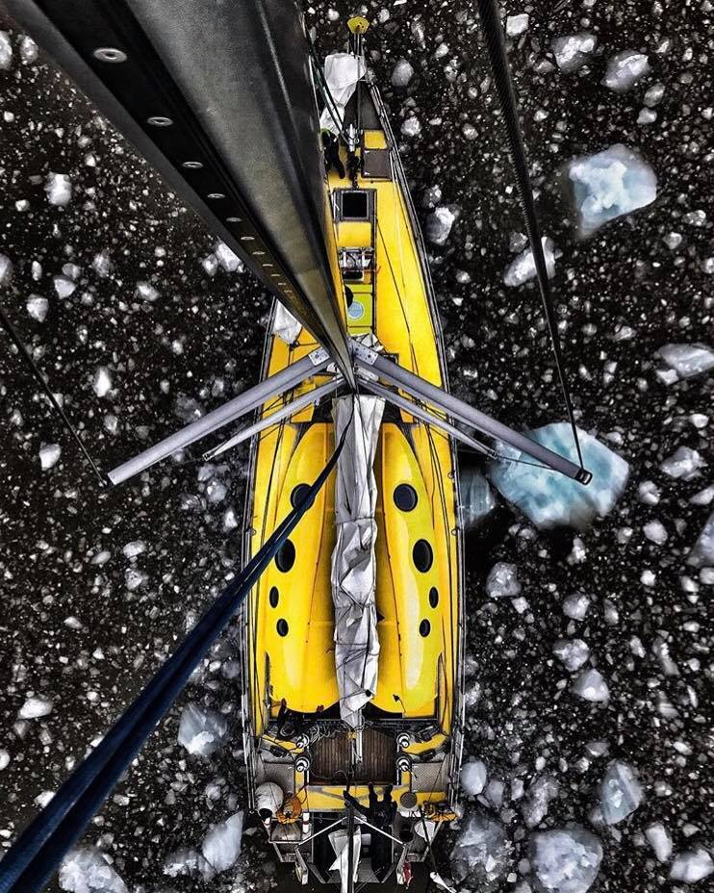
Il Nuovo Saggiatore, Vol 34, anno 2018, no. 5-6
Measuring cosmic ray showers near the North Pole with the Extreme Energy Events project
Rosario Nania, Ombretta Pinazza on behalf of the EEECollaboration
Nanuq at the
Svalbard
Islands
approaching
the pack ice

Slide 22
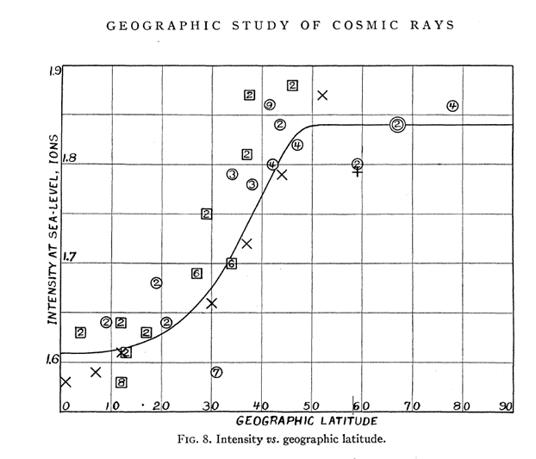
PolarquEEEst results
Northern Canada
& Alaska)
(Svalbard)
Ions/cc s
in standard air
G. Lemaître,
M.S. Vallarta
theory
Phys. Rev.
42 (1932) 914
A.H. Compton
Phys. Rev. 43 (1933) 387
Southern hemisphere — O Northern hemisphere
2 Compton
+ Millikan (Pasadena)
x boat from Genoa to Singapore
PolarQuEEEst

Slide 23
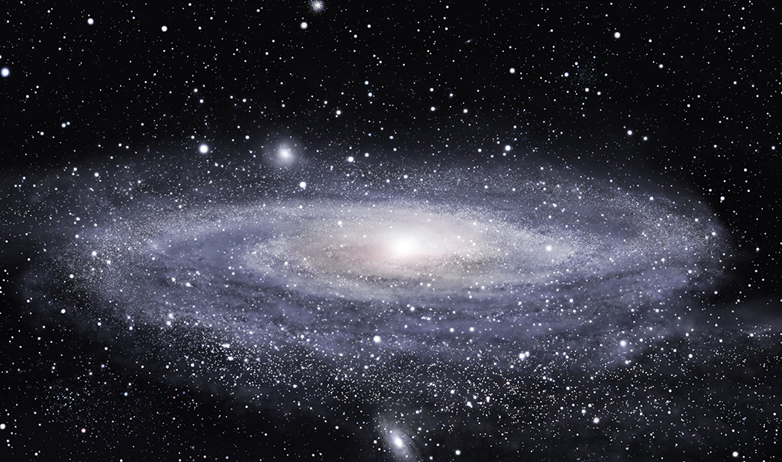
Plans for the future

Slide 24

Take a lot of data!
We are looking for rare events
We are an observatory:
we do not have control on when an interesting phenomen will take place

Slide 25

Being up h24…
The 2016 new year Forbush: at 24.00 of 31/12/2015 our telescopes -in schools- were up and running!
New year!

Slide 26
Being in EEE is an incredible occasion
You are taking part to a real scientific experiment
The instrumentation installed in your schools is unvaluable, in terms of cost and efforts
You have the possibility to learn concepts and tools you do not generally use
Experience done here is considered in many various environments

Slide 27
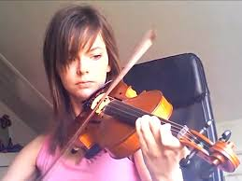
Being in EEE is hard work!
By teachers, students, ALL
EEE needs you!
Keep the telescope in operation
Monitor the telescopes (ALL)
Fill the e-log
Read emails, diffuse them and react
Take part and present to the EEE Run meetings open to schools

Slide 28
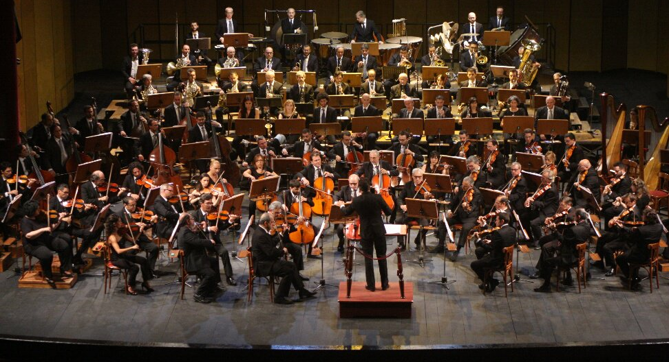
And it is an incredible collaborative effort!

Slide 29
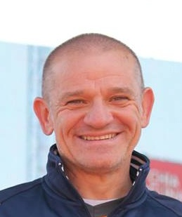
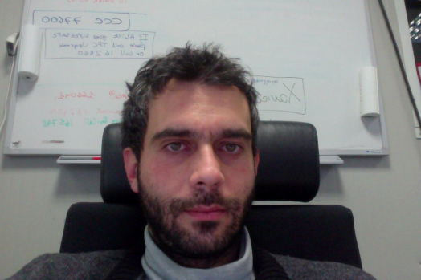
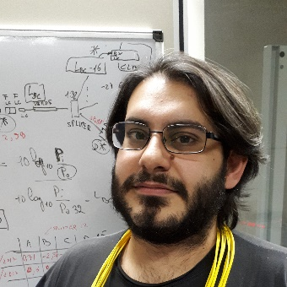
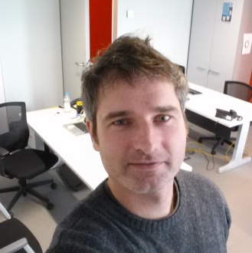
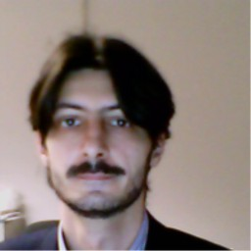
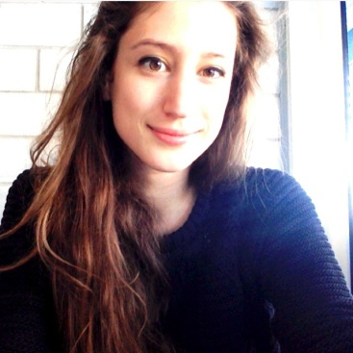
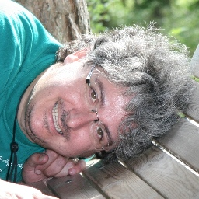
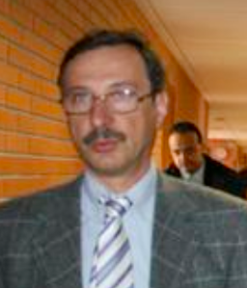
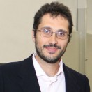

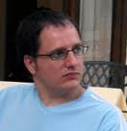
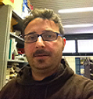

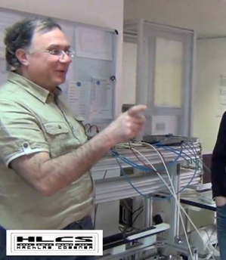
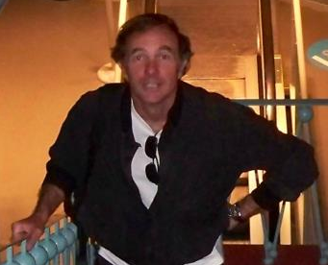
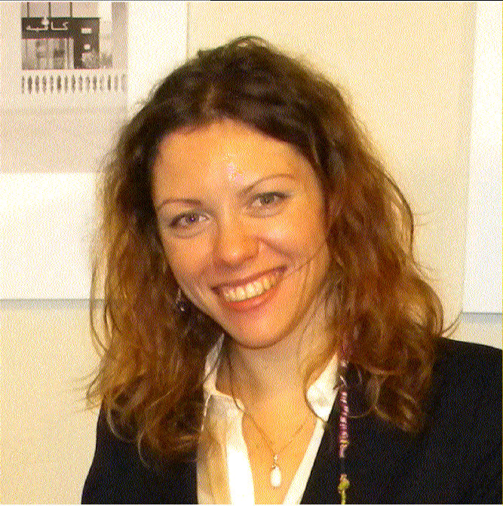
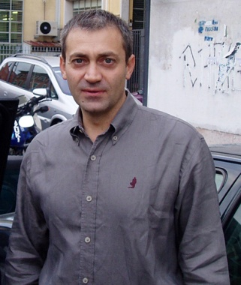
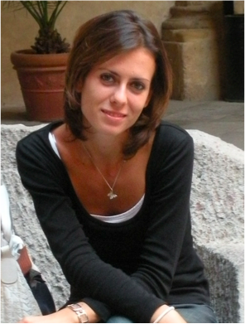



By the EEE crew…

Slide 30

By the schools:
students and teachers

Slide 31



Thanks!!!

