Slide 1
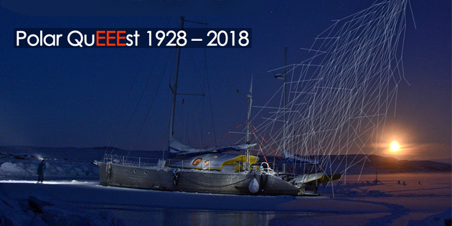
Measuring cosmic rays up to the
North Pole

Slide 2
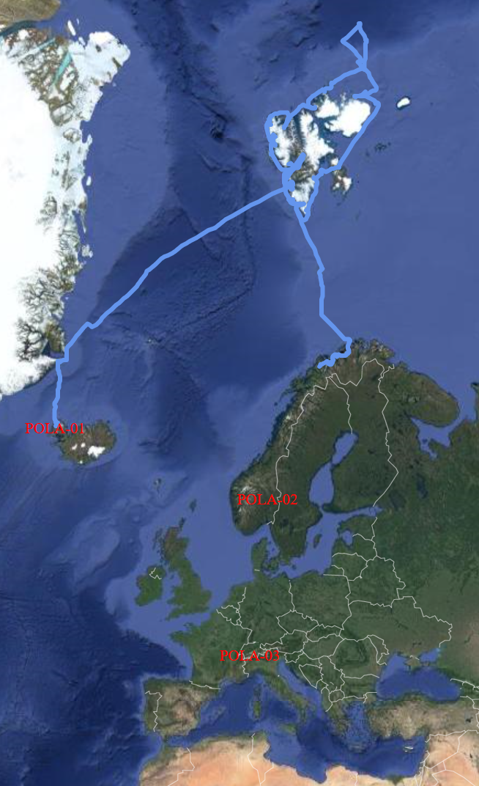
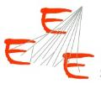
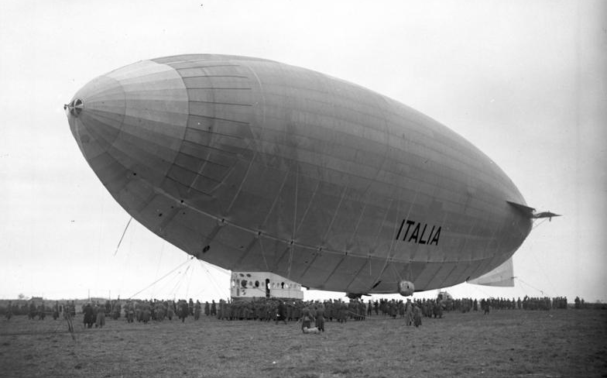
The «crazy» idea
Measure cosmic rays up to the North Pole
The PolarQuEEEst expedition started on the 22 July from Isafjordur and ended in Tromso on 3 September
PolarQuEEEst detector was hosted on Nanuq and sailed towards the North Pole
Two other identical detectors were installed in two high schools: one in Norway and one in Italy

Slide 3
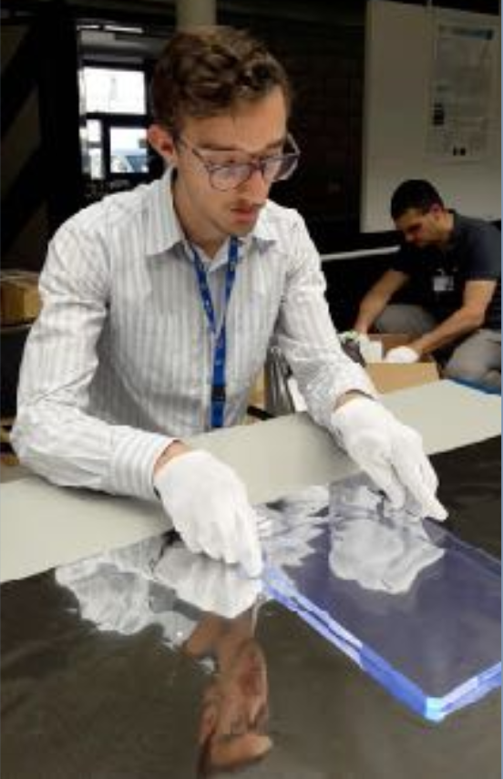
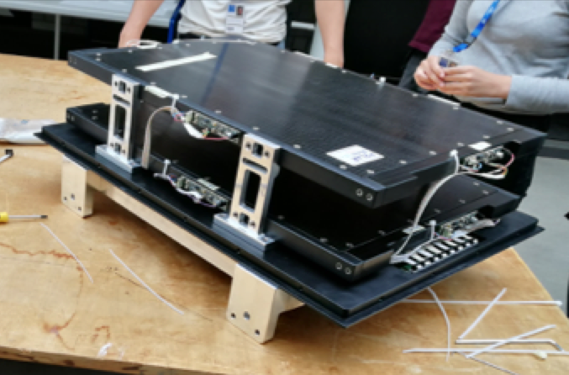
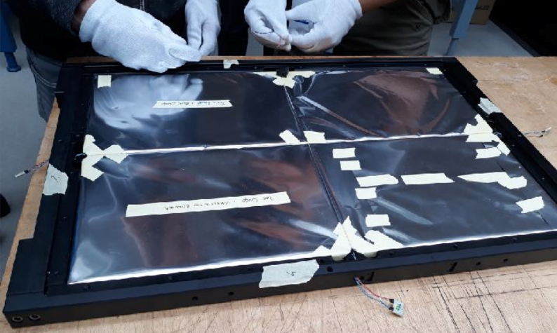
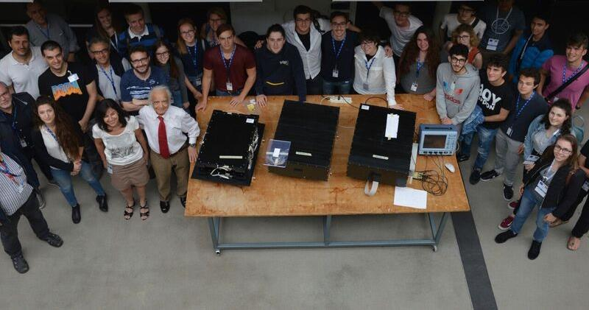
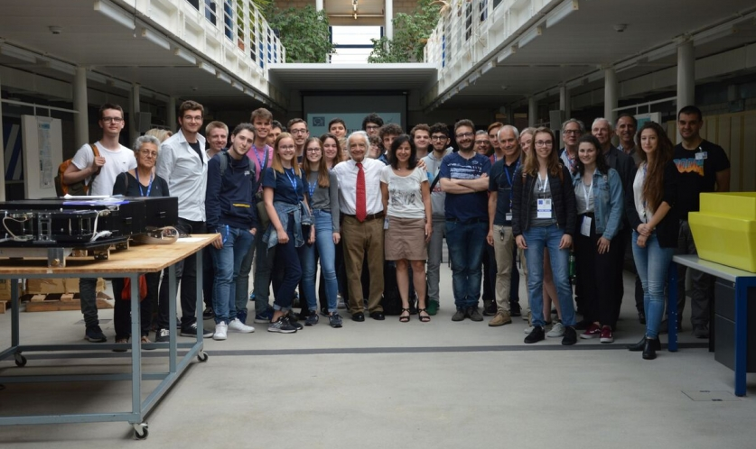
Assembling
Performed at CERN by high schools students form
Italy, Switzerland and Norway
24 May 2018

Slide 4
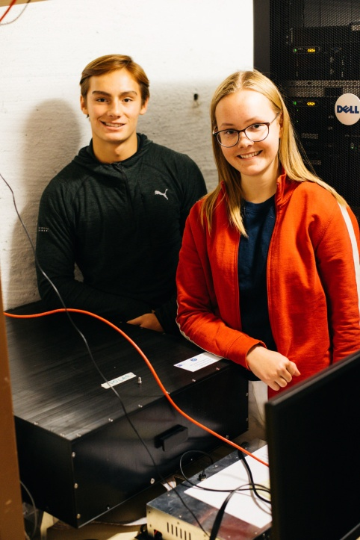
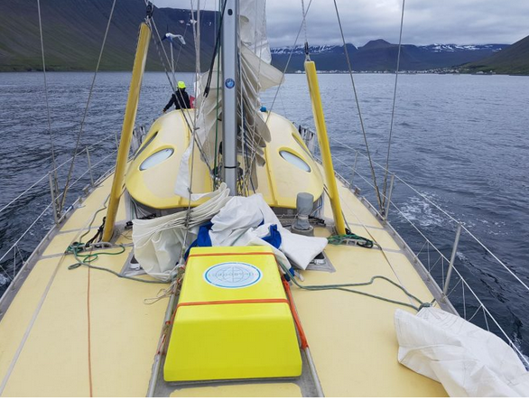
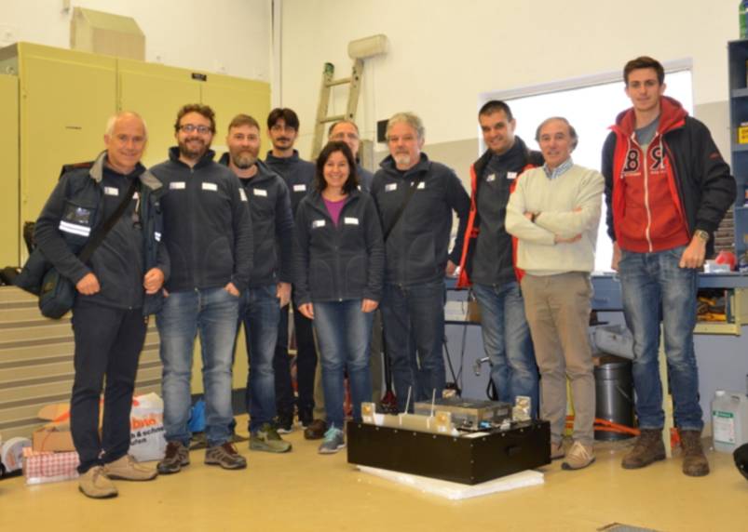
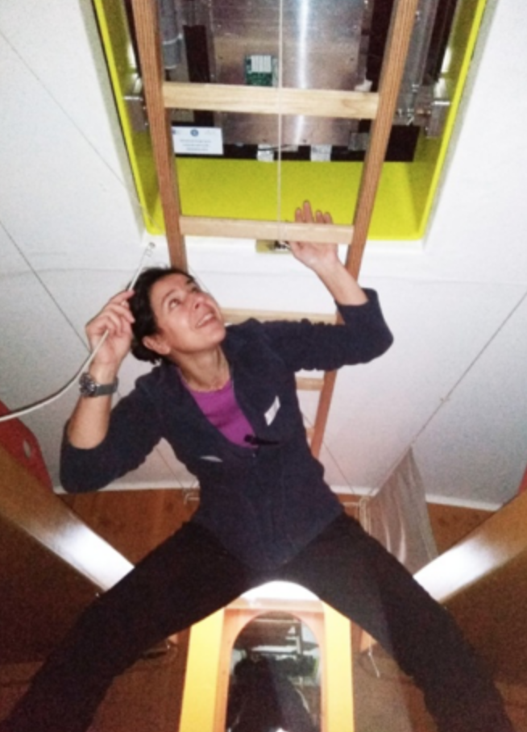
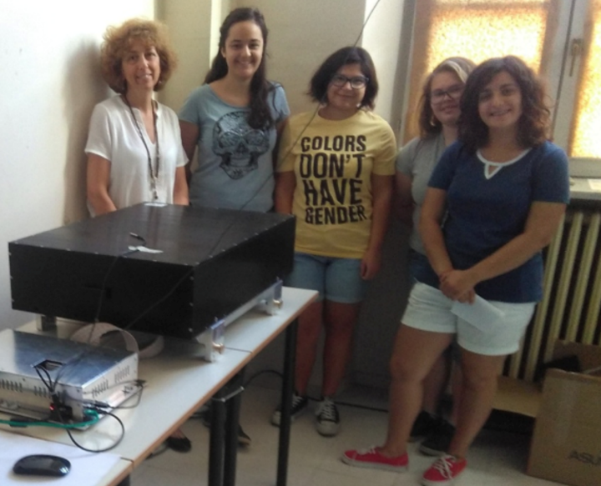
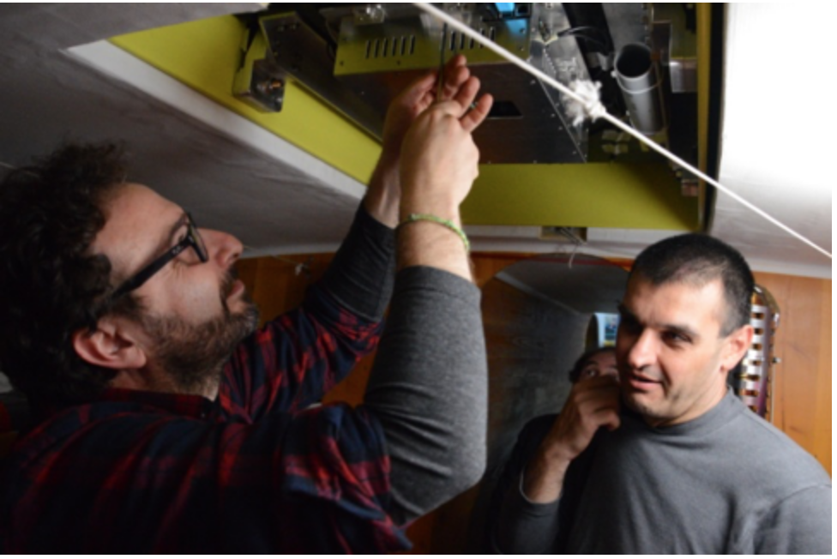
Installation
All the detectors installed by the end of July 2018
POLA-02 @ Oslo
(Nesodden)
POLA-01 @ Isafjordur
POLA-03 @ Torino
(Bra)
POLA-01 on board

Slide 5
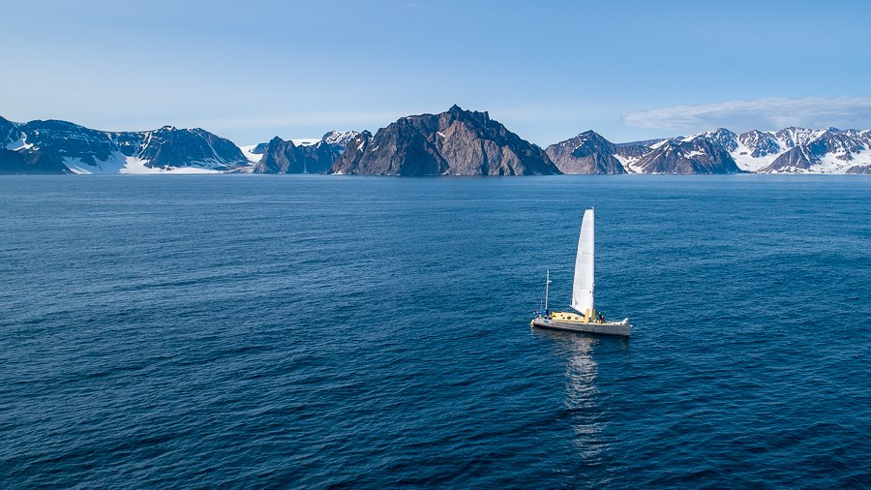
Nanuq en route to the Svalbard Islands

Slide 6
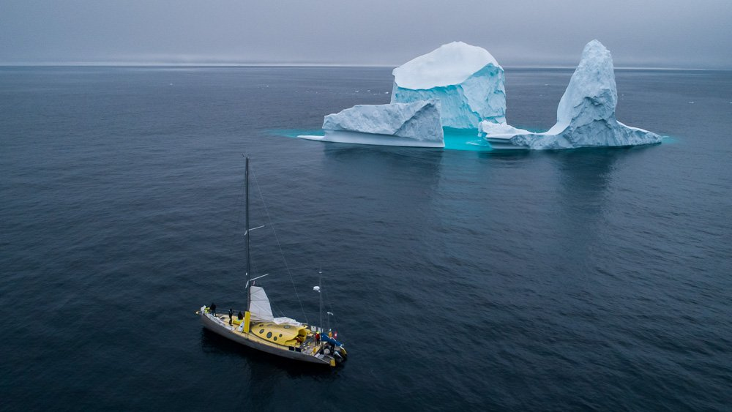
Nanuq en route to the Svalbard Islands

