Slide 1
EEE in collaboration with MIUR, CERN INFN,UniCa:
A scientist’s job

Slide 2
Background
PON funding, Selection, Project planning

Slide 3
The idea
Science is a job: How do you prepare to a scientist’s future work?
«percorsi di alternanza scuola-lavoro e tirocini/stage in ambito interregionale o all’estero»
Your present work: EEE (Centro Fermi)
One of the greatest science’s lab on Earth: CERN
A major national reasearch institute: INFN
Support by a local university: UniCa, University of Cagliari
«Men Power»: local referee, Centro Fermi collab, ALICE collab, teachers…

Slide 4
Selections
if it didn't require you any effort, you did it wrong (Dan Brown).
Selection test on cosmic rays and muon physics
ᴒ
High marks criteria.
15 students, III, IV, V year
3 teacher to help
3 weeks of work/study

Slide 5
Lectures
Before I came here I was confused about this subject. Having listened to your lecture, I am still confused. But on a higher level. (Enrico Fermi)

Slide 6
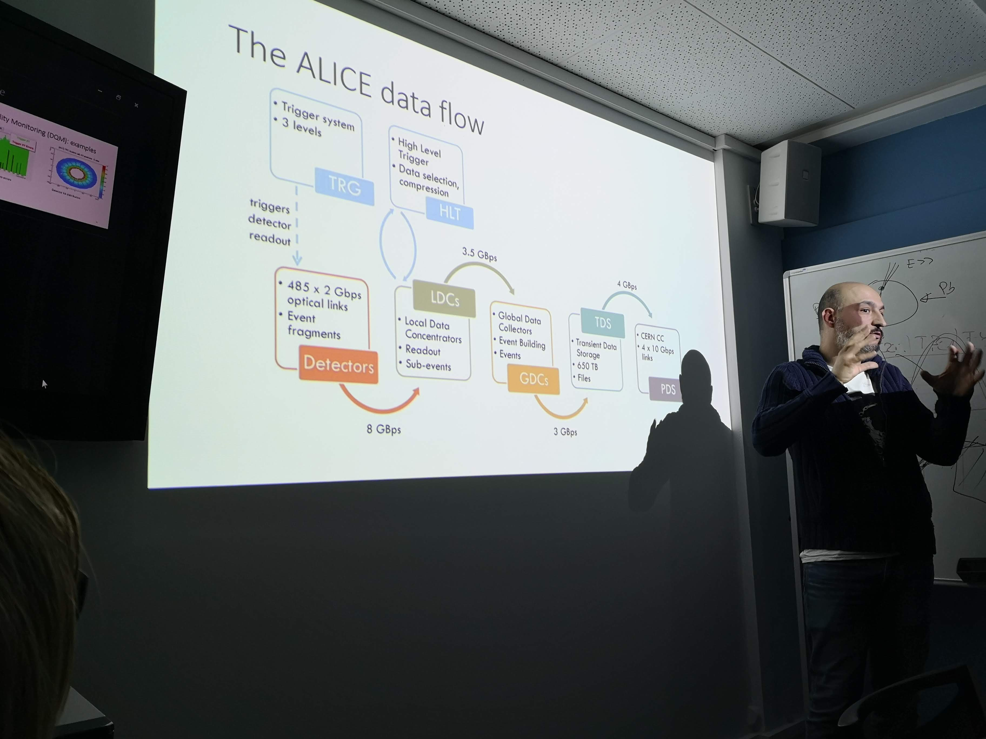
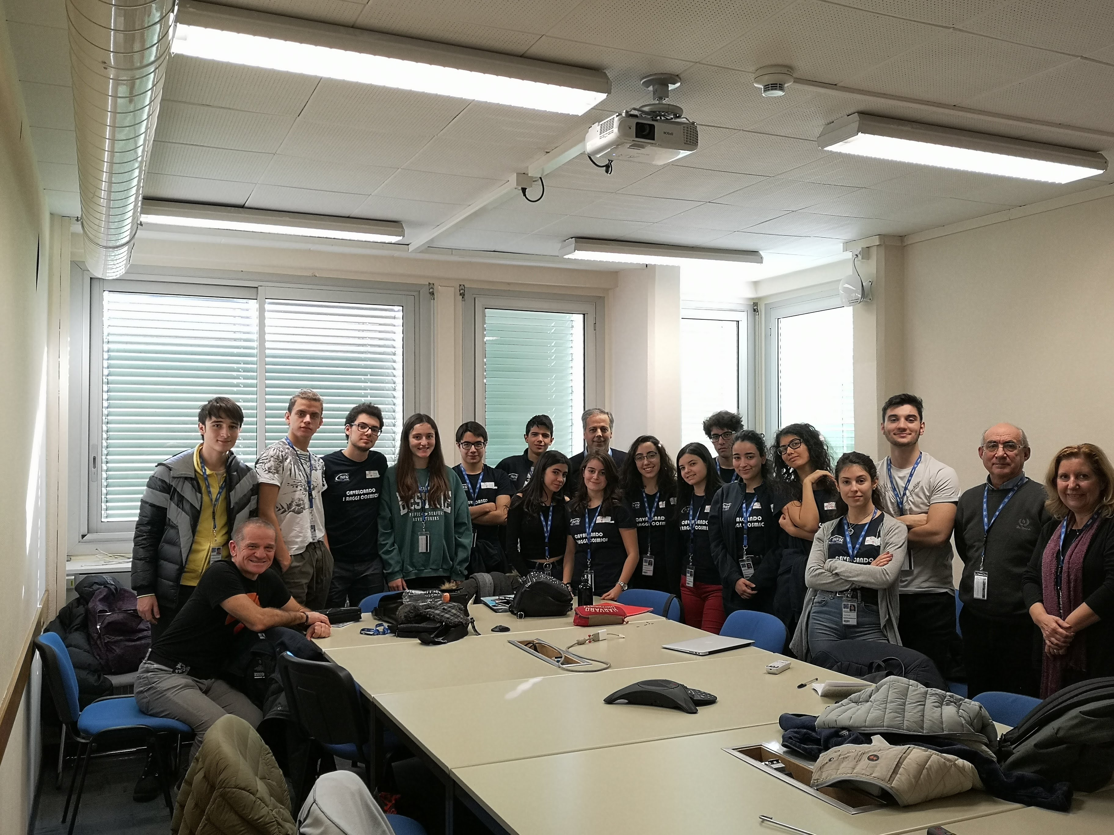
A Physicist’s job: planning an experiment. Some e.g. lectures
From understanding important parameters..
G. Usai “Elementi di Fisica delle Particelle”
R. Landua “Dark Matter e Antimatter”
..tayloring your apparatus…
M. Gagliardi “Data Taking in Alice”
G. Usai “Evoluzione di un esperimento scientifico: dalla sua idea alla realizzazione”
C. Williams “Le camere MRPC - Multigap Restitive Plate Chamber”
L. Musa “Silicon Tracking Detectors”
…reading and understanding the results
S.Siddhanta “Elementi di base della matematica computazionale”, “Elettronica nei rivelatori”

Slide 7
Building chambers
True happiness comes from the joy of deeds well done, the zest of creating things new.
(Antoine de Saint-Exupery)

Slide 8
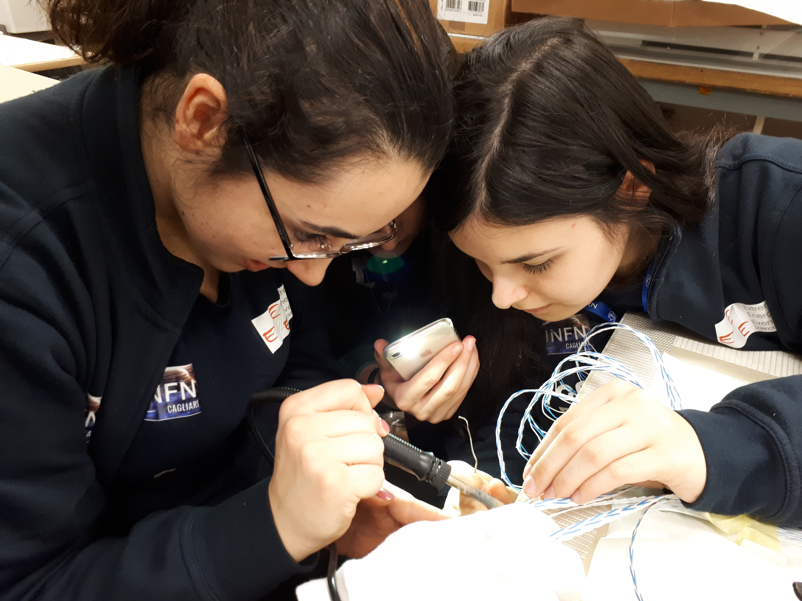
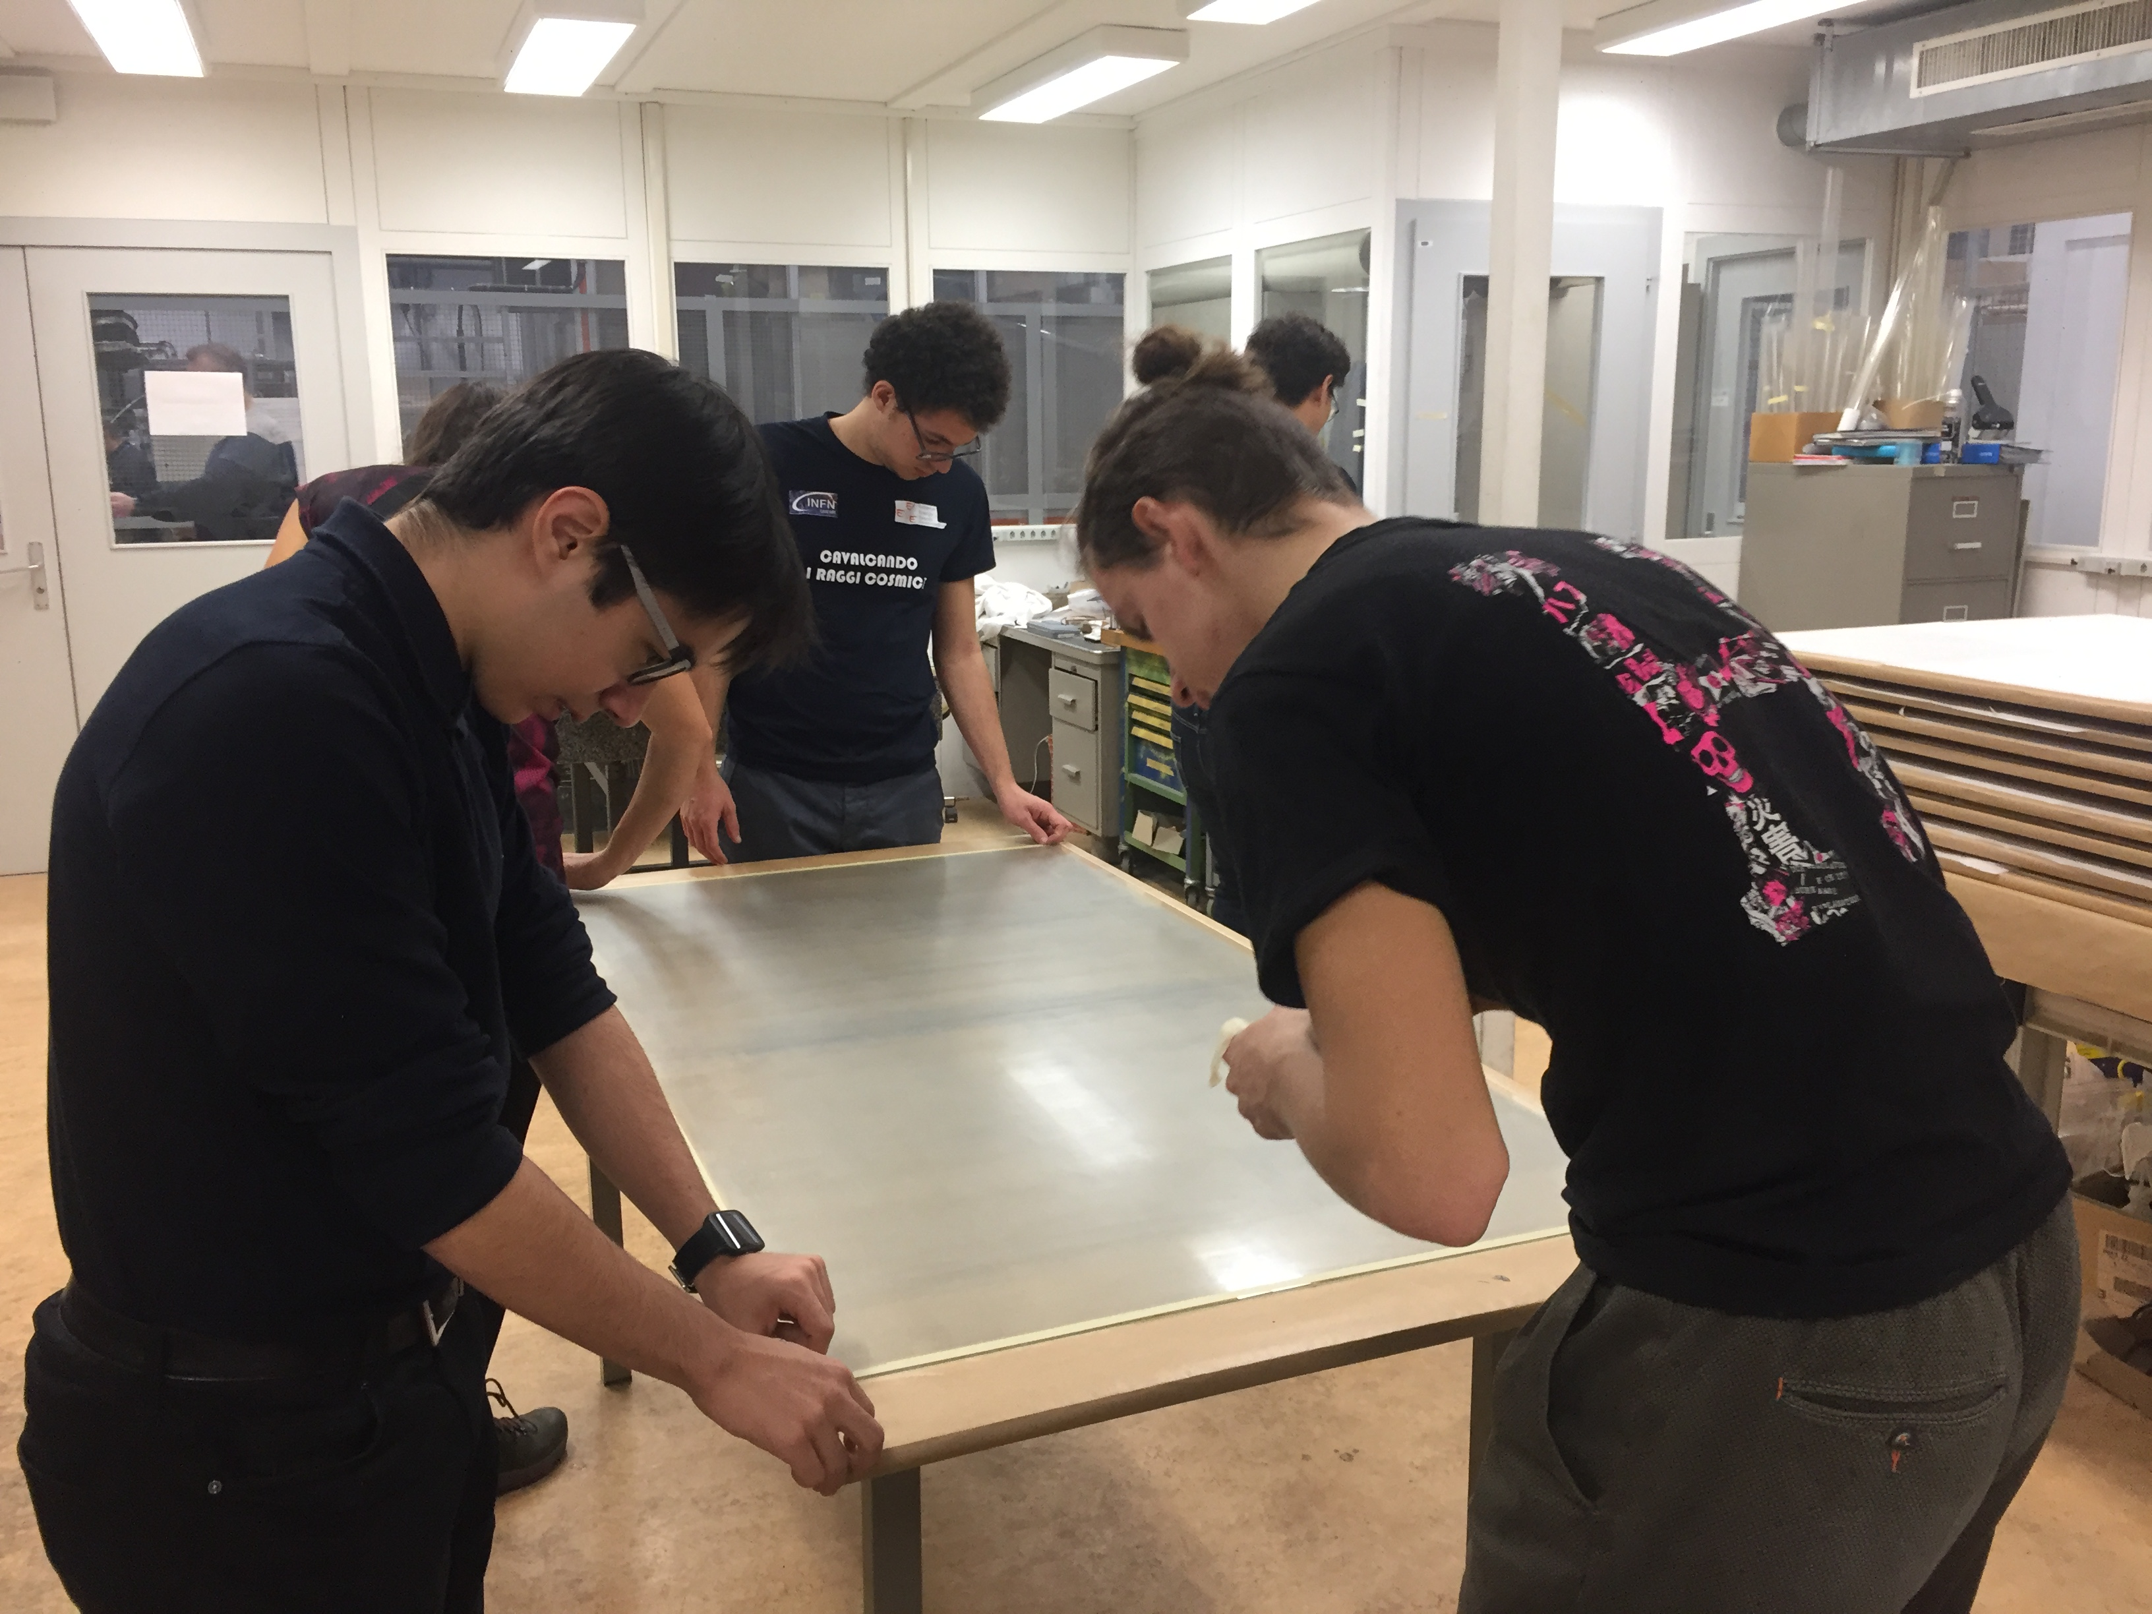
Building 167
The Roman’s empire
Building chambers from scratch is a task well known to EEE most worthy groups..
Built chambers 40&41

Slide 9
Test
Experience is a hard teacher because she gives the test first, the lesson afterward.
(Vernon Law)

Slide 10
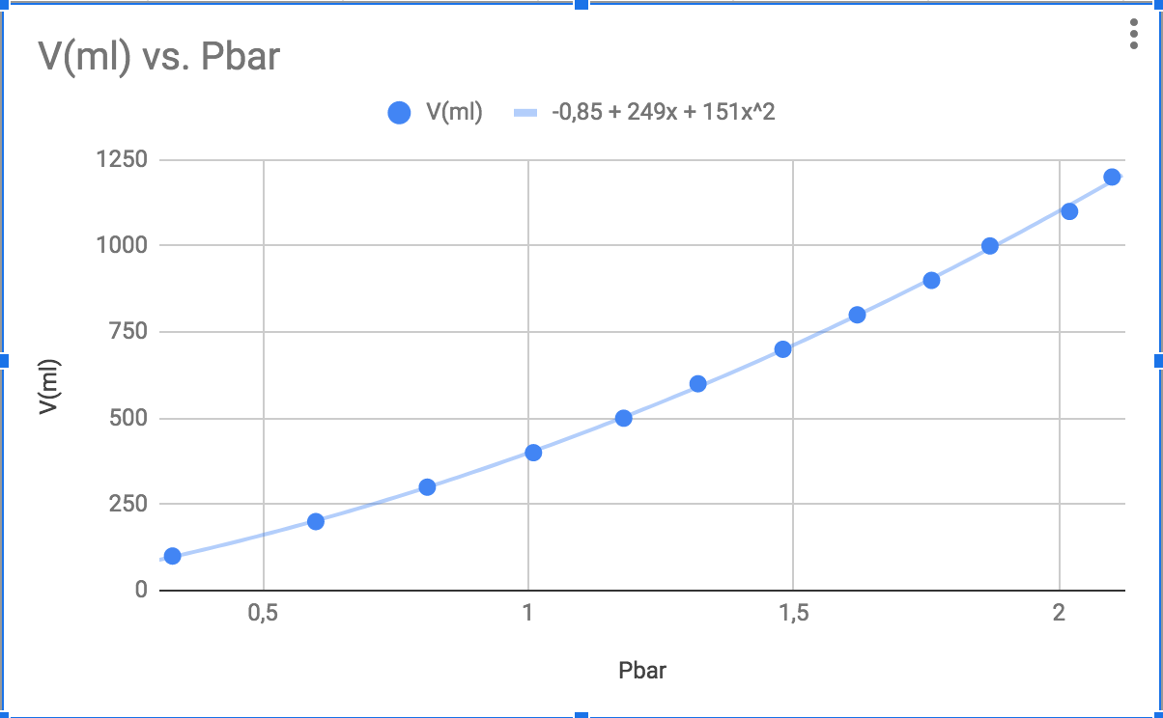
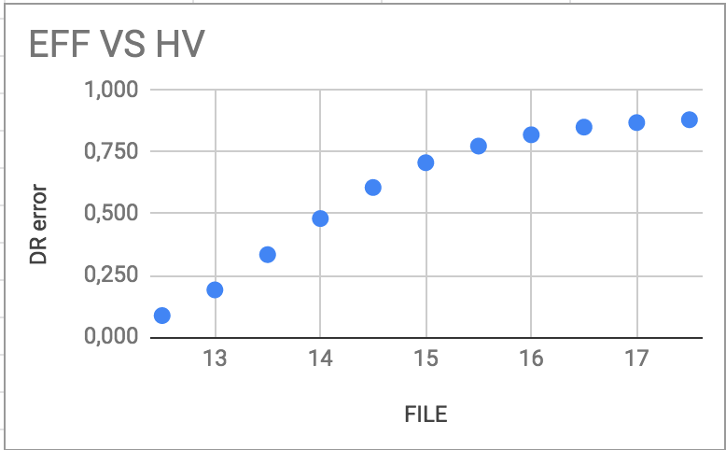
Quality and Performance
Knowing your detector is MANDATORY.
CERN01 to test new chambers
Gas Leakage
Efficiency, new FEA
EFF
HV

Slide 11
Masterclass
Success is no accident. It is hard work, perseverance, learning, studying, sacrifice and most of all, love of what you are doing or learning to do.
(Pelè)

Slide 12
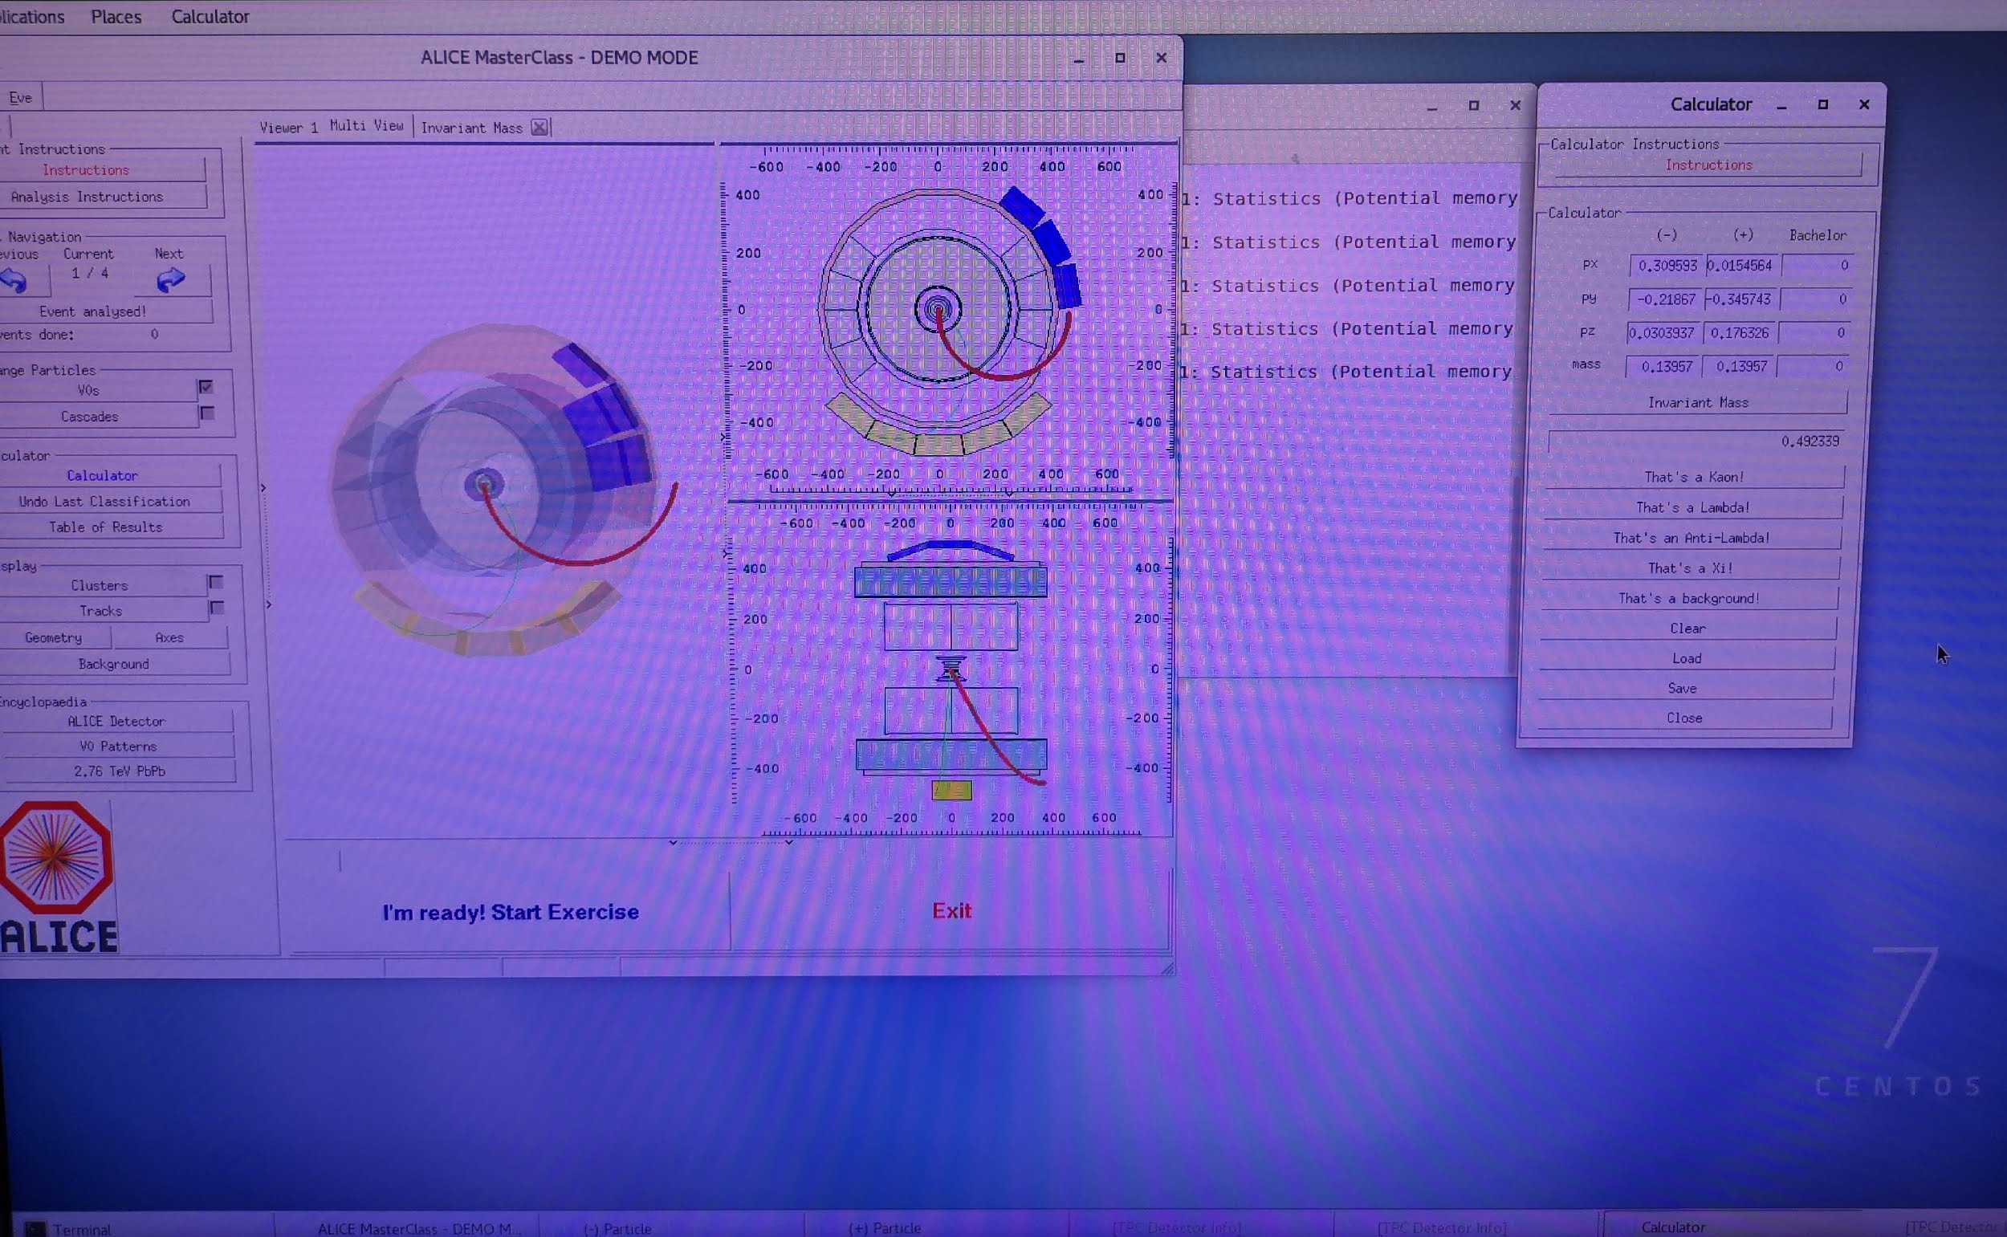
Applying knowledge
Hands in the dough!
S’Cool Lab
Building a cloud chamber with relatively common materials
ALICE’s Masterclass
Working with a particle track reconstruction program, from real ALICE data

Slide 13
Visits to experiments

Slide 14
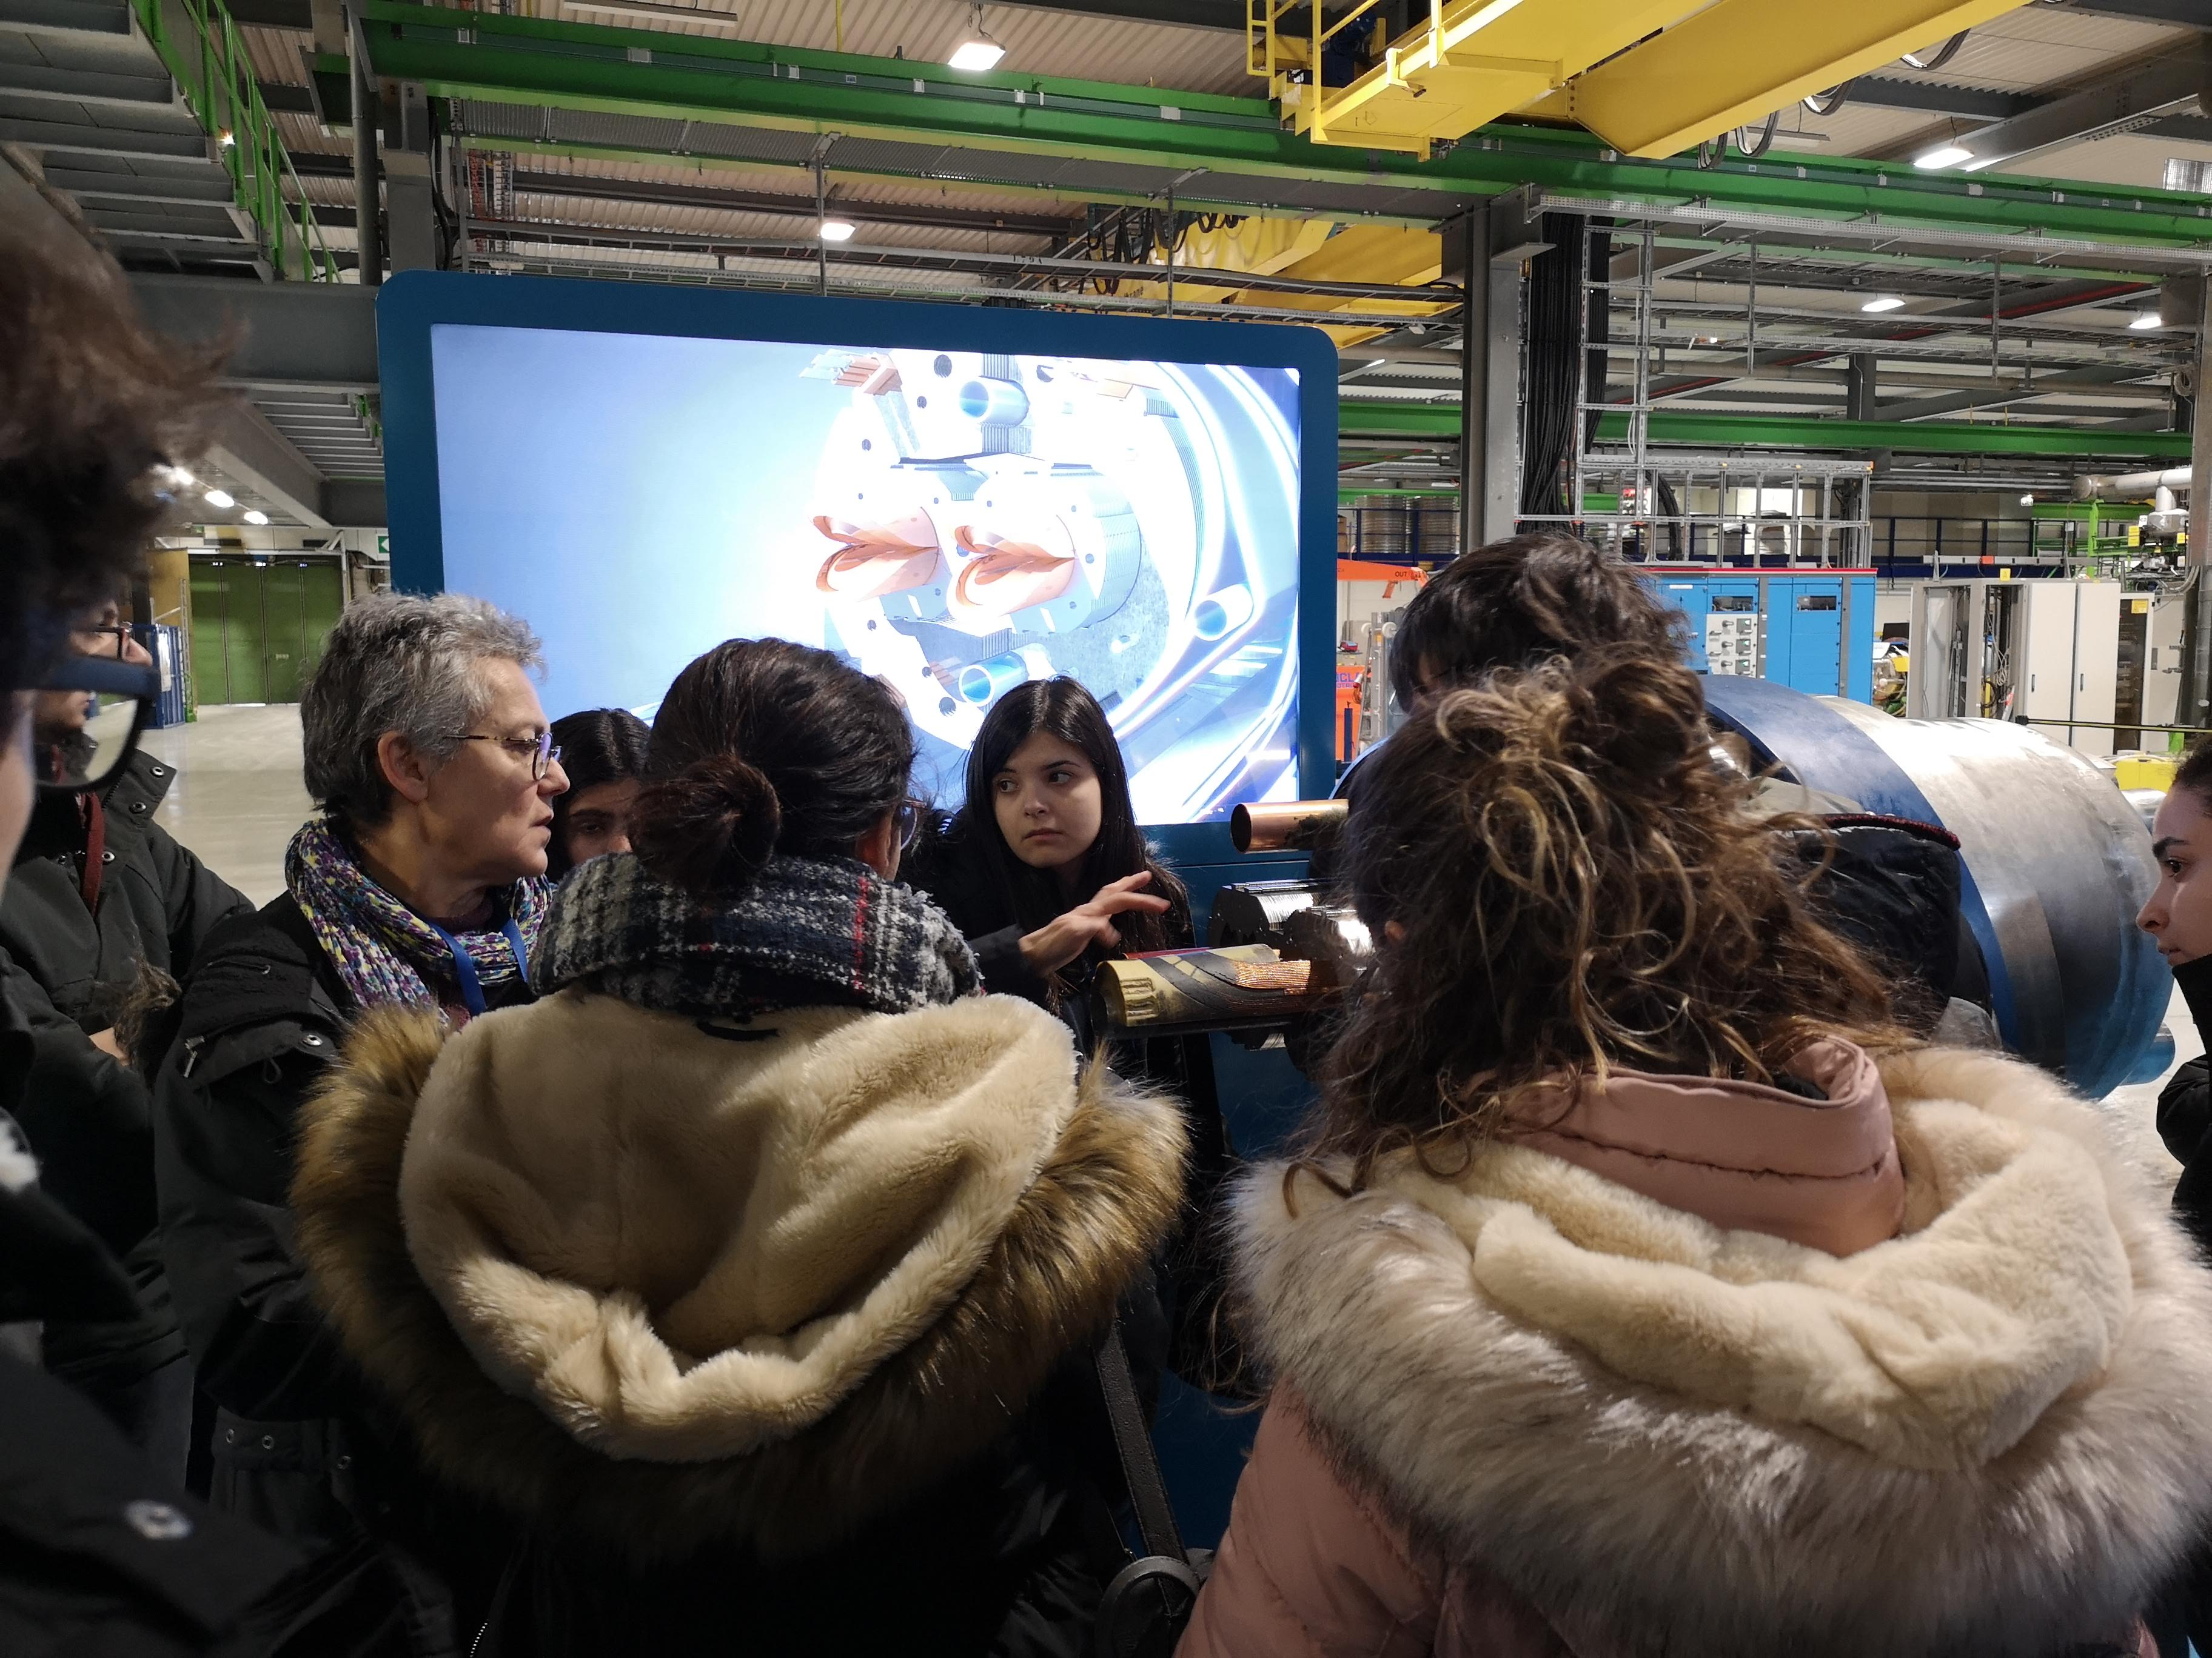
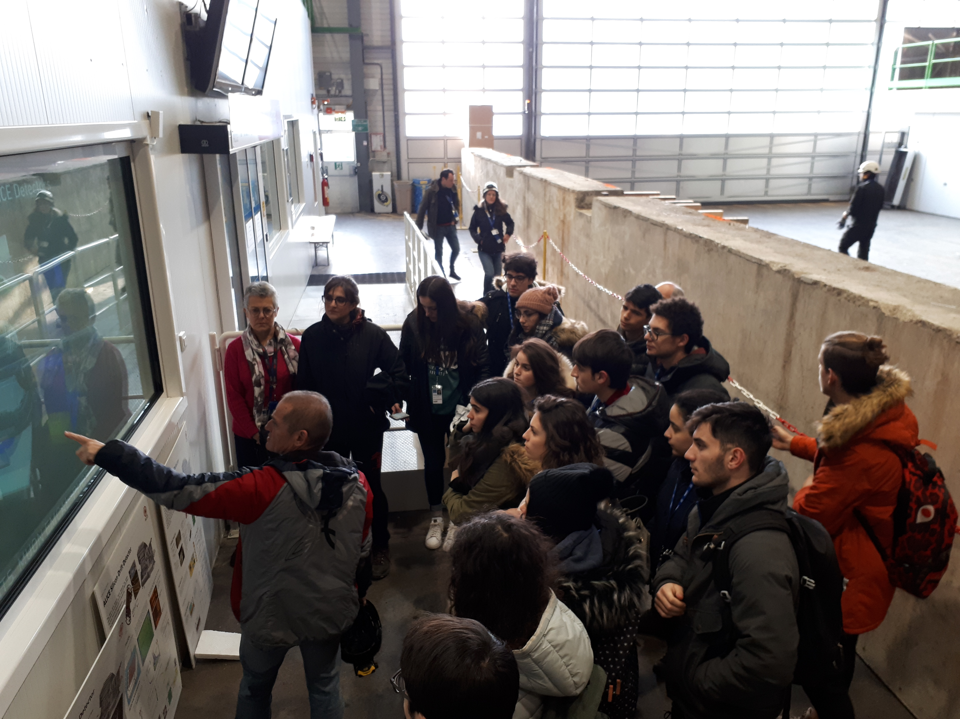
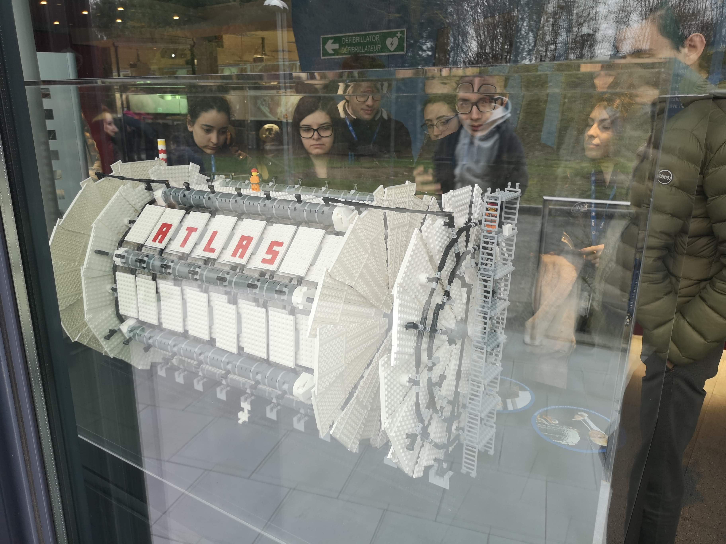
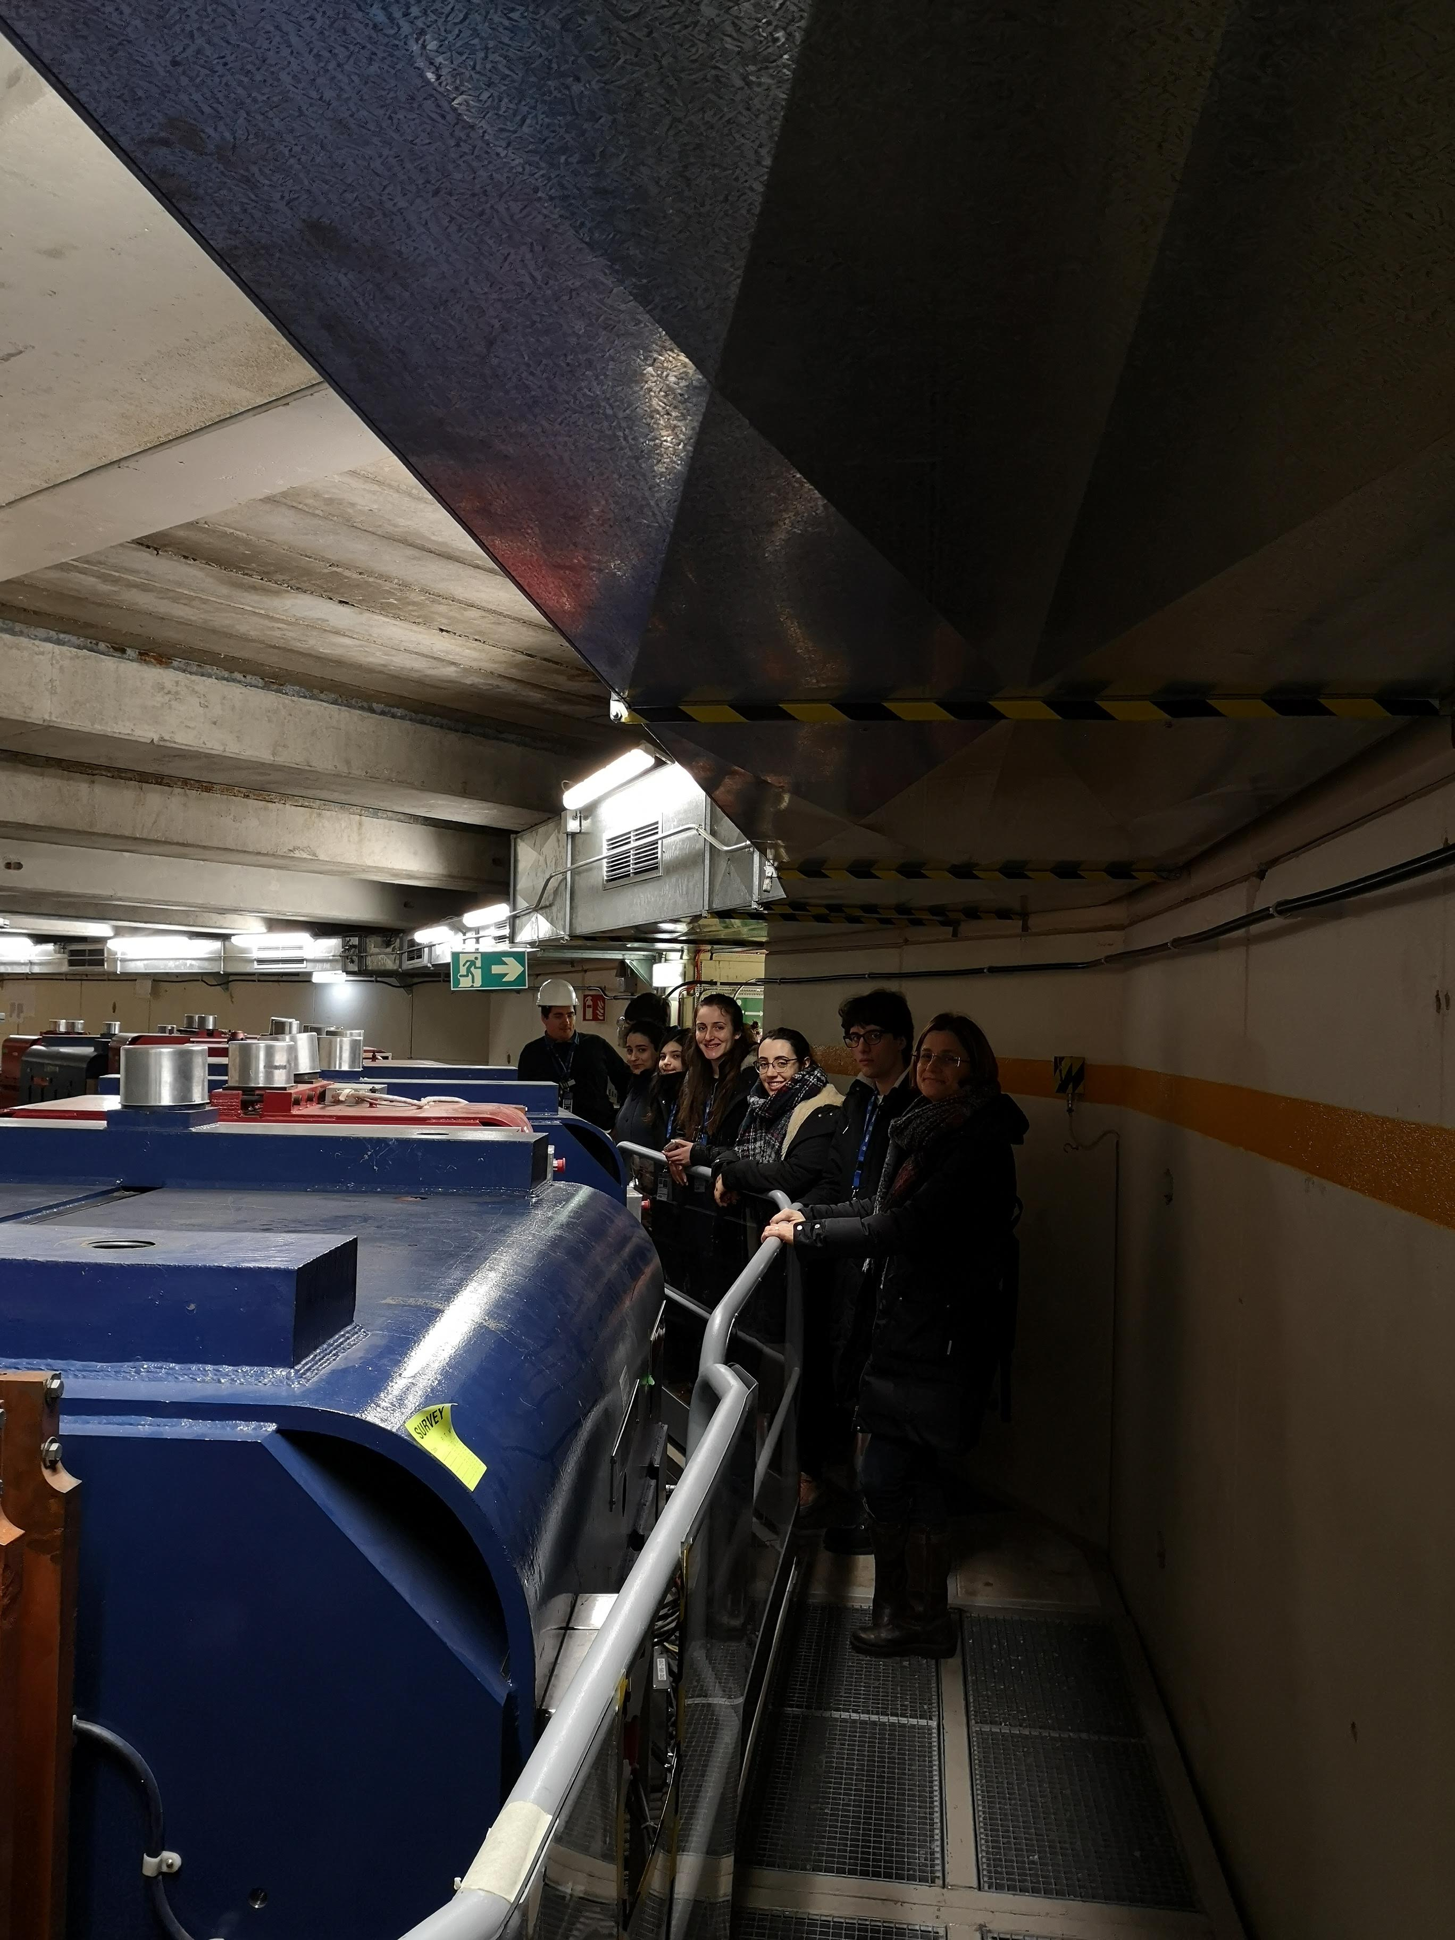
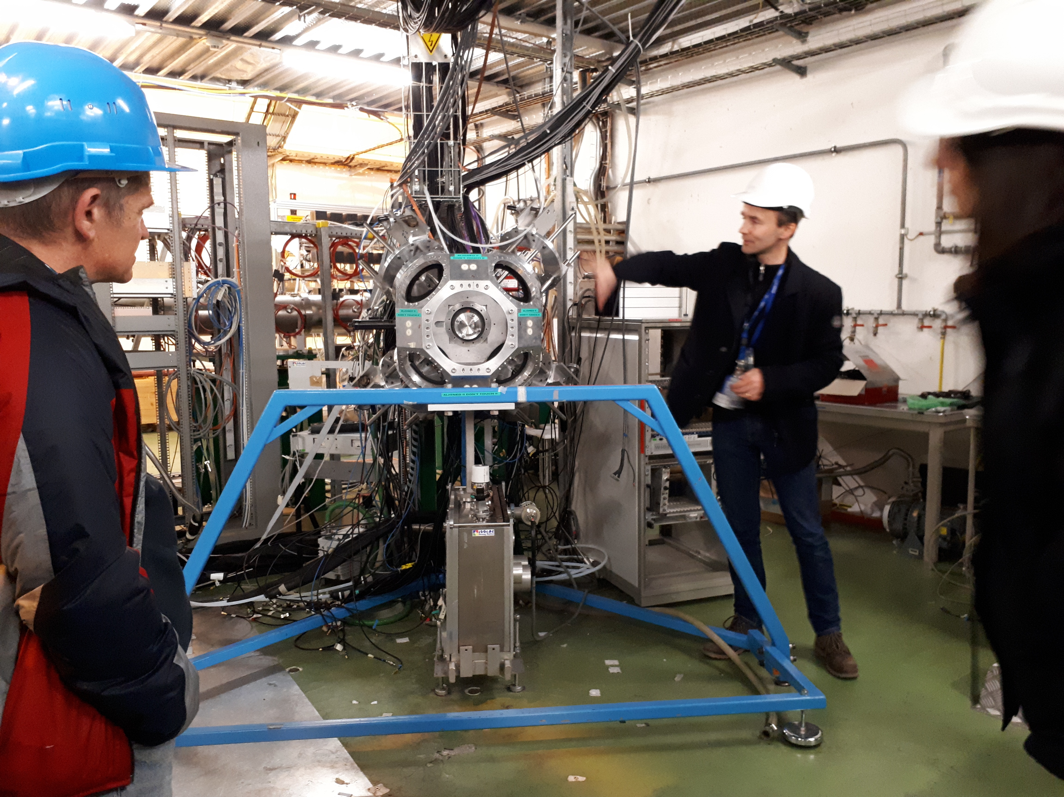
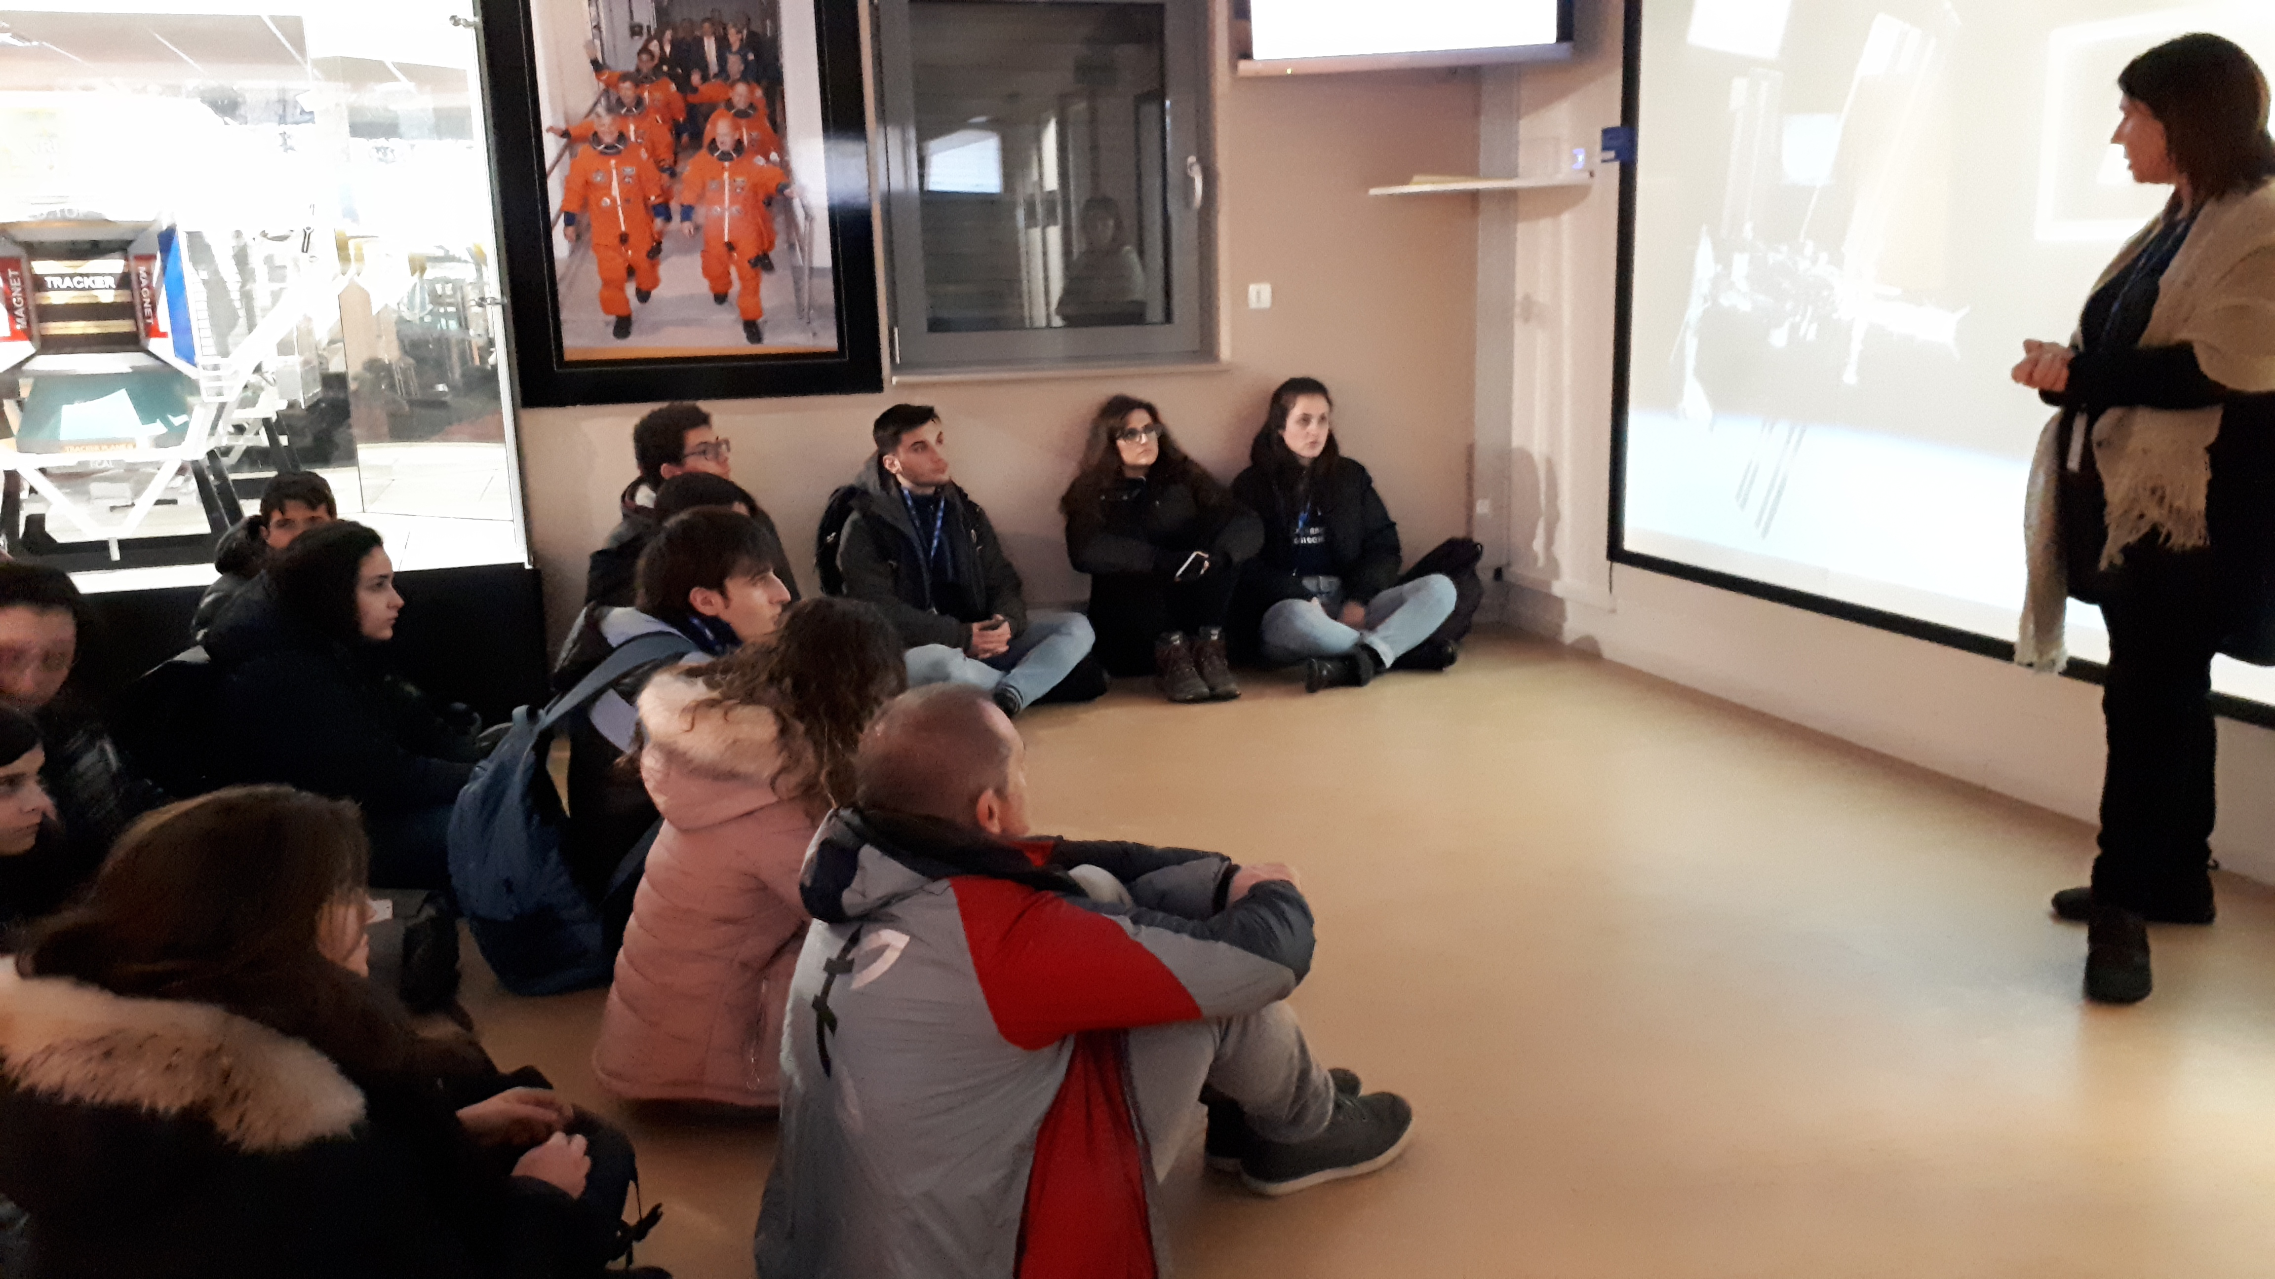
LHC and Beyond
Not your average CERN visit
Visits to experiments and CERN’s structures
The huge ones: ALICE, ATLAS
The fundings: Control room, Data Centre, Magnets, SC
Beyond the ring: ISOLDE, AD, n-TOF, AMS

Slide 15
Productivity is never an accident. It is always the result of a commitment to excellence, intelligent planning, and focused effort. (Paul J. Meyer)

Slide 16
Special thanks to:
Despina Hatzifutiadou, Marcello Abbrescia , Ivan Gnesi, Daniele De Gruttola, Roman Zuyeski, Lorenzo Galante

Slide 17
Thank you
Gabriella Serri
gabriella.serri@studenti.unica.it

Slide 18
Questions Comments Observations

Slide 19
Backup
…fino a questo segno!

Slide 20
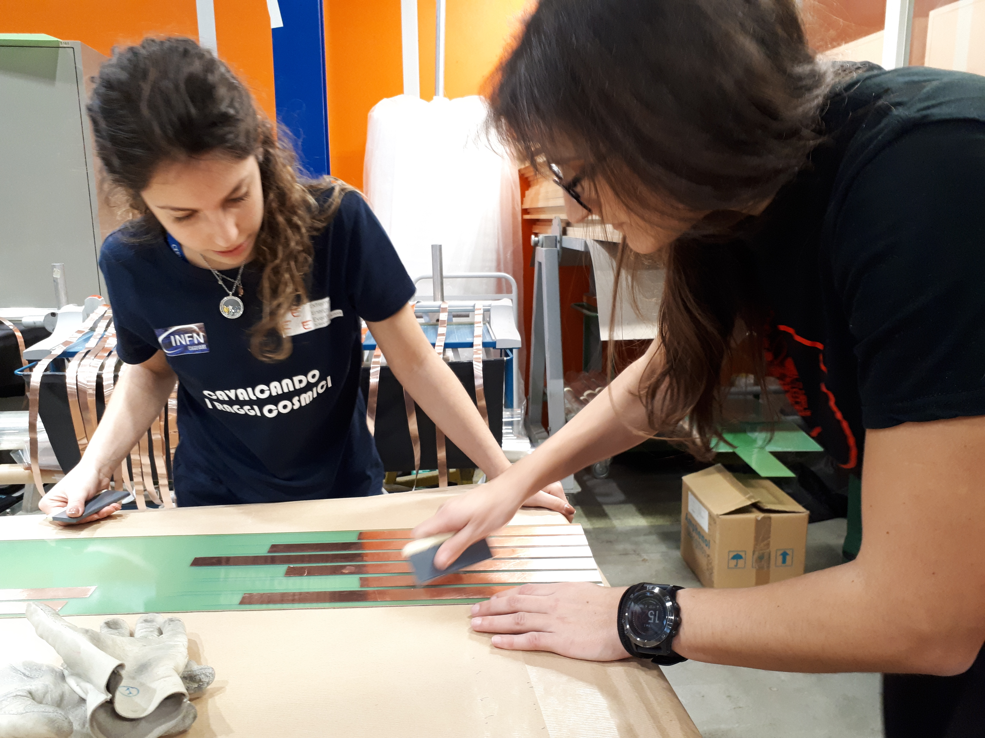
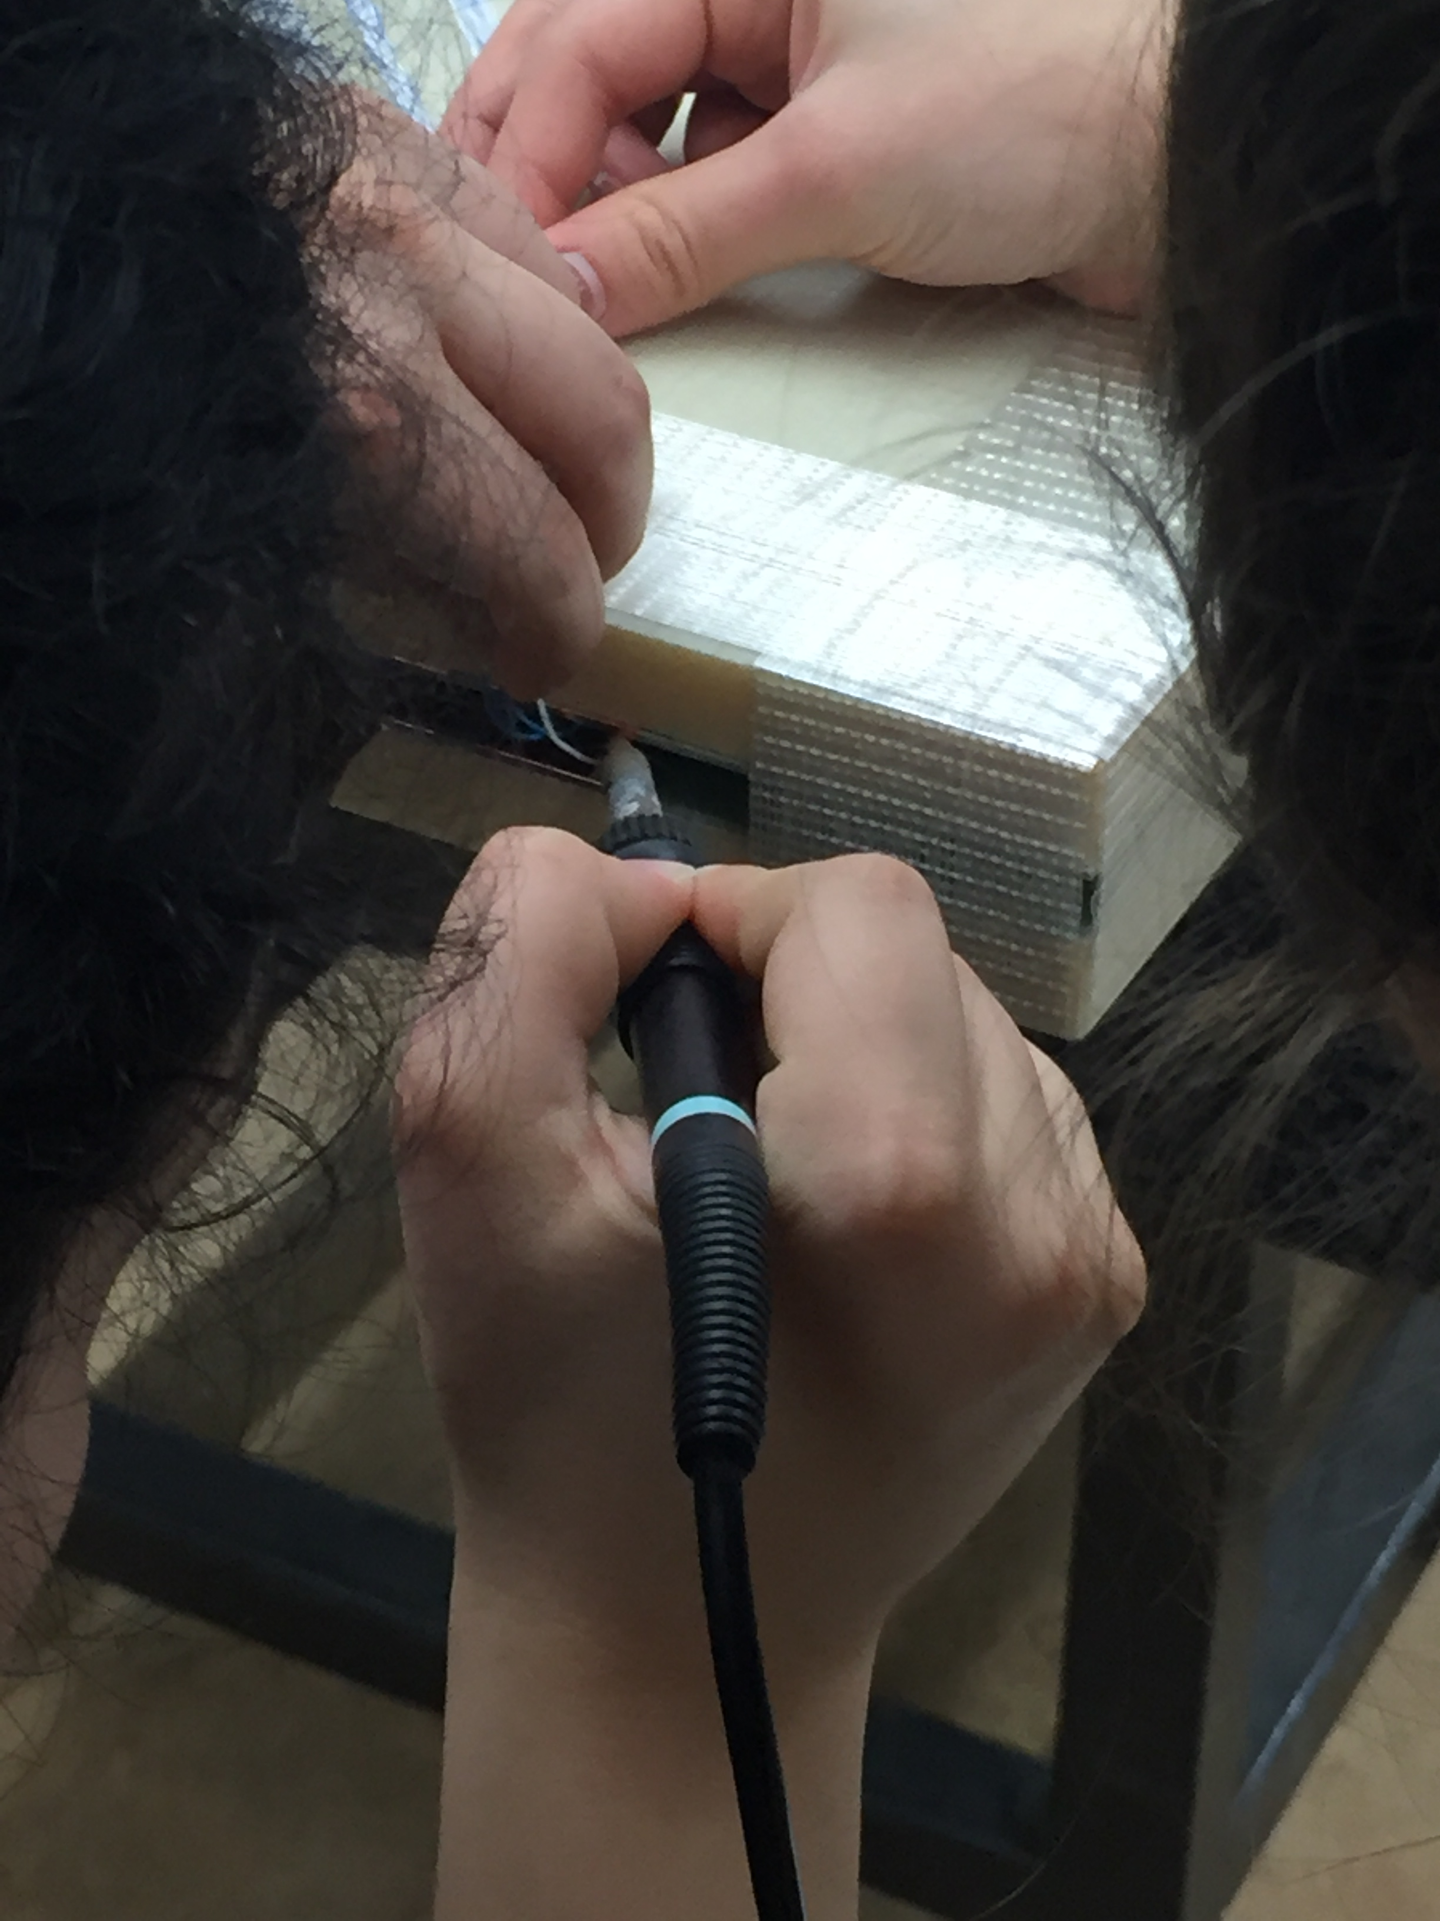
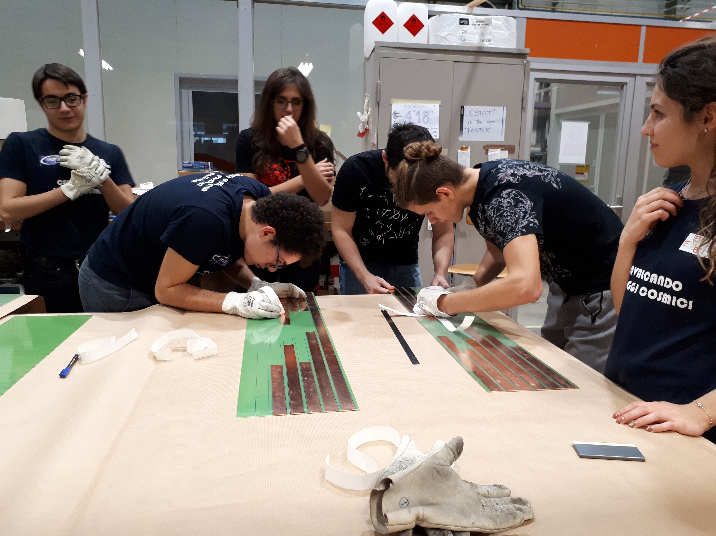
Chambers
Details matter

Slide 21
Achievements
Healthy competition
New Drawing Lines Record!

Slide 22
Test
Understanding
New FEA Polarity
Gas processes in Chambers
CERN01 Coordination
New trigger-GPS unit

Slide 23
“GITA” vs Stuctured program
Diritto vs Dovere
Gita
Progetto di istruzione
Completamento
Tempo adeguato: consolidamento precedenti conoscenze
Standard progetto: locale
Validazione: interna
Integrato nel programma scolastico
Fondamenta
Tempo adeguato: apprendimento nuove conoscenze
Standard progetto: competitivo
Validazione: esterna
Aggiunto al programma scolastico

Slide 24
Grazie&Arrivederci

