Slide 1
LICEO NICOLOSO DA RECCO
Efficiency measurement of Genoa’s telescope
Torino, 6-7-8 Marzo 2019
Notes:
14

Slide 2
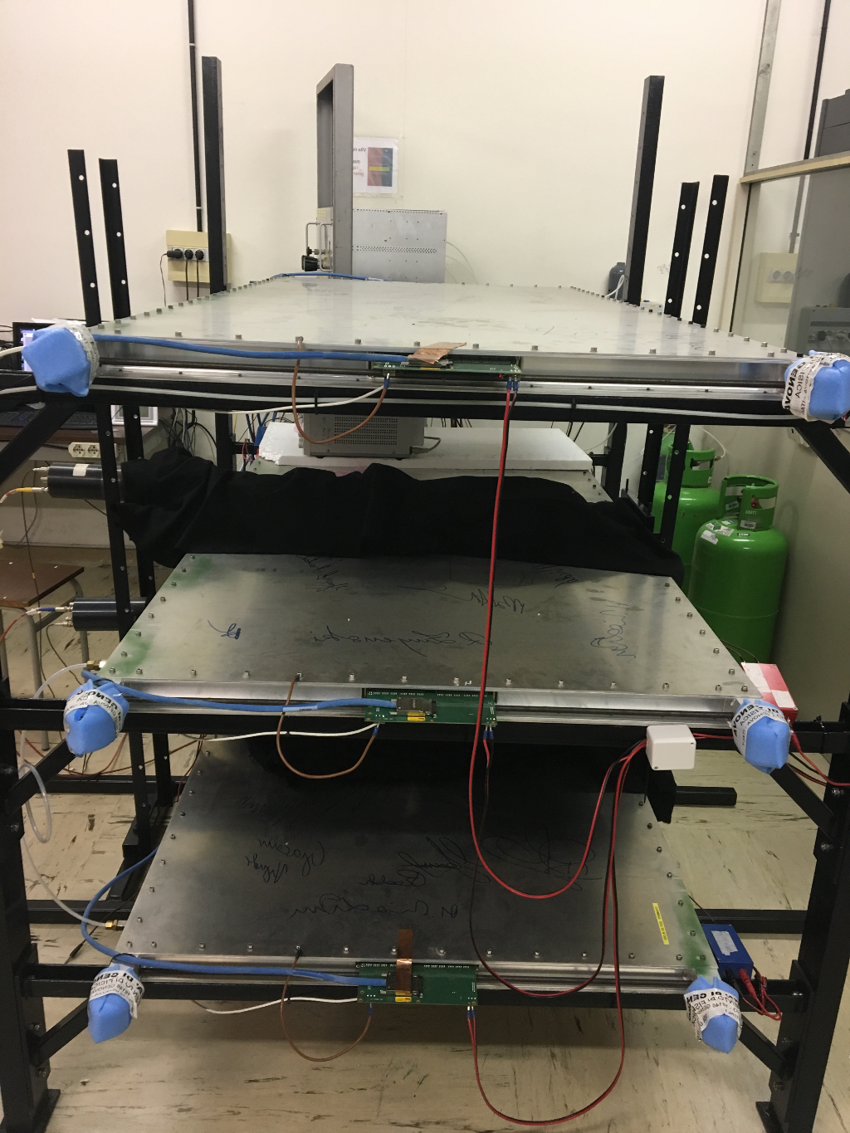
What we did in Genoa
We spent three days collecting data in order to calculate the efficiency of the telescope.
Notes:
14

Slide 3
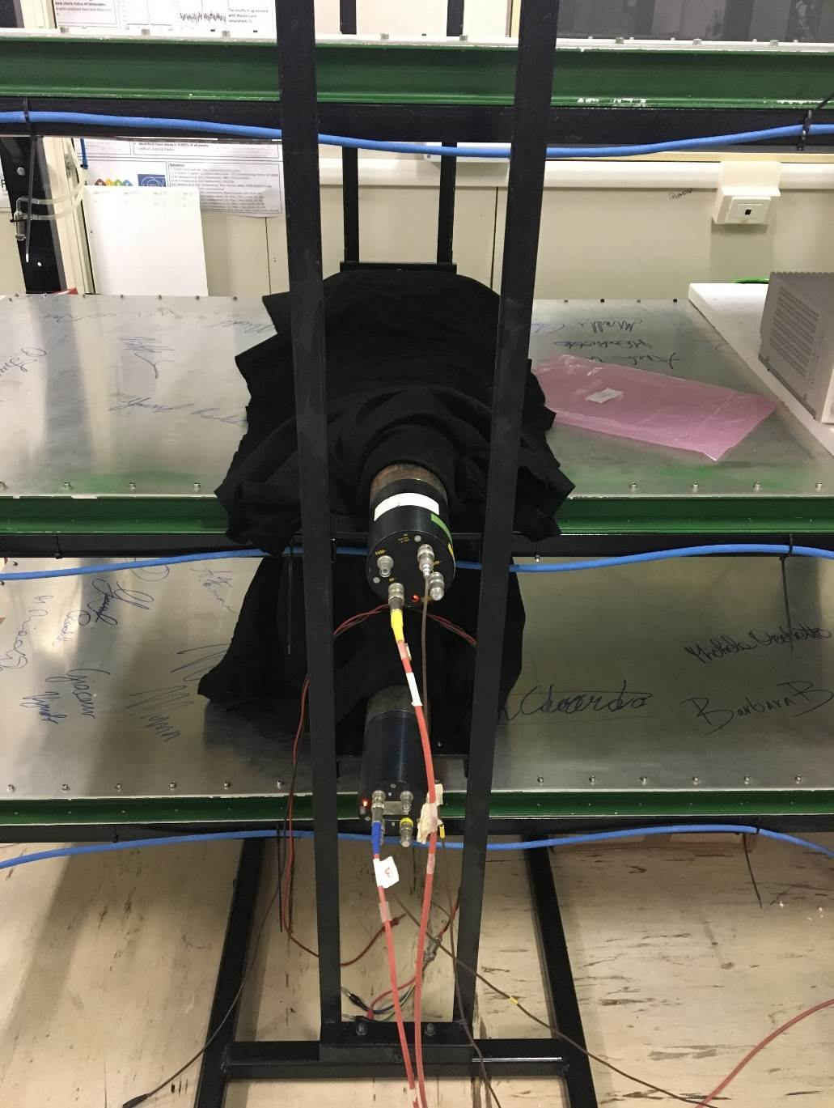
First setup
Coincident Scintillator
Chamber
Coincident Scintillator
Notes:
14

Slide 4
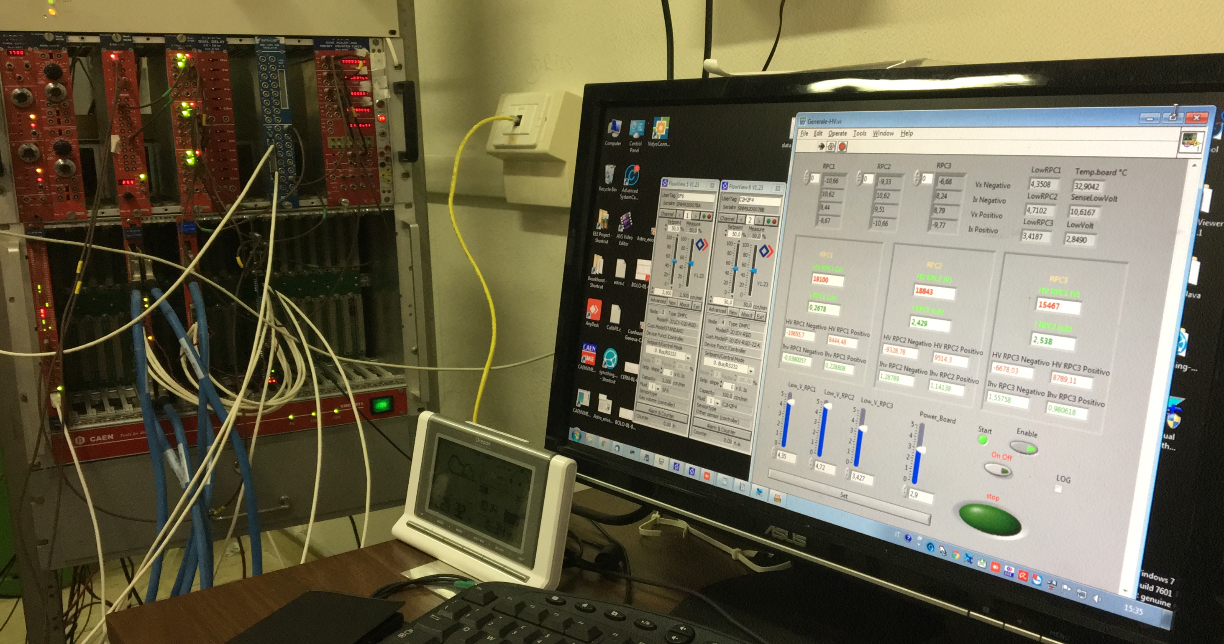
Voltage cursor
Notes:
14

Slide 5
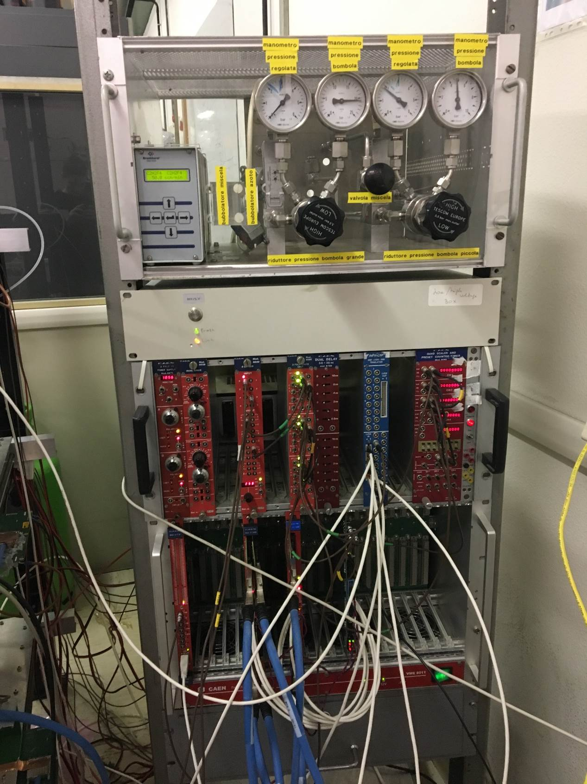
Data collecting
Each measurement lasted two minutes. After a minimum of 6 measurements we changed the voltage of the chamber.
Reset buttons
Notes:
14

Slide 6
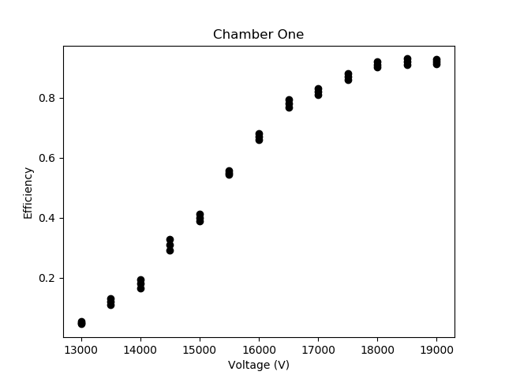
Chamber 1
Efficiency = n° events chamber/n° events scintillator
→ best range of Voltage
Notes:
14

Slide 7
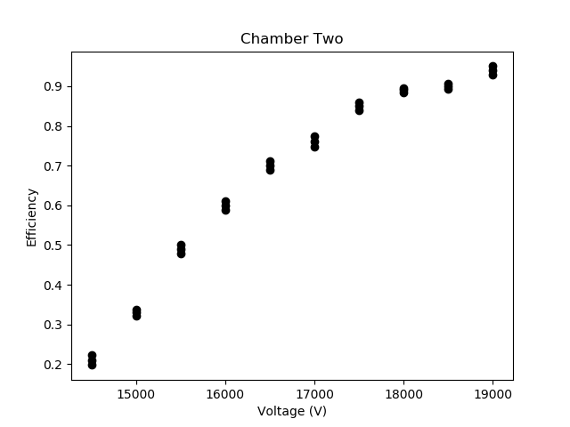
Chamber 2

Slide 8
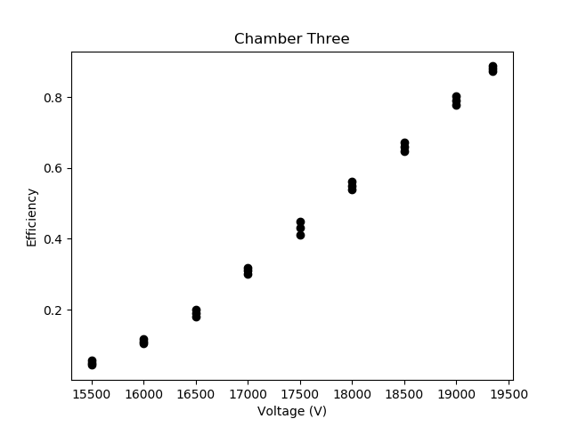
Chamber 3
Notes:
Diverso. Ci si aspetta una poissiana dopo i 19000 V. Errore perché voltaggio a schermo diverso da quello effettivo
<numero>

Slide 9
RESULTS
Presuming a 100% efficiency of scintillators: max. efficiency 1° chamber = 0.8 → around 18000 V max. efficiency 2nd chamber = 0.8 → around 18000 V max. efficiency 3rd chamber → we should redo the measurement

Slide 10
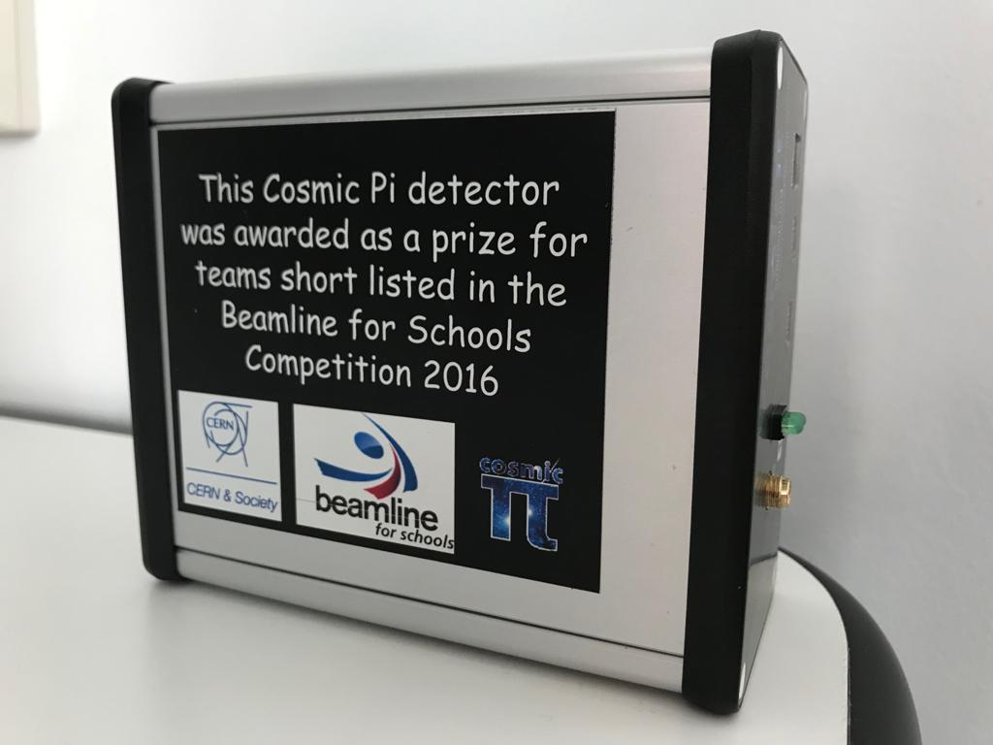
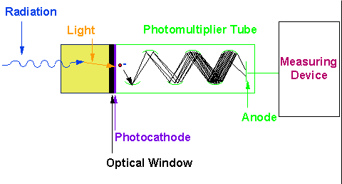
Cosmic π detector
In 2016 our school participated at BL4S (Beamline for Schools) competition. As a prize for team short listed we were given the Cosmic Pi detector. (V 1.0)
Its dimensions are: 10 cm x 12 cm x 5 cm (6,5cmx6,5cm scintillator)

Slide 11
NOISE
Noise is any unwanted signal participating in a communication or measure circuit, that tend to confuse the expected signal.

Slide 12
VARIABLES
In order to verify if any change of the variables could have some influence on the noise, we made several experiments, each time changing the conditions of:
Temperature (under a temperature of 13°C the detector seems not to work)
Light (we tried to cover the box with different materials)
Power source (we tried both with a battery and electric supply)
Lead shielding (we tried to reduce the flux of muons by using a lead cube)

Slide 13
Lead shielding
Thickness: 11 cm ; Weight: 50 kg
 | Without Pb | With Pb
Duration (sec) | 771 | 922
Number of EVT | 905 | 1049
Frequency (Hz) | 1.1738 | 1.1377

Slide 14
HELP
We would like to calibrate our cosmic box using the Genoa’s telescope.
Have you had our same problem? If so, have you been able to solve it?
Notes:
Errori nei grafici diversi perché ci sono più o meno misurazioni
<numero>

