Slide 1
CAGL-02 / CAGL-03 Liceo scientifico Michelangelo & Liceo scientifico Alberti
present . . .
Benedetta Pitzalis, Luca Mascia Liceo Michelangelo Gabriele Todde, Leonardo Porcu Liceo Alberti
Torino, March 8th, 2019

Slide 2
. . . Status EEE project and the NURAXI FIGUS acquired data . . .

Slide 3
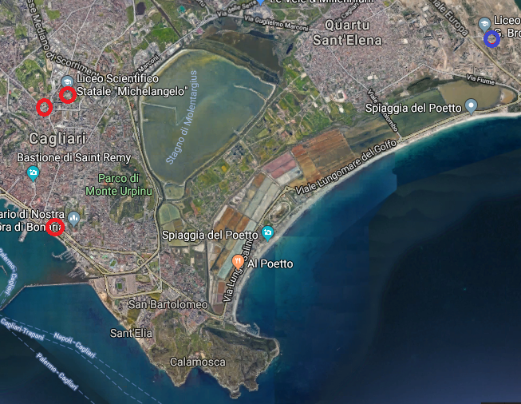
EEE Telescopes status
4 telescopes presently in Cagliari and Quartu Sant’Elena
3 taking data, 1 installed
5 schools involved

Slide 4
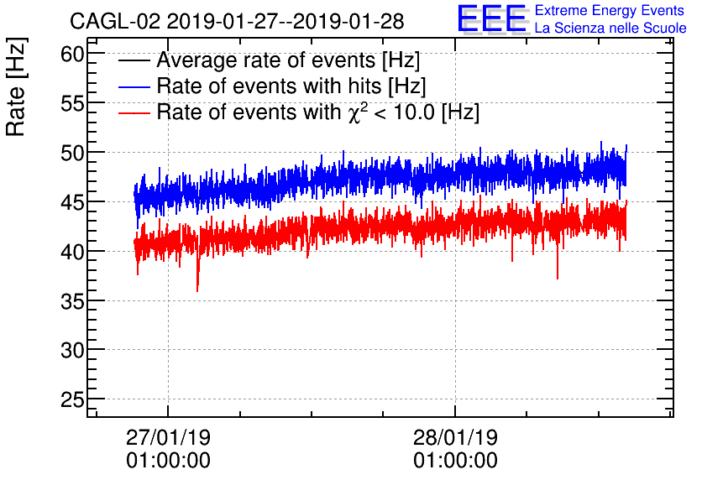
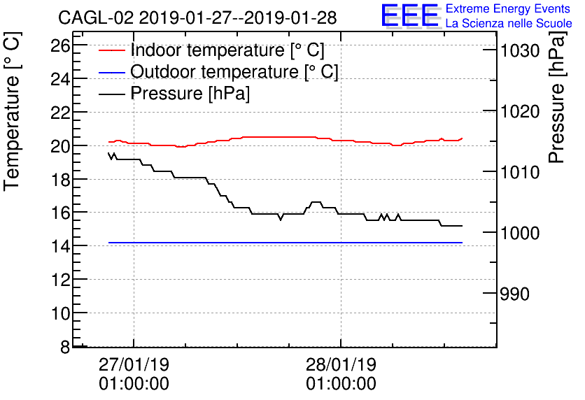
EEE Telescopes status CAGL-02

Slide 5
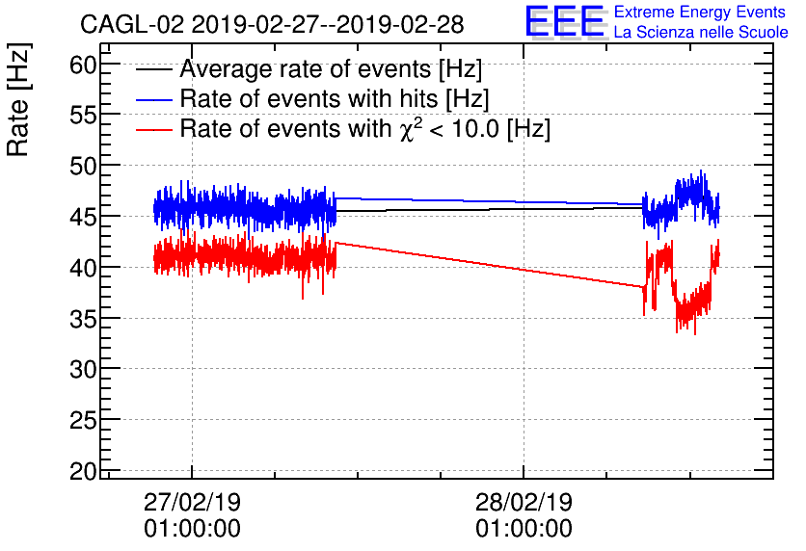
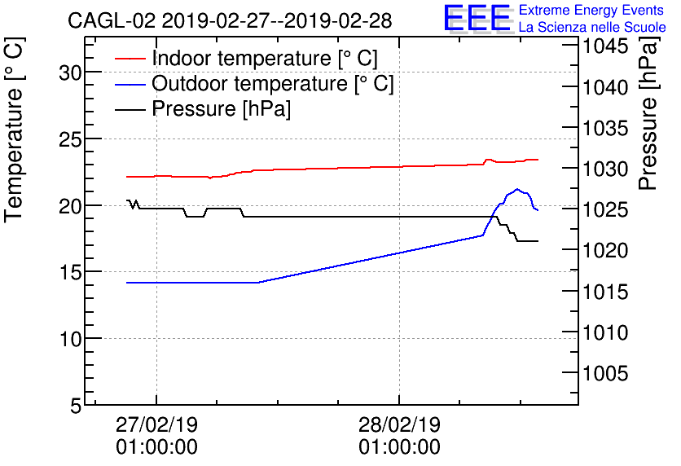
EEE Telescopes status CAGL-02

Slide 6
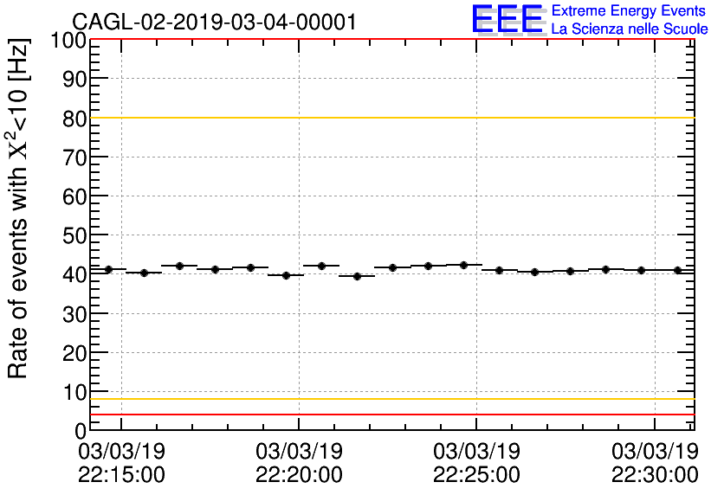
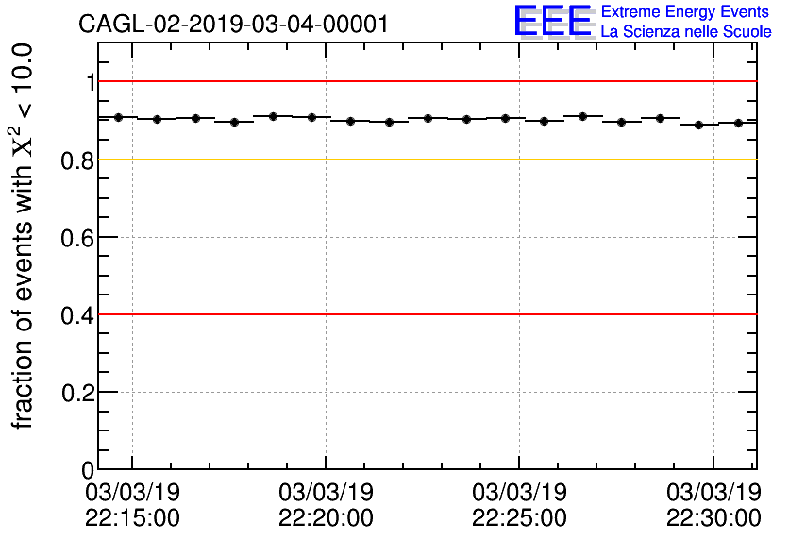
EEE Telescopes status CAGL-02

Slide 7
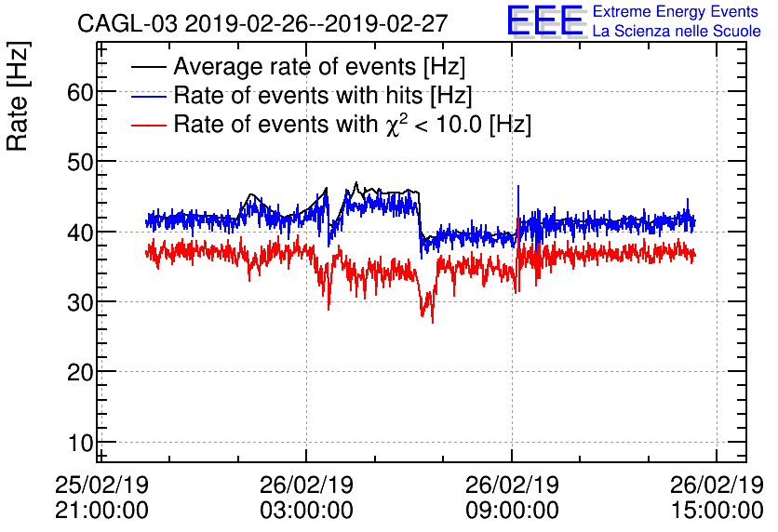
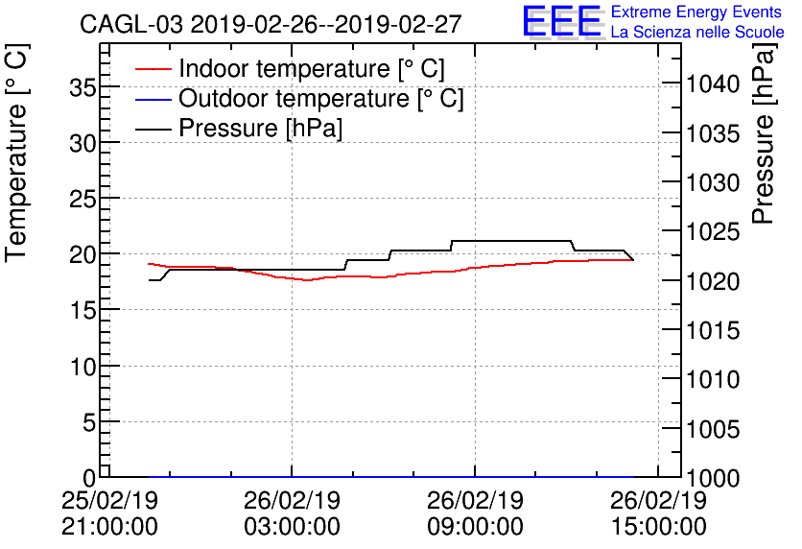
EEE Telescopes status CAGL-03

Slide 8
UNDERGROUND MEASUREMENT
Ongoing activity
What’s the purpose of the measurement? Observe the correlation between muon flux and depth with 3 cosmic boxs.
What do we expect? An exponential decrease of flux ( approximately of one magnitude every 100 meters of depth )

Slide 9
Nuraxi Figus – Seruci mine

Slide 10
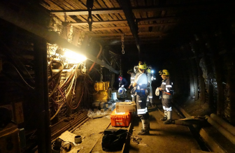
NURAXI FIGUS
Started in 1930 1976: control of «carbosulcis» Connection of the old mine of Nuraxi Figus and Seruci
Why are we using this mine? -Because it is 500m deep and with many galleries at different depths. -We know the average density of rock, which is an important parameter for the muon flux. -It’s easy to move aside, it’s constantly monitored, and there is electricity.

Slide 11
The ARIA Project
A 300m high column for distillation of Aragon 40 will be placed in the mine. This gas is going to be used in the «DarkSide» project, Which has the obkective to observe dark matter particles. After the period of distilaltion the colimn will be used from other companies to distillate other gasses.
Our measurement could also provide information about the amount of ionizing radiation, which plays an important role int he process of distillation.

Slide 12
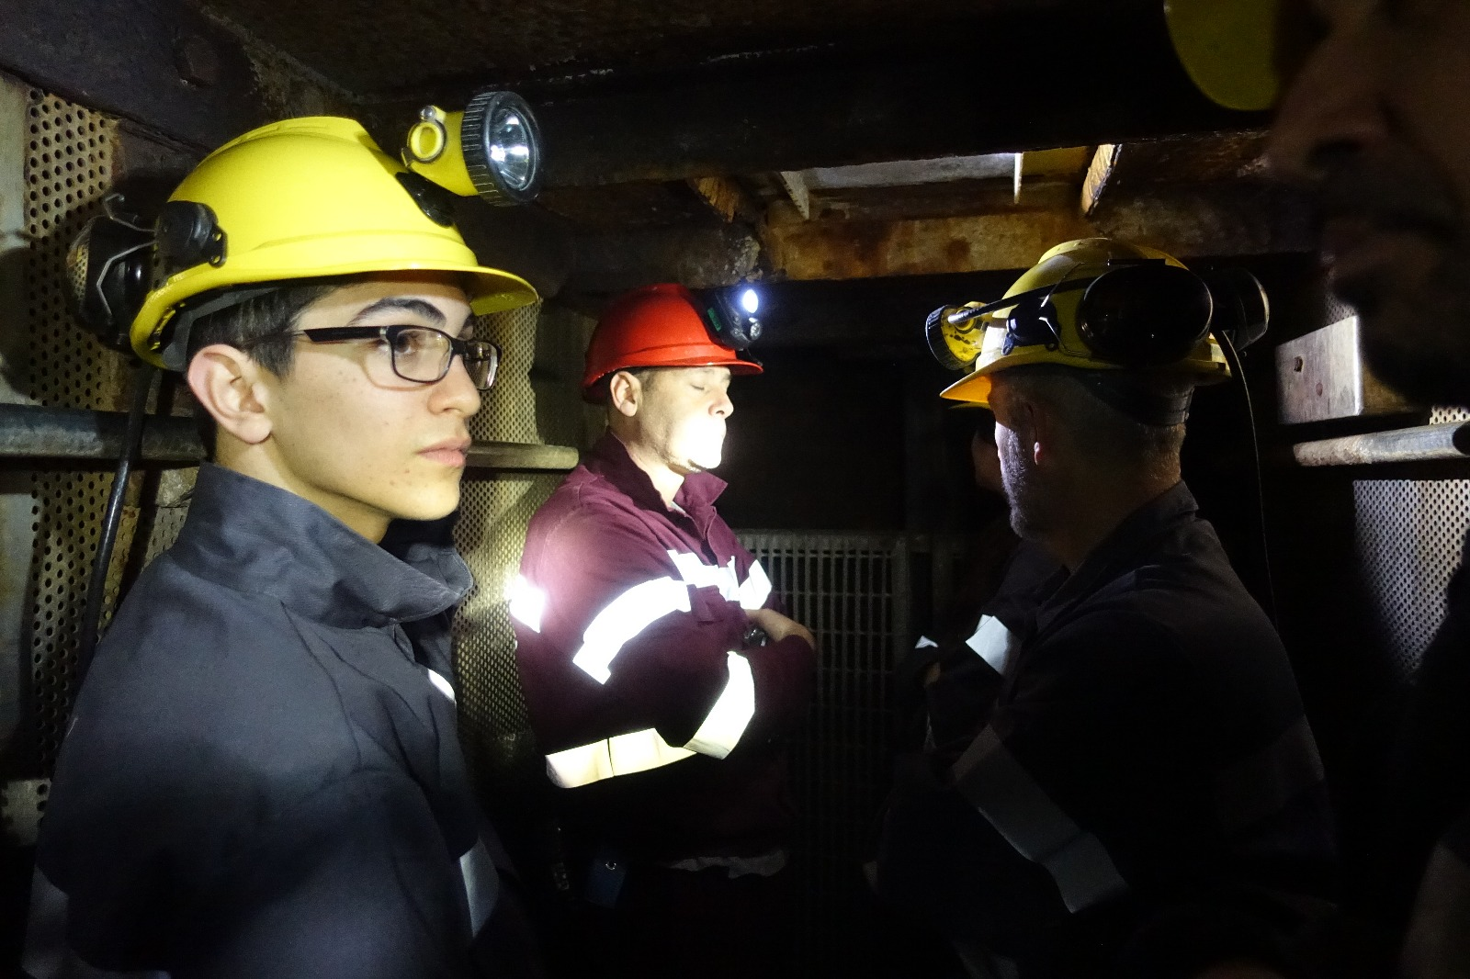
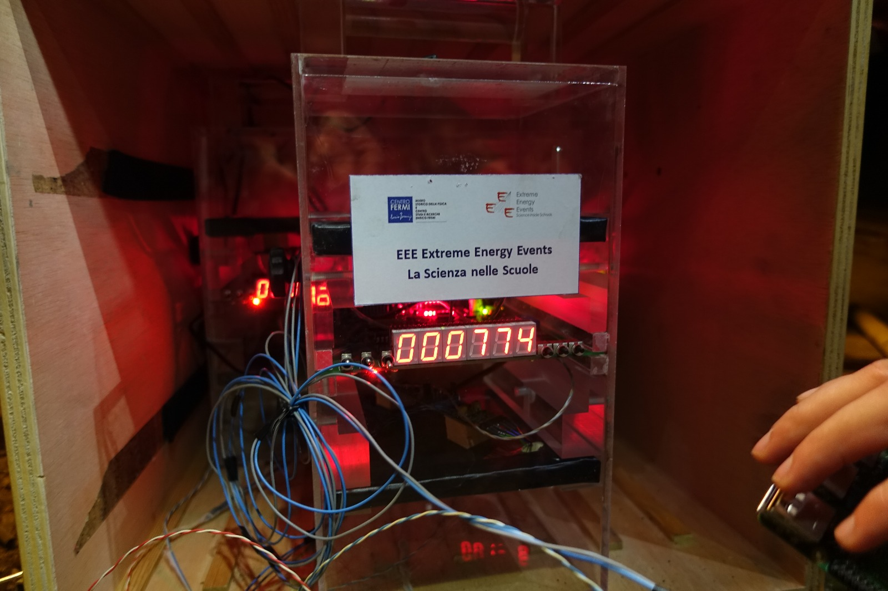
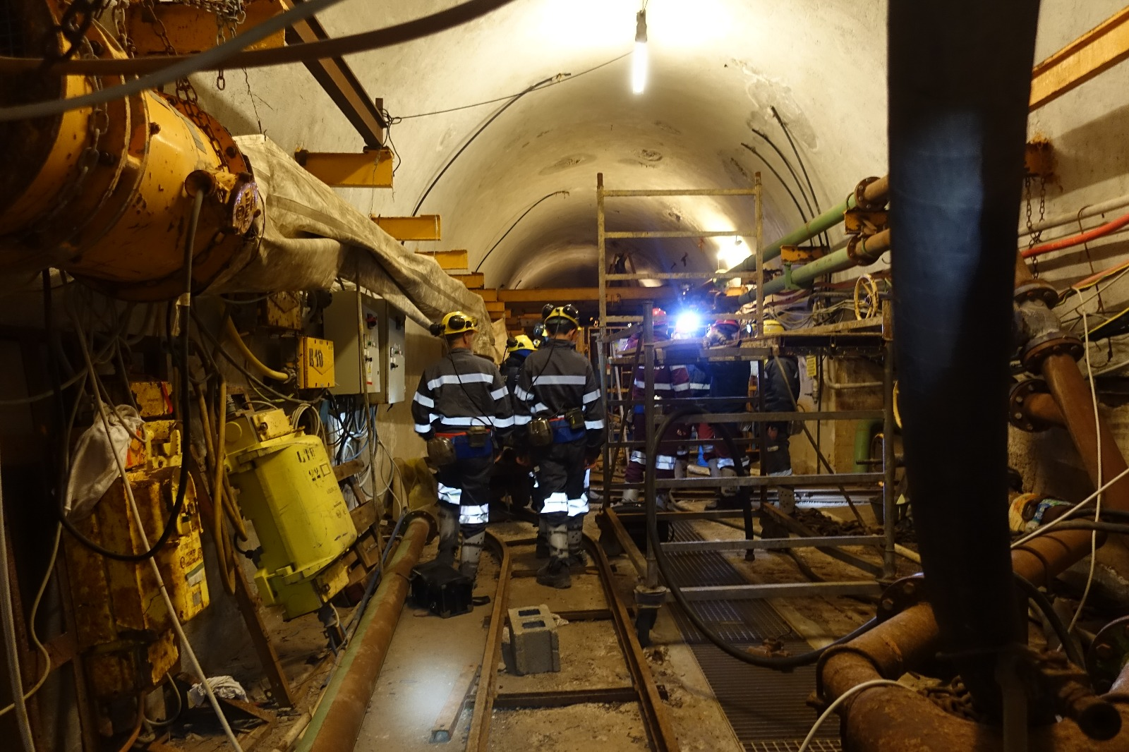
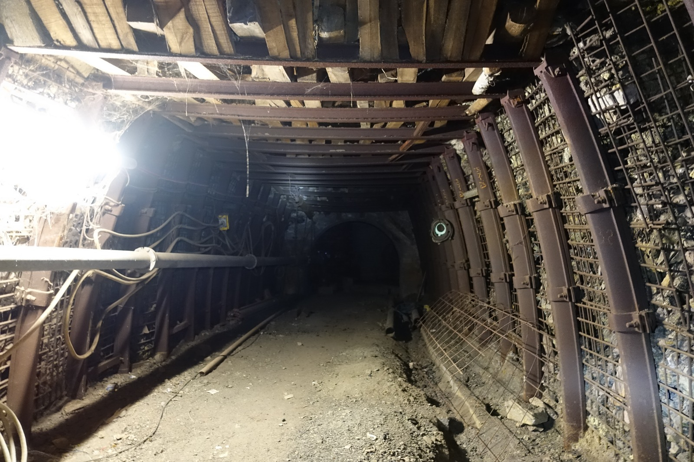

Slide 13
Thank you for your attention!

