Slide 1
ASTRO COSMO and the Physics Afternoons at Pascal's
Dr.Massimo Perucca
Blaise Pascal Institute, Giaveno-TO (ITALY)

Slide 2
Outline
Brief presentation of the Institute Blaise Pascal, Giaveno (TO)
The project aim and drivers
Challenges, strengths, difficulties and lessons learned
The project history and possible future developments within the framework of the EEE project

Slide 3
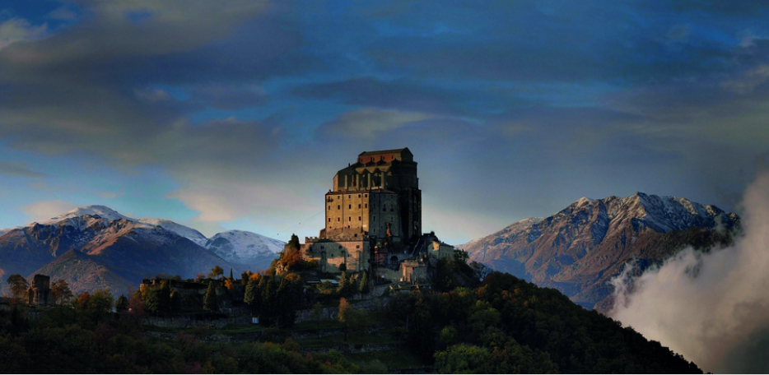
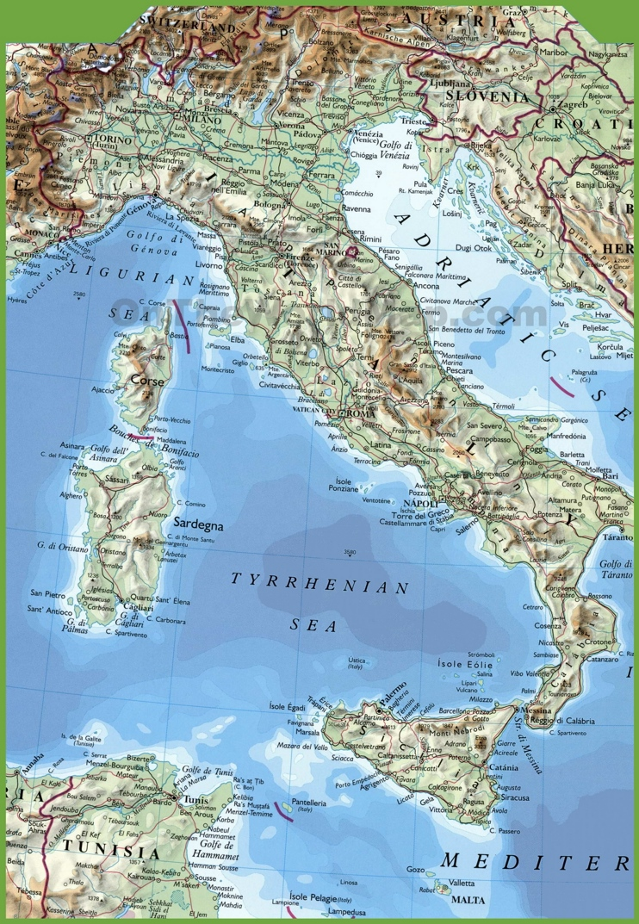
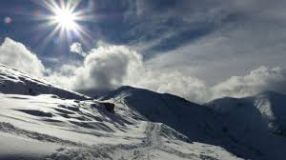
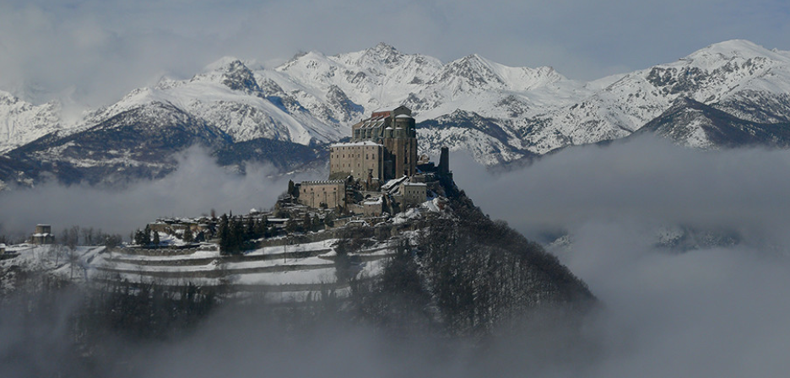
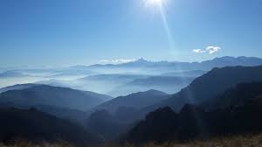
Ist.B.Pascal: where

Slide 4
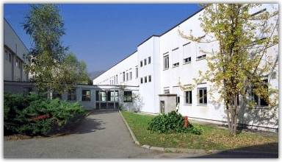
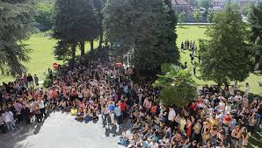
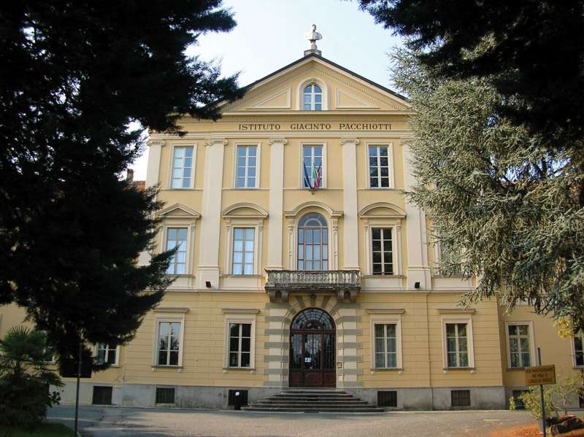
B.Pascal: hystorical highlights
Y 1974-75 born as a branch of the Institute ITCG “Galilei” di Avigliana,
A.S.1982-83 independent Public Insitute with «Maxi-sperimentazione» program
A.S.1992-93 «sperimentazione Brocca» program for the scientific, linguistic and economy & finance courses

Slide 5
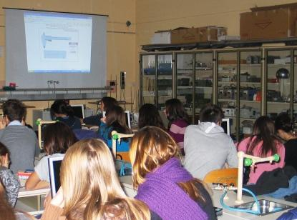
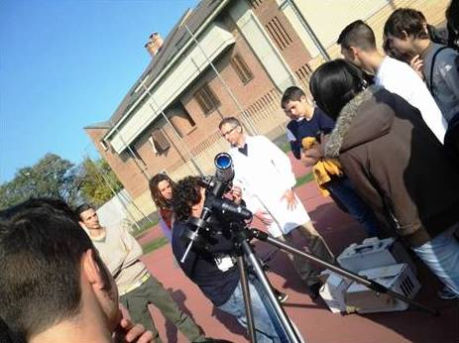
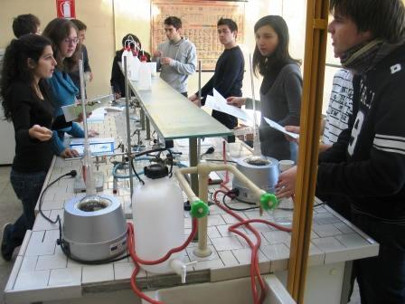
Historical highlights & current features
Now the institute has got a 4000sqm covered surface
Equipped with n.5 scientific labs and one linguistic lab
Serves more than 1200 students
Since the early 2000 progressive increase of the scientific courses, now up to 7 sections

Slide 6
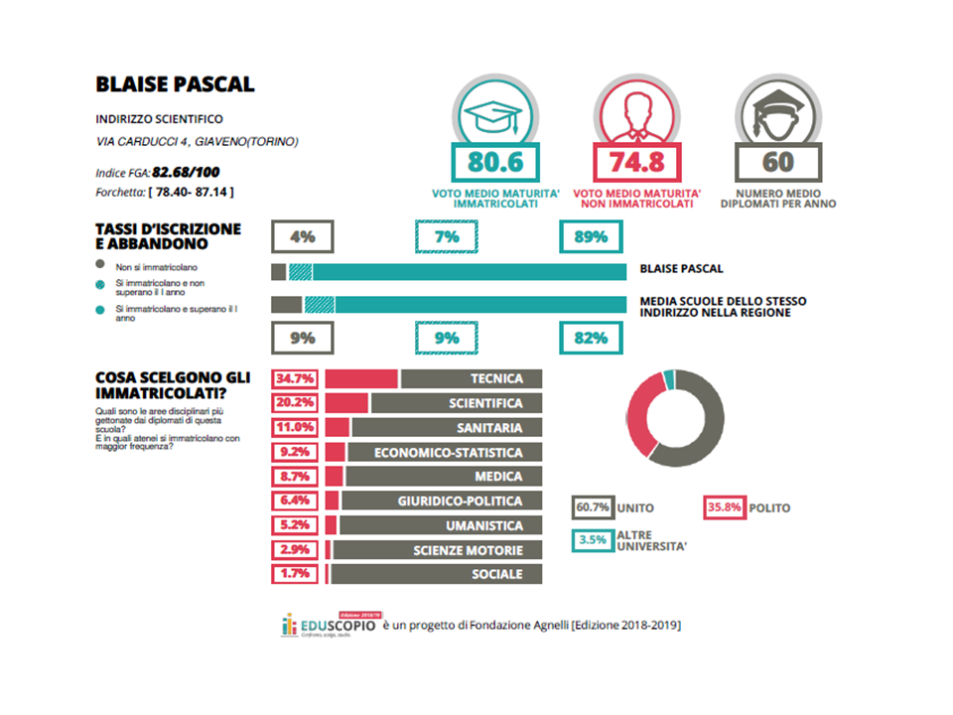
Scientific course: profiles and carriers

Slide 7
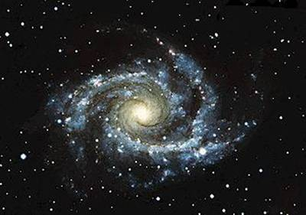
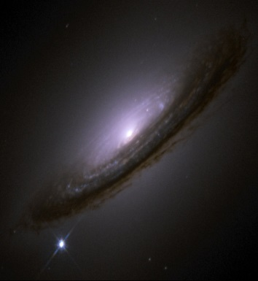
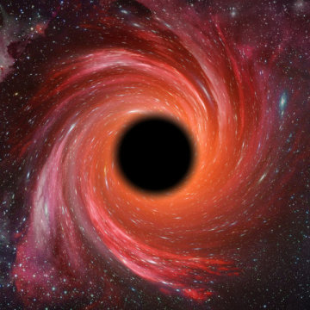
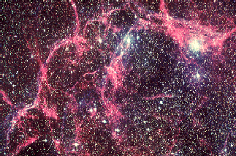
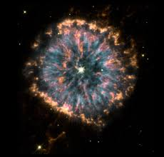
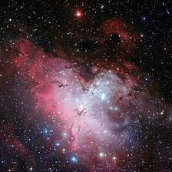
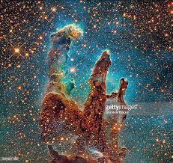
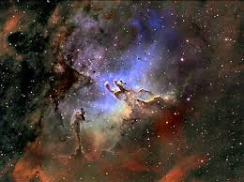
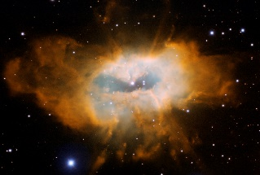
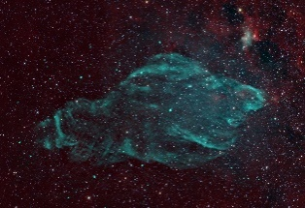
ASTRO-COSMO: a more than 15 years story
From “The Physics Afternoons at Pascal’s, to the nights of Astronomy, up to ASTRO-COSMO 2019: experiments mountain expeditions for astronomy observations, events and experts talks…

Slide 8
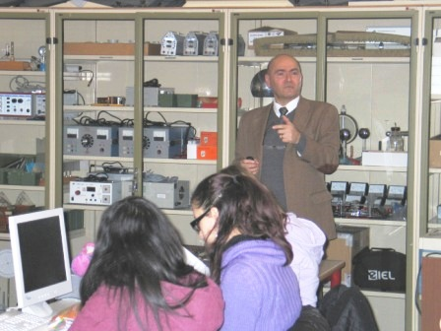
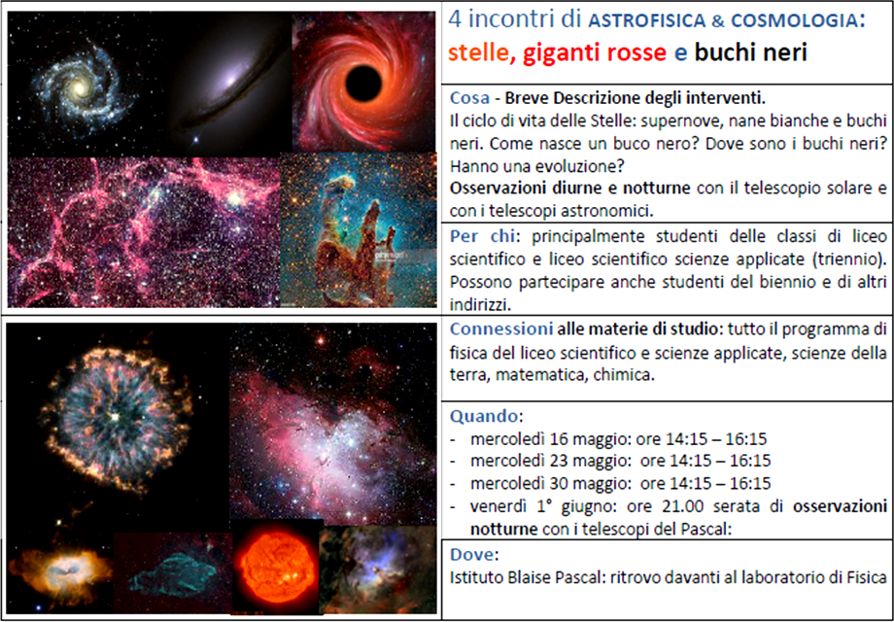
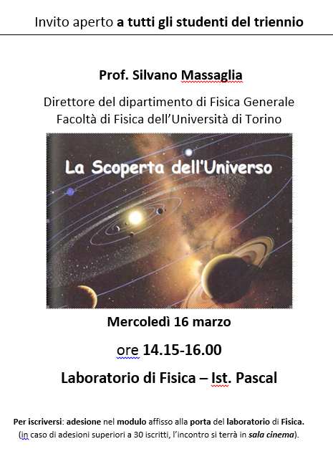
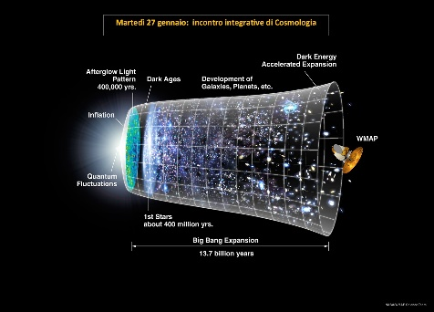
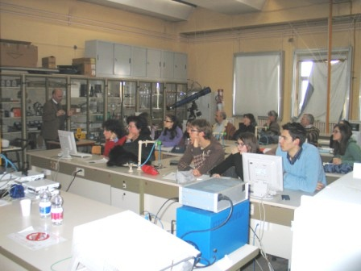
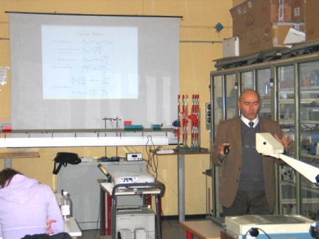
«towards the discovery of the Universe»
Y 2011-2012 Scientific talk of Prof.Silvano.Massaglia Director of the General Physics Department, University of Turin

Slide 9
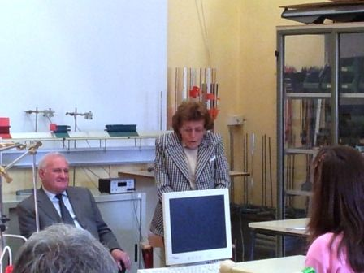
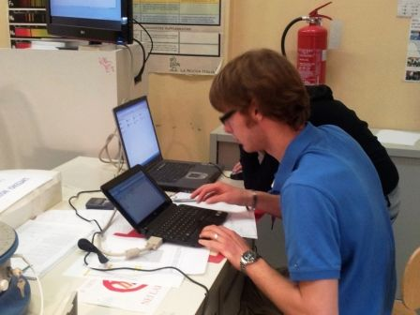
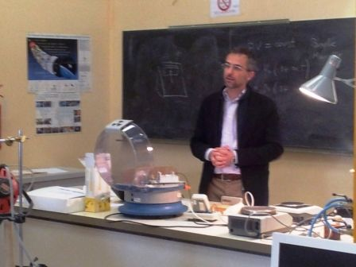
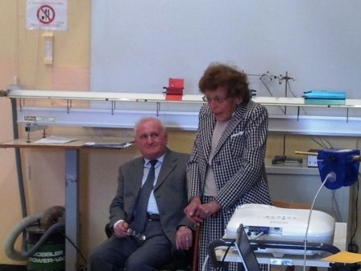
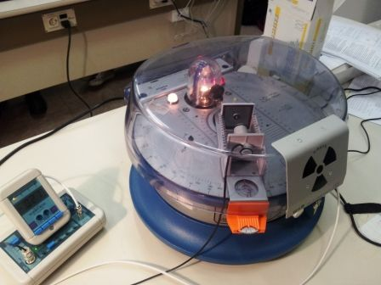
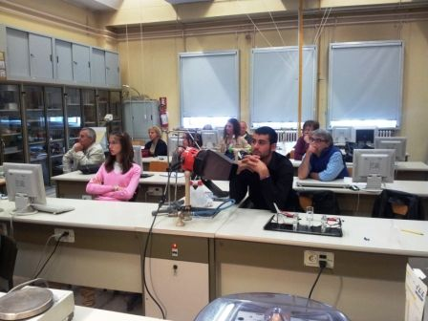
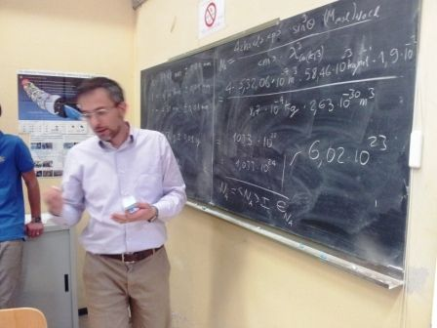
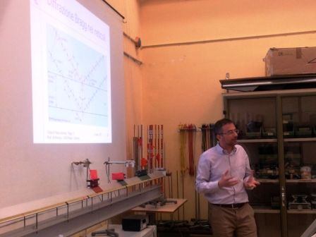
Amedeo Avogadro and Avogadro’s Number determination by experimental means
Prof.Lidia Nuvoli, descendant of Amedeo Avogardo, presents the life and the work of Amedeo Avogadro

Slide 10
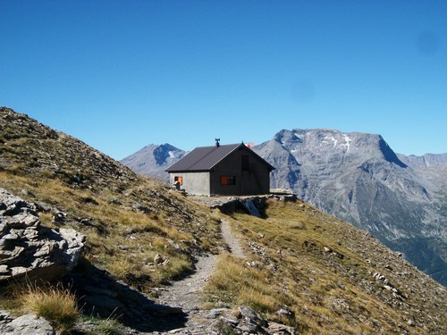
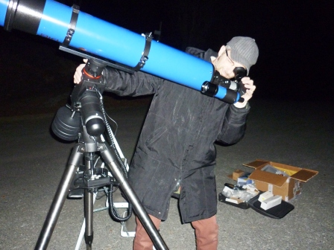
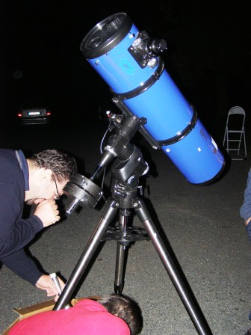
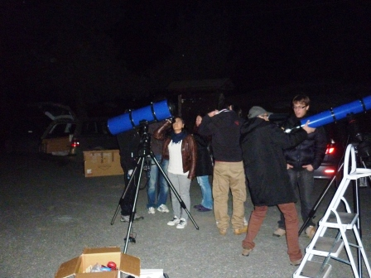
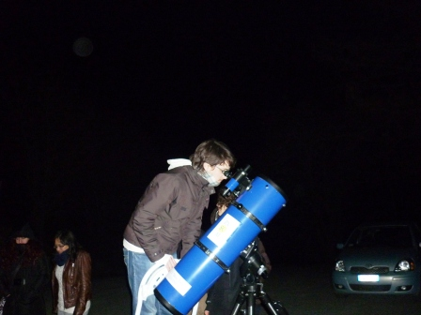
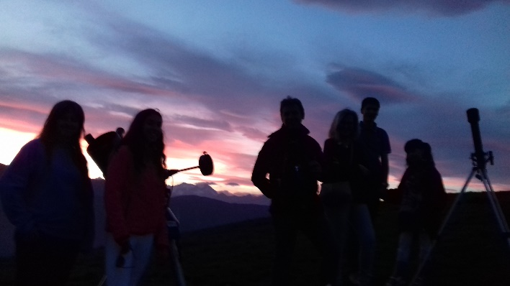
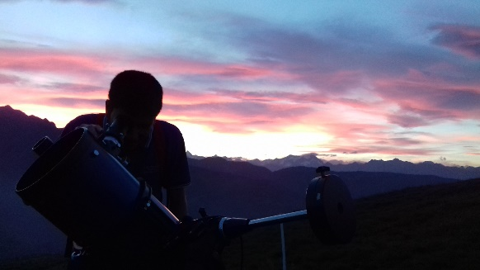
Astronomical observations from mountain sites
Ys 2010-2018 Astronomical observations from: Prarotto quota 1350m amsl , Stellina shelter 2610m amsl , Col del Lys 1311 m amsl , Mount Aquila 2500 m amsl

Slide 11
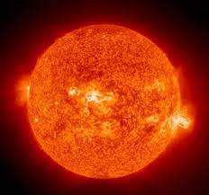
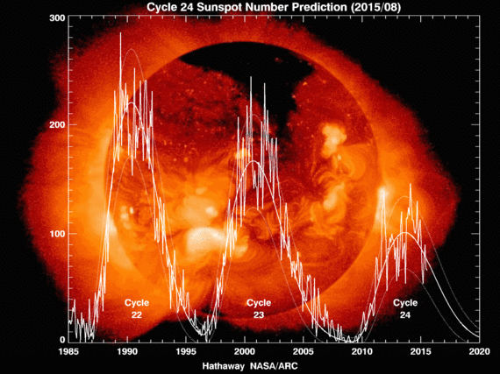
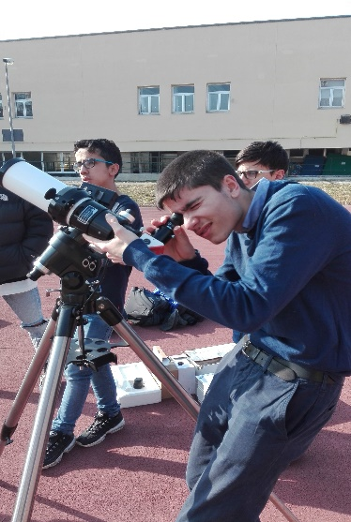
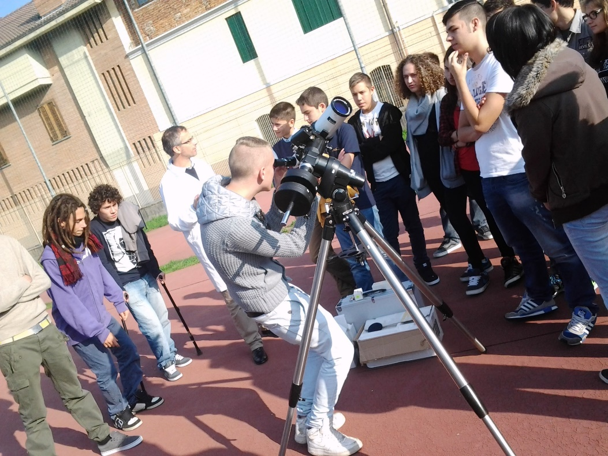
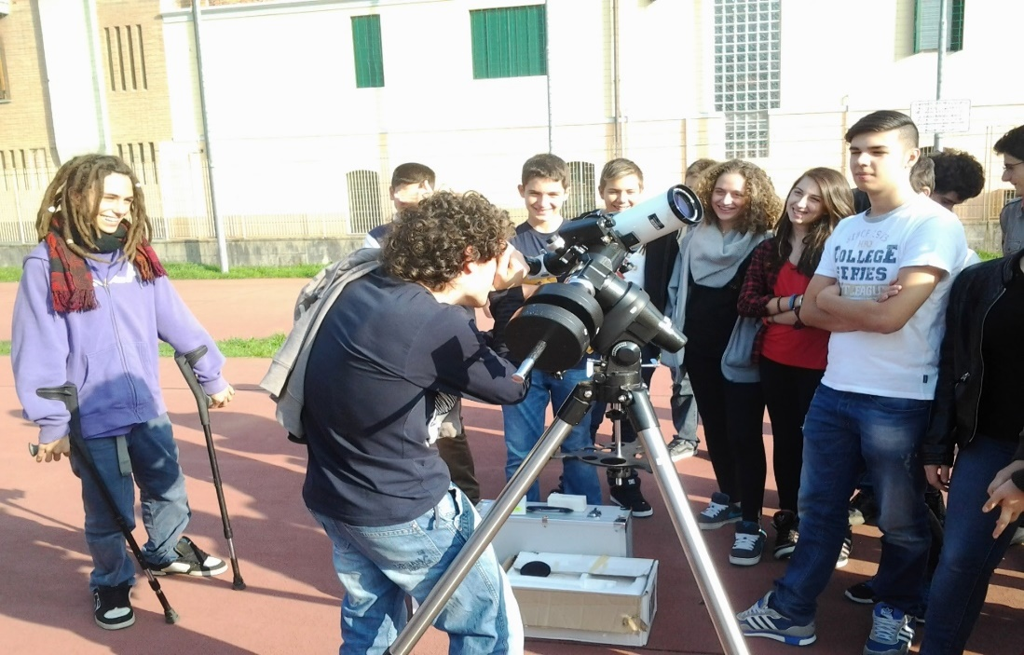
Observations of the Solar chromosphere and solar corona
Y 2013-2014 big solar flares, plumes and sun spots seen in Hα
Y 2018-2019 observations of more quiescent sun

Slide 12
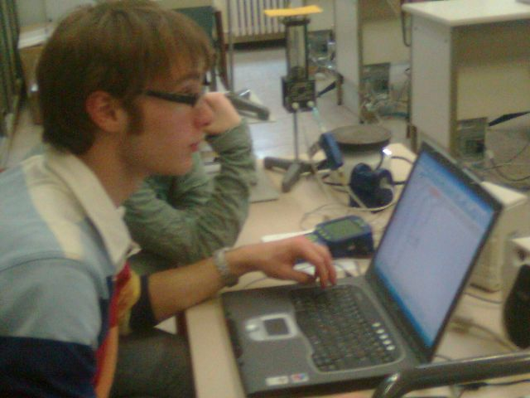
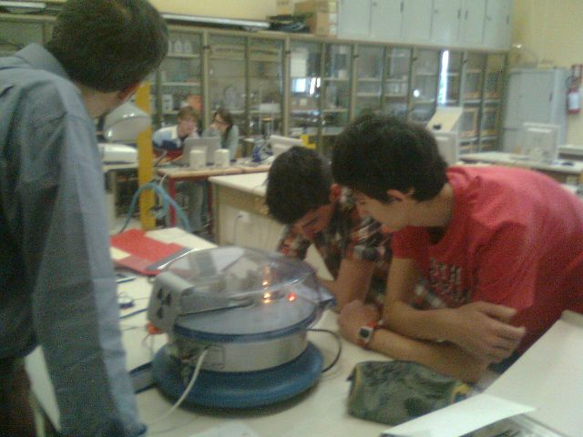




X-rays diffraction and the the solid state

Slide 13





Superconductivity
Y 2012-2013 Talk by Dr. Paola Pecchio and low temperature resistivity measurements with liquid Nitrogen

Slide 14
One of the former programs
M1 | 1-Modulo AC: Corso di astrofisica e cosmologia (con l'utilizzo del web e del lab ed intervento di esperti esterni ed osservazioni astronomiche)
M2 | 2-Modulo X: Corso di raggi X e struttura della materia allo stato solido (con esperienze di laboratorio)
M3 | 3-Modulo PGI: Fisica del plasma e gas ionizzati (con esperienze di laboratorio ed osservazioni della cromosfera solare)
M4 | 4-Modulo A-US: Acustica e Ultrasuoni: dalla musica all'ecografia con esperienze di laboratorio)
M5 | 5- Modulo NMR: l'atomo ed il nucleo risonanza magnetica nucleare e di spin (con esperienze di laboratorio)
M6 | 6- Modulo NT: Intoduzione alle nanoscienze ed alle nanotecnologie
M7 | 7- Modulo O-M: Elettromagnetismo ottica e microonde (con esperienze di laboratorio)
M8 | 8- Modulo S: Superconduttività e levitazione magnetica (con esperienze di laboratorio ed intervento di esperti esterni)
M9 | 9- Modulo M-C: Introduzione alla meteorologia e Climatologia
M10 | 10- Modulo M&S: metodi di misura e metodi statistici per le scienze sperimentali (con esperienze di laboratorio)
M11 | 11- Modulo IT4P: IT for Physics, programmazione dispositivi per il rilevamento e l'analisi dei dati (con esperienze di laboratorio a cura di esperti esterni)

Slide 15
ASTRO-COSMO 2019

Slide 16
Project Scope and Goal
To integrate the curricular physics programs with
  Atomic physics
  Plasma physics
  Quantum mechanics
  Optics and Spectroscopy
  Nuclear physcis
with experimental approach supported by attractive astrophysical and cosmology topics.
To switch on the students’ insterest in astrophysics and cosmology

Slide 17
Project Scope and Goal
Provide experimental expertise by extending the lab activities w.r.t curricular classes
Promote the teamwork and problem solving activities
Provide students the right tools and indications to proceed autonomously in their scientific cultural research

Slide 18
Drivers
Excitement towards astronomy, astrophyscis, cosmology
Engagement in the lab based activities: see, touch, be part of the game
Work in the lab
Interest in diving-in, without the need of performing tests according to the ‘standard logic’
Being involved in team-work activities
Share the same interests with peers

Slide 19
Technical Challenges
To treat complex topics usually not yet studied by students in their corricula
Lack of mathematical means
Students difficulty in following complex computations
Often missing basic experimental knowkedge/competence and sometimes attitude (the mobile phone generation…)
Not used to perform problem solving or to work in team

Slide 20
Challenges: students overloading/overbooking
After a first excitement a considerable number of students in the second semester and by the end of the year slow down or give up the participation, main causes:
  excess of homework work load for preparing to tests and exams
  Preparing university admission tests
  Integrative language course tests for certificates,
  Participation ot the «Olimpyc games of maths, …phylosophy»
  driving licence test…
A deep preparationin physics may not be the best strategy for the final examination: focus energy to maximise score… «science is tough why should I do more than required?»
Result: a limited group of survivors (still remains every year!) in the ASTRO-COSMO group.

Slide 21
The Lesson learned
The curricular school programs force students to fall in the «learn & go-on vortex», compelled to continuously perform oral and written texts, missing to stimulate their interest (just duty,…in the best cases!)
Considered that there are no final tests assessing the experimental competences, the lab activity is normally dramatically compressed if not skipped (why investing in this?...)
Students are busy and overbooked by foreign language courses providing certificates: they are inclined to select this instead of approaching afternoon science initiatives

Slide 22
Way outs?
Possible solutions supporting the stable involvement of more students to deal with fundamental sciences:
  Yeld «super-credits» valuable for the final examination
  Alternanza Scuola Lavoro
  Yield certificates useful for their academic curriculum
  Yield credits for physics and maths at the university
  Offer the chance to participate to international projects
  Validate the direct access to the University bypassing the admission test, or at least part of it
  …

Slide 23
The future of ASTRO-COSMO Prj. In conjunction with the EEE prj.
Excellent opportunity to work in a dynamic network, being part of a community
Share the true research challenges with top international level researchers
Close the gaps between school, academia and the research world, by integrating students in the scientific community
The «social agreement»: the need of meeting the community expectations, helps students to be more focussed and active, to re-set priorities
Last but not least: enhance knowledge and expertise in cosmic rays and high energy physics: a big leap forward for enaching the scientific culture of our students,….and of teachers!

Slide 24

Thank you!
_____________________________________________
Prof. Massimo Perucca
Docente di Fisica, Coordinatore del Dipartimento e Responsabile del Laboratorio Didattico di Fisica
IIS B.Pascal – Giaveno
E-mail: massimo.perucca@istruzione.it

