Slide 1
First steps in data visualisation with CERN-Root Software
The daily angular distribution of muons at the Vicenza MRPC Telescope
Torino, 6-8 March 2019
Annachiara Campesan Chiara Passuello

Slide 2
EEE Project at Liceo Quadri - Vicenza
March 2015: mission to CERN and building of the telescope
Spring 2017: starting tests
September 2017: beginning of data acquisition and insertion of the telescope in the national project for RUN4
7 March 2018: official inauguration
To date at Liceo “Quadri” there is a little group of students and teachers at work to ensure the telescope proper operation and logbook daily compilation.
Many thanks to Dr. Fabrizio Coccetti - Centro Fermi - for his invaluable support

Slide 3
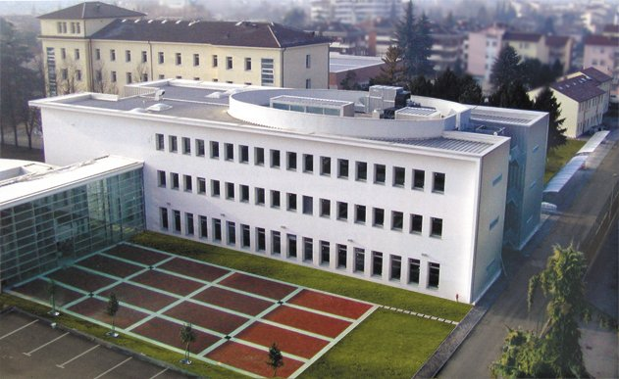
Here is located our telescope

Slide 4
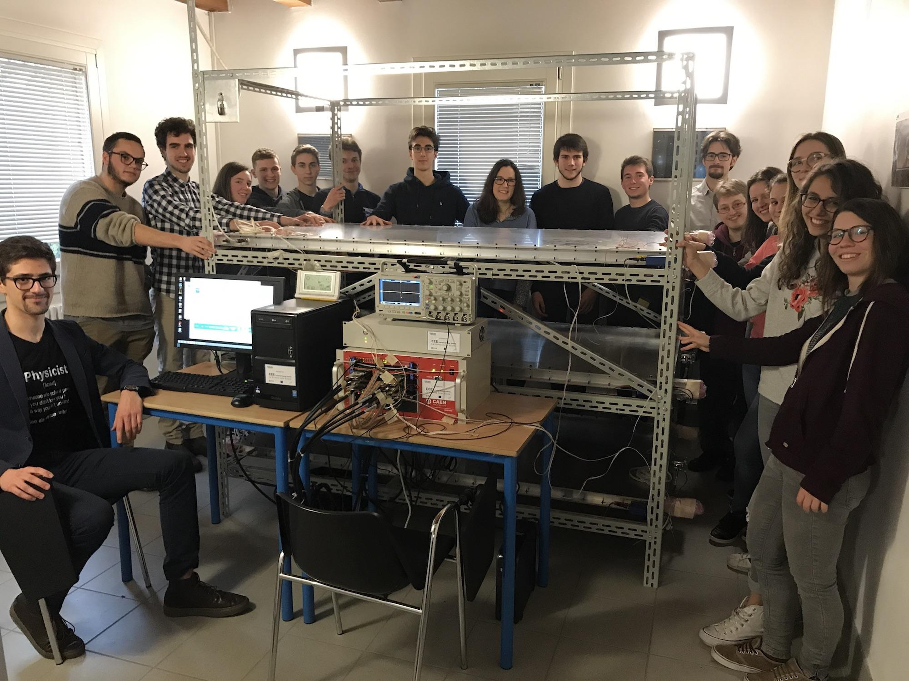
Very important people at the inauguration!

Slide 5
Root is...
A multiplatform, modular scientific software toolkit.
It provides all the functionalities needed to deal with big data processing, statistical analysis, visualisation and storage.
It is mainly written in C++ but integrated with other languages such as Python.
Root is available under the LGPL V. 2.1 license

Slide 6
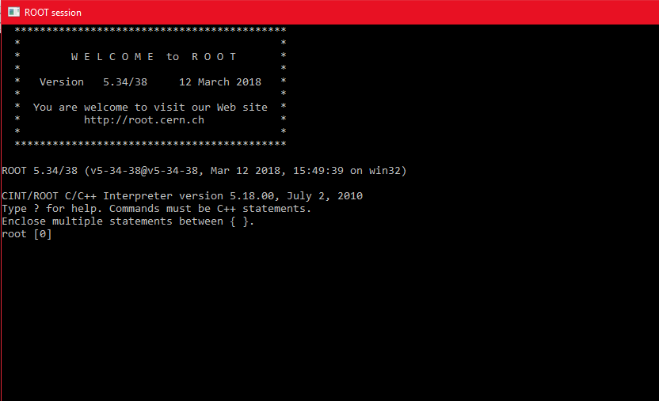
Opening screen

Slide 7
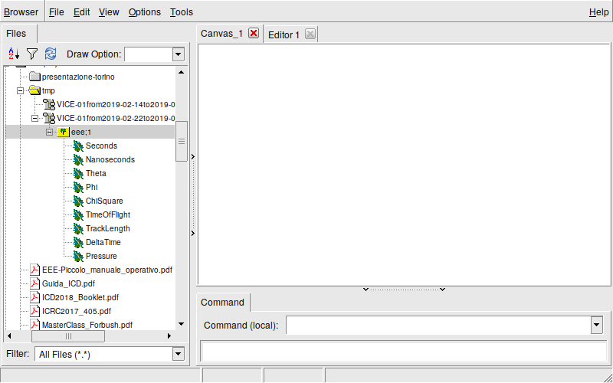
root[0] new TBrowser();
Command to create a browser and display the file tree

Slide 8
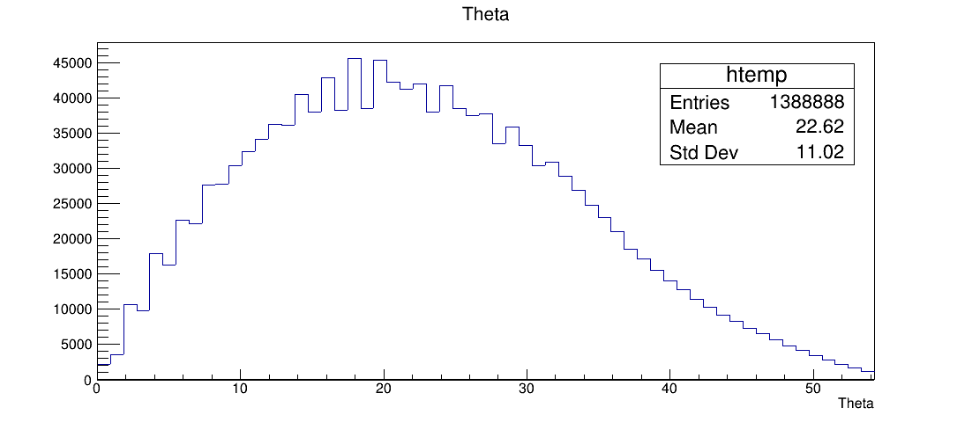
22/02/2019 Vicenza MRPC Data

Slide 9
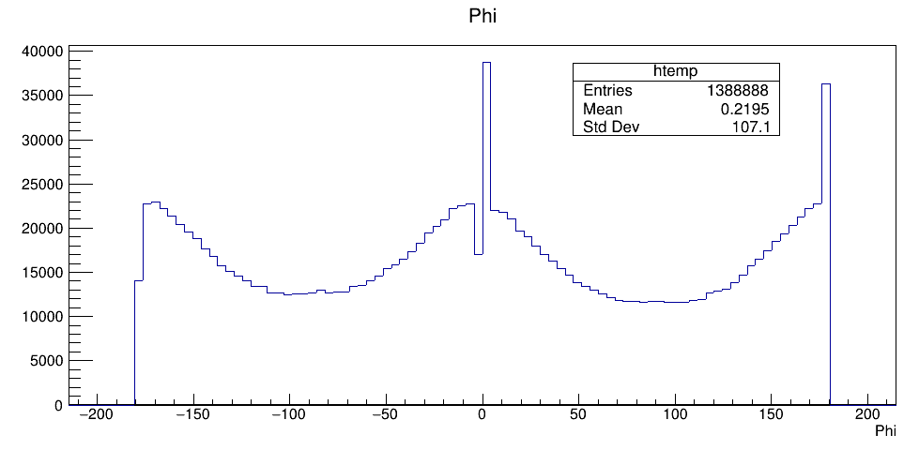

Slide 10
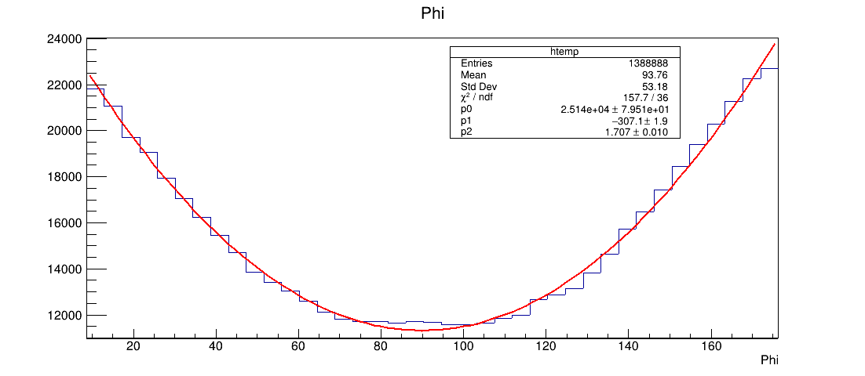
Right Fit

Slide 11
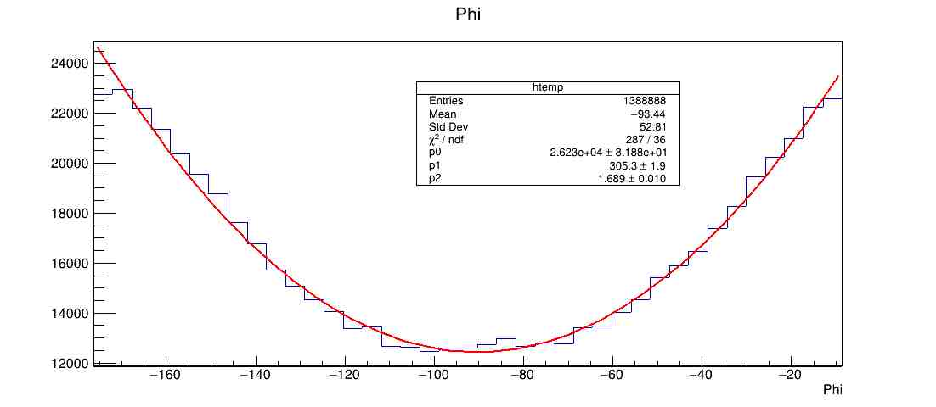
Left Fit

Slide 12
Comparing the coefficients of the two fitted parabola, we found a good match, showing that the two curves are very similar.
Left side
P0 = 2623 ± 82
P1 = 305 ± 1
P2 = 1.69 ± 0.01
Rigth side
P0 = 2514 ± 79
P1 = -307 ± 2
P2 = 1.71 ± 0.01

Slide 13
root [0] TFile *_file0 = TFile::Open("quadri/VICE-01from2019-02-22to2019-02-22.root");
root [1] .ls
root [2] eee->Print();
root [3] eee->Draw();
root [4] eee->Draw(“TrackLength”);
root [5] eee->Draw("TrackLength","ChiSquare<10",”SAME”);

Slide 14
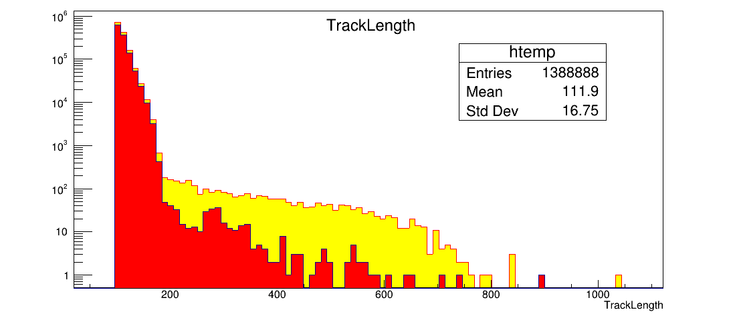
All tracks
Tracks with ChiSquare<10

Slide 15
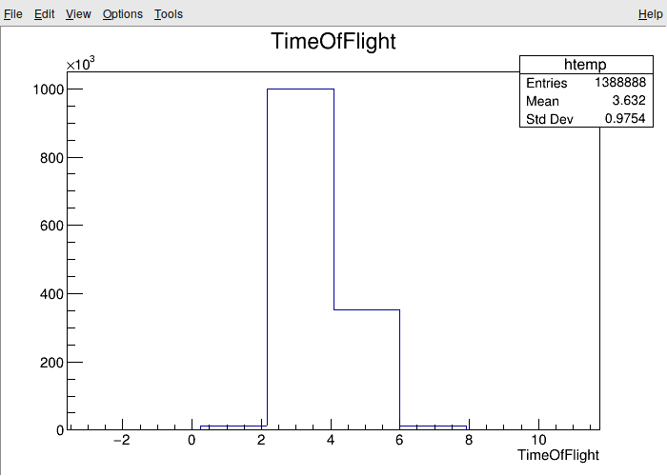
ns

Slide 16
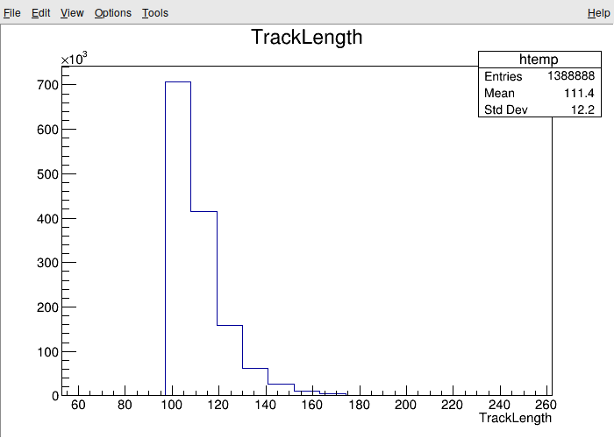

Slide 17
TrackLength (cm) and TimeOfFlight (ns) may be employed to estimate the light velocity.
Considering the given mean and the standard deviation value, we found:
v = (3.06 ± 1.16) x 10⁸ m/s

Slide 18
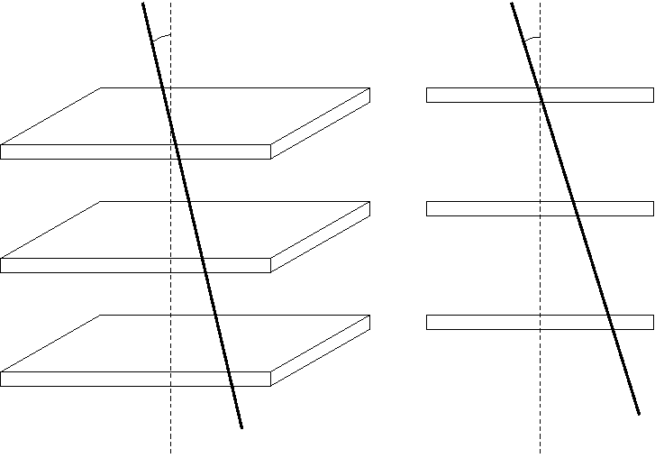
θ
θ
MRPC Scheme
Zenithal angle Theta
100 cm
Front view

Slide 19
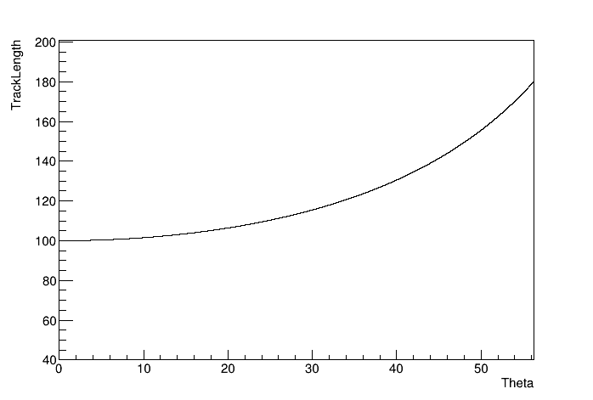
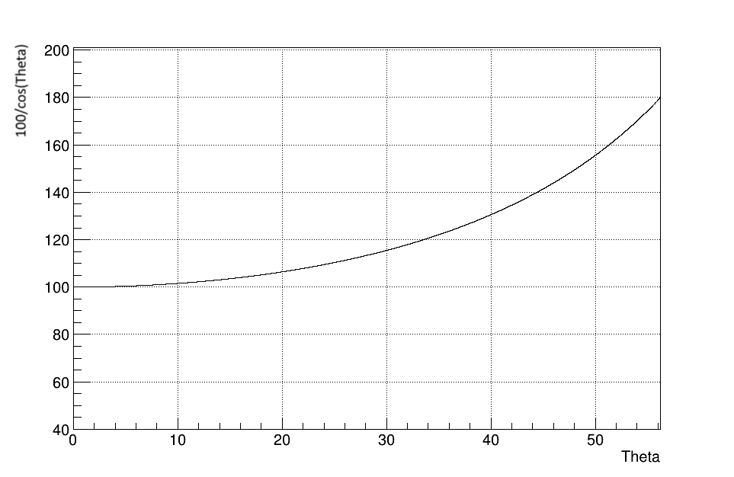
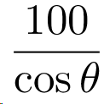
Tracklength (cm): Data vs function 100/cos(θ)
(cm)
root [0] TF1 f1(“f1”,”100/cos(3.1415*x/180)”,0.,55.);
root [1] f1.Draw();
For pure geometrical reasons, the “TrackLength vs Theta“ data should follow the function
… and it did exactly !

