Slide 1
Data analisys and gas R134a consumption forecast
Liceo Fermi – Bologna
Giuseppe Bentivenga, Matteo Bonazzi

Slide 2
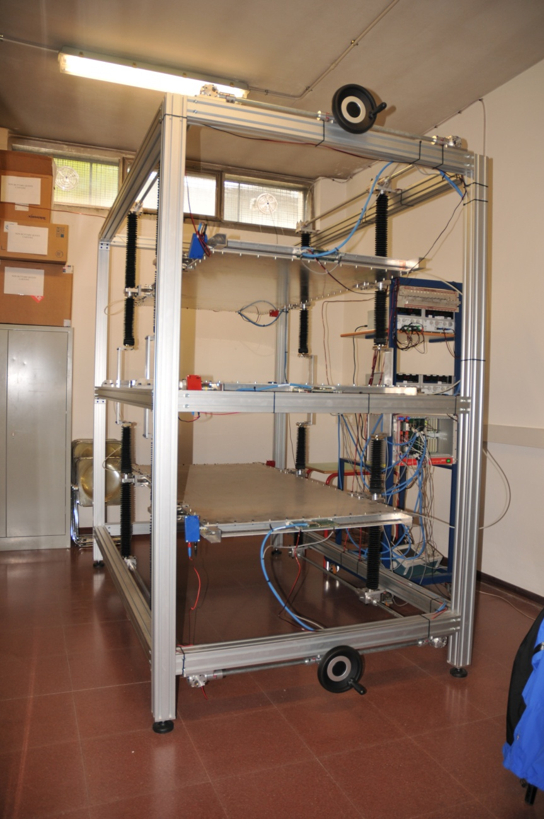
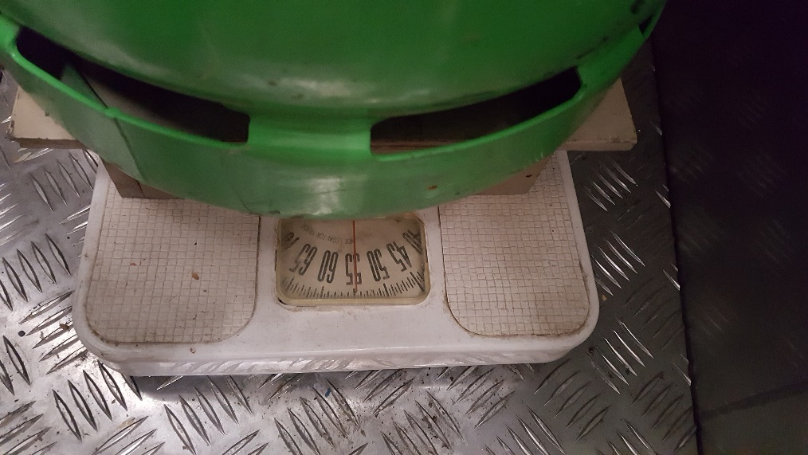
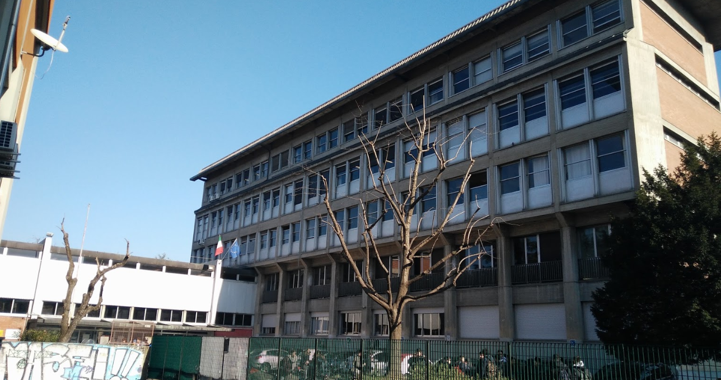
Tank weighting system
Telescopio muonico del Fermi
Liceo Scientifico E. Fermi-Bologna

Slide 3
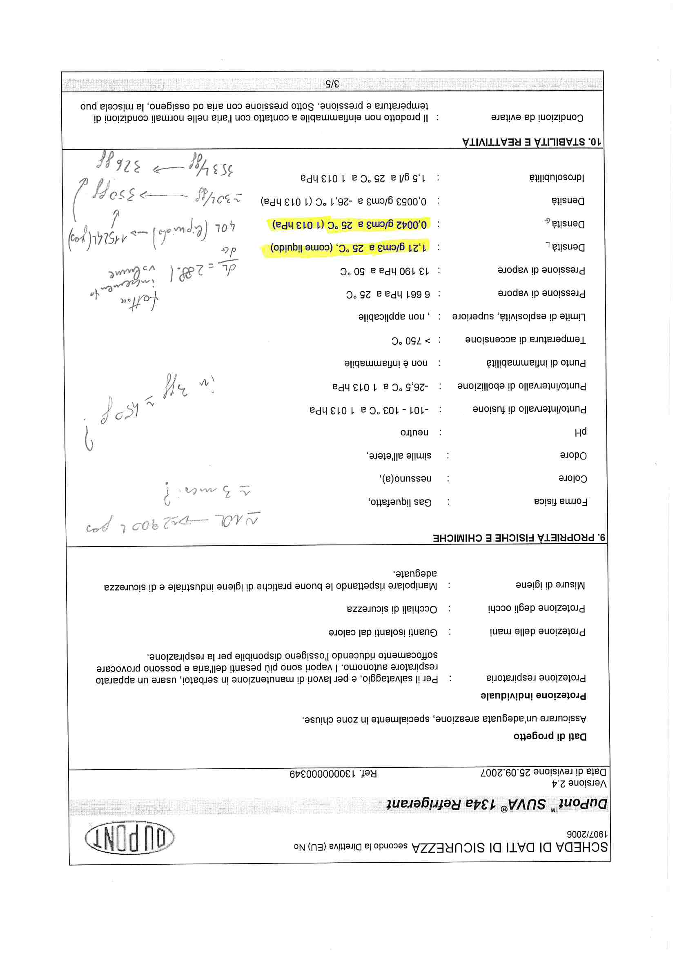
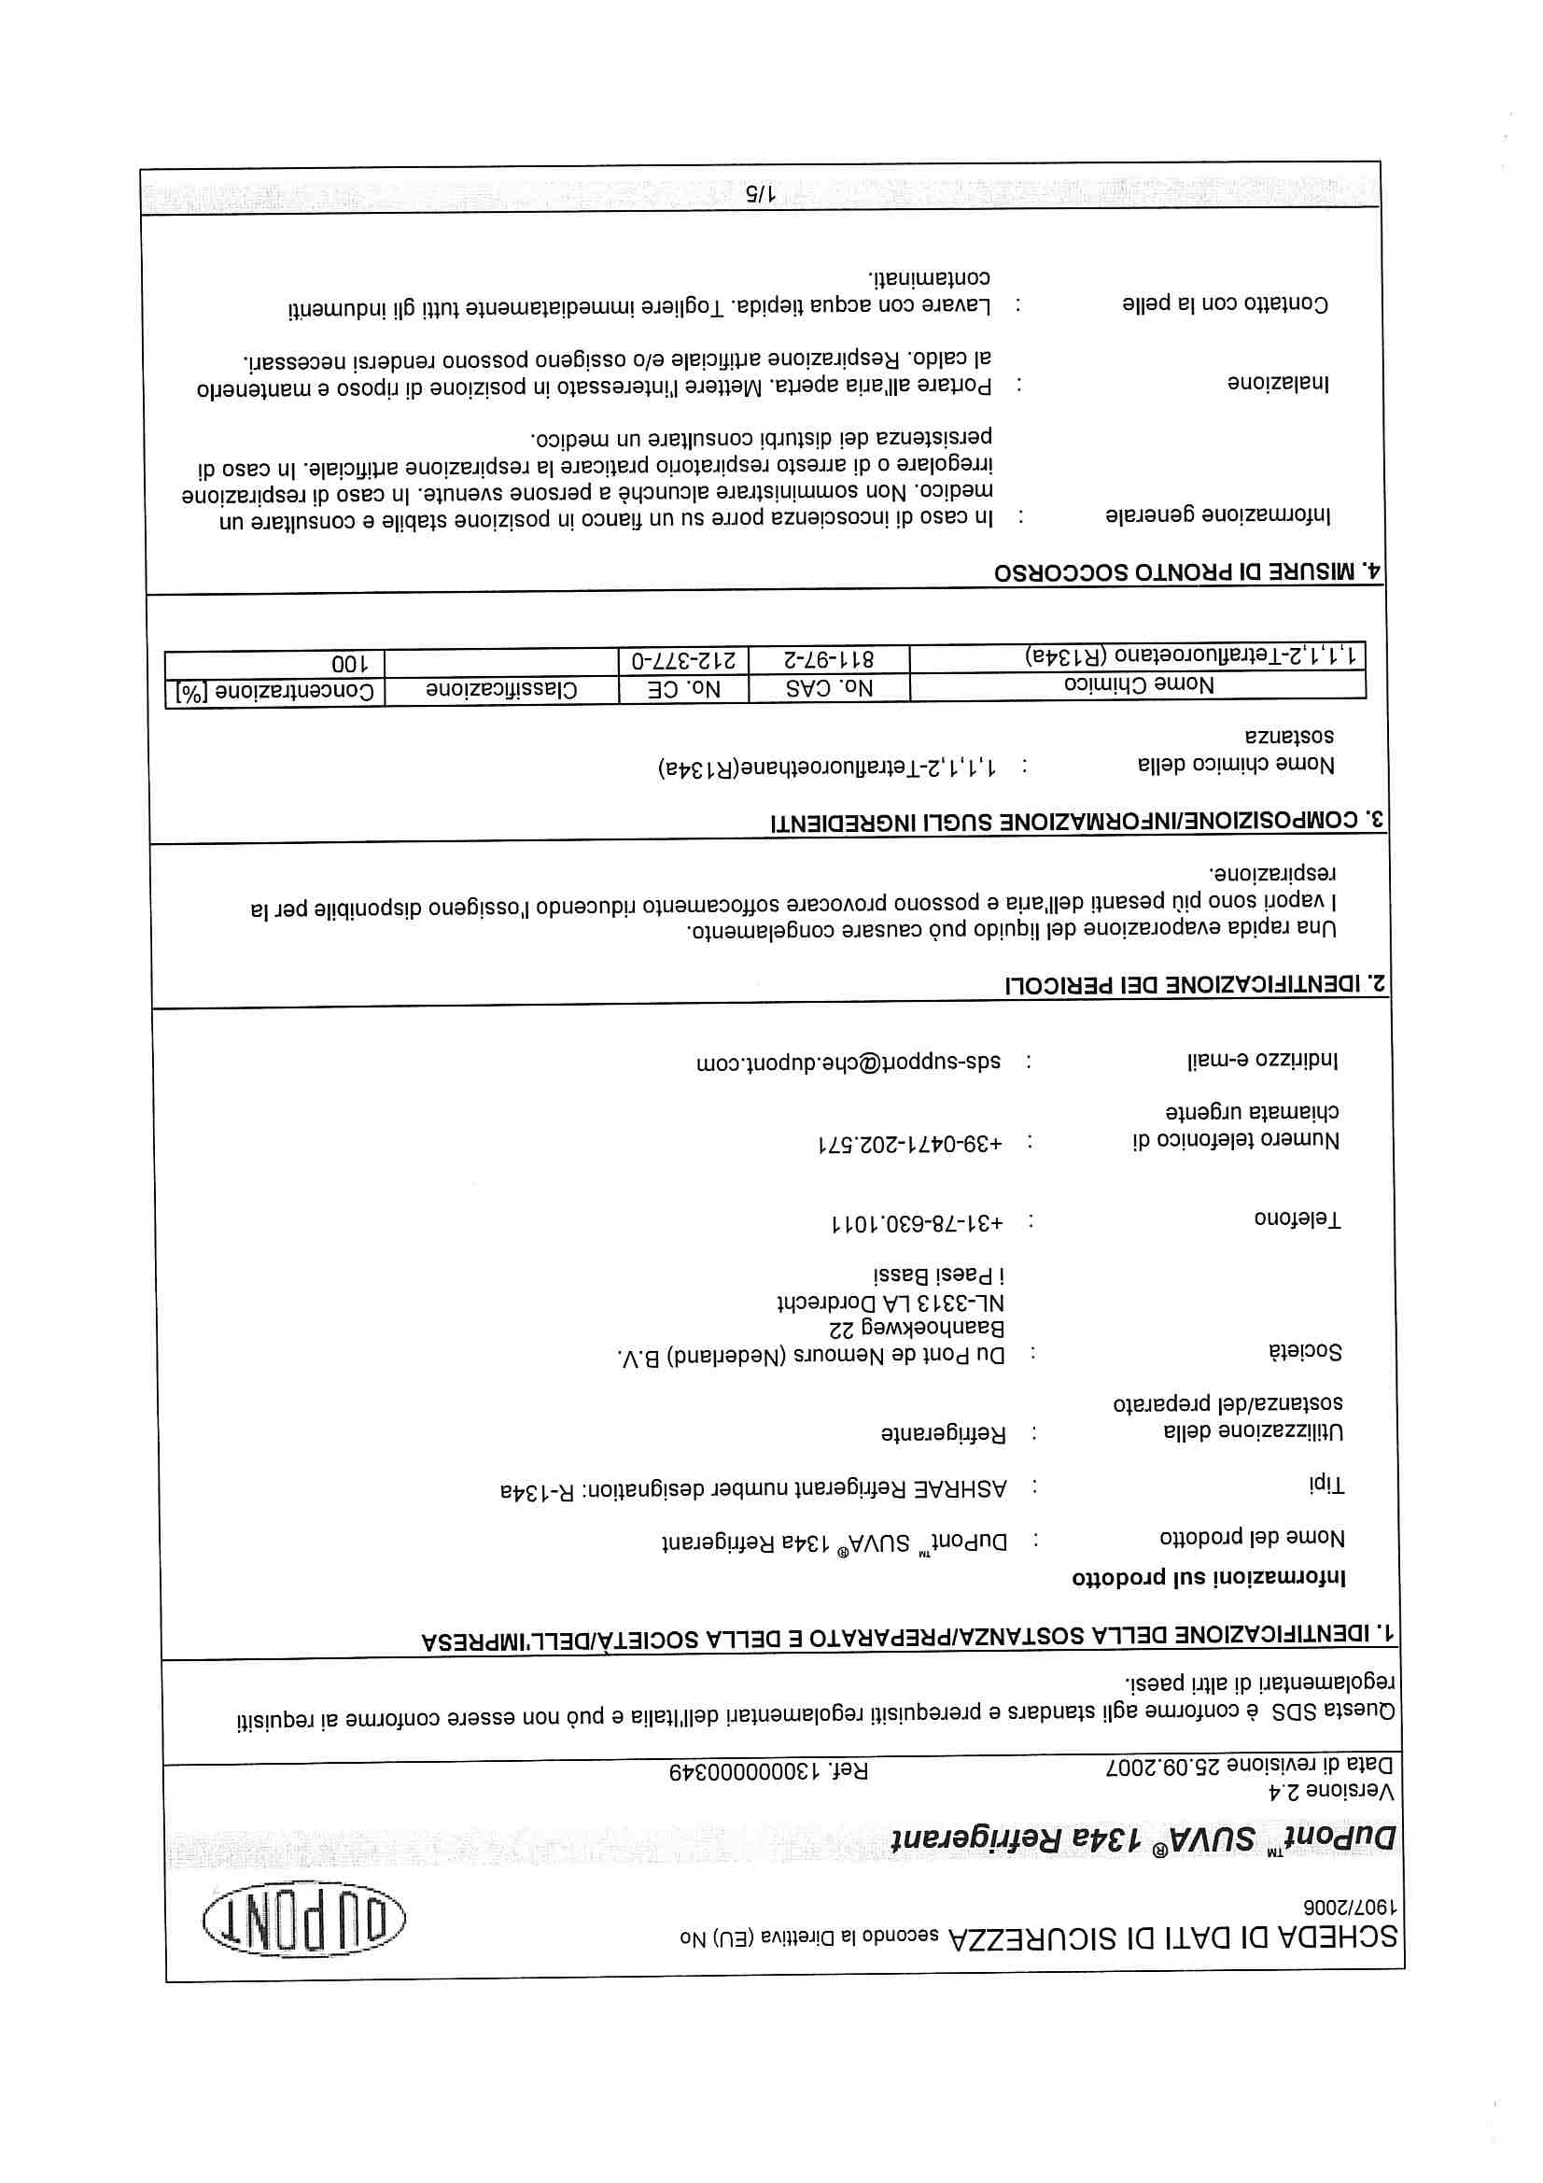
Supplier data sheet

Slide 5
Daily consumption measurament
A mixer is set to give 25% of its maximum capacity,98 mL/min (=24.5 mL/min)
$$\frac{∆V}{∆t}=\left(24,5±0,1\right) \frac{mL}{min}$$
Transforming in L/dd
$$\frac{∆V}{∆t}=\left(35,3±0,1\right)\frac{L}{dd}$$
$$ρ=\left(4,25±0,01\right)\frac{g}{L}$$
Gas $C_{2}H_{2}F_{4}$ density

Slide 6
Daily consumption measurament
$\frac{∆m}{∆t}=\frac{∆V}{∆t} ρ=4,25\frac{g}{L}∗35,3 \frac{L}{dd}=149,9 \frac{g}{dd}$
$∆\frac{∆m}{∆t}=0,0008\frac{kg}{dd}$
$\frac{∆m}{∆t}=\left(0,1499±0,0008\right)\frac{kg}{dd}$
Theoretical daily consumption

Slide 7
Daily consumption measurament
Using the Excel data analisys we were able to obtain the experimental values, with their errors, of the daily gas consumption.
2017/2018 $\frac{∆m}{∆t}=(0,15±0,01)$ $\frac{kg}{dd}$
2018/2019$\frac{∆m}{∆t}=(0,16±0,01)$ $\frac{kg}{dd}$

Slide 8
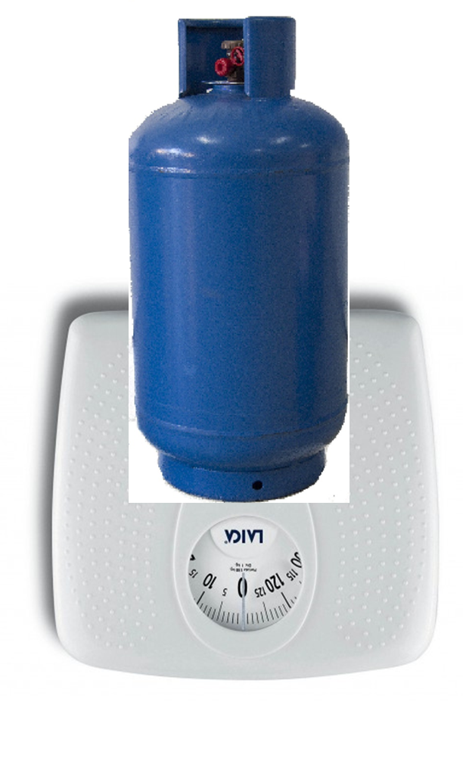
Weighing system
Gas mixer
Rigid pipe
R134a
The tank is on a scale, and periodically mass data are reported.

Slide 9
School year 2017/2018
day (dd/mm/yy) | Progressive day | mass (kg)
17/10/2017 | 0 | 50,0
18/10/2017 | 1 | 50,0
31/10/2017 | 14 | 49,0
08/11/2017 | 22 | 48,5
10/11/2017 | 24 | 48,0
17/11/2017 | 31 | 47,0
06/12/2017 | 50 | 44,0
03/01/2018 | 78 | 39,5
10/01/2018 | 85 | 38,0
16/01/2018 | 91 | 37,0
20/01/2018 | 95 | 36,5
29/01/2018 | 104 | 35,0

Slide 10
Expected first tank duration
$$m\left(t\right)=−\left(0.1508 \frac{\text{kg}}{d}\right)⋅t+51.017 \text{kg}$$
Trend line equation
$$m\left(0\right)=51.017 \text{kg}$$
First mass measurament
$$m_{gas}=40 \text{kg}$$
$$m_{bv}=20 \text{kg}$$
Data provided by the supplier
$$M_{tot}=m_{bv}+m_{gas}=60 \text{kg}$$
Total mass= initial gas mass+ empty gas tank mass
$$t=\frac{51.017 \text{kg}\text{−}m\left(t\right)}{0.1508 \frac{\text{kg}}{d}}$$

Slide 11
Expected first tank duration
$$t_{1}=\frac{51.017 \text{kg}\text{−}m_{bv}}{0.1508 \frac{\text{kg}}{d}}=206 \text{days}$$
Time necessary to exhaust the gas, since the start of the measurament
$$t_{2}=\frac{{\text{M}}_{\text{tot}}−51.017 \text{kg}}{0.1508 \frac{\text{kg}}{d}}=60 \text{days}$$
Time between the start of the consumption and the first
measure.
$$t_{tot}=t_{1}+t_{2}=266 \text{days}$$
Expected tank duration

Slide 12
School year 2018/2019
Day (gg/mm/yy) | Progressive day | Total mass
01/12/2018 | 0 | 57,5
03/12/2018 | 2 | 57,5
04/12/2018 | 3 | 57,0
10/12/2018 | 9 | 56,5
11/12/2018 | 10 | 56,0
13/12/2018 | 12 | 56,0
14/12/2018 | 13 | 56,0
17/12/2018 | 16 | 55,5
18/12/2018 | 17 | 55,0
20/12/2018 | 19 | 52,0
22/12/2018 | 21 | 52,0
27/12/2018 | 26 | 51,5
07/01/2019 | 37 | 50,0
14/01/2019 | 44 | 49,0
15/01/2019 | 45 | 49,0
19/01/2019 | 49 | 49,0
21/01/2019 | 51 | 49,0
22/01/2019 | 52 | 48,5
24/01/2019 | 54 | 48,0
25/01/2019 | 55 | 48,0
28/01/2019 | 58 | 47,0
30/01/2019 | 60 | 47,0
31/01/2019 | 61 | 47,0
01/02/2019 | 62 | 47,0
02/02/2019 | 63 | 47,0
05/02/2019 | 66 | 46,0
09/02/2019 | 70 | 46,0
11/02/2019 | 72 | 46,0
12/02/2019 | 73 | 46,0
13/02/2019 | 74 | 45,0
14/02/2019 | 75 | 45,0
15/02/2019 | 76 | 45,0
16/02/2019 | 77 | 45,0
17/02/2019 | 78 | 45,0
18/02/2019 | 79 | 44,5
19/02/2019 | 80 | 44,5
21/02/2019 | 82 | 44,5

Slide 13
Expected second tank duration
$$m\left(t\right)=−\left(0,1621\frac{\text{kg}}{d}\right)⋅t+57,101 \text{kg}$$
Trend line equation
$$m\left(0\right)=57,101 \text{kg}$$
First mass measurament
$$m_{gas}=\text{39,0} \text{kg}$$
$$m_{bv}=\text{18,5} \text{kg}$$
Data provided by the supplier
$$M_{tot}=m_{bv}+m_{gas}=57,5 \text{kg}$$
Total mass= initial gas mass+ empty gas tank mass
$$t=\frac{57,101\text{kg}\text{−}m\left(t\right)}{0,1621\frac{\text{kg}}{d}}$$

Slide 14
Expected second tank duration
$$t_{1}=\frac{57,101\text{kg}\text{−}m_{bv}}{0,1621\frac{\text{kg}}{d}}=238 \text{days}$$
Time necessary to exhaust the gas, since the start of the measurament
$$t_{2}=\frac{{\text{M}}_{\text{tot}}−57,101\text{kg}}{0,1621\frac{\text{kg}}{d}}=2 \text{days}$$
Time between the start of the consumption and the first
measure.
$$t_{tot}=t_{1}+t_{2}=2\text{40} \text{days}$$
Expected tank duration

Slide 15
Data comparison
The experimental data are compatible with each other and also with the theoretical data.
$$\left|\frac{∆m_{a}}{∆t}−\frac{{∆m}_{b}}{∆t}\right|≤∆\frac{∆m_{a}}{∆t}+∆\frac{{∆m}_{b}}{∆t}$$
2017/18 – Theoretical: $\left|0,15−0,1499\right|≤0,01+0,0008$
2018/19 – Theoretical: $\left|0,16−0,1499\right|≤0,01+0,0008$
2017/18 – 2018/19: $\left|0,16−0,15\right|≤0,01+0,01$
$$0,0001≤0,0108$$
$$0,0101≤0,0108$$
$$0,01≤0,02$$

Slide 16
Observations
From the data it is possible to notice that mass consumption of the gas has a certain regularity.
Monitoring of gas consumption is important in order to check the correct operation of the telescope and to predict the end of the $C_{2}H_{2}F_{4}$tank .

Slide 17
Weighing system improvement
Gas mixer
Gas mixer
Rigid pipe
Flexible pipe
Rigid pipe
R134a
R134a
An improvement to the weighing system could be the replacement of the final part of the rigid pipe with a flexible one whose weight does not influence the measurement.

Slide 18
Thank you !

