Slide 1
A comparison between day and night cosmic muons flux
U. Chiapasco, T. Mizzon
Liceo scientifico Galileo Ferraris, Torino

Slide 2
Data source and file format
The Summary_trending files have been taken from DQM.
Telescope TORI-04.
They refer to the following periods: 3/30/2017-6/02/2017 and 10/15/2018-12/17/2018.
The files have been merged and relevant data for our analysis have been extracted by means of a C++ program.

Slide 3
The «converti.cpp» program
This program merges successive Summary_trending.csv files and remove redundant data.
It selects the following data : Bin_start, Bin_stop, Track_events, Err_track_events, Pressure, Outdoor_temp, Run_ID.
It fills the gaps between the runs with the missing seconds .
It allows to integrate data every 10/60 minutes.
It is possible to calculate the moving average for an odd number of values.
Moving average has been calculated over 5 values (10 min) or 3 values (1 hour).

Slide 4
Track_Events - pressure ComparisoN

Slide 5
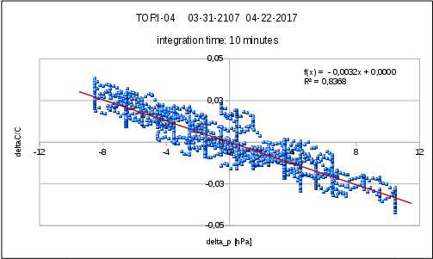
barometric coefficient calculation and data correction
This C++ program calculates the Barometric coefficient Kp by means of least square method using the following relation.
$$\frac{∆C}{C}=−K_{p}∆p$$
and it corrects track_events and their uncertainties.
$$C_{c}=C−\left[C_{m}∗K_{p}\left(p−p_{m}\right)\right]$$

Slide 6
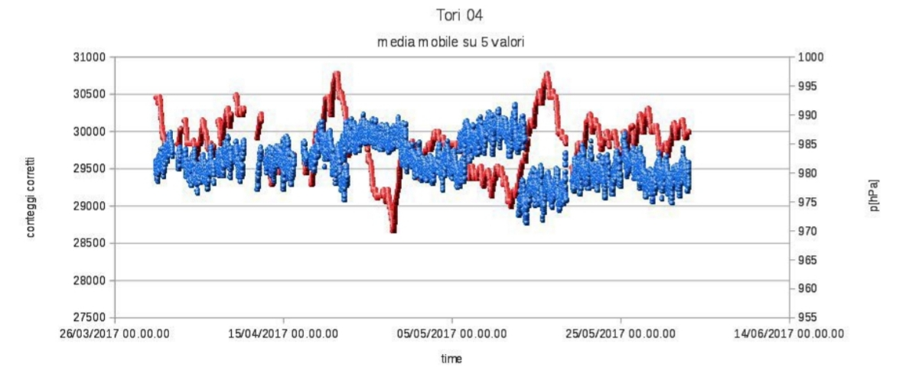
Detected Problems
Firstly we corrected data on a weekly basis. The analysis has highlighted a considerable discontinuity in the data around may 13th
The barometric coefficient changes in a consistent way.
So we proceeded to correct data on the overall period (nine weeks).

Slide 7
time | Kp [hPa⁻¹] | q | R
03/31-04/07 | -0.00269±0.00006 | 0.0000±0.0002 | -0.8348
04/07-04/15 | -0.00335±0.00003 | -0.0000±0.0001 | -0.9659
04/15-04/22 | -0.00343±0.00004 | 0.0000±0.0002 | -0.9421
04/22-04/29 | -0.00308±0.00002 | 0.0000±0.0001 | -0.9839
04/29-05/06 | -0.00324±0.00007 | -0.0000±0.0001 | -0.8118
05/05-05/13 | -0.00295±0.00006 | 0.0000±0.0001 | -0.8531
05/13-05/20 | -0.00352±0.00004 | 0.0000±0.0002 | -0.9556
05/20-05/27 | -0.00316±0.00008 | -0.0000±0.0002 | -0.7857
05/20-06/02 | -0.00276±0.00007 | -0.0000±0.0001 | -0.7998
time | Kp [hPa⁻¹] | q | R
03/31-06/02 | -0.00319±0.00003 | 0.0000±0.0001 | -0.9148
03/31-06/02 | -0.00295±0.00003 | 0.0000±0.0002 | -0.9326
1 hour

Slide 8
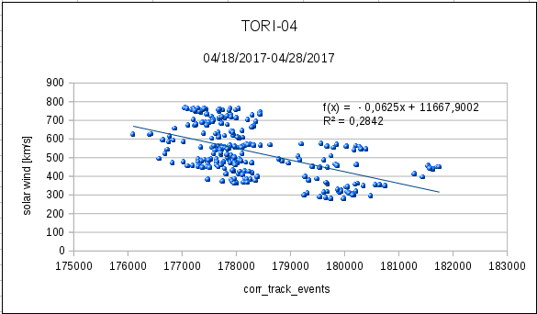
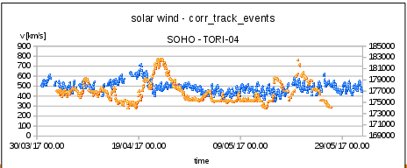
Solar wind and muon flux comparison

Slide 9
DAY-NIGHT PROGRAM
NotteGiorno.cpp program calculates the average of the muon flux integrated over 10 minutes and corrected by the atmospheric pressure contribution.
It normalizes muon flux data to its mean value.
It compares the average time of each interval with the dawn and sunset times of that period.
It calculates the number of day and night intervals, the normalized day and data flux averages and their uncertainties.

Slide 10
results
Period | Day Interval number | Night interval number | Day Normalized average | Night Normalized average
03/30/17-06/02/17 | 4638 | 2958 | 1,0013±0,0001 | 0,998±0,001
10/15/18-12/17/18 | 1914 | 4560 | 1,0073±0,0004 | 0,9969±0,0004

Slide 11
Thanks for the attention !

