Slide 1
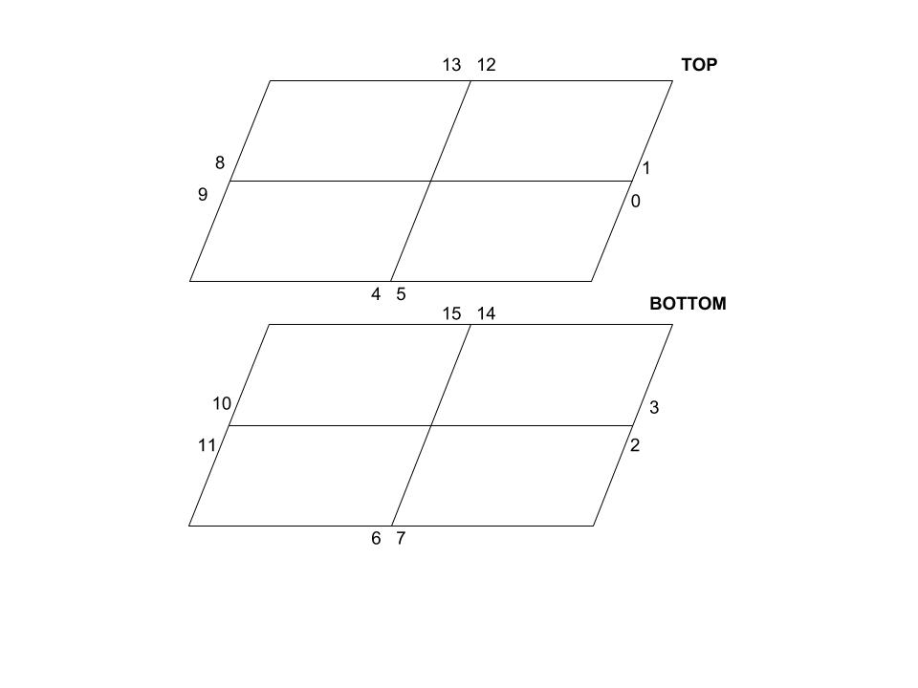
Schema SiPM

Slide 2
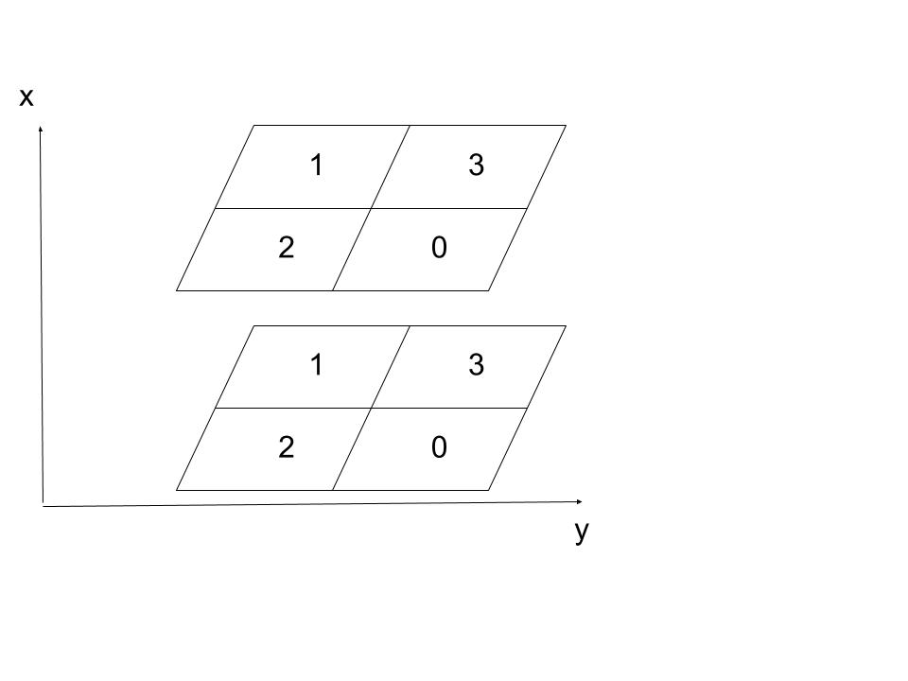
Schema ratepair e ratedir
Direzione | RatePair | RateDir
1 3 o 2 0 | 13, 2 | 7
3 1 o 0 2 | 7, 8 | 1
2 1 o 0 3 | 6, 12 | 5
1 2 o 3 0 | 9, 3 | 3
0 0 o 1 1 o 2 2 o 3 3 | 0, 5, 10, 15 | 4
2 3 | 14 | 8
0 1 | 4 | 2
3 2 | 11 | 0
1 0 | 1 | 6

Slide 3
Confronto dei 3 rivelatori al CERN dal 27/06/18 al 28/06/18

Slide 4
Pola-01 = -0.00213 +/- 0.00002
Pola-02 = -0.00337 +/- 0.00001
Pola-03 = -0.00323 +/- 0.00001

Slide 5
Dati pola02/01 e pola03/01 con RatePair

Slide 6
Dati dei fit delle correzioni con i Pair
RatePair Fit Pola02/01
p0 = 0.991 +/- 0.004
p0 = 0.92 +/- 0.03
p0 = 0.93 +/- 0.01
p0 = 0.95 +/- 0.01
p0 = 1.17 +/- 0.03
p0 = 0.988 +/- 0.004
p0 = 1.15 +/- 0.02
p0 = 1.06 +/- 0.01
p0 = 1.05 +/- 0.01
p0 = 0.92 +/- 0.01
p0 = 0.985 +/- 0.004
p0 = 1.06 +/- 0.03
p0 = 1.09 +/- 0.02
p0 = 0.93 +/- 0.01
p0 = 1.05 +/- 0.03
p0 = 0.997 +/- 0.004
RatePair Fit Pola03/01
p0 = 0.959 +/- 0.005
p0 = 0.98 +/- 0.04
p0 = 1.12 +/- 0.01
p0 = 0.90 +/- 0.01
p0 = 1.05 +/- 0.03
p0 = 0.959 +/- 0.005
p0 = 1.44 +/- 0.02
p0 = 1.02 +/- 0.01
p0 = 1.06 +/- 0.01
p0 = 0.89 +/- 0.01
p0 = 1.017 +/- 0.005
p0 = 1.07 +/- 0.04
p0 = 1.12 +/- 0.02
p0 = 0.94 +/- 0.01
p0 = 2.59 +/- 0.06
p0 = 0.9621 +/- 0.005

Slide 7
Correzioni per pola02/01 e pola03/01 con RatePair4c

Slide 8
Dati dei fit delle correzioni con i Pair4c
Dati Fit Pola02/01 Pair4c
p0 = 0.993 +/- 0.004
p0 = 0.98 +/- 0.02
p0 = 0.936 +/- 0.009
p0 = 0.95 +/- 0.01
p0 = 1.19 +/- 0.03
p0 = 1.030 +/- 0.004
p0 = 1.16 +/- 0.02
p0 = 1.07 +/- 0.01
p0 = 1.06 +/- 0.01
p0 = 0.95 +/- 0.01
p0 = 0.998 +/- 0.005
p0 = 1.06 +/- 0.03
p0 = 1.10 +/- 0.02
p0 = 0.97 +/- 0.01
p0 = 1.04 +/- 0.03
p0 = 1.010 +/- 0.004
Dati Fit Pola03/01 Pair4c
p0 = 0.918 +/- 0.005
p0 = 0.85 +/- 0.03
p0 = 0.83 +/- 0.01
p0 = 0.87 +/- 0.01
p0 = 1.00 +/- 0.03
p0 = 0.946 +/- 0.005
p0 = 1.02 +/- 0.02
p0 = 0.97 +/- 0.01
p0 = 0.98 +/- 0.01
p0 = 0.86 +/- 0.01
p0 = 0.912 +/- 0.005
p0 = 1.01 +/- 0.04
p0 = 1.06 +/- 0.02
p0 = 0.91 +/- 0.01
p0 = 0.984 +/- 0.03
p0 = 0.953 +/- 0.005

Slide 9
Dati pola02/01 e pola03/01 con rateDir

Slide 10
Dati fit delle correzioni con rateDir
Correzioni ratedir pola02
p0 = 1.05 +/- 0.03
p0 = 1.060 +/- 0.008
p0 = 1.16 +/- 0.03
p0 = 0.936 +/- 0.009
p0 = 0.990 +/- 0.002
p0 = 1.11 +/- 0.01
p0 = 0.92 +/- 0.02
p0 = 0.930 +/- 0.007
p0 = 1.05 +/- 0.03
Correzioni rateddir pola03
p0 = 1.07 +/- 0.03
p0 = 1.04 +/- 0.01
p0 = 1.05 +/- 0.03
p0 = 0.90 +/- 0.01
p0 = 0.969 +/- 0.002
p0 = 1.28 +/- 0.01
p0 = 0.98 +/- 0.03
p0 = 1.032 +/- 0.009
p0 = 2.59 +/- 0.06

Slide 11
Grafici ratepair di pola02 sul lungo periodo corretti

Slide 15
Pola03 dentro l’edificio

Slide 16
Pola03 fuori dall’edificio

