Slide 1
Search for anomalous EEE
multi-telescope events
F.Riggi
in collaboration with
P.La Rocca, C.Pinto, F.Noferini
EEE Meeting, February 14, 2019

Slide 2
Current strategies to search for long distance correlations
EEE as an extended network has the capability to search for long distance correlation through different analysis strategies:
● Correlation between local extensive air showers
detected by telescope pairs
Analysis already performed, few candidate events found,
Conference contributions and paper (EPJPlus) published
● Correlation between multi-track events detected in any two telescopes
Analysis partially done, in progress..
Conference contribution to CRIS2018, additional paper to be prepared?
● Correlation between single-track events detected in MANY telescopes
Analysis just started, preliminary results (this contribution)

Slide 3
Correlation between MANY EEE telescopes
● No specific physical mechanism already known able to explain
the existence of multi-particle correlations over a huge area
● Underlying idea: Search for possible unexpected events
● Strategy: Consider all possible correlations between 2, 3, … N among N
telescopes working and look for events outside the expected spurious
rate
● Compare results to expected spurious rate between N telescopes
(not trivial)
● Integrate over long data taking periods (> months)

Slide 4
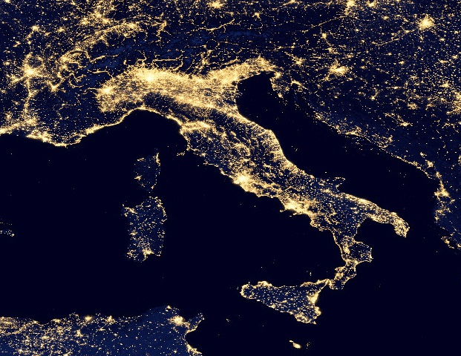

Slide 5
The significance of a N-fold coincidence event
Possible events of interest must be always compared with the expectation of random coincidences.
Assuming roughly the same individual rate from each telescope (R_single), for a N-fold coincidence the spurious rate is given by
R_spurious ~ N (R_single)^{N} x ∆t ^{N-1}
Examples:
N = 2 R_spurious ~ 2 R² ∆t
N = 3 R_spurious ~ 3 R³ ∆t²
Assuming N=2, R_single= 40 Hz, ∆t= 1 ms, R_spurious= 3.2 Hz
(About 270k spurious coincidences/day expected!)
This means that no significance may be associated to a simple coincidence between two telescopes within this large time window.
What about a coincidence between many telescopes (i.e. large N)?

Slide 6
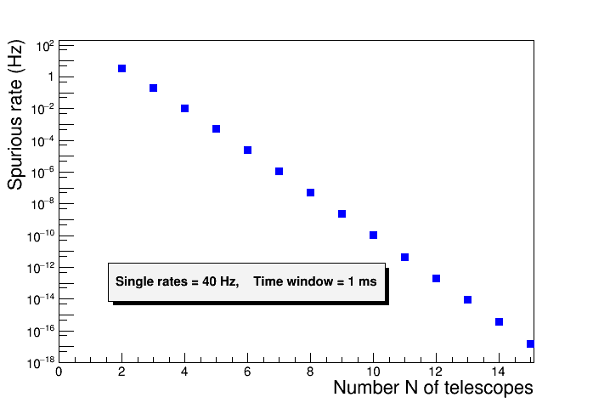
The significance of a N-fold coincidence event
Expected spurious rate for N telescopes in a time window of 1 ms,
assuming a single rate of 40 Hz

Slide 7
The significance of a N-fold coincidence event
Expected spurious rate for N telescopes in a time window of 1 ms,
assuming a single rate of 40 Hz
Observing a coincidence between 10 EEE telescopes is significant?
The spurious rate would be ~ 10⁻¹⁰ Hz

Slide 8
The significance of a N-fold coincidence event
However we have to consider all possible combinations…
If we consider 10 specific telescopes, the expected spurious rate is really 10⁻¹⁰ Hz
But if we have 30 telescopes working, how many combinations of 10 telescopes (out of 30) can we build?
In general, with N telescopes how many k-fold coincidences may be observed?
The answer is:

Slide 9
The significance of a N-fold coincidence event
For instance, for k=2 , the number of combinations is C = N x (N-1)/2
If N = 12 and k=2 C = (12 x 11)/2 = 66 possible 2-fold combinations
This number of combinations increases rapidly with N and k:
If N =30 and k=10 C ~ 3 x 10⁷ possible 10-fold combinations

Slide 10
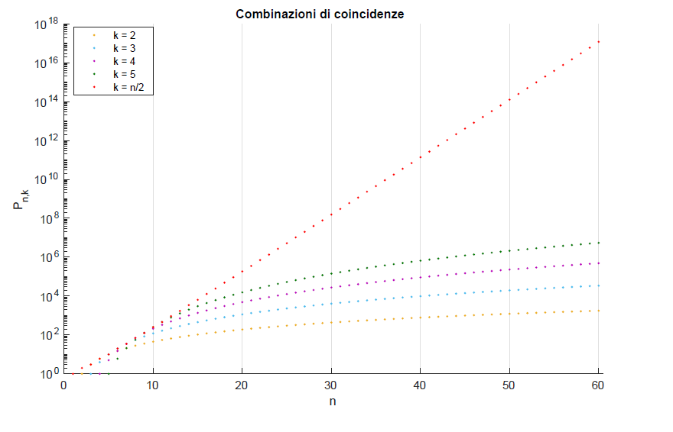
The significance of a N-fold coincidence event
In general, the number of possible combinations of k elements (for a given N) increases with k, up to its limiting value k=N/2, then decreases again.

Slide 11
A first look at EEE data
With this in mind, we started to have a look to recent EEE data..
Computing strategies:
● Process all reconstructed data on a day-by-day basis (.dst files)
from all telescopes and build daily spectra of the number of
telescopes in coincidences within 1 ms
● Assumed a reasonable time window of 1 ms to check for coincidences
● Consider the number of active telescopes day-by-day
● Minimum bias requirement for event selection:
- Reliable GPS information (Nsatellites >3)
- At least a reconstructed track
● Preliminary analysis of about 4 months in progress
(October 2018- January 2019 data)

Slide 12
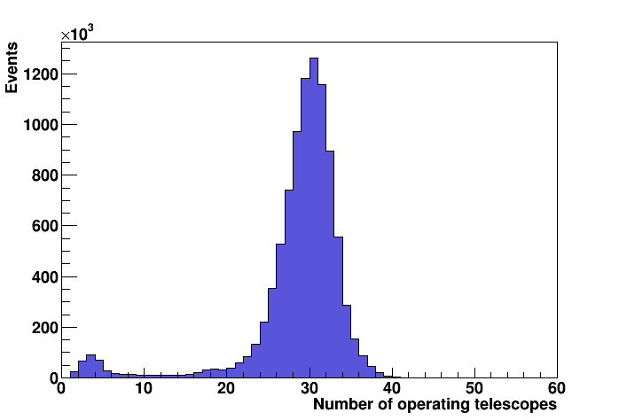
A first look at EEE data
Distribution of operating telescopes over 4 months data taking
Average ~ 30
Probably due to incomplete processing of all .dst files (in progress)

Slide 13
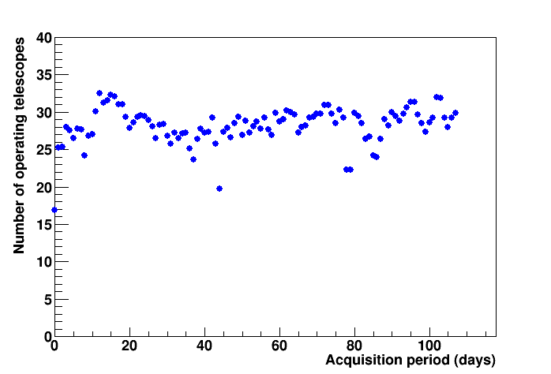
A first look at EEE data
Average number of active telescopes as a function of time

Slide 14
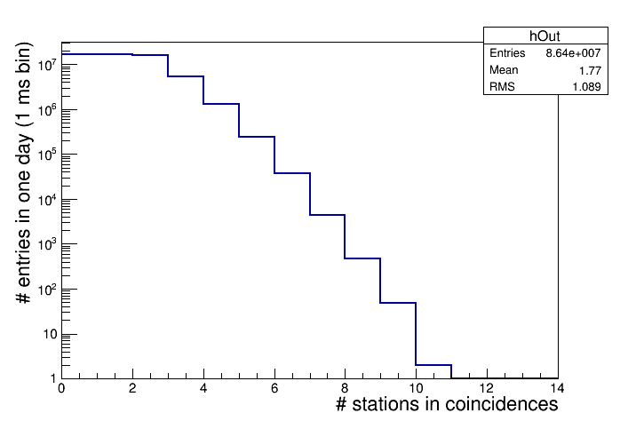
A first look at EEE data
Distribution of the number of EEE telescopes in coincidences in a time interval of 1 ms (1 day data taking)
1 day = 86400*1000 1 ms-bins
Events with up to 10 coincident telescopes observed

Slide 15
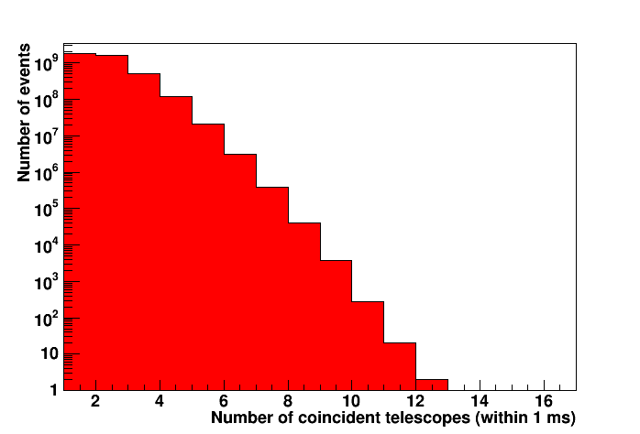
A first look at EEE data
4 months data taking
Events with up to 12 coincident telescopes observed

Slide 16
Estimate of spurious rates
Expected average spurious rate
for a specific combination of N telescopes
assuming a single rate of 40 Hz and a time window of 1 ms

Slide 17
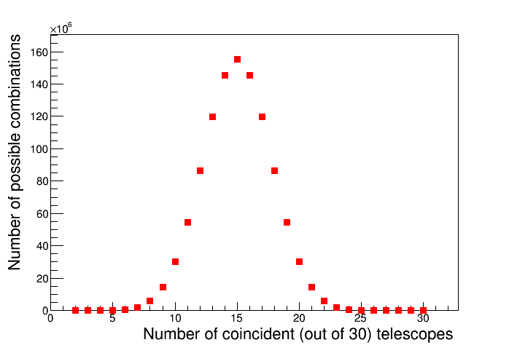
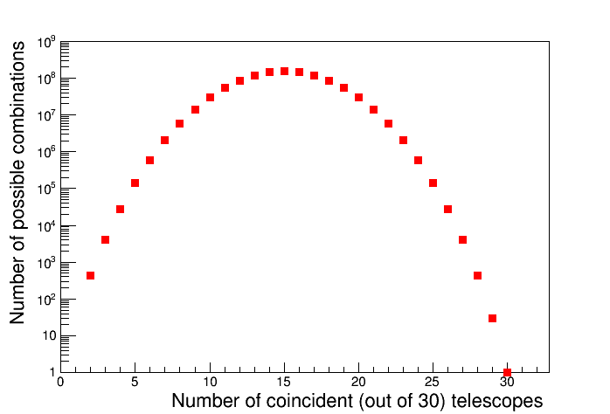
Estimate of spurious rates
Number of possible combination of N telescopes out of 30
(same data, in linear and log scale)

Slide 18
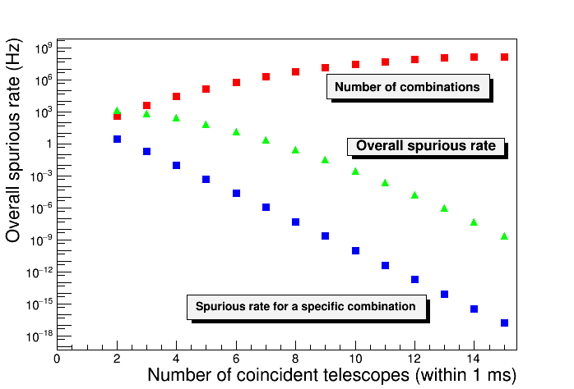
Estimate of spurious rates
Rough estimate: 10⁻⁵ Hz for 12 telescopes, higher than observed
Probably the average rate is lower than 40 Hz … (even 35 Hz would
make the difference)

Slide 19
What we (un)expect……
This would be an unusual signature!

Slide 20
Work in progress
Reprocessing of data, due to incomplete availability of .dst files during the first step
Better estimation of average number of running telescopes
Better estimation of average single rates
Estimate of more precise spurious expected rate and
comparison to experimental data
Scan additional statistics of previous data taking (RUN3,..)

