Slide 1
Update on POLA-01 measurements in Catania
14/02/2019
Chiara Pinto, Francesco Riggi, Paola La Rocca

Slide 2
Outline
Summary on POLA-01 – CATA-01 coincidence measurements
Possible use of these measurements to monitor civil structures stability
MC simulations and optimization of relative position between detectors

Slide 3
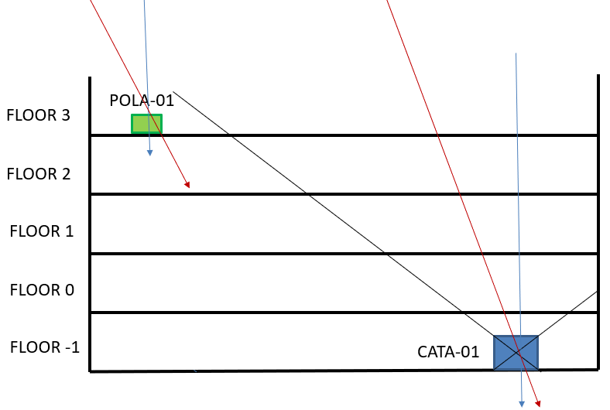
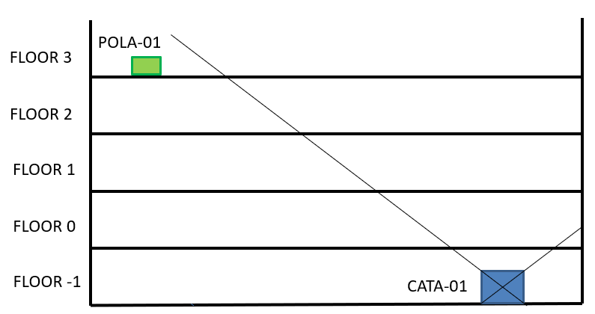
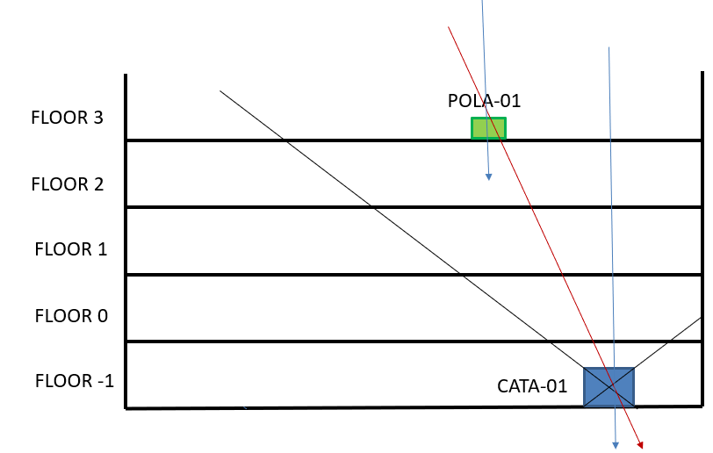
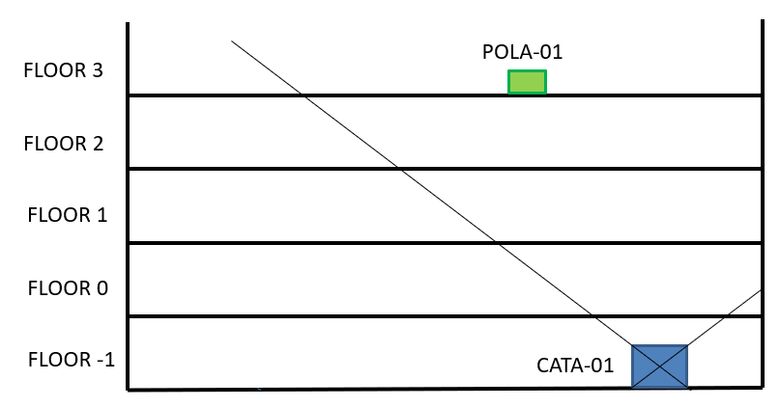
Measurements
Measure 1 – outside the acceptance interval of CATA-01, in order to detect two independent muons coming from the same shower. About 13 days acquisition time.
Measure 2 – inside the acceptance interval of CATA-01, in order to detect also muons passing through both detectors. Detectors geometry select a narrow acceptance cone (POLA-01: 40 cm x 60 cm). About 47 days acquisition time.

Slide 4
CATA-01 → floor -1
POLA-01 → floor 3
POLA-01
floor 3
15 m
5,4 m
floor -1
CATA-01
Geometrical disposition of the two detectors in Catania Physics department.
7,6 m
CATA-01
POLA-01

Slide 5
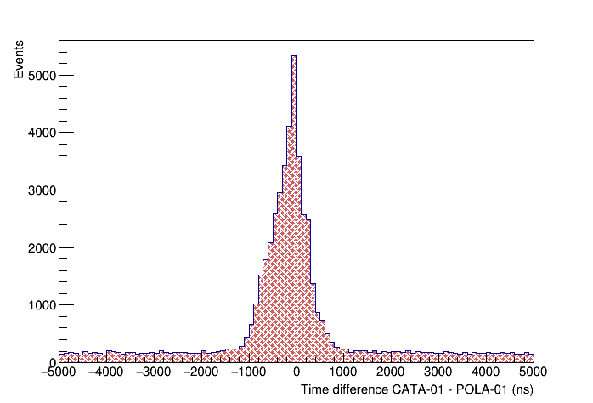
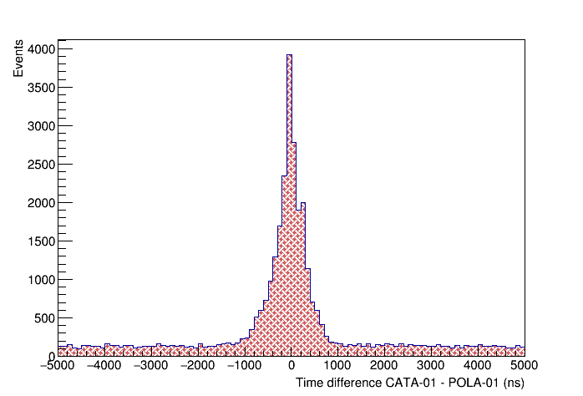
Track selection
Coincidence window
|(Δt + (t-int(t)) ∙ 2500 -1500) – 140| < 600 ns
Quality cuts
χ² < 10
-2 ns < ToF < 10 ns
Number of satellites POLA-01 ≥ 3
Number of satellites CATA-01 ≥ 3
Number of tracks POLA-01 = 1
Number of tracks CATA-01 = 1
Corrected time difference spectrum
Measurements OUTSIDE CATA-01 acceptance cone: 3 days data taking.
Measurements INSIDE CATA-01 acceptance cone: 13 days data taking.

Slide 6
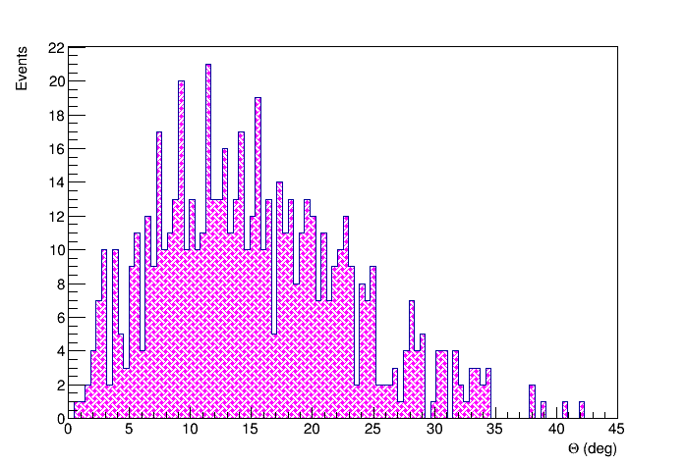
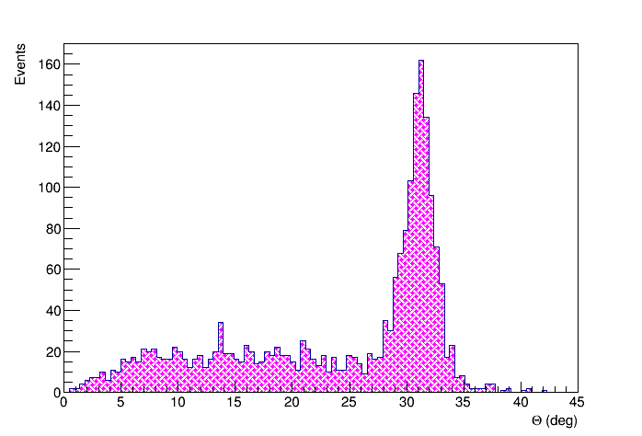
Theta distribution
< θ > | Δ<θ>
31.03° | 0.05°
POLA-01 outside CATA-01 acceptance
POLA-01 inside CATA-01 acceptance
On the left panel the background due to independent muons is shown.
On the right there is a peak in a selected region of θ, corresponding to muons passing through both detectors, superimposed on the background.

Slide 7
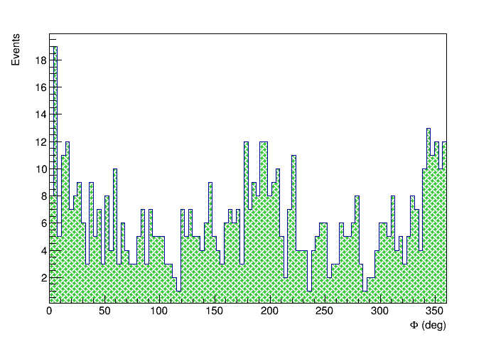
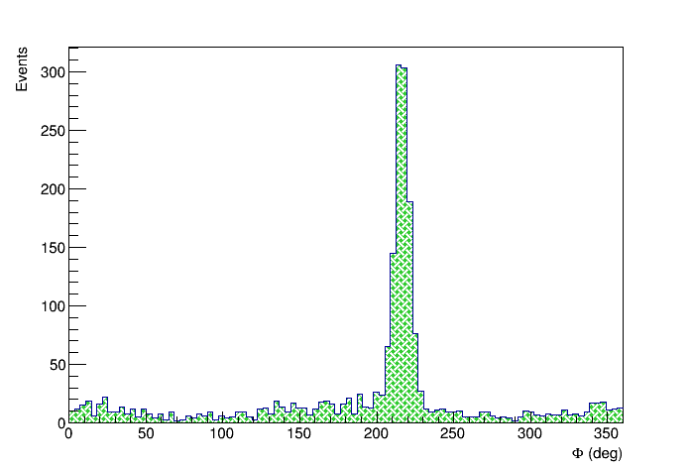
Phi distribution
< φ > | Δ<φ>
216.43° | 0.20°
POLA-01 outside CATA-01 acceptance
POLA-01 inside CATA-01 acceptance
As before, for the φ distribution.

Slide 8
Monitoring of civil structures stability
IDEA → using a tracking detector (EEE telescope) and an additional detector (e.g. a scintillator) to test the civil structures stability on a long time scale.
This tool can monitor small (mm) shifts of parts of the structure over long time periods.
→ No need of visibility or empty spaces (VS optical systems)
Performances of the method depend on the capability of the main tracking detector, geometry and position of the additional detectors , measurement stability, acquisition time, ...

Slide 9
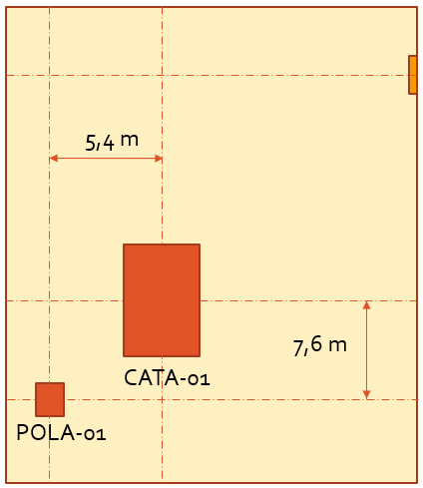
Measurements
Four sets of measurements:
Reference -> 0 cm
First shift -> 20 cm
Second shift -> 10 cm
Third shift -> 5 cm
POLA-01
POLA-01
x [cm] 20 10 5 0

Slide 10
Theta variation per day
Extracting θ centroids day by day one can see that in average there is a shift.
Notes:
blue points (20 cm shift) are higher than red points (reference position), and green points (10 cm shift) are in an intermediate position between red and blue points.

Slide 11
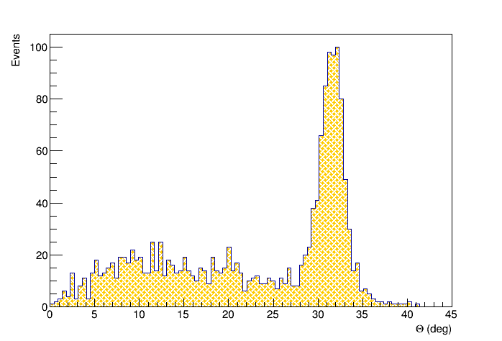
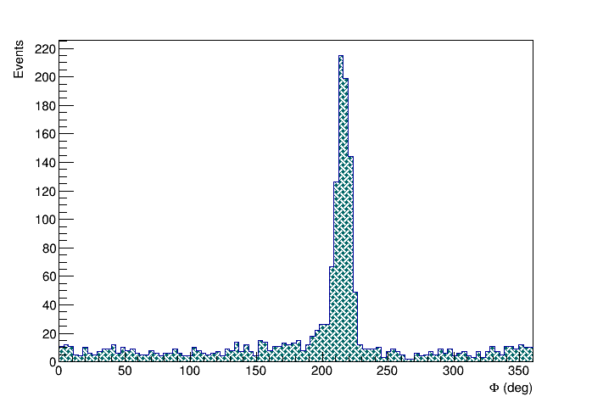
20 cm shift
x [cm] | < θ > ± Δ<θ> | < φ > ± Δ<φ>
0 | 31.03° ± 0.05° | 216.43° ± 0.20°
+20 | 31.45° ± 0.06° | 216.23° ± 0.32°
POLA-01 inside CATA-01 acceptance
POLA-01 inside CATA-01 acceptance

Slide 12
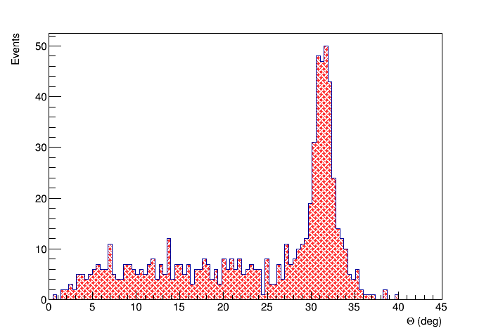
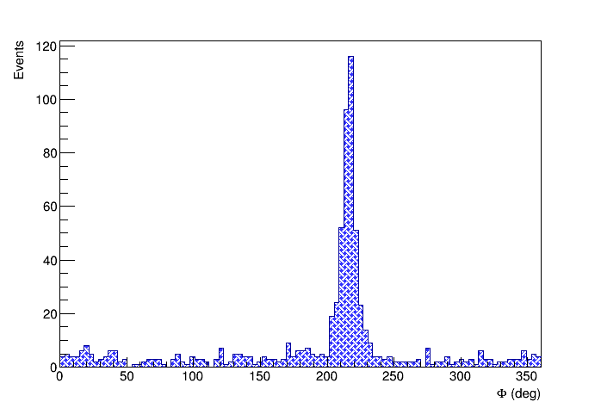
10 cm shift
x [cm] | < θ > ± Δ<θ> | < φ > ± Δ<φ>
0 | 31.03° ± 0.05° | 216.43° ± 0.20°
+10 | 31.36° ± 0.08° | 216.15° ± 0.29°
POLA-01 inside CATA-01 acceptance
POLA-01 inside CATA-01 acceptance

Slide 13
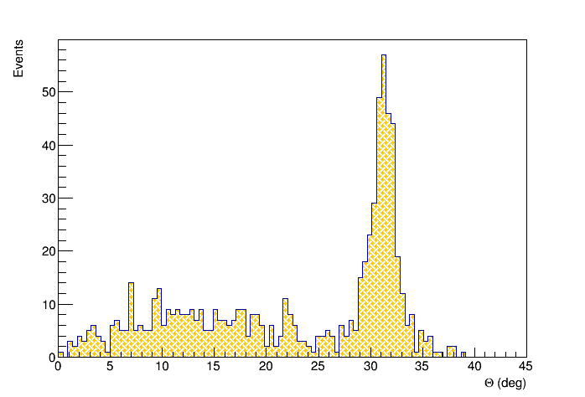
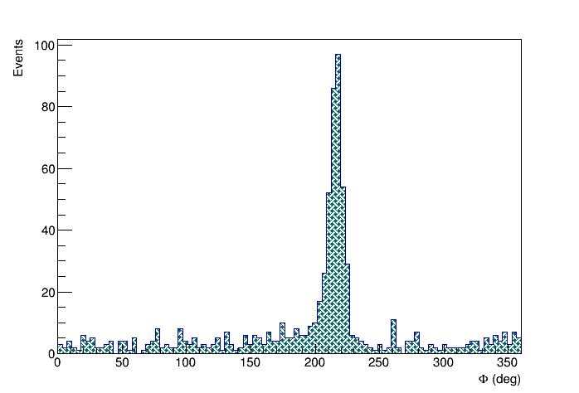
5 cm shift
x [cm] | < θ > ± Δ<θ> | < φ > ± Δ<φ>
0 | 31.03° ± 0.05° | 216.43° ± 0.20°
+5 | 31.36° ± 0.08° | 216.15° ± 0.29°
POLA-01 inside CATA-01 acceptance
POLA-01 inside CATA-01 acceptance

Slide 14
Distribution of average direction in space
Mean values for θ and φ angles, estimated with a gaussian fit.
Estimation of the average direction in space, summing on all the tracks, in 3 configurations (5 cm, 10 cm, 20 cm).
Gaussian fit
x [cm] | < θ > ± Δ<θ> | < φ > ± Δ<φ>
0 | 31.03° ± 0.05° | 216.39° ± 0.16°
+5 | 31.18° ± 0.07° | 215.88° ± 0.33°
+10 | 31.36° ± 0.08° | 215.98° ± 0.30°
+20 | 31.45° ± 0.06° | 215,67° ± 0.20°
Relative distance | Relative angle shift
20 cm | 0.44°
10 cm | 0.24°
5 cm | 0.31°
5 cm measurement has a very short statistics – just 4 days

Slide 15
Effect of relative position
Performances of the method depend on the capability of the main tracking detector, geometry and position of the additional detectors , measurement stability, acquisition time, ...
So, we moved POLA-01 in a different position, in order to estimate the effect of the relative position.
2,5 m
POLA-01
CATA-01
CATA-01 → floor -1
POLA-01 → floor 3

Slide 16
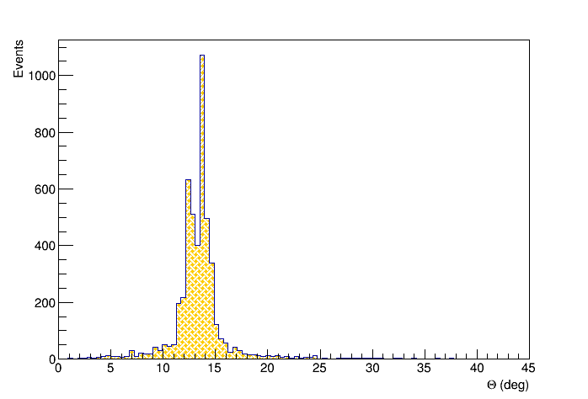
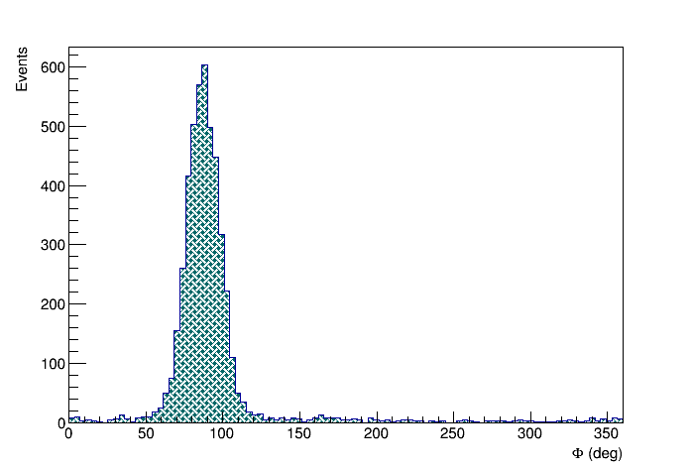
Closer to the vertical position
x [cm] | < θ > ± Δ<θ> | < φ > ± Δ<φ>
vertical | 13.32° ± 0.02° | 87.14° ± 0.17°
POLA-01 inside CATA-01 acceptance
POLA-01 inside CATA-01 acceptance

Slide 17
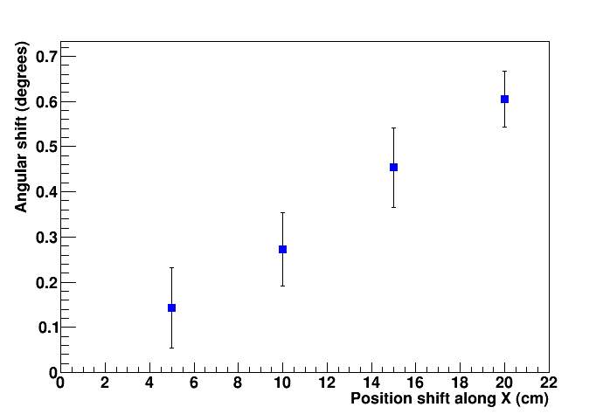
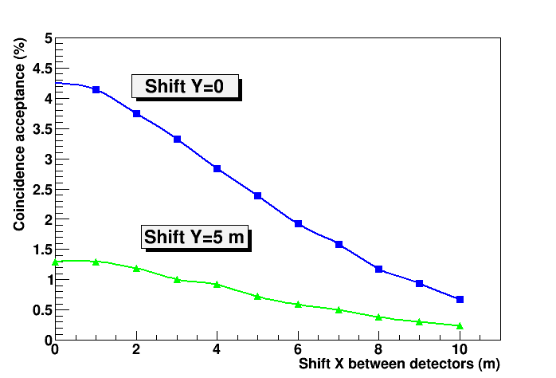
Statistics
Relative distance | Relative angle shift
20 cm | 0.44°
10 cm | 0.24°
5 cm | 0.31°
Simulations Experimental results
Relative horizontal distance between detectors | Acquisition time | # events
9,3 m | ~ 7 ∙ 10⁵ s | 757
2,5 m | ~ 6 ∙ 10⁵ s | 4305
2,5 m
Statistics increased of a factor ~ 7, in agreement with MC simulations.
9,3 m

Slide 18
Conclusions and outlook
Present sensitivity of the method may be roughly estimated of the order of few cm for a data taking period of 1 week
Proper optimization of relative position can increase statistics
Monte Carlo simulations in progress to better understand the results and improve operational conditions
Paper in preparation

