Slide 1
Analysis working groups
Search for Coincidences and Spectrum of the Cosmic Rays: Francesco Noferini - Forbush Analysis: Ivan - Monte Carlo Simulation: Marco B. - Angular Distribution: Marina – No update today - Detector Performance Group: Daniele - Long Distance Correlations: Paola - "Exotica": Francesco Nozzoli
- Moon shadow: Nicola – No update today

Slide 2
Detector Performance
Paper on performance with Run 2/3 data published in 2018
Current analysis needed to check network performance in Run 4
Proposal to include time/spatial resolution checks for each telescope on
the monitor page (similar to the daily check done on Coincidences)
Next publication when a few new chambers (upgrade) will take data?
Analysis ongoing to check bad timing events
Working group
No manpower needed at the moment (maybe two people are enough now)
Daniele
Edoardo Bossini
Corrado Cicalò
Daniele De Gruttola
Marco Garbini
Ivan Gnesi
Stefano Grazzi
Maria Paola Panetta
Cristina Ripoli

Slide 3
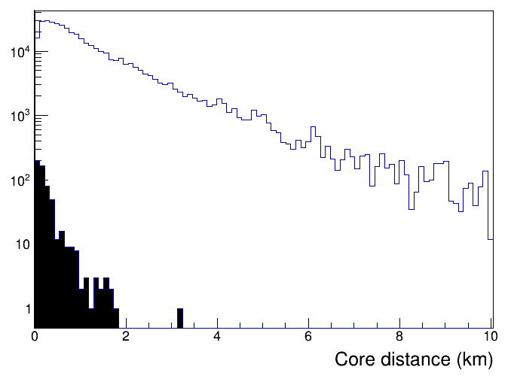
Simulation with Corsika and coincidences
Simulation: coincidence as a function of the energy of primaries
We are currently tuning the simulation to be able to reproduce coincidences in our network.
Shower generation with Corsika:
Available in range 100 GeV – 9 PeV [OK]
Running in range 9 PeV – 50 PeV [expected soon]
Tuning of the framework generation for coincidences [OK]
Integration with Geant4 (DeSi-WG) [to be done]
We should be ready to port all the code needed at CNAF
Estimate of CPU time needed in propagation → TBD
Energy | EEE at 100 m
10⁴ – 10⁵ GeV | 17 +/- 7 day⁻¹
10⁵ – 10⁶ GeV | 18 +/- 3 day⁻¹
For coincs:
E > 1 TeV, R < 1 km
R=
Last update at
https://agenda.centrofermi.it/event/101/
Francesco Nof.

Slide 4
Four interesting measures…
arXiv:1606.06907
1) Muon flux @ sea level
- Angular distribution of relativistic muons
- Energy and angular distribution of slow muons (very few measures!)
2) Flux of primaries
- Reconstruction of average primary energy by means of the even multiplicity (and MC)
3) East-West effect
- crosscheck of the absolute orientation of the telescopes
4) Moon shadow
- sharp crosscheck of the absolute telescope orientation and tracking performanceforte
Francesco Noz.

Slide 5
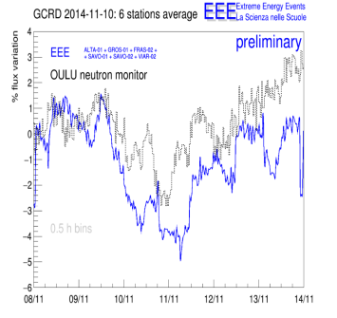
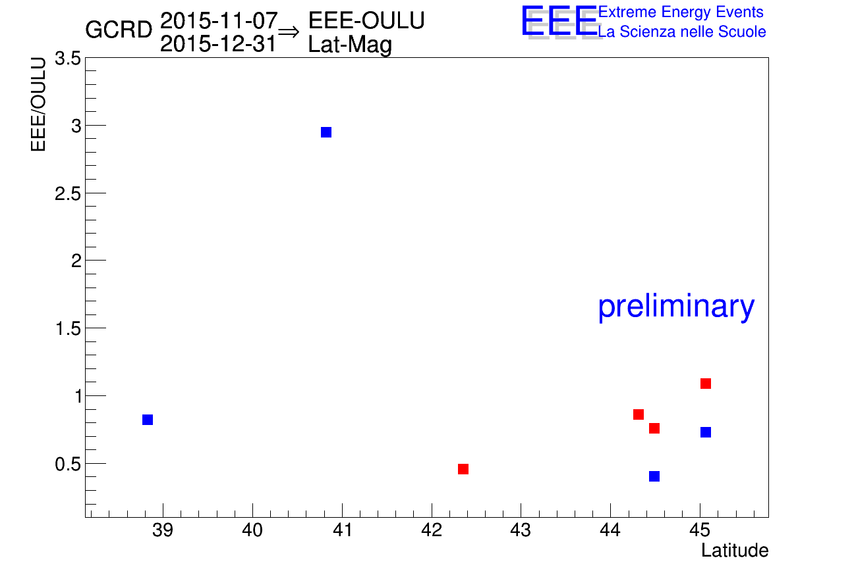
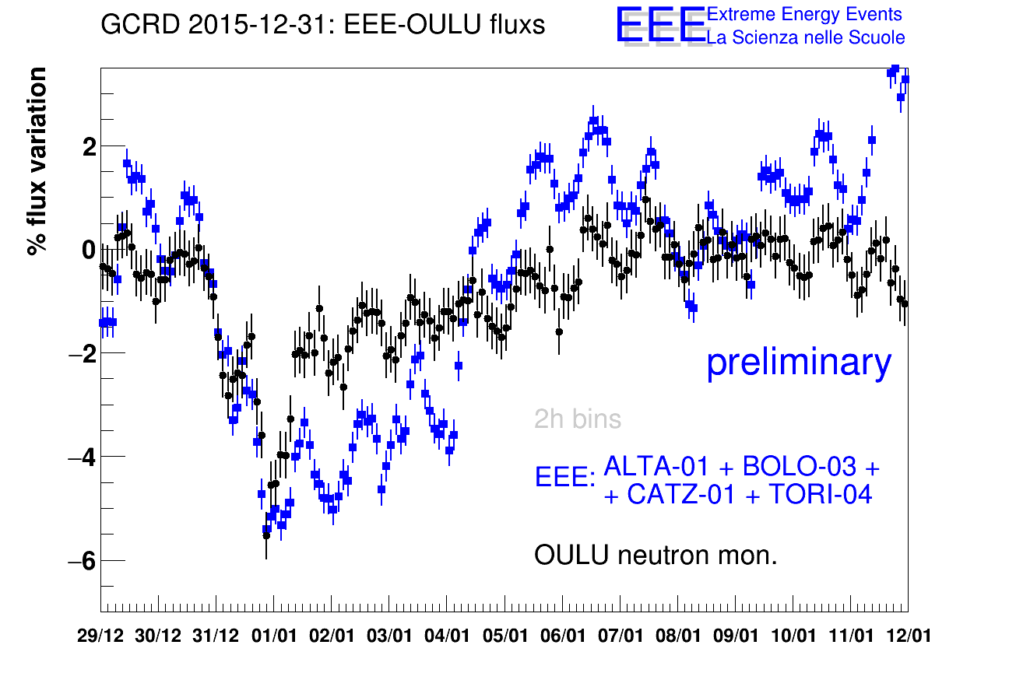
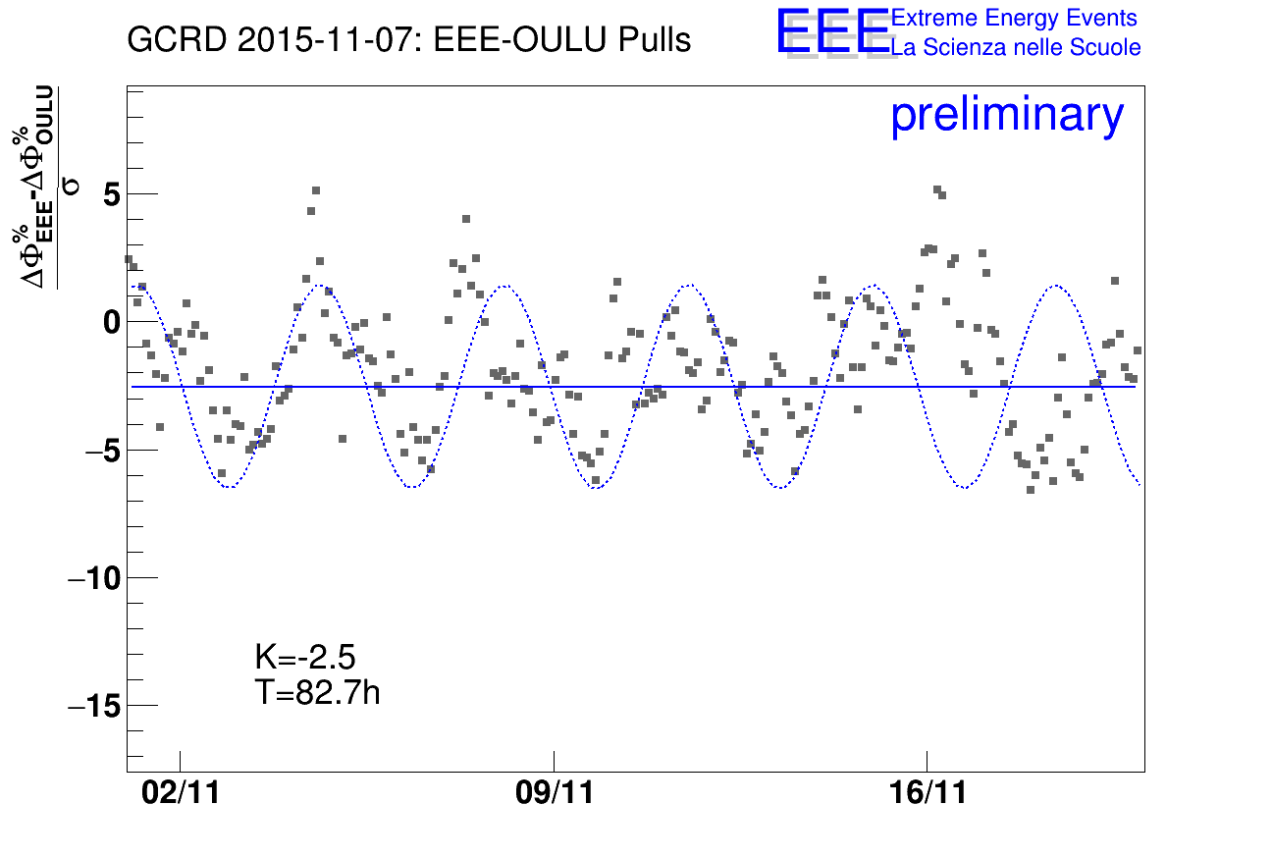
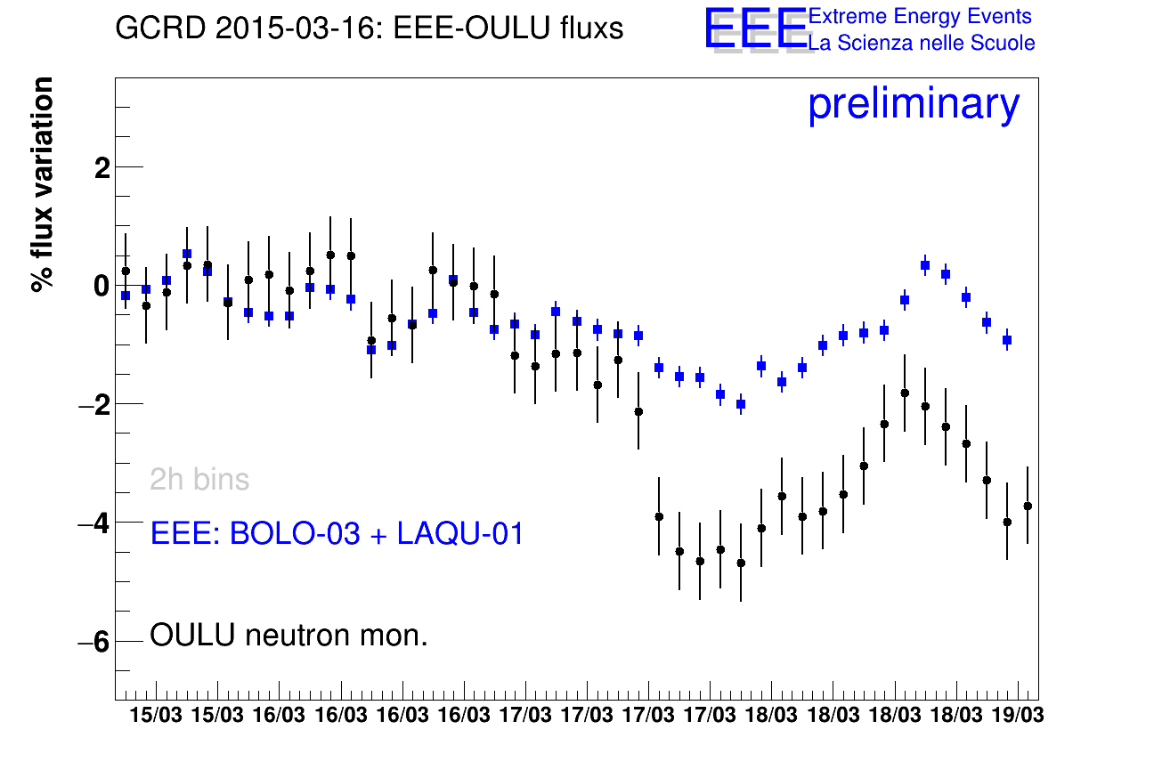
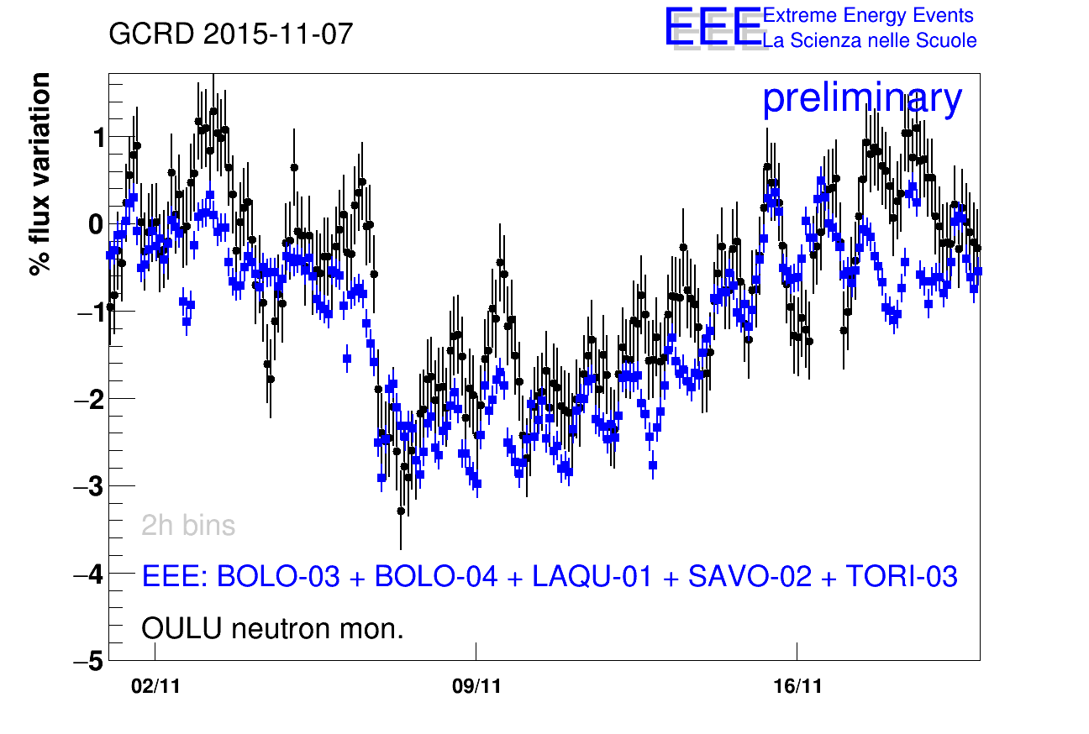
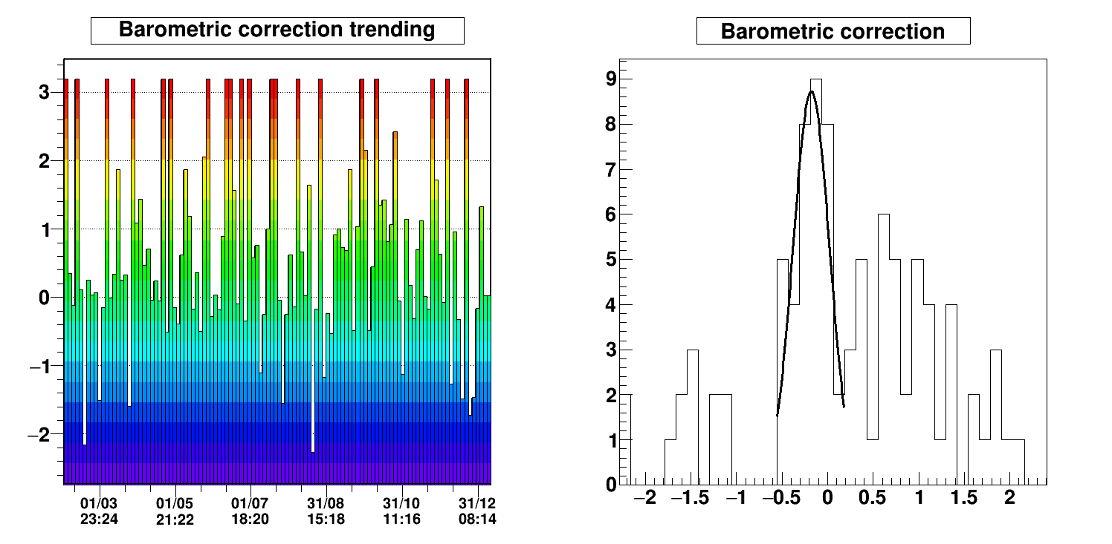
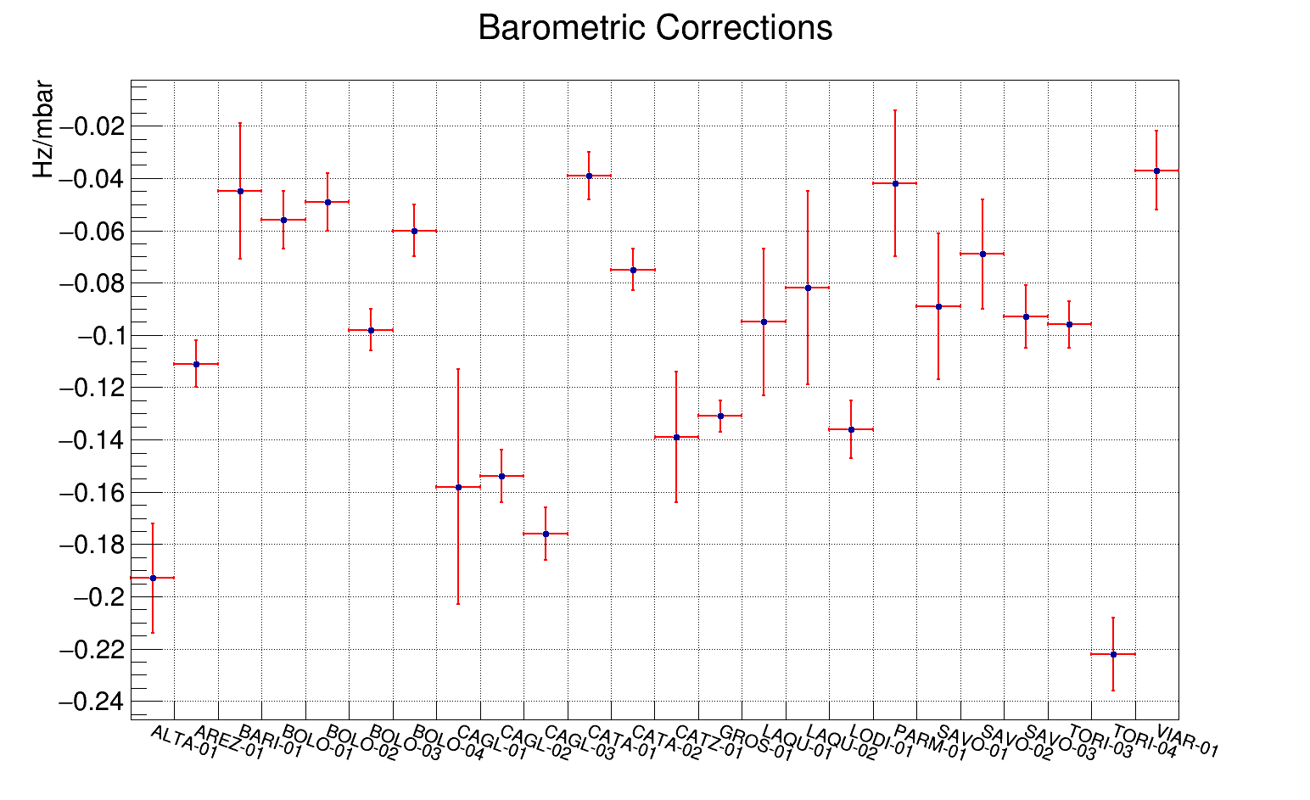
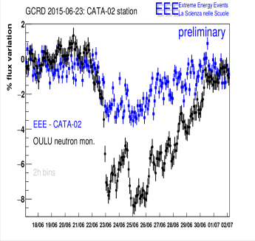
Forbush decreases
Ivan
Observations
5 GCRD observed
Pressure corrections applied
Comparisons with NM done
Lat/Long studies done: does not reveal clear correlations
Additional Studies performed
periodic fluctuations:
82 h periodic fluct found (to be understood)
short/long term pressure correction stability:
on 24 telescopes
--> 25% of telescopes unstable corrections
--> 75% ok
HV stability:
main issue --> up to 10% HV unstability
Temperature dependence (prel.):
observed but further studies to be done
To be Done
Xcheck: anyone available? (important because of EEE/NM discrepancies)
Arrival directions dependence
Finalizing the writing

Slide 6
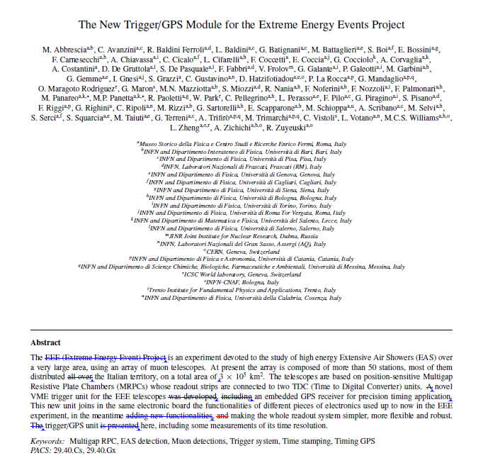
Advanced editing phase
Requested some more plots(checks)

Slide 7
Paper on PolarQuEEEst
You can find it at:
> https://www.overleaf.com/read/szkdnrsxkkyz
Proposed title:
Measurement of cosmic rays intensity in the latitude interval 66-82°N with the PolarquEEEst experiment

Slide 8
Paper on PolarQuEEEst
- Introduction (Francesco R. Marcello, Nicola, Rosario)
- The EEE project and the PolarquEEEst detector (Ivan, Marco, Marcello, Rosario)
- Low power consumption and trigger board (Nicola, Riccardo)
- Experiment set-up and data collection (Francesco N, Francesco R, Marcello, Nicola, Rosario)
Reconstruction and data quality monitoring
Data Selection
Telescopes calibration and corrections
Systematic uncertainties

Slide 9
Paper on PolarQuEEEst
- Results (Francesco N., Francesco R., Marcello, Nicola, Rosario)
Conclusions (ALL)
At the moment some text for Introduction, PolarquEEEst detector, various parts of the experimental set-up, figures for Results
To be immediately started a dedicated series of meetings to converge on this paper

Slide 10
EEE@Ny Alesund
Proposal to bring three PolarquEEEst detector at Ny Alesund later this year for long term CR measurement
Hosted in the “Dirigibile Italia” base and at Gruvbadet (+elsewhere)
Document in preparation to be submitted to CNR and to Kings Bay authority

