Slide 1
Status Report on LDC analysis and MultI-track events
Paola La Rocca

Slide 2
A brief summary
Analysis strategies:
Correlations between telescope pairs (extensive air showers)
Low spurious coincident rate between telescopes (∼ 10⁻⁷ Hz )
Few sites with a cluster of telescopes (n. 10)
Correlations between two and multi-track events in both telescopes
High number of telescopes combinations (higher statistics)
More distances covered
Higher spurious coincident rate between telescopes (∼ 10⁻⁶ Hz )

Slide 3
A brief summary
Analysis strategies:
Correlations between telescope pairs (extensive air showers)
Eur. Phys. J. Plus (2018) 133: 34
3968 days of time exposure
96 observed events against 77.8 estimated background
5 candidate events with a p-value < 0.05

Slide 4
A brief summary
Analysis strategies:
Correlations between two and multi-track events in both telescopes
Pre - selection of multi-track events:
Chi2 < 50
Parallelism constrain (scalar product with the seed track > 0.8)
Data set:
No. of telescopes: 39 telescopes + 5 clusters
No. of Events: 50 millions of events
Period: 2016-01-01 →2018-03-26 (816 days)
Analysis cuts:
Telescope distance > 5 km
Ntracks > 4 on both telescopes

Slide 5
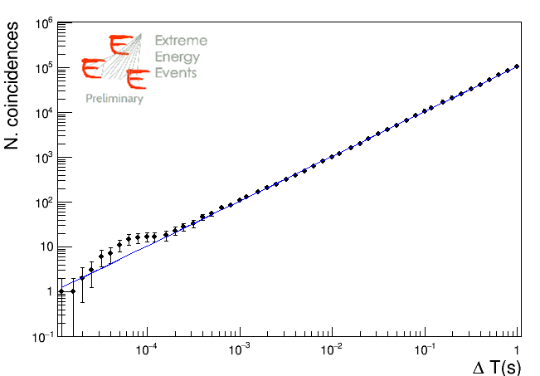
A brief summary
Analysis strategies:
Correlations between two and multi-track events in both telescopes
11 coincident events observed in a time window ∼ 10⁻⁵-10⁻⁴ s
(expected background ∼5 events)
p-value ∼ 4x10⁻³

Slide 6
A brief summary
Analysis strategies:
Correlations between two and multi-track events in both telescopes
Nucl. Phys. B Proc. Suppl.
(Proceeding for CRIS2018 Conference)

Slide 7
Multi-track events
In order to investigate multi-tracks events:
data reprocessed
additional info saved in the analysis tree
Direction cosines of the tracks
Chi2 of the tracks
Sum of the scalar products between tracks (degree of alignment)
Data set available:
3 x 10⁷ coincident events (in +/- 2 seconds window)
Full statistics (2013 -> 2018)
42 telescopes + 5 clusters
Thanks to Francesco!

Slide 8
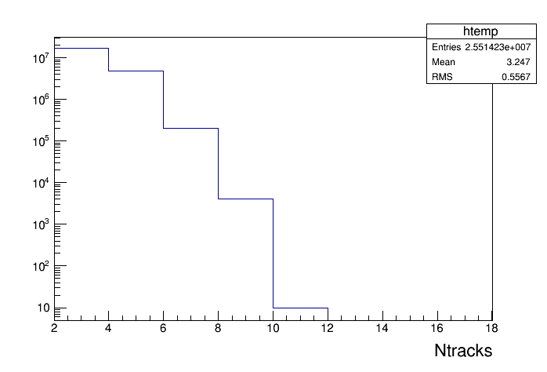
FIRST LOOK AT THE DATA

Slide 9
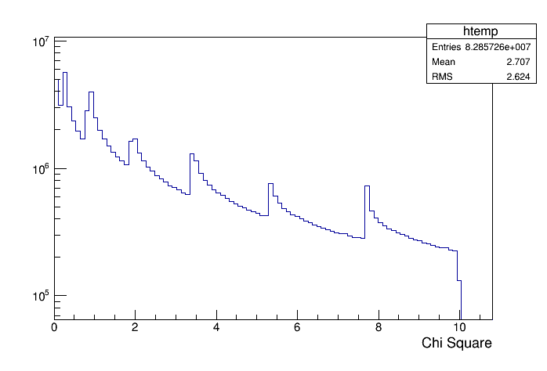
FIRST LOOK AT THE DATA
New cut

Slide 10
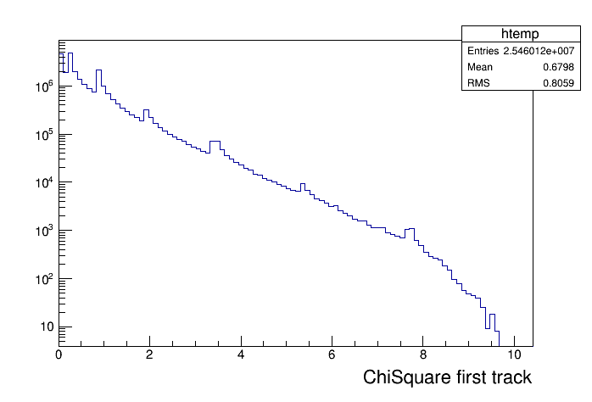
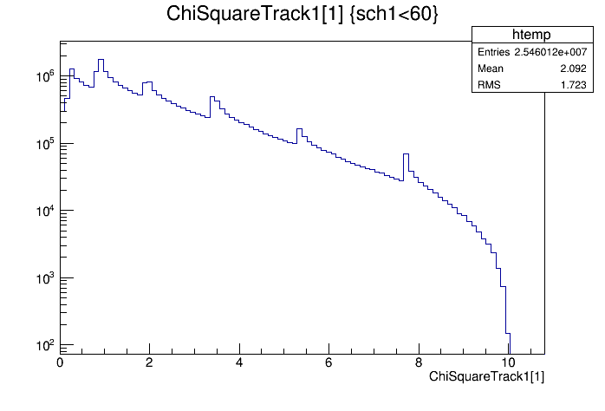
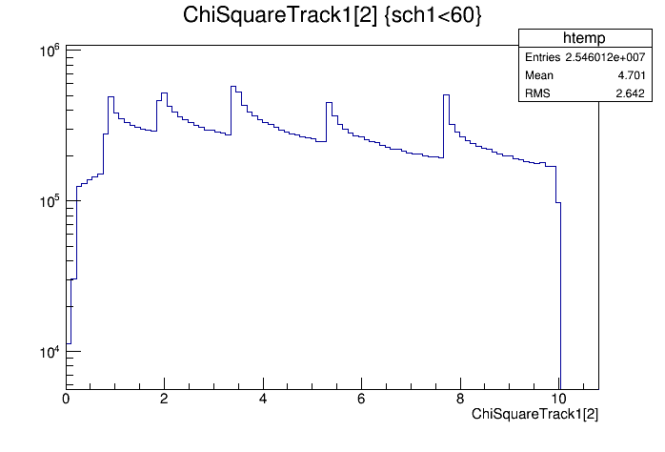
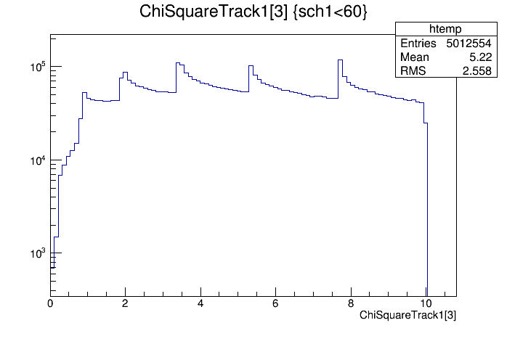
FIRST LOOK AT THE DATA
Track 0
Track 1
Track 2
Track 3

Slide 11
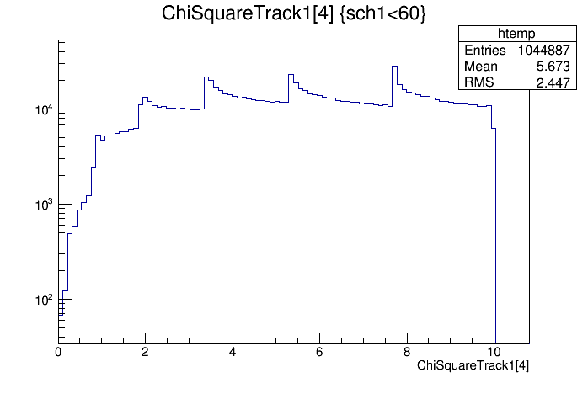
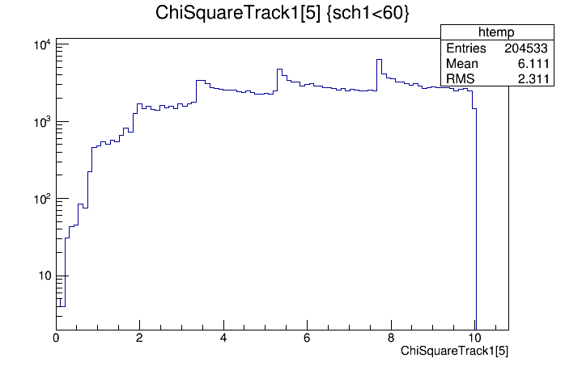
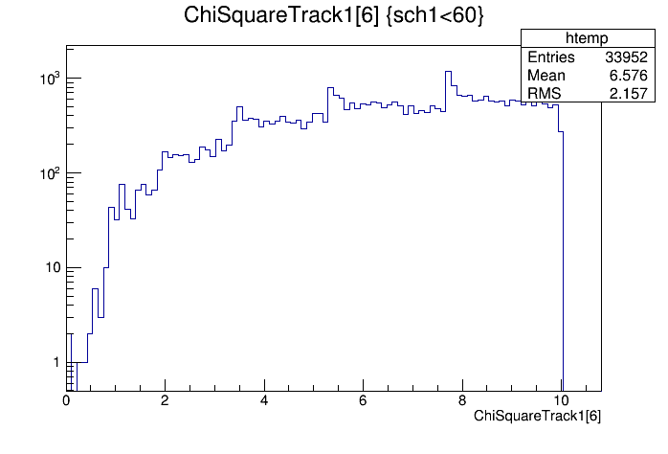
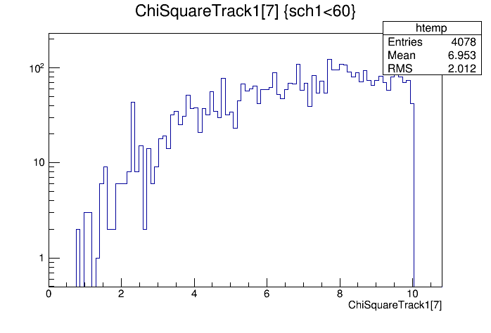
FIRST LOOK AT THE DATA
Track 4
Track 5
Track 6
Track 7

Slide 12
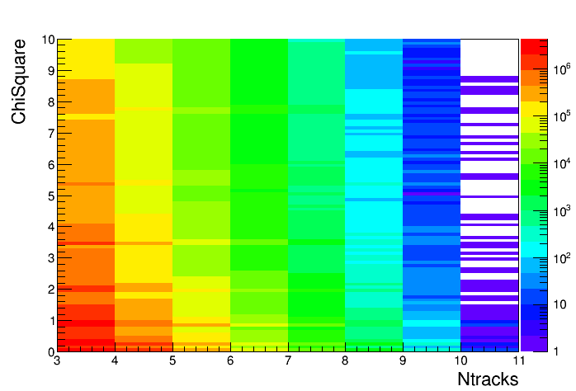
FIRST LOOK AT THE DATA

Slide 13
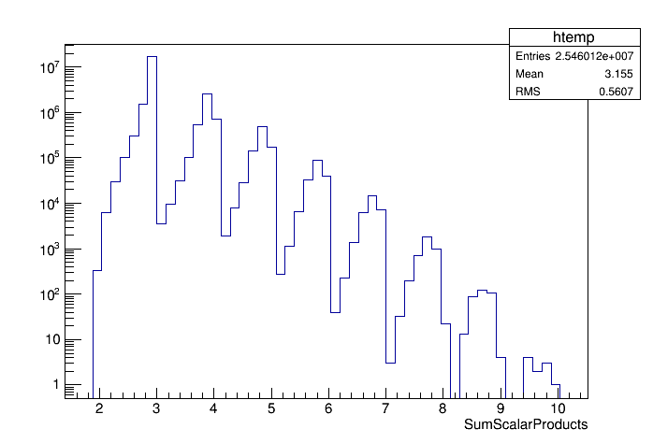
FIRST LOOK AT THE DATA
Sum of the scalar products between tracks (degree of alignment)

Slide 14
outlook
Need to deeply investigate multi-tracks events
Chi2 distributions
Parallelism of the tracks
Study the effect of quality cuts on multi-track events for the LDC search

