Slide 1
Update on measurements underground
Stefano Boi
Rome - January 14th, 2019

Slide 2
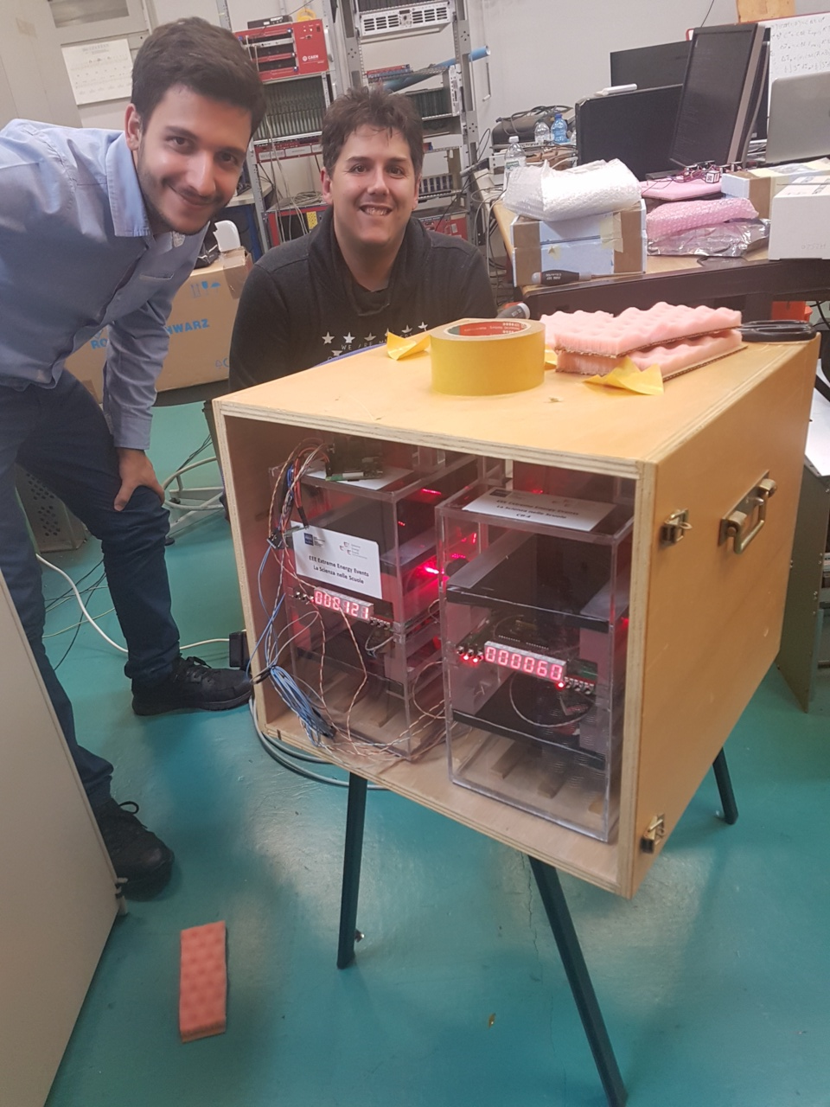
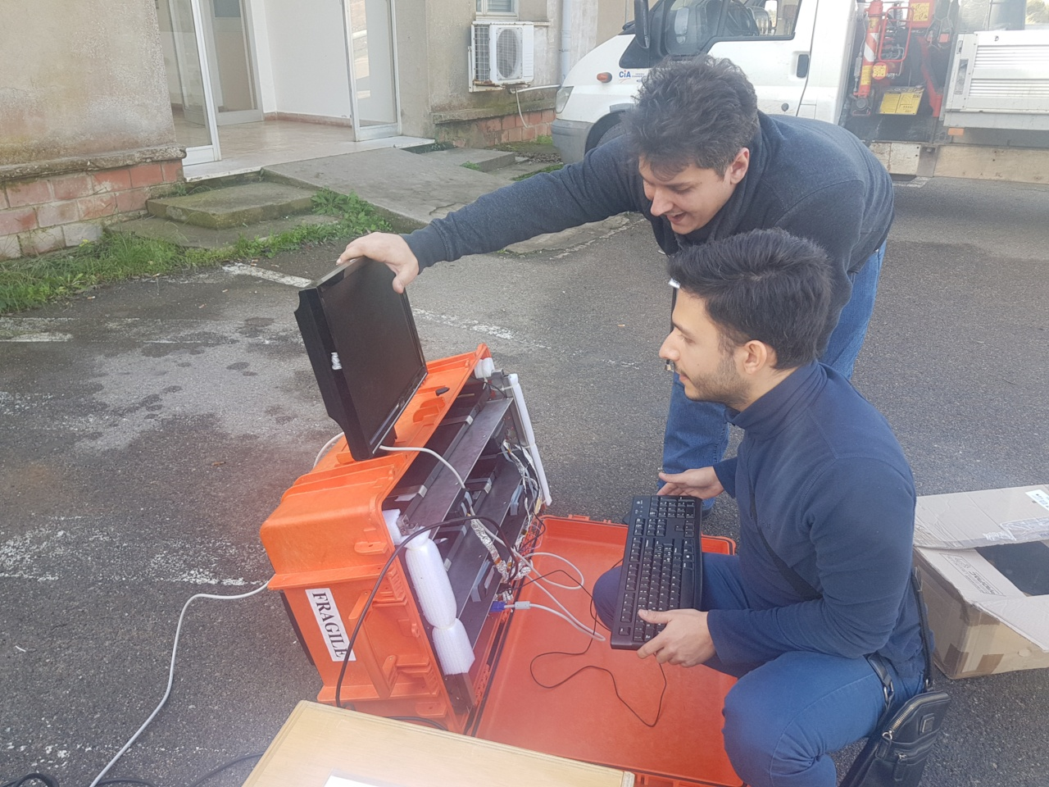
Experimental setup
ASTRO
Scintillator based detector (equipped with SiPM) enclosed in a waterproof suitcase
Integrate backup battery
Stand-alone DAQ
3 cosmic box enclosed in a wooden box
1 Raspberry Pi for DAQ
1 UPS for backup

Slide 3
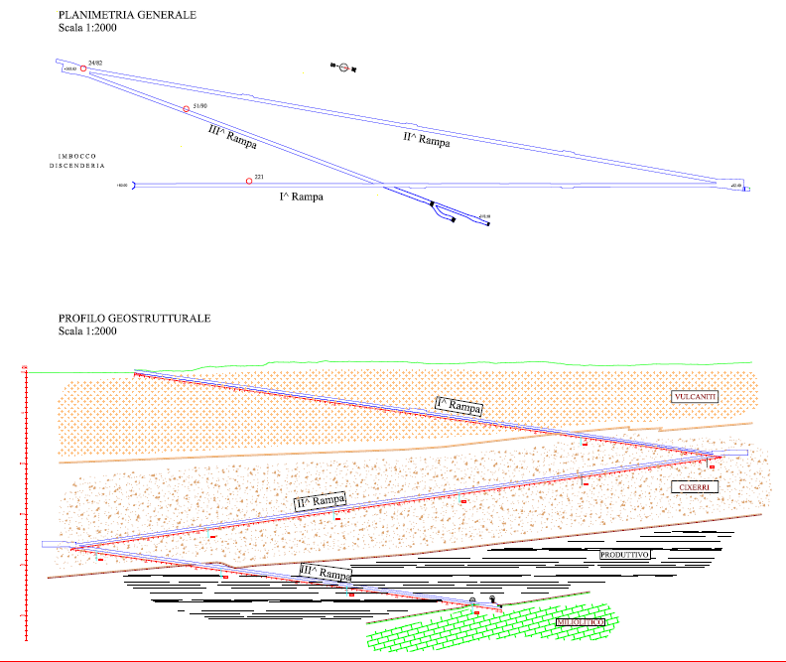
Status of measurements
1 measurement outside
~48 minutes of acquisition
3 measurements underground (one ongoing)
174 m ~71.5 hours ~ 3 days of acquisition
339 m ~ 214.3 hours ~ 9 days of acqusition
512 m ongoing at this time. A few problems during the acquisition
~174 m underground
~339 m underground
~512 m underground

Slide 4
Workforce involved
Preliminary measurements and studies:
2 Centro Fermi researchers + 1 collaborator
Underground measurements:
5 Centro Fermi Researchers (one new entry)
5 students + 3 professors from Liceo Scientifico “A. Pacinotti” (CAGL-01)
Carbosulcis S.p.A. employees for technical support during operations underground
Technical support:
Daniele Monteleone for DAQ development and technical support
4 undergraduate students for a few support in devices development
…

Slide 5
Acquisition stability 174 meters underground

Slide 6
Acquisition stability 339 meters underground

Slide 7
Acquisition stability 512 meters underground (1)

Slide 8
Acquisition stability 512 meters underground (2)

Slide 9
Acquisition stability 512 meters underground (3)

Slide 10
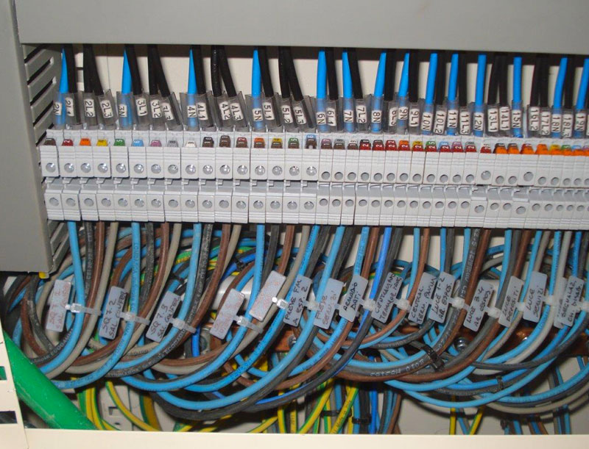
Problems during acquisition at 512 meters underground
+
=
$⇒$DAQ STOP

Slide 11
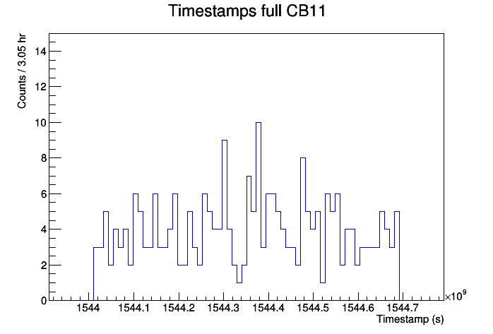
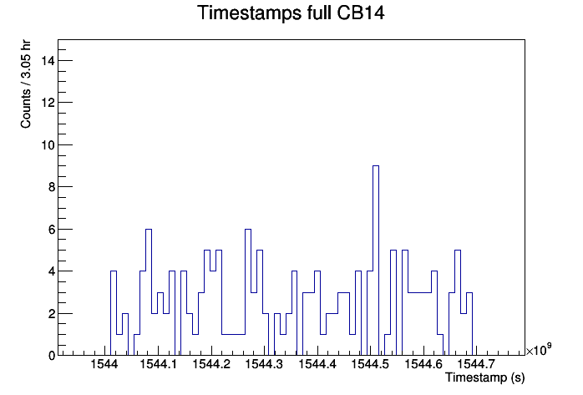
512 meters underground From 2018-12-05 to 2018-12-13

Slide 12
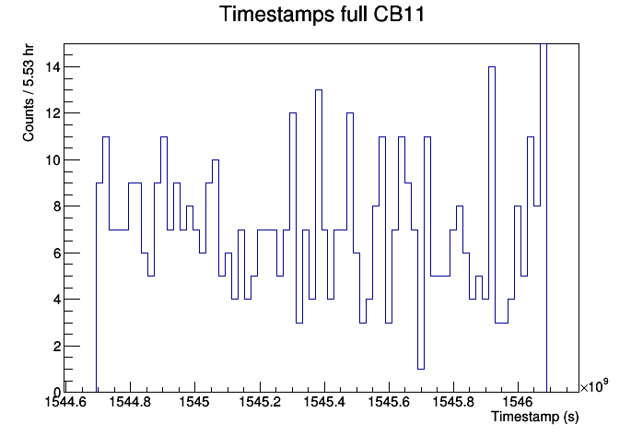
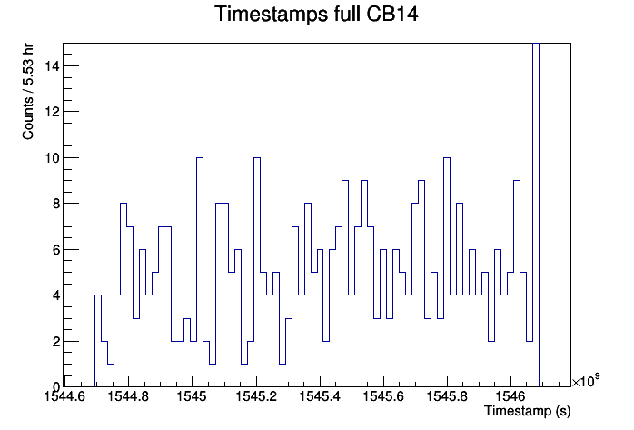
512 meters underground From 2018-12-13 to 2018-12-31

Slide 13
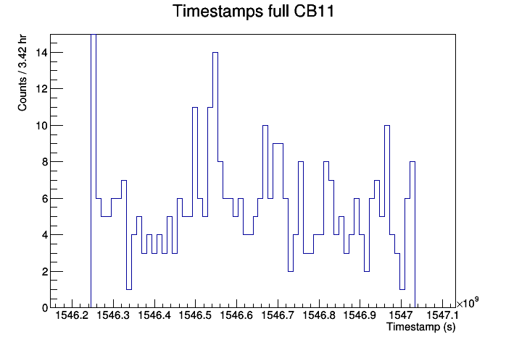
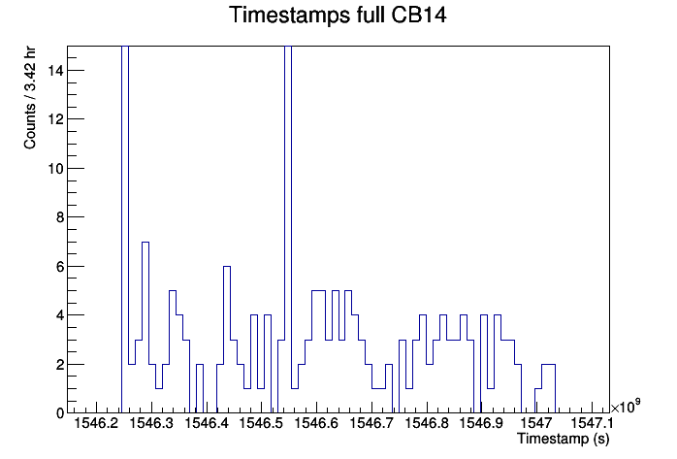
512 meters underground From 2018-12-31 to 2018-12-09

Slide 14
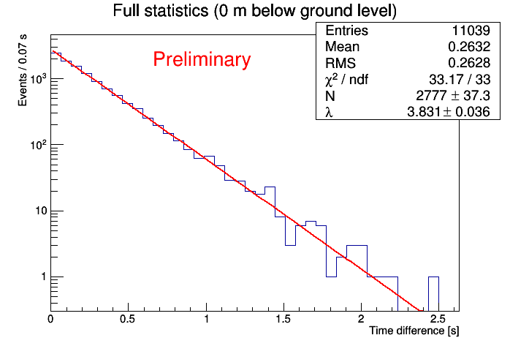
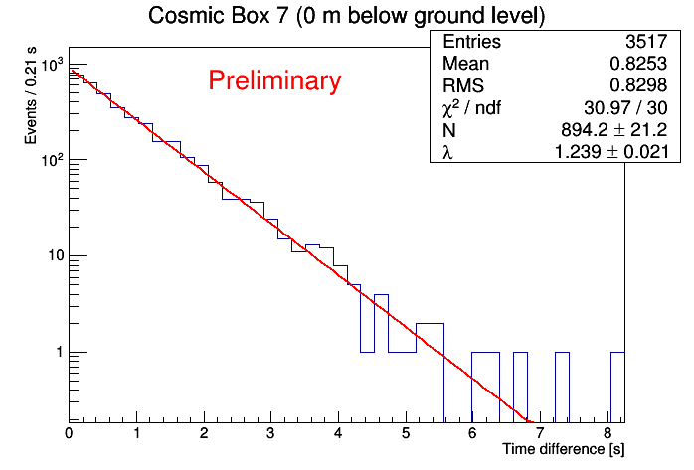
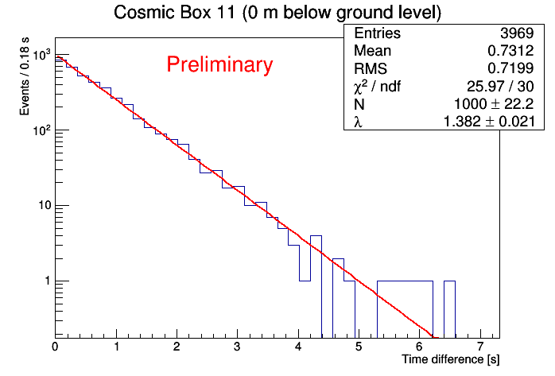
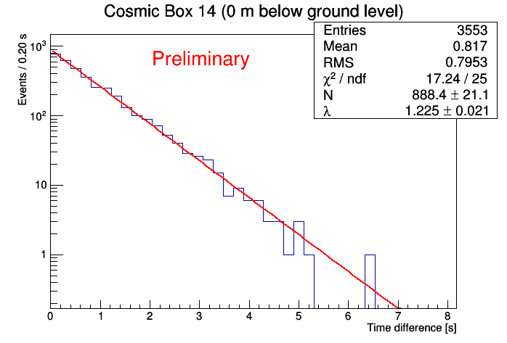
A few results – Ground level

Slide 15
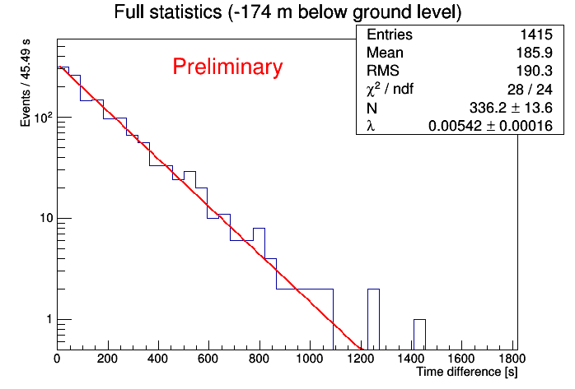
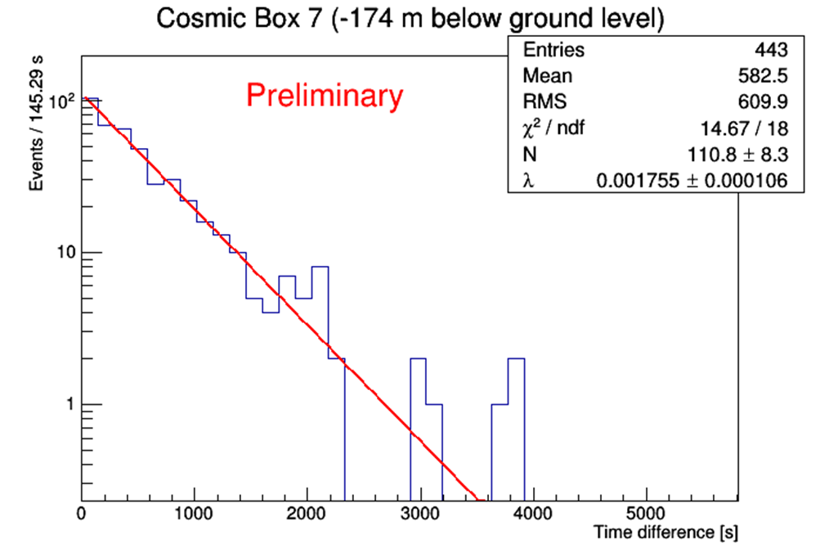
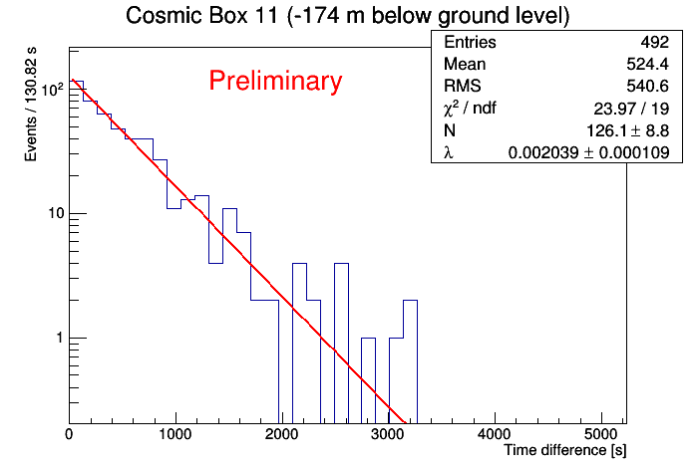
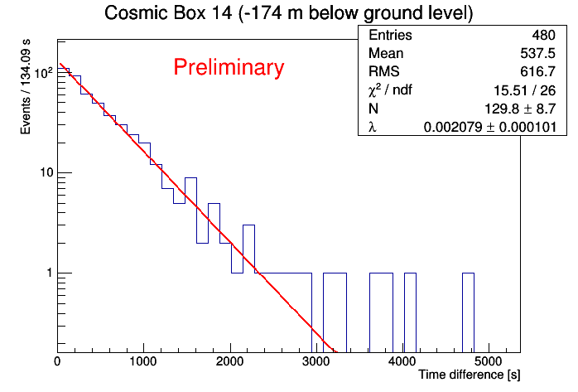
A few results – 174 meters underground

Slide 16
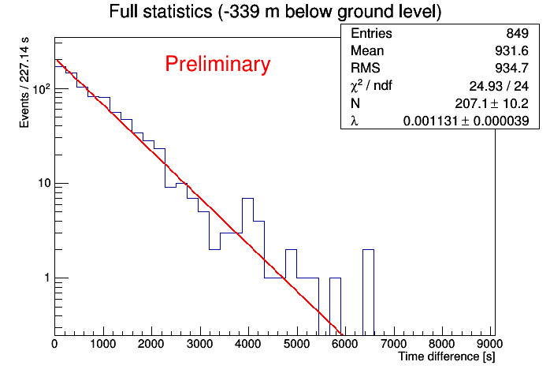
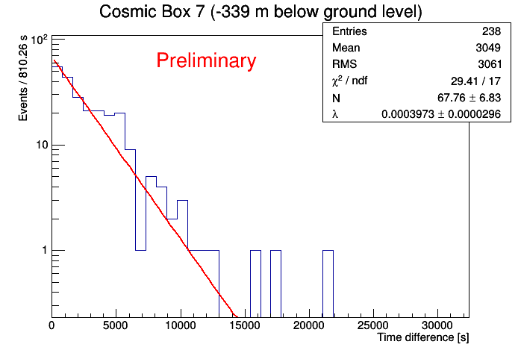
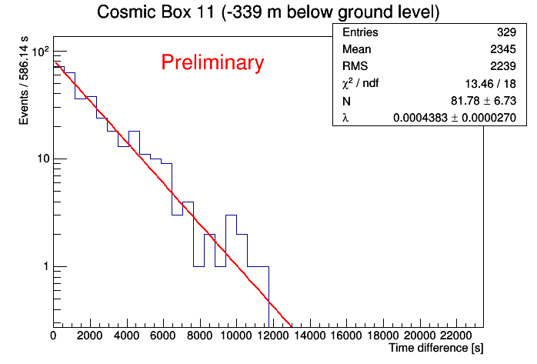
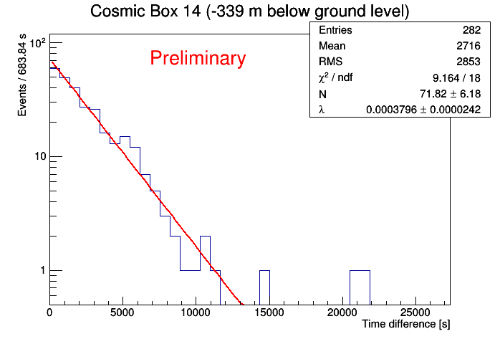
A few results – 339 meters underground

Slide 17
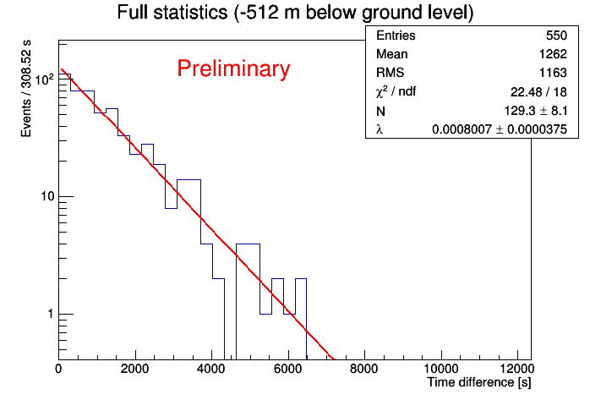
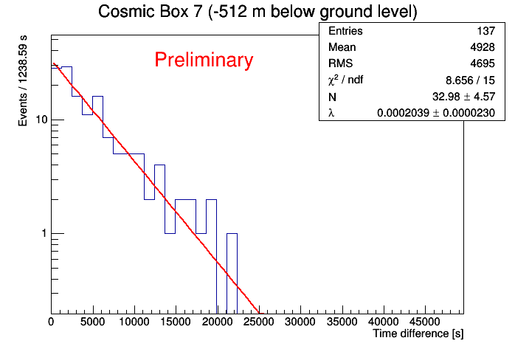
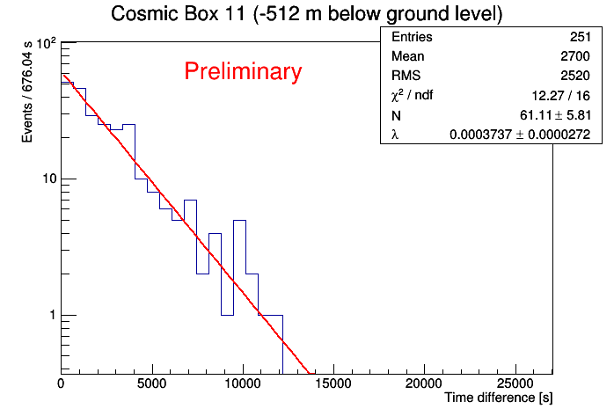
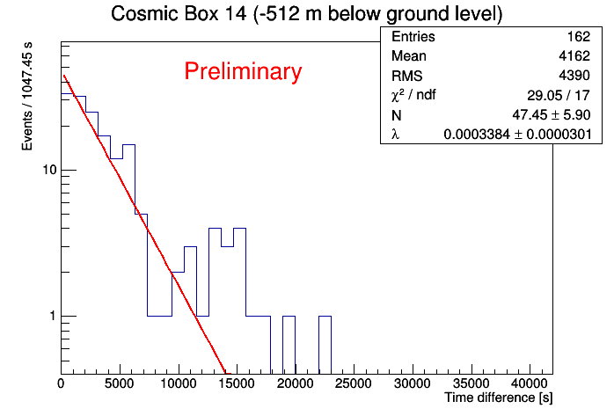
A few results – 512 meters underground (1)

Slide 18
A few results – 512 meters underground (1)
188.5 hours ~ 8 days

Slide 19
A few results – 512 meters underground (1)
188.5 hours ~ 8 days
4.3% of statistical significance on rate estimation based on counts
4.6% of statistical significance on rate estimation with exponential fit

Slide 20
Statistical significance
Depth (m) | Rate ($N/T$) [Hz] | Significance (${\sqrt{N}}/N)$ | Rate ($λ$) [Hz] | Significance (${δλ}/λ)$
0 | 3.80 (4) | 0.010 | 3.83 (4) | 0,009
174 | $$5.5(1)⋅{10}^{−3}$$ | 0.027 | $$5.4(2)⋅{10}^{−3}$$ | 0,030
339 | $$1.1(4)⋅{10}^{−3}$$ | 0.034 | $$1.13(4)⋅{10}^{−3}$$ | 0,034
512 | $$8.1(3)⋅{10}^{−4}$$ | < 0.043 | $$8.0(4)⋅{10}^{−4}$$ | < 0,046

Slide 21
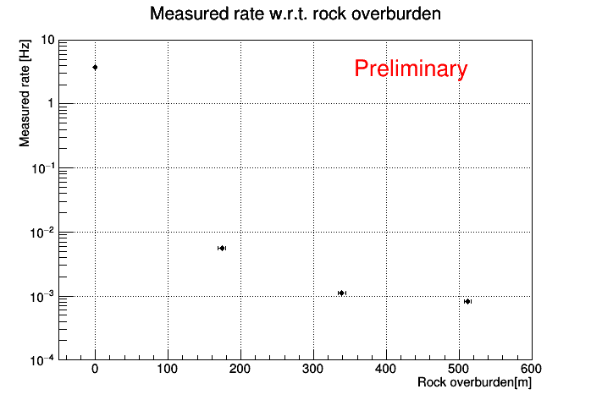

Slide 22
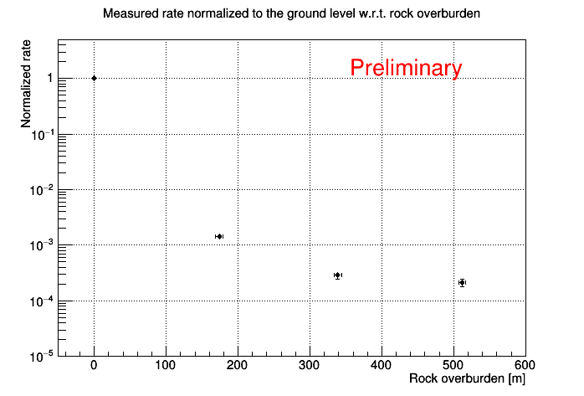
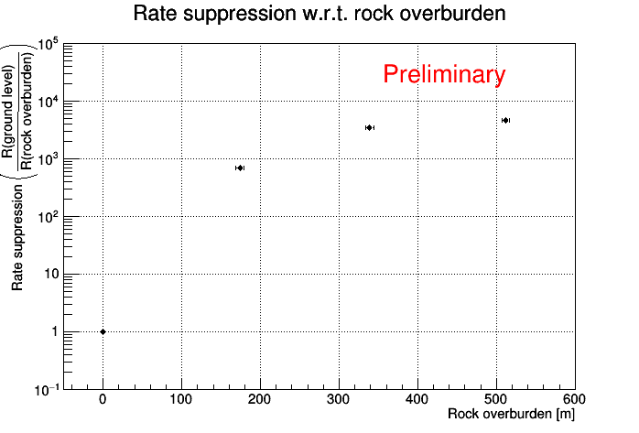

Slide 23
Study of the terrain above measurements sites (1)
Possibility to find the exact position of the measurements sites thanks to QGIS layers (not yet) available from Carbosulcis S.p.A.
Possibility to find the exact ground altitude a.s.l. thanks to data available from Regione Autonoma della Sardegna (http://www.sardegnageoportale.it)
-512 meters site

Slide 24
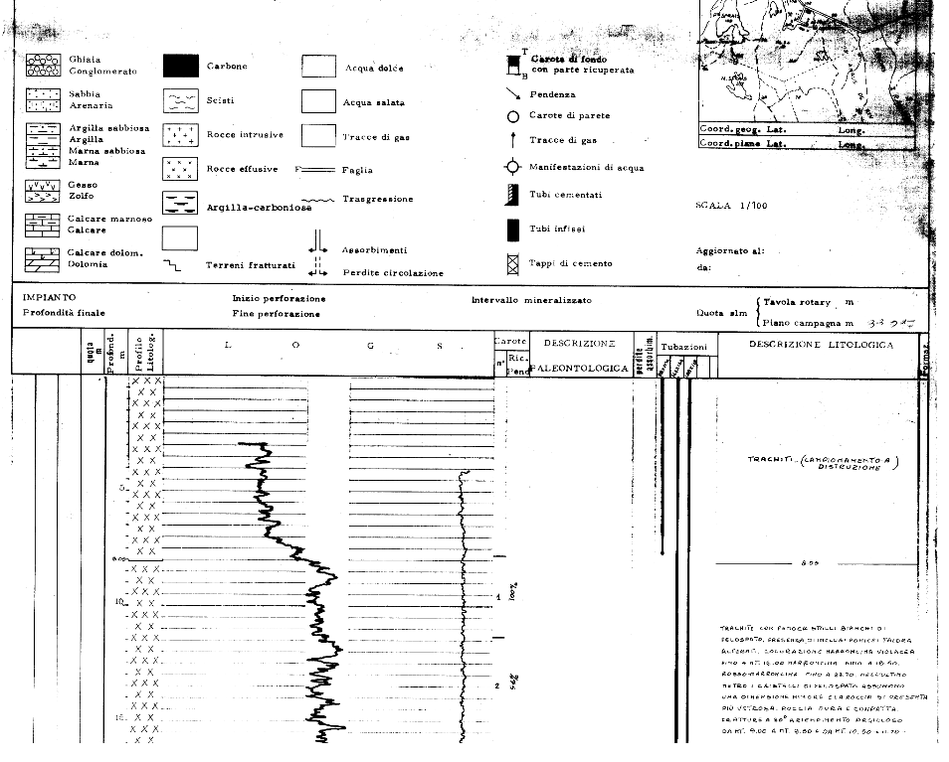
Study of the terrain above measurements sites (2)
Survey on terrain composition

Slide 25
Study of the terrain above measurements sites (3)
Geological data from Seruci site (a few km away)

Slide 26
Meters underground to meter water equivalent conversion
Not so difficult to estimate the terrain composition, even with some big uncertainties
But it requests very much time to recover and implement all terrain data
A few important information are not yet available

Slide 27
Conclusions and perspectives
1 measurement done outside (we could repeat it at the end)
2 measurements done underground (174 m and 339 m)
1 ongoing at deepest level (512 m) with some (solvable) problems
Perspectives
At least two other measurements at different depth
Check on environmental stability with data from weather sensors
Implement geological data and rescale depth in mwe
Simulation of detector acceptance and, maybe, of physics (GEANT4?)
Comparison with ASTRO data
Any other idea?

