Slide 1
Welcome!
(and happy new year)

Slide 2
First two good news!
(in chronological order)
A new bunch of EEE collegues has got a permanent position at CF:
Marco G.
Ivan, Marta, Silvia,

Slide 3
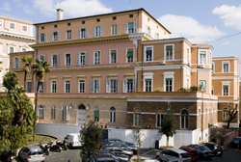
Awaited for many years
CF got the “Palazzina”!
It was really a hard hard work, by the President, Director(s) and the whole staff

Slide 4
Meeting of today
Divided in three parts:
Analysis
with the focus on the ones close to publications
Relations with schools
Data taking and hardware
with the goal to improve duty cycle
+ Additional topics
Meeting in Torino, Junior association to CF

