Slide 1
DATA ANALYSIS WITH PYTHON
Liceo Scientifico Statale
“Benedetto Croce”
Palermo
Speakers:
Ester Di Matteo
Samuele Quartuccio

Slide 2
WHY PYTHON?
Open Source
We will use the Python programming language for all assignments in this course.
Python is a great general-purpose programming language on its own, but with the help of a few popular libraries (numpy, scipy, matplotlib) it becomes a powerful environment for scientific computing.

Slide 3
EEE Data csv_trending
A .csv_trending file has the characteristic that the data are separated by commas.
With Python, after the download of this file from the site https://iatw.cnaf.infn.it/eee/monitor/ or http://eee.centrofermi.it/elog/Query , we can load them as an array and clean up data from duplicate rows.
After this we merged more file (from 01/05/2018 to 31/05/2018) of 14 telescopes and we made a graph of the count/min as a function of time using matplotlib library using a few commands.
Due to some issue there are some holes in data.

Slide 4
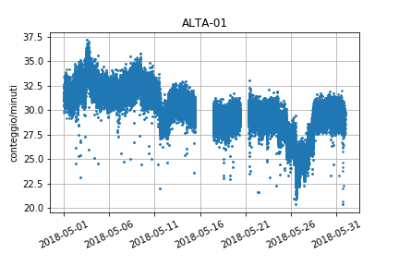
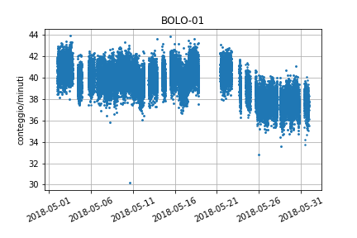
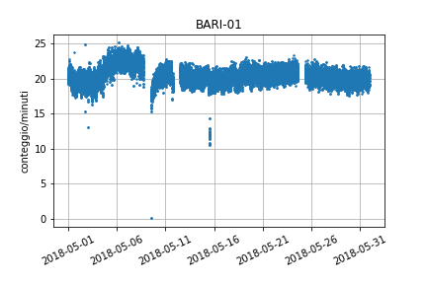
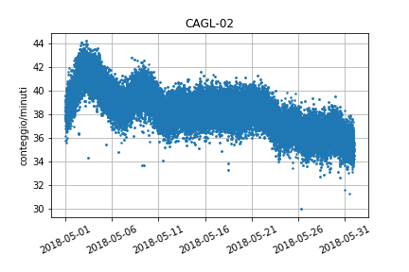
t0=1167609600
timestamps=dataTrev[:,0]+t0
xts = md.date2num([dt.datetime.fromtimestamp(s) for s in timestamps])
yR = dataTrev[:,4]
plt.subplots_adjust(bottom=0.2)
plt.xticks( rotation=25 )
ax=plt.gca()
xfmt = md.DateFormatter('%Y-%m-%d')
ax.xaxis.set_major_formatter(xfmt)
plt.title('TREV-01')
plt.ylabel('conteggio/minuti')
plt.plot(xts,yR,'.',markersize=3)
plt.grid()
plt.savefig('TREV-01.png')
plt.show()

Slide 5
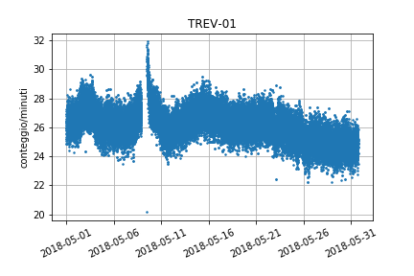
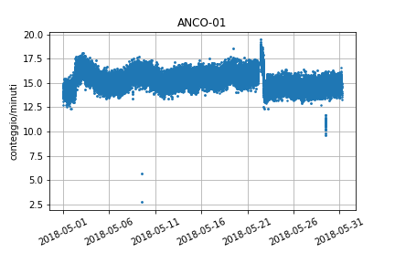
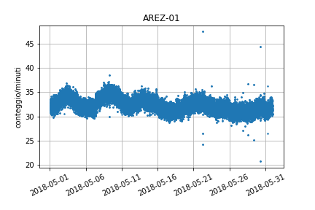
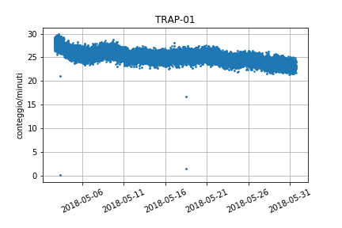
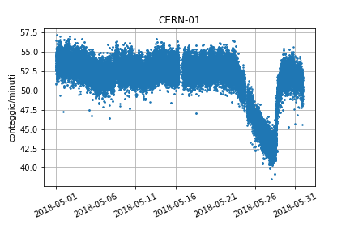
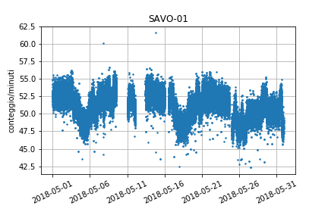
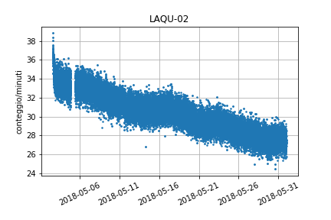
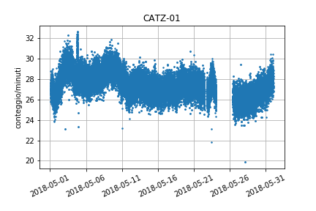
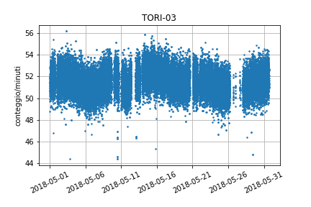

Slide 6
Other work that can be done with python’s library matplotlib are animations. In fact using the data of these telescopes we also made an animated map of the muons flow during the mounth of May 2018 taking the coordinates in pixel on the image and using as radius of these circles the mean of muons flow of every day. This is only a raw work but with some improvement it could be much better.

Slide 8
Flight time measurements of solar cosmic rays through forbush decreases

Slide 9
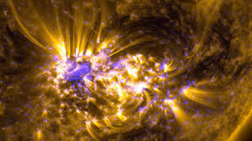
Solar flare
The solar flare is a violent eruption of matter that explodes from the photosphere of a star (in this case the Sun) emitting a high amount of energy. It is caused by a sudden release of energy on the occasion of phenomenon of reconnection of the magnetic field lines.

Slide 10
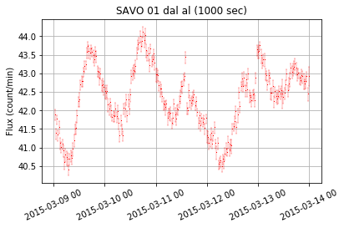
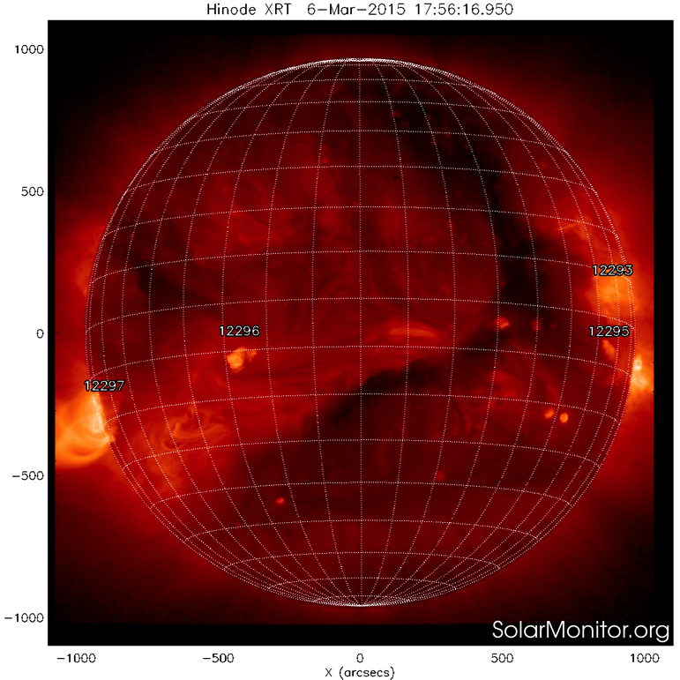
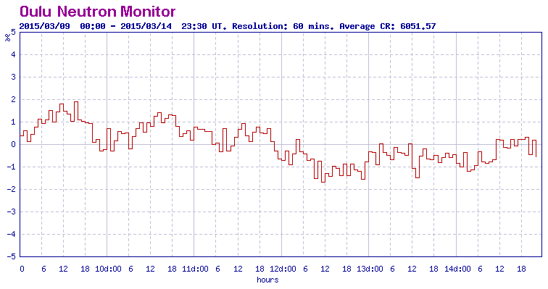
Solar Flare 2015-03-07-21:45
Flare: M9.2
EEE data correct of the systematic error due to atmospheric pressure and averaged every 1000 sec
Forbush decreases
2015-03-11
20:00

Slide 11
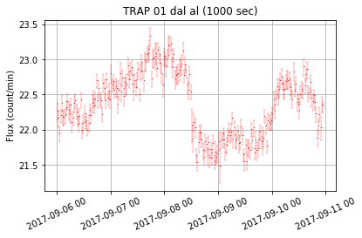
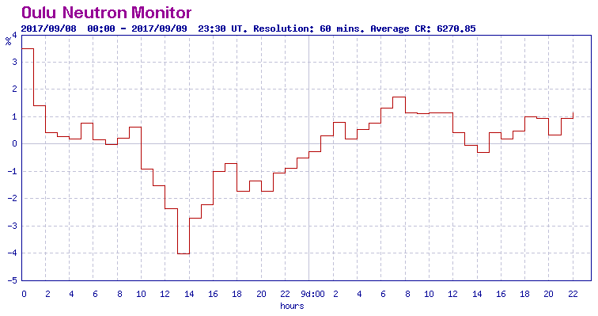
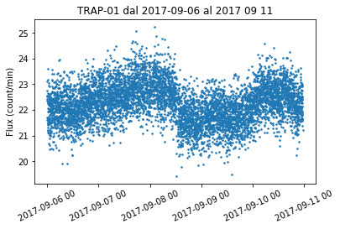
Solar Flare 2017-09-06-10:24
Flare: X9.3.
EEE data correct of the systematic error due to atmospheric pressure and averaged every 1000 sec

Slide 12
Solar wind speed
Time delay between flare X and start of Forbush decreases
Classification FLARES
Peak flux range at 100–800 picometre
(watts/square metre)
A < 10⁻⁷
B 10⁻⁷ – 10⁻⁶
C 10⁻⁶ – 10⁻⁵
M 10⁻⁵ – 10⁻⁴
X > 10⁻⁴
M2.2
2015-03-07
X9.3
2017-09-06
2015:03:11:20:00-
2015:03:07:20:00=
0000:00:03:00:00
2017:09:08:10:30-
2017:09:06:10:00=
0000:00:02:00:00
X9.3 = 2^{9.3} X1.0= 600 times X1
Is 30% faster?

Slide 13
planned works
Day-night effect: it is necessary to take the data relative to the ascent ramps of the flow and to compare the linear best fit of these with those related to the downward ramps. Make a selection, that is based on which there is a study of the increase and reduction of muons, using Boolean masks.
Non-solar cosmic rays: Analysis of night data for a week of all data from 21 to 4 hours of data from at least 10 telescopes. Integration of counts on 3 minutes
Magnetic North-South Determination: Withdraw data from the ELOG interface for an entire day. Group the data according to the angle θ of incidence on the telescope and verify which of them show the greatest effect from east to west. The time additions extend them totwo hours.

